Slide 1


Statistical Causal Inference
A Gentle Introduction to Advanced Analysis of Quantitative Data
Julian Frattini, Ph.D.
Chalmers University of Technology, Sweden
https://julianfrattini.github.io/
JulianFrattini/bda4sci
Public
Copyright © 2024 Julian Frattini.
The source code is licensed under the Apache License 2.0.
This presentation is licensed under CC BY-NC-SA 4.0.

Slide 2





Julian Frattini // about me
2013 - 2019 | Bachelor & Master of Science
 | Technical University of Munich, Munich, Germany
2020 – 2025 | Ph.D. Student
 | Blekinge Institute of Technology, Karlskrona, Sweden
2025 - 2029 | Postdoctoral Researcher
 | Chalmers University of Technology, Gothenburg, Sweden

Slide 3
Julian Frattini // about my research
Good-enough Requirements Engineering
Quantifying the effect of quality factors of requirements artifacts on downstream software development activities
Hybrid-AI Software Engineering
Understanding the interface between traditional and data-driven software components in a hybrid software system.
Software Engineering Research Methodology
Improving the methods used in research to produce more rigorous and valid conclusions

Slide 4
Motivation
The Point of Science

Slide 5
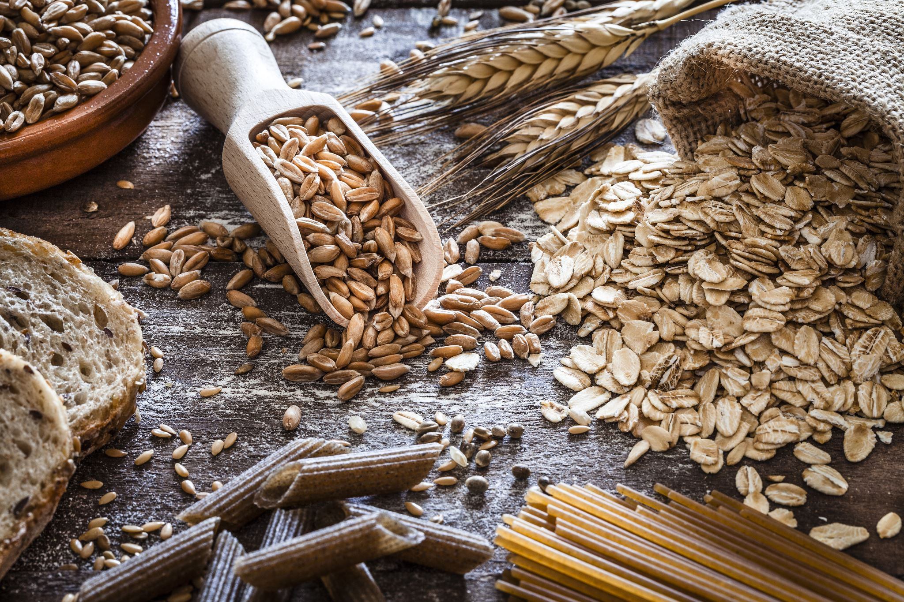


The Point of Science
Science informs decision-making policies.
Babylonian Diet Experiment
Does a plant-based diet imply better health than a diet consisting of meat & wine?
Medical Trials
What is the effect of introducing a (medical) substance to the human body?
Software Engineering Research
What is the effect of LLM-usage on the quality of software systems?
Notes:
Humans were always interested in answering difficult questions
Babylonian diet experiment: 10-day trial of vegetarian vs meat & wine diet, where plant-based diet had better health results
Medical questions: Does smoking cause harm? What is the effect of introducing a substance to a human?
SE questions: Should you use LLMs to automatically generate your software tests?
One point of science is: informing decision-making policies

Slide 6

Types of Scientific Studies
Babylonian Diet Experiment
Does Smoking cause Harm?
We can safely and ethically control the factor of interest (diet), i.e., assign one of two diets (plant- vs. meat-based) to all subjects of our study and record their health outcome.
We cannot force subjects to smoke, we can only observe their natural behaviour (whether they already smoke or not) as well as their health outcome.
→ (controlled) experimental studies
→ observational studies
But what if an observation that smokers have worse health is caused by another factor (e.g., social status or general health)?
Notes:
We can generally differentiate two types of scientific studies

Slide 7
Types of Scientific Evidence
Experimental Studies
Observational Studies
If we only vary one particular factor (e.g., the diet), we can assume that any change in health is caused by this factor.
If several factors vary (e.g., social status, general health) in addition to the one of interest (i.e., smoking), we only know that any change in health is correlated with the main factor.
Changing that factor (i.e., switching ones diet) should show the same effect in any person.
Changing that factor (i.e., stopping to smoke) might not show the same effect in any person as the other factors that remain the same may be responsible for the effect (i.e., change in health).
Notes:
We can generally differentiate two types of scientific studies

Slide 8
Correlation versus Causality
Correlation:
when we observe X,
we also observe Y
Causality:
when we do X,
we observe Y.
If we want to make a positive impact on the target audience of our research (i.e., software engineers), we need to provide reliable decision-making policies – which we can only derive from causal relationships, not correlations.
We cannot infer causality from data alone – we must also know the process that created that data.¹
¹we’ll revisit this statement later
Notes:
We all know “Correlation does not imply causality” – but what exactly differentiates the two concepts?
Only causal relationships give us reliable recommendation on how to act, and therefore, how to make a positive impact on the target audience of our research (i.e., RE/SE practitioners).
Disclaimer:
I do not want to discredit correlational studies.
They are valuables to detect patterns and trends.
However, they do not get us any further and are unfit to recommend changes in an organization.
This is the fundamental difference between observing (correlations) and doing (interventions with causal effects).

Slide 9
Limitations of Experiments
There are several reasons why we cannot investigate any phenomenon with a controlled experiment, as they are
Expensive
Recruiting eligible participants is difficult
Unrealistic
Experiments perturb the natural context
Impossible
Some factors are impossible to control
Assumed
The validity of experimental results depends on several conditions
Still, we can draw causal conclusions from non-experimental studies using the principles of statistical causal inference.
Notes:
But: experiments are expensive and perturb the natural context of a phenomenon. Some phenomena cannot be studied in controlled experiments at all (e.g., impact of human factors) since the values of that variable cannot be assigned randomly.

Slide 10
Goals of this Lecture
Convincing you of the value of causal conclusions
Learning the fundamentals of drawing causal conclusions from quantitative data
collected in observational studies
Notes:
Convincing you of the value of causal inference (check)
Learning the fundamentals of drawing causal conclusions from quantitative data collected in observational studies

Slide 11
Learning Outcomes
Causal Modelling
Communicating transparent causal assumptions in graphical models
Statistical Causal Inference (SCI)
Drawing reliable conclusions from quantitative, observational data
Causal Workflow
Structured process for performing statistical causal inference in an empirical study
Notes:
Causal modelling: visualizing causal assumptions graphically
Statistical causal inference: drawing reliable conclusions from observational data
Causal workflow: a reliable workflow for SCI

Slide 12
Causal Modelling
Concisely Framing Causal Assumptions

Slide 13
Basic Terminology
“We study the effect of different document reading techniques on the number of identified defects in Bachelor- and Master-level students.”
Factors: variables that associate measurements with a construct (e.g., document reading technique, identified defects, student level)
Treatment/Exposure: main independent factor of interest
Outcome/Response: main dependent factor(s) of interest
Phenomenon: main causal effect of interest (treatment → outcome)

Slide 14
Causal Modeling
Directed, acyclic graphs (DAGs) can represent causal assumptions, where nodes represent variables and edges represent assumed/potential causal relationships between those variables.
document reading technique
document reading technique
identified defects
identified defects
participation
motivation
DAGs are subjective and represent the view of a domain expert.
treatment
phenomenon
outcome
other factors
Notes:
More importantly, the absence of an edge encodes the certainty that two variables are not directly related.

Slide 15
Causal Modeling
DAGs allow visualizing causal hypotheses clearly:
Babylonian Diet Experiment
Does Smoking cause Harm?
diet
health
smoking
health
social status
In experimental studies, no factor influences the exposure (other than “randomness”).

Slide 16
Exercise: Formulating a DAG
Derive a causal DAG from the following description:
“Researchers are interested in knowing if using ChatGPT affects the quality and length of code reviews at a company. Since they cannot interrupt the regular workflow, they cannot force anyone to use or not use ChatGPT. They do know, however, that younger developers use ChatGPT more often. On the other hand, they know that more skilled developers generally produce more concise (i.e., shorter) and better code reviews.”

Slide 17
Solution: Formulating a DAG
“Researchers are interested in knowing if using ChatGPT affects the quality and length of code reviews at a company. Since they cannot interrupt the regular workflow, they cannot force anyone to use or not use ChatGPT. They do know, however, that younger developers use ChatGPT more often. On the other hand, they know that more skilled developers generally produce more concise (i.e., shorter) and better code reviews.”
CR quality
ChatGPT
CR length

Slide 18
Solution: Formulating a DAG
“Researchers are interested in knowing if using ChatGPT affects the quality and length of code reviews at a company. Since they cannot interrupt the regular workflow, they cannot force anyone to use or not use ChatGPT. They do know, however, that younger developers use ChatGPT more often. On the other hand, they know that more skilled developers generally produce more concise (i.e., shorter) and better code reviews.”
CR quality
ChatGPT
CR length
age

Slide 19
Solution: Formulating a DAG
“Researchers are interested in knowing if using ChatGPT affects the quality and length of code reviews at a company. Since they cannot interrupt the regular workflow, they cannot force anyone to use or not use ChatGPT. They do know, however, that younger developers use ChatGPT more often. On the other hand, they know that more skilled developers generally produce more concise (i.e., shorter) and better code reviews.”
CR quality
ChatGPT
CR length
age
skill

Slide 20
Solution: Formulating a DAG
“Researchers are interested in knowing if using ChatGPT affects the quality and length of code reviews at a company. Since they cannot interrupt the regular workflow, they cannot force anyone to use or not use ChatGPT. They do know, however, that younger developers use ChatGPT more often. On the other hand, they know that more skilled developers generally produce more concise (i.e., shorter) and better code reviews.”
CR quality
ChatGPT
CR length
age
skill
Notes:
You sometimes need “domain knowledge” to complete a DAG

Slide 21
Fundamentals & Notation
Syntax and Pedagogics of this Lecture
Notes:
This may be a lengthy background section, but also
A good reminder for fundamentals of statistics,
The introduction of a valuable modeling concept, and
A recommendation for a statistical workflow.

Slide 22
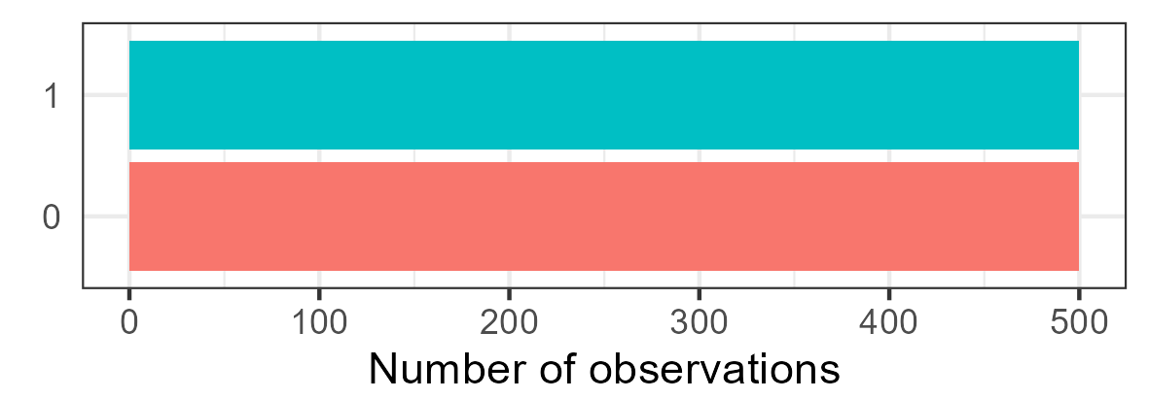
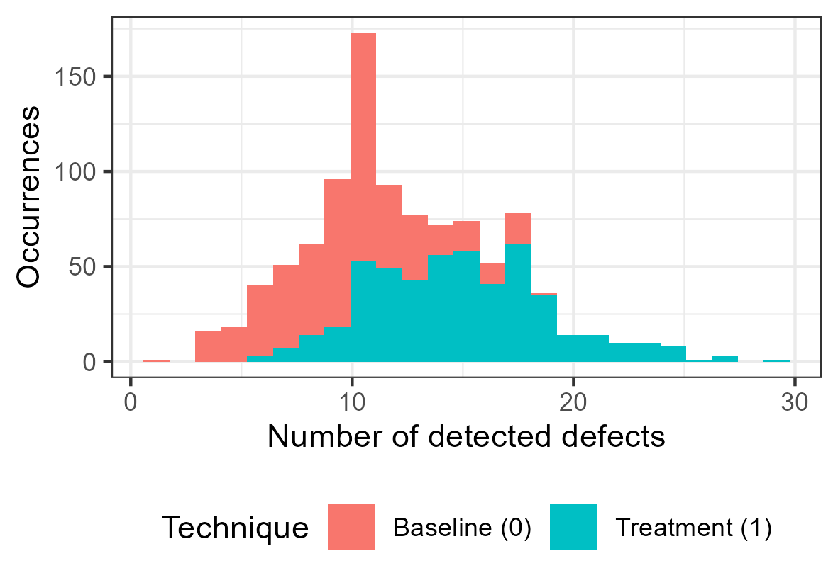
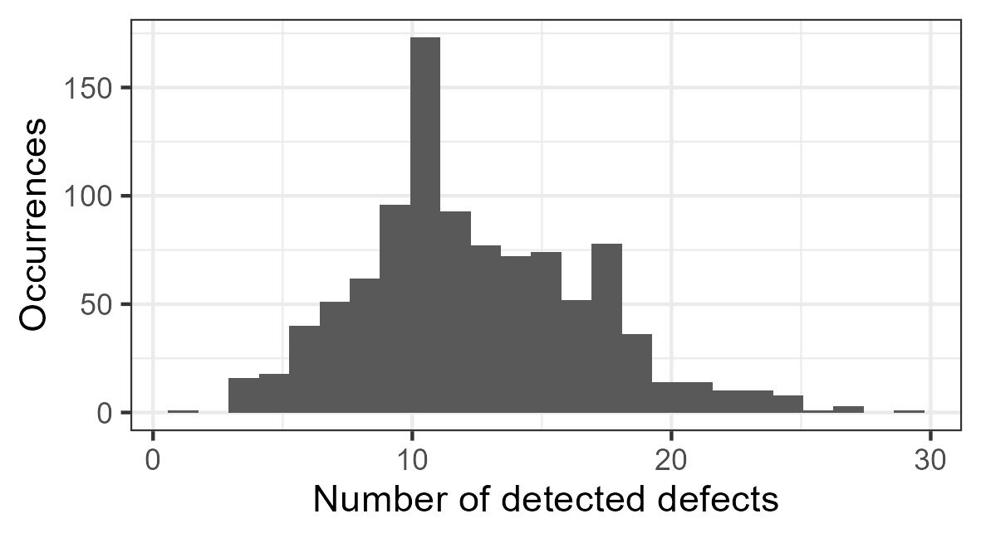
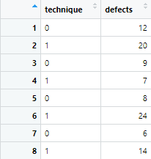



Simulations
To demonstrate the process of SCI, we simulate data sets. This gives us control over phenomena, i.e., a reliable ”ground truth.”
Discrete uniform distribution
Simulation of an independent variable
Simulation
$$technique=unif\{0, 1\}$$
$$10+$$
$$technique∗5$$
$$defects=Poisson(10+technique∗5)$$
Simulation of a dependent variable
Poisson distribution
Dependency of defects on technique
Notes:
(introduce random variables)
(show simulation formula and explain all terms)
(visualize simulated data)

Slide 23


Causal Modeling and Simulations
DAGs are typically used to formalize assumed causal relationships. They can also be used to represent simulated causal relationships.
Simulation
document reading technique
$$technique=unif\{0, 1\}$$
$$5$$
$$defects=Poisson(10+technique∗5)$$
identified defects
Path coefficient
Changing the cause by one unit causes the effect to change by <path coefficient> units. It is, therefore, our variable of interest representing effect strength.
Notes:
This represents our ground truth (both in terms of effects and their strength.
The path coefficient is the variable of interest, as it represents the effect strength (and direction) of one variable on another.

Slide 24
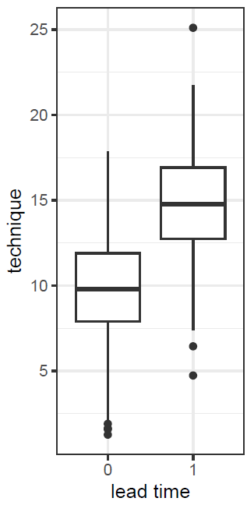
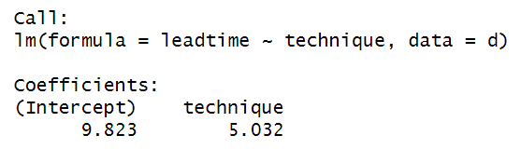



Data Analysis Tool: (Linear) Modeling
+ more accessible
more difficult to use and apply -
- less granular
more granular +
Null-Hypothesis
Significance Test
e.g., Student’s t-test,
Mann-Whitney U Test
(Generalized) Linear
(Mixed) Model
Bayesian Data
Analysis
outcome
predictor
$$leadtime \sim technique$$
$$leadtime \sim α+β_{t}∗ technique$$
intercept
path coefficient
Simulation
$$technique=unif\{0, 1\}$$
$$leadtime=N(10+technique∗5, 3)$$
Notes:
For our data analysis tool, we will use linear regressions (which are more powerful than NHSTs but more approachable than Bayesian data analysis).
Limitations: assumption of monotonicity, etc.
(example of a regression formula with explanations, regression+data, and results)

Slide 25

From causal to statistical Models
Model Derivation
Causal Models
encode causal assumptions
Statistical Models
implement inference
document reading technique
$$defects \sim technique+motivation$$
identified defects
How to derive statistical from causal models is core to statistical causal inference.
participation
motivation
Notes:
Connection between causal and statistical models:
Causal models encode causal assumptions
Statistical models implements inference
Statistical causal inference (SCI) = deriving statistical models from causal models
(how to do this is a major learning outcome of this tutorial)
“Science before statistics”

Slide 26
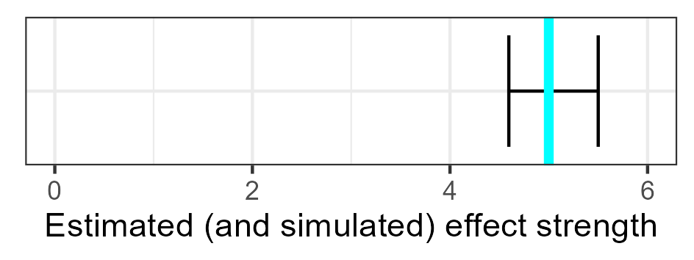


Pedagogy of this Tutorial
1. Ground Truth
Simulating data based on defined causal relationships
2. Regression
Deriving statistical models and running regression analyses
3. Comparison
Comparing the results of the analysis with the ground truth
4. Inference
Deducing obtainable knowledge from the analysis results
document reading technique
document reading technique
Model Derivation
$$5$$
identified defects
$$m:defects \sim 1+technique$$
identified defects
Notes:
With all of these fundamentals, this is how the following examples will look like:
example phenomenon x -> y with assumed DAG and data
derivation of a statistical model, running a regression analysis
comparing the results of the regression analysis with the values of the simulation: if they overlap, we inferred the correct causal conclusion
revealing the actual DAG with simulation weights

Slide 27
Statistical Causal Inference
Confounders and Mediators
Notes:
Since
most relationships of interest are rarely limited to only two variables, and
these additional variables may interact with the relationship of interest in unforeseen ways,
we need to be aware of how they can interact.

Slide 28




Confounding: Common Causes
“The company pushed for a use case driven requirements specification approach. We investigate whether the specification format of a requirement decreased the normalized lead time.”
specification format
(0 = baseline, 1 = use case driven)
lead time
$$\sim bernoulli(0.8−0.5∗pressure)$$
$$\sim N(0−2∗pressure+0∗format, 1)$$
$0$: the specification format does not affect lead time
$−0.5$: high pressure lets requirements engineers resort to their baseline way-of-working.
$−2$: high pressure strongly reduces the lead time
pressure (0 = low, 1 = high)
$$\sim bernoulli(0.3)$$

Slide 29

Confounding: Common Causes
“The company pushed for a use case driven requirements specification approach. We investigate whether the specification format of a requirement decreased the normalized lead time.”
specification format
$$m_{1}: leadtime\sim 1+format$$
Model Derivation
lead time
$$m_{2}: leadtime\sim 1+format+pressure$$
pressure

Slide 30
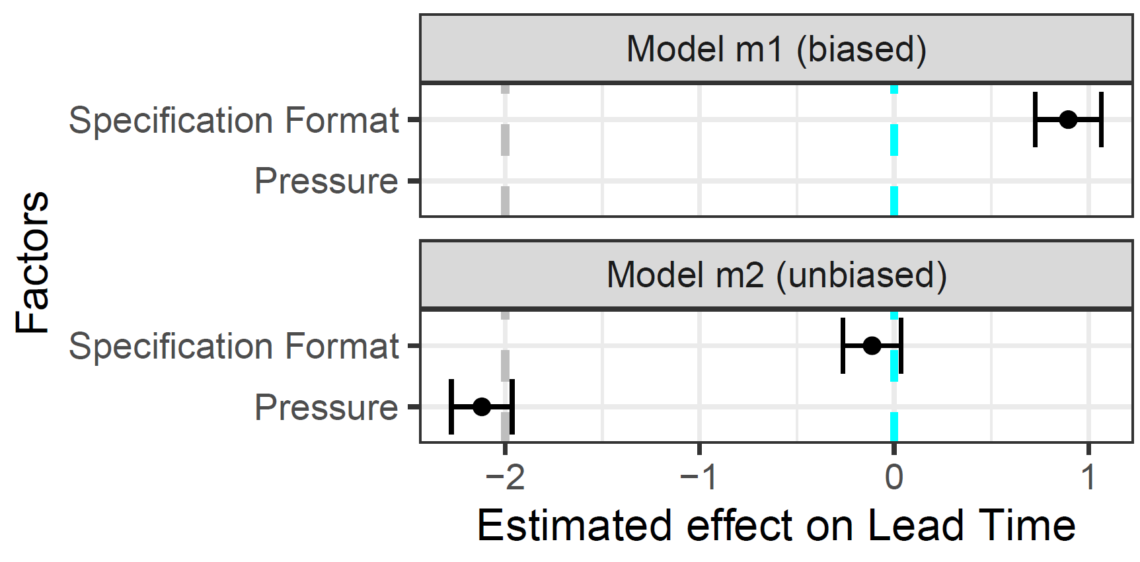

Confounding: Common Causes
“The company pushed for a use case driven requirements specification approach. We investigate whether the specification format of a requirement decreased the normalized lead time.”
$$m_{1}: leadtime\sim 1+format$$
$$m_{2}: leadtime\sim 1+format+pressure$$

Slide 31
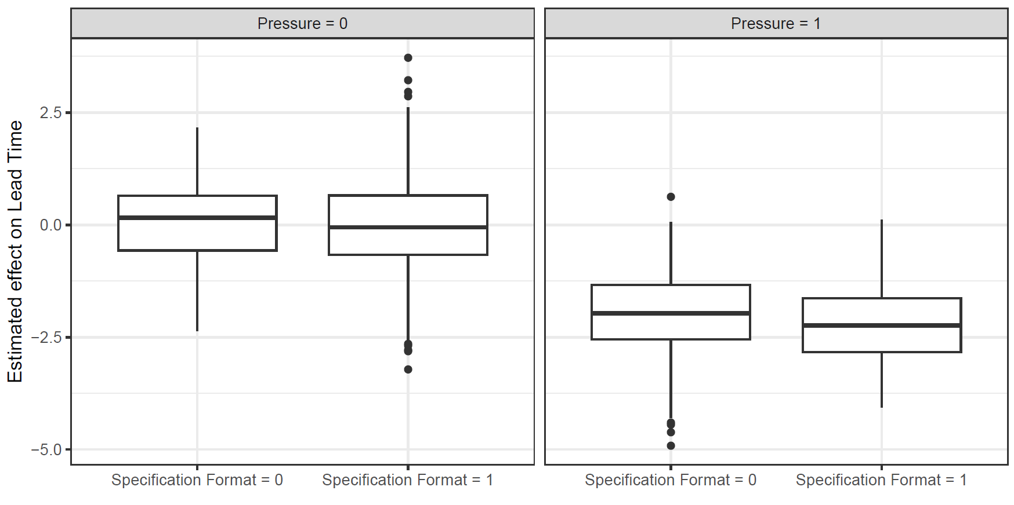
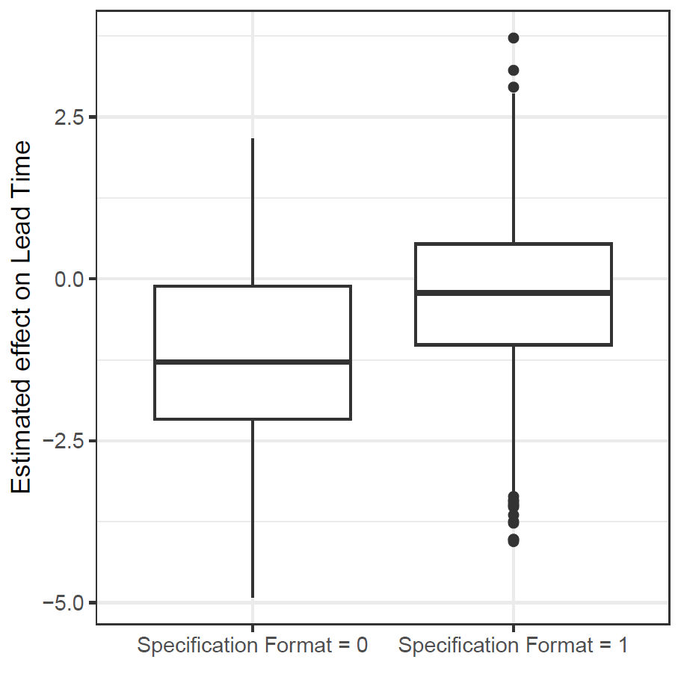
Confounding: Common Causes
“The company pushed for a use case driven requirements specification approach. We investigate whether the specification format of a requirement decreased the normalized lead time.”
Notes:
Only looking into the effect of format on lead time suggests that the specification format has a positive effect
However: stratifying by pressure levels shows that the specification format has no impact at all

Slide 32

Confounding: Common Causes
“The company pushed for a use case driven requirements specification approach. We investigate whether the specification format of a requirement decreased the normalized lead time.”
specification format
$$m_{1}: leadtime\sim 1+format$$
Model Derivation
lead time
$$m_{2}: leadtime\sim 1+format+pressure$$
pressure
If both exposure and outcome have a common cause, we need to statistically adjust for (i.e., control) the confounder to de-bias the effect of interest.
Notes:
But why is it so?

Slide 33
Confounding: Common Causes
Whenever specification format = 0, the likelihood that pressure = 1 is much higher which causes a lower lead time.
specification format
“Whenever specification format = 0, the likelihood that pressure = 1 is much higher” is an association, but not causal in this direction!
lead time
Remember:
observing ≠
doing
pressure
When not controlling the confounder, “information flows” from the cause through the confounder to the effect in a non-causal direction.

Slide 34

Practical Example of Confounding
“Coverage Is Not Strongly Correlated with Test Suite Effectiveness”
test suite coverage
mutation score
test suite coverage
mutation score
test suite size
http://dx.doi.org/10.1145/2568225.2568271
Inozemtseva, L., & Holmes, R. (2014, May). Coverage is not strongly correlated with test suite effectiveness. In Proceedings of the 36th international conference on software engineering (pp. 435-445).
Most Influential Paper at ICSE’24

Slide 35





Mediation: Pipes
“The company tested a new technique in their requirements engineering phase that is enabled by a prototype tool. We investigated whether this technique improved the engineers’ productivity.”
technique
(0 = baseline, 1 = treatment)
productivity
$$\sim bernoulli(0.5)$$
$$\sim N(0+0.5∗technique+2∗appeal, 1)$$
$0.5$: the treatment technique slightly improves productivity
$−1$: the prototype implementation of the new technique is not yet appealing
$2$: the more appealing the tool, the greater the productivity
tool appeal
$$\sim N(0−1∗technique)$$

Slide 36

Mediation: Pipes
“The company tested a new technique in their requirements engineering phase that is enabled by a prototype tool. We investigated whether this technique improved the engineers’ productivity.”
technique
$$m_{1}:productivity\sim 1+technique$$
Model Derivation
productivity
$$m_{2}:productivity\sim 1+technique+appeal$$
tool appeal

Slide 37
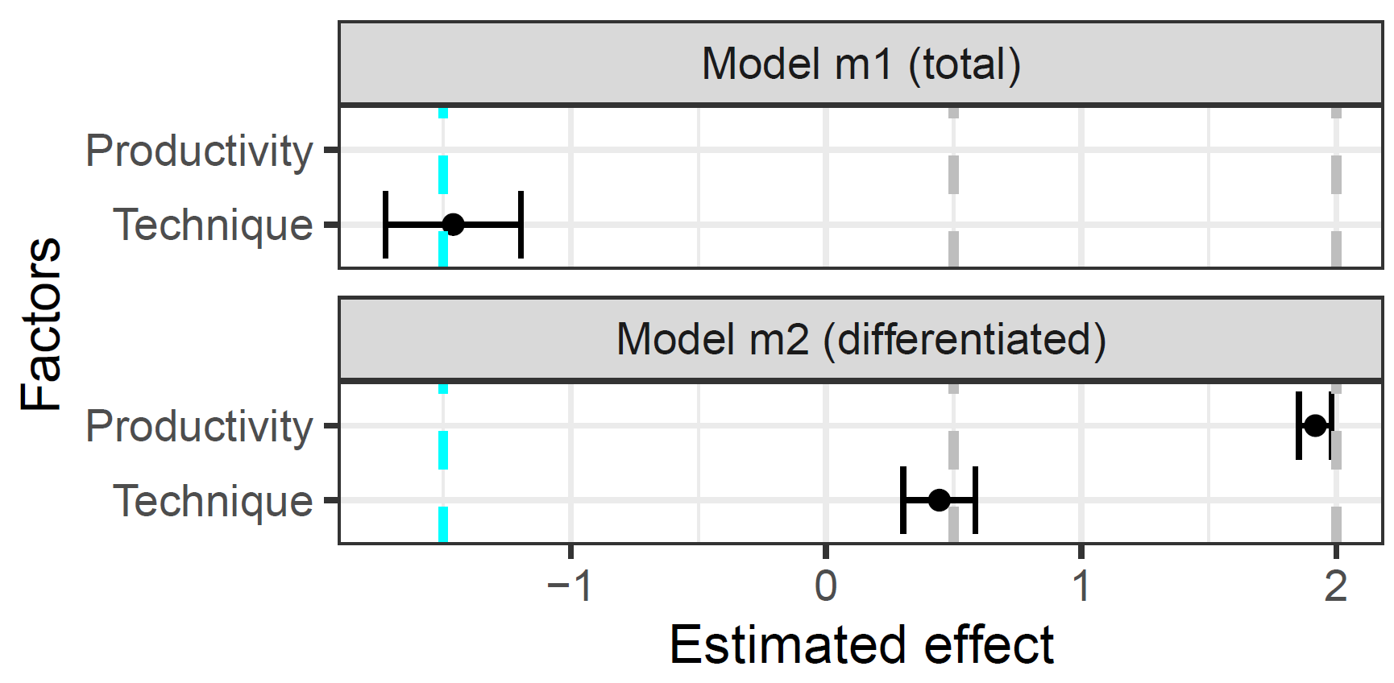
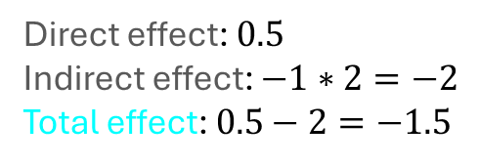



Mediation: Pipes
“The company tested a new technique in their requirements engineering phase that is enabled by a prototype tool. We investigated whether this technique improved the engineers’ productivity.”
technique
productivity
$$0.5$$
$$−1$$
$$2$$
tool appeal
Direct effect: $0.5$
Indirect effect: $−1∗2=−2$
Total effect: $0.5−2=−1.5$

Slide 38
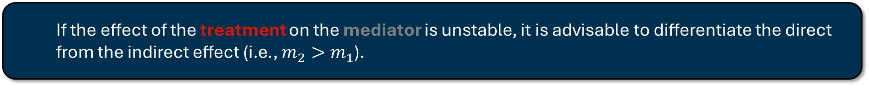

Mediation: Pipes
Both statistical models are causally unbiased. The choice, which of them to prefer depends on whether one is interested in the direct or total effect of the treatment.
technique
$$m_{1}:productivity\sim 1+technique$$
Model Derivation
productivity
$$m_{2}:productivity\sim 1+technique+appeal$$
tool appeal
If the effect of the treatment on the mediator is unstable, it is advisable to differentiate the direct from the indirect effect (i.e., $m_{2}>m_{1}$).

Slide 39
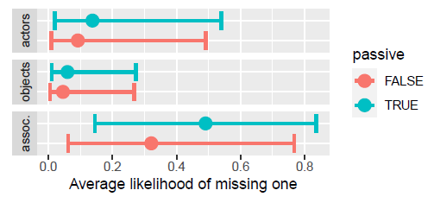
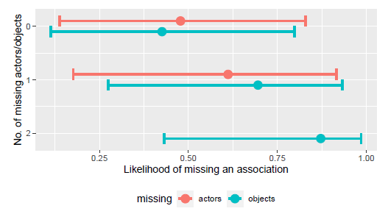
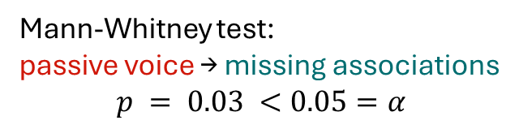
Practical Example of Mediation
missing actors
missing actors
passive voice
missing associations
passive voice
missing associations
missing objects
missing objects
Mann-Whitney test:
passive voice → missing associations
$$p = 0.03 <0.05=α$$
https://doi.org/10.1145/2652524.2652554
https://doi.org/10.1145/3643664.3648211
Femmer, H., Kučera, J., & Vetrò, A. (2014, September). On the impact of passive voice requirements on domain modelling. In Proceedings of the 8th ACM/IEEE international symposium on empirical software engineering and measurement (pp. 1-4).
Frattini, J., Fucci, D., Torkar, R., & Mendez, D. (2024, April). A second look at the impact of passive voice requirements on domain modeling: Bayesian reanalysis of an experiment. In Proceedings of the 1st IEEE/ACM International Workshop on Methodological Issues with Empirical Studies in Software Engineering (pp. 27-33).
Notes:
Studying the effect of passive voice on the completeness of resulting domain models, we found a mediation.

Slide 40




Colliding: Common Effects
“Does the length of a requirements specification affect its quality? Both factors do affect whether the specified feature is implemented successfully.”
specification size
specification quality
$$\sim N(0, 1)$$
$$\sim N(0, 1)$$
$0$: the specification size does not affect its quality
A feature is successful if it is very elaborately described ...
... or its description is high-quality
feature success (0 = rejected, 1 = approved)
$$\sim \left(size+quality>0.7\right)$$

Slide 41
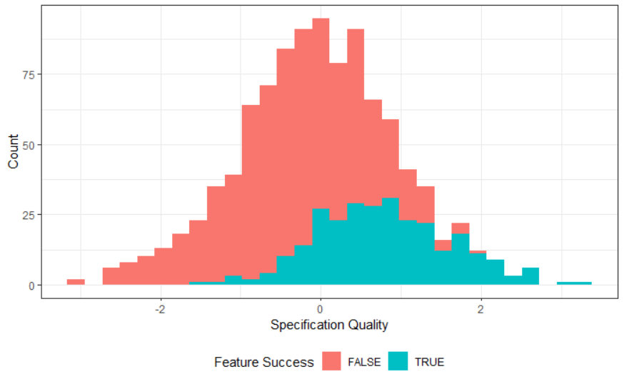


Colliding: Common Effects
“Does the length of a requirements specification affect its quality? Both factors do affect whether the specified feature is implemented successfully.”
specification size
specification quality
$$m_{1}:quality\sim 1+size+success$$
Model Derivation
$$m_{2}:quality\sim 1+size$$
feature success
Notes:
You can rightfully ask: why include “success” in the statistical model anyways?
We do see that “feature success” contains information about “specification quality”
Hence, it might be valuable for the estimation

Slide 42
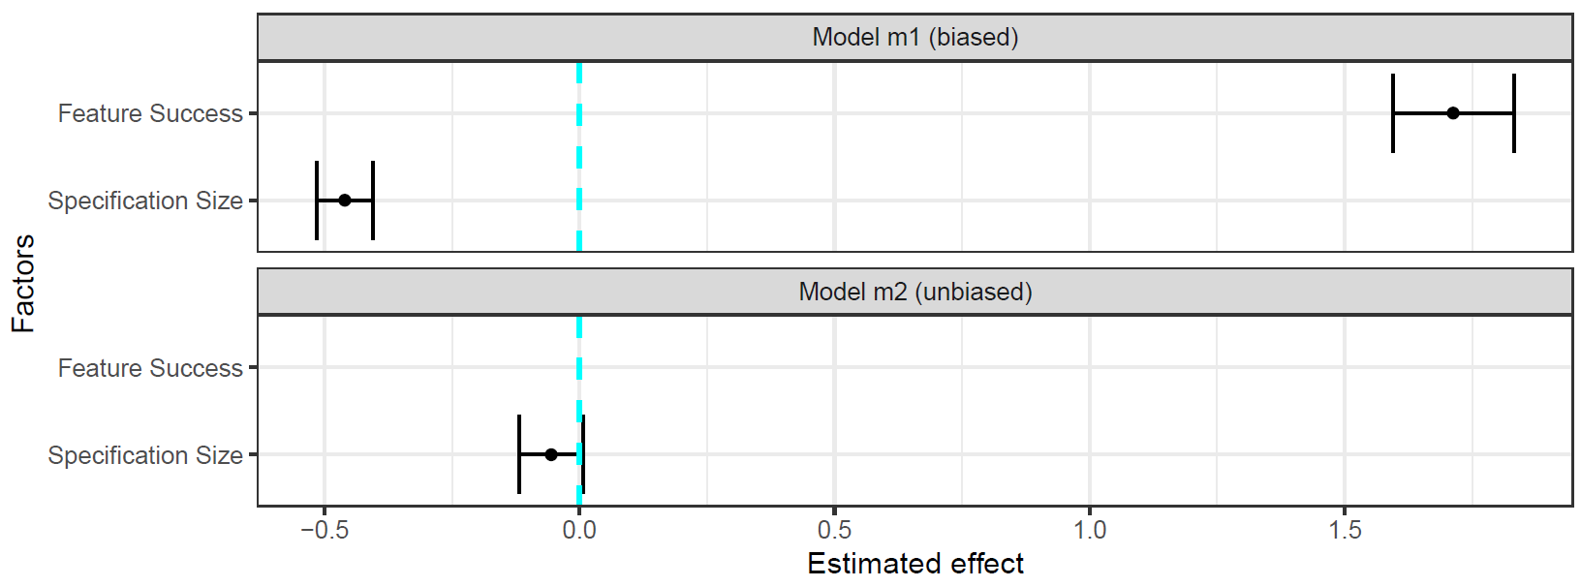

Colliding: Common Effects
“Does the length of a requirements specification affect its quality? Both factors do affect whether the specified feature is implemented successfully.”
$$m_{1}:quality\sim 1+size+success$$
Notes:
The estimation suggests that specification size has an effect far beyond what we simulated

Slide 43
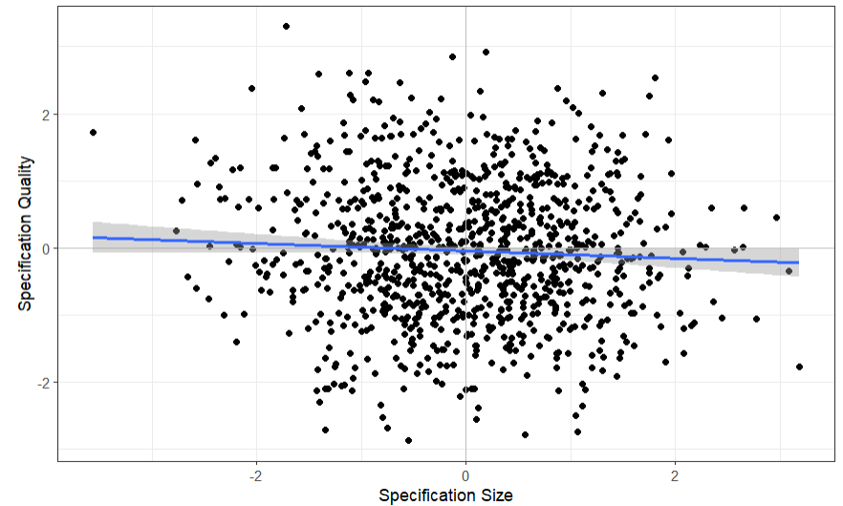
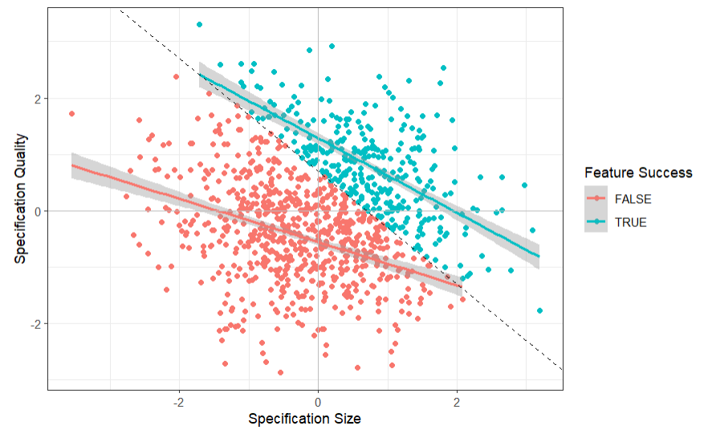
Colliding: Common Effects
“Does the length of a requirements specification affect its quality? Both factors do affect whether the specified feature is implemented successfully.”
Notes:
The visualization of the raw data shows that there is indeed no effect
The trendline is nearly horizontal
That means: there is no effect of one variable on the other
But stratifying by the third variable (feature success) paints a different picture:
Stratification by color (and the grey cut-off line intersects the y-axis at exactly 0.7)
Looking into each of the two strata individually, there is a negative association between the variables

Slide 44
Colliding: Common Effects
“Does the length of a requirements specification affect its quality? Both factors do affect whether the specified feature is implemented successfully.”
For any high quality value, if feature success is false, then it is more likely that the specification size was small.
For any low quality value, if feature success is true, then it is more likely that the specification size was large.

Slide 45
Colliding: Common Effects
“Does the length of a requirements specification affect its quality? Both factors do affect whether the specified feature is implemented successfully.”
specification size
specification quality
feature success
The non-causal association suggests a negative relationship between the cause and effect (Berkson’s paradox/fallacy).

Slide 46


Colliding: Common Effects
“Does the length of a requirements specification affect its quality? Both factors do affect whether the specified feature is implemented successfully.”
$$m_{1}:quality\sim 1+size+success$$
$$m_{2}:quality\sim 1+size$$

Slide 47


Colliding: Common Effects
“Does the length of a requirements specification affect its quality? Both factors do affect whether the specified feature is implemented successfully.”
specification size
specification quality
$$m_{1}:quality\sim 1+size+success$$
Model Derivation
$$m_{2}:quality\sim 1+size$$
feature success
If both treatment and outcome have a common effect, we must not condition on this common effect. Consequently, we cannot simply add all relevant variables as predictors.

Slide 48
Basic Types of Association
There are three basic types of association
Mediator
Fork
Collider

Slide 49
Basic Types of Association
The three basic types of association behave differently when statistically controlling for the third variable:
Not controlling z
Controlling z
z
Mediator
x
y
z
Fork
x
y
z
Information flows from x to y
Collider
Information does not flow
from x to y
x
y

Slide 50


Causal Modelling
Causal modelling is imperative for drawing the correct conclusions when conducting statistical causal inference.
We cannot infer causality from data alone – we must also know the process that created that data.
Causal Model
Model Derivation
Statistical Model
z
Fork
x | y | z
$$m:y\sim x+z$$
x
y
z
Collider
$$m:y\sim x$$
x
y
But how does this approach scale beyond three variables?
Notes:
Remember: “Data alone cannot give us causal inference – we must also know about how the data emerged” (show collider versus fork: same data, different statistical models from the causal models)

Slide 51
d-Separation
Statistical Control for Reducing Bias

Slide 52
Deriving a statistical Model from a causal Model: d-separation
A general framework to derive statistical models from causal models uses d-separation. It produces an adjustment set, i.e., the set of variables to control statistically in order to de-confound the causal effect between the exposure and the outcome.
https://bayes.cs.ucla.edu/BOOK-2K/d-sep.html

Slide 53

Deriving a statistical Model from a causal Model: d-separation
A general framework to derive statistical models from causal models uses d-separation. It produces an adjustment set, i.e., the set of variables to control statistically in order to de-confound the causal effect between the exposure and the outcome.
c
d
Model Derivation
$$m:b\sim a$$
a
b
e
f
g
https://bayes.cs.ucla.edu/BOOK-2K/d-sep.html

Slide 54
Deriving a statistical Model from a causal Model: d-separation
A general framework to derive statistical models from causal models uses d-separation. It produces an adjustment set, i.e., the set of variables to control statistically in order to de-confound the causal effect between the exposure and the outcome.
c
d
Model Derivation
$$m:b\sim a$$
Identify every backdoor path.
a
b
e
f
g
https://bayes.cs.ucla.edu/BOOK-2K/d-sep.html

Slide 55
Deriving a statistical Model from a causal Model: d-separation
A general framework to derive statistical models from causal models uses d-separation. It produces an adjustment set, i.e., the set of variables to control statistically in order to de-confound the causal effect between the exposure and the outcome.
c
d
Model Derivation
$$m:b\sim a$$
Identify every backdoor path.
Check if there is a collider between the cause and effect of interest.
  If yes, do not condition on any of the variables on this path.
a
b
e
f
g
https://bayes.cs.ucla.edu/BOOK-2K/d-sep.html

Slide 56


Deriving a statistical Model from a causal Model: d-separation
A general framework to derive statistical models from causal models uses d-separation. It produces an adjustment set, i.e., the set of variables to control statistically in order to de-confound the causal effect between the exposure and the outcome.
$$m:b\sim a+f$$
c
d
Model Derivation
$$m:b\sim a+g$$
Identify every backdoor path.
Check if there is a collider between the cause and effect of interest.
  If yes, do not condition on any of the variables on this path.
  If not, condition on any of the variables on this path to “close” the backdoor path.
a
b
e
f
g
https://bayes.cs.ucla.edu/BOOK-2K/d-sep.html

Slide 57


Deriving a statistical Model from a causal Model: d-separation
A general framework to derive statistical models from causal models uses d-separation. It produces an adjustment set, i.e., the set of variables to control statistically in order to de-confound the causal effect between the exposure and the outcome.
$$m:b\sim a+f(+e)$$
c
d
Model Derivation
$$m:b\sim a+g(+e)$$
Identify every backdoor path.
Check if there is a collider between the cause and effect of interest.
  If yes, do not condition on any of the variables on this path.
  If not, condition on any of the variables on this path to “close” the backdoor path.
Optionally, condition on mediators to discern the direct effect.
a
b
e
f
g
https://bayes.cs.ucla.edu/BOOK-2K/d-sep.html

Slide 58
Deriving a statistical Model from a causal Model: d-separation
A general framework to derive statistical models from causal models uses d-separation. It produces an adjustment set, i.e., the set of variables to control statistically in order to de-confound the causal effect between the exposure and the outcome.
$$m:b\sim a+f(+e)$$
c
d
Model Derivation
$$m:b\sim a+g(+e)$$
Identify every backdoor path.
Check if there is a collider between the cause and effect of interest.
  If yes, do not condition on any of the variables on this path.
  If not, condition on any of the variables on this path to “close” the backdoor path.
Optionally, condition on mediators to discern the direct effect.
a
b
e
f
g
https://bayes.cs.ucla.edu/BOOK-2K/d-sep.html

Slide 59
Exercises
Determine the adjustment set of variables to de-confound the estimation of the effect of the phenomenon a → b via d-separation.
c
d
a
b

Slide 60
Exercises
Determine the adjustment set of variables to de-confound the estimation of the effect of the phenomenon a → b via d-separation.
c
d
c
d
a
b
a
b
Adjustment set = {d}
Adjustment set = {c}

Slide 61
Exercises
Determine the adjustment set of variables to de-confound the estimation of the effect of the phenomenon a → b via d-separation.
c
e
d
a
b

Slide 62
Exercises
Determine the adjustment set of variables to de-confound the estimation of the effect of the phenomenon a → b via d-separation.
c
e
d
a
b
Adjustment set = {}

Slide 63
Exercises
Determine the adjustment set of variables to de-confound the estimation of the effect of the phenomenon a → b via d-separation.
c
e
d
a
b

Slide 64
Exercises
Determine the adjustment set of variables to de-confound the estimation of the effect of the phenomenon a → b via d-separation.
c
e
d
a
b
The DAG contains two backdoor paths:
a ← c → d ← e → b
a ← d ← e → b

Slide 65
Exercises
Determine the adjustment set of variables to de-confound the estimation of the effect of the phenomenon a → b via d-separation.
c
e
c
c
e
d
d
a
b
a
b
Adjustment set = {e}
Adjustment set = {c, d}
Conditioning on d opens the backdoor-path a ← c → d ← e → b which then has to be closed by additionally conditioning on c.

Slide 66
Exercises
Determine the adjustment set of variables to de-confound the estimation of the effect of the phenomenon a → b via d-separation.
unobservable variable
c
e
d
a
b

Slide 67
Exercises
Determine the adjustment set of variables to de-confound the estimation of the effect of the phenomenon a → b via d-separation.
c
e
d
a
b
Adjustment set = {e}

Slide 68
Exercises
Determine the adjustment set of variables to de-confound the estimation of the effect of the phenomenon a → b via d-separation.
c
e
d
a
b

Slide 69
Exercises
Determine the adjustment set of variables to de-confound the estimation of the effect of the phenomenon a → b via d-separation.
c
e
d
a
b
For some DAGs, it is impossible to find an adjustment set that deconfounds the effect of interest.

Slide 70
Causal Workflow
Applying Statistical Causal Inference in Research and Practice
Notes:
How can you use these techniques for your own research?

Slide 71
Workflow for Statistical Causal Inference
1) Modelling
Creating a DAG of assumed causal relationships
x
y
z
Notes:
Firstly: always draw a causal DAG that represents your causal assumptions

Slide 72
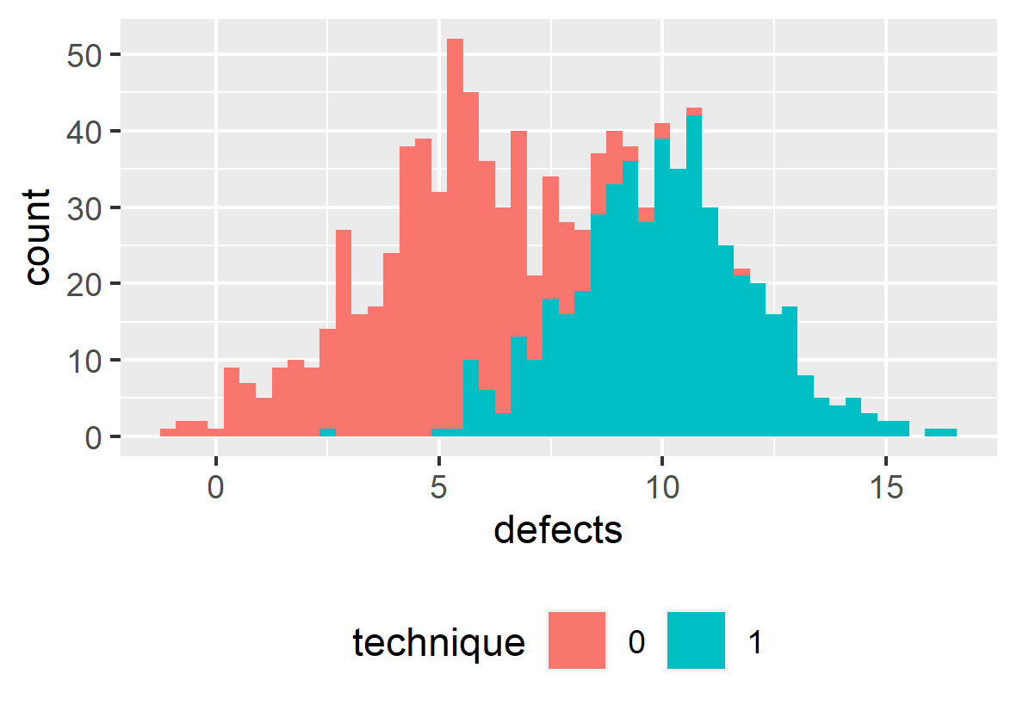

Workflow for Statistical Causal Inference
1) Modelling
Creating a DAG of assumed causal relationships
x
y
z
2) Identification
Deriving a statistical from the causal model
$$y\sim x+z$$
Model Derivation
3) Estimation
Training a statistical model with the observed data and evaluating the results
Siebert, J. (2023). Applications of statistical causal inference in software engineering. Information and Software Technology, 159, 107198.

Slide 73
Scientific Workflow: Traditional
Data Collection
Assumed DAG
Collected Data
Modelling
x | y
Identification
x
y
Estimation
Too often, we derive hypotheses from the data available to us.
Notes:
How do these conceptual steps intertwine with the operational steps necessary for quantitative studies?

Slide 74
Scientific Workflow: Traditional
Data Collection
Assumed DAG
Collected Data
hard-to-measure
confounder
Modelling
x | y
z
Identification
x
y
Estimation
Not collecting data about a confounder will threaten the internal validity of your result
Notes:
How do these conceptual steps intertwine with the operational steps necessary for quantitative studies?

Slide 75
Scientific Workflow: Better
Modelling
Assumed DAG
Collected Data
hard-to-measure
confounder
Identification
x | y
x | y | z
z
Data Collection
x
y
Estimation
Determine the variables about which you need to collect data in order to estimate an unbiased effect of interest before collecting that data.

Slide 76
Scientific Workflow: Best
Modelling
Assumed DAG
Collected Data
hard-to-measure
confounder
Identification
x | y | z | a
 |  |  | x
 |  |  | x
 |  |  | x
 |  |  | x
z
Data Collection
x
y
feasible?
a
Alternate
Strategy
Estimation
unobservable
confounder
Unobservable confounders require (a) acknowledgement in the threats to (internal) validity and (b) different research strategies.

Slide 77
Recommendations
Data Collection
Is a part of data analysis, not its precursor
Draw a DAG
representing your causal assumptions
Use d-separation
to figure out (1) if you can conduct your study and (2) what data you need to collect
Notes:
In summary, when you aim to conduct a rigorous and relevant study, consider these three recommendations:
Consider data collection as a part of data analysis, not as two separate, subsequent steps
Start your data analysis with a DAG
Apply d-separation to figure out (1) if you can actually conduct your study and – if so – (2) what data you need to collect

Slide 78
Conclusion
Final Remarks

Slide 79
Reading list
Pearl, J., & Mackenzie, D. (2018). The book of why: the new science of cause and effect. Basic books.
McElreath, R. (2018). Statistical rethinking: A Bayesian course with examples in R and Stan. Chapman and Hall/CRC.
Cinelli, C., Forney, A., & Pearl, J. (2024). A crash course in good and bad controls. Sociological Methods & Research, 53(3), 1071-1104.
Siebert, J. (2023). Applications of statistical causal inference in software engineering. Information and Software Technology, 159, 107198.
Furia, C. A., Feldt, R., & Torkar, R. (2019). Bayesian data analysis in empirical software engineering research. IEEE Transactions on Software Engineering, 47(9), 1786-1810.
Furia, C. A., Torkar, R., & Feldt, R. (2022). Applying Bayesian analysis guidelines to empirical software engineering data: The case of programming languages and code quality. ACM Transactions on Software Engineering and Methodology (TOSEM), 31(3), 1-38.

Slide 80
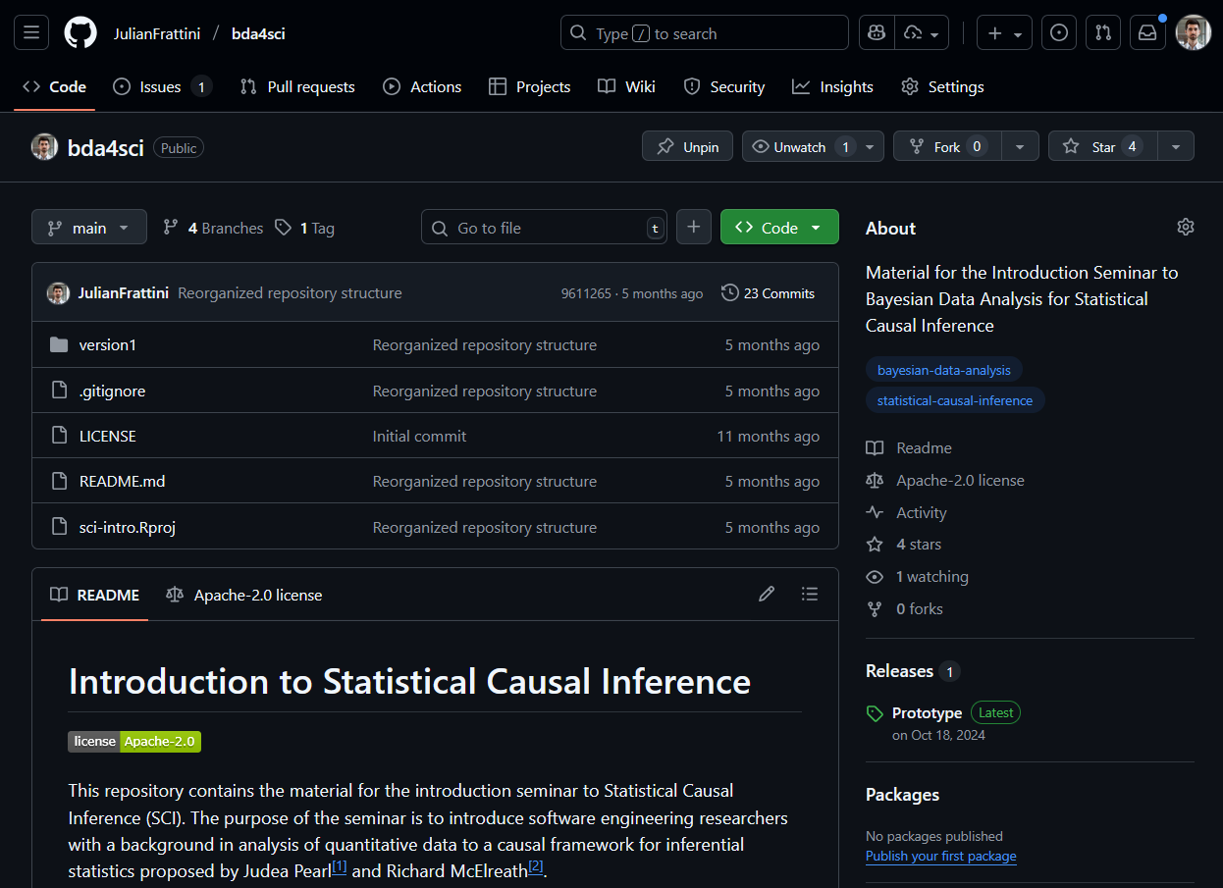
Material
JulianFrattini/bda4sci
Public
All material is public and open-source on GitHub. Feel free to clone, fork, and share the study material.
Comments, requests, and additions are welcome.

Slide 81
Limitations
This was but a gentle introduction. The topic of statistical causal inference contains many more elements, like
Ancestors: parent-child relationships in DAGs
Interaction: moderated inter-relationship between two or more variables and an outcome
Hierarchical model: partial pooling
Different types of regression: regression models for different outcome variable distributions
Bayesian data analysis: advanced estimation technique
And many more …

