Slide 1


Structural Causal Models
A Shared Language for Scientific Inquiry
Julian Frattini, Ph.D.
Chalmers University of Technology, Sweden
https://julianfrattini.github.io/
JulianFrattini/bda4sci
Public
Copyright © 2026 Julian Frattini.
This work is licensed under the Apache-2.0 License.

Slide 2
Directed Acyclic Graphs
A Syntax to Formalize Causal Assumptions

Slide 3
Causal Modelling
A (structural) causal model is a conceptual model that represents the causal mechanisms of a system [1]. They serve two main purposes [2]:
Visualizing causal assumptions and determining testable implications.
Proving the possibility of computing causal effects from observational data.

Slide 4
Structure of this Seminar
Every lesson consists of its theory and one or more use cases.
Theory
Use Case

Slide 5
Directed Acyclic Graphs
Theory
Use Case
Causal models can be realized as directed, acyclic graphs (DAGs).
x
y
exposure
(assumed) causal relationship
response
phenomenon

Slide 6

Formulating Casual Hypotheses
Theory
Use Case
DAGs can visualize a causal hypothesis graphically
RQ: Does the use of generative AI (GenAI) have an effect on the productivity of developers?
RQ: Does the use of generative AI (GenAI) have an effect on the productivity of developers?
use of GenAI
x
y
productivity

Slide 7
Directed Acyclic Graphs
Theory
Use Case
Causal models can be realized as directed, acyclic graphs (DAGs).
b
x
y
z
a
exposure
(assumed) causal relationship
response
phenomenon
other factors

Slide 8
Formulating Complex Hypotheses
Theory
Use Case
DAGs convey complex relationships between multiple variables in a simple and straightforward manner.
RQ: Does the use of generative AI (GenAI) have an effect on the productivity of developers, assuming that motivation affects both usage (moderated by GenAI experience) and productivity, and accounting for an indirect effect of the IDE’s user experience?
b
IDE’s user experience
use of GenAI
productivity
x
y
GenAI experience
z
a
motivation

Slide 9
Disputing Causal Hypotheses
Theory
Use Case
The explicit formulation of causal hypotheses in DAGs makes it easy to compare and contrast assumptions.
IDE’s user experience
IDE’s user experience
b
b
use of GenAI
use of GenAI
x
y
x
y
productivity
productivity
GenAI experience
GenAI experience
z
a
motivation
z
a
motivation
These comparisons can inform the design of an empirical study to verify, which of the two hypotheses reflects reality better.

Slide 10
Distinguishing Study Types
Theory
Use Case
The causal DAG also reveals controlled vs. observational studies: a controlled study is indicated by a DAG where no variable affects the exposure.
Observational study
Controlled Experiment
IDE’s user experience
IDE’s user experience
b
b
use of GenAI
use of GenAI
x
y
x
y
productivity
productivity
GenAI experience
GenAI experience
z
a
motivation
z
a
motivation

Slide 11
Types of Relationships
Theory
Use Case
When a DAG involves more than two variables, certain relationships can emerge:
Mediation
Confounding
Collider
x
y
x
y
x
y
z
z
z
z mediates the effect of x on y. There is a direct (x → y) and an indirect (x → z → y) effect.
z confounds the effect of x on y. An observed effect (x → y) might be caused by the confounder (x ← z → y).
z is a common effect of x and y.

Slide 12
Dealing with Variables
Theory
Use Case
Based on the type of relationship between variables, these additional factors need to be treated differently.
Mediation
Confounding
Collider
x
y
x
y
x
y
z
z
z
You can control z if you want to distinguish the direct from the indirect effect
You must control z to avoid confounding
You must not control z to avoid confounding
Control can either be by design (fixing variables) or by analysis (stratifying the data).

Slide 13
Encoding Observability
Theory
Use Case
Nodes in DAGs can indicate whether a variable is observable or not.
b
x
y
a
exposure
(assumed) causal relationship
response
phenomenon
other (observed)
factors
other (observed)
factors

Slide 14
Determining Study-ability
Theory
Use Case
Causal DAGs allow deciding whether it is even possible to determine the (unbiased) causal effect of a phenomenon.
use of GenAI
x
y
productivity
a
motivation
If a phenomenon has an unobserved confounder, then the causal effect of the exposure on the outcome cannot be estimated from observational data.

Slide 15
Visualizing Moderation
Theory
Use Case
Factors can not only affect other factors, but also other relationships in a process called moderation.
use of GenAI
x
y
productivity
a
experience
A moderator changes the effect that one variable has on another.

Slide 16

















Determining Moderation
Theory
Use Case
The existence of a moderator evokes a distinct effect pattern.
no covariation,
no moderation
covariation, but
no moderation
no covariation, but moderation
covariation and moderation
$$β_{x}$$
$$β_{x}$$
$$β_{x}$$
$$β_{x}$$
x
y
x
y
x
y
x
y
$$γ_{a}$$
$$γ_{a}$$
a
a
$$β_{a}$$
a
a
$$β_{a}$$
y
y
y
y
$$β_{x}$$
$$β_{x}$$
$$β_{x}$$
$$β_{a}$$
$$β_{x}$$
$$β_{x}$$
$$γ_{a}$$
$$γ_{a}$$
$$β_{a}$$
a
a
a
a

Slide 17
Probabilistic vs. Deterministic Relationships
Theory
Use Case

Slide 18
Exercises
Applying Causal Modelling

Slide 19
Exercise: Formulating a DAG
Derive a causal DAG from the following description:
“Researchers are interested in knowing if using ChatGPT affects the quality and length of code reviews at a company. Since they cannot interrupt the regular workflow, they cannot force anyone to use or not use ChatGPT. They do know, however, that younger developers use ChatGPT more often. On the other hand, they know that more skilled developers generally produce more concise (i.e., shorter) and better code reviews.”

Slide 20
Solution: Formulating a DAG
“Researchers are interested in knowing if using ChatGPT affects the quality and length of code reviews at a company. Since they cannot interrupt the regular workflow, they cannot force anyone to use or not use ChatGPT. They do know, however, that younger developers use ChatGPT more often. On the other hand, they know that more skilled developers generally produce more concise (i.e., shorter) and better code reviews.”
CR quality
ChatGPT
CR length

Slide 21
Solution: Formulating a DAG
“Researchers are interested in knowing if using ChatGPT affects the quality and length of code reviews at a company. Since they cannot interrupt the regular workflow, they cannot force anyone to use or not use ChatGPT. They do know, however, that younger developers use ChatGPT more often. On the other hand, they know that more skilled developers generally produce more concise (i.e., shorter) and better code reviews.”
CR quality
ChatGPT
CR length
age

Slide 22
Solution: Formulating a DAG
“Researchers are interested in knowing if using ChatGPT affects the quality and length of code reviews at a company. Since they cannot interrupt the regular workflow, they cannot force anyone to use or not use ChatGPT. They do know, however, that younger developers use ChatGPT more often. On the other hand, they know that more skilled developers generally produce more concise (i.e., shorter) and better code reviews.”
CR quality
ChatGPT
CR length
age
skill

Slide 23
Solution: Formulating a DAG
“Researchers are interested in knowing if using ChatGPT affects the quality and length of code reviews at a company. Since they cannot interrupt the regular workflow, they cannot force anyone to use or not use ChatGPT. They do know, however, that younger developers use ChatGPT more often. On the other hand, they know that more skilled developers generally produce more concise (i.e., shorter) and better code reviews.”
CR quality
ChatGPT
CR length
age
skill
Notes:
You sometimes need “domain knowledge” to complete a DAG

Slide 24
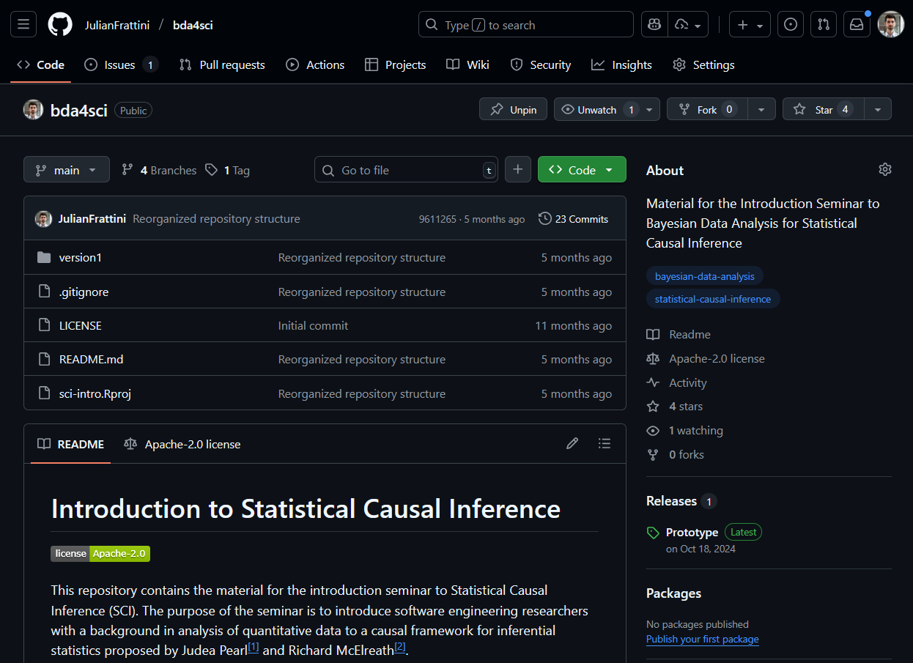
Material
JulianFrattini/bda4sci
Public
All material is public and open-source on GitHub. Feel free to clone, fork, and share the study material.
Comments, requests, and additions are welcome.

Slide 25
References
[1] Pearl, J. (2009). Causality. Cambridge university press.
[2] Cinelli, C., Forney, A., & Pearl, J. (2024). A crash course in good and bad controls. Sociological Methods & Research, 53(3), 1071-1104.

