Slide 1


Statistical Causal Inference
a gentle introduction to advanced analysis of quantitative data
Julian Frattini, Ph.D.
Chalmers University of Technology, Sweden
https://julianfrattini.github.io/
JulianFrattini/bda4sci
Public
Copyright © 2024 Julian Frattini.
This work is licensed under the Apache-2.0 License.

Slide 2
Overview
Session | Time | Content | Style
Introduction | 09:00-09:15 | State-of-the-art, motivation, and goals | Lecture
Fundamentals & Notation | 09:15-09:45 | Fundamental terminology in statistics, and notation used throughout this tutorial | Lecture
Causal Inference I | 09:45-10:30 | Mediation and confounders | Lecture & Exercises
Break | 10:30-10:45
Causal Inference II | 10:45-11:15 | Colliders and model comparison | Lecture & Exercises
Conclusion | 11:15-11:30 | Workflow for causal inference | Lecture
Outlook | 11:30-11:45 | Further applications, structured reading list | Lecture
Feedback | 11:45-12:00 | Reflection, discussion, and closing | Open discussion

Slide 3
Introduction
Goals and Expectations

Slide 4
State-of-the-art
Notes:
There seems to be an implicit, collective agreement in our community that
Studying causal relationships is hard, and therefore
Detecting correlations is good-enough.
So: Why care about causality?

Slide 5
Correlation versus Causality
Correlation: When we observe X, we also observe Y.
Causality: When we do X, we observe Y.
Only causal relationships give us reliable recommendation on how to act, and therefore, how to make a positive impact on the target audience of our research (i.e., RE/SE practitioners).
Data alone cannot give us causal inference – we must also know about how the data emerged (we’ll revisit this statement later).

Slide 6
Experimental vs. Observational Studies
One ”straightforward” fix to distinguish correlation from causality: conduct an experimental study, where we exert control over a treatment and isolate its effect from all confounding.
But: experiments are expensive and perturb the natural context of a phenomenon. Some phenomena cannot be studied in controlled experiments at all (e.g., impact of human factors) since the values of that variable cannot be assigned randomly.

Slide 7
Goals
Convincing you of the value of causal inference (check)
Learning the fundamentals of drawing causal conclusions from quantitative data collected in observational studies

Slide 8
Learning Outcomes
Causal modelling: visualizing causal assumptions graphically
Statistical causal inference: drawing reliable conclusions from observational data
Causal workflow: a reliable workflow for SCI

Slide 9
Fundamentals & Notation
Syntax and Pedagogics of this Tutorial

Slide 10
Terminology
Variable:
Phenomenon

Slide 11
Simulations
To demonstrate the process of SCI, we simulate data sets. This gives us control over the ”ground truth” of relationships.
(introduce random variables)
(show simulation formula and explain all terms)
(visualize simulated data)

Slide 12
Causal Modeling
Directed, acyclic graphs (DAGs) can represent causal assumptions, where nodes represent variables and edges represent assume/potential causal relationships between those variables. More importantly, the absence of an edge encodes the certainty that two variables are not directly related.

Slide 13
Causal Modeling and Simulations
(Visualizations of a causal model with values from the data simulation)

Slide 14
Regression analyses
For our data analysis tool, we will use linear regressions (which are more powerful than NHSTs but more approachable than Bayesian data analysis).
Limitations: assumption of monotonicity, etc.
(example of a regression formula with explanations, regression+data, and results)

Slide 15
From causal to statistical Models
Connection between causal and statistical models:
Causal models encode causal assumptions
Statistical models implements inference
Statistical causal inference (SCI) = deriving statistical models from causal models
(how to do this is a major learning outcome of this tutorial)

Slide 16
Example
With all of these fundamentals, this is how the following examples will look like:
(example phenomenon x -> y with assumed DAG and data)
(derivation of a statistical model, running a regression analysis)
(comparing the results of the regression analysis with the values of the simulation: if they overlap, we inferred the correct causal conclusion)
(revealing the actual DAG with simulation weights)

Slide 17
Causal Inference I
Confounders and Mediators

Slide 18
Statistical Causal Inference from Observational Data
Since (1) most relationships of interest are rarely limited to only two variables and (2) these additional variables may interact with the relationship of interest in unforeseen ways, we need to be aware of how they can interact.
Mediator
Fork
Collider

Slide 19
(Confounding)
(assumed causal DAG of x->y and z->y with simulated data)
(running y~x and y~x+z and comparing the results)
(revealing the correct DAG that also includes z->x)

Slide 20
Break

Slide 21
Causal Inference II
Colliders, D-separation, and Model Comparison

Slide 22
Causal Modelling
Imperative for drawing the correct conclusions through statistical inference is the causal model of our data.
Remember: “Data alone cannot give us causal inference – we must also know about how the data emerged” (show collider versus fork: same data, different statistical models from the causal models)
But in real life, there is no grand reveal about the “actual” causal model as I just provided.
So how do you determine the “correct” causal model?

Slide 23
Causal Modelling
It is impossible to determine the ”correct” causal model – we would need to look behind the curtain and see the ”fabric of the world.”
Instead of aiming for a ”correct” causal model, rather aim for a ”transparent” and ”useful” causal model.
“transparent” is easy: visualize your causal assumptions via DAGs
“useful” is more difficult: how do you assess the usability of a causal model?

Slide 24
Model Comparison
There is no absolute way to assess the usefulness of a causal model, but a relative way: model comparison!
(show 2x2-matrix of actual DAGs versus assumed DAGs + statistical model)
(infer from their comparison which model is more useful)

Slide 25
Example: Impact of Passive Voice on Domain Modelling
(MVT example showing revised causal assumptions)

Slide 26
Conclusion
A Workflow for Causal Inference to take home

Slide 27
Outlook
Other Applications and Further Reading

Slide 28
Managing Variance Theories
The process of model comparison lends itself to a transparent evolution of empirical evidence about a phenomenon resulting in a more robust variance theory.
Frattini, J., Fischbach, J., Fucci, D., Unterkalmsteiner, M., & Mendez, D. (2024). Replications, Revisions, and Reanalyses: Managing Variance Theories in Software Engineering. arXiv preprint arXiv:2412.12634.

Slide 29
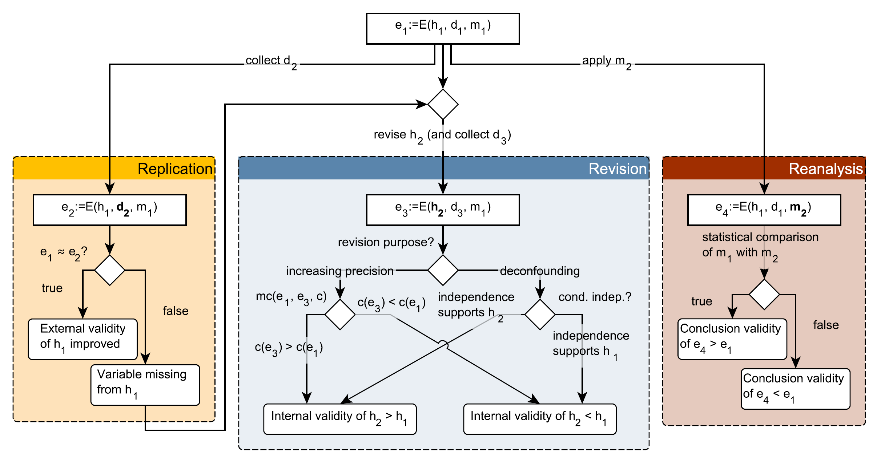
Managing Variance Theories
Frattini, J., Fischbach, J., Fucci, D., Unterkalmsteiner, M., & Mendez, D. (2024). Replications, Revisions, and Reanalyses: Managing Variance Theories in Software Engineering. arXiv preprint arXiv:2412.12634.

Slide 30
Causal Inference for Requirements Engineering
Notes:
This whole tutorial was designed to teach applying causal inference to RE *research*, but it can also be used for RE itself

Slide 31
Reading list

Slide 32
Closing
Open Exchange

Slide 33
Material

Slide 34
References

