Slide 1
Bayesian Data Analysis for Statistical Causal Inference
A gentle Challenging of Data Analysis Habits in Software Engineering Research

Slide 2
Context
Software engineering research – as most disciplines – aim to determine causal effects (e.g., the benefit of using TDD vs. TL or agile vs. Plan-driven).
Many researchers are, however, ill-equipped to obtain valid answers to these causal questions.

Slide 3
Goals
This tutorial is aimed at academics that aim to tackle causal questions but lack the tools for it.

Slide 4
Status Quo
Data Analysis in Software Engineering Research

Slide 5
Typical Process
Formulate a hypothesis (ind -> dep)
Collect some data
Select an appropriate hypothesis test depending on the properties of the variables
Perform the hypothesis test and calculate the effect size
Report the results and limit the conclusions based on the context factors
This process is based on an impression, not a systematic review.
Sometimes, step 1 and 2 are even switched.

Slide 6
Issues
Lack of a causal inference framework
Simple frequentist methods

Slide 7
Statistical Causal Inference
A rigorous approach to obtaining causal conclusions from data
Notes:
What is the problem with the simple causal assumptions?

Slide 8
Overview
Most questions relevant to research are of causal nature
But: answers to such questions cannot be computed from data alone
Instead, they require knowledge about the data-generating process.
Statistical causal inference: infering causal relationships from quantitative data
Pearl-2009-ssurv

Slide 9
Terminology
Factors/variables
Treatment (incl. Levels), main factor
Outcome/response variable
Relationships: causal/correlational

Slide 10
Syntax of Causal Assumptions
Causal directed acyclic graphs: variables as nodes, effects as edges, independency as lack of edges, parents, children
Examples: simple 2-variable DAG, complex DAG with many variables

Slide 11
Experimental vs. Observational Studies
In experimental studies, the variable of interest (the treatment) is controlled, i.e., set to specific levels
If the assignment of treatments to units is random, then we can assume that the effect is causal (see: SUTVA, ignorability, etc.)
However: controlled experiments are expensive to conduct
Sometimes we need to resort to observational studies
This, in turn, means that in the data generation process, the relationship between the treatment and outcome may be confounded through different types of association

Slide 12
Sources of Association
Mediators/chains
Common causes/forks
Common effects/colliders

Slide 13
Mediation
Direct vs indirect effect
Does not matter when interested in the total effect
May matter when interested in the direct effect
Counterfactual scenario: what if the the mediator is fixed at a certain level?

Slide 14
Forks/Common Causes
Forks introduce spurious associations:
Example for a 3-variable DAG with a fork
Concrete example: LLMs -> productivity, LLMs <- motivation -> productivity
Association between LLMs and productivity
Can be spurious
But it does not have to
How would we know? Controlling for motivation
Check for the effect of LLMs -> productivity in all strata of motivation

Slide 15
Colliders
Usually, pre-treatment variables are considered safe to include in a regression model
Collider example: researcher -> teacher, researcher -> tenure <- teacher

Slide 16
Paths
These sources of association call for a systematic analysis of DAGs via the concept of paths.
Definition of a path
Causal vs. Non-causal path
Backdoor path

Slide 17
Working with DAGs
Backdoor criterion/adjustment set
Example
Exercises
This is why it is important to respect the data generation process when trying to infer causal relationships from quantitative data: simply adding all available variables is not correct.

Slide 18
Summary of Part I
Answering causal questions in research requires knowledge about the data generation process
We can visualize causal hypotheses using DAGs
There are three basic types of association in DAGs: mediators, forks, and colliders
Using the backdoor criterion, we can decide which variables to adjust for and which to ignore

Slide 19
References

Slide 20
Frequentist Methods
State of the art for statistical inference in software engineering

Slide 21
Overview
Frequentist methods are the state of the art in software engineering research (assumption)
Out-of-the-box methods (like NHSTs)
Popularity possibly stems from Claes Wohlins book

Slide 22
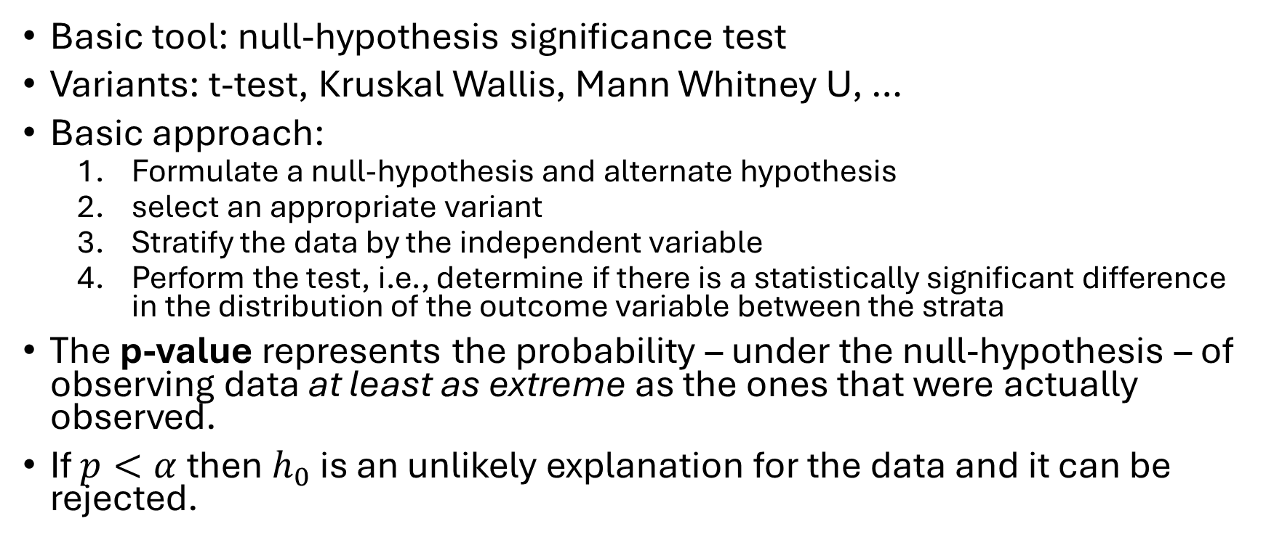
Basics
Basic tool: null-hypothesis significance test
Variants: t-test, Kruskal Wallis, Mann Whitney U, …
Basic approach:
Formulate a null-hypothesis and alternate hypothesis
select an appropriate variant
Stratify the data by the independent variable
Perform the test, i.e., determine if there is a statistically significant difference in the distribution of the outcome variable between the strata
The p-value represents the probability – under the null-hypothesis – of observing data at least as extreme as the ones that were actually observed.
If $p<α$ then $h_{0}$ is an unlikely explanation for the data and it can be rejected.

Slide 23
Issues
The selection of the significance level is arbitrary
The answer to a research question is a scalar summary, i.e., binary (significant difference or no significant difference)
Frequentist approaches use an unsound extension of the modus tollens

Slide 24


Modus tollens in frequentist Analyses
This extension is not sound!
Modus tollens
Probabilistic extension
Example 1:
X: a person lives in Switzerland
Y: a person is the King of Sweden
P[Y|X] is probably false, so if we observe Y then P[X] is probably false.
$$\frac{X→¬Y Y}{¬X}$$
$$\frac{P\left[Y | X\right]<ε Y}{P\left[X\right]< ε}$$
If X implies that Y is false, and we observe Y, then X is false.
If X implies that Y is probably false (equivalently: Y is improbably true), and we observe Y, then X is probably false.
Example 2:
X: a person lives in London
Y: a person is the Queen of England
P[Y|X] is probably false, but if we observe Y then P[X] is actually true.
Furia, C. A., Feldt, R., & Torkar, R. (2019). Bayesian data analysis in empirical software engineering research. IEEE Transactions on Software Engineering, 47(9), 1786-1810.

Slide 25
Standard Tests are Linear Models

Slide 26
Bayesian Data Analysis

Slide 27
Bayes Theorem

Slide 28
The Bayesian Approach
Define regression formula
Determine model distribution
Select priors
Run prior predictive check
Fit the model
Run posterior predictive check
Plot marginal distributions

Slide 29
Demonstration of the Bayesian Approach

Slide 30
Interaction Effects

Slide 31
Bayesian Data Analysis for Statistical Causal Inference

Slide 32
General Framework
Modeling
Identification
Estimation:
Data collection
Bayesian data analysis

Slide 33
Discussion

Slide 34
References

