Slide 1


Statistical Causal Inference
Emerging Paradigms for Advanced Data Analysis
Julian Frattini, Ph.D.
Chalmers University of Technology, Sweden
https://julianfrattini.github.io/
JulianFrattini/bda4sci
Public
Copyright © 2024 Julian Frattini.
This work is licensed under the Apache-2.0 License.

Slide 2





Julian Frattini // about me
2013 - 2019 | Bachelor & Master of Science
 | Technical University of Munich, Munich, Germany
2020 – 2025 | Ph.D. Student
 | Blekinge Institute of Technology, Karlskrona, Sweden
2025 - 2029 | Postdoctoral Researcher
 | Chalmers University of Technology, Gothenburg, Sweden

Slide 3



Julian Frattini // about my research
Good-enough Requirements Engineering
Quantifying the effect of quality factors of requirements artifacts on downstream software development activities
Hybrid-AI Software Engineering
Understanding the interface between traditional and data-driven software components in a hybrid software system.
Software Engineering Research Methodology
Improving the methods used in research to produce more rigorous and valid conclusions

Slide 4
Motivation
The Point of Science

Slide 5
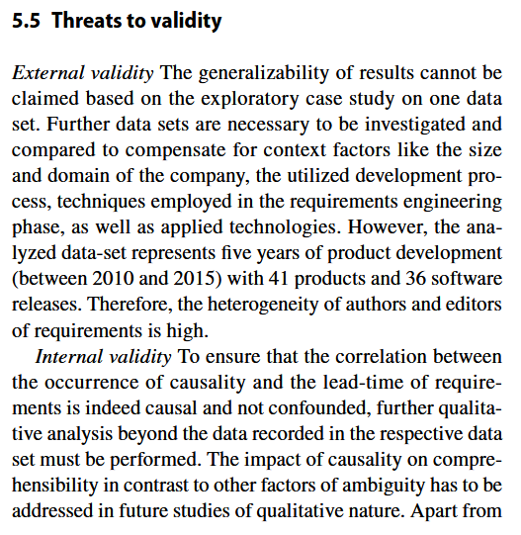
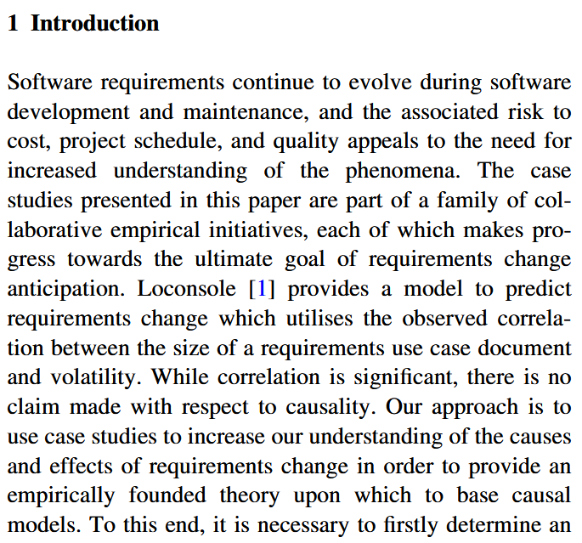
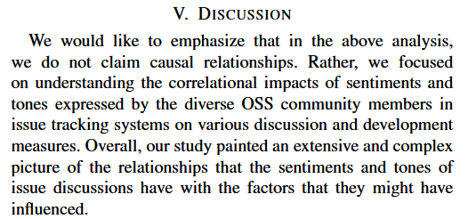
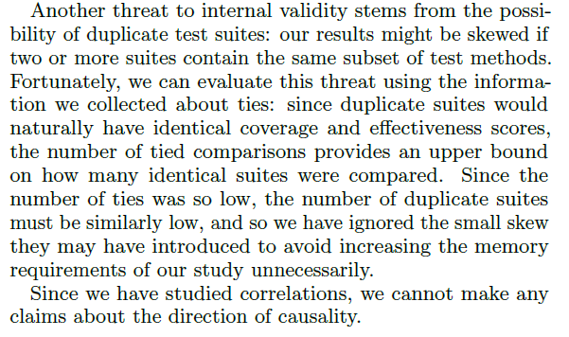
State-of-the-art
Sanei, A., Cheng, J., & Adams, B. (2021, May). The impacts of sentiments and tones in community-generated issue discussions. In 2021 IEEE/ACM 13th International Workshop on Cooperative and Human Aspects of Software Engineering (CHASE) (pp. 1-10). IEEE. DOI: 10.1109/CHASE52884.2021.00009
Inozemtseva, L., & Holmes, R. (2014, May). Coverage is not strongly correlated with test suite effectiveness. In Proceedings of the 36th international conference on software engineering (pp. 435-445). 10.1145/2568225.2568271
McGee, S., & Greer, D. (2012). Towards an understanding of the causes and effects of software requirements change: two case studies. Requirements Engineering, 17, 133-155. DOI: 10.1007/s00766-012-0149-0
Referring to Loconsole, A., & Borstler, J. (2005, December). An industrial case study on requirements volatility measures. In 12th Asia-Pacific Software Engineering Conference (APSEC'05) (pp. 8-pp). IEEE. DOI: 10.1109/APSEC.2005.38
Frattini, J., Fischbach, J., Mendez, D., Unterkalmsteiner, M., Vogelsang, A., & Wnuk, K. (2023). Causality in requirements artifacts: prevalence, detection, and impact. Requirements Engineering, 28(1), 49-74. DOI: 10.1007/s00766-022-00371-x
Notes:
There seems to be an implicit, collective agreement in our community that
Studying causal relationships is hard, and therefore
Detecting correlations is good-enough.
So: Why care about causality?

Slide 6



Correlation versus Causality
Correlation:
when we observe X,
we also observe Y
Causality:
when we do X,
we observe Y.
If we want to make a positive impact on the target audience of our research (i.e., SE practitioners), we need to provide reliable decision-making policies – which we can only derive from causal relationships, not correlations.
We cannot infer causality from data alone – we must also know the process that created that data.¹
¹we’ll revisit this statement later
Notes:
We all know “Correlation does not imply causality” – but what exactly differentiates the two concepts?
Only causal relationships give us reliable recommendation on how to act, and therefore, how to make a positive impact on the target audience of our research (i.e., RE/SE practitioners).
Disclaimer:
I do not want to discredit correlational studies.
They are valuables to detect patterns and trends.
However, they do not get us any further and are unfit to recommend changes in an organization.
This is the fundamental difference between observing (correlations) and doing (interventions with causal effects).

Slide 7




Experimental vs. Observational Studies
One ”straightforward” way to distinguish correlation from causality: conduct a controlled experiment, where we exert control over a treatment and isolate its effect from all confounding.
Expensive
Recruiting eligible participants is difficult
Unrealistic
Experiments perturb the natural context
Impossible
Some factors are impossible to control
Assumed
The validity of experimental results depends on several conditions
Notes:
But: experiments are expensive and perturb the natural context of a phenomenon. Some phenomena cannot be studied in controlled experiments at all (e.g., impact of human factors) since the values of that variable cannot be assigned randomly.

Slide 8
Causal Modelling
Framing Causal Assumptions

Slide 9

Causal Modeling
Directed, acyclic graphs (DAGs) can represent causal assumptions, where nodes represent variables and edges represent assumed/potential causal relationships between those variables.
document reading technique
document reading technique
identified defects
identified defects
treatment
(assumed) causal relationship
participation
motivation
outcome
phenomenon
DAGs are subjective and represent the view of a domain expert.
other (observed)
factors
other (unobserved)
factors
Notes:
More importantly, the absence of an edge encodes the certainty that two variables are not directly related.

Slide 10
Exercise: Formulating a DAG
Derive a causal DAG from the following description:
“Researchers are interested in knowing if using ChatGPT affects the quality and length of code reviews at a company. Since they cannot interrupt the regular workflow, they cannot force anyone to use or not use ChatGPT. They do know, however, that younger developers use ChatGPT more often. On the other hand, they know that more skilled developers generally produce more concise (i.e., shorter) and better code reviews.”

Slide 11
Solution: Formulating a DAG
“Researchers are interested in knowing if using ChatGPT affects the quality and length of code reviews at a company. Since they cannot interrupt the regular workflow, they cannot force anyone to use or not use ChatGPT. They do know, however, that younger developers use ChatGPT more often. On the other hand, they know that more skilled developers generally produce more concise (i.e., shorter) and better code reviews.”
CR quality
ChatGPT
CR length

Slide 12
Solution: Formulating a DAG
“Researchers are interested in knowing if using ChatGPT affects the quality and length of code reviews at a company. Since they cannot interrupt the regular workflow, they cannot force anyone to use or not use ChatGPT. They do know, however, that younger developers use ChatGPT more often. On the other hand, they know that more skilled developers generally produce more concise (i.e., shorter) and better code reviews.”
CR quality
ChatGPT
CR length
age

Slide 13
Solution: Formulating a DAG
“Researchers are interested in knowing if using ChatGPT affects the quality and length of code reviews at a company. Since they cannot interrupt the regular workflow, they cannot force anyone to use or not use ChatGPT. They do know, however, that younger developers use ChatGPT more often. On the other hand, they know that more skilled developers generally produce more concise (i.e., shorter) and better code reviews.”
CR quality
ChatGPT
CR length
age
skill

Slide 14
Solution: Formulating a DAG
“Researchers are interested in knowing if using ChatGPT affects the quality and length of code reviews at a company. Since they cannot interrupt the regular workflow, they cannot force anyone to use or not use ChatGPT. They do know, however, that younger developers use ChatGPT more often. On the other hand, they know that more skilled developers generally produce more concise (i.e., shorter) and better code reviews.”
CR quality
ChatGPT
CR length
age
skill
Notes:
You sometimes need “domain knowledge” to complete a DAG

Slide 15
Types of Associations
Relationships Between Three (or more) Variables

Slide 16
Three Types of Associations
Confounder
(or: fork)
z is a common cause of both exposure x and the outcome y
Mediator
(or: pipe)
z is an effect of exposure x and a cause the outcome y
Collider
z is a common effect of both exposure x and the outcome y
x
y
x
y
x
y
z
z
z
To get an unbiased estimation of the effect x → y we must control z.
To get the direct effect x → y we must control z. To get the total effect, we must not control z.
Notes:
There are (main) three ways in which a third variable can interact with a phenomenon of interest

Slide 17




Colliding: Common Effects
“Does the length of a requirements specification affect its quality? Both factors do affect whether the specified feature is implemented successfully.”
specification size
specification quality
$$\sim N(0, 1)$$
$$\sim N(0, 1)$$
$0$: the specification size does not affect its quality
A feature is successful if it is very elaborately described ...
... or its description is high-quality
feature success (0 = rejected, 1 = approved)
$$\sim \left(size+quality>0.7\right)$$

Slide 18

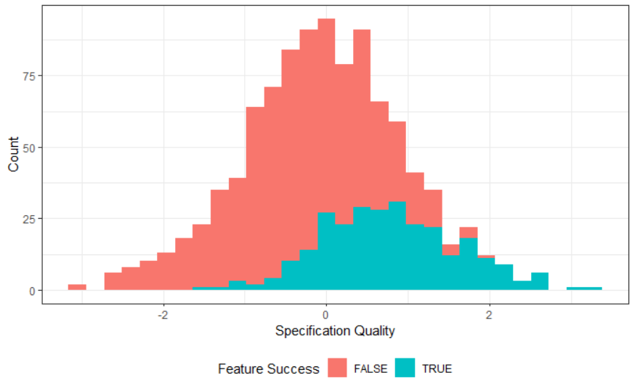


Colliding: Common Effects
“Does the length of a requirements specification affect its quality? Both factors do affect whether the specified feature is implemented successfully.”
specification size
specification quality
$$m_{1}:quality\sim 1+size+success$$
Model Derivation
$$m_{2}:quality\sim 1+size$$
feature success
Notes:
You can rightfully ask: why include “success” in the statistical model anyways?
We do see that “feature success” contains information about “specification quality”
Hence, it might be valuable for the estimation

Slide 19
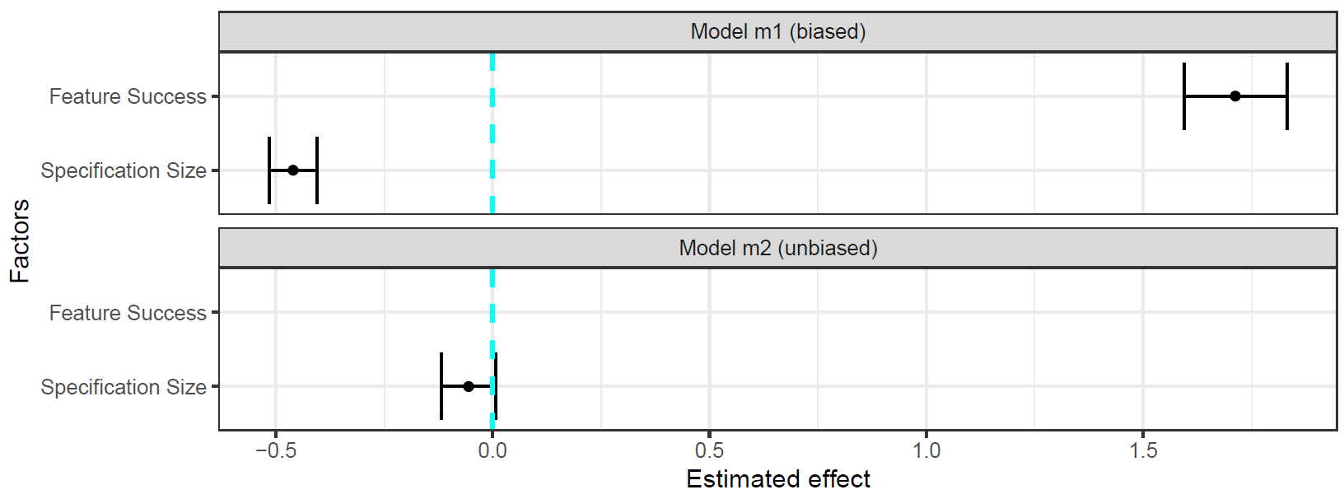

Colliding: Common Effects
“Does the length of a requirements specification affect its quality? Both factors do affect whether the specified feature is implemented successfully.”
$$m_{1}:quality\sim 1+size+success$$
Notes:
The estimation suggests that specification size has an effect far beyond what we simulated

Slide 20
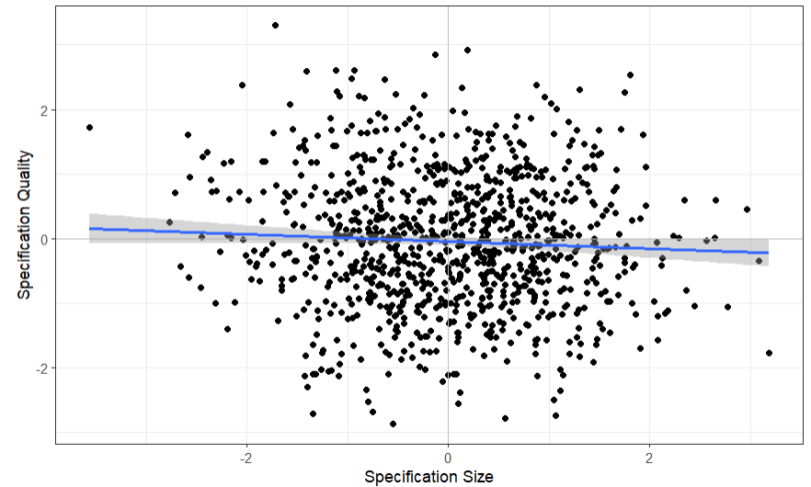
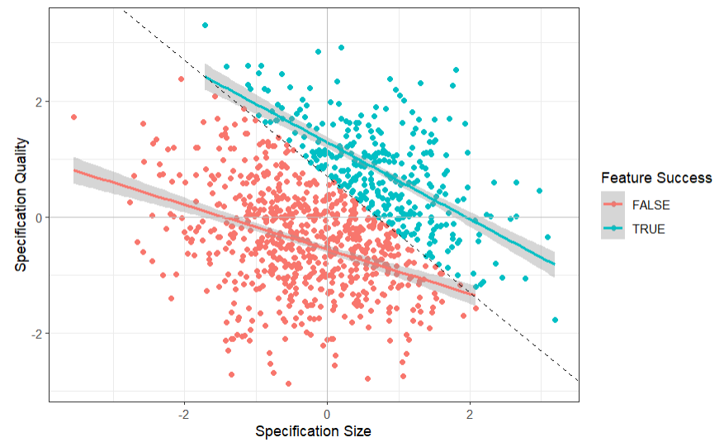
Colliding: Common Effects
“Does the length of a requirements specification affect its quality? Both factors do affect whether the specified feature is implemented successfully.”
Notes:
The visualization of the raw data shows that there is indeed no effect
The trendline is nearly horizontal
That means: there is no effect of one variable on the other
But stratifying by the third variable (feature success) paints a different picture:
Stratification by color (and the grey cut-off line intersects the y-axis at exactly 0.7)
Looking into each of the two strata individually, there is a negative association between the variables

Slide 21
Colliding: Common Effects
“Does the length of a requirements specification affect its quality? Both factors do affect whether the specified feature is implemented successfully.”
For any high-quality value, if feature success is false, then it is more likely that the specification size was small.
For any low-quality value, if feature success is true, then it is more likely that the specification size was large.

Slide 22

Colliding: Common Effects
“Does the length of a requirements specification affect its quality? Both factors do affect whether the specified feature is implemented successfully.”
specification size
specification quality
feature success
The non-causal association suggests a negative relationship between the cause and effect (Berkson’s paradox/fallacy).

Slide 23


Colliding: Common Effects
“Does the length of a requirements specification affect its quality? Both factors do affect whether the specified feature is implemented successfully.”
$$m_{1}:quality\sim 1+size+success$$
$$m_{2}:quality\sim 1+size$$

Slide 24


Colliding: Common Effects
“Does the length of a requirements specification affect its quality? Both factors do affect whether the specified feature is implemented successfully.”
specification size
specification quality
$$m_{1}:quality\sim 1+size+success$$
Model Derivation
$$m_{2}:quality\sim 1+size$$
feature success
If both treatment and outcome have a common effect, we must not condition on this common effect. Consequently, we cannot simply add all relevant variables as predictors.

Slide 25

Basic Types of Association
The three basic types of association behave differently when statistically controlling for the third variable:
Not controlling z
Controlling z
x
y
Confounder
z
x
y
Mediator
z
Information flows from x to y
x
y
Information does not flow
from x to y
Collider
z

Slide 26
Identification
Causal Inference Based on Causal DAGs
Notes:
Formalizing causal assumptions is already valuable, but causal DAGs can help even more

Slide 27
Deriving a statistical Model from a causal Model: d-separation
A general framework to derive statistical models from causal models uses d-separation. It produces an adjustment set, i.e., the set of variables to control statistically in order to de-confound the causal effect between the exposure and the outcome.
https://bayes.cs.ucla.edu/BOOK-2K/d-sep.html

Slide 28

Deriving a statistical Model from a causal Model: d-separation
A general framework to derive statistical models from causal models uses d-separation. It produces an adjustment set, i.e., the set of variables to control statistically in order to de-confound the causal effect between the exposure and the outcome.
c
d
Model Derivation
$$m:b\sim a$$
a
b
e
f
g
https://bayes.cs.ucla.edu/BOOK-2K/d-sep.html

Slide 29
Deriving a statistical Model from a causal Model: d-separation
A general framework to derive statistical models from causal models uses d-separation. It produces an adjustment set, i.e., the set of variables to control statistically in order to de-confound the causal effect between the exposure and the outcome.
c
d
Model Derivation
$$m:b\sim a$$
Identify every backdoor path.
a
b
e
f
g
https://bayes.cs.ucla.edu/BOOK-2K/d-sep.html

Slide 30
Deriving a statistical Model from a causal Model: d-separation
A general framework to derive statistical models from causal models uses d-separation. It produces an adjustment set, i.e., the set of variables to control statistically in order to de-confound the causal effect between the exposure and the outcome.
c
d
Model Derivation
$$m:b\sim a$$
Identify every backdoor path.
Check if there is a collider between the cause and effect of interest.
If yes, do not condition on any of the variables on this path.
a
b
e
f
g
https://bayes.cs.ucla.edu/BOOK-2K/d-sep.html

Slide 31


Deriving a statistical Model from a causal Model: d-separation
A general framework to derive statistical models from causal models uses d-separation. It produces an adjustment set, i.e., the set of variables to control statistically in order to de-confound the causal effect between the exposure and the outcome.
$$m:b\sim a+f$$
c
d
Model Derivation
$$m:b\sim a+g$$
Identify every backdoor path.
Check if there is a collider between the cause and effect of interest.
If yes, do not condition on any of the variables on this path.
If not, condition on any of the variables on this path to “close” the backdoor path.
a
b
e
f
g
https://bayes.cs.ucla.edu/BOOK-2K/d-sep.html

Slide 32


Deriving a statistical Model from a causal Model: d-separation
A general framework to derive statistical models from causal models uses d-separation. It produces an adjustment set, i.e., the set of variables to control statistically in order to de-confound the causal effect between the exposure and the outcome.
$$m:b\sim a+f(+e)$$
c
d
Model Derivation
$$m:b\sim a+g(+e)$$
Identify every backdoor path.
Check if there is a collider between the cause and effect of interest.
If yes, do not condition on any of the variables on this path.
If not, condition on any of the variables on this path to “close” the backdoor path.
Optionally, condition on mediators to discern the direct effect.
a
b
e
f
g
https://bayes.cs.ucla.edu/BOOK-2K/d-sep.html

Slide 33
Deriving a statistical Model from a causal Model: d-separation
A general framework to derive statistical models from causal models uses d-separation. It produces an adjustment set, i.e., the set of variables to control statistically in order to de-confound the causal effect between the exposure and the outcome.
$$m:b\sim a+f(+e)$$
c
d
Model Derivation
$$m:b\sim a+g(+e)$$
Identify every backdoor path.
Check if there is a collider between the cause and effect of interest.
If yes, do not condition on any of the variables on this path.
If not, condition on any of the variables on this path to “close” the backdoor path.
Optionally, condition on mediators to discern the direct effect.
a
b
e
f
g
https://bayes.cs.ucla.edu/BOOK-2K/d-sep.html

Slide 34
Exercises
Determine the adjustment set of variables to de-confound the estimation of the effect of the phenomenon a → b via d-separation.
c
d
a
b

Slide 35
Exercises
Determine the adjustment set of variables to de-confound the estimation of the effect of the phenomenon a → b via d-separation.
c
d
c
d
a
b
a
b
Adjustment set = {d}
Adjustment set = {c}

Slide 36
Exercises
Determine the adjustment set of variables to de-confound the estimation of the effect of the phenomenon a → b via d-separation.
c
e
d
a
b

Slide 37
Exercises
Determine the adjustment set of variables to de-confound the estimation of the effect of the phenomenon a → b via d-separation.
c
e
d
a
b
Adjustment set = {}

Slide 38
Exercises
Determine the adjustment set of variables to de-confound the estimation of the effect of the phenomenon a → b via d-separation.
c
e
d
a
b

Slide 39
Exercises
Determine the adjustment set of variables to de-confound the estimation of the effect of the phenomenon a → b via d-separation.
c
e
d
a
b
The DAG contains two backdoor paths:
a ← c → d ← e → b
a ← d ← e → b

Slide 40
Exercises
Determine the adjustment set of variables to de-confound the estimation of the effect of the phenomenon a → b via d-separation.
c
e
c
c
e
d
d
a
b
a
b
Adjustment set = {e}
Adjustment set = {c, d}
Conditioning on d opens the backdoor-path a ← c → d ← e → b which then has to be closed by additionally conditioning on c.

Slide 41
Exercises
Determine the adjustment set of variables to de-confound the estimation of the effect of the phenomenon a → b via d-separation.
unobservable variable
c
e
d
a
b

Slide 42
Exercises
Determine the adjustment set of variables to de-confound the estimation of the effect of the phenomenon a → b via d-separation.
c
e
d
a
b
Adjustment set = {e}

Slide 43
Exercises
Determine the adjustment set of variables to de-confound the estimation of the effect of the phenomenon a → b via d-separation.
c
e
d
a
b

Slide 44
Exercises
Determine the adjustment set of variables to de-confound the estimation of the effect of the phenomenon a → b via d-separation.
c
e
d
a
b
For some DAGs, it is impossible to find an adjustment set that deconfounds the effect of interest.

Slide 45
Conclusion
Implications for Better Science

Slide 46
Internal vs. External Validity
Threats to external validity are conditions that limit our ability to generalize the results of our experiment to industrial practice.
Wohlin, C., Runeson, P., Höst, M., Ohlsson, M. C., Regnell, B., & Wesslén, A. (2012). Experimentation in software engineering (Vol. 236). Berlin: Springer.
An insufficiently distributed variable with a causal effect on the phenomenon threatens the external validity of the conclusion.
z
x
y
An unobserved/unobservable variable with a causal effect on the phenomenon threatens the internal validity of the conclusion.
a
Threats to internal validity are influences that can affect the independent variable with respect to causality, without the researcher’s knowledge.
Wohlin, C., Runeson, P., Höst, M., Ohlsson, M. C., Regnell, B., & Wesslén, A. (2012). Experimentation in software engineering (Vol. 236). Berlin: Springer.
Notes:
Causal DAGs facilitate an easy discussion of internal vs. external threats to validity.

Slide 47

Workflow for Statistical Causal Inference
1) Modelling
Creating a DAG of assumed causal relationships
x
y
z

Slide 48

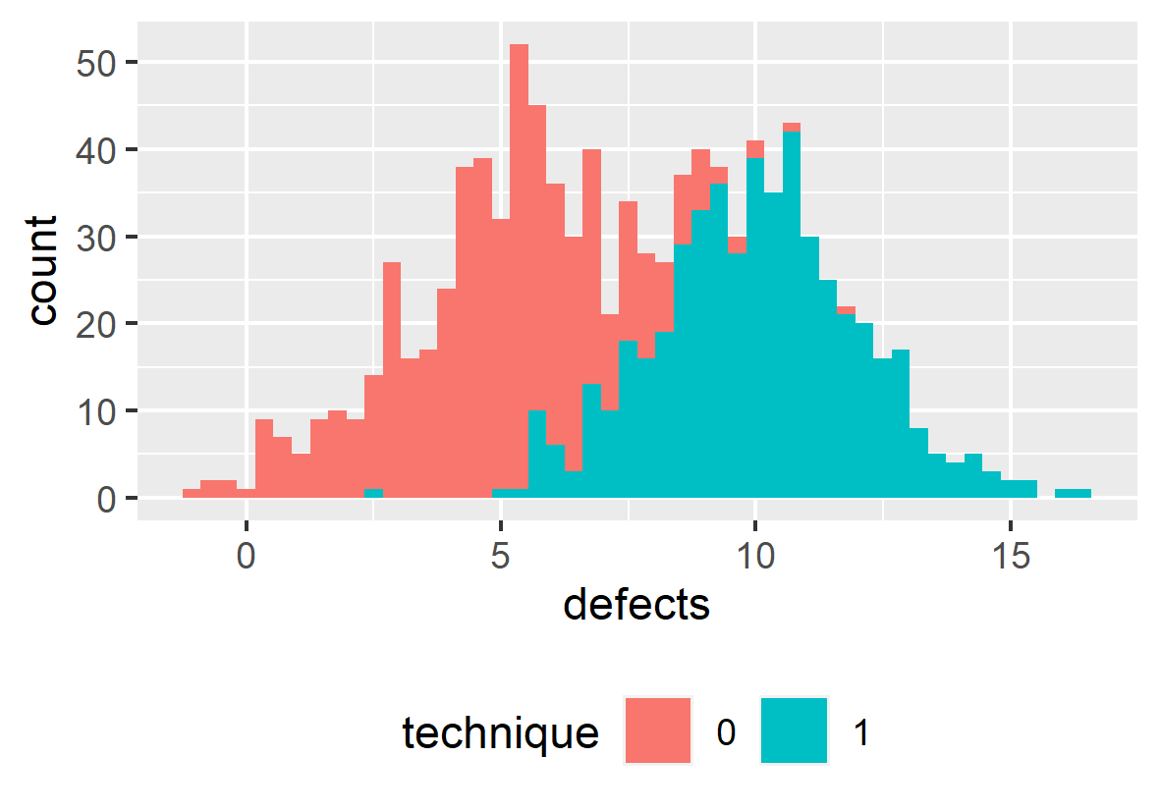


Workflow for Statistical Causal Inference
1) Modelling
Creating a DAG of assumed causal relationships
x
y
z
2) Identification
Deriving a statistical from the causal model
$$y\sim x+z$$
Model Derivation
3) Estimation
Training a statistical model with the observed data and evaluating the results
Siebert, J. (2023). Applications of statistical causal inference in software engineering. Information and Software Technology, 159, 107198.

Slide 49

Scientific Workflow: Traditional
Data Collection
Assumed DAG
Collected Data
Modelling
x | y
Identification
x
y
Estimation
Too often, we derive hypotheses from the data available to us.
Notes:
How do these conceptual steps intertwine with the operational steps necessary for quantitative studies?

Slide 50
Scientific Workflow: Traditional
Data Collection
Assumed DAG
Collected Data
hard-to-measure
confounder
Modelling
x | y
z
Identification
x
y
Estimation
Not collecting data about a confounder will threaten the internal validity of your result
Notes:
How do these conceptual steps intertwine with the operational steps necessary for quantitative studies?

Slide 51
Scientific Workflow: Better
Modelling
Assumed DAG
Collected Data
hard-to-measure
confounder
Identification
x | y | z
x | y
z
Data Collection
x
y
Estimation
Determine the variables about which you need to collect data in order to estimate an unbiased effect of interest before collecting that data.

Slide 52

Scientific Workflow: Best
Modelling
Assumed DAG
Collected Data
hard-to-measure
confounder
Identification
x | y | z | a
 |  |  | x
 |  |  | x
 |  |  | x
 |  |  | x
z
Data Collection
x
y
feasible?
a
Alternate Strategy
Estimation
unobservable
confounder
Unobservable confounders require (a) acknowledgement in the threats to (internal) validity and (b) different research strategies.

Slide 53
Coherent Science
Following this scientific workflow enables us as a community to effectively contribute to a coherent scientific endeavor.
Original Contribution
Close Replication
Causal Revision
Causal Revision
The Effect of X on Y
The Effect of X on Y: A Replication Study
The Effect of X on Y is mediated by A
Z confounds the Effect of X on Y
z
x
y
x
y
x
a
y
x
a
y

Slide 54


Recommendations
Data Collection
Is a part of data analysis, not its precursor
Draw a DAG
representing your causal assumptions
Use d-separation
to figure out (1) if you can conduct your study and (2) what data you need to collect
Notes:
In summary, when you aim to conduct a rigorous and relevant study, consider these three recommendations:
Consider data collection as a part of data analysis, not as two separate, subsequent steps
Start your data analysis with a DAG
Apply d-separation to figure out (1) if you can actually conduct your study and – if so – (2) what data you need to collect

Slide 55

Reading list
Pearl, J., & Mackenzie, D. (2018). The book of why: the new science of cause and effect. Basic books.
McElreath, R. (2018). Statistical rethinking: A Bayesian course with examples in R and Stan. Chapman and Hall/CRC.
Cinelli, C., Forney, A., & Pearl, J. (2024). A crash course in good and bad controls. Sociological Methods & Research, 53(3), 1071-1104.
Siebert, J. (2023). Applications of statistical causal inference in software engineering. Information and Software Technology, 159, 107198.
Furia, C. A., Feldt, R., & Torkar, R. (2019). Bayesian data analysis in empirical software engineering research. IEEE Transactions on Software Engineering, 47(9), 1786-1810.
Furia, C. A., Torkar, R., & Feldt, R. (2022). Applying Bayesian analysis guidelines to empirical software engineering data: The case of programming languages and code quality. ACM Transactions on Software Engineering and Methodology (TOSEM), 31(3), 1-38.

Slide 56
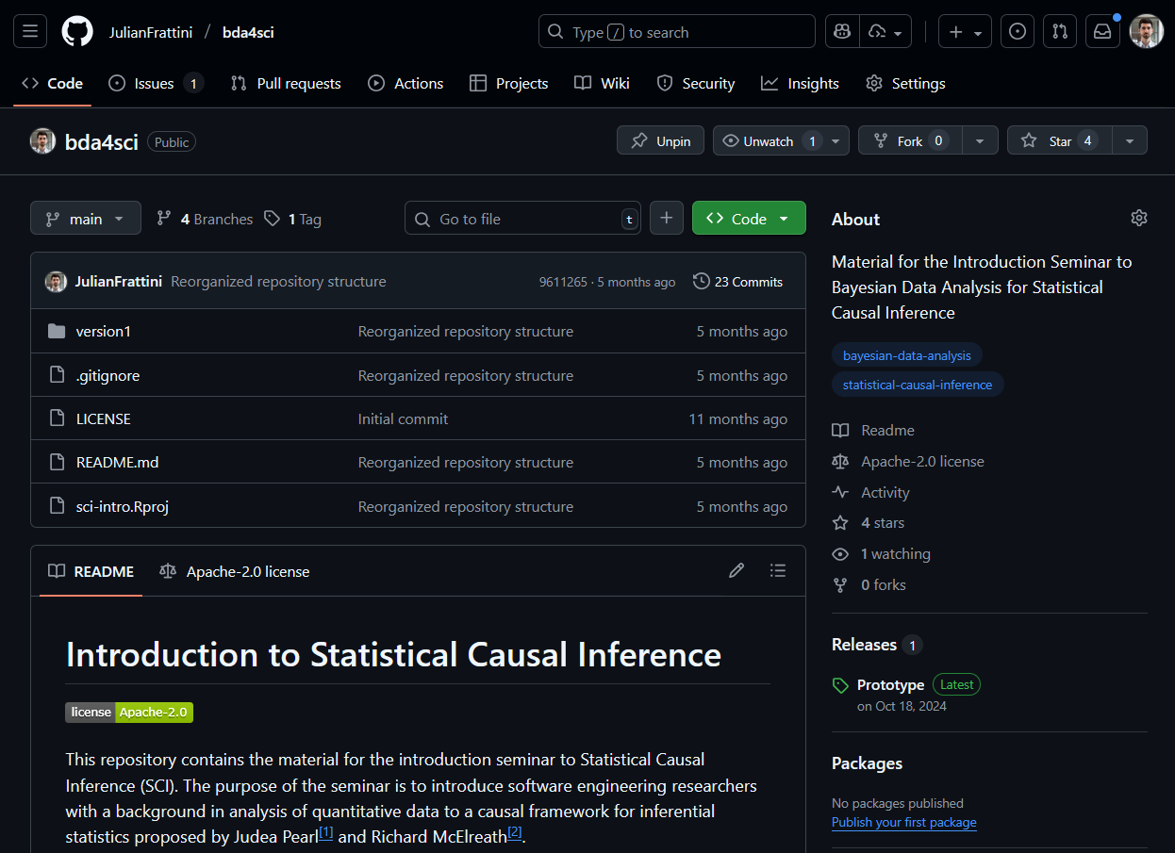
Material
JulianFrattini/bda4sci
Public
All material is public and open-source on GitHub. Feel free to clone, fork, and share the study material.
Comments, requests, and additions are welcome.

