Slide 1


Statistical Causal Inference
a gentle introduction to advanced analysis of quantitative data
Julian Frattini, Ph.D.
Chalmers University of Technology, Sweden
https://julianfrattini.github.io/
JulianFrattini/bda4sci
Public
Copyright © 2024 Julian Frattini.
This work is licensed under the Apache-2.0 License.

Slide 3
Overview
Session | Time | Content | Style
Introduction | 09:00-09:15 | State-of-the-art, motivation, and goals | Lecture
Fundamentals & Notation | 09:15-09:45 | Fundamental terminology in statistics, and notation used throughout this tutorial | Lecture
Causal Inference I | 09:45-10:30 | Mediation and confounders | Lecture & Exercises
Break | 10:30-10:45
Causal Inference II | 10:45-11:15 | Colliders and model comparison | Lecture & Exercises
Conclusion | 11:15-11:30 | Workflow for causal inference | Lecture
Outlook | 11:30-11:45 | Further applications, structured reading list | Lecture
Feedback | 11:45-12:00 | Reflection, discussion, and closing | Open discussion

Slide 4
Introduction
Goals and Expectations

Slide 5
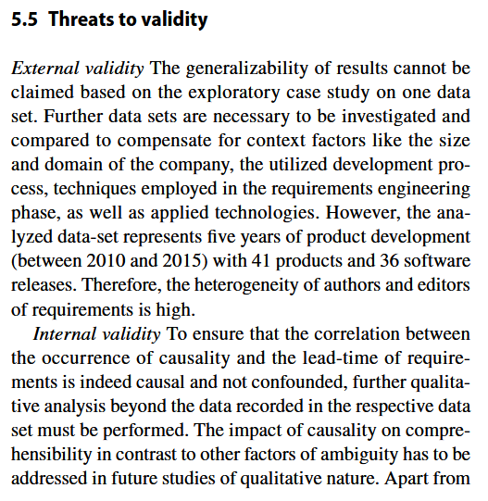
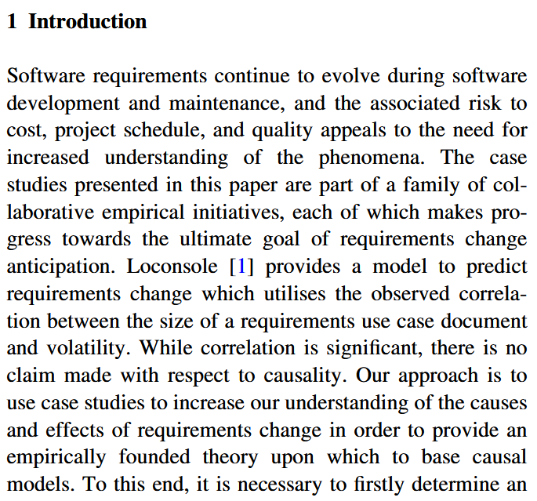
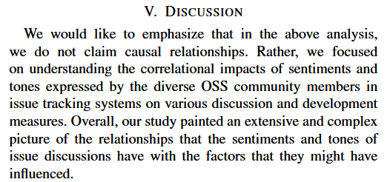
State-of-the-art
Sanei, A., Cheng, J., & Adams, B. (2021, May). The impacts of sentiments and tones in community-generated issue discussions. In 2021 IEEE/ACM 13th International Workshop on Cooperative and Human Aspects of Software Engineering (CHASE) (pp. 1-10). IEEE. DOI: 10.1109/CHASE52884.2021.00009
McGee, S., & Greer, D. (2012). Towards an understanding of the causes and effects of software requirements change: two case studies. Requirements Engineering, 17, 133-155. DOI: 10.1007/s00766-012-0149-0
Referring to Loconsole, A., & Borstler, J. (2005, December). An industrial case study on requirements volatility measures. In 12th Asia-Pacific Software Engineering Conference (APSEC'05) (pp. 8-pp). IEEE. DOI: 10.1109/APSEC.2005.38
Frattini, J., Fischbach, J., Mendez, D., Unterkalmsteiner, M., Vogelsang, A., & Wnuk, K. (2023). Causality in requirements artifacts: prevalence, detection, and impact. Requirements Engineering, 28(1), 49-74. DOI: 10.1007/s00766-022-00371-x
Notes:
There seems to be an implicit, collective agreement in our community that
Studying causal relationships is hard, and therefore
Detecting correlations is good-enough.
So: Why care about causality?

Slide 6



Correlation versus Causality
Correlation:
when we observe X,
we also observe Y
Causality:
when we do X,
we observe Y.
If we want to make a positive impact on the target audience of our research (i.e., RE/SE practitioners), we need to provide reliable recommendations on how to act – which we can only derive from causal relationships, not correlations.
We cannot infer causality from data alone – we must also know the process that created that data.¹
¹we’ll revisit this statement later
Notes:
We all know “Correlation does not imply causality” – but what exactly differentiates the two concepts?
Only causal relationships give us reliable recommendation on how to act, and therefore, how to make a positive impact on the target audience of our research (i.e., RE/SE practitioners).
Disclaimer:
I do not want to discredit correlational studies.
They are valuables to detect patterns and trends.
However, they do not get us any further and are unfit to recommend changes in an organization.
This is the fundamental difference between observing (correlations) and doing (interventions with causal effects).

Slide 7




Experimental vs. Observational Studies
One ”straightforward” way to distinguish correlation from causality: conduct a (controlled) experiment, where we exert control over a treatment and isolate its effect from all confounding.
Expensive
Recruiting eligible participants is difficult
Disruptive
Experiments perturb the natural context
Impossible
Some factors are impossible to control
Assumed
The validity of experimental results depends on several conditions
Notes:
But: experiments are expensive and perturb the natural context of a phenomenon. Some phenomena cannot be studied in controlled experiments at all (e.g., impact of human factors) since the values of that variable cannot be assigned randomly.

Slide 8


Goals of this Tutorial
Convincing you of the value of statistical causal inference
Learning the fundamentals of drawing causal conclusions from quantitative data
collected in observational studies
Notes:
Convincing you of the value of causal inference (check)
Learning the fundamentals of drawing causal conclusions from quantitative data collected in observational studies

Slide 9
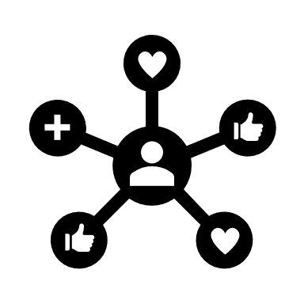

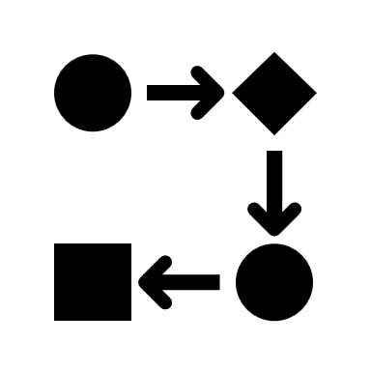
Learning Outcomes
Causal Modelling
Communicating transparent causal assumptions in graphical models
Statistical Causal Inference (SCI)
Drawing reliable conclusions from quantitative, observational data
Causal Workflow
Structured process for performing statistical causal inference in an empirical study
Notes:
Causal modelling: visualizing causal assumptions graphically
Statistical causal inference: drawing reliable conclusions from observational data
Causal workflow: a reliable workflow for SCI

Slide 10
Fundamentals & Notation
Syntax and Pedagogics of this Tutorial
Notes:
This may be a lengthy background section, but also
A good reminder for fundamentals of statistics,
The introduction of a valuable modeling concept, and
A recommendation for a statistical workflow.

Slide 11
Terminology
Factor: a variable projecting a construct onto a value (e.g., document reading technique, identified defects)
Type: level of measurement of the data type (i.e., nominal, ordinal, interval, ratio)
Exposure/Treatment & Outcome: main independent variable and main dependent variable
Phenomenon: treatment-outcome-pair of interest (e.g., document reading technique → identified defects)

Slide 12
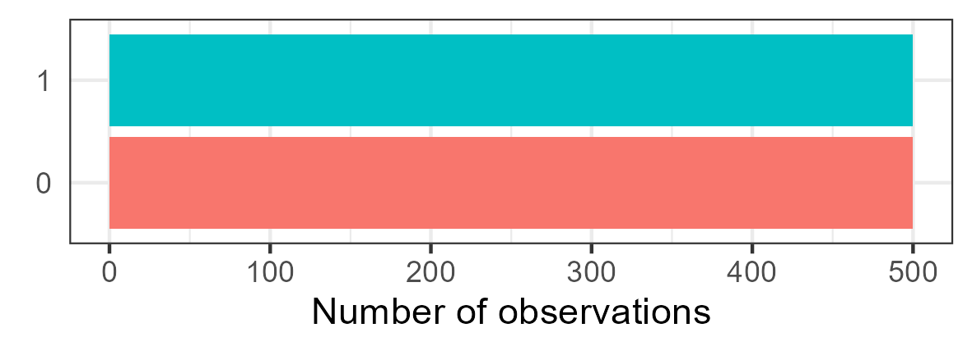

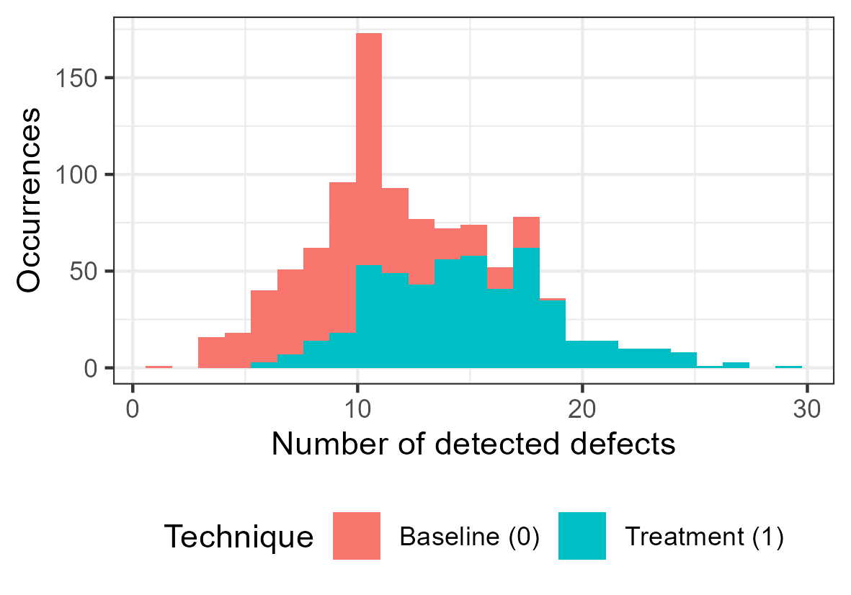
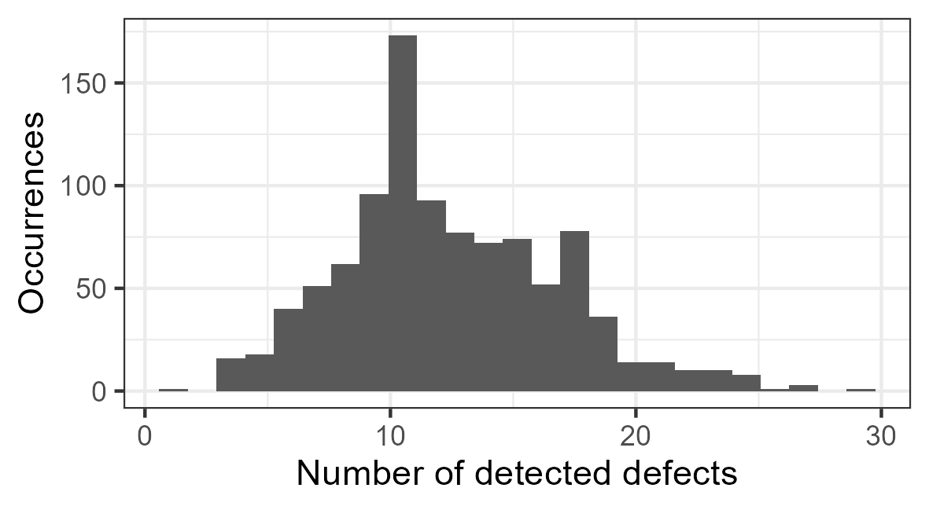
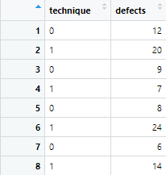



Simulations
To demonstrate the process of SCI, we simulate data sets. This gives us control over phenomena, i.e., a reliable ”ground truth.”
Discrete uniform distribution
Simulation of an independent variable
Simulation
$$technique=unif\{0, 1\}$$
$$10+$$
$$technique∗5$$
$$defects=Poisson(10+technique∗5)$$
Simulation of a dependent variable
Poisson distribution
Dependency of defects on technique
Notes:
(introduce random variables)
(show simulation formula and explain all terms)
(visualize simulated data)

Slide 13
Causal Modeling
Directed, acyclic graphs (DAGs) can represent causal assumptions, where nodes represent variables and edges represent assumed/potential causal relationships between those variables.
document reading technique
document reading technique
identified defects
identified defects
treatment
phenomenon
participation
motivation
outcome
other factors
Notes:
More importantly, the absence of an edge encodes the certainty that two variables are not directly related.

Slide 14


Causal Modeling and Simulations
DAGs are typically used to formalize assumed causal relationships. They can also be used to represent simulated causal relationships.
Simulation
document reading technique
$$technique=unif\{0, 1\}$$
$$5$$
$$defects=Poisson(10+technique∗5)$$
identified defects
Path coefficient
The path coefficient is the variable of interest, as it represents the effect strength (and direction) of one variable on another.
Notes:
This represents our ground truth (both in terms of effects and their strength.

Slide 15


Data Analysis Tool: (Linear) Modeling
easier to use and apply
more difficult to use and apply
less sophisticated
more sophisticated
Null-Hypothesis
Significance Test
(Generalized) Linear
(Mixed) Model
Bayesian Data
Analysis
outcome
regressors
$$defects \sim technique$$
$$defects \sim α+β_{t}∗ technique$$
intercept
path coefficient
Notes:
For our data analysis tool, we will use linear regressions (which are more powerful than NHSTs but more approachable than Bayesian data analysis).
Limitations: assumption of monotonicity, etc.
(example of a regression formula with explanations, regression+data, and results)

Slide 16



From causal to statistical Models
Causal Models
encode causal assumptions
Statistical Models
implement inference
document reading technique
$$defects \sim technique+motivation$$
identified defects
How to derive statistical from causal models is core to statistical causal inference.
participation
motivation
Notes:
Connection between causal and statistical models:
Causal models encode causal assumptions
Statistical models implements inference
Statistical causal inference (SCI) = deriving statistical models from causal models
(how to do this is a major learning outcome of this tutorial)

Slide 17


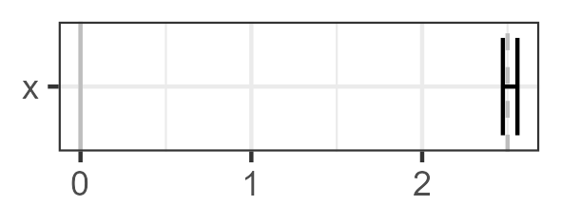

Pedagogy of this Tutorial
1. Phenomenon
Creating an assumed causal DAG
2. Regression
Deriving a statistical model and running a regression analysis
3. Comparison
Comparing the results of the analysis with the ground truth
4. Reveal
Revealing the actual causal DAG
document reading technique
document reading technique
$$defects \sim technique$$
$$5$$
identified defects
identified defects
Notes:
With all of these fundamentals, this is how the following examples will look like:
example phenomenon x -> y with assumed DAG and data
derivation of a statistical model, running a regression analysis
comparing the results of the regression analysis with the values of the simulation: if they overlap, we inferred the correct causal conclusion
revealing the actual DAG with simulation weights

Slide 18
Causal Inference I
Confounders and Mediators
Notes:
Since
most relationships of interest are rarely limited to only two variables, and
these additional variables may interact with the relationship of interest in unforeseen ways,
we need to be aware of how they can interact.

Slide 19
(Confounding)
Example:
(assumed causal DAG of x->y and z->y with simulated data)
(running y~x and y~x+z and comparing the results)
(revealing the correct DAG that also includes z->x)

Slide 20
Practical Example of Confounding
(inozemtseva-2014-icse)

Slide 21
(Mediation)
Example: passive voice (PV), missing associations (MA), and missing entities (ME)
(assuming PV -> MA and PV -> ME)
(running MA ~ PV with a positive result)
(however: effect is actually 0)
(actual DAG also includes ME -> MA)
Direct effects =!= total effect (other examples: mediation is in the opposite direction of the direct effect)

Slide 22
Practical Example of Mediation

Slide 23
Break

Slide 24
Causal Inference II
Colliders, D-separation, and Model Comparison

Slide 25
Including Variables
So far, we learned that including additional variables is beneficial to (1) differentiate the total from the direct effect (in the case of a mediator) and (2) deconfound a causal effect (in the case of a confounder. So: just add all available variables?
Common conception: it is safe to include all pre-treatment variables.
However, this is not the case.

Slide 26
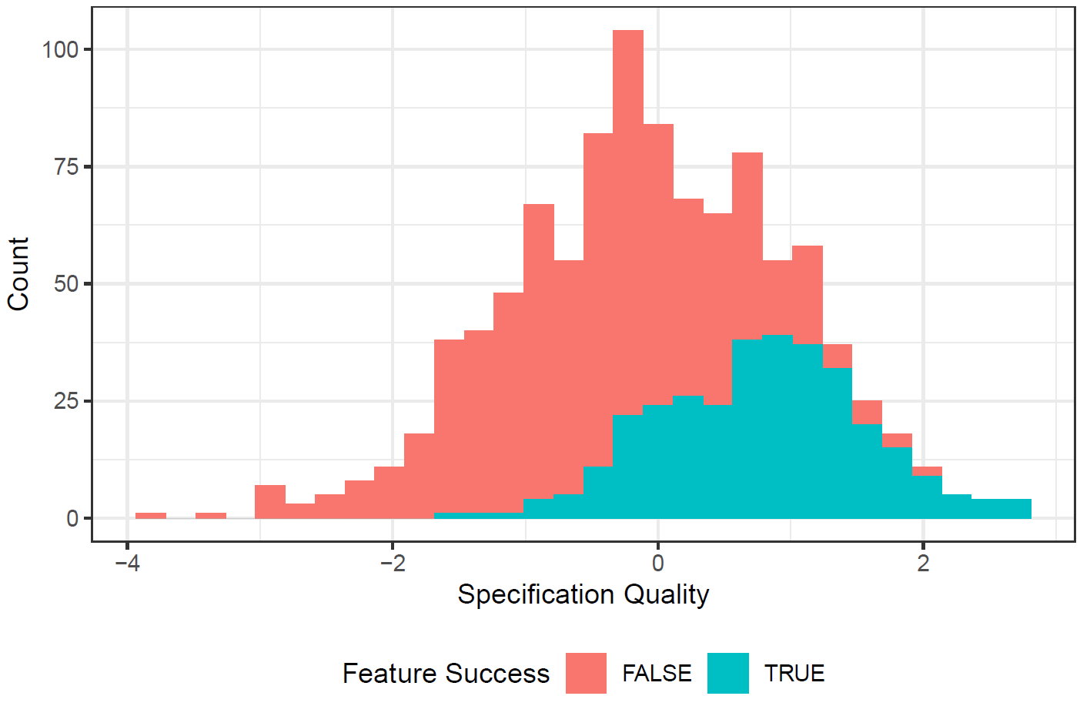





Colliders
Case: Does the length of a requirements specification affect its quality? Both factors do affect whether the specified feature is implemented successfully.
Specification length l
Specification
Quality q
$$0$$
$$N(0, 1)$$
$$N(0, 1)$$
$$l+q>0.7$$
Feature Implementation Success
$$length\sim quality+success$$

Slide 27
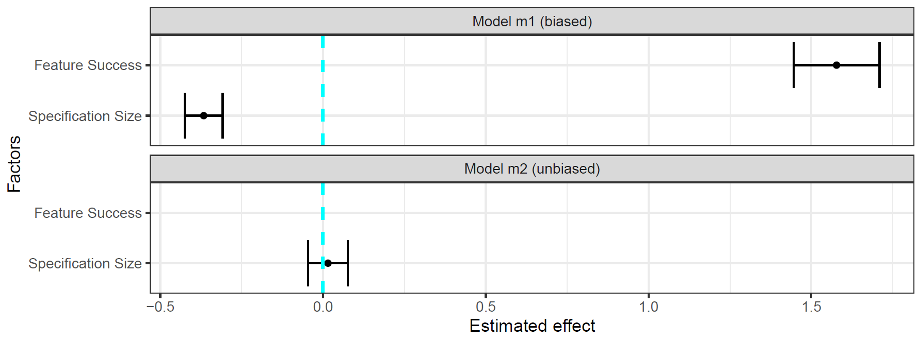
Colliders

Slide 28
Colliders

Slide 29
(Collider)
Example:
This is known as Berkson’s paradox/fallacy.

Slide 30
Basic Types of Association
There are three basic types of association
Mediator
Fork
Collider

Slide 31


Basic Types of Association
The three basic types of association behave differently when statistically controlling for the third variable:
Not controlling z
Controlling z
z
Mediator
x
y
z
Fork
x
y
z
x
y
Collider

Slide 32
Deriving a statistical Model from a causal Model: d-separation
A general framework to derive statistical models from causal models uses d-separation. Its outcome is the adjustment set, i.e., the set of variables to control statistically in order to deconfound the causal effect between the exposure and the outcome.
https://bayes.cs.ucla.edu/BOOK-2K/d-sep.html

Slide 33
Exercises

Slide 34
Causal Modelling
Imperative for drawing the correct conclusions through statistical inference is the causal model of our data.
Remember: “Data alone cannot give us causal inference – we must also know about how the data emerged” (show collider versus fork: same data, different statistical models from the causal models)
But in real life, there is no grand reveal about the “actual” causal model as I just provided.
So how do you determine the “correct” causal model?

Slide 35
Causal Modelling
It is impossible to determine the ”correct” causal model – we would need to look behind the curtain and see the ”fabric of the world.”
Instead of aiming for a ”correct” causal model, rather aim for a ”transparent” and ”useful” causal model.
“transparent” is easy: visualize your causal assumptions via DAGs
“useful” is more difficult: how do you assess the usability of a causal model?

Slide 36
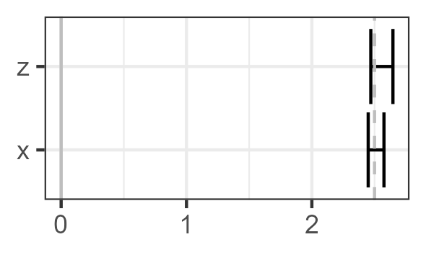
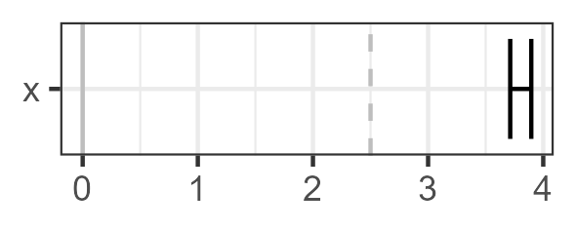
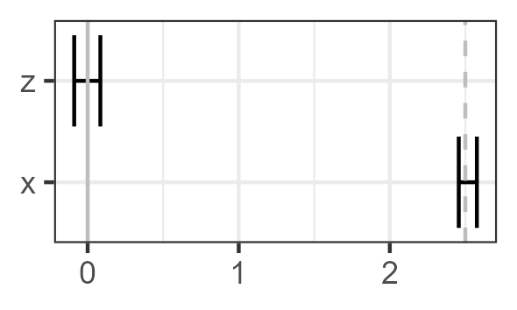


Model Comparison
There is no absolute way to assess the usefulness of a causal model, but a relative way: model comparison!
Assumed causal model
Depending on the observed change in results, you can infer which assumed causal model describes the data creation process best
x
y
x
y
z
z
$$y\sim x+z$$
$$y\sim x$$
If the effect of x on y changes when including z, then z has a causal effect on y.
x
y
z
Simulated ground-truth
x
y
If the effect of x on y does not when including z, then z has no causal effect on y.
z

Slide 37
Example: Impact of Passive Voice on Domain Modelling
(MVT example showing revised causal assumptions)

Slide 38
Statistical Causal Inference for Requirements Engineering
An Application Example of SCI in RE

Slide 39
Conclusion
A Workflow for Causal Inference to take home

Slide 40

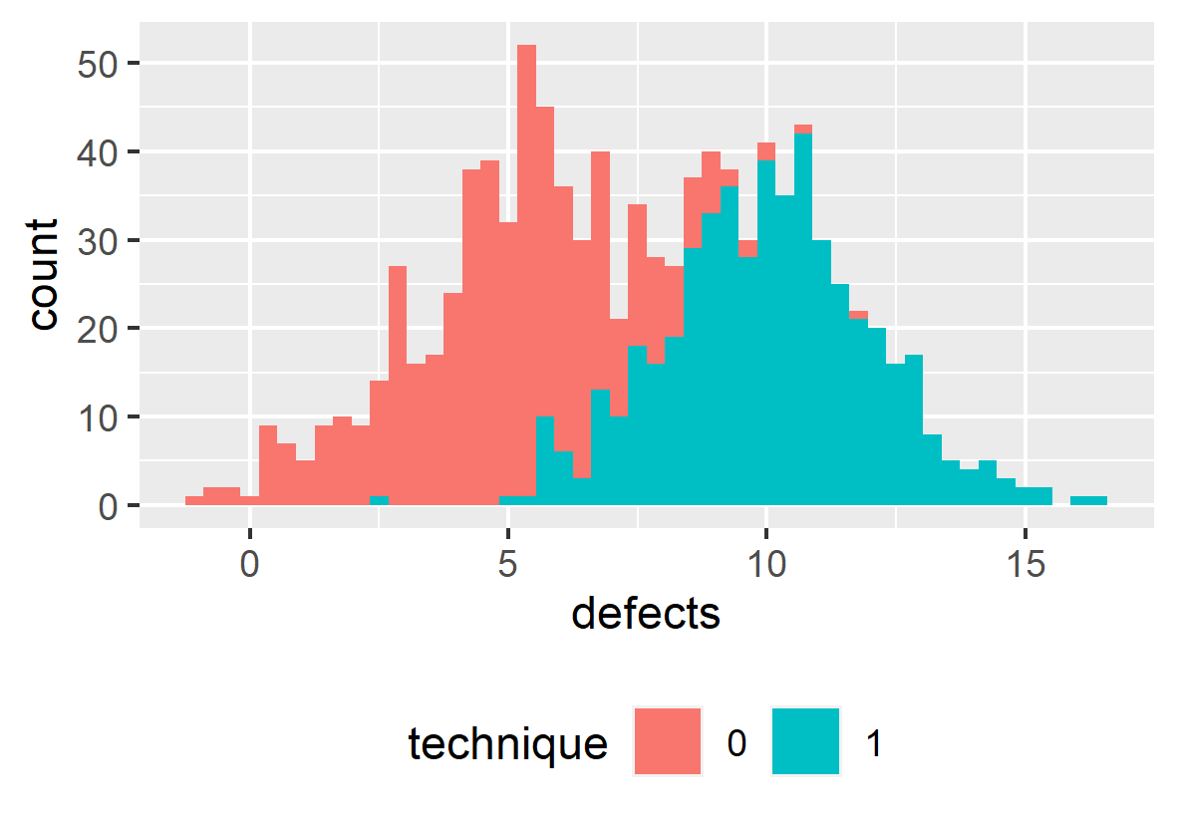

Workflow for Statistical Causal Inference
1) Modelling
Creating a DAG of assumed causal relationships
x
y
z
2) Identification
Deriving a statistical from the causal model using d-separation
$$y\sim x+z$$
3) Estimation
Training a statistical model with the observed data and evaluating the results
Siebert, J. (2023). Applications of statistical causal inference in software engineering. Information and Software Technology, 159, 107198.

Slide 41

Scientific Workflow: Traditional
Data Collection
Assumed DAG
Collected Data
Modelling
x | y
Identification
x
y
Estimation
Too often, we derive hypotheses from the data available to us.
Notes:
How do these conceptual steps intertwine with the operational steps necessary for quantitative studies?

Slide 42
Scientific Workflow: Better
Modelling
Assumed DAG
Collected Data
hard-to-measure
confounder
Identification
x | y | z
z
Data Collection
x
y
Estimation
Determine the variables about which you need to collect data in order to estimate an unbiased effect of interest before collecting that data.

Slide 43

Scientific Workflow: Best
Modelling
Assumed DAG
Collected Data
hard-to-measure
confounder
Identification
x | y | z | a
 |  |  | x
 |  |  | x
 |  |  | x
 |  |  | x
z
Data Collection
x
y
feasible?
a
Alternate Strategy
Estimation
impossible-to-measure
confounder
Impossible-to-measure confounders require (a) acknowledgement in the threats to (internal) validity and (b) different research strategies.

Slide 44

A Vision of Coherent Science
Following this scientific workflow enables us as a community to effectively contribute to a coherent scientific endeavour.
Original Contribution
Close Replication
Causal Revision
Causal Revision
The Effect of X on Y
The Effect of X on Y: A Replication Study
The Effect of X on Y is mediate by A
Z confounds the Effect of X on Y
z
x
y
x
y
x
a
y
x
a
y

Slide 45
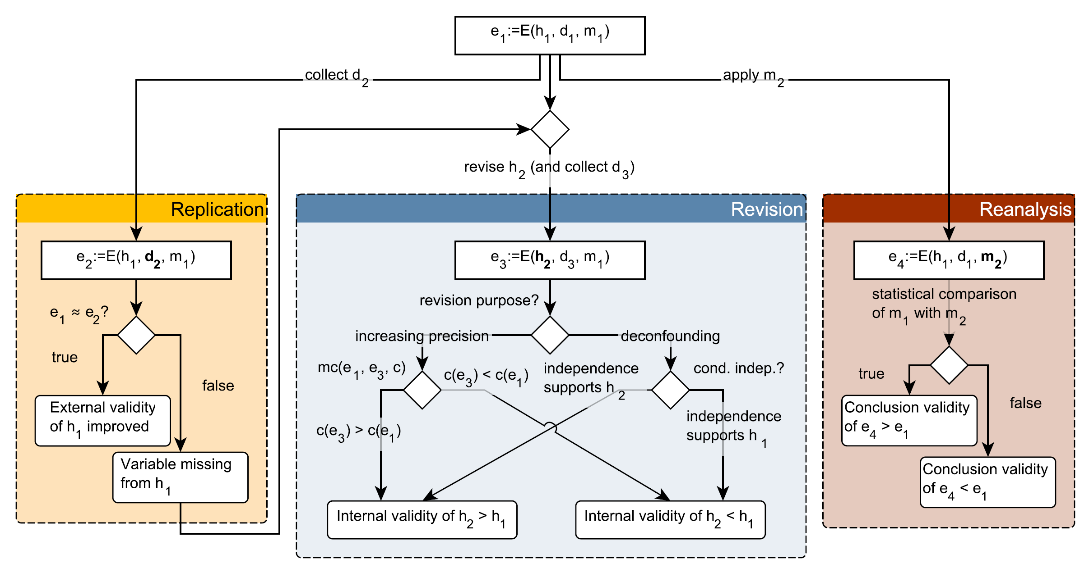
Supporting the Vision of Coherent Science
Frattini, J., Fischbach, J., Fucci, D., Unterkalmsteiner, M., & Mendez, D. (2024). Replications, Revisions, and Reanalyses: Managing Variance Theories in Software Engineering. arXiv preprint arXiv:2412.12634.

Slide 46
Closing
Final Remarks

Slide 47
Limitations
This was but a gentle introduction. The topic of statistical causal inference contains many more elements, like
Ancestors: parent-child relationships in DAGs
Interaction: complex inter-relationship of two or more variables and an outcome
Hierarchical model: partial pooling
Different types of regression: regression for different outcome variable distributions
Bayesian data analysis: advanced estimation technique
And many more …

Slide 48

Reading list
Pearl, J., & Mackenzie, D. (2018). The book of why: the new science of cause and effect. Basic books.
McElreath, R. (2018). Statistical rethinking: A Bayesian course with examples in R and Stan. Chapman and Hall/CRC.
Cinelli, C., Forney, A., & Pearl, J. (2024). A crash course in good and bad controls. Sociological Methods & Research, 53(3), 1071-1104.
Siebert, J. (2023). Applications of statistical causal inference in software engineering. Information and Software Technology, 159, 107198.
Furia, C. A., Feldt, R., & Torkar, R. (2019). Bayesian data analysis in empirical software engineering research. IEEE Transactions on Software Engineering, 47(9), 1786-1810.
Furia, C. A., Torkar, R., & Feldt, R. (2022). Applying Bayesian analysis guidelines to empirical software engineering data: The case of programming languages and code quality. ACM Transactions on Software Engineering and Methodology (TOSEM), 31(3), 1-38.

Slide 49
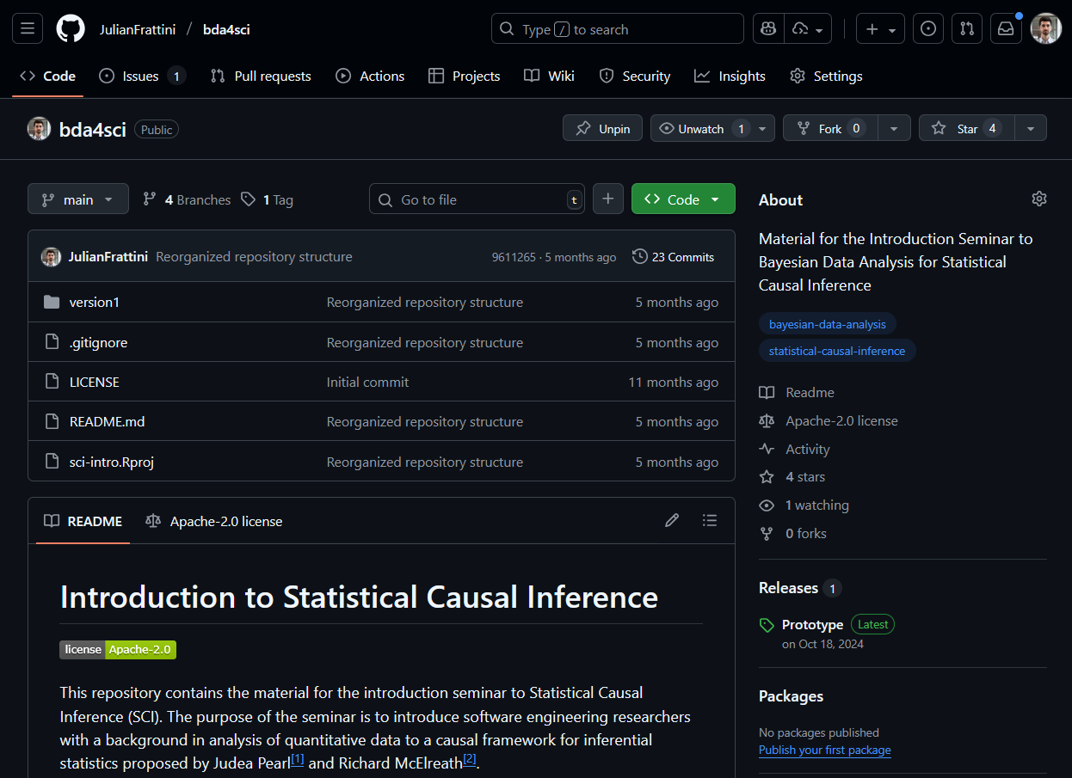
Material
JulianFrattini/bda4sci
Public
All material is public and open-source on GitHub. Feel free to clone, fork, and share the study material.
Comments, requests, and additions are welcome.

