Slide 1
UNDERSTAND THE
PROBLEM BEFORE YOU
BUILD THE SOLUTION
Creating Software that Matters
with Requirements Engineering

Slide 2



Requirements Engineering
A Brief Introduction
Julian Frattini, Ph.D.
Chalmers University of Technology, Sweden
https://julianfrattini.github.io/
JulianFrattini/seminar-refun
Public
Copyright © 2025 Julian Frattini.
This work is licensed under CC BY-NC 4.0.

Slide 3


Motivation
Starting a software development project
Minimizing wasted effort and costly rework
Notes:
My goal is to teach about requirements engineering, but learning a subject should not be motivated by itself, but rather by a real reason.
The reason for RE are the following two questions
How do I get started with a software development project?
How do I minimize both wasted effort and costly rework?

Slide 4



Goals
Understand the fundamentals and definitions
Understand the impact of requirements engineering
Apply basic techniques to specify requirements
Notes:
At the end of the lecture, you should be able to
Understand the fundamentals of requirements engineering
Understand the impact of requirements engineering
Apply basic techniques to specify requirements

Slide 5
Agenda
Definitions or: what exactly are requirements?
Impact or: why should I care about requirements?
Application or: how do I do requirements engineering?

Slide 6
Definitions
What exactly are Requirements?

Slide 7





Software Development Lifecycle
Requirements Engineering
Architecture
Implemen-tation
Verification
Deployment
Requirements Specification
Architecture
Source Code
Test Cases
Product
Notes:
To understand requirements engineering, we need to begin by putting it on a map.
Implementation: producing source code, core activity in software engineering
Verification: verifying and validating the produced source code
Deployment: delivering the tested product to the customer
Architecture: basic plan of the software system
Requirements Engineering: where all begins

Slide 8
Requirement & Requirements Artifact
Requirement:
A need or constraint imposed by a stakeholder.
A capability or property that a system shall have.
(Requirements) Artifact: A documented representation of a (1) need, constraint, (2) capability or property.
REQ1: When a user enters the webpage, the login option shall be highlighted.
REQ2: The system shall be secure and comply to data privacy guidelines
Adapted from [1] and [2]
Notes:
(Definitions)
Be aware of the distinction between a requirement and a requirements artifact
(Exemplary requirements)

Slide 9
Requirements Engineering
Requirements Engineering (RE) is the systematic, iterative, and disciplined approach to develop an explicit requirements specification that all stakeholders agree upon.
Based on [1]

Slide 10
Levels of Abstraction
What is the relationship between the following two statements?
is refined to
REQ2: Communication between users of the system shall not be accessible to external actors.
REQ1: The system shall be secure.
Statements exist on different levels of abstraction.
Notes:
Another important concept: levels of abstraction
Important to know because different statement may refer to the same thing on different levels

Slide 11

Levels of Abstraction
Context Layer (why?)
Requirements Layer (what?)
System Layer (how?)
Project scope, stakeholders, goals, …
REQ1: The system shall be secure.
Data model, system architecture, …
REQ2: Communication between users of the system shall not be accessible to external actors.
In scope of requirements engineering
In scope of subsequent phases, e.g., software architecture
System
(black-box view)
System
(glass-box view)
Based on [3]
Notes:
A popular framework for thinking about levels of abstraction: three levels
Context layer (why does one have interest in the system under development?): containing project scope, stakeholders, goals
Requirements layer (what does one do with the system under development?): containing requirements
System layer (how does the system under development work?): containing system specifications
Context & requirements layer are in scope of requirements engineering, the system layer not
Another way to think about it: black- vs. glass-box view
Black-box: no information about the internals of a system
Glass-box: detailed look “under the hood”

Slide 12
Impact
Why care about requirements?

Slide 13

Cost of Defect Removal
Requirements Engineering
Architecture
Implemen-tation
Verification
Deployment
Underspecified Requirements Artifact
Suboptimal Architecture
Faulty Implementation
Misleading Test cases
Unsatisfying Product
The cost of removing a defect from an artifact scales approximately by the factor 10 for each phase that it survives.
Based on [4] and [5]
Notes:
Consider a potential defect:
An underspecified requirement might be caused by a lack of communication (the requirements author assumed it was clear)
This requirement results in a suboptimal architecture
Which produces a faulty implementation (which might be compliant to the requirements artifact, but not to the actual requirement
The test cases mislead that the system is doing fine
But in the end an unsatisfying product is deployed
The cost of removing a defect from each type of artifact increases the further it progresses
Fixing a requirements artifact is a matter of rewriting some sentences
Fixing a product is a matter of redoing the whole development process
The cost of removing defects from artifacts scales approximately by factor 10.
That means: most defects are easiest to fix in the requirements engineering phase

Slide 14


Problem- versus Solution-Space
Problem-Space
Why should the system do something and what should it do?
Solution-Space
How should the system do it?
Notes:
To grasp another dimension of the importance of requirements, understand the problem- vs. solution space.
A ”space” in this sense describes a set of statements. We differentiate the following two spaces:
Problem-space: identifies the context (why?) and requirements (what?) of a system
Solution-space: identifies the solution concept and realization (how?) of a system
This is another way of grouping the previously mentioned levels of abstraction.

Slide 15
Problem- versus Solution-Space
Problem Space
Solution Space
The system shall be secure.
The system shall perform well with a large number of concurrent users.
The system’s architecture will contain a broker-pattern at the client-server interface with at least 5 subscribed servers
Large scale maintenance and/or an upgrade shall give the possibility to reach a lifetime of 50 years.
The primary data storage subsystem will adhere to active redundancy.
All subsystems shall not lose more than 4 hours of acquired or processed measurement data (not yet permanently stored) as a result of an outage in the external power supply.
All communication shall be encrypted with SHA-2.

Slide 16
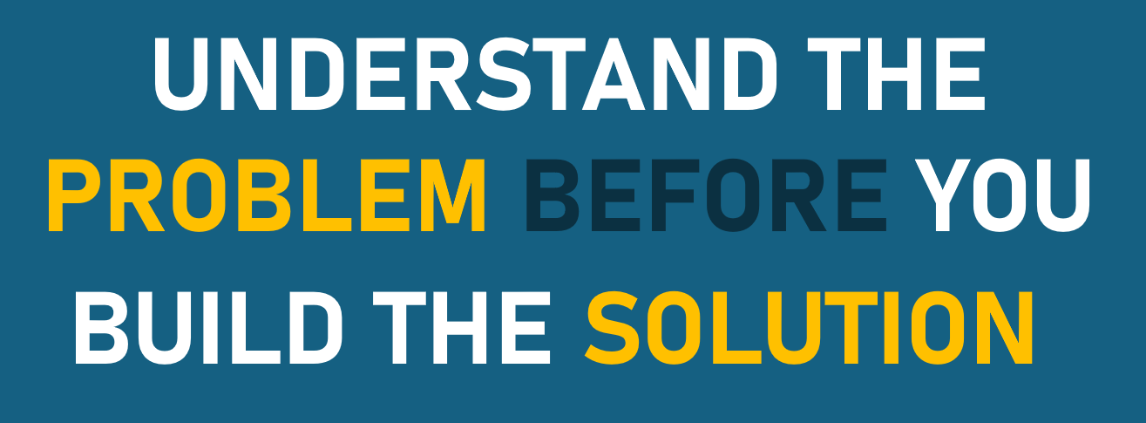
Problem- versus Solution-Space
SOL1: The website will be implemented using the Hugo framework.
Good choice for static websites
REQ1: The purpose of the website is to make static information available.
SOL2: The website will be implemented using the Svelte framework.
Good choice for interactive websites
For every solution-space statement you receive, first determine the problem you are trying to solve.

Slide 17
Insights
Every project has requirements …
… but not every team decides to write them down.

Slide 18
Application
How to Requirements Engineering?

Slide 19
Motivation
It is desirable to specify requirements, but these requirements need to be free of defects.
ambiguous
irrelevant
incomplete
vague
Rather than eliciting requirements all-at-once, we can incrementally elicit and refine them.
Notes:
It should be clear: having requirements specified is desirable.
Challenge: those requirements must be free of defects,
Otherwise: scaling cost for removing defects
(not having requirements at all is a defect in itself)
Approach: incrementally elicit and refine requirements -> purpose of requirements engineering

Slide 20


Techniques
Stakeholder Elicitation
Goal Modeling
System
Vision
Requirements Elicitation
Notes:
Four techniques to discuss today
These techniques are a selection
But they are the backbone for a requirements engineering approach
Stakeholder identification: who contributes relevant requirements?
Goal modeling: what is their expected outcome?
System vision: what is in scope of the system?
Requirements elicitation: how do we specify these requirements?

Slide 21



Stakeholder Elicitation
A stakeholder is a person or a group of persons, interest group, or organization that has to a certain extent interest in the system to be developed, or that takes/should take influence on the system’s development.
Elementary Steps:
Elicit stakeholders: list all relevant stakeholders
Elicit relationships: make relationships between stakeholders explicit

Slide 22
Stakeholder Elicitation
”A user – regardless of their ability to see colors – can log into the system.”
Group stakeholders
Identify explicitly mentioned stakeholders
Identify implicit stakeholders
Determine relationships
User
Customer Support
has interest in
Normal Vision
Colorblind
is a type of

Slide 23
Stakeholder Elicitation
Identify all stakeholders in the following system description:
TechStack Inc. issued the development of a platform where users can upload coding problems. Other users can submit solutions to those problems and a third set of users reviews the solutions and ranks them by code quality. Problem-submitting users get to see the ranked solutions, solution-submitting users get credits depending on the quality of the solution, and reviewers get credit based on the overlap between their ranking and the overall ranking of solutions. Software companies can pay to get the contacts of well-performing users (for targeted hiring).

Slide 24

Stakeholders
TechStack Inc.
User
Software Development Companies
Problem-submitter
Solution-submitter
Reviewer
has interest in
is a type of

Slide 25

Goal Modelling
A goal is a prescriptive statement of intent, i.e., it describes an abstract property that a system must fulfill.
Goal types:
Usage Goals: Goals with immediate relevance for end users which serve as basis for inference of user requirements
System Goals: Goals directed at system properties and capabilities (typically quality, i.e., non-functional
Business Goals: All organization-specific (strategic) goals with relevance to the project
Notes:
What are these stakeholders for?
From stakeholders, we can derive goals
Goals describe the stake, the statement of intent, placed in the system
”prescriptive”: no justification needed -> they are the justification for everything further
Goals are the pillar of the context specification
They answer “why” we are building the system

Slide 26
Goal Modelling
For each of the following stakeholders in the previously mentioned scenario, identify one goal and classify it as a usage, system, or business goal.
Usage Goals: Goals with immediate relevance for end users which serve as basis for inference of user requirements
System Goals: Goals directed at system properties and capabilities (typically quality, i.e., non-functional
Business Goals: All organization-specific (strategic) goals with relevance to the project
TechStack Inc.
Solution-submitter

Slide 27
Goal Modelling
Generate revenue
Protect private data
Contact skilled developers
TechStack Inc.
User
Software Development Companies
Business
Problem-submitter
Solution-submitter
Reviewer
Usage
Receive help for coding tasks
Show skills on coding tasks
Show skills on review tasks
System
Notes:
Generate revenue: classic business goal of a company
Show skills on a coding task: usage goal for one of the types of users (why would this user group use the system)
(other type of usage goals)
(other type of business goals)
Protect private data: system goal of all users

Slide 28
Goal Refinement
Goals can be further refined with the following relations:
Conflict: one goal may conflict with another goal
Support: one goal may support another goal
Refinement: one goal can be decomposed into more specific sub-goals

Slide 29


Goal Relationships
Obtain sharable contact data
Generate revenue
Protect private data
Contact skilled developers
TechStack Inc.
User
Software Development Companies
Notes:
If the goal ”contact skilled developers” is fulfilled by the system, the goal of ”generating revenue” can be achieved easier
“contact skilled developers” clashes with “protect private data”
This sparks a new goal to find a compromise

Slide 30
Goal Refinement
Solution-submitter
Show skills on coding tasks
Receive merit on the platform
Receive merit outside of the platform

Slide 31
System Vision
A system vision is the transition point between the context specification and the requirements specification. Its main purpose is to
give a comprehensive overview of the most important use cases and
boundaries, thus it clearly defines the scope of the system. It clearly distinguishes which parts belong to the system and which parts are external.

Slide 32
System Vision
Use Case Diagram procedure:
Elicit concrete functionality necessary to enable the goal.
Connect it to stakeholders that are involved with that use case.
Determine, whether the use case is part of the system or external.

Slide 33
System Vision
Step 1: Elicit concrete functionality necessary to enable the goal.
Context Layer (why?)
Requirements Layer (what?)
get an overview over existing tasks
view task in a code editor
Receive merit on the platform
Submit solution to a task
Make rating of solution public

Slide 34
System Vision
Step 2: Connect it to stakeholders that are involved with that use case.
get an overview over existing tasks
view task in a code editor
Problem-submitter
Submit solution to a task
Solution-submitter
Make rating of solution public
Reviewer

Slide 35
System Vision
Step 3: Determine, whether the use case is part of the system or external.
System
get an overview over existing tasks
Solution-submitter
Problem-submitter
Submit solution to a task
External System
view task in a code editor
Make rating of solution public
Reviewer
Notes:
This view can be used to achieve agreement on
Who is involved with the system
Which features does the system offer
Which features of external systems are used
Use the system vision to agree with your customer on the scope of the system

Slide 36
Requirements Elicitation
You can specify functional requirements using the following template:
REQ<id>: When <stakeholder> <action>, then the system <reaction>.

Slide 37
Requirements Elicitation
Refine features into measurable, specific requirements.
REQ<id>: When <stakeholder> <action>, then the system <reaction>.
Requirements Layer (what?)
REQ1: When a user opens the challenge overview, the system visualizes all active challenges.
get an overview over existing tasks
REQ2: When the user hovers over a challenge name, the system shows a preview of the challenge description.
REQ3: …

Slide 38
Requirements Elicitation for System Goals
Approach 1: Decompose a system goal into measurable quality requirements along its aspects.
REQ42: Any request sent from the server shall be encrypted.
The service should be safe
REQ43: Personal data shall be removable at any point in time.
Approach 2: Specify a misuse-case, i.e., a functional requirement of what is not supposed to happen.
The service shall ensure data privacy
REQ44: When an unauthorized user accesses another user’s profile, the system shall not display any contact information.
Notes:
More challenging: system goals
They may pertain to the whole system rather than a single functionality
They are much more difficult to assess during validation & verification

Slide 39
Requirements Engineering Template
Context Layer (why?)
Goal
Goal
Goal
Goal
System
External
Feature
Feature
Feature
External
Feature
Feature
Requirements Layer (what?)
REQ44: When an unauthorized user accesses another user’s profile, the system shall not display any contact information.
REQ2: When the user hovers over a challenge name, the system shows a preview of the challenge description.
Notes:
Decomposition from stakeholders to goals to system vision to requirements
Final requirements document

Slide 40
Beyond Requirements Engineering
How to continue from Requirements

Slide 41
Using Requirements
System
(black-box view)
Requirements Layer (what?)
System Layer (how?)
System
(glass-box view)
Notes:
“Open up the black box”: once the why and what are specified, start working on the how.
Use requirements to
Derive your architecture,
Implement your system, and
test your system
Disclaimer: this is a very plan-driven perspective
A more agile approach will involve an iterative, back-and-forth exploration of the solution space

Slide 42



Concluding Thoughts
Tailoring there is no one-size-fits-all solution
Change requirements are rarely static
Means-to-an-end
Requirements are no means-to-itself
Notes:
Tailoring: there is no one solution
Adjust your way of working to the circumstances
Change: beware of change throughout the development lifecycle
A waterfall-like approach is unlikely to succeed
trace your requirements
Requirements are a means to an end, not a means to itself
This also means that effort in requirements must be justified

Slide 43
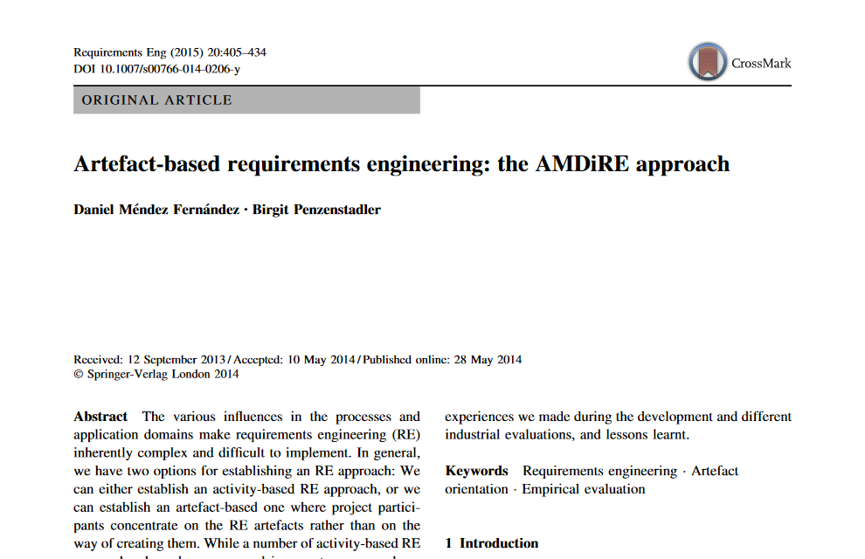
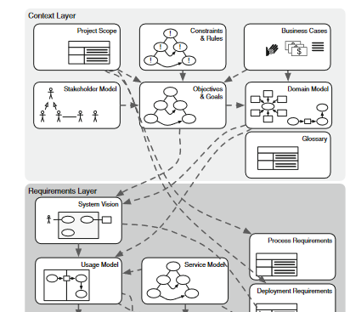
Recommended Reading
Méndez Fernández, D., & Penzenstadler, B. (2015). Artefact-based requirements engineering: the AMDiRE approach. Requirements Engineering, 20, 405-434. https://link.springer.com/article/10.1007/s00766-014-0206-y

Slide 44
References
[1] Glinz, M. (2011). A glossary of requirements engineering terminology. Standard Glossary of the Certified Professional for Requirements Engineering (CPRE) Studies and Exam, Version, 1, 56.
[2] Méndez Fernández, D., Böhm, W., Vogelsang, A., Mund, J., Broy, M., Kuhrmann, M., & Weyer, T. (2019). Artefacts in software engineering: a fundamental positioning. Software & Systems Modeling, 18, 2777-2786.
[3] Méndez Fernández, D., & Penzenstadler, B. (2015). Artefact-based requirements engineering: the AMDiRE approach. Requirements Engineering, 20, 405-434.
[4] Fernández, D. M., Wagner, S., Kalinowski, M., Felderer, M., Mafra, P., Vetrò, A., ... & Wieringa, R. (2017). Naming the pain in requirements engineering: Contemporary problems, causes, and effects in practice. Empirical software engineering, 22, 2298-2338.
[5] Boehm, B. W. (1984). Software engineering economics. IEEE transactions on Software Engineering, (1), 4-21.

