Slide 1



Information is all you need:
Requirements Engineering Quality Reframed
Henning Femmer, Ph.D.
Fachhochschule Südwestfalen
JulianFrattini/study-req
Public
Julian Frattini, Ph.D.
Chalmers University of Technology, Sweden
https://julianfrattini.github.io/
Copyright © 2026 Julian Frattini.
This work is licensed under the Apache-2.0 License.

Slide 2

Requirements Quality Research
Requirements Specification e.g., SRS, user story, …
*
affects
*
Activity e.g., implementation, testing, …
1
characterize
1
characterize
*
*
Quality Factor e.g., ambiguous pronoun, passive voice, …
*
impacts
1
Attribute e.g., duration, correctness, …
Frattini, J., Montgomery, L., Fischbach, J., Mendez, D., Fucci, D., & Unterkalmsteiner, M. (2023). Requirements quality research: a harmonized theory, evaluation, and roadmap. Requirements engineering, 28(4), 507-520.
Notes:
Status quo in requirements quality research: artifact-centric
Looks good and sounds plausible, but there are still issues

Slide 3
Observed Inconsistencies
Despite the plausibility of the artifact-centric theory of requirements quality, we still observe inconsistencies.
Interview
Analyse
Document
Stakeholder
Developer
Notes:
Sometimes we observe that the model/theory does not hold
Despite a “perfect” requirements specification (and a formal process), requirements artifacts are sometimes circumvented
Observed anomaly

Slide 4
Research Philosophy: Kuhn’s Paradigms
Thomas Kuhn describes scientific progress as follows:
Anomaly
Paradigm
New Paradigm
Governing theory
Governing theory
Accepted examples
Accepted examples
Measurement instruments
Measurement instruments
Crisis
Kuhn, T. S., & Hacking, I. (1970). The structure of scientific revolutions (Vol. 2, No. 2, p. 310). Chicago: University of Chicago press.
Notes:
Paradigm: defines what counts as legitimate questions and valid answers (e.g., Newtonian mechanics)
Normal science: productive scientific work within the framework defined by the paradigm
Anomalies: results that do not fit the paradigm
Crisis: anomalies that resist resolution
Revolution: replacing an existing paradigm with a new one
New paradigm is incommensurable with the old one

Slide 5
Information-centric RE
From Requirements Artifact Quality to Requirements Engineering Quality

Slide 6
Information-Centric Requirements Engineering
Requirements are information.
Legend
<information particle>
It would be neat if I could export my data into a CSV file.
Notes:
Principle: requirements are information
Information particle
Information storage
Information transfer
Information flow
-> The quality of requirements engineering = effectiveness and efficiency of the information flow

Slide 7
Information-Centric Requirements Engineering
Information storages contain information particles.
Legend
End user
<information particle>
It would be neat if I could export my data into a CSV file.
<information storage>
Notes:
Principle: requirements are information
Information particle
Information storage
Information transfer
Information flow
-> The quality of requirements engineering = effectiveness and efficiency of the information flow

Slide 8
Information-Centric Requirements Engineering
Information storages can be tangible or intangible.
Legend
End user
Backlog
<information particle>
It would be neat if I could export my data into a CSV file.
<information storage>
Notes:
Principle: requirements are information
Information particle
Information storage
Information transfer
Information flow
-> The quality of requirements engineering = effectiveness and efficiency of the information flow

Slide 9
Information-Centric Requirements Engineering
Information particles can transfer from one storage to another.
Legend
End user
Backlog
<information particle>
It would be neat if I could export my data into a CSV file.
<information storage>
<information transfer>
Notes:
Principle: requirements are information
Information particle
Information storage
Information transfer
Information flow
-> The quality of requirements engineering = effectiveness and efficiency of the information flow

Slide 10
Resolving the Anomaly
The new, information-centric paradigm explains the anomaly and allows resolving the crisis.
Interviewing
Requirements Engineer
Documenting
Requirements Specification
Reading
Stakeholder
Developer
Directly communicating
It would be neat if I could export my data into a CSV file.
What matters is through which path does the information (i.e., the requirements particle) flow better/faster to the developer?

Slide 11
Resolving the Anomaly
Tangible and intangible information storages are equally represented
Interviewing
Requirements Engineer
Documenting
Requirements Specification
Reading
Stakeholder
Developer
Directly communicating
It would be neat if I could export my data into a CSV file.
The goal of RE is formalized as the transport of information from sources to targets
The properties of the information flow constitute RE quality

Slide 12
Application
Syntaxes for Information-centric RE

Slide 13
Modelling RE as Information Flow
Information as discrete, concrete particles
High granularity and specificity
Directly empirically grounded
Useful for retrospective analyses (e.g., identifying bottlenecks)
Models requirements semantically
Notes:
How can this be used prospectively?

Slide 14
Use Case: Modelling Information Merge
Information particles about the same target may merge at a single information storage, potentially, producing conflicts.
The system should be available 100% of the time.
Stakeholder
Interviewing
Requirements Engineer
Documenting
Requirements Specification
No system can be available 100% of the time.

Slide 15
Use Case: Modelling Information Merge
Information particles about the same target may merge at a single information storage, potentially, producing conflicts.
The system should be available 100% of the time.
Stakeholder
Interviewing
Requirements Engineer
Documenting
Requirements Specification
No system can be available 100% of the time.

Slide 16
Use Case: Modelling Information Merge
Information particles about the same target may merge at a single information storage, potentially, producing conflicts.
The system should be available 99.5% of the time.
Stakeholder
Interviewing
Requirements Engineer
Documenting
Requirements Specification
No system can be available 100% of the time.

Slide 17
Modelling RE as Information Flow
Information as discrete, concrete particles
High granularity and specificity
Directly empirically grounded
Only retrospective
Low generalizability
Useful for retrospective analyses (e.g., identifying bottlenecks)
Models requirements semantically
Notes:
How can this be used prospectively?

Slide 18
From Description to Inference
Modelling several RE contexts with discrete particles would allow us to abstract certain properties from it.

Slide 19
From Description to Inference
Modelling several RE contexts with discrete particles would allow us to abstract certain properties from it.
Stakeholder
(i = 0.8)
On average, the “Stakeholder” contains 80% of the total requirements information

Slide 20
Modelling RE as Information Flow
Alternatively, we can model information as a quantity, i.e., the fraction of the total information that a storage possesses.
Stakeholder
(i = 0.8)
Interviewing
Requirements Engineer
(i = ?)
How much information ends up at the target of the transfer?

Slide 21
Modelling RE as Information Flow
Information transfers become a function of the input information:
How much information will be transferred depends on more parameters
$$transfer\left(input:i\right)→output:i$$
$$transfer\left(input:i,parameters:p\right)→output:i$$
Skill of the entity performing the transfer
Time invested in the transfer
...
Complexity of the system under construction
Confusion of the entity performing the transfer
...
Notes:
For example: cumulative Beta-distribution function

Slide 22
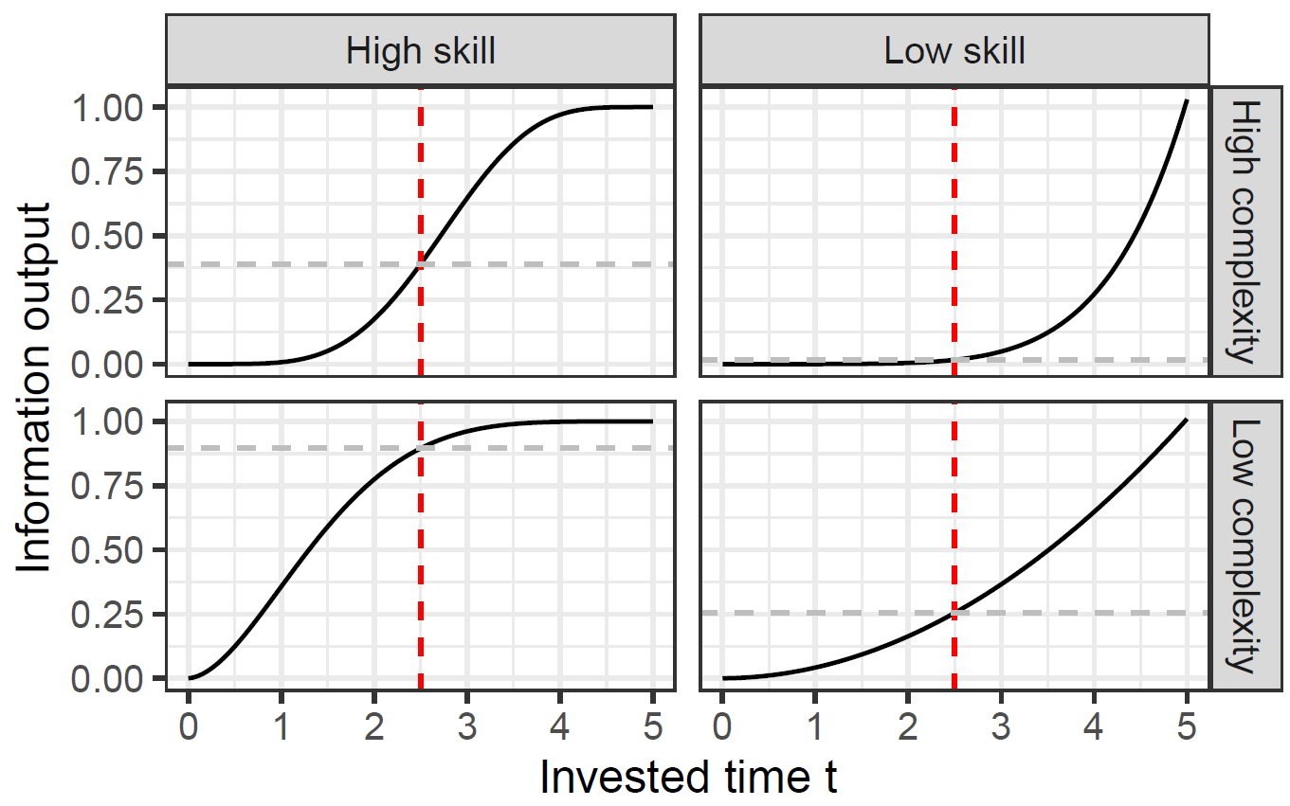

Modelling RE as Information Flow
$$transfer\left(input:i, time:t, complexity:c, skill:s\right)→output:i$$
<Transfer>
$$(c, s, t, t_{max})$$
Notes:
For example: cumulative Beta-distribution function

Slide 23
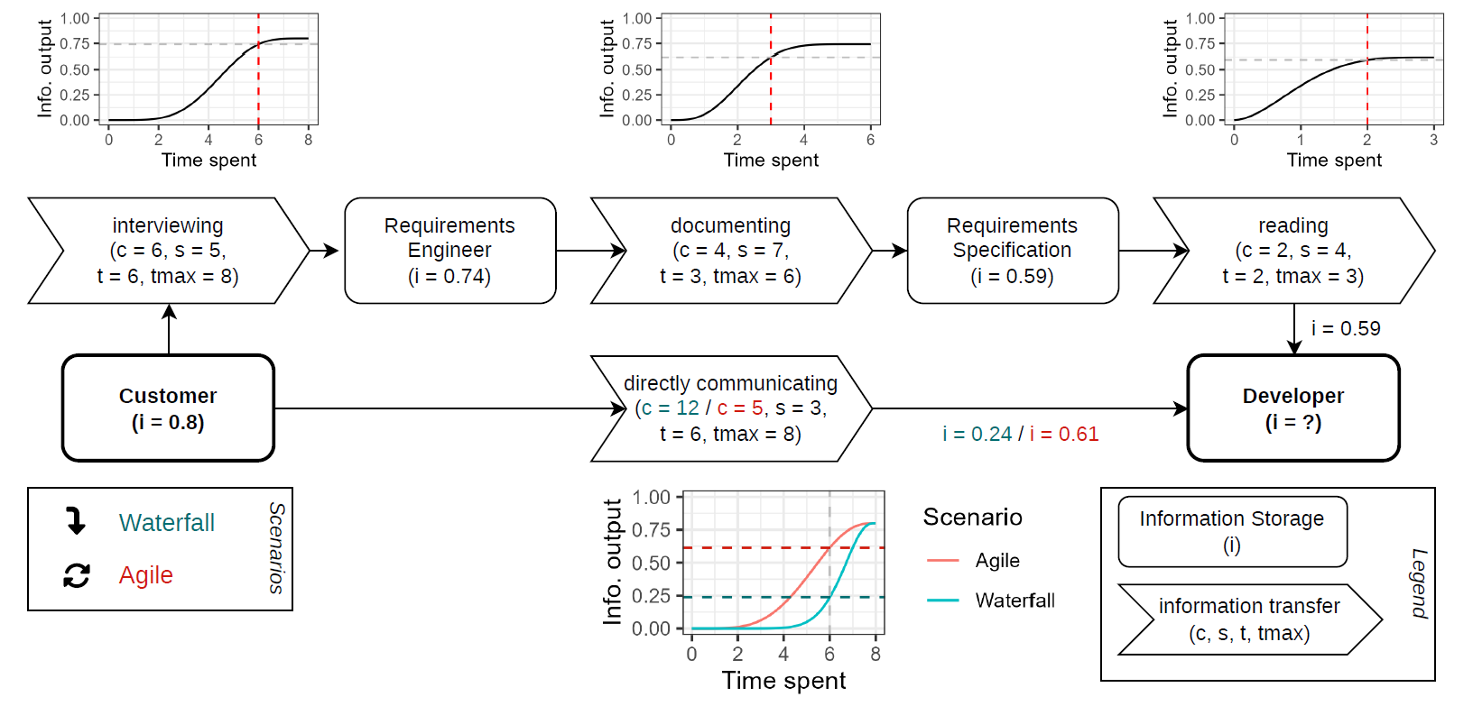
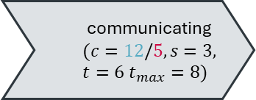
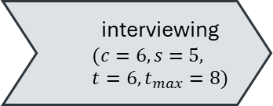
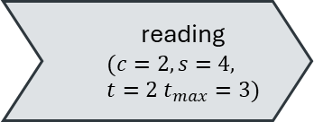
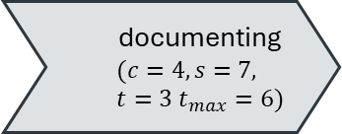
Modelling RE as Information Flow
interviewing
$$(c=6, s=5, t=6, t_{max}=8)$$
Requirements Engineer
(i = 0.74)
documenting
$$(c=4, s=7, t=3 t_{max}=6)$$
Requirements Specification
(i = 0.59)
reading
$$(c=2, s=4, t=2 t_{max}=3)$$
Customer
(i = 0.8)
communicating
$$(c=12/5, s=3, t=6 t_{max}=8)$$
Developer
(i =0.24/0.61)

Slide 24
Modelling RE as Information Flow
Information as discrete, concrete particles
Information as continuous distributions
High granularity and specificity
Directly empirically grounded
Only retrospective
Low generalizability
Useful for retrospective analyses (e.g., identifying bottlenecks)
Models requirements semantically
Generalizable and transferrable
Requires extensive empirical evidence
Implies several mathematical assumptions
Useful for identifying optimal flows
Prospective analyses (e.g., simulation of change)
Notes:
How can this be used prospectively?

Slide 25
Conclusion

Slide 26
From Description to Inference
Modelling several RE contexts with discrete particles would allow us to abstract certain properties from it.
Stakeholder
(i = 0.8)
interviewing
Requirements Engineer
(i = 0.6)

Slide 27
Future Work
Considering requirements engineering as information flow has the potential to resolve anomalies observed in requirements quality, but the current formalizations are just scaffolding.
It remains to be solved how to model
information merging,
iterations and change over time,
decay and retention of information,
...

Slide 28
Requirements are Information
and the purpose of RE is to transfer that information
from its sources
to its targets
Stakeholders
Requirements Engineering
Design
Legacy systems
Implementation
Competitor analysis
Testing
As such,
Requirements Engineering Quality = effectiveness and efficiency of the information flow.

