Slide 1


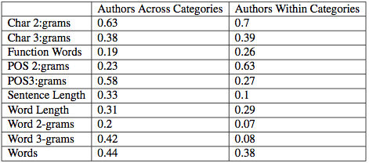
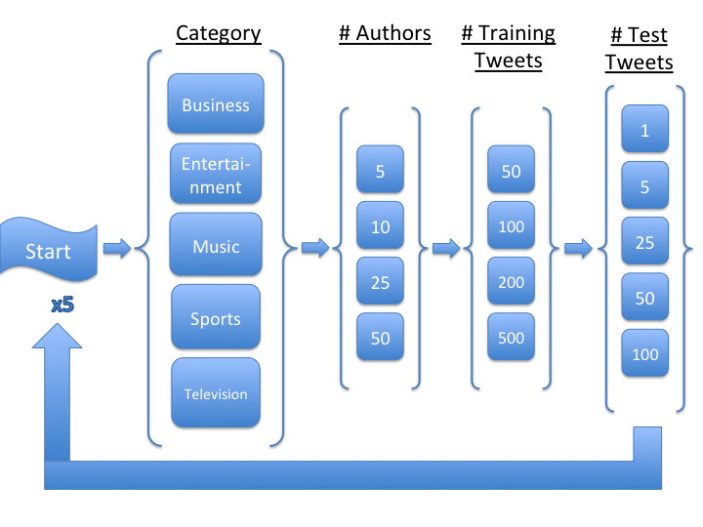

Authorship Attribution on Twitter:
A Comparative Methods Study
Julian Griggs, Class of 2015 Advised by: Prof. Andrea LaPaugh, Princeton University
Motivation
Overall Results
Varying Training and Test Set Sizes
Stylometric analysis is becoming an increasingly powerful tool for de-anonymizing written texts on the web.
Despite the large growth in social media based text, authorship attribution studies focusing on this domain are relatively scarce.
What are the best linguistic features and machine learning algorithms for authorship attribution?
How are authorship attribution rates impacted by additional variables (# Authors, # Training/Test Tweets, etc.)?
Growth is logarithmic, beginning to level out towards larger sizes
No drop in prediction accuracy as training set increases in size
Evidence for being resistant to over-fitting
What is Stylometry? How does it work?
Linear SVM using Character 2-grams is best overall pairing: 79.77%
4 of the top 5 feature-method pairings involve Linear SVM
Using statistical analysis and machine learning to classify texts according to various properties
Mainly used for authorship attribution i.e. “Which of these potential people authored this anonymous text?”
Works through the extraction of linguistic features
Lexical: relating to the actual words present in a given piece of text
Syntactic: relating to the grammatical structure of a given text
Application-specific : relating to text-specific meta-data often present as a result of medium specific structure
Machine learning algorithms use these features to build author profiles that can be used to extrapolate to unseen texts
Instance based methods
Profile based methods
Varying Number of Authors
Varying Across Categories
Very minor variation between categories
Preliminary experiments reveal no distinction between attribution rates when author pools are random vs. categorically similar
My Project / Experimental Design
2,452,800 Tweets gathered from 1533 users spanning across 28 categories
Multiple variables are considered
Further Research
Move from testing features independently to seeing how the use of multiple feature sets in combination increases accuracy
Explore how resistant different feature-analysis method combinations are to unevenly distributed training set sizes
Stress test with hundreds/thousands of potential authors
Determine if these same findings hold up across other social media sites

