Slide 1

Pinpoint to success – A Strategic Proposal to Microsoft Movie Studio
Presenter: Julian(Xibei) He

Slide 2


Agenda
Industry Profile
Approach Intro
Key Questions
Recommendations
Looking forward

Slide 3

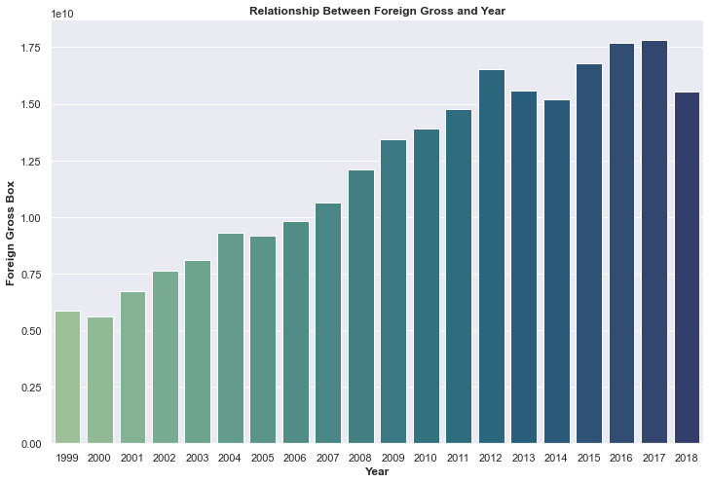

INDUSTRY Profile
Film making budget increases 42% in last 20 years
Box Revenue in the NA increases 53% same period
International box number TRIPLE in last 20 years.
Marketing costs increase 44% from 2014 to 2019 alone

Slide 4
What the Data tell us
As US market has entered mature stage for movie industry, Hollywood has strategically focus on the opportunities worldwide.
Marketing has become an essential part of whole movie production.

Slide 5
Approach: Exploratory Data Analysis - CRISP-DM
3rd party Data
IMDB database
Box office
Movie Budgets
External data and links
Measures
Profitability
Correlations
Category

Slide 6



Does spending more money make movie profitable?

Slide 7
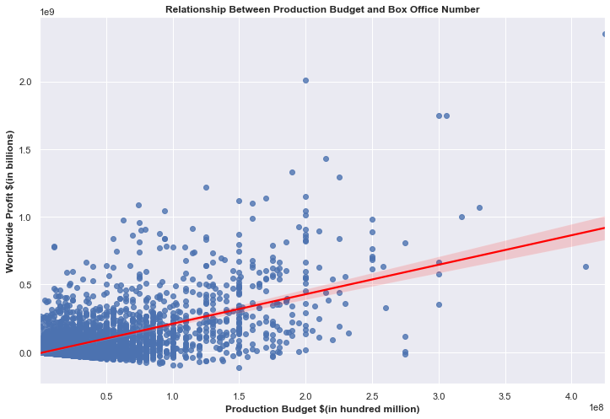
Higher budget leads to higher profit

Slide 8
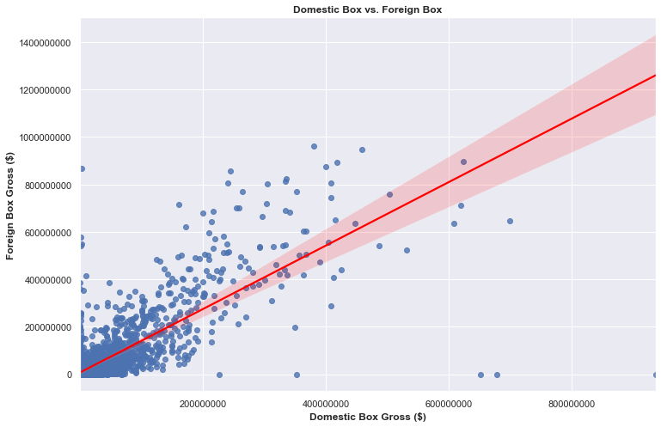
High domestic gross leads to high international gross
Stronger correlation

Slide 9

What factors contribute to the popularity of a movie

Slide 10
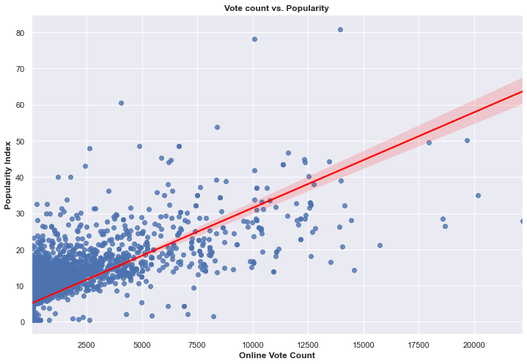
higher vote count means higher popularity
Assume the vote count data as a proxy for online exposure
Higher vote count number (exposure) leads to higher popularity.

Slide 11
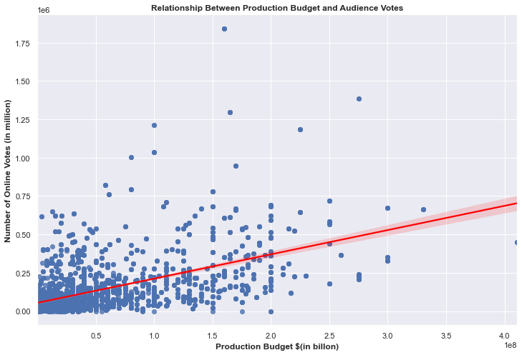
Higher budget leads to higher vote count
Assume the vote count variable positively affect popularity
Higher budget leads to a higher popularity according to transitive law.

Slide 12

How genre of movie affects its profitability

Slide 13
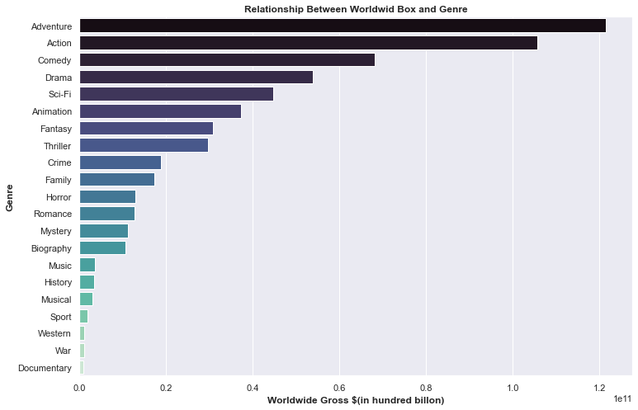
ADVENTURE, ACTION, COMEDY, DRAMA ARE THE HOTTEST MOVIE GENRES
Top Performers!

Slide 14
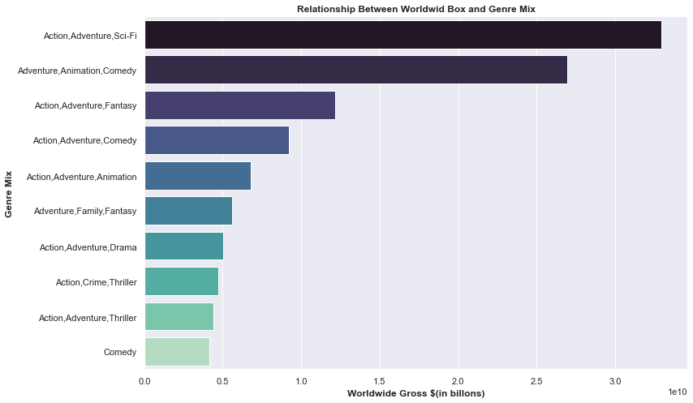
Certain genre mix are incredibly profitable
First 2 mixes generated more than twice of revenue than 3rd place

Slide 15
Recommendations
Higher production budget
higher budget for online exposure
Make movie across multiple genres
Top 5% movies that generated the most worldwide revenues invest average $140,000,000
Keep targeting on international market with huge potential
Positive relation between vote count, budget and popularity.
Spend at least industry level (50%) in increasing movie online exposure
Action, Adventure
Comedy, Drama also score high in this category

Slide 16




Looking forward – Macro factors
Social Media Strategy
Online Streaming Platform
Social Aspects

Slide 17

Thank you
Julian(Xibei) He
Julianhe1991@gmail.com
https://github.com/JulianHe1991

