Slide 1
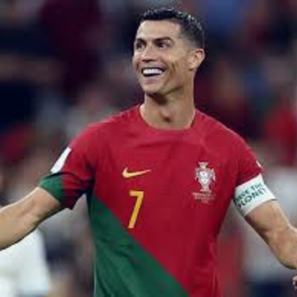
DRAG YOUR IMAGE HERE.
USER: Describe this image.<image>
Folder

Slide 2
DRAG YOUR IMAGE HERE.
USER: Describe this image.<image>
VANILLA ASSISTANT INFERENCE: The image features a man wearing a red and green soccer jersey, standing on a field and smiling. He appears to be a soccer player, possibly a professional athlete, as he is wearing a uniform and a wristband. The man is the main focus of the scene, and he is surrounded by several other people in the background, some of whom are also wearing uniforms. The atmosphere seems to be lively and energetic, likely related to a soccer game or practice session.
Folder

Slide 3
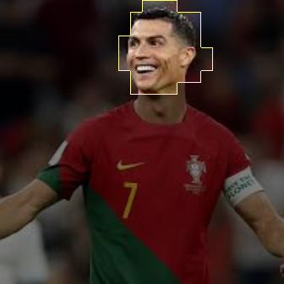

DRAG YOUR IMAGE HERE.
Highlighting Image with User Input
USER: Describe this image.<image>
HIGHLIGHTED INFERENCE: Ronaldo, a smiling soccer player, is the main focus of the image. He is wearing a red and green jersey and is happily posing for the camera. The smile on his face is contagious, and he appears to be enjoying the moment.
In the background, there are several other people present, but they are not the main focus of the image. The primary focus remains on the happy soccer player, who is the center of attention in this scene.
Folder

Slide 4
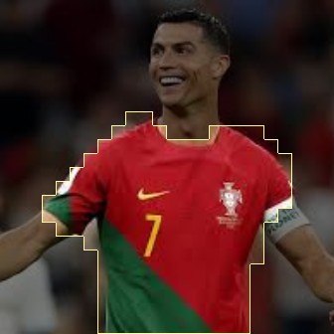

DRAG YOUR IMAGE HERE.
Highlighting Image with User Input
USER: Describe this image.<image>
HIGHLIGHTED INFERENCE: The image features a soccer player wearing a red, green, and yellow jersey with the number seven on it. The player is smiling and appears to be enjoying the game. He is wearing green and red stripes on his jersey, which are a part of his uniform. The player is standing on a field, possibly during a match or practice session.
In the background, there are several other people present, possibly teammates or opponents, but they are not the main focus of the image. The main focus is on the soccer player in the red, green, and yellow uniform.
Folder

