Slide 1
Cluster-based State Encoding
Mini Task Low Level Synthesis
Florian Prott and Julian Käuser
Supervisor: Dennis Wolf, M.Sc.
Date: 14.06.2017
TU Darmstadt
Computer Systems Group
Prof. Dr.-Ing. Christian Hochberger

Slide 2
Overview of Task
optimize state encoding
2 typical approaches for state encoding
One-Hot:
- #states FlipFlops
- fast transition logic (one LUT layer)
- easy to implement
- state-of-the-art for FPGAs
Binary:
- ld(#states) FlipFlops
- more transition logice(more LUT layers)
- but only if state-machine can't fit in one LUT
Idea: combination of both

Slide 3
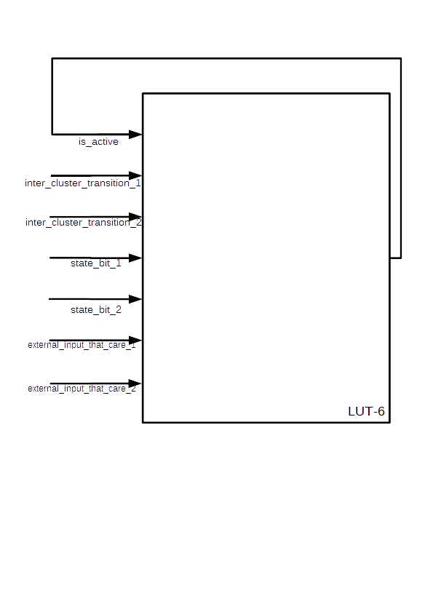
Clustering Constraints
To goal is to minimize the number of Clusters
Each cluster must fit into one LUT
  Nlut_inputs ≥
  #external inputs that are not dc
  + log2(#states in cluster)
  + #transitions from other clusters
  + 1 bit cluster itself is active

Slide 4
Clustering Example
----
1---
St_1
St_2
0---
Cluster 3
N = 4
----
----
-000
St_6
--11
Cluster 2
N = 6
St_3
0101
St_4
1-11
--11
----
0-00
St_7
1-01
St_8
0-11
St_5
----
Cluster 5
N = 6
Cluster 4
N = 9
11--
0--1
0111
Cluster 1
N = 6

Slide 5
Approach: Simulated Annealing
combinatorial problem heuristic necessary
problem-specific cluster searches are greedy unefficient
Reasons for this decision:
  + SA requires only cost/fitness function and mutation scheme
  + easy to implement
  - optimal parameter set hard to find
  - runtime
(but not necessary here)
  (not for ~200 state FSMs)

Slide 6
Mutation Scheme
Extract one random state from one random cluster
Instert it in another random cluster
With 25 % propablity use that cluster again

Slide 7
Parameters for Simulated Anneling
initial temperature: 20*standard deviation of Δfitness
final temperature: 0.01
innerNumber: 1.0, N= #states
Temperature update: Tnew = f(α, Tcurrent) (table)

Slide 8
Results – Ideal LUT

Slide 9
Results – Ideal FF

Slide 10
Results – Practical LUT

Slide 11
Results – Practical FF

Slide 12
Thank you for your attention
Any Questions?

