Slide 1
EQE- and JV-Analysis of Tandem Solar Cells

Slide 2
Part 1: EQE-Analysis
Task: Match two solar cells for use in a tandem solar cell
  force same current by adjusting the thickness
Given data:
  EQE-Spectra of the top cell, the bottom cell and the bottom cell if covered by the top cell
  Standard solar spectrum

Slide 3
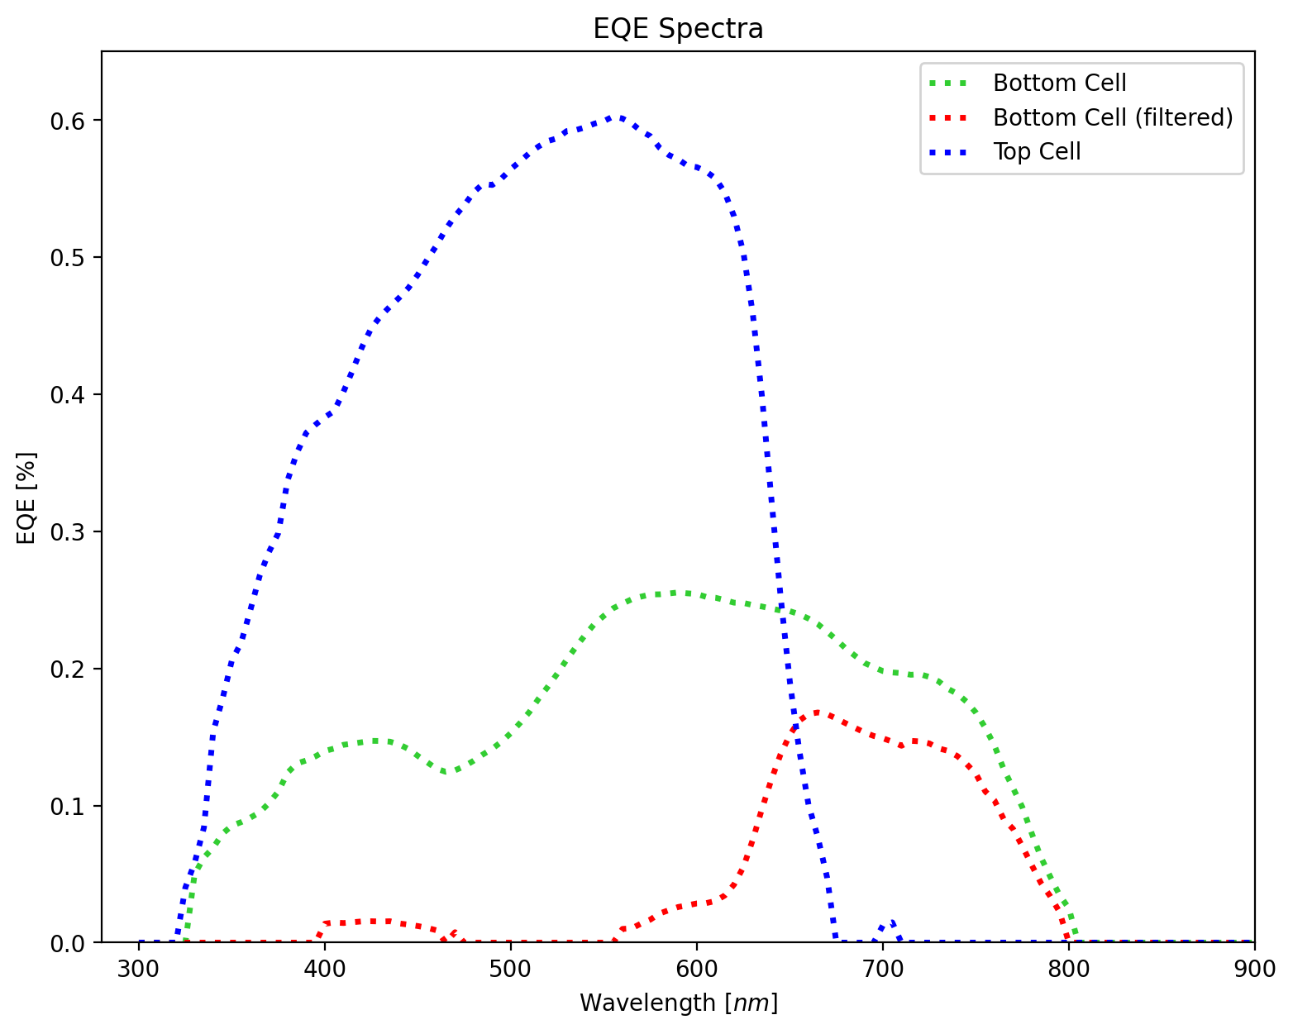
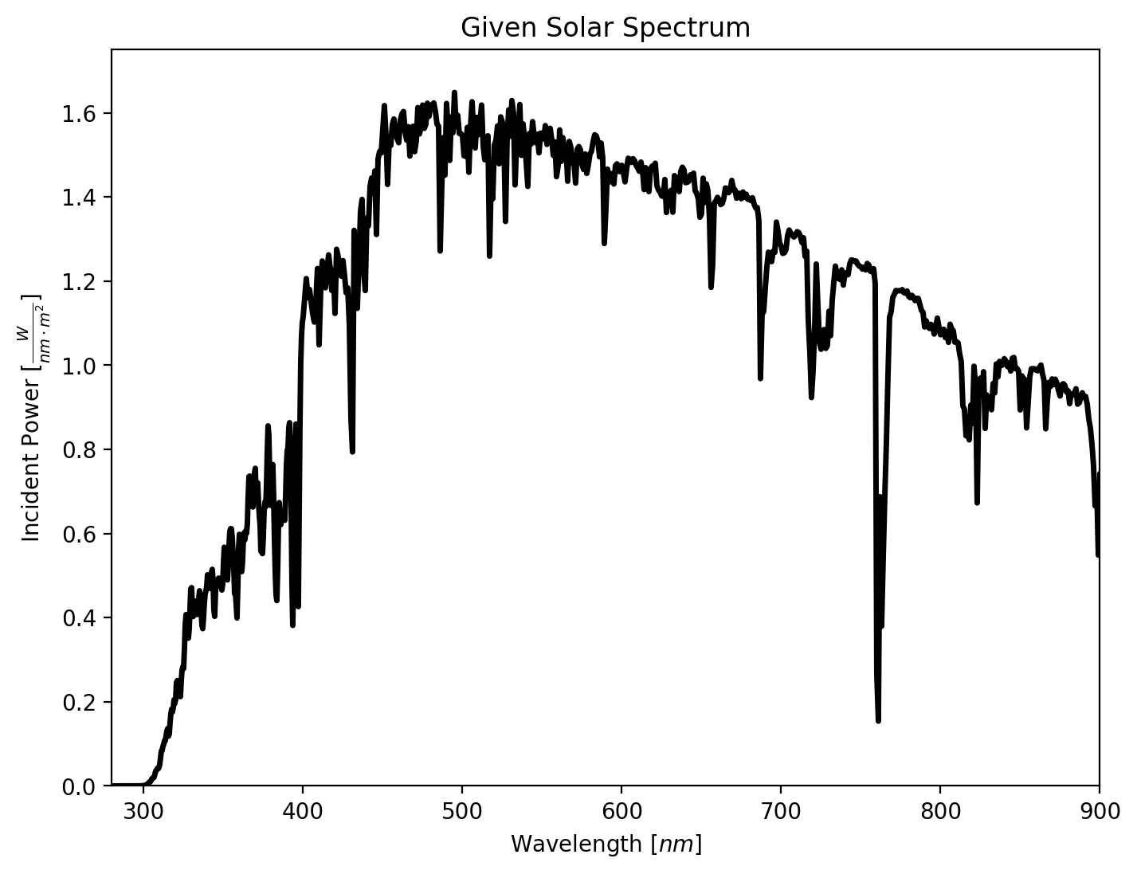
Given Data
Top Cell: P3HT:PCBM
Bottom Cell: KP115:IDTBR

Slide 4
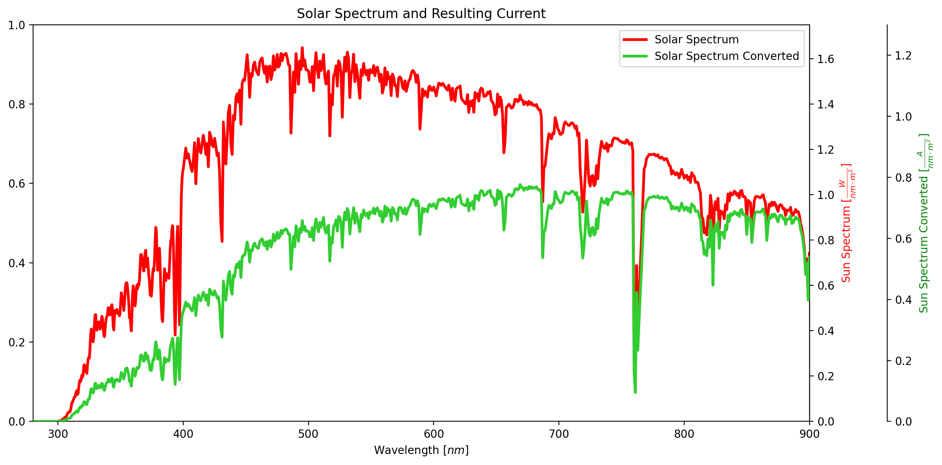
Step 1: Solar Spectrum to Current Spectrum

Slide 5
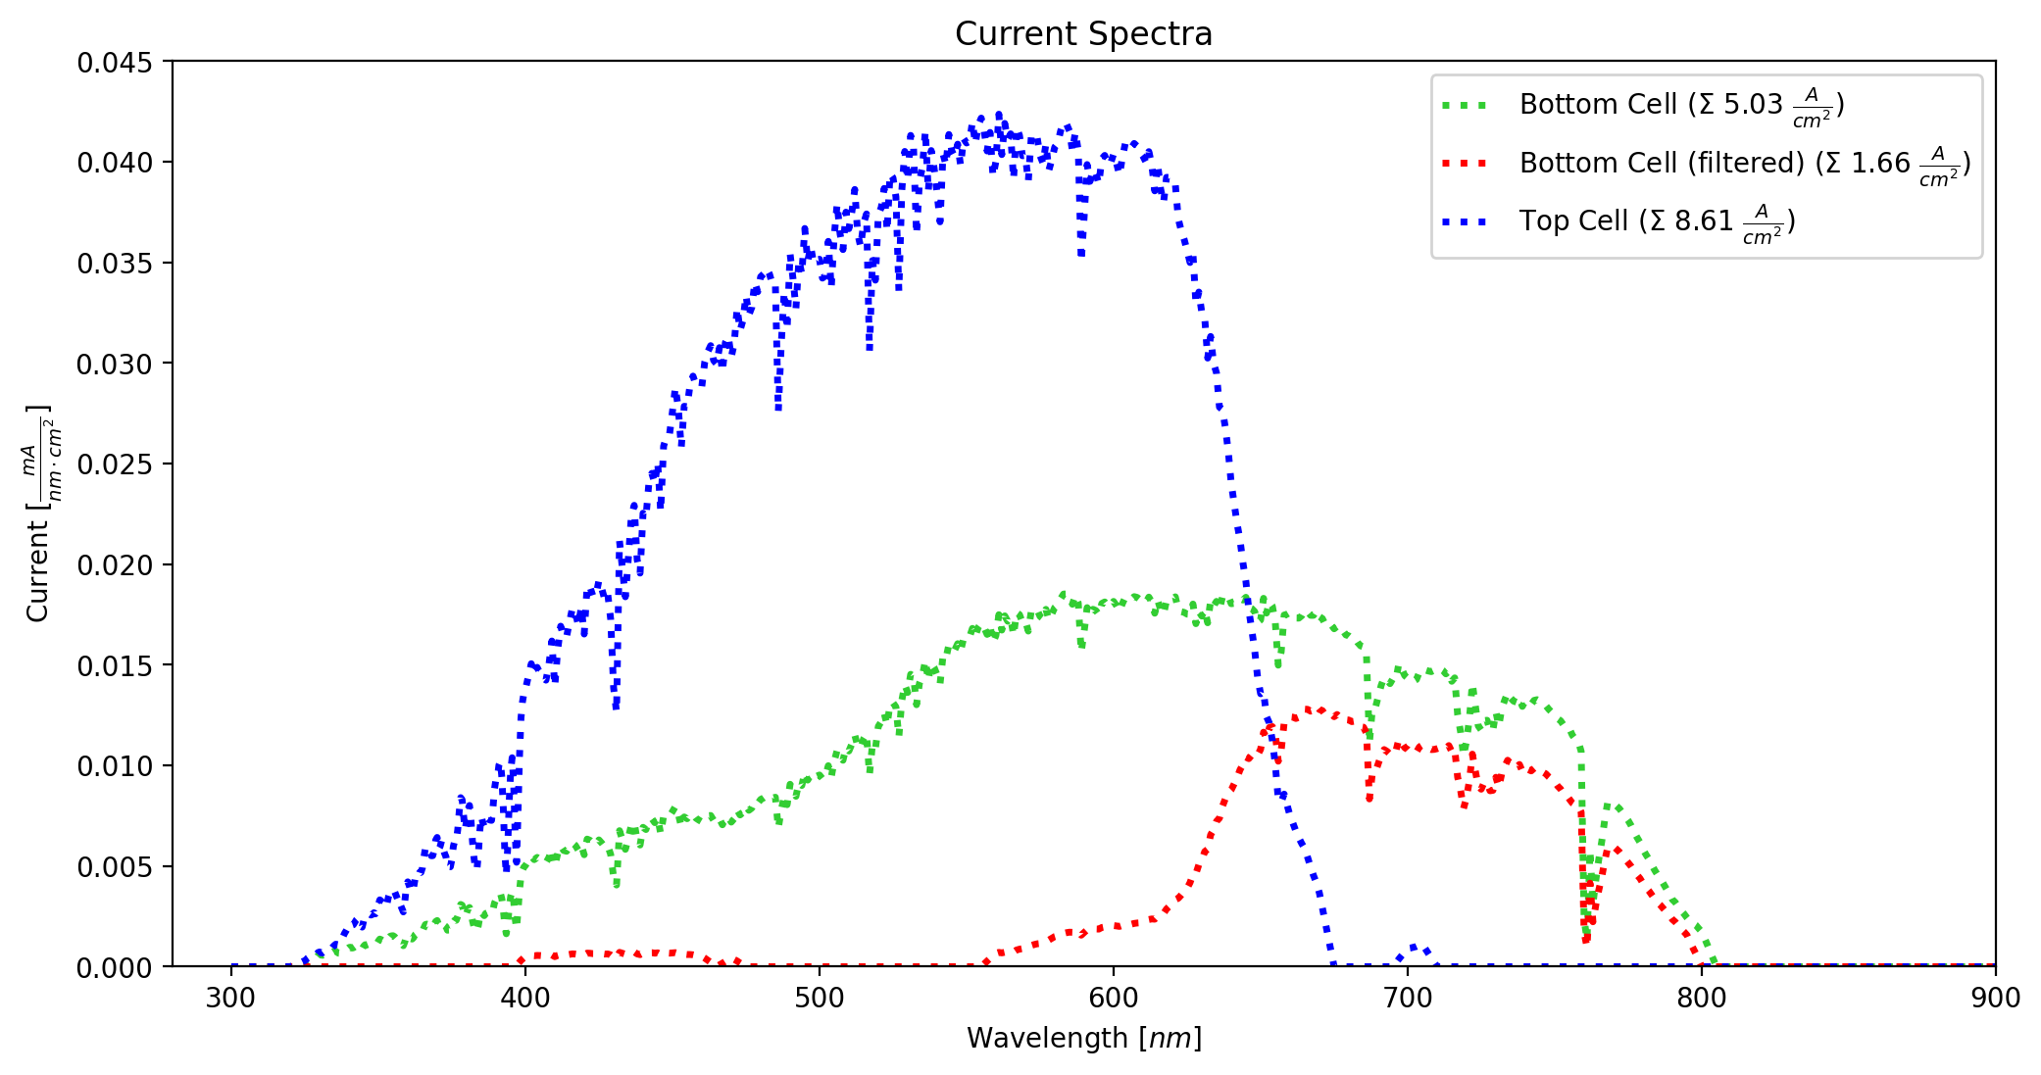
Step 2: EQE

Slide 6
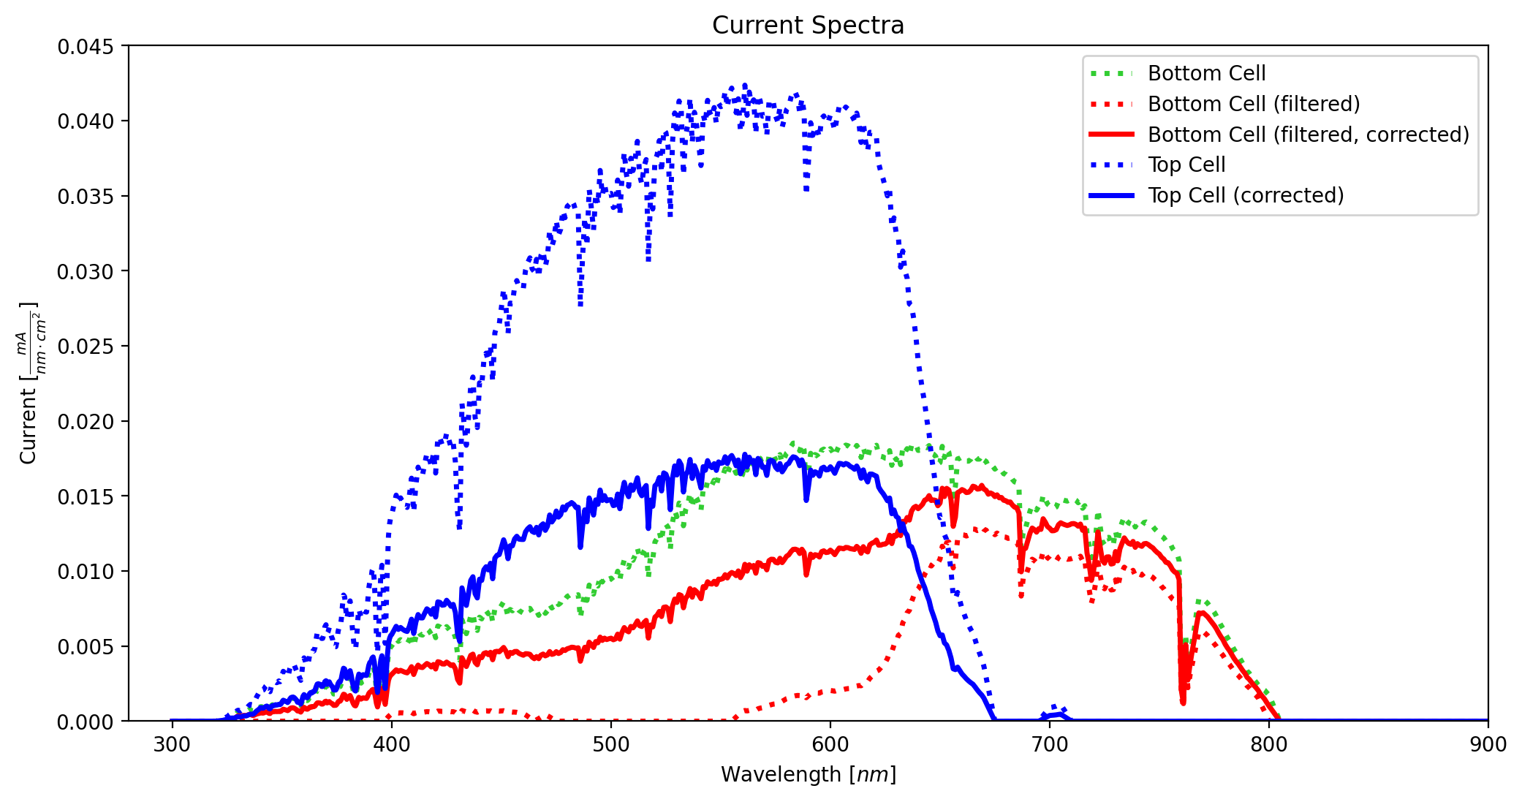
Step 3: Scale Thickness Appropriately

Slide 7
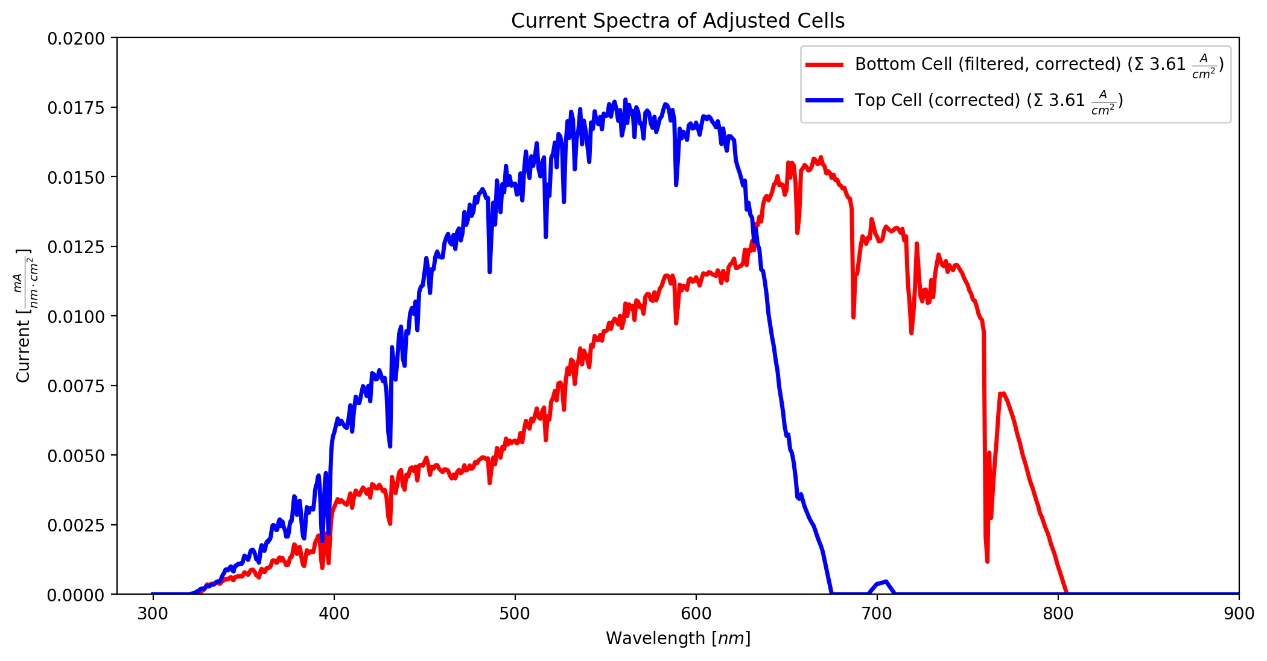
Step 3: Scale Current Appropriately

Slide 8
Part 2: JV-Analysis
Task: Apply the correction factor to JV-Curves, discuss the effect on VOC, JSC, FF
Given data:
  JV-Curves of the uncorrected cells

Slide 9
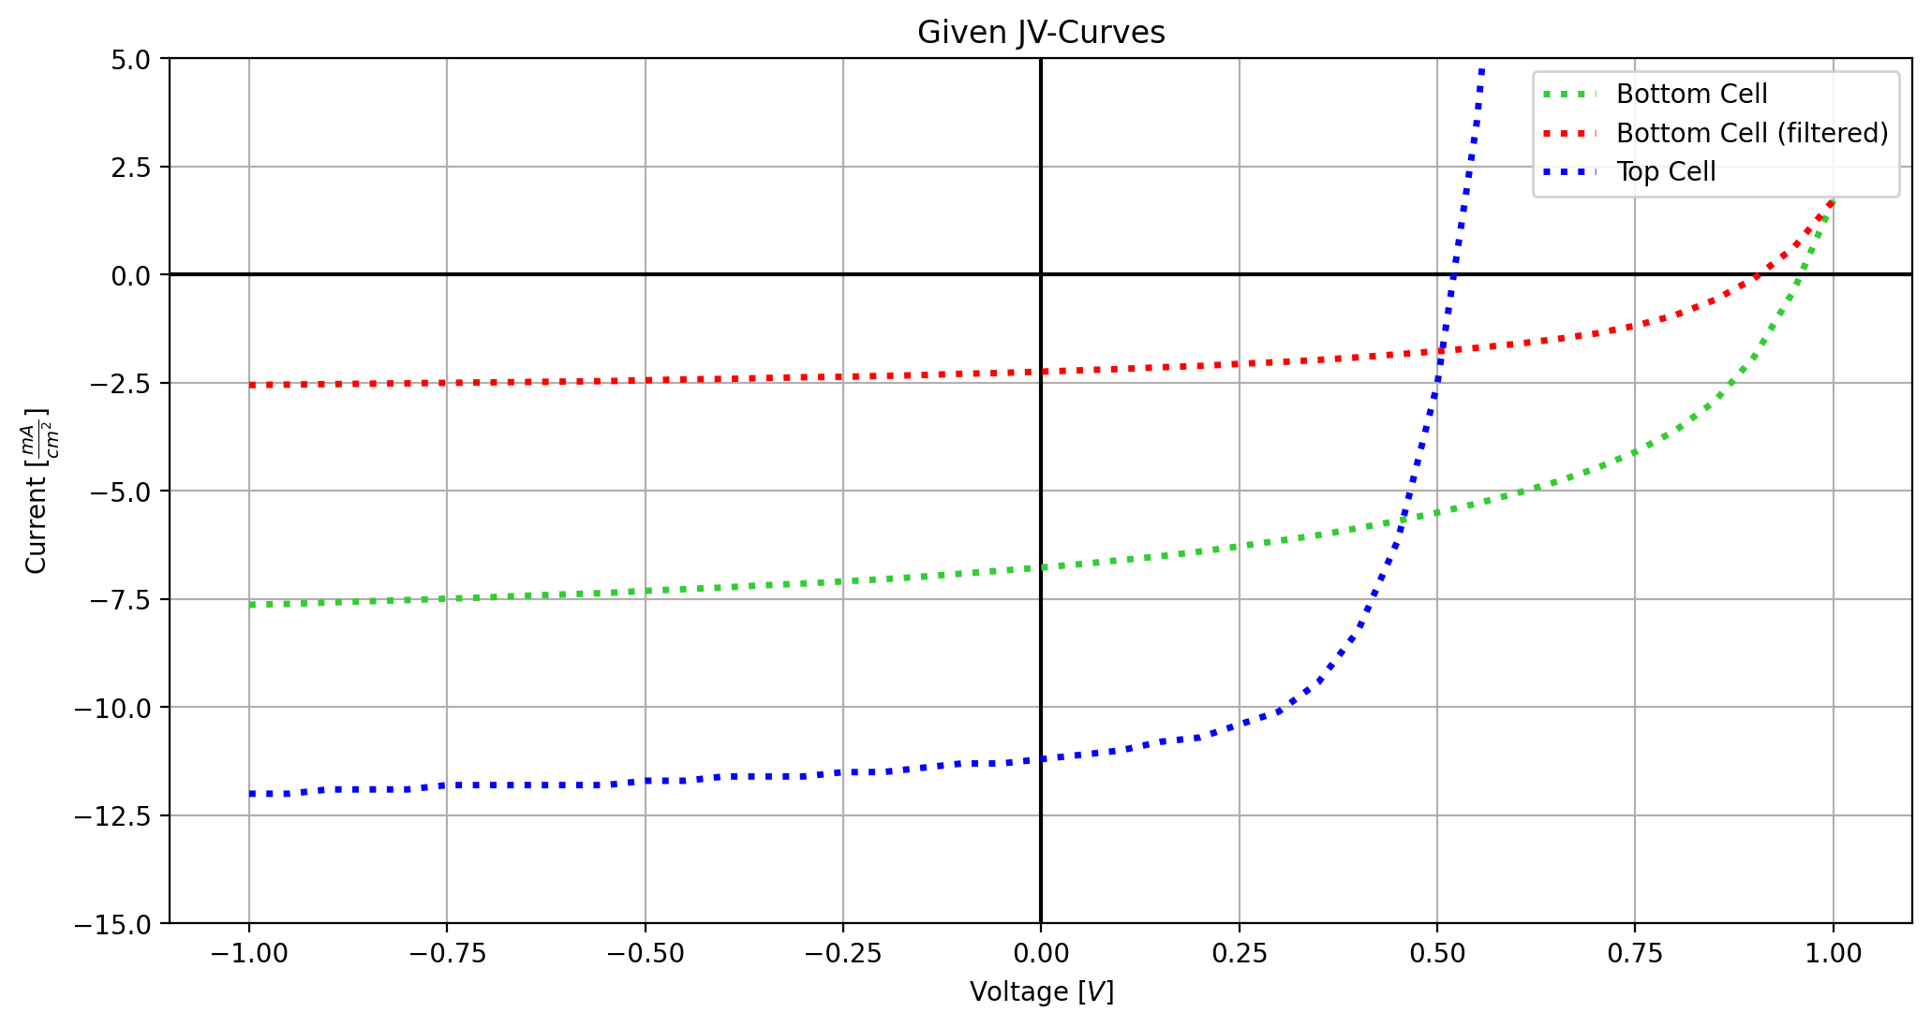
Given Data

Slide 10
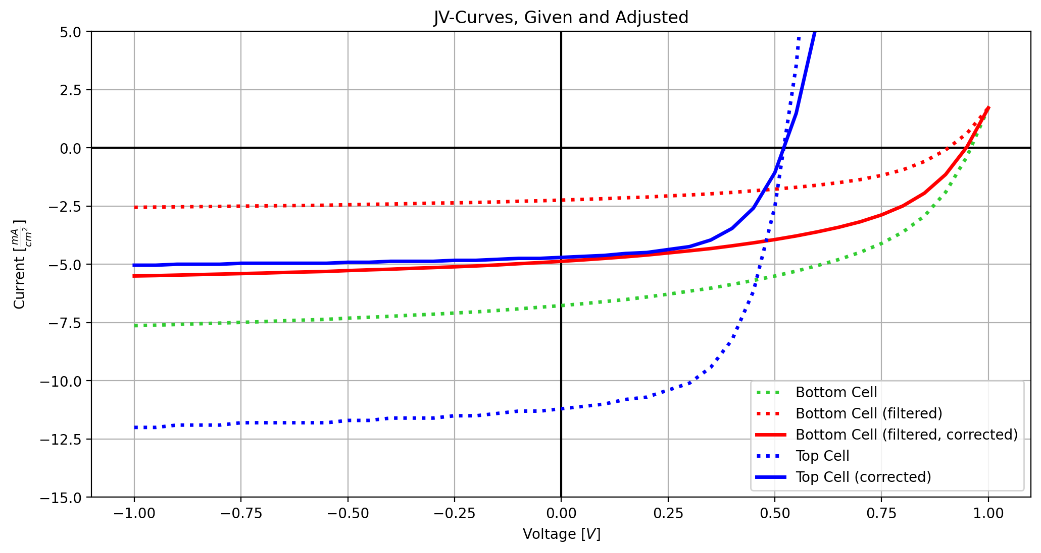
Step 1: Adjust JV-Curves

Slide 11
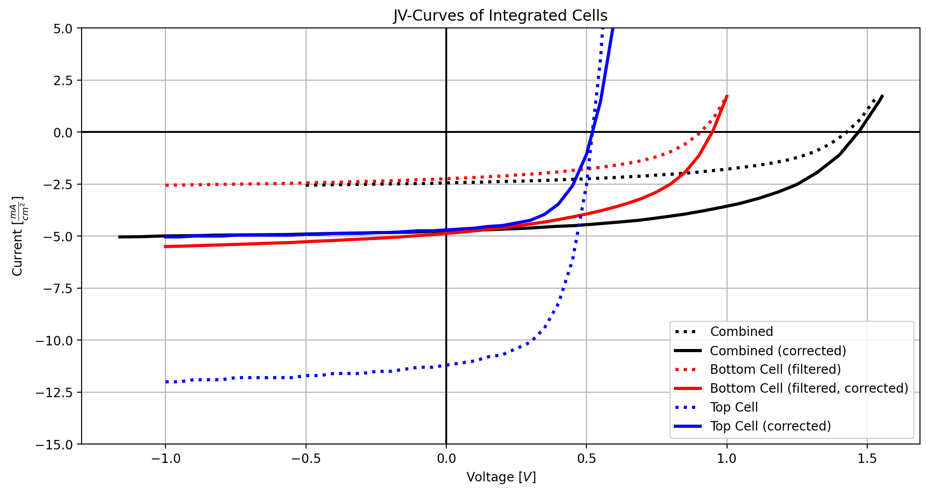
Step 2: Combine JV-Curves

Slide 12
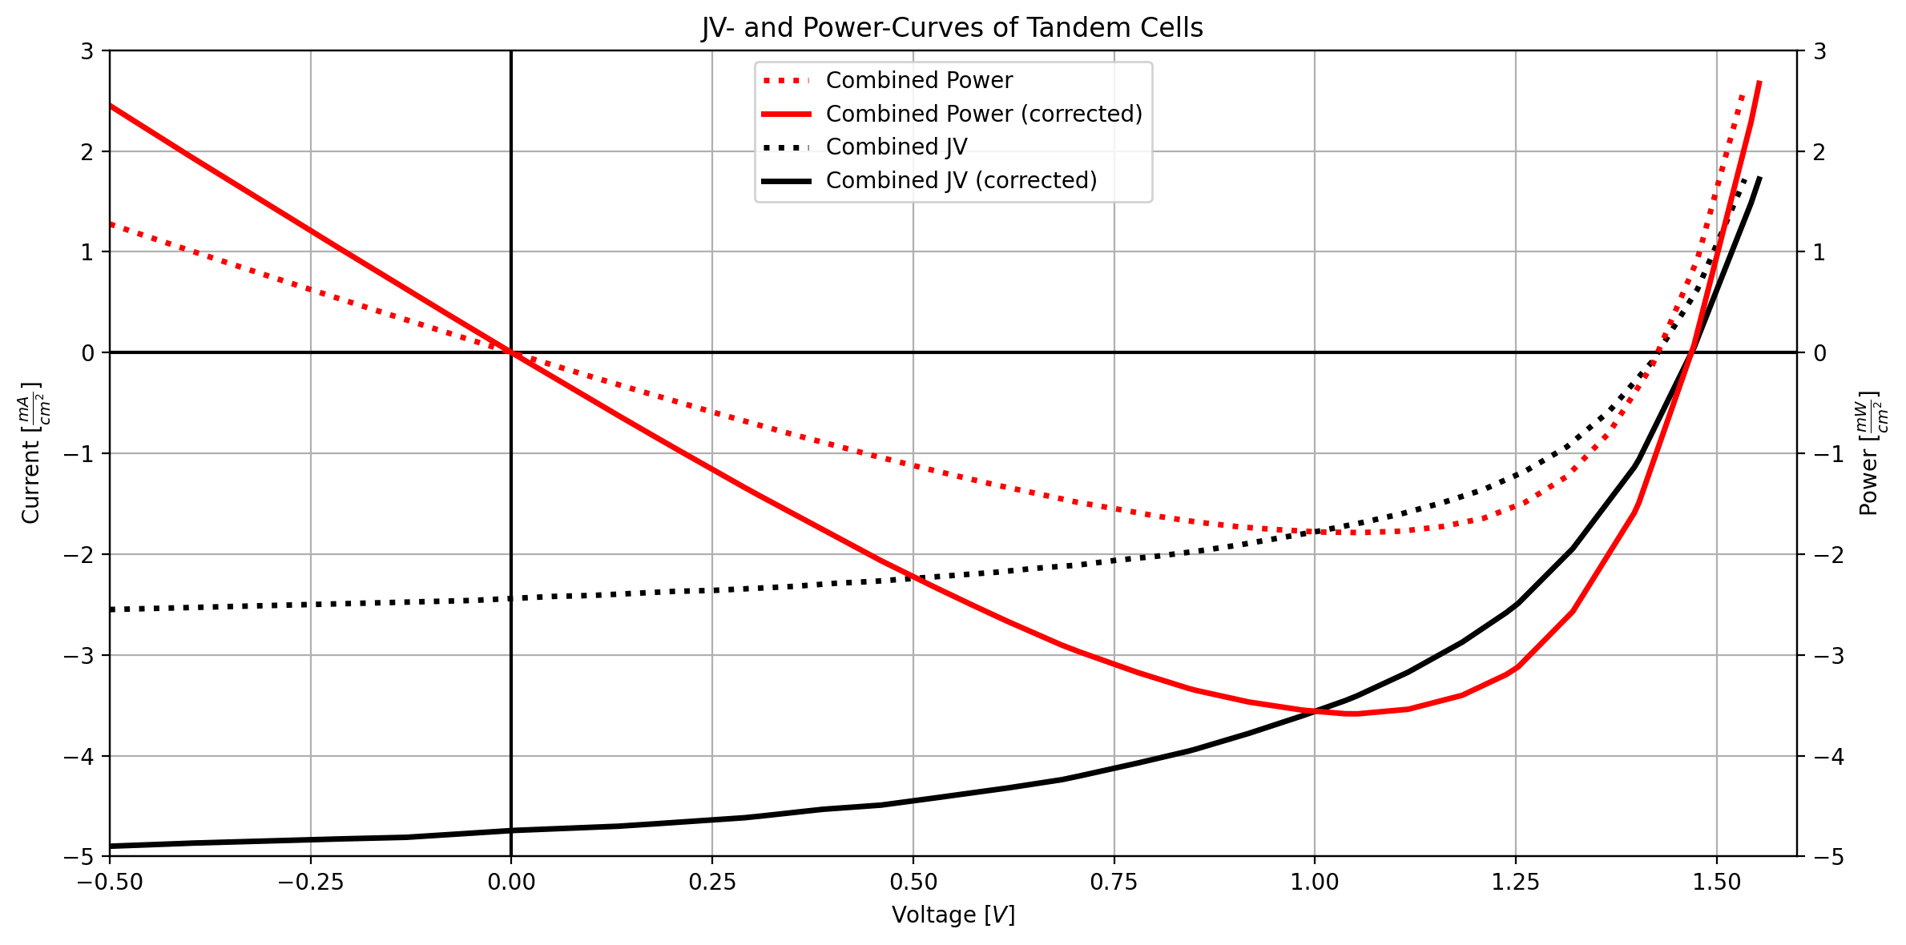
Step 3: Calculate Peak Power

Slide 13
Results
 | Initial Cells | Adjusted Cell
FF | 0.51 | 0.51
VOC [V] | 1.43 | 1.47
JSC [mA/cm²] | 2.44 | 4.74
Peak Power [mW/cm²] | 1.79 | 3.58

Slide 14

Step 1: Solar Spectrum to Current Spectrum

