Slide 1

Remote access
Julian Keller Ben Eavenson Tyler Higgins Austin Cari

Slide 2
Topics that our project covers
This project covers a few different vulnerabilities and combines them together to create a devastating access point onto any Linux computer with a Bash shell and crontab installed.
Crontab/Bash: We can create a reverse shell on a victim’s machine without the user detecting any odd or suspicious behavior. We also use other Linux utilities like crontab to execute our payload every minute.
Malicious site/Deauth: A flavor of Man-in-the-middle attacks, deauthorization are able to to kick devices off a network and make them automatically connect back onto a spoofed network, where traffic is redirected to a malicious webpage that downloads our shellshock script onto the user’s device.

Slide 3
Malicious site
Social engineering approach to infiltrating a device. Rely on the impatience and ignorance of users to click on untrusted links and buttons.
This approach is used in combination with attacks like a man-in-the-middle attack. When a device wants to reach an IP address like 192.168.0.1, the attacker can redirect traffic to their own locally hosted webpage instead.
This is an effective approach because if traffic is managed carefully enough, the victim will not even realize that their device has become compromised. If they try to use a login prompt and enter another webpage, the attacker can log their keystrokes, stealing their credentials, and still redirect them to their desired page with ease.
This is also a way to farm credentials from users who enter their actual passwords.

Slide 4
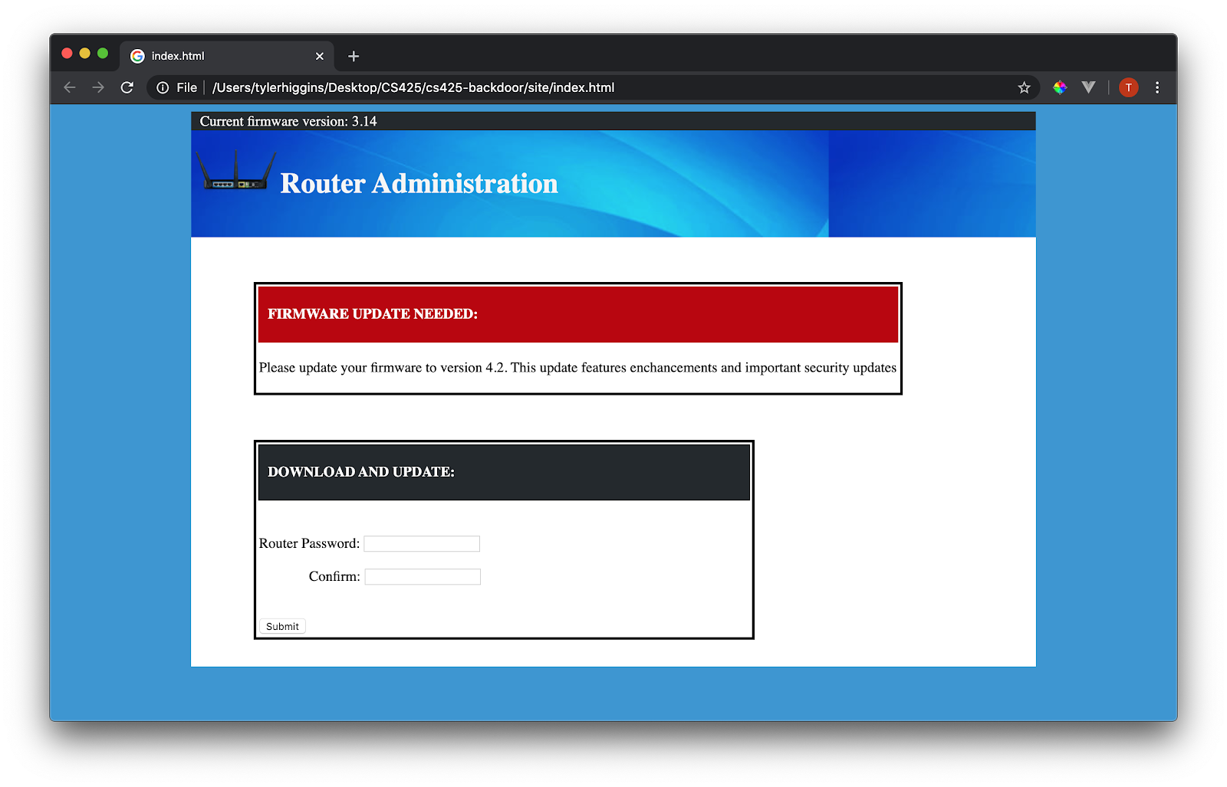
Malicious site example

Slide 5
Setting up the page is a chore
The steps are split up into 6 different shell scripts, each performing a crucial task
setup.sh – Only needs to be executed the first time. Essentially works like a dependency manager, makes sure all the right software is downloaded on the attacker’s computer.
launch-ap.sh – Use a wireless LAN adapter as an access point that can transmit wifi.
bridge.sh – bridges our evil twin to another network with internet access.
startserver.sh – Start an Apache server that hosts the Captive Portal webpage
spoof.sh – sets up and runs a program to begin DNS spoofing on our network.
deauth.sh - performs a deauthorization attack on the access point specified by the MAC address given to BSSID
These scripts can be combined together into a single script to help reduce the complexity for end-users, and even accept a few optional parameters, like the name of the network you would like to spoof, the MAC address you would like to use, etc.

Slide 6
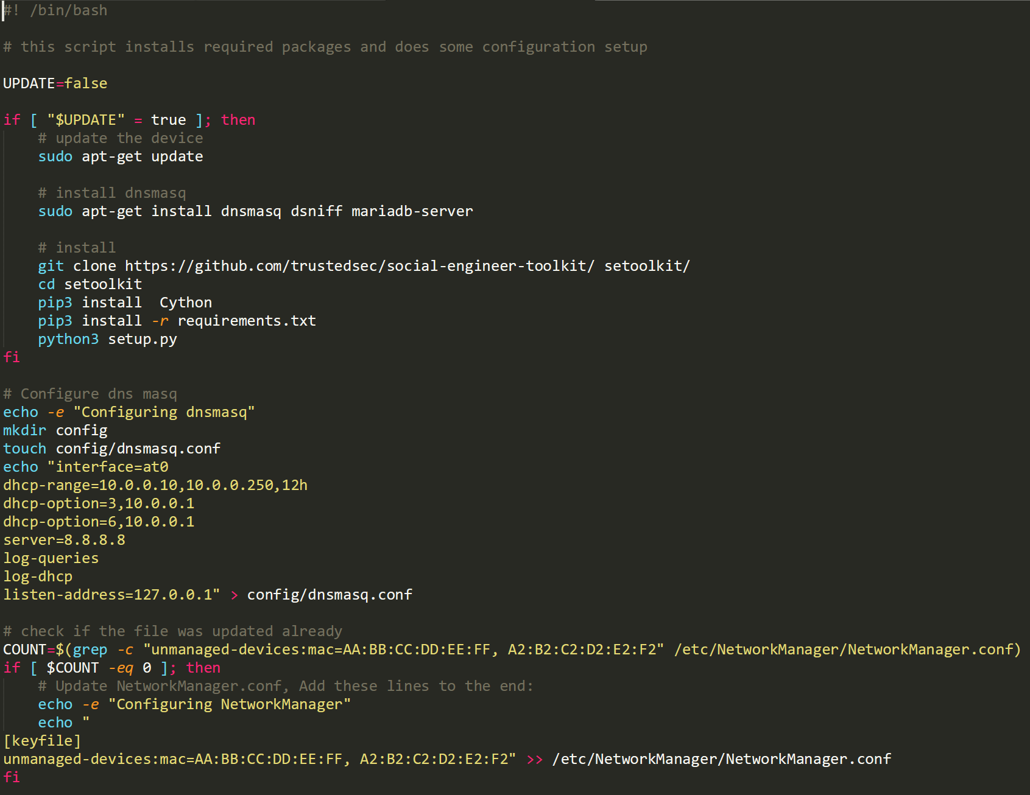
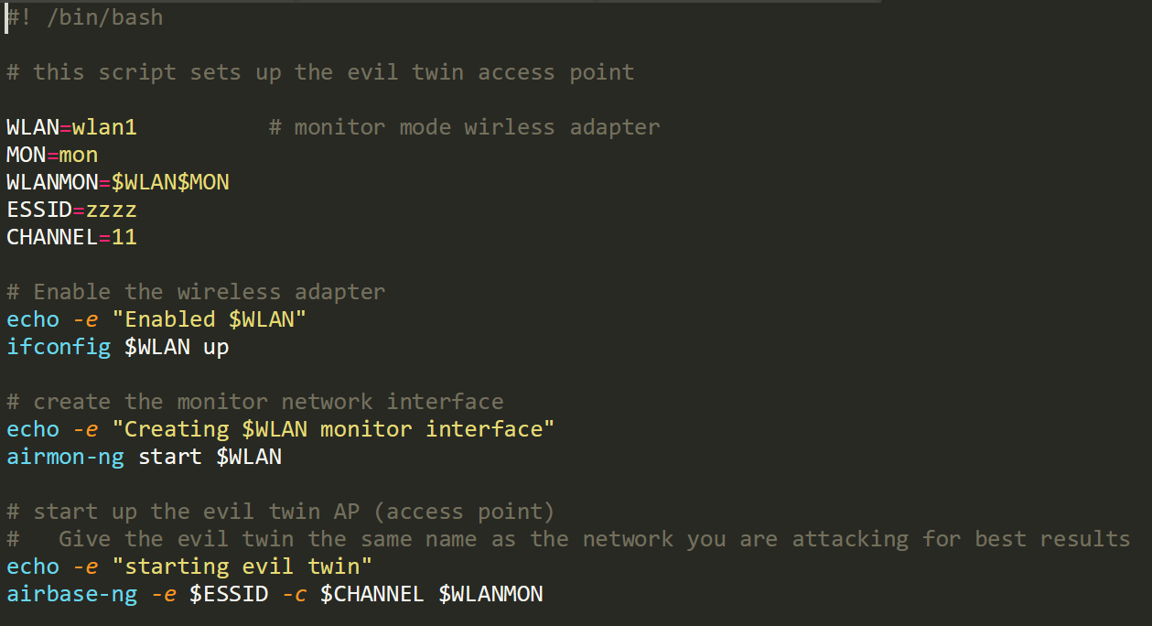
setup.sh
launch-ap.sh

Slide 7
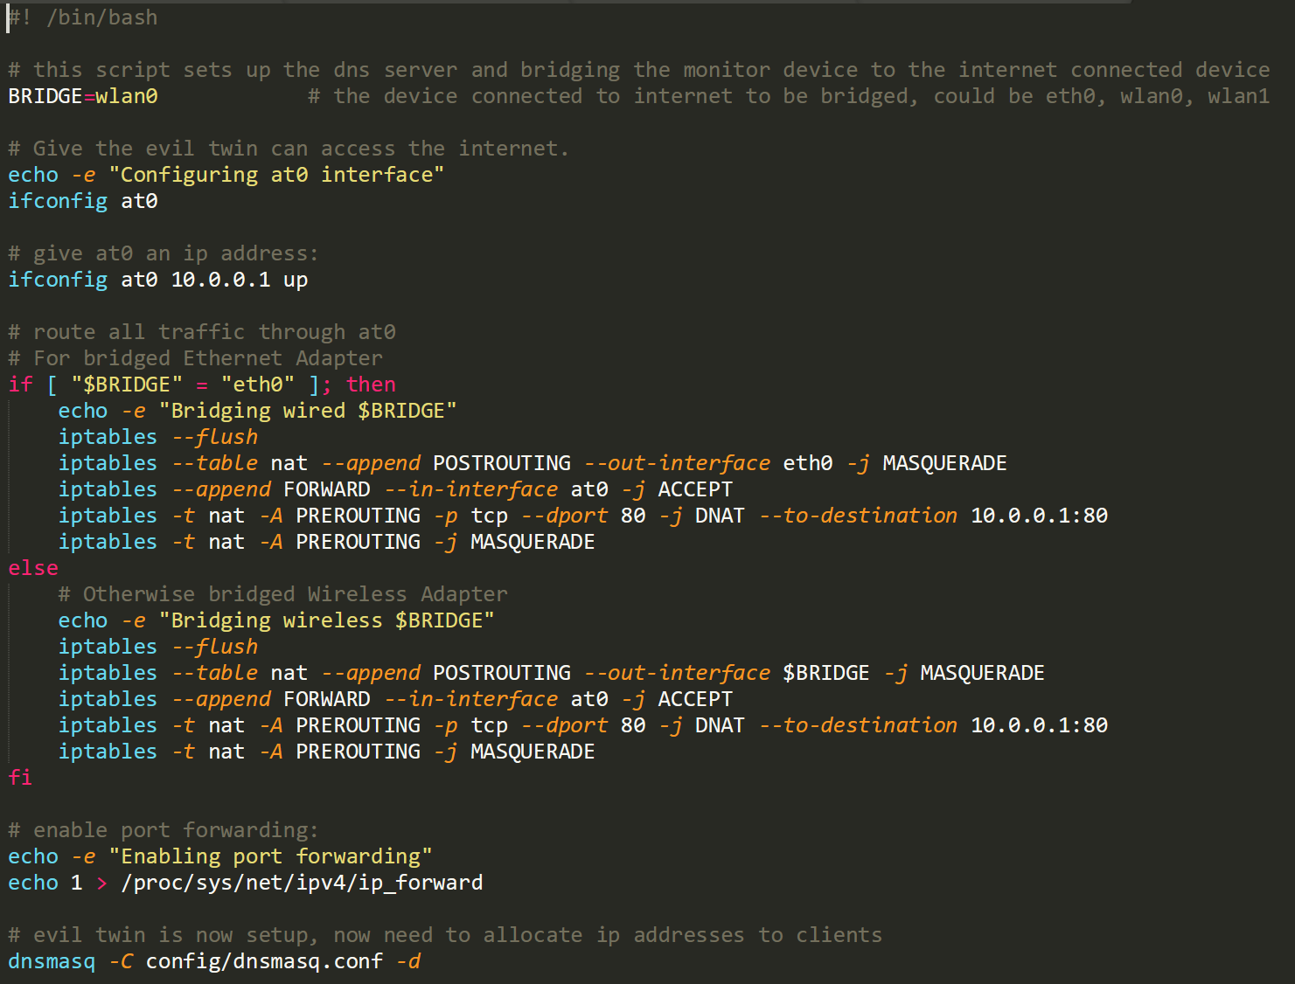
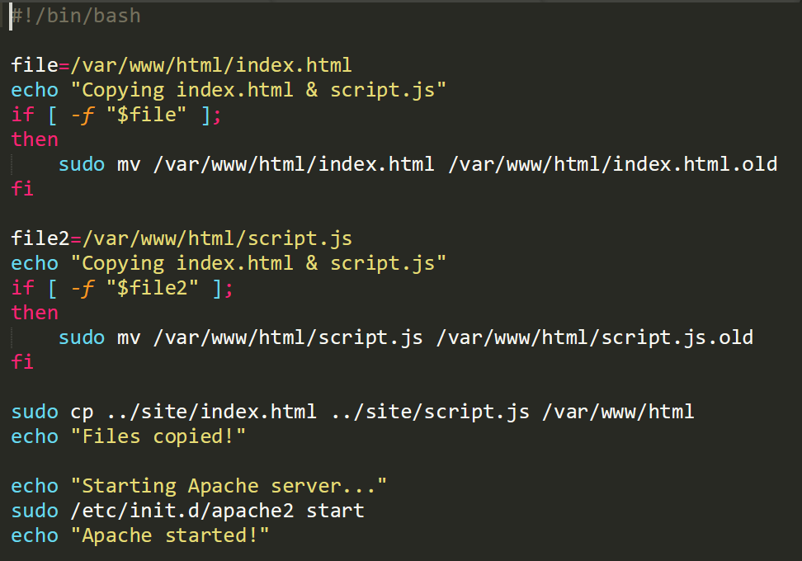
bridge.sh
startserver.sh

Slide 8
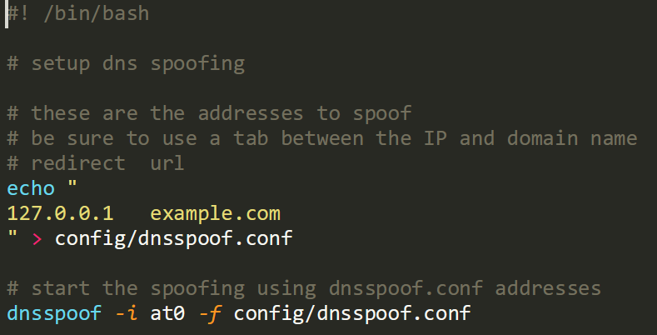
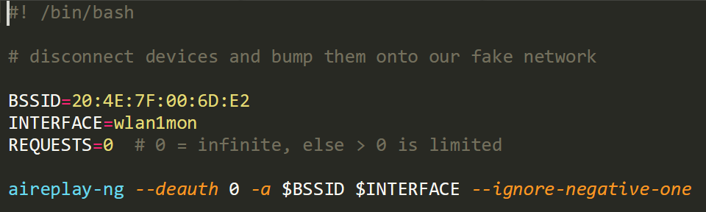
spoof.sh
deauth.sh

Slide 9
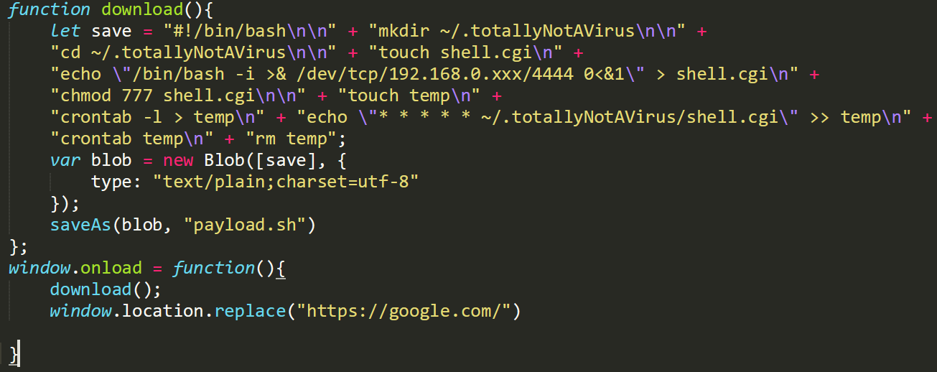
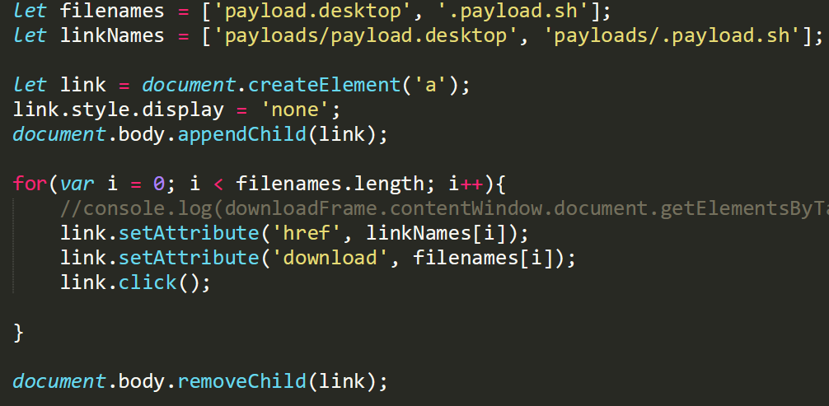
Now we can deliver our payload over JavaScript
In order to achieve some sense of anonymity, we quickly download the shellshock script and redirect the user to the real Google landing page. This process happens in a matter of seconds, so while an attentive user might notice, a distracted or misinformed user might miss it.

Slide 10
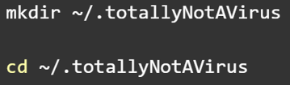
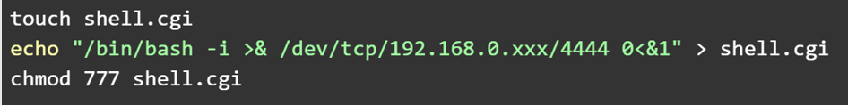
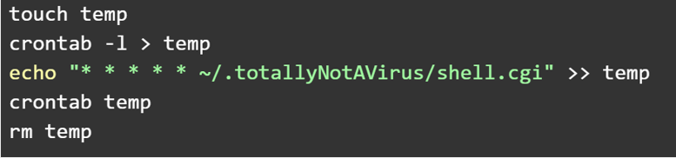
Payload contents explanation
Step 1:
Create a hidden directory and work inside the new dir
Create the file shell.cgi. Echo the payload and redirect the output to shell.cgi. Give it all permissions.
Step 2:
Create a temporary file and store a crontab command there to execute the payload every minute. Then redirect the file as stdin to crontab. remove the temporary file.
Step 3:

Slide 11
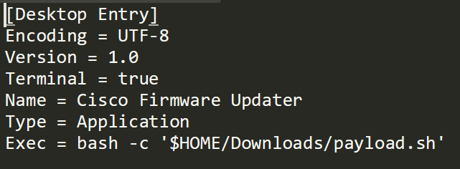
Getting the payload to run
This is where we run into trouble. We created this which is essentially a desktop shortcut where the script will run. We want to store the file on the desktop so the user sees it and has a higher probability of running our script.

Slide 12
How to gain entry using the backdoor
All the attacker has to do now is listen on the port 4444 using netcat. The victim’s machine will ping the attacker’s machine, and the shell switches over to kali, exactly as if you were to ssh into the machine.
Blocks here until the compromised machine runs the script again

Slide 13
Limitations
This technique doesn’t open a shell with root access unless the user we hacked into has root access on their machine.
The user must also have permissions on the computer to be able to create and edit their own crontabs so that the payload can be executed automatically every minute.
This will only work if the computers are connected to the same network, not over the internet. It is the only way to intercept their traffic and redirect them to the spoofed website.
The attacker does not gain access immediately. They must rely on social engineering tactics and wait for the user to run their script from the desktop first. In some cases, they may not run the script at all.
Our payload leaves the IP address of our computer on the victim’s machine. If a forensics investigator were to find that file, they might be able to track the IP address back to the attacker.

Slide 14
Protecting yourself
1. Turn off Wi-Fi capabilities when you’re not using them
2. Avoid open Wi-Fi networks if possible
Anyone can connect to these networks. They are unmonitored and no one is watching.
3. Use a VPN
Your data will be encrypted and your location will be secure
4. Do not leave obsolete devices connected to networks
Interestingly, when you can get the MAC address of a single device, you can see the MAC addresses of all devices connected to that device. The less devices on your network, the better.
5. Change your passwords often
Keep 3-5 unique passwords or a password generator.
6. Don’t click on suspicious links/buttons
7. Listen to warnings your device gives you. They’re probably for a good reason

Slide 15


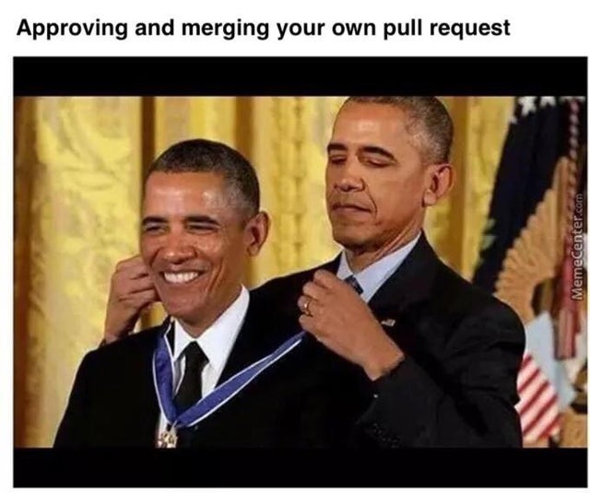
Thank you!

