Slide 1
Analgesia Predictor Summary
Updated preprocessing, metrics, and figures

Slide 2
Split Characteristics (Table 1)
Split | n | Outcome % | Age mean (SD) | Female patients % | Female physicians % | VAS_on_scene mean (SD) | NACA mean (SD)
Training | 3307 | 32.2% | 46.8 ± 19.4 | 39.6% | 45.5% | 6.9 ± 1.7 | nan
Validation | 827 | 32.2% | 46.6 ± 19.3 | 41.1% | 47.0% | 6.8 ± 1.8 | nan
Testing | 1034 | 32.2% | 45.3 ± 18.9 | 40.6% | 44.3% | 6.9 ± 1.8 | nan

Slide 3
Model Performance by Split
Model | Split | Roc Auc | Pr Auc | Average Precision | Accuracy | Precision | Recall | F1 | Brier
Logistic Regression | Training | 0.800 | 0.652 | 0.653 | 0.721 | 0.549 | 0.742 | 0.631 | 0.185
Logistic Regression | Validation | 0.676 | 0.477 | 0.479 | 0.644 | 0.459 | 0.594 | 0.518 | 0.224
Logistic Regression | Testing | 0.669 | 0.453 | 0.455 | 0.633 | 0.451 | 0.637 | 0.528 | 0.232
XGBoost | Training | 0.926 | 0.862 | 0.862 | 0.834 | 0.694 | 0.867 | 0.771 | 0.137
XGBoost | Validation | 0.718 | 0.543 | 0.544 | 0.675 | 0.495 | 0.583 | 0.535 | 0.203
XGBoost | Testing | 0.719 | 0.529 | 0.530 | 0.667 | 0.487 | 0.604 | 0.539 | 0.206

Slide 4
Cross-validation Summary
Model | Metric | Mean | Std
Logistic Regression | ROC AUC | 0.659 | 0.014
Logistic Regression | Average Precision | 0.474 | 0.030
XGBoost | ROC AUC | 0.701 | 0.007
XGBoost | Average Precision | 0.528 | 0.025

Slide 5
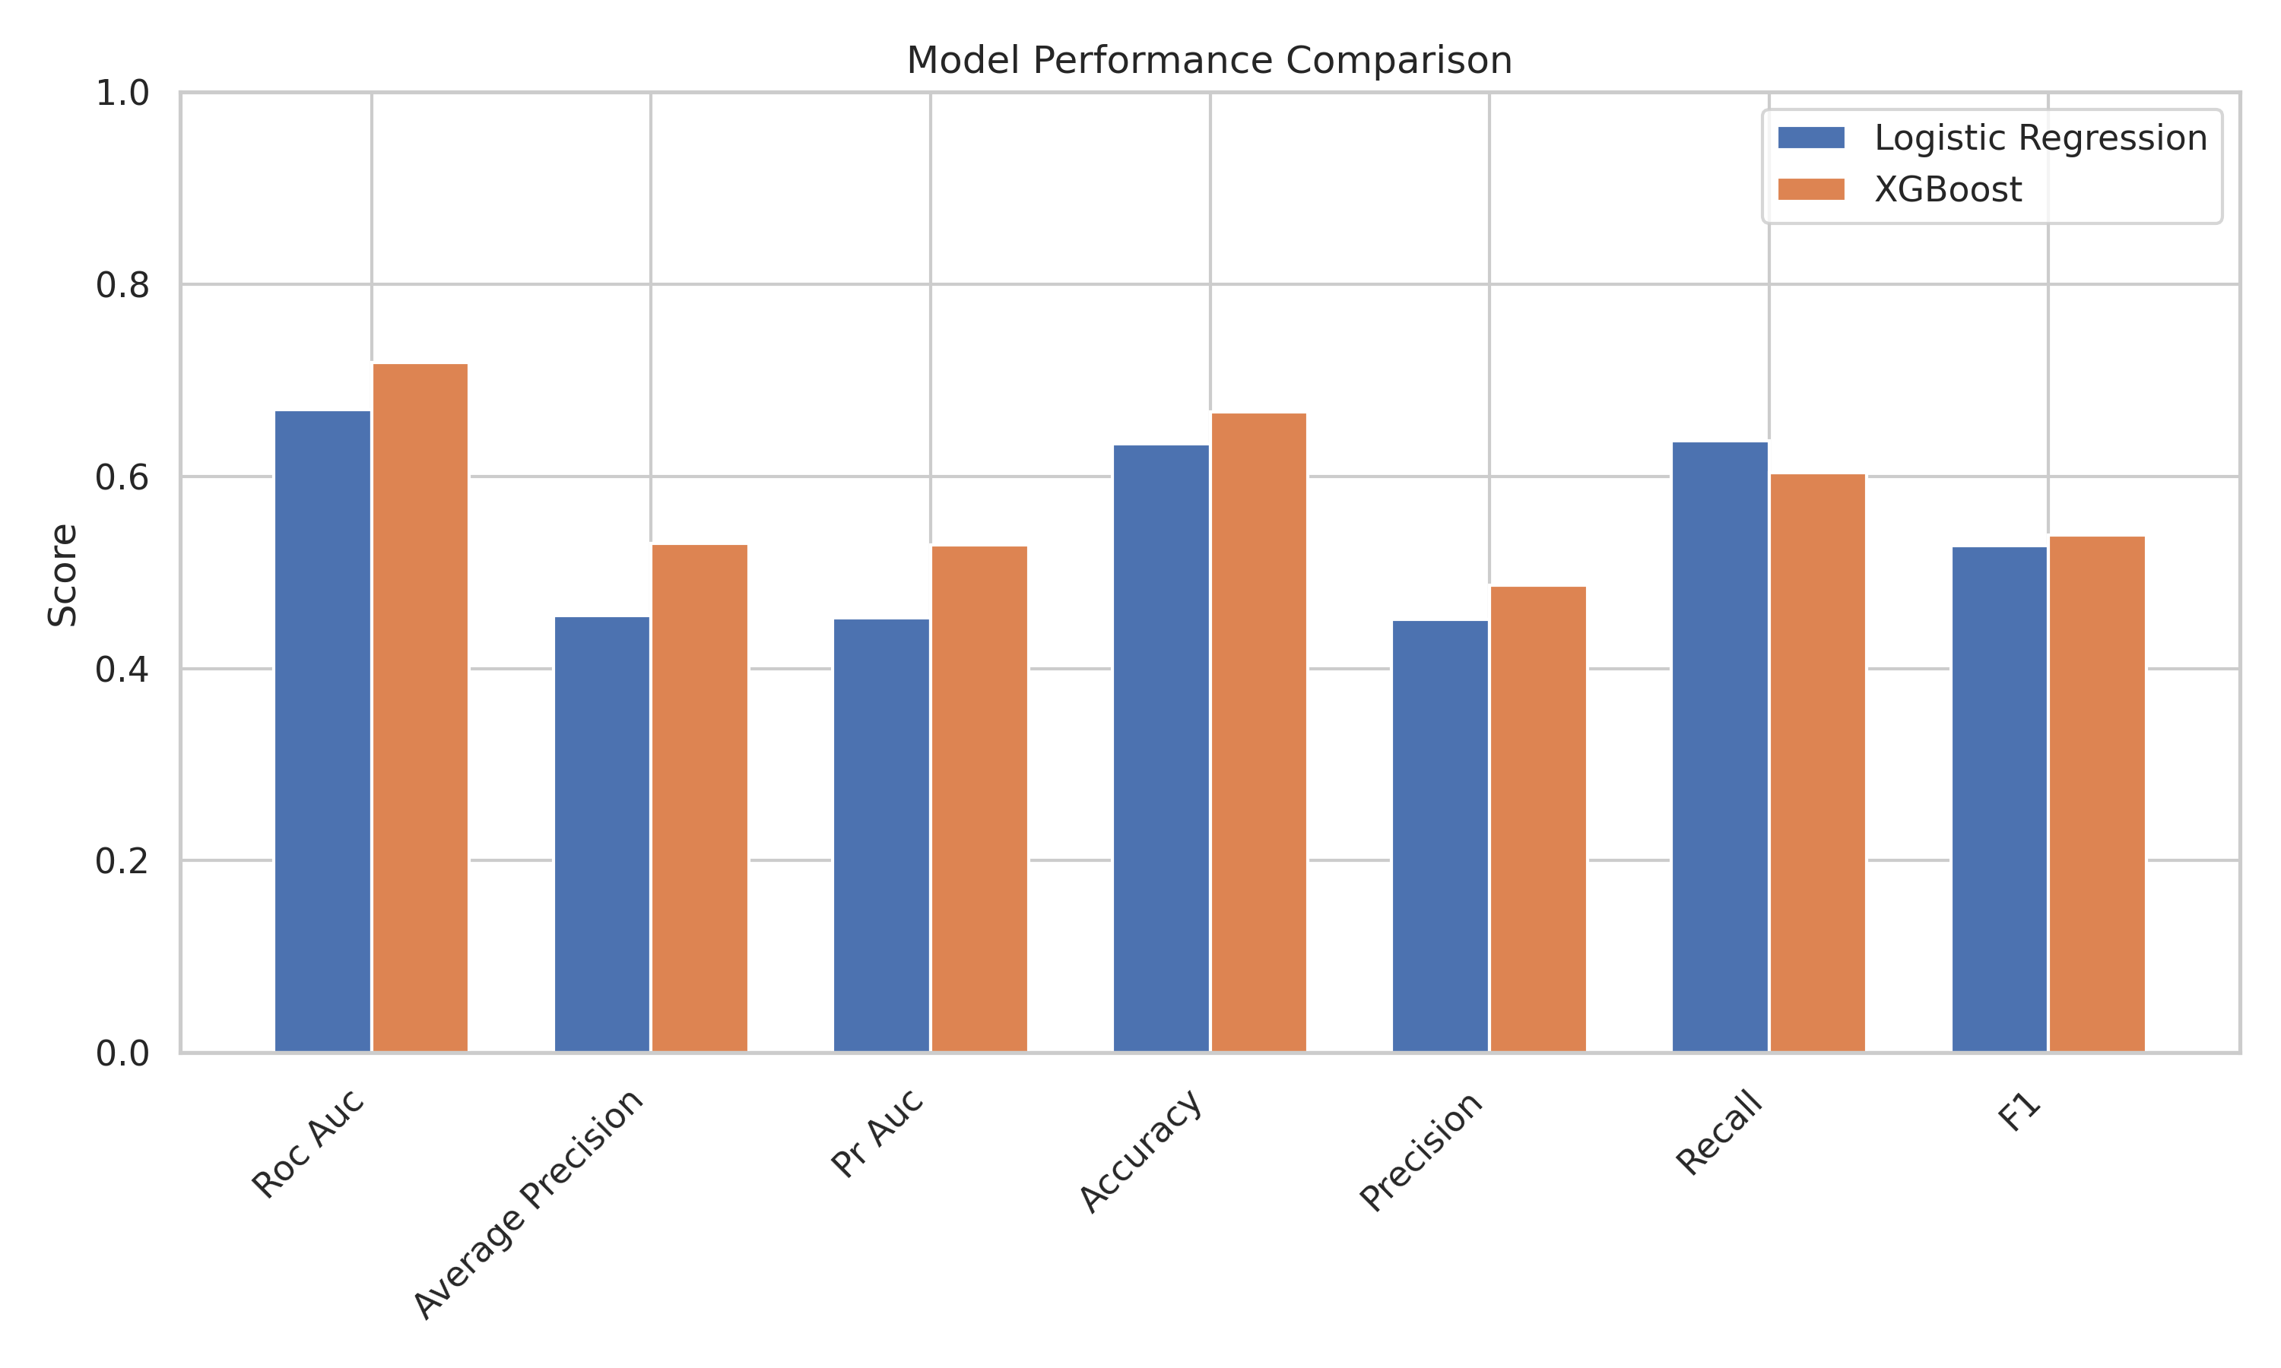
Metric Comparison

Slide 6
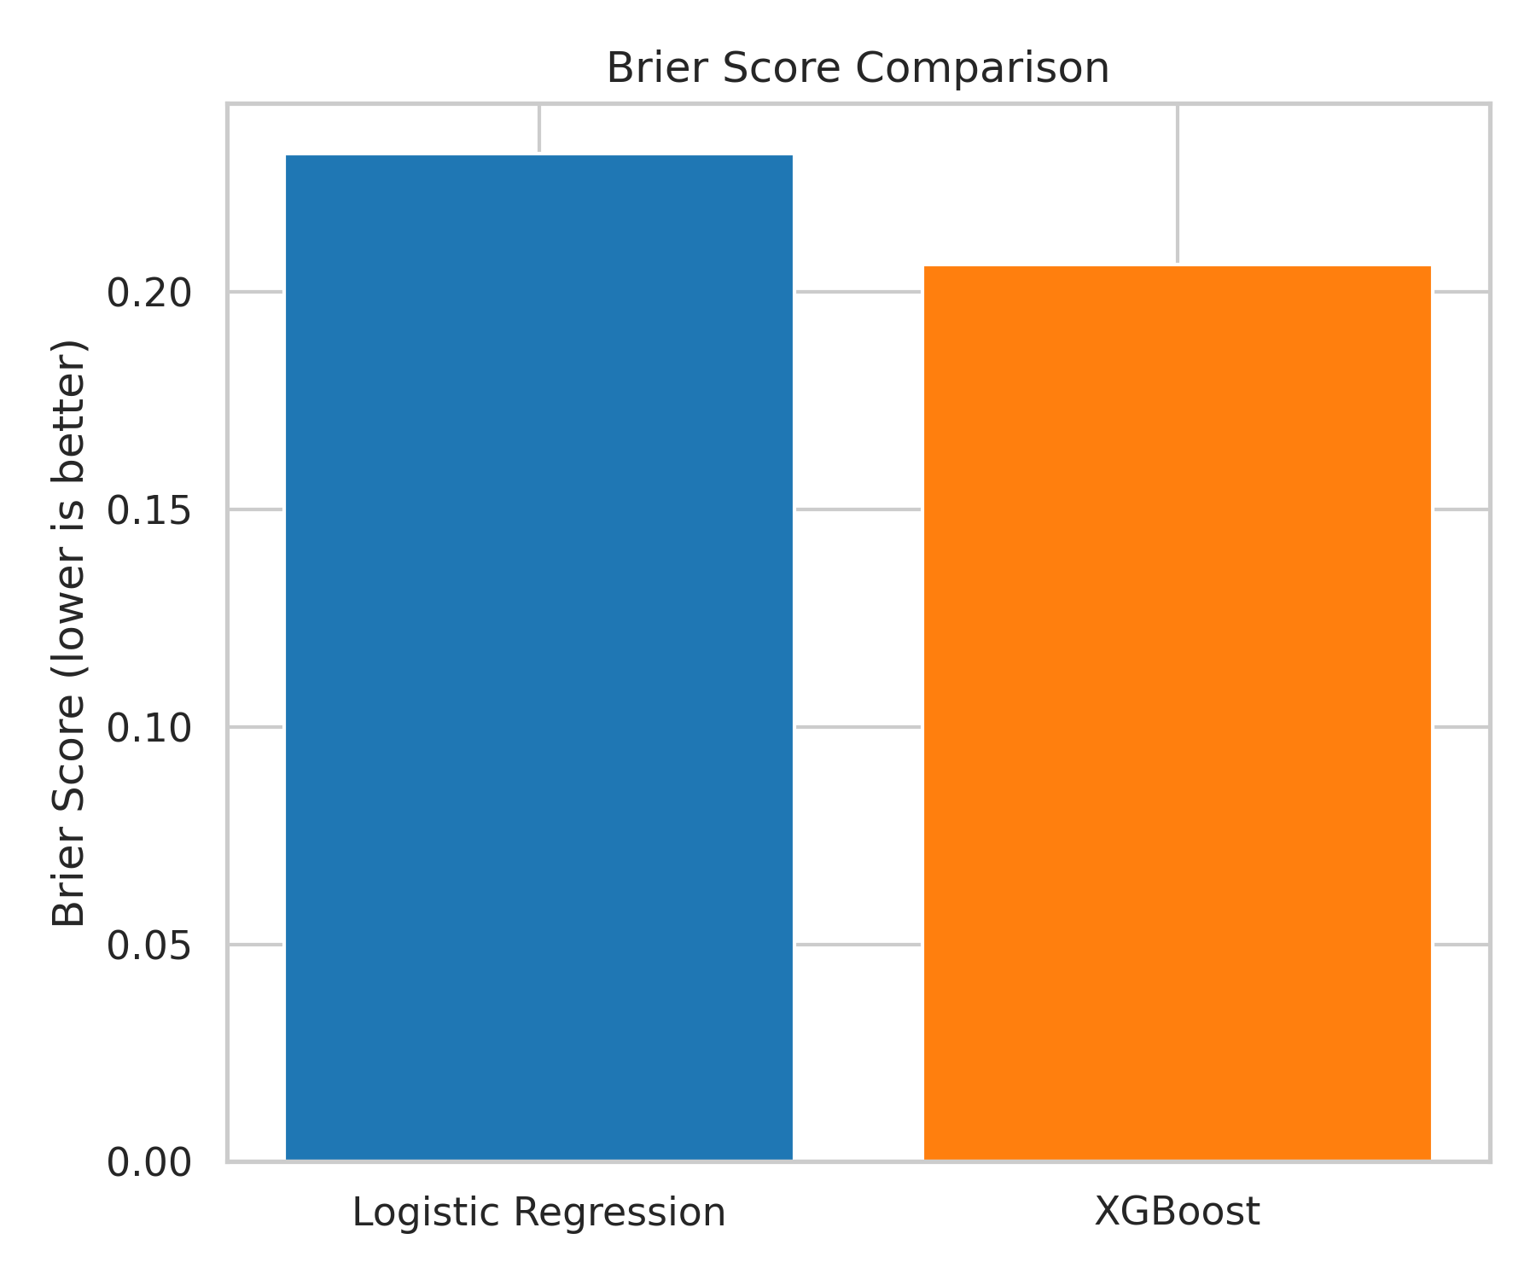
Brier Score Comparison

Slide 7
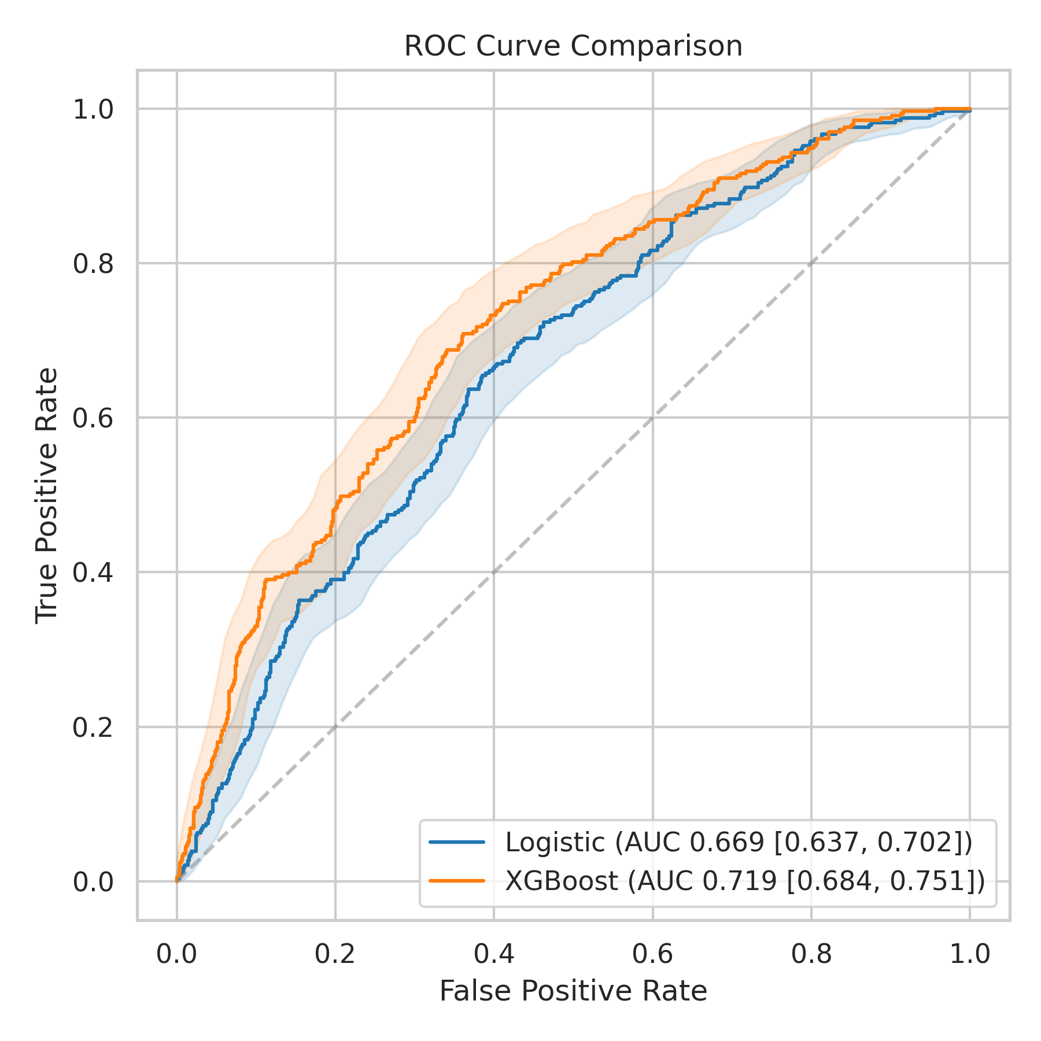
ROC Curve Comparison

Slide 8
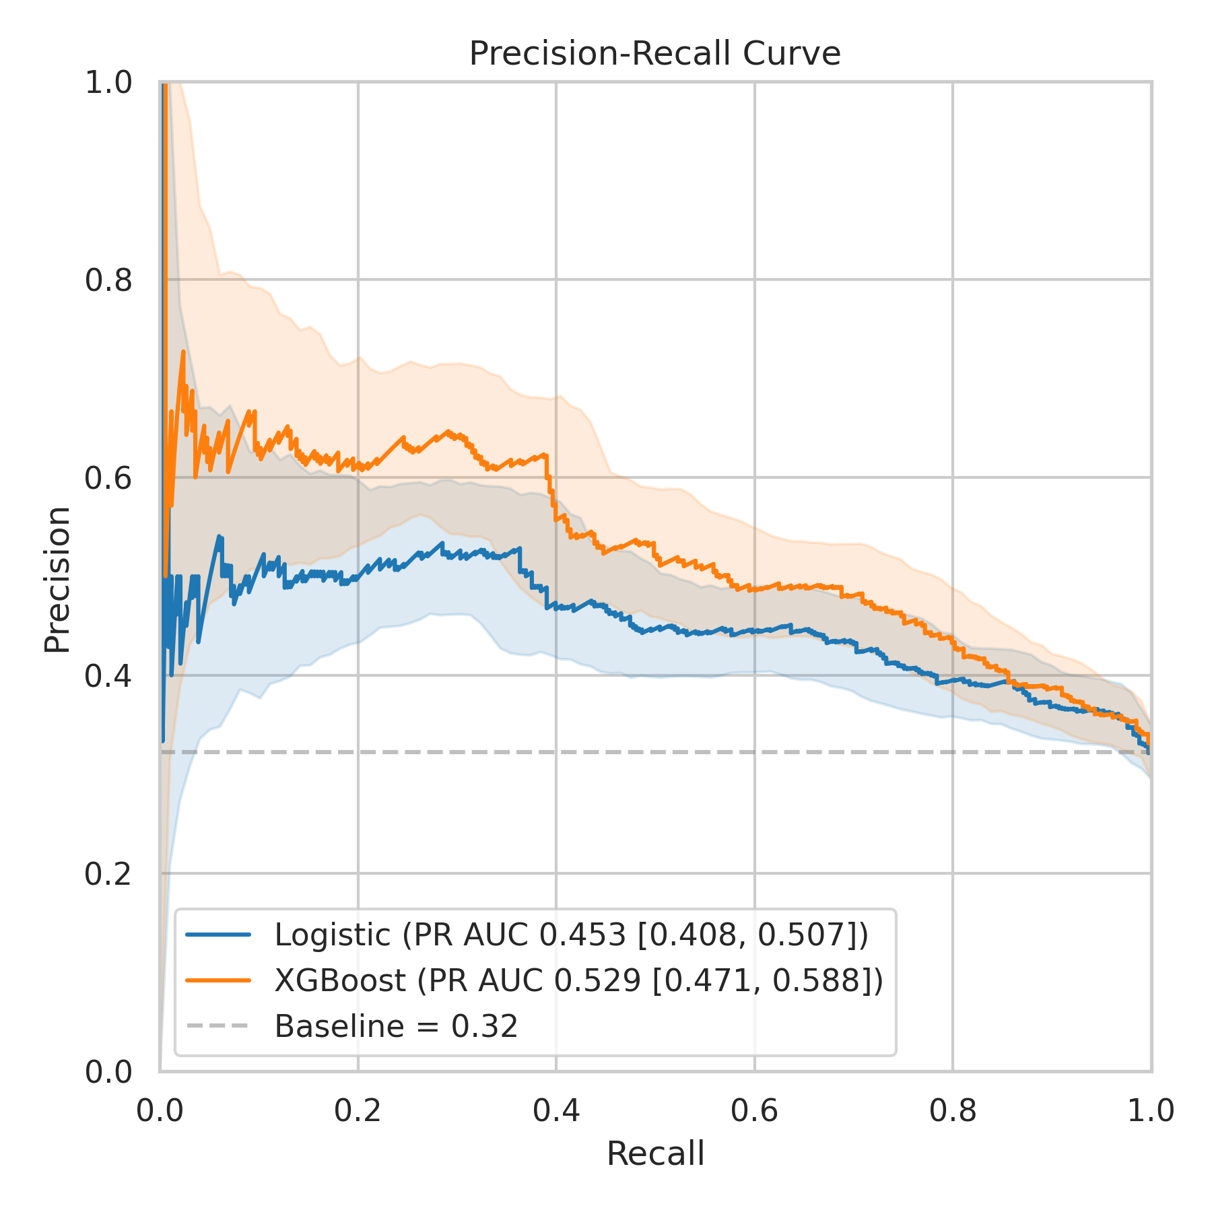
Precision-Recall Curve

Slide 9
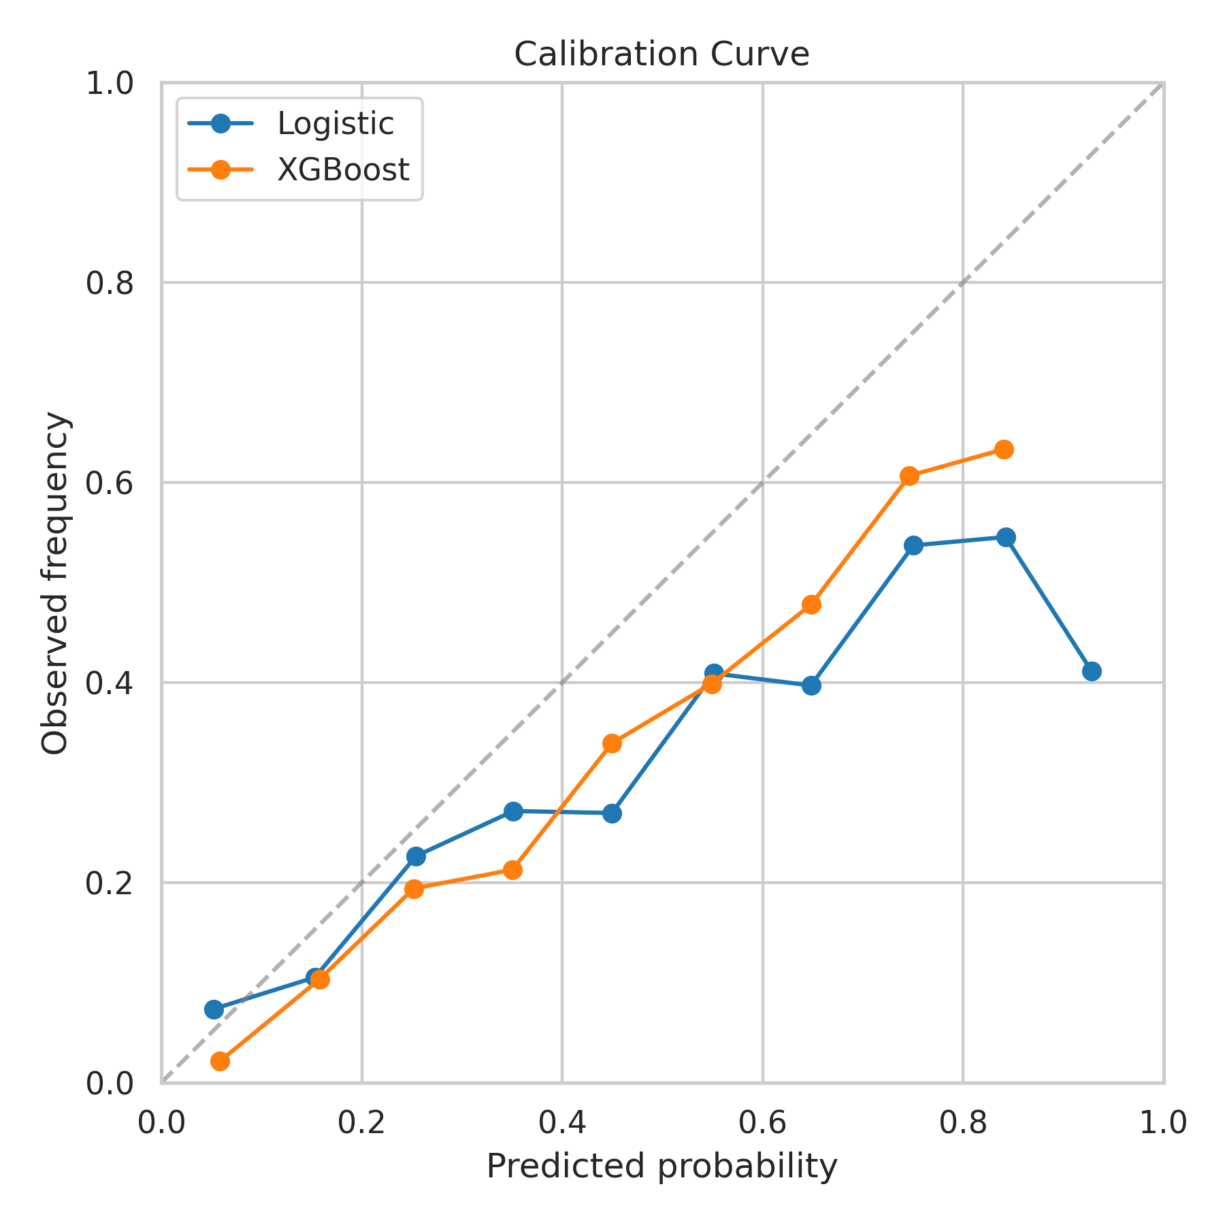
Calibration Curve

Slide 10
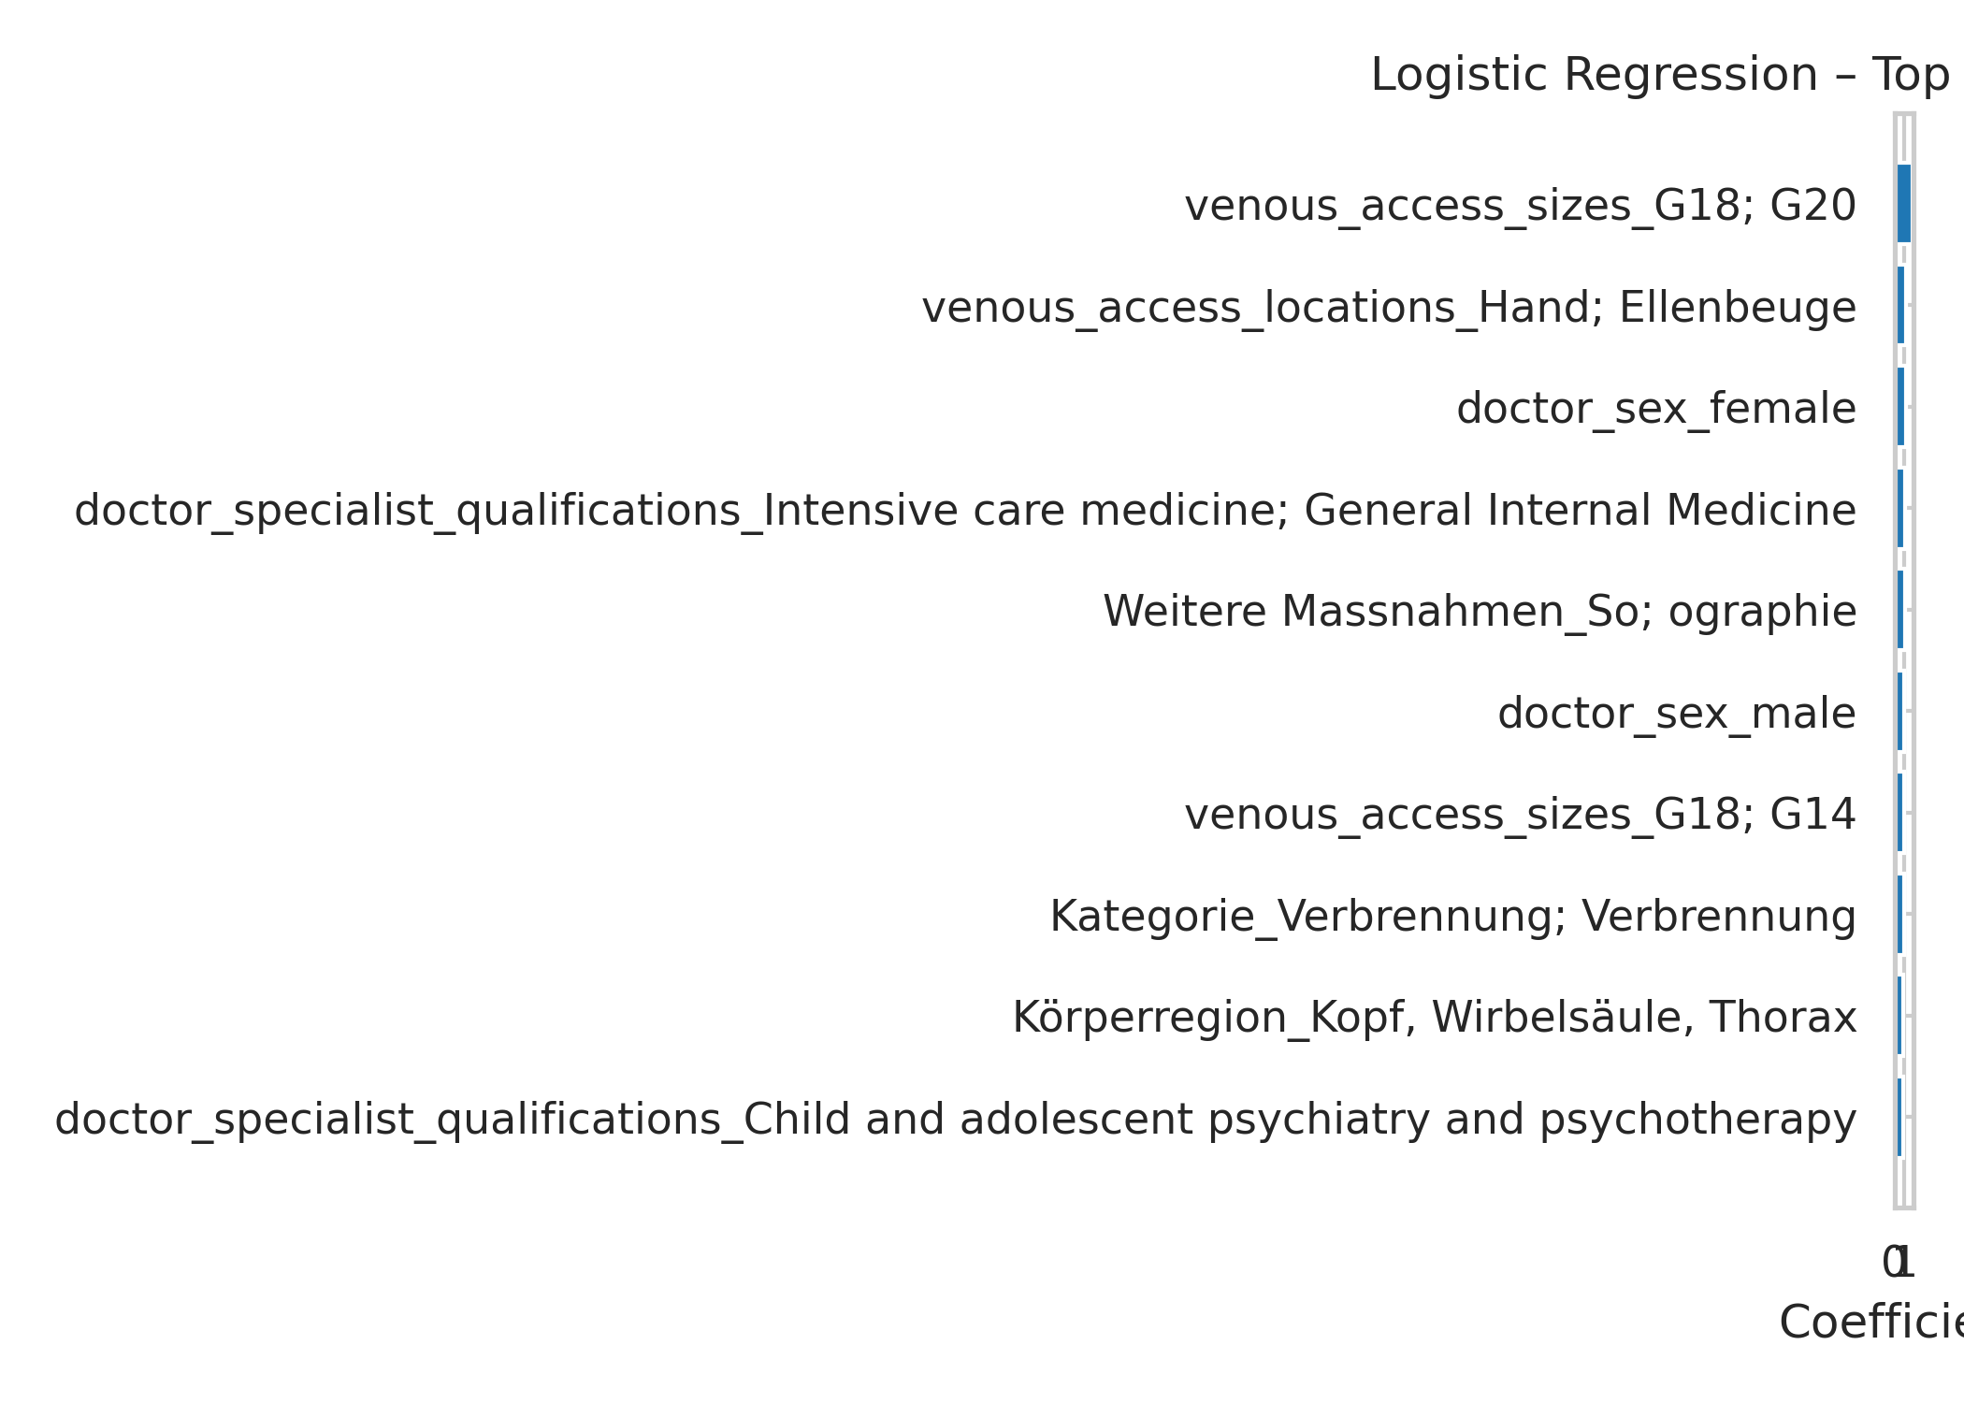
Logistic Regression – Top Positive Coefficients

Slide 11
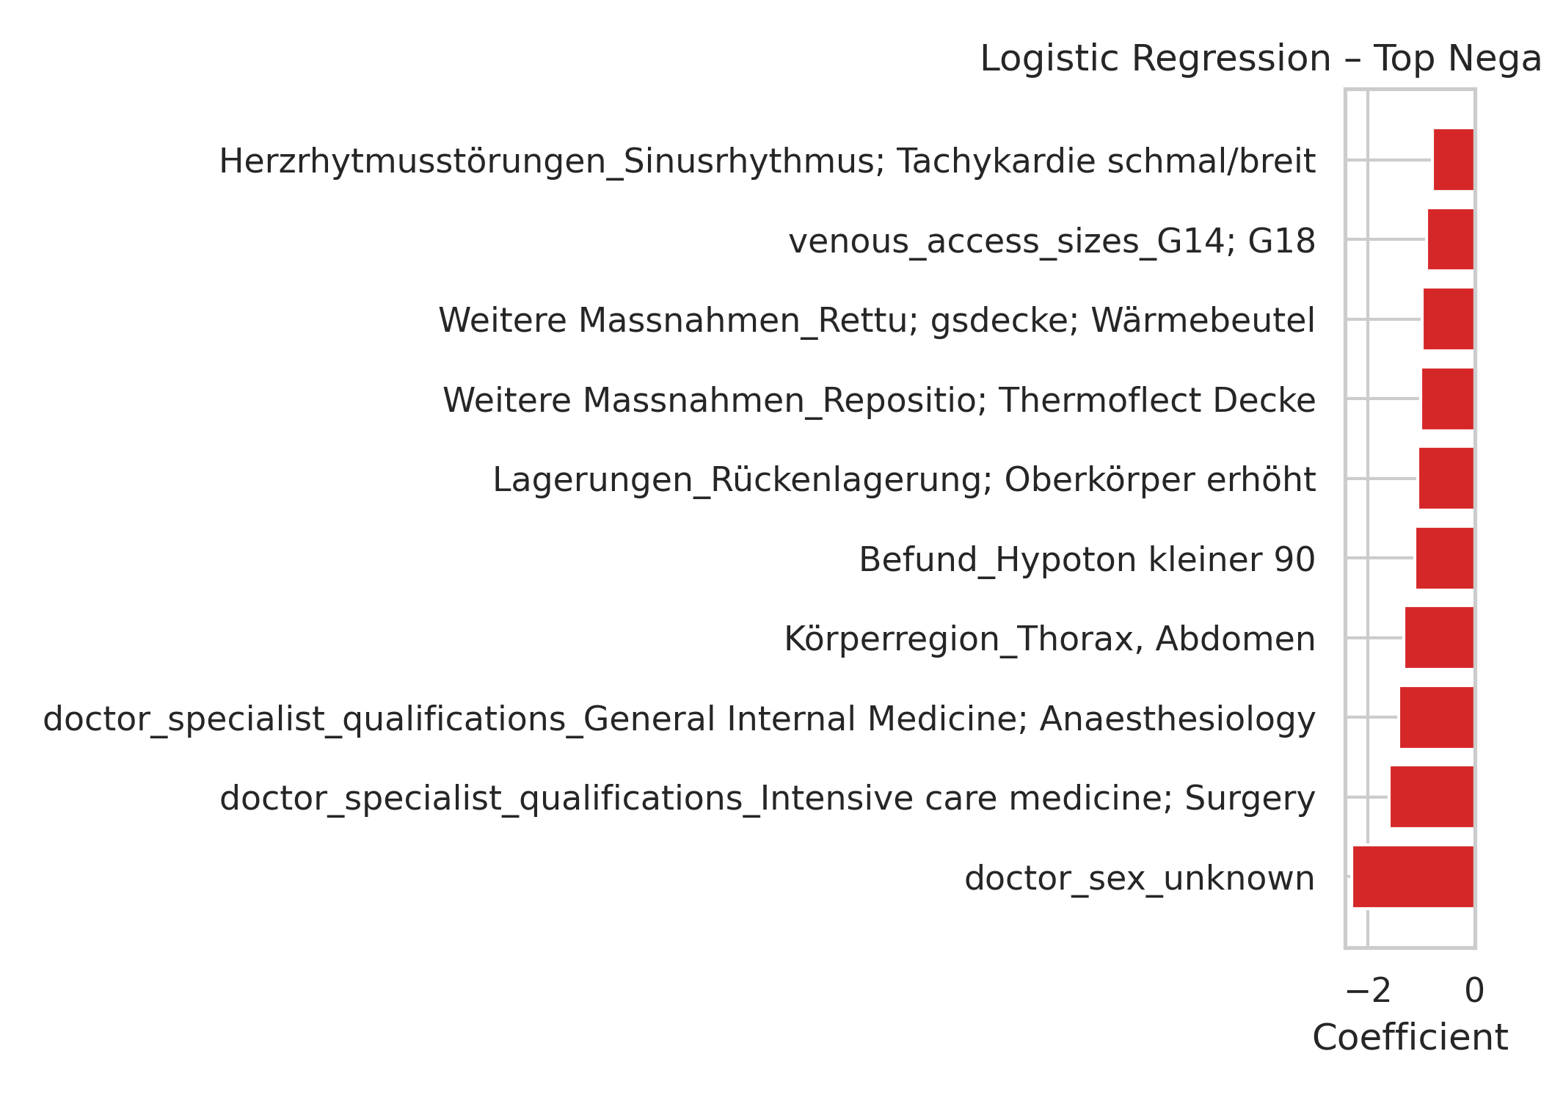
Logistic Regression – Top Negative Coefficients

Slide 12
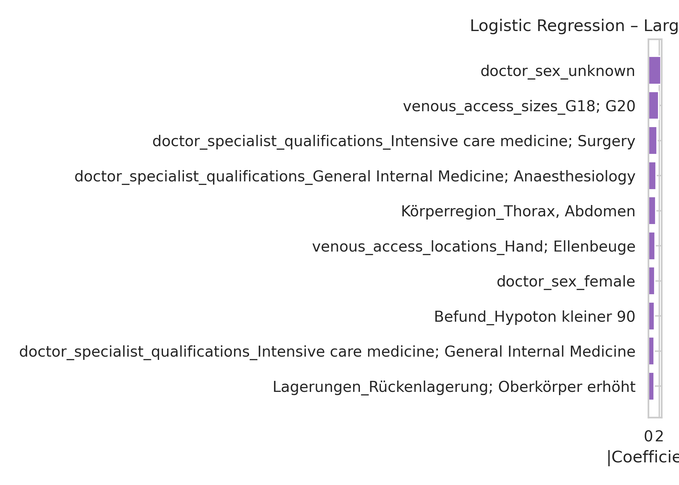
Logistic Regression – Largest Absolute Effects

Slide 13
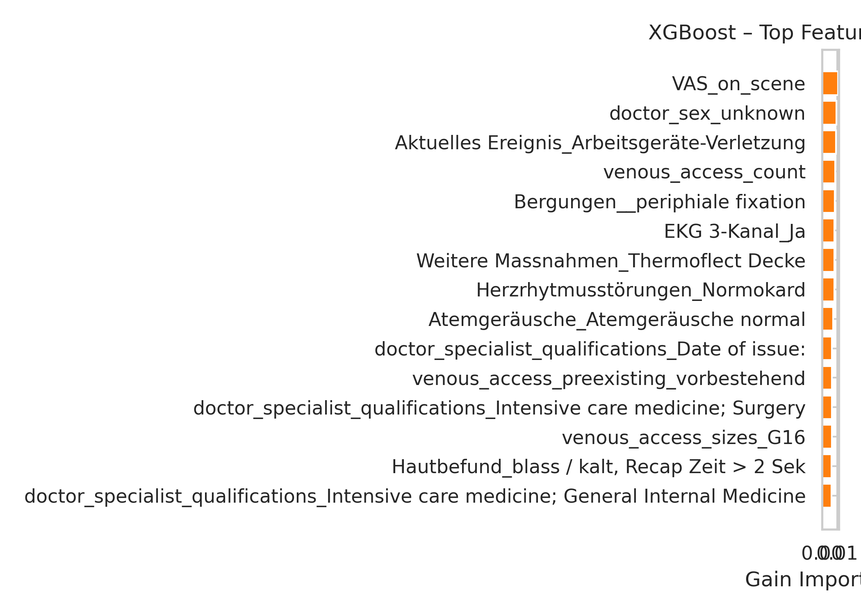
XGBoost Feature Importances

