Slide 1
Insufficient Pain Management Prediction
Primary Adult Trauma Cohort
Generated: 2025-10-07 10:28 UTC

Slide 2
Model Performance Summary
Metric | Value
ACCURACY | 0.596
PRECISION | 0.362
RECALL | 0.619
F1 | 0.457
ROC_AUC | 0.637

Slide 3
Population Filter Summary
Initial records: 12269
  Excluded VAS ≤ 3: 3805
  Removed duplicates: 51
  Excluded non-trauma: 1411
  Excluded secondary transports: 179
  Excluded pediatric (<16): 762
  Final cohort size: 6061

Slide 4
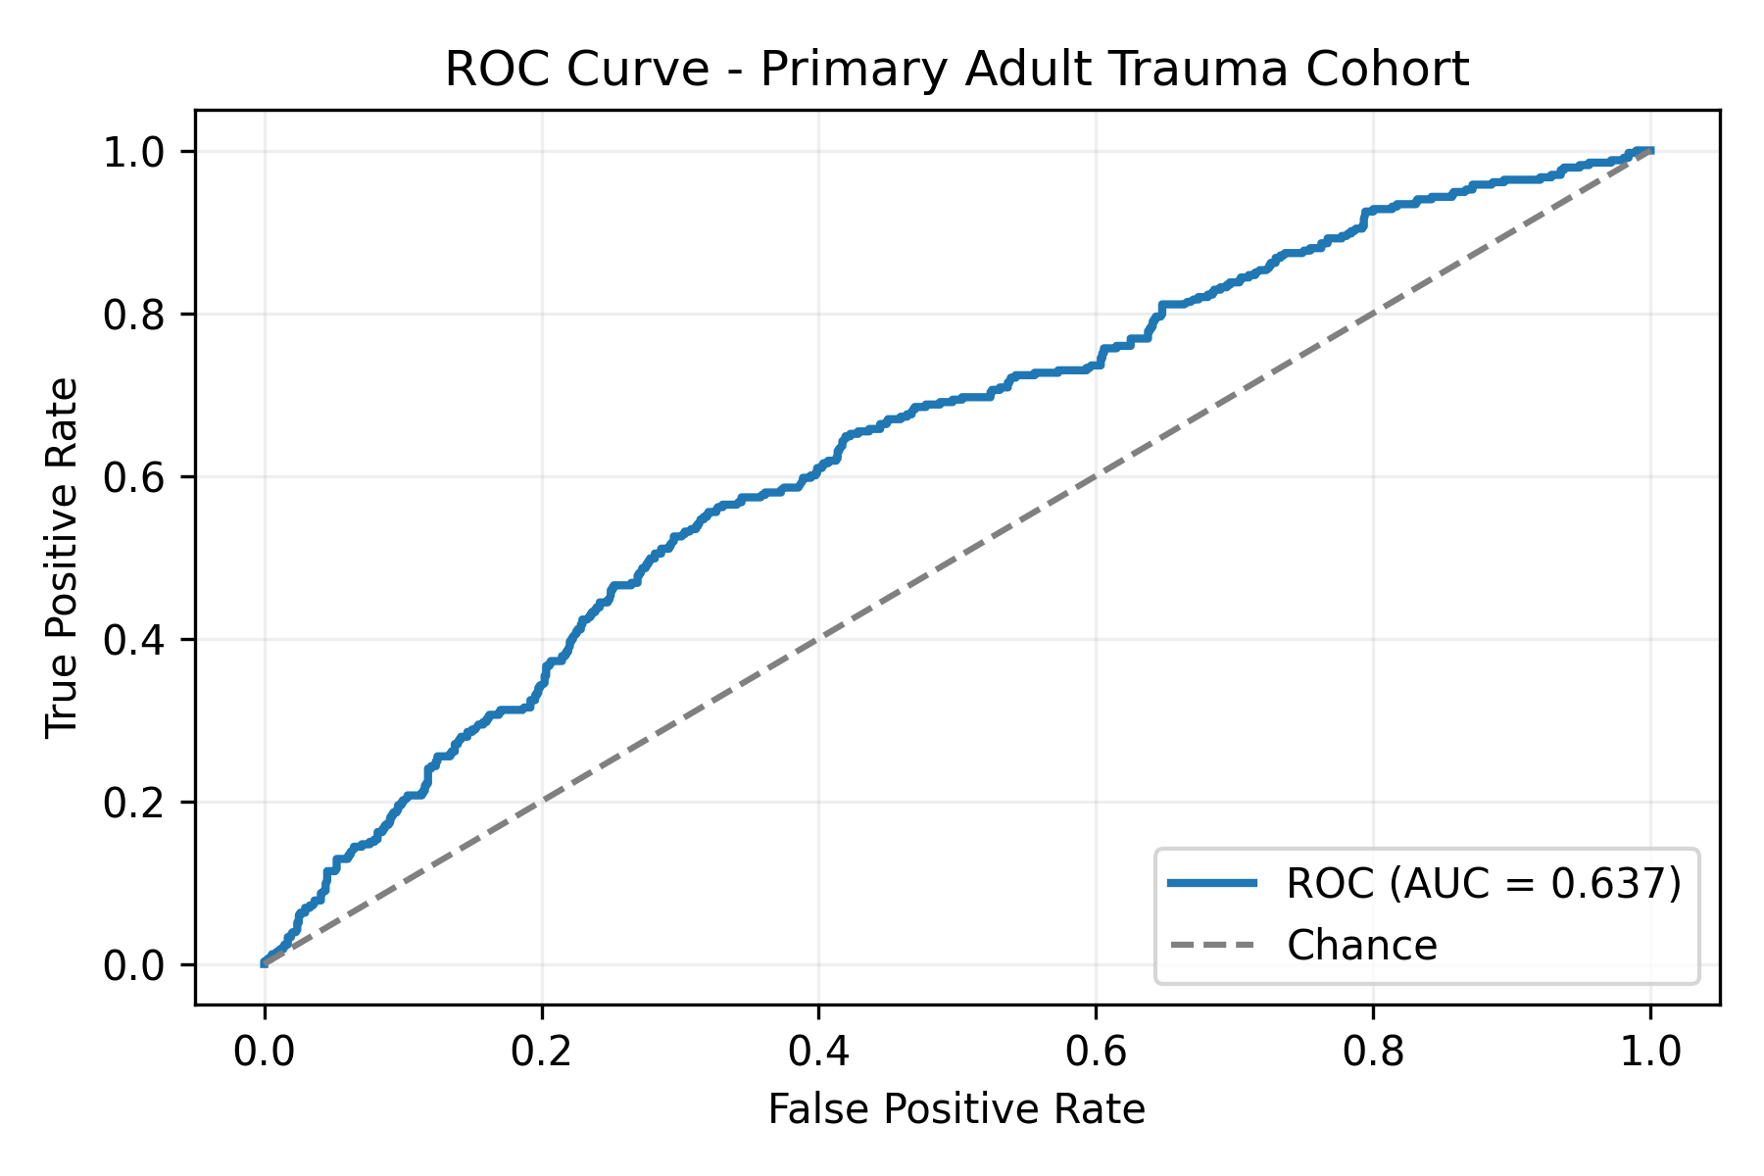
ROC Curve

Slide 5
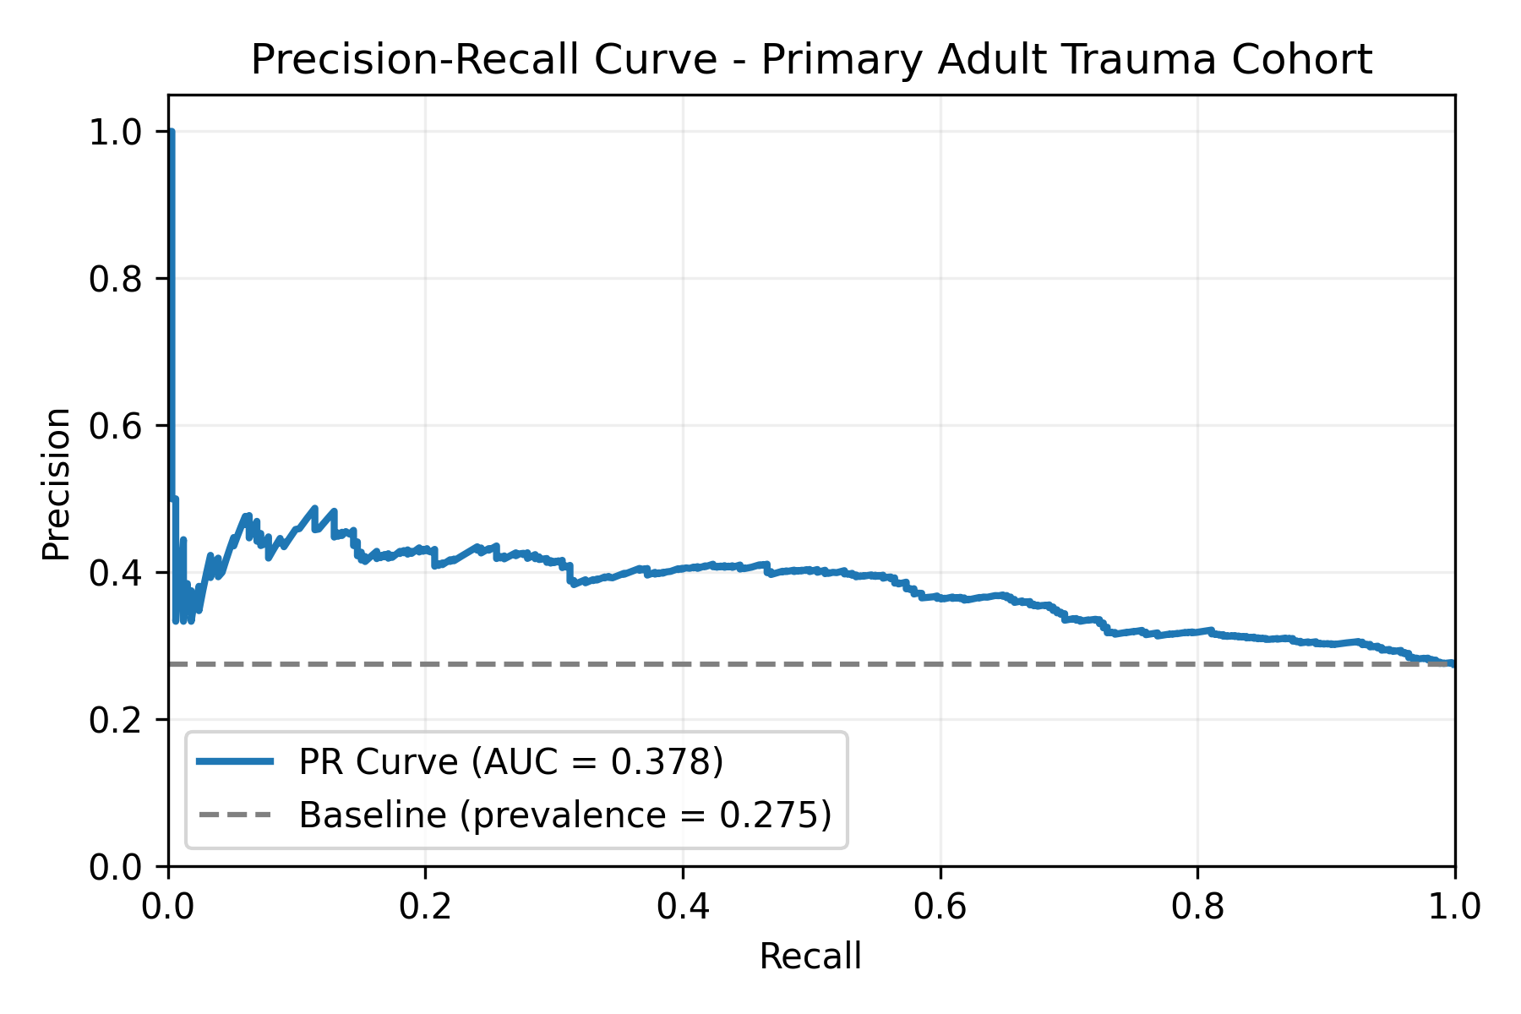
Precision-Recall Curve

Slide 6
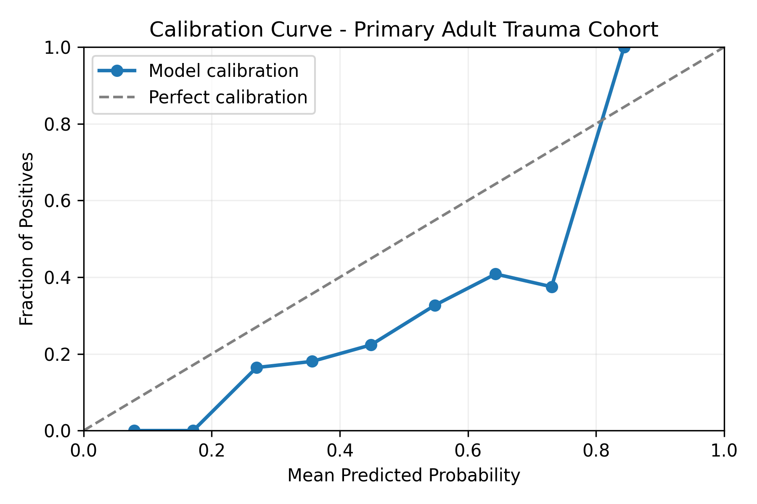
Calibration Curve

