Slide 1
HDTrace/Simulation Environment
Overview & Current Status
Julian M. Kunkel

Slide 2
Agenda
HDTrace/Simulation Environment
  Components of the Environment
  Trace Format
  HDMPIWrapper
  Cluster model
  HDJumpshot
Ongoing works
Future works / Ideas

Slide 3
Components of Environment
Trace Format
  C Library to write traces
  MPI wrapper for MPI traces
  Visualizer for Trace format (HDJumpshot)
  Trace Converter to third party formats
Cluster Model
Viewer for Model (dropped)
Simulator

Slide 4
Project Dependencies
HDMPIwrapper
HDJumpshot
TAU
Includes as jar
HDTraceWritingCLibrary
HDTraceFormat
HDTraceConverter
HDTraceConverter
PIOsimHD-Model
PIOsimHD-GUI
PIOsimHD-Simulator
Java
C

Slide 5
Agenda
HDTraceFormat

Slide 6
HDTraceFormat
Project description
  Links together other files in a ”topology”
  Provides semantics
  Existing ”topology” files are integrated during load
    Allows to copy additional files into project
Traces (.trc)
  Typically a sequence of execution
  Contains Events & States (might be nested)
Statistic Groups (.stat)
  Trace of statistical information (might be periodical)

Slide 7
Topology
Named/labeled hierachy
  Example: Host / Rank / Thread
  Can be a simple as: Component /../ Component
TopologyLabels
  Used in the viewer to identify semantics
TopologyNode
  Virtual entity which might attach:
    One trace
    Multiple statistic groups

Slide 8
Statistics
Statistic Group
  Contains one or multiple named statistics
  Sequence of timestamp and contained values
  Example: Energy <Power, Current, Voltage>
Statistic Description
  Provides ”unit” and statistic type (float, int...)
Statistic Entry
  Single timestamp and all group values
Typical timetamp is Epoch (gettimeofday)

Slide 9
HDTraceFormat physical mapping
Project description file (.proj)
  XML based
  Contains Topology, multiple Mappings to files (Communicator, files, datatypes)
Traces (.trc)
  XML based
Statistic Groups (.stat)
  XML header, binary data
All .trc and .stat files are independently created
Can be added later (adapt .proj file)

Slide 10
Trace Format interactions
HDJumpshot
Text
HDTraceWritingCLibrary
HDTraceFormat
HDTraceConverter
for testing
TAU
PIOsimHD-Model
PIOsimHD-Simulator

Slide 11
Agenda
HDMPIWrapper

Slide 12
Agenda
PIOsimModel

Slide 13
PIOSimModel (1)
Simple Model for cluster components
  IOSubsystem, NIC, Node, Server, (MPI)Client
Contains important characteristics of components
  Example: Throughput, Latency (for a NIC)
Contains also a Java representation of Program
  Parses HDTraceFormat states
  Used by the simulator

Slide 14
PIOSimModel (2)
Allows clonation of components
Builder classes ease creation of model
Stored as XML
Annotated attributes
  Allow to read/write element attributes XML
  Allows to verify component attributes
  Eases maintaing of new components/attributes

Slide 15
Agenda
HDJumpshot

Slide 16
HDJumpshot
Major rewrite of Jumpshot-4
  47849 LOC (before) - 22465 LOC (Now) (+ 5000 LOC HDTraceFormat)
Main features:
  Use HDTraceFormat (SLOG2 not longer supported)
  Trace Format does not save any view-related data
  Can view multiple files together:
    I.e. Load files for pvfs2 server and clients!
  Supported views:
    Timeline
    Profile for trace (complete rewrite)
    Histogram for statistics (NEW)

Slide 17
Topology in the viewer
Named/labeled hierachy
  Example: Host / Rank / Thread
  Can be a simple as: Component / Component / …
Used to identify semantics
  Parse topology to determine rank for MPI programs
Different Topology Mappings in the viewer:
  Default: take it as it is stored in Project file.
  MPI view: show Rank first, then threads
    Simply strips hierachy above rank
Note: Topology mapping can be choosen by right click in the topology manager

Slide 18
Timelines
Show topology mapping (TopologyManager)
Automatic redraw (can be disabled)
Drawing is done in a separate thread
  Results are rendered on screen
  Better interactivity
Dynamic Arrow computation
Info Panel (like in PIOviz)
Info Dialog per TraceObject (right click on obj)

Slide 19
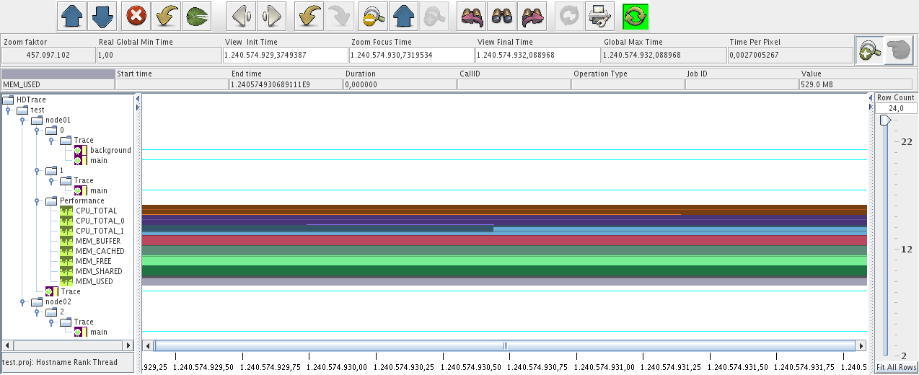
Example Timeline Window

Slide 20
Trace Info Dialog
Right click on an object
Provided information:
  Object XML
  Parsed information for example:
    Communicator name (if provided)
  Supports view of datatypes:
    View all used datatypes in this call (filetype, memory type, element type)
    Dependency Graph of datatype (expanded on click)

Slide 21
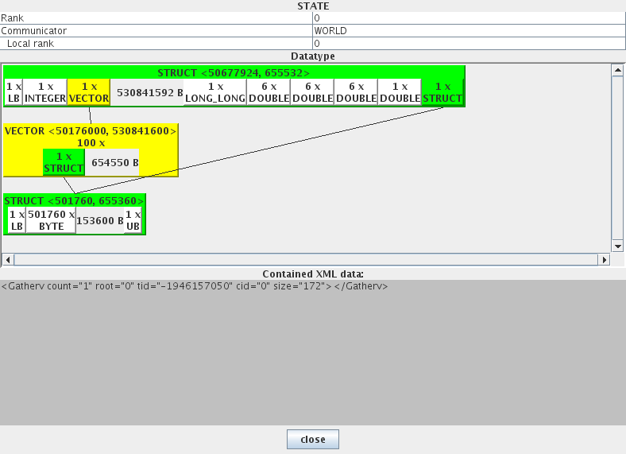
Example Trace Info Dialog
Note: created just for demonstration, extends do not make sense!

Slide 22
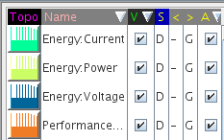
Support for statistics
Nativly supported by trace format
Average statistic value shown in timeline
Statistic value mapping can be adjusted in Legend window
      If a statistic gets invisible it is removed from topology mapping
      Logarithmic or decimal view.
      Adjustment is global, time line specific or in groups.
      Height relative to minimum or maximum
Histogram for statistic values (right click on Topology)

Slide 23
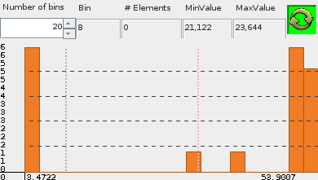
Statistic Histogram
Shows a single statistic (avg, and stddev x1,2,3)
Multiple windows can be opened
Adjusts to zoomed area (viewport) in timeline
Note: Does not account for variable time intervals between statistic values

Slide 24

Dynamic Arrows
Arrows can be computed on purpose
  Right now integrated in Legend Window
Computed when shown for the first time
Supported right now:
  MPI-Internal-Communication
It would be possible to visualize only arrows for
  Small messages, slow messages, different tags...
Also, use different colors for different types

Slide 25
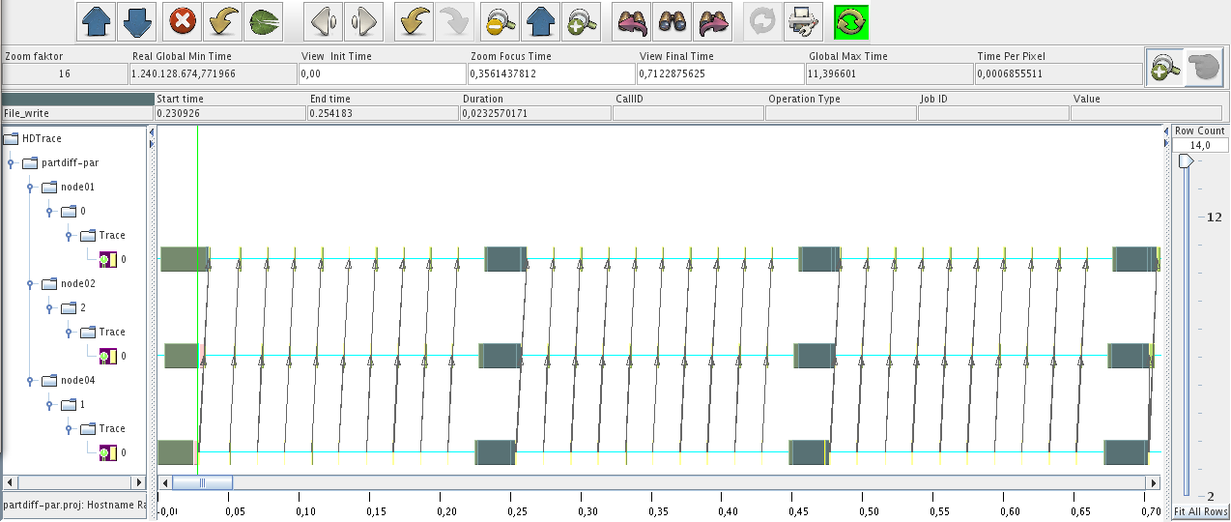
Example: MPI Comm. arrows

Slide 26
Profile view
Similar to previous Jumpshot-4 profile
Shows profile for zoomed time
Metrics are computed on runtime
Supported metrics
  Inclusive/Exclusive time
  Min/Max Inclusive/Exclusive time
  Number of occurences in trace
Count only root level TraceObjects or nested also

Slide 27
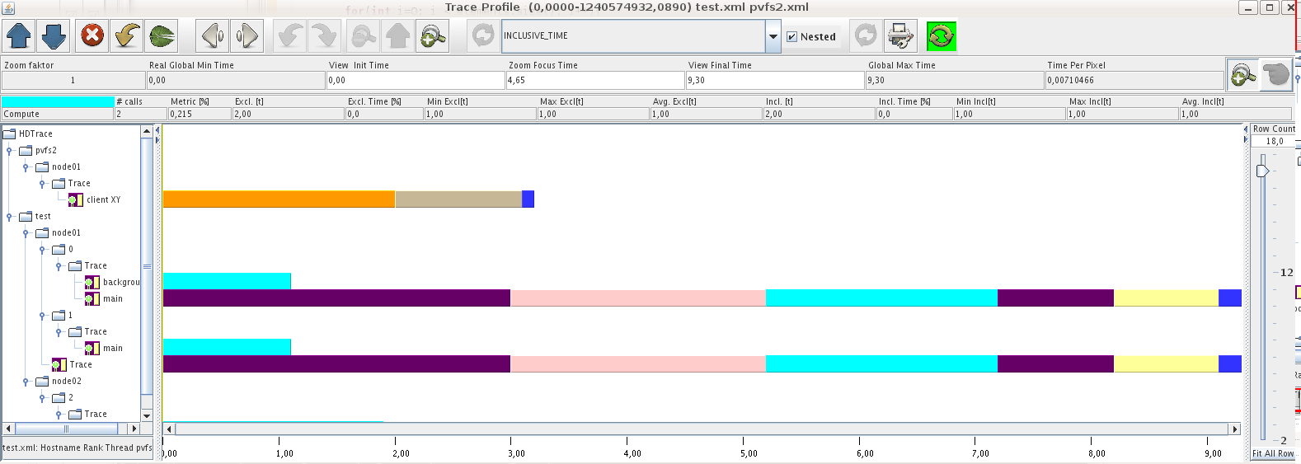
Example Profile
In this example two files are loaded (see topology manager)

Slide 28
Planned Features (1)
Trace Info Dialog:
  Show file name
  Show accessed bytes in an I/O operation
    Color by size, small are more dangerous
Arrows on different purposes
  Many options => requires reqspec.
Filters/Assistants to help to drill down analysis:
  Show only I/O specific stuff, arrows ...

Slide 29
Planned Features (2)
Background computation (profile, histograms)
Use histogram for other purposes:
  Message sizes (for one trace, across hole project)
Communication view
  Show matrix of communication
  Number of bytes exchanged between ranks
  Additionally: Number of send/revc. etc. exchanged between ranks

Slide 30
Known issues
Bug in JColorChooser Dialog
  Sometimes hung up application during creation
Not all datatype mappings done
Cleanup necessary
  Abstraction for topology specific stuff needed
  Plugin concept for different views
NTP synchronization accuracy only ~40 ms
  Worker nodes synchronize with master:
    Expected to be around 1ms

Slide 31
Agenda
Current Works

Slide 32
HD* Involved People / Overview
Main Projects:
Christian Lohse
Timo Minartz
Paul Müller*
Stephan Krempel
Michael Kuhn
Tien Duc Dinh
Dulip Withanage*
*: contribution ends/ended
Third party trace formats and environments
Green IT / Simulated power consumption
New MPIWrapper, Trace C-API implementation
C-API implementation, Power/Kernel Trace
MPI-I/O simulation + optimization
HDTrace in PVFS2
GUI for model (incomplete)

Slide 33
Agenda
Third party trace formats and environments
Power/Kernel Statistic Traces
HDTrace in PVFS2
Green IT / Simulated power consumption
MPI-I/O simulation + optimization

Slide 34
Third party trace formats and environments
Christian Lohse (Bachelor Thesis)
Check out other trace formats and tools
  Compare trace formats (including HDTrace)
  Write simple Trace Examples
Formalize our requirements for format/tools
  Regarding I/O, Energy (Simulator)
  Assess trace formats and tools regarding the reqs

Slide 35
Power/Kernel Statistic Traces
Stephan Krempel (Master Thesis)
Idea: link Energy consumption of program to program trace
  Might allow to optimize program towards Energy Efficient computing
Also link kernel statistics to program
  Allows to see Network/CPU/disk utilization and more
Apply to sequential programs and MPI programs
Start development of a benchmark to measure Energy Efficiency

Slide 36
MPI Program
MPI Wrapper
Performance Tracing
Library (PTL)
Power Tracer (PT)
HDTrace Writing Library
HDTrace Writing Library
Project
Description
Merger
(PDM)
Trace Info
[text]
Info [text]
Project Description
[XML]
Event Trace
[XML]
Performance Trace
[text/binary]
Power Trace
[text/binary]
Event Trace
[XML]
Performance Trace
[text/binary]
Event Trace
[XML]
HDTrace
Document
HDJumpshot
C Program
Java Program
Python Program
Schema provided by SK

Slide 37
Cluster
Node
Node
Node
Node
LMG
Power Tracer Node
Power Tracer (PT)
Node
Node
Node
Node
LMG
HDTrace Writing Library
LMG:
Using continuous mode
Max. speed supported: 50ms per cycle
Power Tracer:
Knowlege about messurement topology
Trace File:
Description in XML
Values stored binary in network byte order
00193
<TopologyNode>
<Label value=“host0“>
</TopologyNode>
<Energy timestampDatatype=“EPOCH“>
<Voltage type=”float” unit=“mV“>
<Current type=”float” unit=“mA“>
<Power type=”float” unit=“mW“>
</Energy>
################################
################################
################
Schema provided by SK

Slide 38
HDTrace in PVFS2
Tien Duc Dinh (Bachelor Thesis)
Uses current PVFS version
Server sided tracing (PIOviz like)
Link: MPI <=> PVFS2 via new PVFS hints
Add information of internal states (SMs, Trove)
One tracefile per client source
  Client must ensure that each source gets a own hint
Embed PerformanceTracer in PVFS server
Add metrics from JK Master thesis

Slide 39
Green IT / Simulated power consumption
Timo Minartz (Master Thesis)
Investigation on energy saving mechanisms
Evaluation on mechanisms in HD* environment
First step:
  Use average utilization of components to estimate energy consumption with and without energy saving mechanisms
Depending on results deceide next steps!

Slide 40
Green IT / Simulated power consumption
First Step (1)
Use HDTrace
  Existing PerformaceTraces can be used
    Use Utilization of IOSubsystem, CPU, Network
    Compute power consumption
  Apply energy saving strategy and compute energy consumptions
  Generate new StatisticTraces with computed values
  Applicable for ”normal” users to estimate energy consumption and potential energy savings
  Compare real power utilization with PowerTraces
  View in HDJumpshot

Slide 41
Green IT / Simulated power consumption
First Step (2)
Modeling
  Use SimModel: Performance characteristics are available in the Simulator for further usage
  Store energy consumption for 0%, 100% util., linear interpolation
  Store energy consumption change between saving states (similar to ACPI levels)
  Store time needed to change saving states

Slide 42
Green IT / Simulated power consumption
First Step
Strategy:
  Look into the future (trace) to determine best energy conserving strategy independent for each component
  Do not slow down application in any case
    e.g. DISK utilization is ~0% in next 30 seconds
    => power down the disk and spin up early
Compare energy consumption in best application of mechansims with the case without mechanisms
  Upper bound on savings without application adaption

Slide 43
MPI-I/O simulation + optimization (1)
Michael Kuhn (Master Thesis)
Simulate Server side I/O optimization: Server directed I/O
  Server orders I/O requests across all pending requests and deceides which data it received/sends
    Server effectivly does scheduling across requests
  Also effective for flash storage (bundle small requests into Erasure Blocks)

Slide 44
MPI-I/O simulation + optimization (2)
Add client side I/O optimization into Simulator:
  Two-phase I/O
  Cooperative Client sided caching of I/O data
  Own algorithm(s) / playground
Compare simulated results for Two-phase with traced results
Assess new strategies
  It is expected that server directed I/O is effective

Slide 45
MPI-I/O simulation + optimization (3)
Embed a effecient client side I/O optimization into MPI
  Write own MPI_File_XX_all simple library and test with client application(s)
  Might be aware of some cluster characteristics

Slide 46
Agenda
Future works / ideas

Slide 47
Future works / ideas
PIOviz new = Duc's work + HDJumpshot +
  Knowledge we got from extensions made with Yuichi - Instrumentation of internal MPI communication
  => Additional instrumentation of MPI interna
Support more file systems
  Glusterfs good candiate
  Others?
Extensions to HDJumpshot (as discussed)

Slide 48
Future works / ideas
Cleanup of environment (always ongoing)
Make source / binary available (under GPL)
Could be used in lectures?
  Optimization/visualization of (MPI) programs
  Let students implement MPI algorithms for communication or for I/Osubsystem scheduling

Slide 49
Future works / ideas
Simulator: allow to write generic and parameter depending programs
  e.g. lets simulate partdiff-par for any parameter and number of clients
  Could be done by providing a command source which generates appropriate commands on demand
Implementation of a server directed I/O algorithm into a parallel file system

Slide 50
Future works / ideas
Cluster component and topology aware MPI (is that useful? Also for Grids?)
  Choose optimization not longer on empirical data, instead MPI chooses best algorithm for the ”cluster”
Simulator: Adapt programs to announce likeliness of I/O and communication requests earlier
  Simulator could prefetch future commands
  Announce future operations earlier to optimize order

