Slide 1
HDTrace Environment
HDTrace - PVS-Cluster setup
Julian M. Kunkel

Slide 2
Working steps
Cluster login
Compile an MPI application
  module load hdtrace-0.9
  mpicc test-mpi.c -o test-mpi
Run the application
  Creates multiple trace & statistic files
Prepare project file for the viewer (see next slide)
View with sunshot

Slide 3
Prepare project file
Create project file from MPI run:
  project-description-merger.py -o test-mpi.proj test-mpi*.info
  It is mandatory that the file prefix (test-mpi) is identical to the prefix of the trc & info files
Manually add additional statistics to project file:
<ExternalStatistics>
<Energy/>
<Performance/>
</ExternalStatistics>

Slide 4
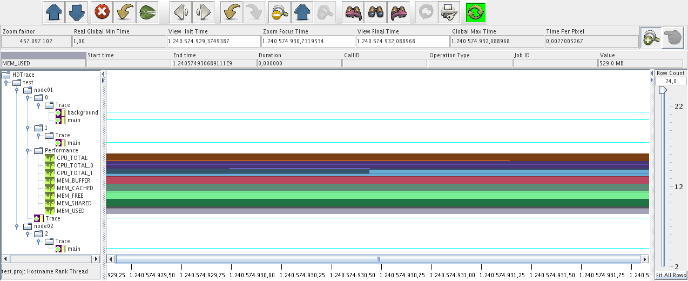
Installation of sunshot
Requires JRE-6
Download (or run on cluster):
  /home/kunkel/PIOsimHD/PIOsimHD-Bin-1.01
  bin/sunshot

