Slide 1




Machine learning classification applying the combination of functional near-infrared spectroscopy and APACHE-II scoring on extracorporeal membrane oxygenation patients
Student: Chang-Yi Lee
Advisor: Chia-Wei Sun
Date: 2022/12/03

Slide 2
Outline
Introduction of ECMO system
2. Experimental method
Experiment design
Disease severity classification system
Result and discussions
Conclusions

Slide 3
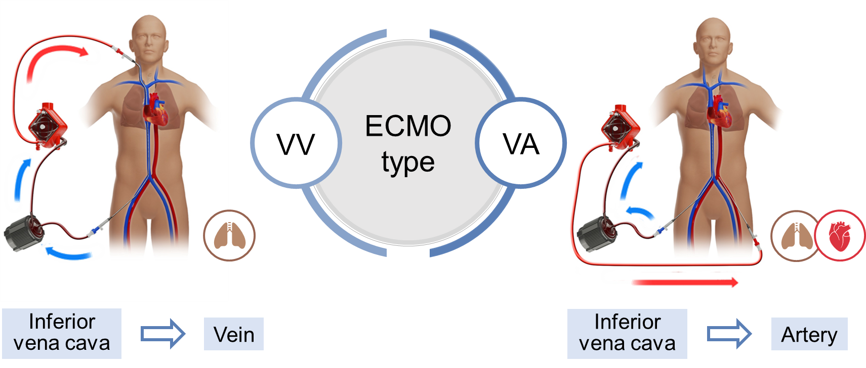
What is ECMO?
Extracorporeal Membrane Oxygenation (ECMO)
femoral vein
jugular vein
femoral vein
femoral artery
H.­H. Chang, Y.­C. Chen, et al. Journal of Biopho­tonics, vol. 13, no. 10, p. e202000116, 2020.

Slide 4



Problems of ECMO
Consumption of medical resources
High proportion of complications
High ECMO usage
Over 2,000 patients in Taiwan use EMCO for adjuvant treatment per year.
It consumes nearly NT$ 1 billion of healthcare resources every year.
Thrombosis Hemorrhagic
or ischemic stroke

Slide 5
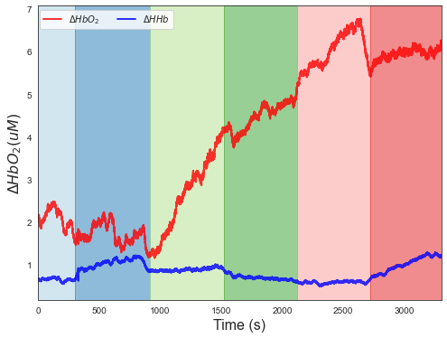




Purpose
Near-infrared spectroscopy
Machine learning algorithm
grgr
Classification
Real time
Quantitative evaluation
Non-invasive
Processing complex data
Non-radioactive

Slide 6
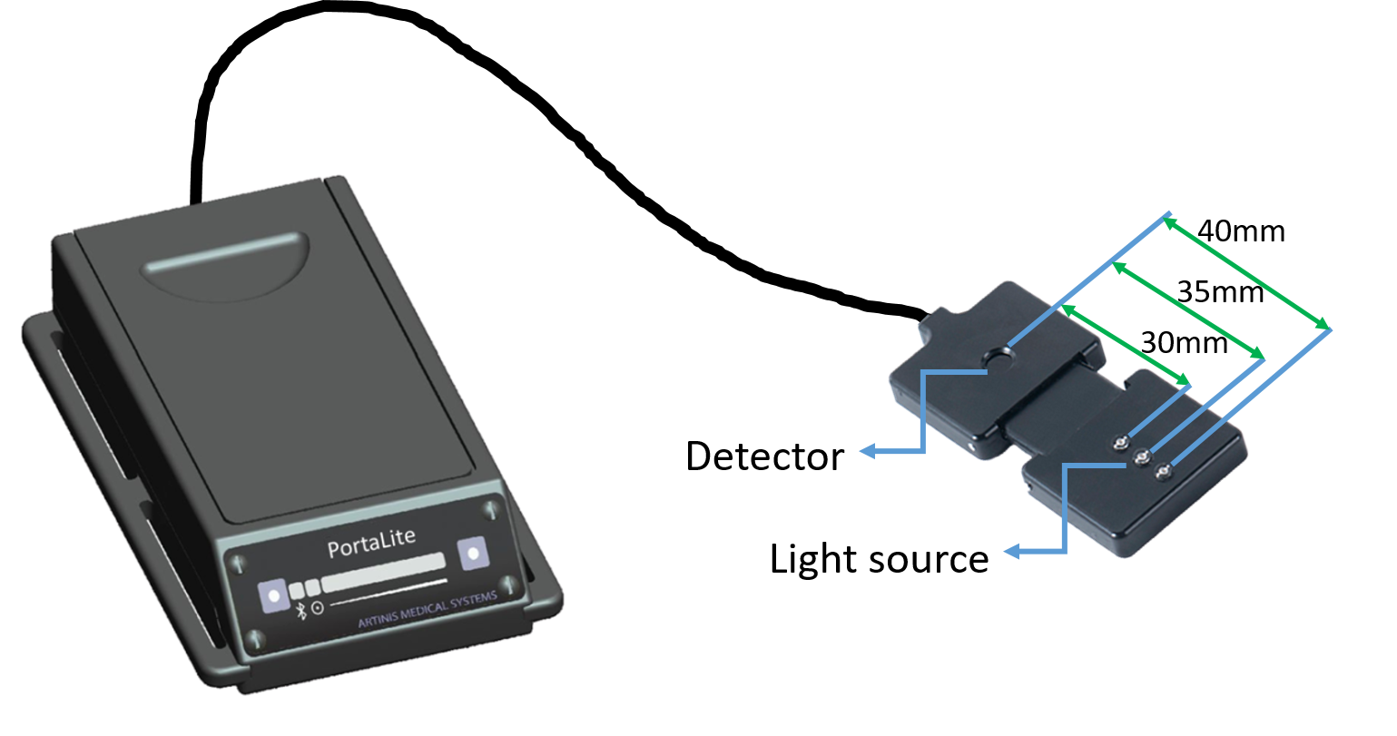



Portable NIRS Device
PortaLite – Netherlands Artinis Medical Systems
Light weight
Easy to carry
Real-time
760nm
850nm

Slide 7
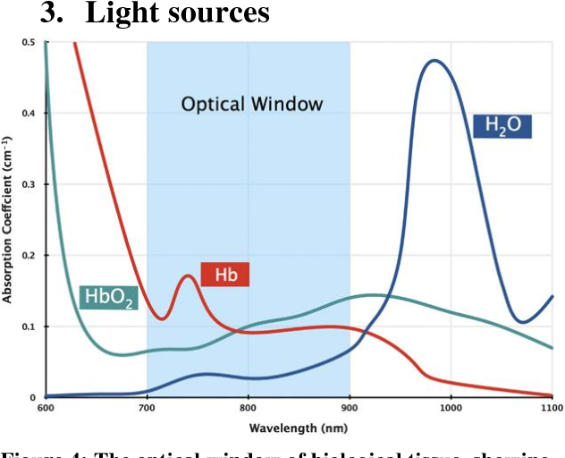



Introduce to NIRS
760 nm
850 nm
I₀
I
H
H
Tissue

Slide 8
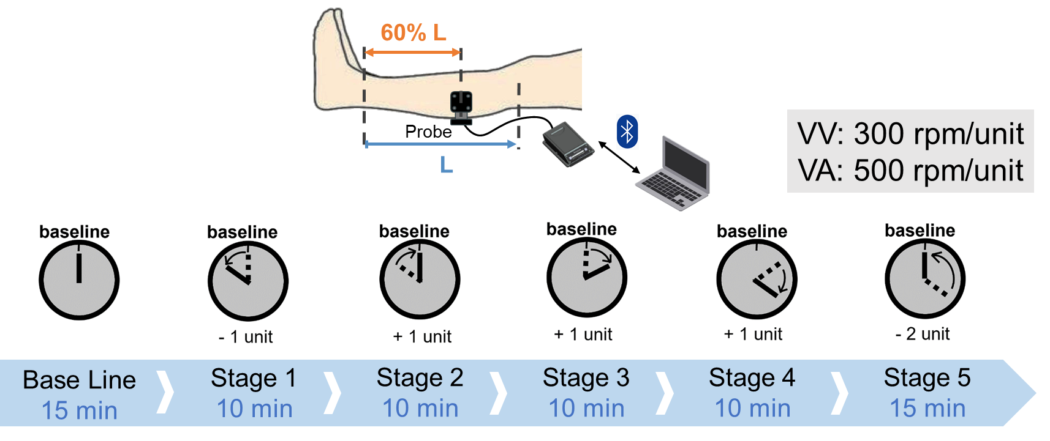
Experimental Design - Blood Data Collection
Unit:
VV: 300 rpm
VA: 500 rpm

Slide 9





Experimental Design - APACHE II score
APACHE II
APACHE II score | Mortality | Category
0 to 4 | ~ 4% | Low
5 to 9 | ~ 8%
10 to 14 | ~ 15%
15 to 19 | ~ 25%
20 to 24 | ~ 40%
25 to 29 | ~ 55% | High
30 to 34 | ~ 75%
Over 34 | ~ 85%
Acute physiologic score
(12 variables)
HR
Temperature
WBC
HCT
Age
Chronic Health Evaluation
KNAUS, et al. Critical care medicine, 1985, 13.10: 818-829.
HR: Heart rate; WBC: White blood cell; HCT: Hematocrit

Slide 10
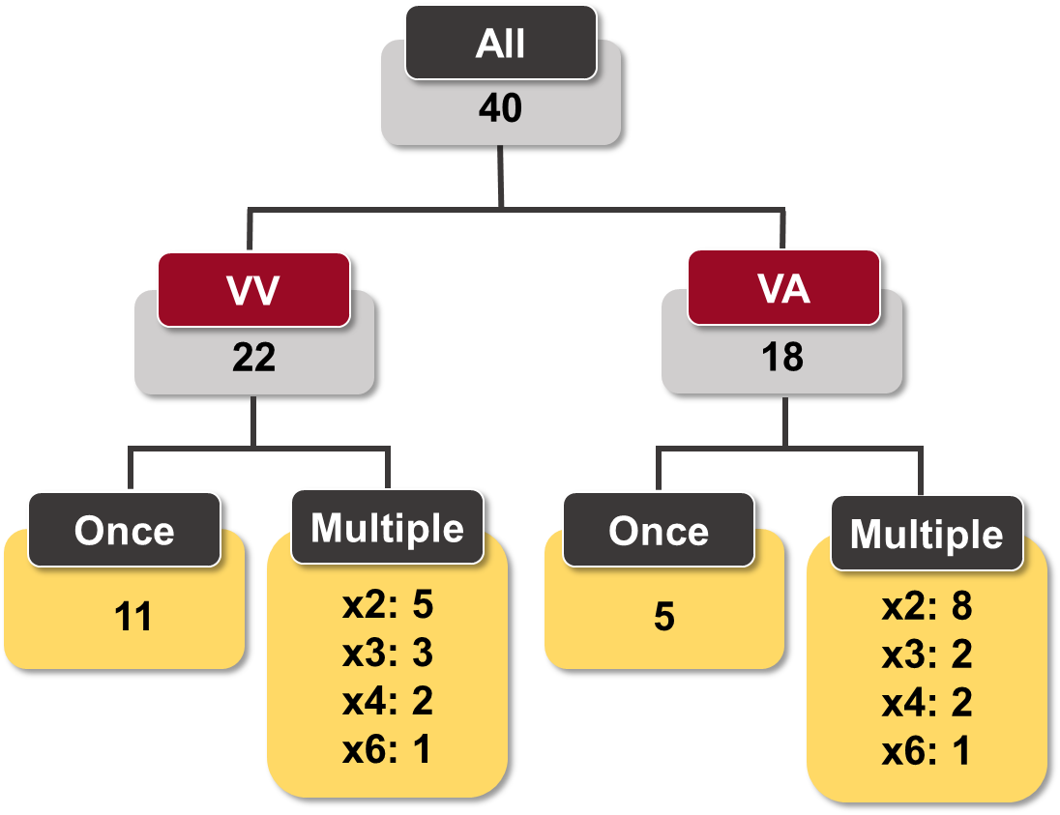
Classification System – Recruitment
Training set ：Testing set = 7：3
 | VV-ECMO |  | VA-ECMO
 | Low | High | Low | High
Dataset | 14 | 30 | 22 | 19
Training data | 10 | 21 | 15 | 13
Testing data | 4 | 9 | 7 | 6

Slide 11




Classification System – Filter
Low-pass filter
Order: 4, cut-off: 0.1 Hz
Neurovascular
coupling
Myogenic response
Respiration
Heartbeat
0.005
0.02
0.06
0.15
0.4
Frequency (Hz)
Z. Li, et al. Medical physics, vol. 39, no. 4, pp. 2179–2185, 2012.

Slide 12
Classification System – Feature Extraction
6 Stages
Features
Hemoglobin
▪ Baseline
▪ Stage1
▪ Stage2
▪ Stage3
▪ Stage4
▪ Stage5
▪ Stage mean
▪ Stage activation
▪ Stage difference
▪ Stage slope
▪ HbO
▪ HHB
▪ TSI
66 Features

Slide 13
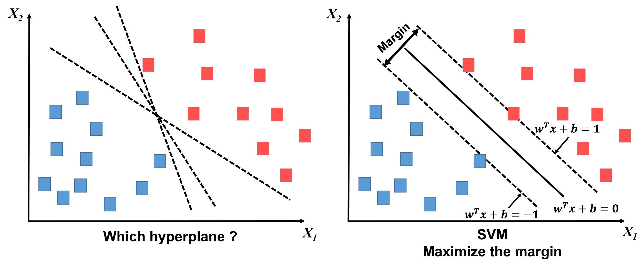
Classification System – SVM

Slide 14
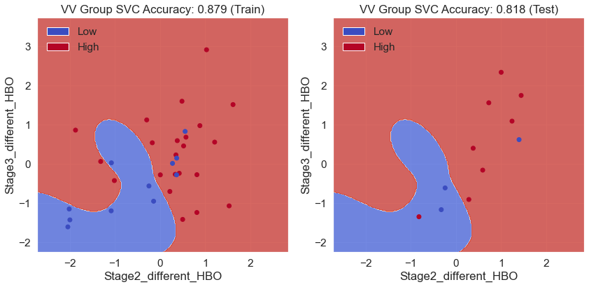
Result & Discussion - VV Group
 | Training data | Testing data
Accuracy | 87.9% | 81.8%

Slide 15
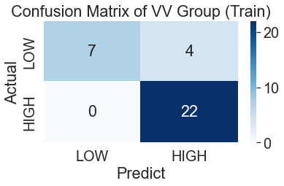
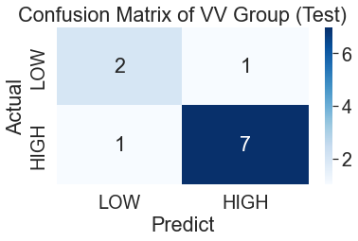
Result & Discussion - VV Group
positive predictive value (PPV)
Training data = 84.6%
Testing data = 87.5%
Specificity
training data = 63.6%
testing data = 66%
Sensitivity
training data = 100%
testing data = 87.5%
negative predictive value (NPV)
Training data = 100%
Testing data = 66%

Slide 16
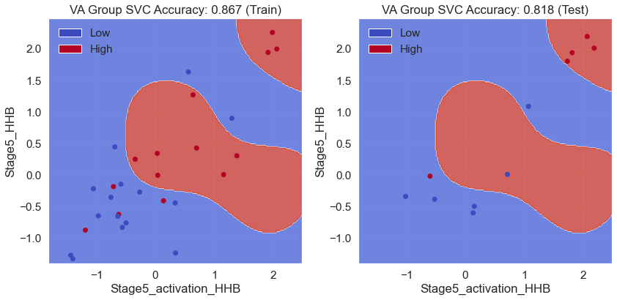
Result & Discussion - VA Group
 | Training data | Testing data
Accuracy | 86.7% | 81.8%

Slide 17
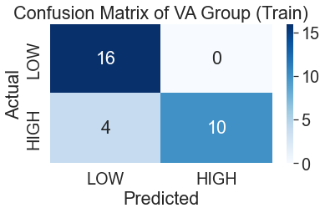
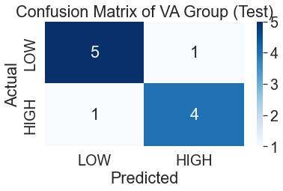
Result & Discussion - VA Group
Specificity
training data = 100%
testing data = 83.3%
Sensitivity
training data = 71.4%
testing data = 80%
negative predictive value (NPV)
Training data = 80%
Testing data = 83.3%
positive predictive value (PPV)
Training data = 100%
Testing data = 80%

Slide 18
Conclusions
In the VA group, we obtain a training accuracy of 86.7% and testing accuracy of 81.8%. In the VV group, we obtain a training accuracy of 87.9% and testing accuracy of 81.8%.
Combining non-invasive NIRS and our model, we predict the degree of severity of patients, providing an assistant tool for clinic doctors.

Slide 19
Thank you for your attention

Slide 20
Q&A

Slide 21
Appendix – Advantage of our research
While applying ECMO, the doctors inject Heparin into the patients to avoid coagulation. However, the dosage is based on the experience of the doctors, so we hope to help the determination of dosage by fNIRS.
Through acquiring the degree of severity of patients, we avoid non-beneficial medical treatment and assist the family members to do mental preparation.

Slide 22
Why we choice APACHE-II as label
APACHE II combines 12 examination items and choices the worst score in 24 hours.
0~71 is calculated, and a higher score responds to higher risk of death. In addition, we can substitute the APACHE II score into the formula to get the predicted mortality rate. It is an important index in the emergency system.
Kanus WA, Draper EA, Wagner DP, et al. APACHE II: aseverity of disease classifIcation system. Crit Care Med 1985;13:818-29.

Slide 23
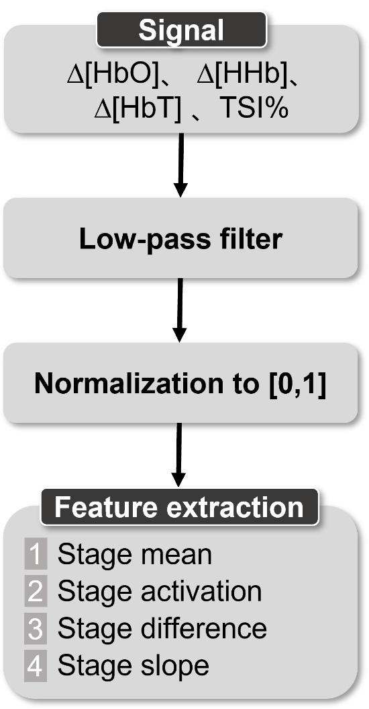
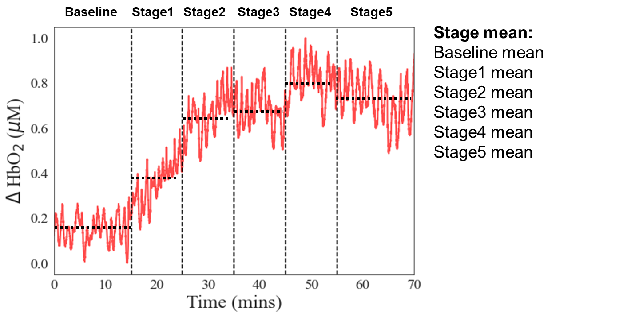
Classification System – Feature selection
TSI%
Notes:
Stage mean is the mean from stage start to stage end.

Slide 24
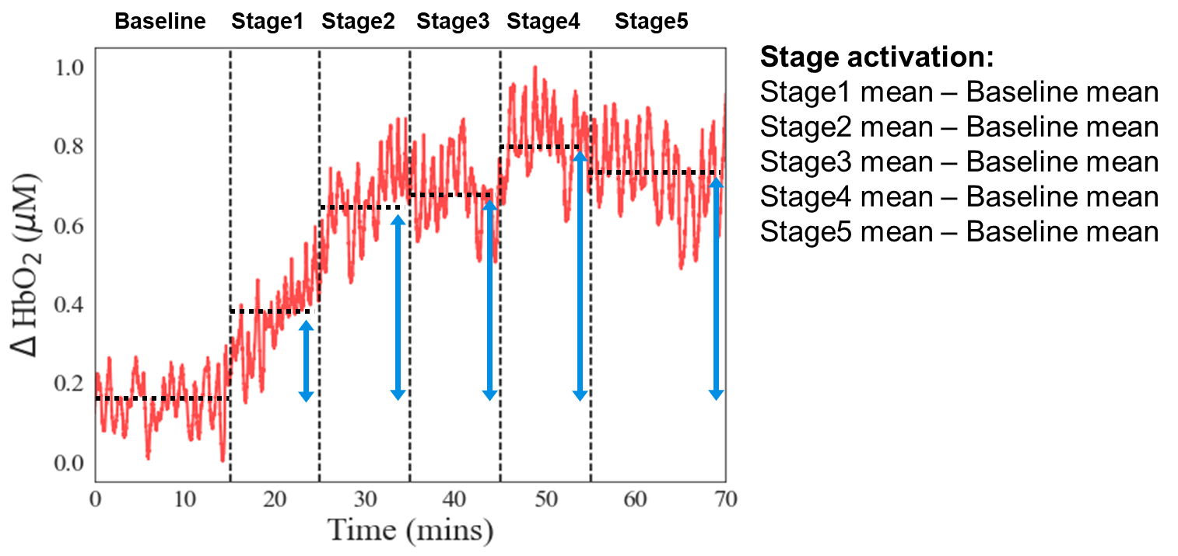
Classification System – Feature selection
TSI%
Notes:
Stage activation is the difference of the average of baseline and the average of 5 stages

Slide 25
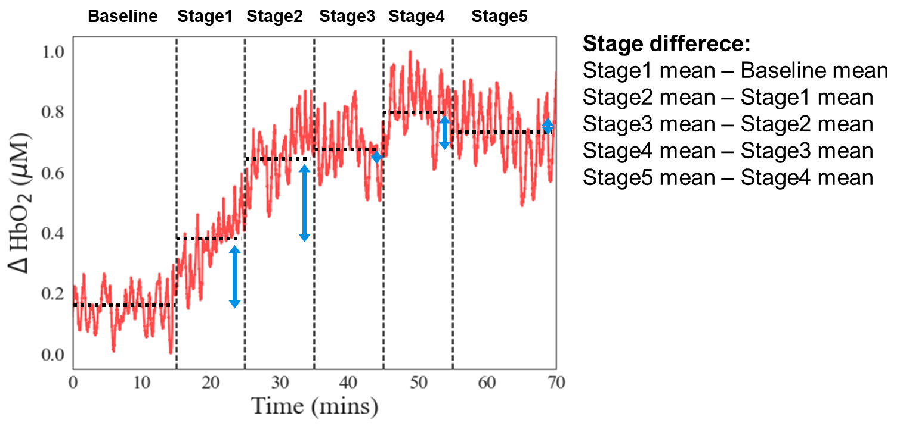
Classification System – Feature selection
TSI%
Notes:
Stage difference is the difference of the average of stage and the average of previous stage

Slide 26
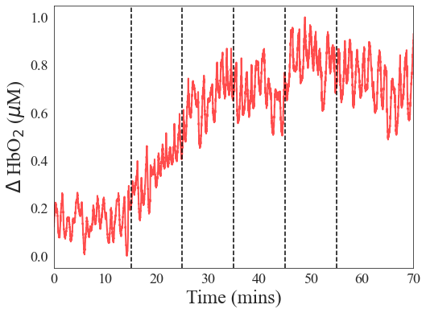
Classification System – Feature selection
Baseline
Stage1
Stage2
Stage3
Stage4
Stage5
Stage slope:
Baseline slope
Stage1 slope
Stage2 slope
Stage3 slope
Stage4 slope
Stage5 slope
TSI%
Notes:
Stage slope is the slope of the beginning and the end of the stage

