Slide 1
MGNT 5506 Strategic Management for Competitive Advantage
Jingyu (Sissi) Li

Slide 2
Jingyu li 李晶钰（鈺） Sissi

Slide 3
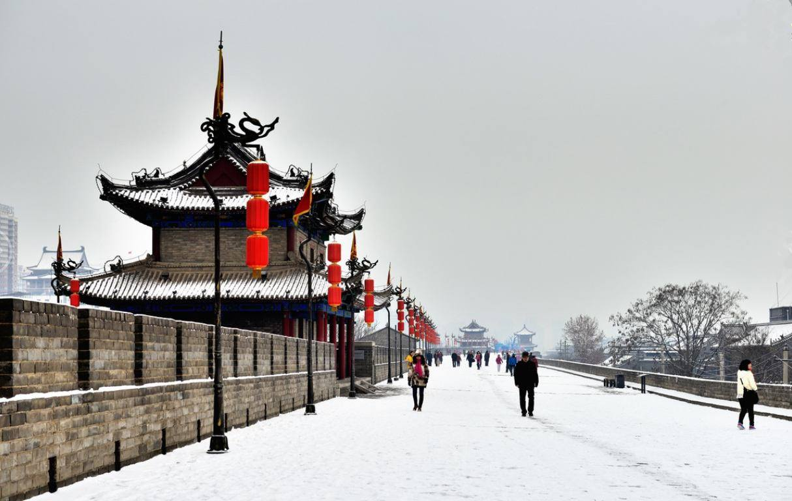
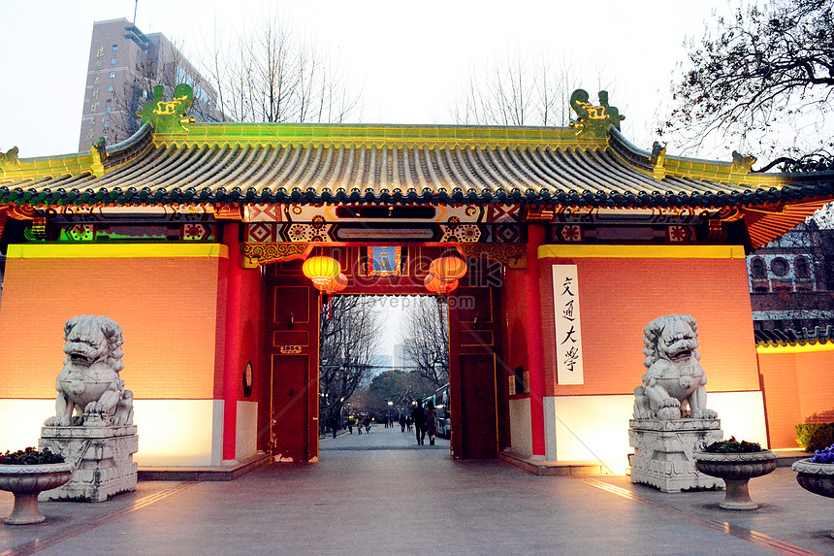
About me
Hometown: Xi'an
One of the oldest cities in China
Capitals for 13 dynasties
Moved to Shanghai
Shanghai Jiao Tong University
B.S. in Accounting
M.S. in Finance

Slide 4
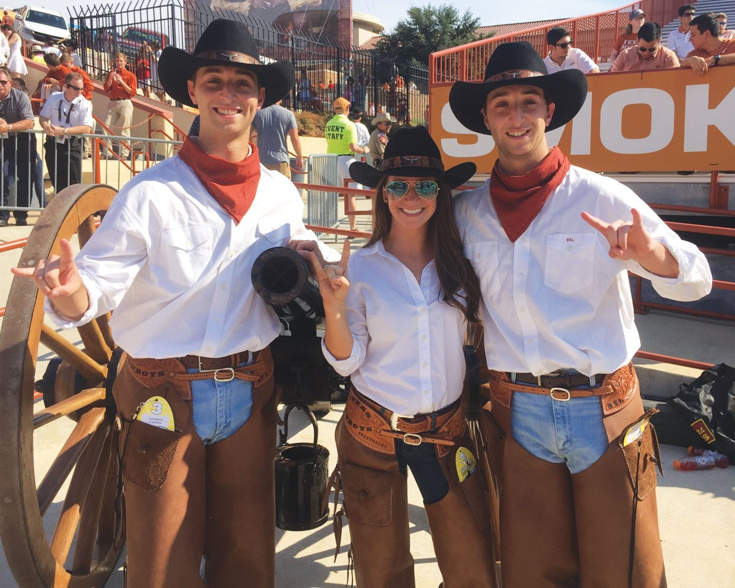
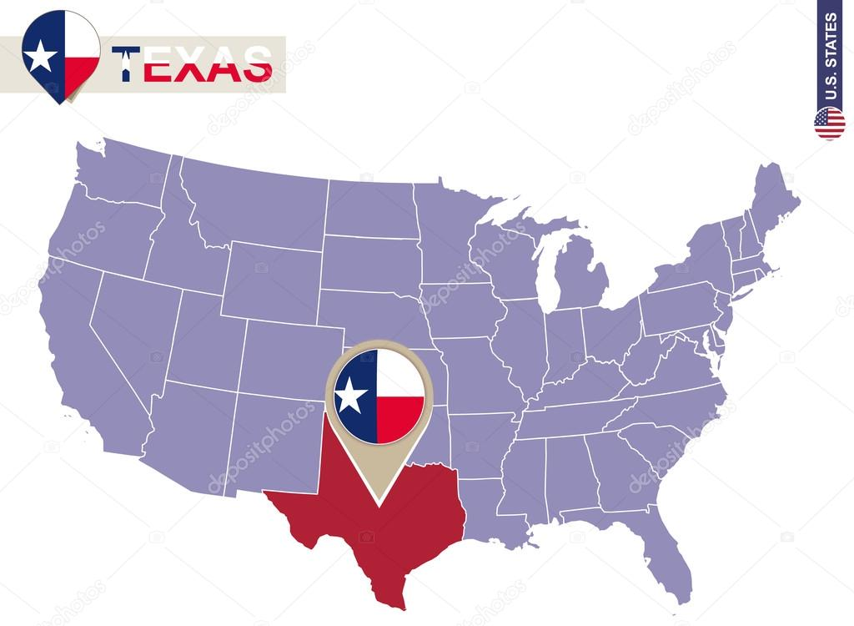
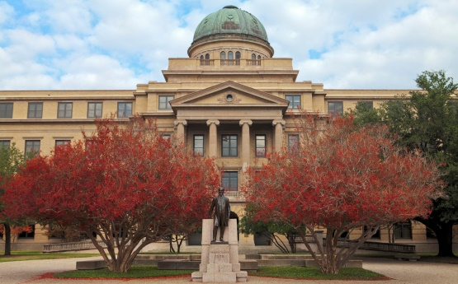

Texas
Attend Texas A&M University
Ph.D. in Management
Strong traditions of Texas A&M University

Slide 5
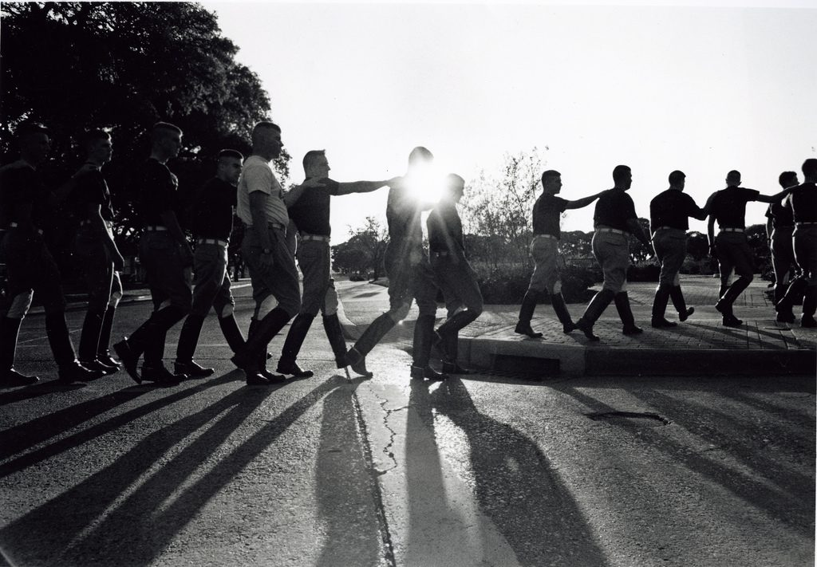
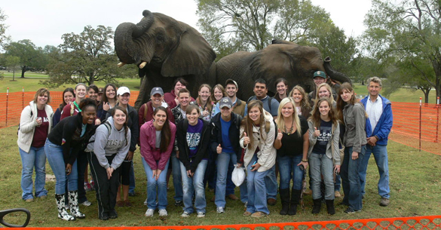
Elephant Walk

Slide 6


Midnight Yell

Slide 7

The Aggie War Hymn
Hullabaloo, Caneck! Caneck! Hullabaloo, Caneck! Caneck!
Good-bye to texas university So long to the orange and the white Good luck to dear old Texas Aggies They are the boys that show the real old fight “The eyes of Texas are upon you . . .” That is the song they sing so well
So good-bye to texas university We’re going to beat you all to
Chig-gar-roo-gar-rem Chig-gar-roo-gar-rem Rough Tough! Real Stuff! Texas A&M!

Slide 8
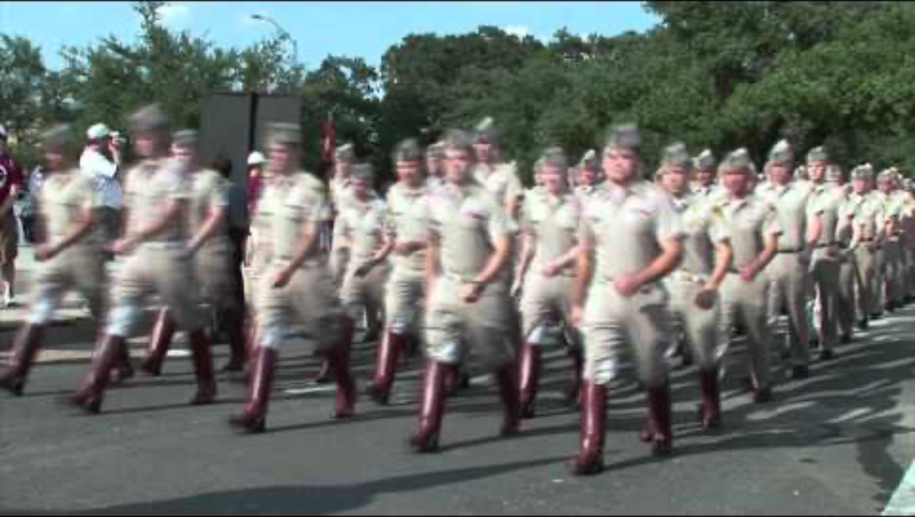

Slide 9
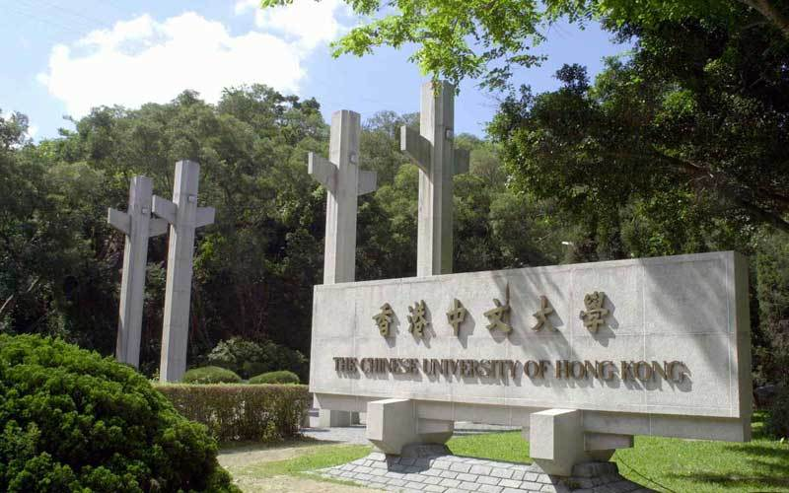
Hong Kong
Moved to Hong Kong in 2019
CUHK and me
Dream school When in the high school

Slide 10

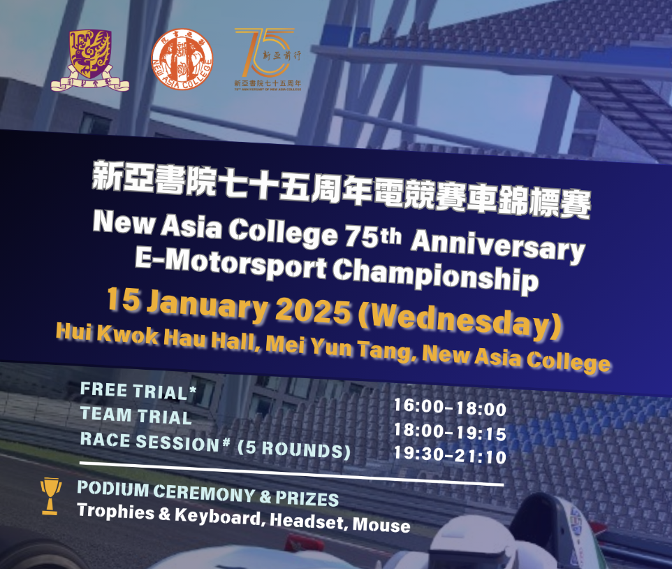
CUHK and me：College system
Imaged college activities
Actually college activities

Slide 11

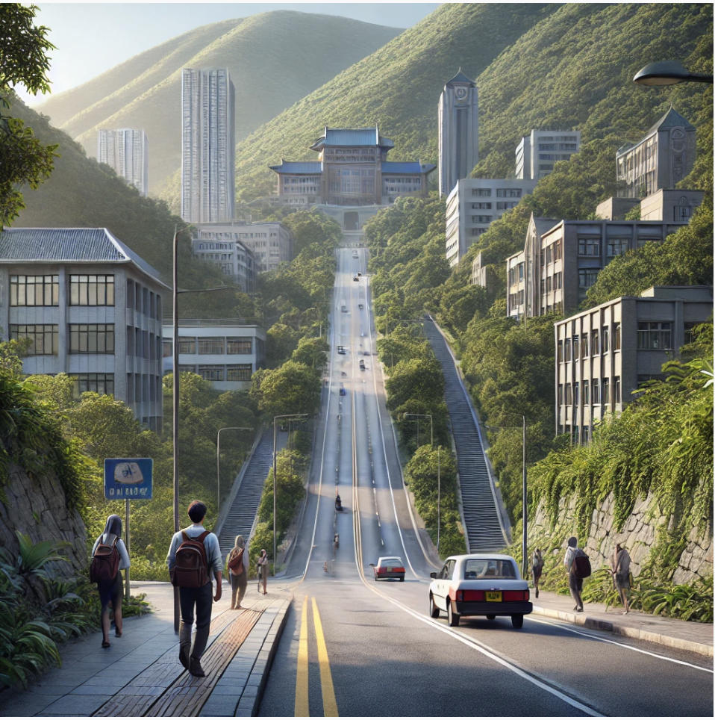
CUHK and me：Stunning Campus
Imaged Campus
Actually Campus

Slide 12


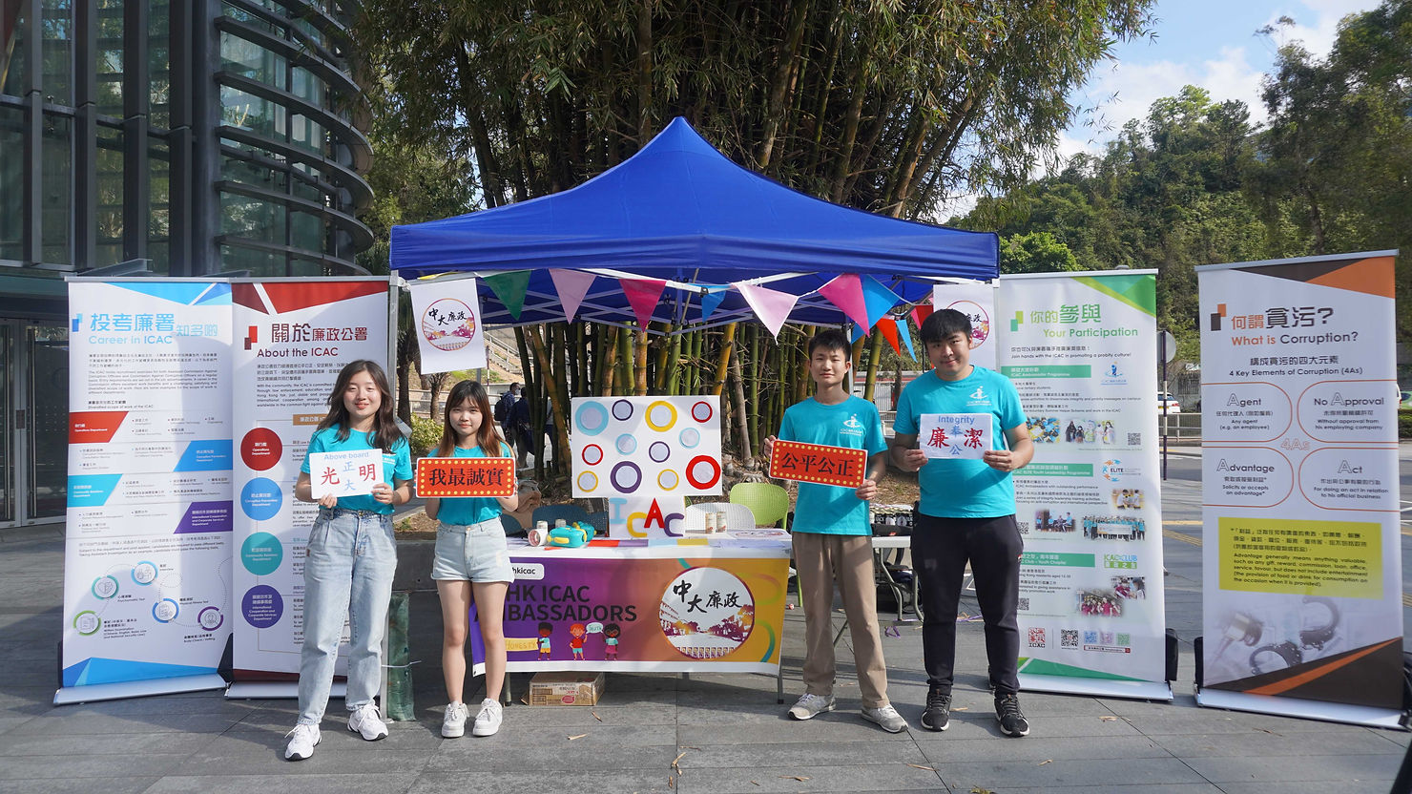

CUHK and me: On-campus Activities
Imaged Student Activities
Actually Student Activities

Slide 13

Teaching Philosophy
Real & Practical
Diversity & Interaction
Communication & Mutual-understanding
Friendship and support

Slide 14
What else do you want to know about me?

Slide 15

What you can expect
INTENSIVE Participation
Weekly case (Readings)
Cooperation and competition
No homework and assignments
Pass the course (in normal situation)
Support and Friendship

Slide 16

What you may gain
Possibly nothing if you do not devote
Strategic way of thinking
Knowledge and Experiences
Examples, tools and frameworks for managerial analysis
Useful experiences for future careers

Slide 17
Class Schedule
Three sections
Lecture
Break (15)
Lecture & Class Activities
Break (15)
Case activities & project sharing
Interaction and discussion-oriented class
PARTICIPATION is the key

Slide 18
Class Requirements and Syllabus

Slide 19
Class Requirements
Attend class on time
Build a positive and effective learning environment
Show respect for your fellow students and the instructor.
Develop good habits that will benefit your future career and life
Request leave in advance
University-approved excuses will be accepted.
Up to two additional excused absences may be granted
Participation is key
Not a lecture-style class
What you learn depends on how much you participate
Grades are typically strongly aligned with participation levels
No AI Tools Allowed
Ensure work reflects your own thinking and learning
Maintain fairness and academic integrity

Slide 20
Any Questions?

Slide 21
NOW, it is your turn

Slide 22
Ice Breaking Time
You all seem to know each other pretty well already: But I don’t know you yet
So please tell me:
What is your dream job?
How do you plan to achieve it?
How can strategic management help you get there? (What can I do for you?)

Slide 23


Slide 24
Objectives for Today
Sign up a case!
Form your project group!
A brief introduction about strategy, mission, vision, and strategic management process
Interactive Case Exercise: Alaska Gold Mine

Slide 25
What is a strategy?
When will you use the term “strategy”?

Slide 26
What is Strategy?
What is not a strategy
A Goal
A leader
A Plan
Approach of doing things
The term “Strategy” origins in military history:
strategus
a military commander in ancient Athens and a member of the Council of War
stratos (στατοζ) – army
agein (αγειν) – to lead
Carl von Clausewitz, On War 1832 – “the intelligent use of individual battles for the design of a sustainable campaign”
Sun Tzu The Art of War (circa 500 B.C.): “Strategy without tactics is the slowest route to victory. Tactics without strategy is the noise before defeat.”

Slide 27

Strategy in the Business Context
Business Strategies are streams of related actions that managers take to increase their company’s performance
Strategic Management Process(SMP):
Leadership
Task of effectively managing a company’s strategy-making process
Formulation
Task of determining and selecting strategies
Implementation
Task of putting strategies into action
Feedback and revisions
Revise your strategy based on the current implementation results

Slide 28
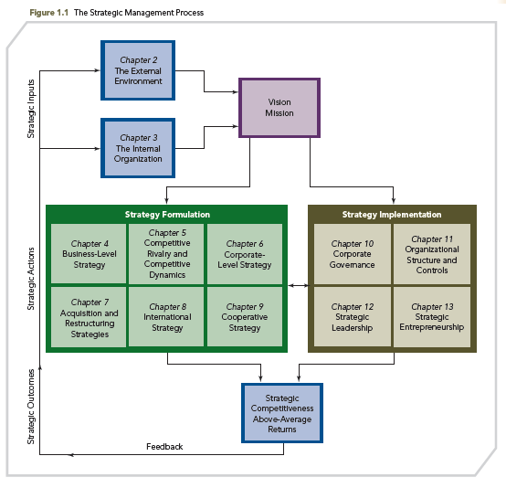
The Strategic Management Process (SMP)

Slide 29
Step 1: Analyze strategic inputs
External analysis
External environment is primary determinant of a firm’s strategic actions
Models focus on the firm’s external environment:
Macro environment analysis
Industrial organization (I/O) model
Internal Analysis:
Resource-based model: A model focuses on the firm’s internal environment
A firm’s unique resources and capabilities are the critical link to strategic competitiveness.
Why does a firm or entrepreneur need to conduct these analysis?

Slide 30
Mission
Specifically about what your organization actually does
Short and easy to memorize
Selection of choices regarding:
Customer needs – WHAT is to be satisfied
Customer groups – WHO is to be satisfied
Strategic orientation – HOW customers are to be satisfied
Example:
“To assist in the preservation, creation, application and dissemination of knowledge by teaching, research and public service in a comprehensive range of disciplines, thereby serving the needs and enhancing the well-being of the citizens of Hong Kong, China as a whole, and the wider world community.”
Foundation of consistent strategy formulation

Slide 31
Exercise: Mission Matching
Can you match the mission statement with organizations?
Act in the public interest, serving all audiences through the provision of impartial, high-quality and distinctive output and services which inform, educate and entertain
To seek the truth and help people understand the world
To organize the world’s information and make it universally accessible and useful
To give everyone the power to create and share ideas and information instantly without barriers
To give people the power to build community and bring the world closer together
To be Earth's most customer-centric company
Inspire creativity and bring joy
Google
New York Times
BBC
Meta (Facebook)
Tik Tok
X (Twitter)
Amazon

Slide 32
Vision
Can be logical extension of current path
Answers the question, “What would the company aspires to be?”
A good vision is meant to stretch a company by articulating an ambitious but attainable FUTURE state
A good vision can help drive decisions and goals in your company
Meta’s vision: “Bring the metaverse to life and help people connect, find communities and grow businesses.”
Amazon’s vision: “Be Earth's most customer-centric company, where customers can find and discover anything they might want to buy online, and endeavours to offer its customers the lowest possible prices”

Slide 33
Vision
Can also be ambitious communication of strategic intent
Avoids the strategic fit model, which focuses too much on the current state
Sets ambitious vision and goals that stretch a company and then finds ways to build to attain those goals
Interesting Examples:
“Crush Adidas” (Nike in the1960s)
“Become the company most known for changing the worldwide poor quality image of Japanese products” (Sony in the 1950s)
“Become the Harvard of the West” (Stanford in the 1940s)
“Become a $125 billion company by the year 2000” (Walmart in the 1990s)
“Be the world's most trusted and influential social media platform, where people can connect, express themselves, and stay informed from X

Slide 34
Step 2: Take Strategic Action
THE FIRM
Mission, Vision &
Values
Resources &
Capabilities
Structure &
Systems
THE
INDUSTRY
ENVIRONMENT
Competitors
Customers
Suppliers
STRATEGY
STRATEGY
Develop relevant strategies at different levels
Business level strategy & Corporate level strategy
Competitive & cooperative
International & regional

Slide 35
Monitoring through Goals
A goal is a precise and measurable desired future state that a company must realize if it is to attain its vision or mission.
Key characteristics of well-constructed goals
Precise and measurable
To provide a yardstick or standard to judge performance
Address crucial issues
With a limited number of key goals that help to maintain focus
Challenging but realistic
To provide employees with incentive for improving
Optional: Specify a time period
To motivate and inject a sense of urgency into goal attainment
Focus on long-run performance and competitiveness.

Slide 36
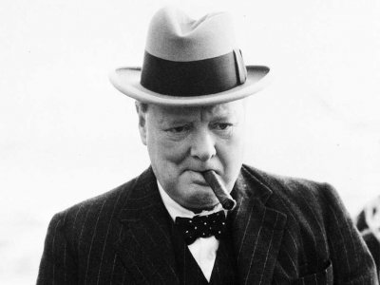
Step 3: Realize strategic outcomes
Strategic leaders must
Predict the potential outcomes of their strategic decisions.
Monitor and re-evaluate strategy execution
Determine if strategic goals and objectives are being achieved
Strategic planning is ongoing.
“However beautiful the strategy, you should occasionally look at the results”
-Sir Winston Churchill

Slide 37
Step 3: Realize strategic outcomes
How does strategic leaders make decisions during SMP?
Identify a strategic issue from analyzing strategic inputs (step 1)
Strategic issue:
Major problem affecting the organization toward its mission and vision.
Resolving it can have a major impact on the direction and success of the firm.
Can only be addressed by top executives
Different strategic leaders may perceive different strategic issues
Develop multiple alternative course of actions (Step 2)
Evaluate and select the final strategy (Step 3)
Limitations of decision making takes place during this process
Corporate governance and leadership
Organizational structure and controls
Our case analysis is to mimic the decision-making during SMP

Slide 38
Pros and Cons of Formal Strategy Process
Benefits:
Reduces uncertainties of depending on luck or constraints of following history
Provides systematic method and improves probability of business success
Reduces the psychological biases inherent in human decision-making
Problems:
Could lead to rigidities (poor adaptation to new information)
Could be restrictive (low foresight or ambition)
Could be time consuming (counter-productive in dynamic environments)

Slide 39

Case Analysis: Alaska Gold Mine

Slide 40
Case Analysis: Alaska Gold Mine
You have taken a 3-month option on a possible gold mine in Alaska
During your trek and exploration, you have remained relatively healthy except for an injured left hand which sometimes can suddenly become quite weak.
With 2 weeks to go before your option expires, you have finally discovered gold in what appears to be good quantity.
You have exactly 2 weeks to get to the claims office. If you arrive late and attempt to secure the property with the owners knowing you have visited it, they will probably hold an auction, at which you, given your limited resources, could easily be outbid.
The weather is only moderately favorable; a mountain storm may be brewing. You will know within 48 hours if the storm is coming and will know whether the mountain is passable (if the storm comes) about one day later.

Slide 41
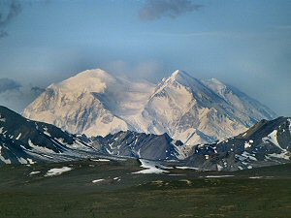
The Alaska Gold Mine
Here are your alternatives:
1. Wait 3 or 4 weeks until the weather warms up and enjoy a safe trip home
2. Go over the mountains. This is dangerous. It is sometimes impassible. It is quick, however (usually 7 to 10 days), if you can make it without harm. If you encounter storms or are injured before you reach the top, you will probably have to turn back. In either case, you may perish, because the longest part of the journey is on the way over the top.

Slide 42
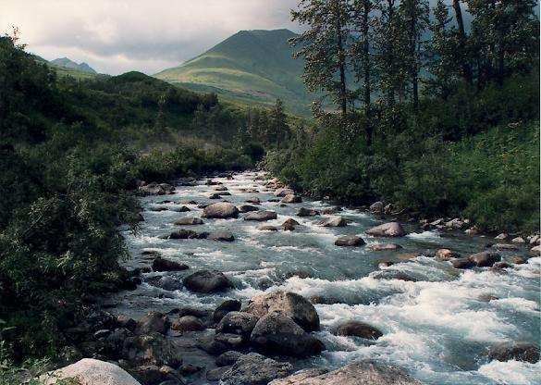
The Alaska Gold Mine
3. Go through the valley passes. This is less dangerous and is usually passable. However, it is slow and tiring. Most people can usually complete this journey in 2 to 3 weeks
4. Wait 2 to 4 days, take #2 if the weather permits; if not take #3. (There is no advantage to waiting if you prefer #3 anyway, and waiting to take #1 = #1).

Slide 43
The Alaska Gold Mine
Which alternative do you prefer?
Join the group representing your choice
Talk to your teammates for 10 minutes to develop your reasoning
Everyone needs to develop his/her arguments
Let’s debate!

Slide 44
The Alaska Gold Mine
Only 14 days
Option | Min Time | Max Time | Possible gain | Personal Risk
#1 Wait 3-4 weeks |  |  | None | None
#2 Over top | 7 days | 10 days | For sure $$$ | Life
#3 Valley | 14 days | 21 days | For sure $$$ | None
# Wait 2-4 days | 9-14 days to top | 16-25 days to Valley | $$$, if top Lose, if storm | Win if no storm; Lose if storm

Slide 45

The Alaska Gold Mine
Other options
Valley 3 days, then re-assess
Bluff
Bring a sat phone next time so that you can order a helicopter
Anything else?

Slide 46
Step 1: Analyze strategic inputs
Step 2: Take Strategic Action
Environment
Strategy Formulation
Values
Goal & Mission
Capabilities

Slide 47
Part II Assume you chose the valley pass (#3)
5 days later you are halfway there. But, you may have pushed too hard as you sprained your ankle. Fortunately, you run into Pat, an old friend on a trapping expedition. Pat could get you to the claims office and offers to take you.
1. If you were healthy, you could get there easily in 7 days, but you cannot make it alone without a few days rest, and even then it could take 10 days or more, depending on how your ankle holds up.
2. Traveling together, you might make it in 10 to 14 days.
3. If you tell Pat about the gold and make a deal, Pat alone could get there in 8 to 10 days.
You are not sure whether Pat can exercise the option and file the claim correctly, because Pat is not bright, tends to drink in excess, and is not the single-minded hustler that you are.
Pat is a simple, decent person who likes trapping but would, you suspect, both need and desire financial independence. You think you could trust Pat if you offer to split 50-50, because Pat would need your expertise to capitalize on the discovery.

Slide 48
The Alaska Gold Mine
Which alternative do you prefer?
Go alone__ Go with Pat__ Send Pat__
Join the group representing your choice
Talk to your teammates for 10 minutes to develop your reasoning
Everyone needs to develop his/her arguments
Let’s debate!
Any other alternatives?

Slide 49
Step 1: Analyze strategic inputs
Step 2: Take Strategic Action
Step 3: Realize strategic outcomes
Implementation
Structure
Processes
Rewards
Leadership
Resource allocation
Stakeholder support
Environment
Strategy Formulation
Intended
Emergent and realized
Values
Goal
Capabilities
Performance

Slide 50


Slide 51
Lyrics
We must all efficiently operationalize our strategies.
Invest in world-class technology, and leverage our core competencies.
In order to holistically administrate exceptional synergy, we'll set a brand trajectory using management's philosophy (to) advance our market share vis-à-vis our proven methodology.
With strong commitment to quality, effectively enhancing corporate synergy, transitioning our company by awareness of functionality, promoting viability, providing our supply chain with diversity, we will distill our identity through client-centric solutions and synergy.
At the end of the day, we must monetize our assets, the fundamentals of change. Can you visualize a value-added experience? That will grow the business infrastructure and monetize our assets.
Bringing to the table, our capitalized reputation, proactively overseeing, day-to-day operations, services and deliverables with cross-platform innovation, networking, soon will bring, seamless integration robust and scalable, bleeding-edge and next-generation best of breed.
We'll succeed in achieving globalization and gaining traction with our resources in the marketplace.
It's mission-critical to stay incentivized. Against this purple-poster-flexible-solutions for our customer base if you can't think outside the box. You'll be downsized. It's a paradigm shift!

