Slide 1
MGNT 5506G f Strategic Management for Competitive Advantage
Jingyu (Sissi) Li

Slide 2
Objectives for Today
1. Which macroeconomic environment factors to examine?
2. How does industry structure affect firms’ profitability?
3. What determines the strength of industry forces acting on firms?
4. Practice the Five forces analysis

Slide 3

“To assure victory, always carefully survey the field before battle.”
- Sun Tzu

Slide 4
Environments of a Firm
General
Industry
Competitive
Firm

Slide 5
What environmental analyses have you studied thus far?

Slide 6

The Macroeconomic Environment
Demographic
Political-Legal
Sociocultural
Economic
Technological
Global
Physical

Slide 7

Aspects of the General Environment
Political/legal
Attention and resources from government
Law and regulations guiding competition
Economic
Nature and direction of macroeconomy
Sociocultural
Social attitudes, cultural values
Technological
Institutions and activities that effect knowledge creation
Translation of new knowledge into new products and processes
Demographic
Population size, age structure, geographic mix, ethnicity, income distribution
Global
Trends and events in other 6 segments that are international in scope
Physical
Impact of business activities on the ecological environment

Slide 8
The Role of the Macro Environment
Changes in one or more aspects of the macro environment can affect:
The performance of all industries in a country
The competitiveness of certain industries more than others
General
Industry
Competitive
Firm

Slide 9
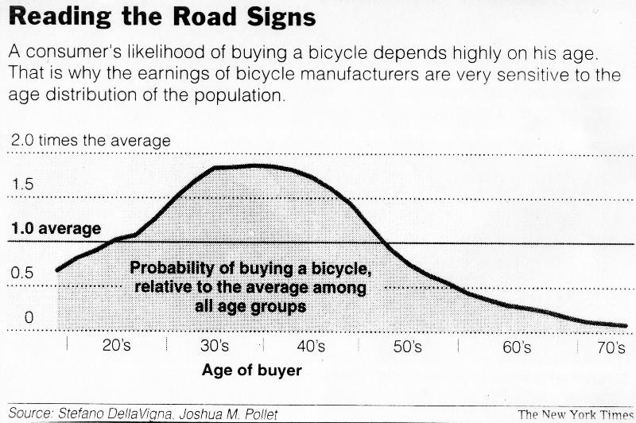
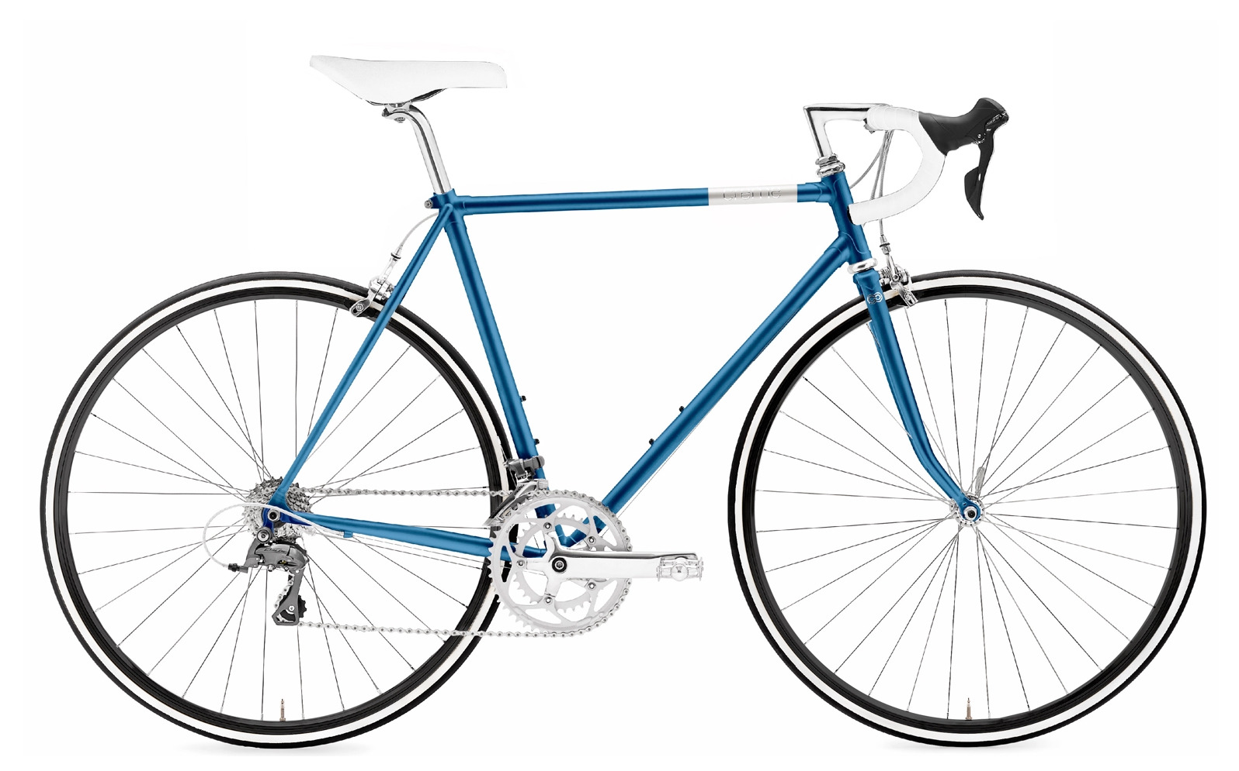
Exercise: interpreting environmental statistics
If you were the CEO of a bicycle producer
Which age group shall you focus on?
Why?

Slide 10
Exercise: "TikTok Refugees"
In early 2025, the Biden administration intensified its scrutiny of TikTok due to national security concerns.
Facing the threat of an imminent U.S. ban, millions of American TikTok users who label themselves “TikTok refugees” began to migrate many other social media platforms, including a Chinese social media platform, RedNote.
RedNote suddenly saw a surge in its user base. In response to the unexpected influx, Rednote rapidly updated its platform features.
From above facts, how do macro-environmental factors play a role to impact global social media industry?

Slide 11
Environments of a Firm
General
Industry
Competitive
Firm

Slide 12
Defining an Industry
Market Segments
Distinct groups of customers of an industry
Can be differentiated from each other with distinct attributes and specific demands
Industry
A group of companies offering products or services that are close substitutes for each other and that satisfy the same basic customer needs
Industry boundaries may change as customer needs evolve and technology changes
Sector
A group of closely related industries

Slide 13
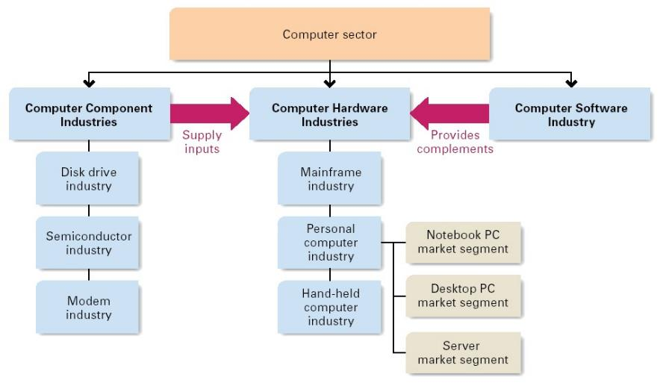
The Computer Sector, Industries and Segments

Slide 14
Challenges of Industry Definition
Multiple levels of aggregation possible
Restaurants vs. Fine Dining
New industries emerge from existing industries
e.g., social media industry from high-tech industry
Domestic versus global perspective
Domestic fashion industry vs global fashion industry
Widely different business models
Online retail stores vs physical department stores
Identify the relevant industry: SUBSTITUTABILITY
On the demand side: are buyers willing to substitute between various products and across countries
On the supply side: are suppliers able to switch between manufacturers and across countries
May need to analyze industry at different levels for different types of decision

Slide 15
Always Define the industries You focus on!

Slide 16
Industry Analysis: The Five Forces Model
Why do we need an industry analysis?
Identify threats to your existing business
Identify opportunities that will allow you to transform your business
Level of analysis: industry level!!!
Risk of entry
by potential
competitors
Rivalry
Among
Established
Firms
Bargaining
power of
suppliers
Bargaining
power of
buyers
Threat of
substitute
products

Slide 17
① Risk of Entry by Potential Competitors
Potential Competitors:
Companies that are NOT currently competing in an industry but have the capability to do so if they choose
Potential competitors can be prevented or reduced by having/enhancing the barriers of entry
Barriers to new entrants:
Economic of scale
Supply-side economies of scale
Cost benefits and operation efficiencies from large scale
Demand-side benefits of scale: network effects
Customers Brand loyalty and switching costs
Familiarity with products
Trust in established brands
Access to limited resources
Location
Investments, inputs & channels
Government regulation

Slide 18


Slide 19
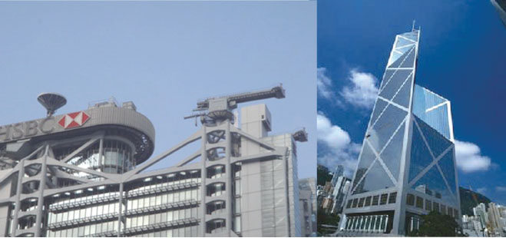
② Rivalry Among Established Companies
Competitive Rivalry:
Competitive struggle between companies in the same industry to gain market share from each other
Intensity of rivalry is strong when:
Competitors are numerous or are roughly equal in size and power
Industry growth is slow
High Exit Barriers
High investment in specific assets
Economic dependence on industry
Emotional attachment to industry
Bankruptcy regulations
Notes:
The story of Fengshui in the building design of HSBC and Bank of China in Hong Kong is noteworthy. Both buildings, situated prominently on the Hong Kong skyline, adopted different approaches to incorporate Fengshui principles.
The HSBC Building, designed by architect Sir Norman Foster, embraced Fengshui considerations. The structure features an open atrium at its base, allowing the free flow of energy (Qi). The bank consulted with Fengshui experts during the design phase, showcasing a blend of modern architecture with traditional Chinese principles.
In contrast, the Bank of China Tower, designed by I. M. Pei, took a more contemporary stance. The building's distinctive angular design has been interpreted by some as conflicting with Fengshui principles. Its sharp angles are believed to direct negative energy (Shar Chi) towards neighboring structures, leading to controversy and discussions about the impact on the financial district's energy balance.
One notable incident occurred in response to the Bank of China Tower's angular design.
As a symbolic gesture, HSBC placed two cannon-like structures on the roof of its Hong Kong headquarters, aiming in the direction of the Bank of China Tower. This move was widely interpreted as a Fengshui countermeasure to deflect negative energy directed towards HSBC by the sharp angles of the Bank of China building.
The installation of these structures was seen as a strategic response, emphasizing the significance of Fengshui in the cultural and business landscape of Hong Kong.
The building located between the HSBC and Bank of China towers is known as the Cheung Kong Center. In the context of the Fengshui controversy between HSBC and Bank of China, the Cheung Kong Center is often considered a mediator.
Designed by Cesar Pelli, the Cheung Kong Center adopts a more neutral and conventional architectural style. Its design incorporates rounded edges and a less imposing structure compared to its angular neighbors. This deliberate effort to maintain a harmonious aesthetic is thought to mitigate any negative energy flow between the HSBC and Bank of China buildings.
The Cheung Kong Center's design is seen as a compromise, serving as a buffer and promoting a balanced energy flow within the vicinity. Its presence reflects a nuanced approach to architectural harmony, attempting to bridge the contrasting styles of the neighboring iconic structures in the heart of Hong Kong's financial district.

Slide 20
Question: What is the difference between competitors/rivalry and risk of Entry?

Slide 21
③ Bargaining Power of Buyers
Industry Buyers
Consumers or end-users who ultimately use the product or intermediaries that distribute or retail the products
Buyers are powerful when:
Buyers are dominant
Large in size and few in number.
The industry supplying the product is composed of many small companies
Buyers purchase in large quantities
Buyers have purchasing power as leverage for price reductions
The industry is dependent on the buyers
Buyers purchase a large percentage of a company’s total orders
Switching costs for buyers are low
Buyers can play off the supplying companies against each other
Buyers can purchase from several supplying companies at once
Buyers can threaten to enter the industry themselves
Buyers can use threat of entry as a tactic to drive prices down

Slide 22
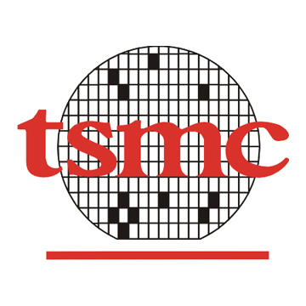
④ Bargaining Power of Suppliers
Suppliers
Organizations that provide inputs such as material and labor into the production for the industry
Suppliers are powerful when
The product supplied is vital to the industry and has few substitutes
The industry is not an important customer to suppliers.
Suppliers are not significantly affected by the industry
Switching costs for companies in the industry are significant
Suppliers can threaten to enter their customers’ industry
Companies in the industry cannot threaten to enter their suppliers’ industry by making their own inputs

Slide 23
Question: What is the relationship between the app provider and the phone manufacturer?

Slide 24

⑤ Substitute Products
Substitute Products
Products from different businesses or industries that can satisfy similar customer needs
The existence of close substitutes is a strong competitive threat
Substitutes limit the price that companies can charge for their product
Substitutes are a weak competitive force if an industry’s products have few close substitutes
Other things being equal, companies in the industry have the opportunity to raise prices and earn additional profits

Slide 25
Question: What is the difference between competitors/rivalry and substitutes?

Slide 26
The 5 Forces and Industry Profitability
The stronger that each of these five forces is, the more limited is the ability of established companies to earn greater profits
A weak competitive force may be viewed as an opportunity
A strong competitive force may be viewed as a threat
Strength of forces may change as industry conditions change
Take advantage of the Five forces (The adaption view of organizations)
POSITION YOUR COMPANY WHERE THE FORCES ARE WEAKEST
Focus on specific market segmentation
EXPLOIT CHANGES IN THE FORCES
The emergence of ITunes Music store
RESHAPE THE FORCES IN YOUR FAVOR
To neutralize supplier power, standardize specifications.
To counter customer power, expand your services.
To temper price wars initiated by established rivals, invest more heavily in product differentiations.
To scare off new entrants, elevate the fixed costs of competing
To limit the threat of substitutes, offer better value through wider product accessibility

Slide 27
Five Forces Exercise
Risk of entry
by potential
competitors
The first victim selected student must:
Describe the general business of the company
Explain the one of the five forces for that company
Pick another company for the next victim student
The fellow student must repeat the previous process
The force select by the fellow student must be different from those chosen by previous victims students
Bargaining
power of
suppliers
Rivalry
Among
Established
Firms
Bargaining
power of
buyers
Threat of
substitute
products

Slide 28
So What?
Why do we need to know this?
How to use this knowledge?

Slide 29
Five Forces Application: 🚗 EV Market Masters
4-6 student form a team: each team represents an EV company
Each team starts with 100 Million.
The Game lasts for 3 rounds (10 minutes per round)
Each round, the market changes.
Teams choose up to 3 strategies.
Competitive adjustments modify returns based on what other teams do.
The team with the highest Final Wealth ($M) wins.
Final Wealth ($M) = Total Profits+ Final Market Share × 10 + Market Share Bonus
Market Share Rank Bonus ($M):
🥇 1st Place: +30M
🥈 2nd Place: +20M
🥉 3rd Place: +10M
4th Place: +5M
5th and after: +0M

Slide 30
Round 1: New Entrants & Supplier Crisis
Industry Scenario:
A new EV startup, VoltRide, enters with aggressive pricing
Battery demand surges, causing supply shortages and rising costs
Strategy | Investment | Rev | Market Share | Competitive Adjustments
Secure long-term battery contracts | $40M | +$50M | 0% | If 2+ teams choose, suppliers raise prices: All teams pay $5M extra. If only 1 team choose: they gain $10M extra
Lobby for government subsidies | $20M | +$15M | +3% | If 2+ teams lobby, government splits funds: Each team gets only 50% of expected benefits. If no one lobbies, government support are withdrawn: All team lose 5M
Price cuts to compete with VoltRide | $30M | - $25M | +8% | If 3+ teams cut prices, price war: Market share gain is halved and each team loses $10M.
Target premium market | $50M | +$75M | +2% | If only 1 team does this: they gain +2% extra market share. If no teams target premium, luxury EV demand drops: All team lose 1% market share
Develop battery technology | $60M | +$90M | +3% | If 3+ teams invest, market gets oversaturated: Each team loses $10M. If no one invests: battery crisis continues: All team pay 8M extra

Slide 31
Round 2: Rivalry & Threat of Substitutes
Industry Scenario:
Tesla and Rivian aggressively increase marketing.
Hydrogen cars start gaining interest among consumers.
Strategy | Investment | Profit | Market Share | Competitive Adjustments
Trade-in program for old EVs | $30M | +$25M | +4% | If 2+ teams offer, customers demand more: reducing profit by $10M. If only 1 team offers it, they gain +1% extra market share.
Expand EV charging network | $50M | +$60M | +6% | If 3+ teams do, infrastructure gets oversaturated: Each team gains only +3% market share If no teams invest, all teams lose -2% market share
Lower prices | $40M | -$20M | +10% | If 3+ teams cut prices, price war: Market share gain reduced to +4%, and each team loses $15M.
Invest in hydrogen EV research | $60M | +$85M | +3% | If 3+ teams invest, market gets crowded: Each team only gets +1.5% market share If no team invests, hydrogen EVs lose traction: All team lose 1.5% market share.
Expand into commercial fleet EVs | $50M | +$65M | +5% | If only 1 team does this: they gain an extra +3% market share. If no teams invest: corporate customers shift to Tesla: all team lose 2% market share

Slide 32
Round 3: Regulation & Consumer Trends
Industry Scenario:
Governments introduce stricter EV regulations, forcing companies to invest in sustainability
Consumers demand cheaper EVs with wider ranges, increasing buyer power
Strategy | Investment | Profit | Market Share | Competitive Adjustments
Invest in battery recycling | $50M | +$55M | +3% | If 3+ teams invest, sustainability branding is oversaturated: Each team only gains +1.5% market share If no teams invest: all teams lose $5M in government fines.
Lobby for policy flexibility | $40M | +$30M | 0% | If 2+ teams lobby, government resistance increases: Each team gets only $15M
Launch budget EV | $50M | -$15M | +10% | If 3+ teams do this, oversupply occurs, reducing market share gains to +6%
Invest in self-driving EVs | $60M | +$90M | +3% | If only 1 team does this, they gain +2% extra market share. If no teams invest: all team loose 1% market share and 50M
Develop luxury ESUVs | $50M | +$75M | +2% | If only 1 team invests, they gain +1% extra market share. If no teams invest, luxury EV demand drops: all team lose 2% market share

Slide 33
EV Market Masters: Wrap-Up
How did your team approach decision-making?
What was the biggest challenge your team faced?
How did your competitors' actions affect your decisions?
If you could play again, what would you do differently

Slide 34
EV Market Masters: Takeaways
✅ No company operates in isolation:
External forces influence profitability.
✅ Industry competition is dynamic
Firms must continuously adapt.
✅ Ignoring external analysis leads to failure
Companies must balance short-term wins with long-term growth.
✅ Winning requires trade-offs
Profitability and market share must be carefully managed.

Slide 35
Limitations of the Five Forces Model
Endogenous structural change: Firms change industry structures through their own efforts
Punctuated Equilibrium: an industry’s long term stable structure is punctuated with periods of rapid change by innovation
Hypercompetitive industries: permanent and ongoing innovation and competitive change
Collaboration and cooperation: significant interaction between rivals, substitute providers, buyers and suppliers
Horizontal and vertical alliances, ecosystem building, research collaboration
Company differences: significant variances in the profit rates of individual companies within an industry
Company resources and capabilities are also important determinants of its profitability
New Types of Forces and Industry structure emergence
Digital Platform industries and various ecosystems
Industry analysis doesn’t consider these phenomena

Slide 36


Slide 37
Pfizer and the Pharmaceutical Industry
Can you briefly describe the Pharmaceutical industry?
What is the development and production process of drugs?
Which process can be controlled by a Pharmaceutical company?
What are the general environment factors should be considered?
Political/legal: Institutional health-care system and public spending; IPR protection
Sociocultural: early health check and prevention drugs
Technology; Biotech drugs
Demographic: aging population
Production of inputs
R&D
Drug Production
Marketing/sales
Drug distribution: wholesalers, pharmacies, hospitals
Drug consumption

Slide 38
Pfizer and the Pharmaceutical Industry
What were the boundaries on the pharmaceutical industry?
How was power—and therefore profitability—distributed?
Five Forces Model
Government and public health care institutions
Doctors
Manufacturers
Wholesalers
Pharmacies
Patients

Slide 39
Pfizer and the Pharmaceutical Industry
What is the power of the suppliers?
Input products (i.e., raw materials): a low value compared to the final drug:
About 15 per cent for innovative drugs, and 30 per cent for generics.
Usually commodities
Produced by a large number of different suppliers
Increasing trend by pharmaceutical firms of backward
Many large M&As in the pharmaceutical industry
Fewer customers/buyers for the suppliers
High concentration of power with buyers.
Summary of supplier power: quite low.

Slide 40
Pfizer and the Pharmaceutical Industry
What is the power of the buyers?
Who are the key buyers?
Governments and public health-care institutions
Fully or partially absorb the cost of public health-care institutions and prescribed drugs.
High public expenditure on pharmaceuticals (Exhibit 18).
Strong buying power
Actively influence prices and demand for specific pharmaceuticals
Situations vary across countries:
Local strategies was necessary
Parallel imports
Influence prescriptions of doctors
Referencing methods: hard to use international price discrimination strategies
No negotiation advantage for producers in general
Strong buyers power

Slide 41
Pfizer and the Pharmaceutical Industry
What is the power of the buyers?
Wholesalers & Pharmacies
Cannot control the price: set by pharmaceutical companies and affected by governments
Cannot control the volume: driven by the doctors and end-customer
Low power
Doctors:
May affect product selection: Depending on the country’s health-care system
Low level of power concentration: individual differences are huge
Hospitals
Concentrated doctors: a higher influence on demand
Sales targets for pharmaceutical companies: can affect price by requesting quantity discounts
Medium power
Patients
Increasing willingness to self-medicate: increasing demand for OTC
Could push for a certain prescripted treatment if they were aware of it
Low power
Overall buyers power: Medium to high

Slide 42
Pfizer and the Pharmaceutical Industry
What is the power of new entrants?
Barrier to entry:
High level of regulation
Large capital requirements for manufacturing set-up and R&D.
Long market lead time for new drugs: slow capital return
Extensive costs associated with marketing and sales: diverse customer segments.
Economies of scale in R&D, manufacturing, marketing and sales, and distribution.
High risk of failure: no return on investment
Innovative drugs could be replaced by other innovative drugs with similar effects: reduced by focused strategies
Low threats from new entrants
Are biotech firms potential new entrants?
What is power of possible substitutes?
Patent protection: increasing complementary products but not substitutes
Low power of possible substitutes during patent protection
Generics: strong substitutes after the patent protection

Slide 43
Pfizer and the Pharmaceutical Industry
What is the power of competitors?
Two types of competition
Between-patent competition: competition between different innovative drugs
Within-patent competition: competition of a generic with an innovative drug
High concentration of power within a few large pharmaceutical companies (M&A)
Strict government regulations
Constant pressure to innovate
Specialization of large pharma firms in certain treatment areas
Strong power from competitive rivalry
Overall industry power structural:
Low power: supplier, new entrants, substitutes
Medium to high power: Buyers and competitors
What do you think about the profitability of this industry?

Slide 44
Pfizer and the Pharmaceutical Industry
It seems the general environment and industry analysis suggest a decent operating environments. But Pfizer perceived a problem…
Which overall trends can be observed?
Increasing volume of sales, but share in innovative drugs was decreasing:
$832 billion) but generics by 67 per cent (from $60 billion to $100 billion) (Exhibit 10)
Stagnating R&D productivity
Decreasing R&D inputs: 2010-2017: 21%-23% of sales
Decreasing sales of innovative drugs: 2010 ($30 billion) to 2017 ($15 billion)
Growing number of biologics (Exhibit 7) by small biotech companies
More drugs approved by FDA but blockbuster successes were decreasing
Shift to specialization strategies
Patent protection was decreasing in effectiveness
Decreasing motivation for pharmaceutical companies to do R&D
M&A was increasing
Big marketing expenditure (compared to R&D). (Exhibit 11 & 12).

Slide 45
Pfizer and the Pharmaceutical Industry
How will the profitability of the industry change?
Slower growth in all core markets
A shift toward generics and biosimilars
A shift toward developing markets
Higher pressure from new market incumbents (generics) in these markets
Institutional and inter-regional protectionism in emerging-market countries
Increasing pressure to differentiate the product portfolio
Higher profitability should be expected
How might Pfizer react to changes in the industry?
Enhance M&A activities
Specialize in specific therapeutic areas
Reduce sales forces and cooperate with competitors.
Change R&D
Restructure

