Slide 1
MGNT 5506G f Strategic Management for Competitive Advantage
Jingyu (Sissi) Li

Slide 2
Objectives for Today
Understand the definition of business level strategy
Discussion of different types of business level strategy and competitive advantage
Practice how different types of business level strategies can help mitigate unfavorable industry situations

Slide 3
Recall and Warmup
What is the VRIN/VRIO model?
How would you use the VRIN/VRIO model discussed in the last class to design an actionable strategy?

Slide 4
Core Competencies and Strategy
Core Competencies
Resources and superior capabilities that are sources of competitive advantage over a firm’s rivals (VRIN/VRIO)
An integrated and coordinated set of actions taken to exploit core competencies and gain competitive advantage
Strategic actions
Providing value to customers and gaining competitive advantage by exploiting core competencies in individual product markets
Business-level Strategy

Slide 5
Business Level Strategy
Definition
An integrated and coordinated set of commitments and actions the firm uses to gain a competitive advantage by exploiting core competencies in specific product markets.
To formulate the business level strategy
Customers are the foundation of successful business-level strategies
Key issues to address when try to develop a business level strategy
Who will be served?
What needs will be satisfied?
How will those needs be satisfied?

Slide 6
Business Level Strategy
Definition
An integrated and coordinated set of commitments and actions the firm uses to gain a competitive advantage by exploiting core competencies in specific product markets.
To formulate the business level strategy
Ex. Launching a Campus Food Delivery Startup
You and a group of friends recently launched "SpeedBites", a food delivery service designed specifically for CUHK students. Unlike large platforms like Foodpanda or Deliveroo, SpeedBites focuses only on CUHK on-campus deliveries, offering faster service and cheaper delivery fees.
At first, the business seemed to be a great idea—students don’t have to wait long, and you have a steady stream of orders from those too busy or lazy to go out.
However, after a month, you noticed that your order volume is lower than expected.
As the co-founders, you realize that you need to rethink your strategy to make SpeedBites stand out.
What key questions must you address to make this business succeed?

Slide 7
Business Level Strategy
To formulate the business level strategy
Customers are the foundation of successful business-level strategies
Who will be served?
Should SpeedBites focus only on students in dorms or expand to faculty and staff?
Should they serve only night-time orders when students are lazy to go out, or aim for lunch and dinner crowds?
Should they target students who don’t cook, or busy students who don’t have time to eat out?
What needs will be satisfied?
Is the main customer need faster delivery than Foodpanda/Deliveroo?
Or is it lower delivery fees?
Should SpeedBites add services like bringing milk tea, late-night snacks, or even medicine?
Should SpeedBites expand to food and drinks outside the campus?
How will those needs be satisfied?
Offer General service: Offer the same standard food delivery as competitors?
Or Customized service: Focus on late-night deliveries, group orders, or delivering items other than food (e.g., stationery, medicine)?
Should they introduce subscription models, where students pay a flat monthly fee for unlimited deliveries?

Slide 8
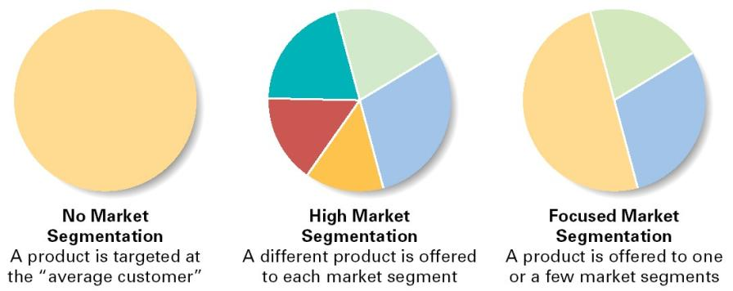

Business Level Strategy
To formulate the business level strategy
Step 1: Who will be served?
Segment the market to identify your group of customers:
Market Segmentation: customers grouped based on differences in needs or preferences
Main Approaches to Segmenting Markets
Ignore differences in segments: make product for typical/average customer
Recognize differences between segments: make products that meet needs of all/most segments
Target specific segments: focus on/serve one or two selected segments
BROAD
NARROW

Slide 9
Market Segmentation
Market
Market Segments
Market Subsegments
Delivery Services
Food and drinks delivery
On-campus delivery
Everywhere delivery
Supermarket delivery
Flexible delivery
All students, faculty and staff
All students
Undergrads

Slide 10
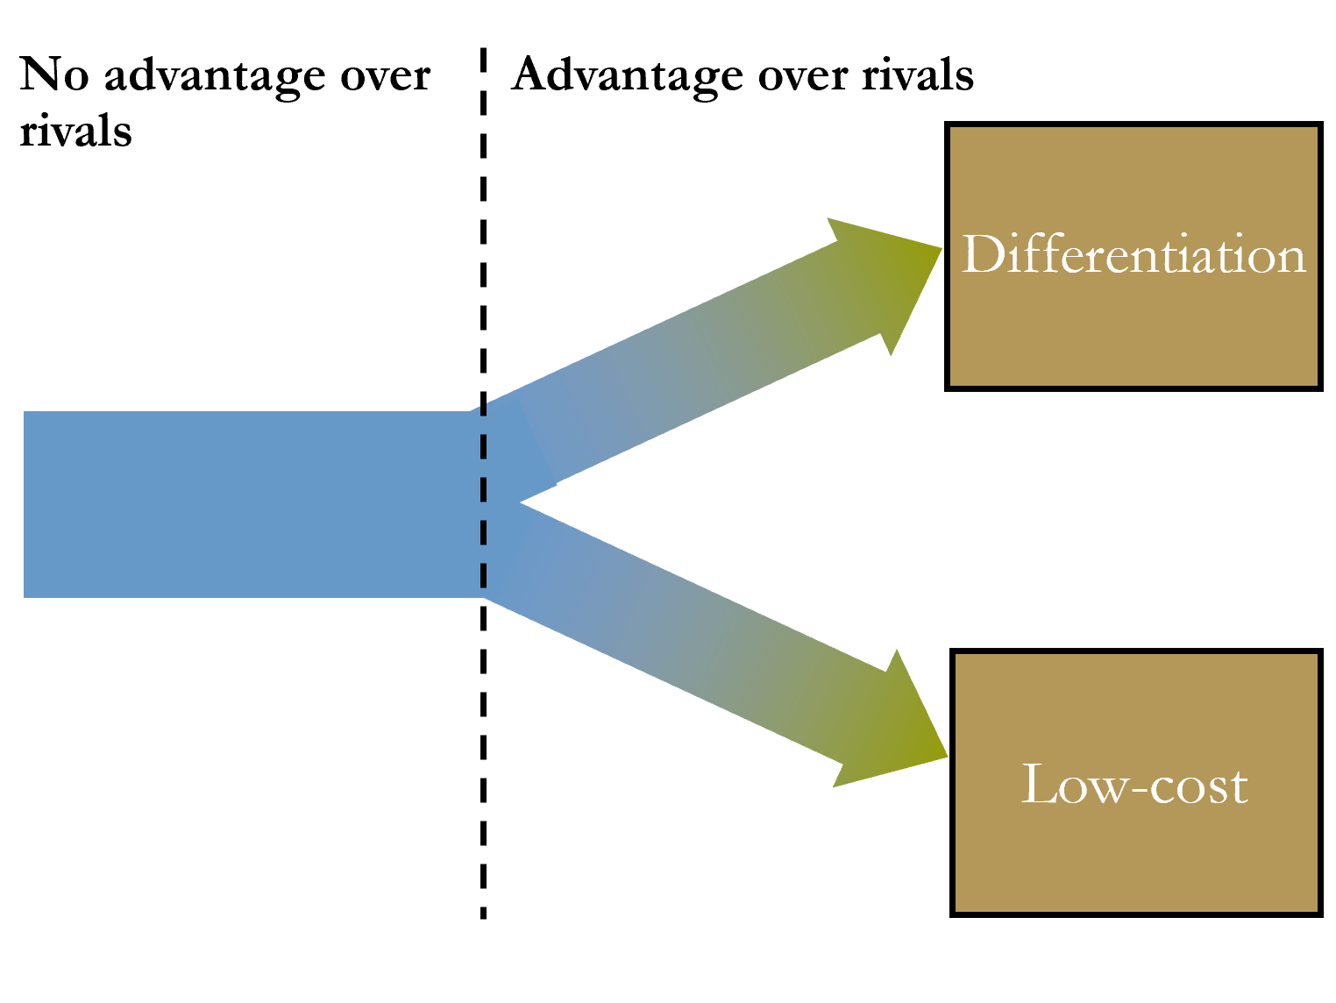
Business Level Strategy
Step2: What needs will be satisfied?
Identify strategic opportunities in terms of customer needs
Customer needs: desires, wants, or cravings to be satisfied by product attributes
Opportunity discovery vs opportunity creation
Step 3: How will those needs be satisfied?
Formulate a strategy for each targeted segment market
Customers choose product based on:
How product is differentiated from others:
Differentiation: Produce a different product and charge sufficiently higher prices
Cost reduction: Produce an essentially equivalent product at a lower cost
A profitable business level strategy depends on providing customer with most value while keeping cost structures viable.

Slide 11
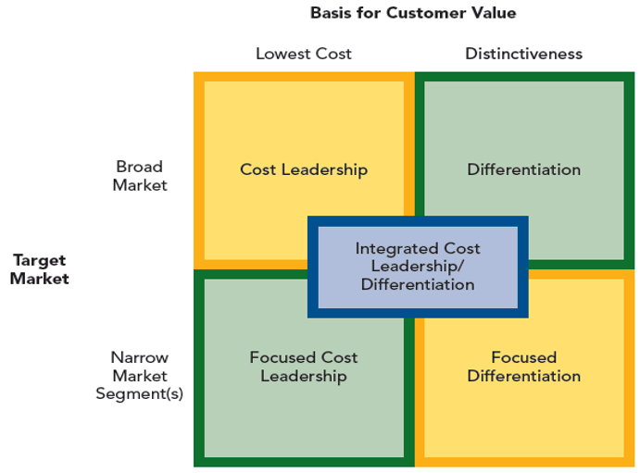
Five Generic Business-Level Strategies

Slide 12
Generic Business-Level Strategies
Cost Leadership
Lowest cost structure vis-à-vis competitors allowing price flexibility & higher profitability
Focused Cost Leadership
Cost leadership in selected market niches where it has a local or unique cost advantage
Differentiation
Features important to customers & distinct from competitors that allow premium pricing
Focused Differentiation
Distinctiveness in selected market niches where it better meets the needs of customers than the broad differentiators
Integrated Cost Leadership/Differentiation
A strategy supposed to integrate benefits of both cost leadership and differentiation.
“Stuck in the middle”

Slide 13

Cost Leadership Strategy
Using a cost leadership strategy, a firm
Produces no-frills, standardized products for typical customers
Offers these low-cost products with competitive levels of differentiation
Focuses on efficiency so costs are lower than competitors’ costs
Key drivers of cost leadership strategy
Economies of scale
Learning
Product technology
Product design
Location advantages for sourcing inputs
Risks
Obsolescence/dated
Overly Cost reductions/compromised quality
Imitation

Slide 14
Surviving in the Budget Hotel Industry
You are an executive at StayCheap Hotels, a budget hotel chain struggling to survive in a brutal industry. The hotel industry, especially the budget hotel segment is highly unfavorable because all five forces in Porter’s model are strong, creating a challenging business environment:
High Rivalry Among Competitors 🏨:
Large budget hotel chains (e.g., Holiday Inn Express) are engaged in price wars, harming profit margins.
High Threat of New Entrants 🚪
The hotel industry has low entry barriers: anyone can open a small budget hotel.
Airbnb and boutique hostels have flooded the market, offering cheap alternatives.
Strong Bargaining Power of Buyers 💰
Customers are extremely price-sensitive
Online travel agencies like Booking.com force hotels to offer steep discounts, further eroding profits.
Strong Bargaining Power of Suppliers 🛏️
Costs for cleaning, utilities, furniture, and staff remain high.
Franchise hotel brands demand high licensing fees, squeezing small operators.
High Threat of Substitutes 🏠
Travelers can choose Airbnb, capsule hotels, hostels, or even coworking spaces with nap rooms.
Customers are not loyal: if another option is cheaper, they switch.
Our CEO believes adopting a cost leadership strategy is the best approach. How can cost leadership help address each of these five forces?

Slide 15
A firm that successfully implements a cost leadership strategy can earn above-average returns even when the five forces are strong.
Industry Force | How Cost Leadership Helps StayCheap Survive | Examples of Cost Leadership Strategies
High Rivalry Among Competitors | By having the lowest operational costs, StayCheap can sustain lower prices than rivals while still making a profit. | Use prefabricated hotel rooms to lower construction costs. Operate in smaller cities & suburban areas where rent is lower.
High Threat of New Entrants | If StayCheap achieves extreme cost efficiency, new entrants will struggle to match its low prices, discouraging them from entering the market. | Bulk purchase furniture & supplies at lower costs. Use self-check-in kiosks to reduce labor expenses.
Strong Bargaining Power of Buyers | Customers can compare prices easily, so being the cheapest available option ensures demand. | Offer bare-bones pricing but charge for add-ons (e.g., towels, late check-out, room cleaning). - Introduce a membership program to lock in frequent guests.
Strong Bargaining Power of Suppliers | By operating at scale and cutting non-essential costs, StayCheap can negotiate better supplier contracts. | Sign long-term contracts with cleaning companies to get bulk discounts. Use one standardized hotel design to reduce furniture and maintenance costs.
High Threat of Substitutes | If StayCheap is the cheapest and most reliable option, fewer people will switch to alternatives like Airbnb. | Offer consistently low pricing with no seasonal fluctuations. Locate hotels near train stations, airports, or universities to attract budget travelers.

Slide 16
Differentiation Strategy
Firms using differentiation strategy
Provide products that have different, valued features that are sold at a premium price
Differentiate their products along as many dimensions as possible.
The less similarity to competitors’ products, the more buffered a firm is from competition with its rivals
Risks: price differential; value diminished; experience; counterfeit
Key Drivers
Purpose
Premium brand image
Customization
Unique styling
Speed
More convenient access
Unusually high-quality
To drive up customer’s willingness to pay and generate demand sufficient to
1. Recoup added costs and
2. Generate enough profits to make strategy worthwhile

Slide 17
Differentiation in the Streaming Service Industry
You are an executive at CineMax+, a new premium streaming service provider. The video streaming industry is extremely unfavorable.
High Rivalry Among Competitors 🎬
The market is dominated by global giants like Netflix, Disney+, HBO Max, Amazon Prime, and Apple TV+.
Intense competition has led to aggressive content spending and price wars.
High Threat of New Entrants 🚪
New players keep entering the market (e.g., Paramount+, Peacock, YouTube Premium).
Even non-media tech giants (e.g., Apple, Google, and TikTok) have launched video services.
Strong Bargaining Power of Buyers 💰
Consumers have many streaming options and can easily cancel subscriptions.
Some users rotate between services based on new releases.
Many customers now prefer free or ad-supported streaming instead of paying for multiple premium services.
Strong Bargaining Power of Suppliers 🎥
Hollywood studios, independent filmmakers, and content creators hold immense power by controlling content.
Large media companies sometimes pull their content to boost their own streaming services
Top-tier talent (directors, actors, scriptwriters) demand high salaries and creative control, increasing costs.
High Threat of Substitutes 📱
Consumers don’t need premium streaming when they have cheap alternatives like YouTube, TikTok, Instagram etc.
Many users pirate movies and TV shows instead of paying for legal streaming services.
CineMax+ is losing subscribers rapidly. The CEO decides that: “We can’t win a price war. Instead, we must offer something so unique that customers choose us over other platforms.
How exactly can differentiation help us deal with each of the five forces?

Slide 18
Industry Force | How Differentiation Helps CineMax+ Compete | Examples of Differentiation Strategies
High Rivalry Among Competitors | Instead of fighting a price war, CineMax+ can differentiate through exclusive content and innovative viewing experiences. | - Develop high-budget, interactive content (e.g., choose-your-own-adventure movies). - Focus on a specific niche (e.g., best sci-fi, indie films, or international cinema).
High Threat of New Entrants | A unique brand identity and strong customer loyalty can make it harder for new entrants to take market share. | - Offer personalized AI-driven recommendations better than competitors. - Provide exclusive live experiences (e.g., streaming concerts, celebrity Q&A sessions).
Strong Bargaining Power of Buyers | If CineMax+ provides an irreplaceable experience, customers will keep their subscriptions even with other options available. | - Introduce bundled subscriptions (e.g., include premium podcasts, live sports, or gaming content). - Offer co-viewing features, allowing users to watch with friends in virtual rooms.
Strong Bargaining Power of Suppliers | Unique production partnerships and in-house content creation reduce dependence on Hollywood studios. | - Invest in original content and acquire exclusive streaming rights for niche categories. - Partner with independent filmmakers to showcase unique stories.
High Threat of Substitutes | If CineMax+ offers exclusive content and immersive experiences, customers will prefer it over substitutes. | - Create AI-generated, interactive stories that evolve based on viewers' choices. - Offer VR/AR-enhanced entertainment experiences.
A firm that successfully implements a differentiation strategy can earn above-average returns even when the five forces are strong

Slide 19
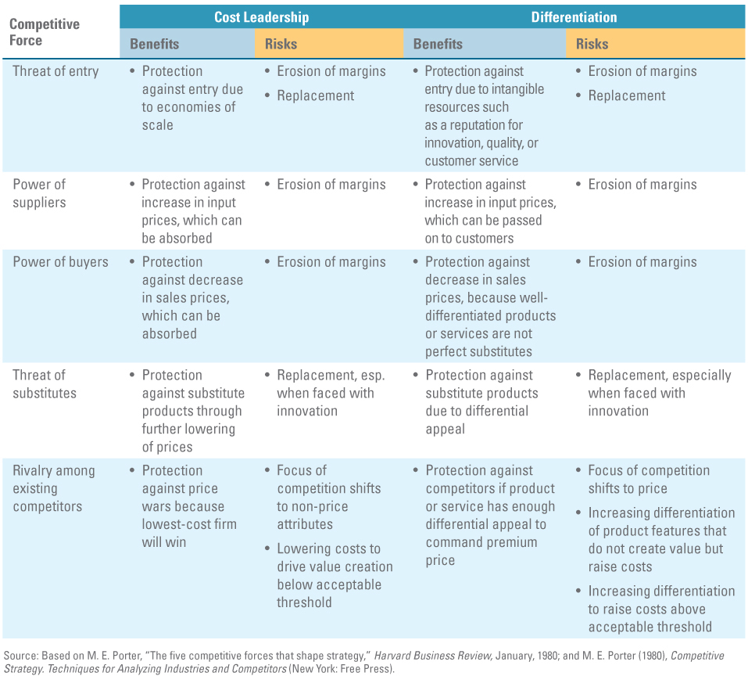

Slide 20
Five Generic Business-Level Strategies
Nike
Huawei
Wal-Mart; Wellcome
IKEA
759 Store
Abercrombie and Fitch
Apple

Slide 21
Business Level Strategy – TRADE-OFFS
Southwest airlines’ Competitive Advantages (rivals unable to imitate):
Tight integration among activities
Cost leadership strategy
Unique culture and customer service
No Meals
No baggage transfers
No connections with other airlines
Limited Passenger Service
No seat assignment
Limited use of travel agents
Standardized fleet of 737 aircraft
Short haul, point-to-point routes between midsized cities and secondary airports
Frequent, reliable departures
15-minute gate turnaround
Automatic ticketing machines
High compensation of employees
Lean, highly productive ground and gate crews
Very low ticket prices
Flexible union contracts
High level of employee stock ownership
“Southwest, the low-fare airline”
High aircraft utilization

Slide 22
Business Level Strategy - Example
Traditional
Airline
High
Offering
South
West
Meals
Seating
Friendly
Service
Frequent
Departures
Price
Connections
(Hubs)
Speed
Reliability
Lounges

Slide 23

Companies face a choice of competing based on cost, differentiation, or some combination of these factors
Business strategy must fit the company, the market, and the competitive landscape

Slide 24
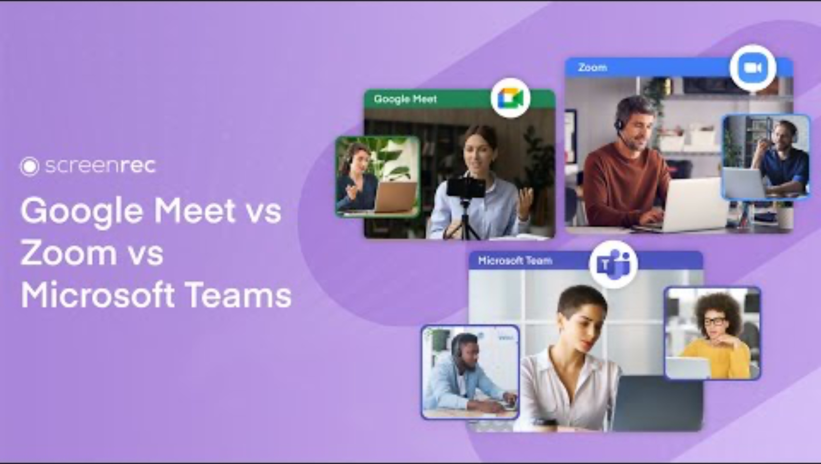

Slide 25
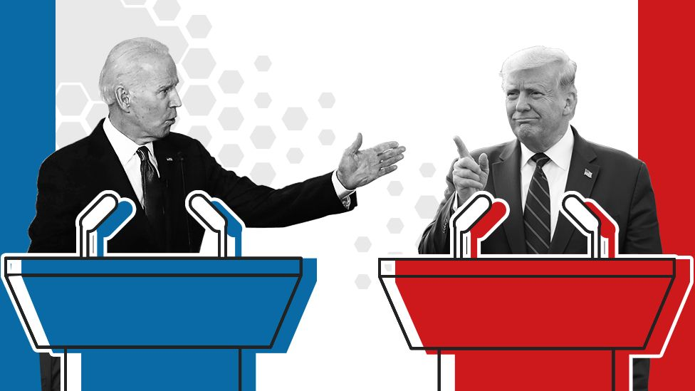
Case Debate: Does Zoom have a sustained competitive advantage?
Opening Presentations
Proposition Team (Player 1) — 1.5 min
Opposition Team (Player 1) — 1.5 min
Proposition Team (Player 2) — 1 min
Opposition Team (Player 2) — 1 min

Slide 26

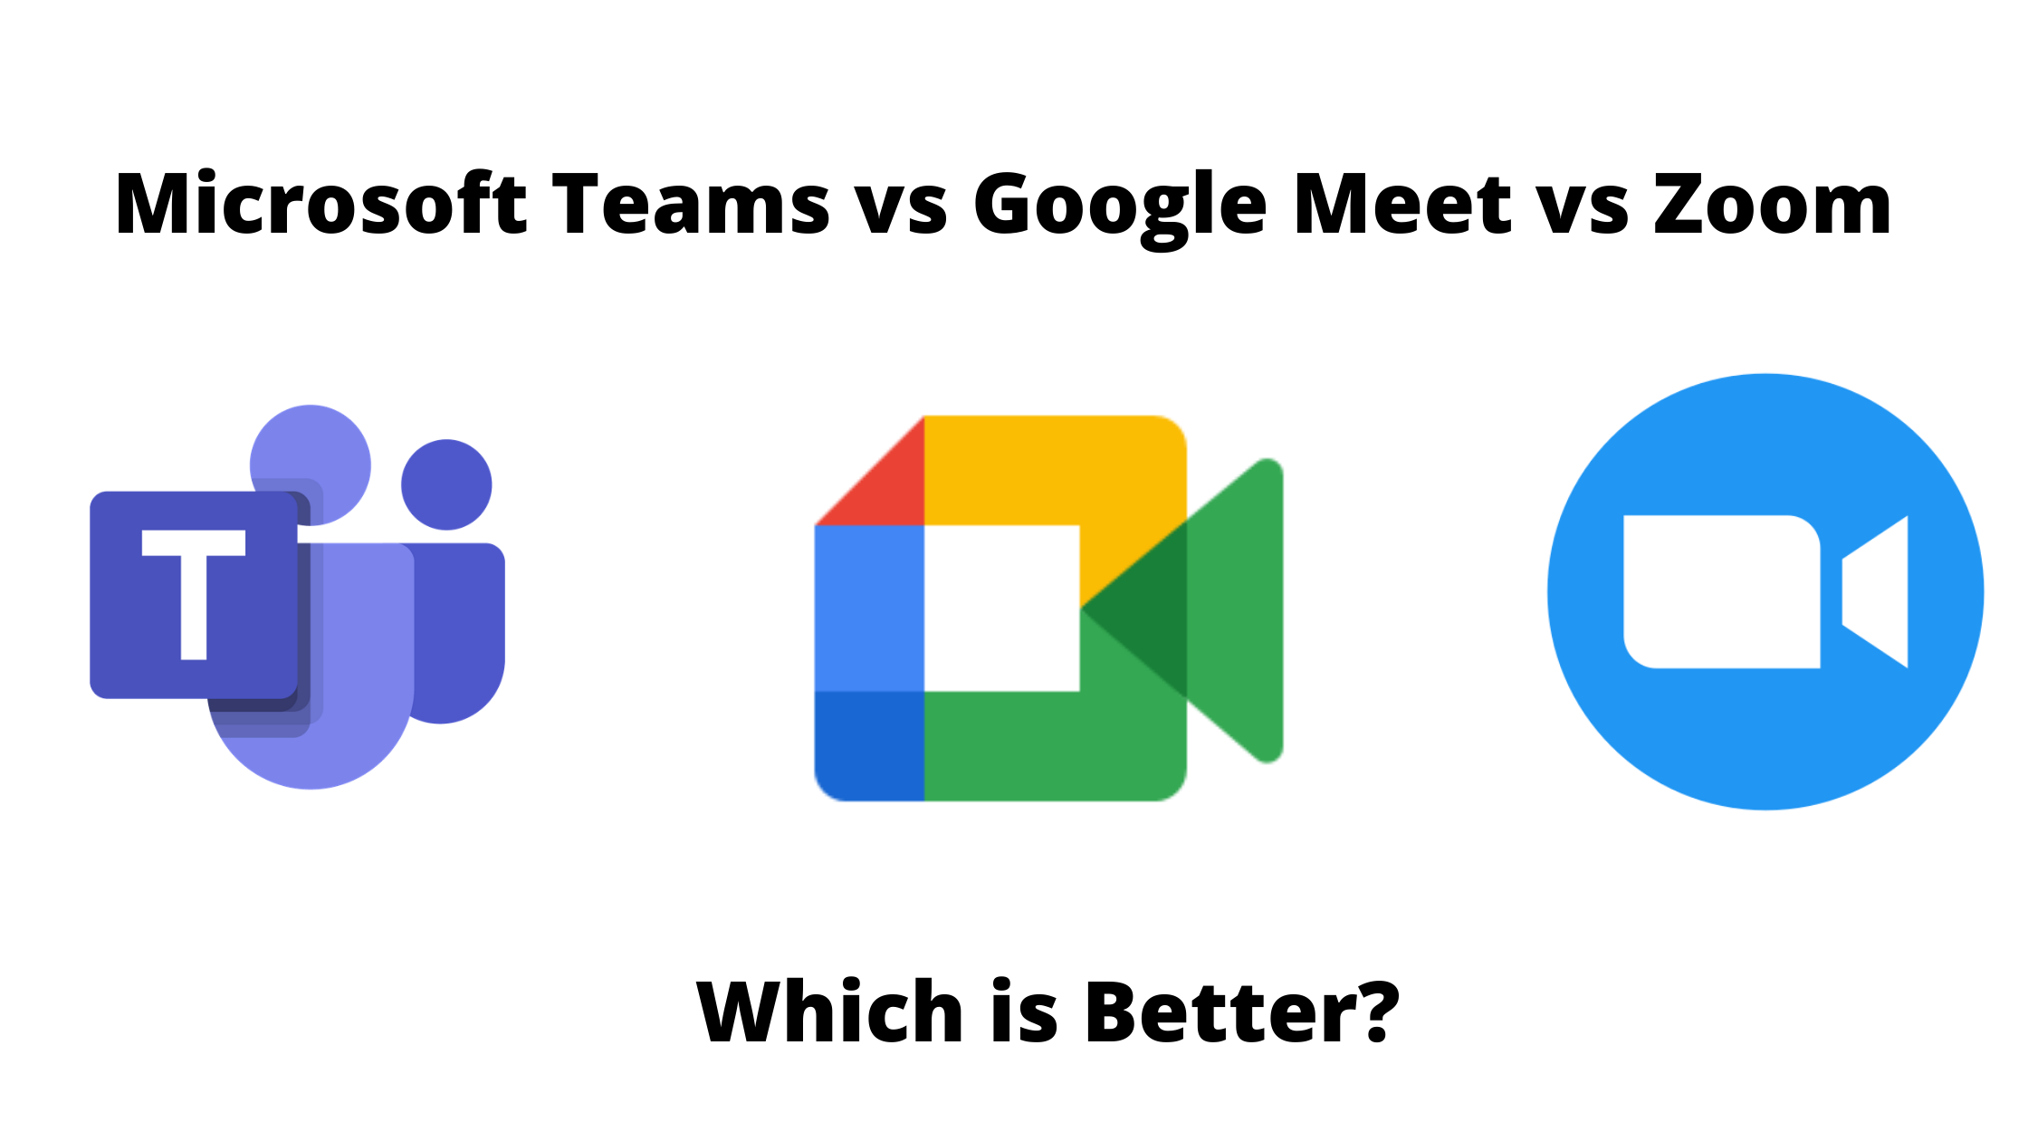
Case Debate: Does Zoom have a sustained competitive advantage?
Q&A Session 1
Proposition (Player 3) attacks — 1 min
Opposition (Player 3) defends — 1 min
Q&A Session 2
Proposition (Player 4) attacks — 1 min
Opposition (Player 4) defends — 1 min
Q&A Session 3
Proposition (Player 5) attacks — 1 min
Opposition (Player 5) defends — 1 min
Free Debate
Open attacks and defenses — 10 min

Slide 27
Case Debate: Does Zoom have a sustained competitive advantage?
Q&A Session 4
Opposition (Player 6) attacks — 1 min
Proposition (Player 6) defends — 1 min
Q&A Session 5
Opposition (Player 7) attacks — 1 min
Proposition (Player 7) defends — 1 min
Q&A Session 6
Opposition (Player 8) attacks — 1 min
Proposition (Player 8) defends — 1 min

Slide 28



Case Debate: Does Zoom have a sustained competitive advantage?
Closing Statements
Proposition (Player 1) concludes — 1.5 min
Opposition (Player 1) concludes — 1.5 min
Final Statements
Proposition (Player 2) finalizes — 1.5 min
Opposition (Player 2) finalizes — 1.5 min
Judges’ Deliberation
Break — 5 min
Feedback and results — 3 min
Best and worst practices you observed during the debate?
Which team win this round of debate? Why?
Who is the best debater? Why?

Slide 29


