Slide 1

IOT – PBBT Team
IOT Monitoring Camera
Valentin EYRAUD
Julian NDENDE
Louis-Quentin AMSELLEM
Baptiste ALLEX
Arnaud HO-CHOUCK
Antoine VAN GORP

Slide 2
Summary :
I/ Real-Time Face Detection Using IoT
II/ Team Members and Roles
III/ Project Ideation and Evolution
IV/ Technical Architecture
V/ Challenges and Solutions
VI/ Project Results
VII/ Demo
VIII/ Conclusion

Slide 3
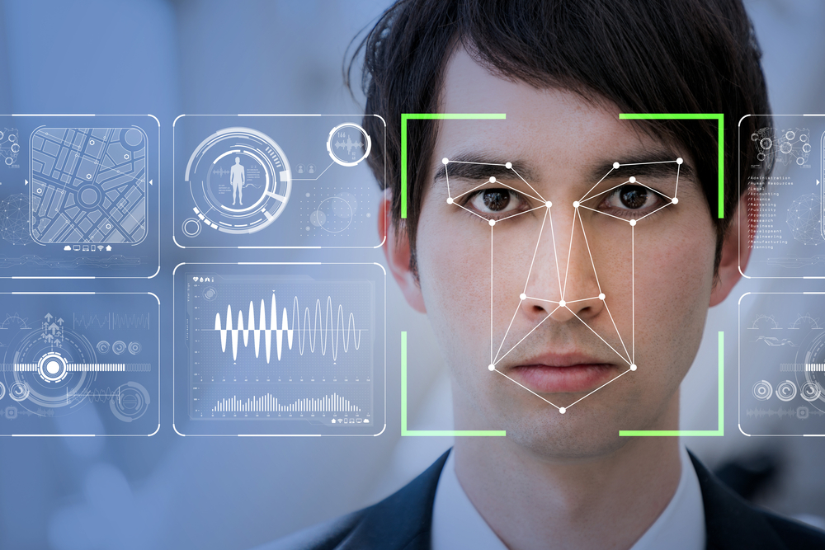
I/ Real-Time Face Detection Using IoT
Project Purposes and Goals

Slide 4
II/ Team Members and Roles
Our roles in the project
Individual contributions and collaboration
- Valentin EYRAUD : Team Leader and Developer
- Julian NDENDE : Surveyor and Developer
- Louis-Quentin AMSELLEM : Facilitator and Developer
- Baptiste ALLEX : Presenter and Developer
- Arnaud HO-CHOUCK : Recorder and Developer
- Antoine VAN GORP : Process Observer and Developer

Slide 5
III/ Project Ideation and Evolution
Outcome of brainstorming sessions
Evolution of our idea and the decision making process

Slide 6
IV/ Technical Architecture
Hardware Components : Raspberry Pi, Camera
Software used : Python, OpenCV…
Implementation steps

Slide 7
V/ Challenges and Solutions
Model precision detecting screens as Human
Improving model and setting up the confidence
Sending screenshots constantly when a person was found
Adding a timer that send one screenshot each 30 seconds

Slide 8
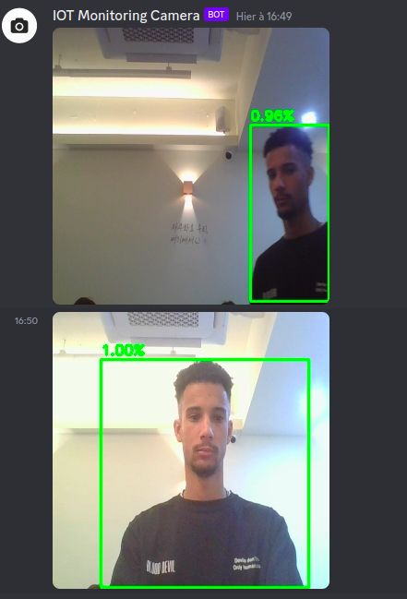
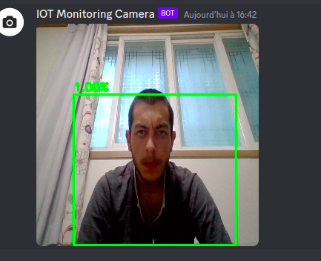
VI/ Project Results

Slide 9
VII/ Demo
Different cases for the demo (4 examples):
Light effect example
Dark effect example
Bend camera position effect example
Blur effect example

Slide 10
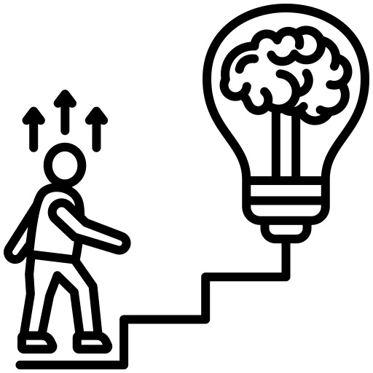

VIII/ Conclusion

