Slide 1
E-News Express Analysis
PGP - Data Science and Business Analytics . PGP-DSBA-UTA-APR22-A2
07/13/2022

Slide 2
Contents / Agenda
Executive Summary
Business Problem Overview and Solution Approach
EDA Results
Hypotheses Tested and Results
Appendix

Slide 3
Executive Summary
Within the E-News Express Dataset, there are 100 entries based off the randomly selected users with no duplicate entries.
Our Team Conducted an A/B Split Test between the old landing page vs. the newer landing page:
The Older landing Page sampled 50 users within an Independent Control group.
The Newer landing Page sampled 50 users within an Independent Treatment group.
Page Conversions: 54% users subscribed & 46% users did not subscribe.
Average Time Spent on Page: 5.37 Minutes
34% of users Preferred Spanish, 34% of users Preferred French, 32% of users Preferred English.

Slide 4
Executive Summary (Con’t)
It appears that users spent more time indeed on the new landing page versus the older landing page.
Referencing the data from our crosstab chart, we conclude that the newer landing page has a higher conversion rate than the older page.
Referencing the data from our crosstab chart, we conclude that the newer landing page has a higher conversion rate than the older page
Referencing the data from our boxplots, we discover that the languages preferred have different mean averages in time spent on the page.

Slide 5
Business Problem Overview
The advent of e-news, or electronic news, portals has offered us a great opportunity to quickly get updates on the day-to-day events occurring globally. The information on these portals is retrieved electronically from online databases, processed using a variety of software, and then transmitted to the users. There are multiple advantages of transmitting new electronically, like faster access to the content and the ability to utilize different technologies such as audio, graphics, video, and other interactive elements that are either not being used or aren’t common yet in traditional newspapers.
E-news Express, an online news portal, aims to expand its business by acquiring new subscribers. With every visitor to the website taking certain actions based on their interest, the company plans to analyze these actions to understand user interests and determine how to drive better engagement. The executives at E-news Express are of the opinion that there has been a decline in new monthly subscribers compared to the past year because the current webpage is not designed well enough in terms of the outline & recommended content to keep customers engaged long enough to make a decision to subscribe.

Slide 6
Solution Approach
The design team of the company has researched and created a new landing page that has a new outline & more relevant content shown compared to the old page. In order to test the effectiveness of the new landing page in gathering new subscribers, the Data Science team conducted an experiment by randomly selecting 100 users and dividing them equally into two groups. The existing landing page was served to the first group (control group) and the new landing page to the second group (treatment group). Data regarding the interaction of users in both groups with the two versions of the landing page was collected. Being a data scientist in E-news Express, you have been asked to explore the data and perform a statistical analysis (at a significance level of 5%) to determine the effectiveness of the new landing page.

Slide 7
Solution Approach Con’t
E-News Express asked us to answer the following questions:
Do the users spend more time on the new landing page than on the existing landing page?
Is the conversion rate (the proportion of users who visit the landing page and get converted) for the new page greater than the conversion rate for the old page?
Does the converted status depend on the preferred language?
Is the time spent on the new page the same for the different language users?

Slide 8
Data Dictionary
The data contains information regarding the interaction of users in both groups with the two versions of the landing page.
User_ID - Unique user ID of the person visiting the website. | Group - Whether the user belongs to the first group (control) or the second group (treatment).
Landing_Page - Whether the landing page is new or old. | Time_spent_on_the_page - Time (in minutes) spent by the user on the landing page
Converted - Whether the user gets converted to a subscriber of the news portal or not. | Language_preferred - Language chosen by the user to view the landing page

Slide 9
Exploratory Data Analysis (EDA) Overview
The Shape of the dataset is 100, based from the randomly sampled users to conduct the A/B Split Test between the old landing page vs. the new landing page. (User_ID)
Our team found no duplicates within the dataset.
Out of the 100 sampled users, we factor:
Time Spent on the Page.
Which Group was used (Controlled/Treatment).
Whether the user was converted or not.
The Language the user preferred.
Link to Appendix slide on data background check

Slide 10
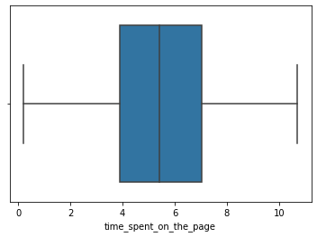
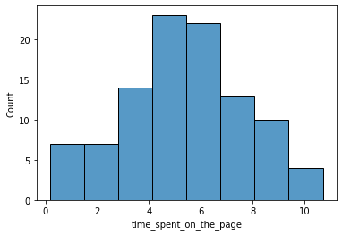
Univariate Analysis - Time Spent on Page
Average Time Spent on Page: 5.37 Minutes
25% Time Spent on Page: 3.88 Minutes
75% Time Spent on Page: 7.02 Minutes
Minimum Time Spent on Page: 0.19 Minutes
Maximum Time Spent on Page: 10.71 Minutes
Link to Appendix slide on data background check

Slide 11
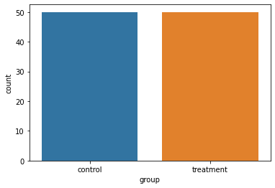
Univariate Analysis - Groups
Out of the 100 Randomly Sampled Users:
50% Control Groups
50% Treatment Groups
Link to Appendix slide on data background check

Slide 12
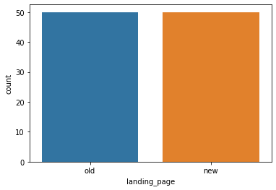
Univariate Analysis - Landing Page
Congruent to our univariate analysis for groups:
The Old Landing Page:
Controlled Group (50 Users)
The New Landing Page:
Treatment Group (50 Users)
Link to Appendix slide on data background check

Slide 13
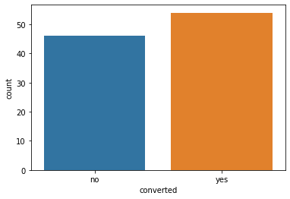
Univariate Analysis - Conversions
Out of the 100 Sampled Users:
54% of the users were successfully converted.
46% of the users were not successfully converted.
Link to Appendix slide on data background check

Slide 14
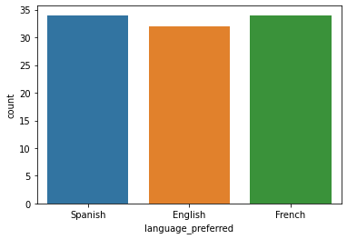
Univariate Analysis - Language Preferred
Out of the 100 Sampled Users:
34% Preferred Spanish
34% Preferred French
32% Preferred English
We Observe that E-News Express provides content to users who prefer 3 different languages. It would be beneficial to ensure the ideal site appeals to all demographics for optimum engagement.
Link to Appendix slide on data background check

Slide 15
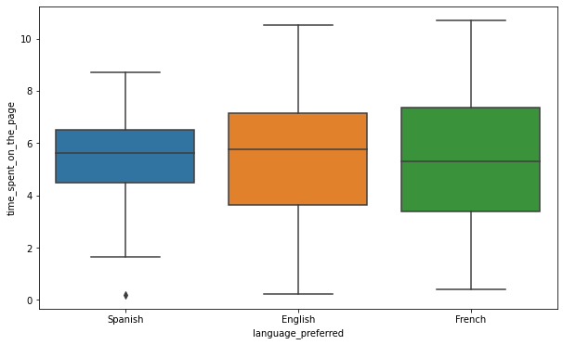
Bivariate - Language Preferred vs Time Spent on Page
Users who prefer Spanish have some minimum outliers in the data.
Median Data:
English: 5.50 Minutes Est.
French 5.30 Minutes Est.
Spanish: 5.60 Minutes Est.
Users who prefer English and French have similar minimum and maximum values with no outliers.
Link to Appendix slide on data background check

Slide 16
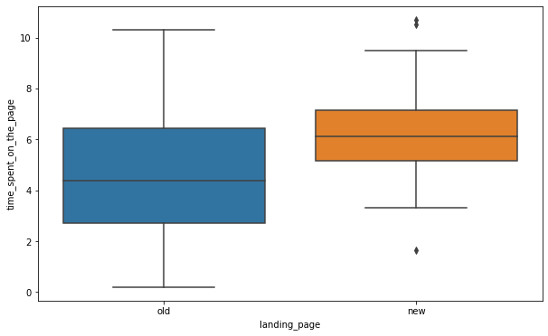
Bivariate - Landing Page vs Time Spent on Page
Median Data:
Old page - 4.30 Minutes Est.
New page - 6.10 Minutes Est.
The New page has larger outliers for the time spent on site.
The Old Page has a wider minimum and maximum values.
It appears that on average, most users spent more time on the new landing page than the old landing page.
Link to Appendix slide on data background check

Slide 17
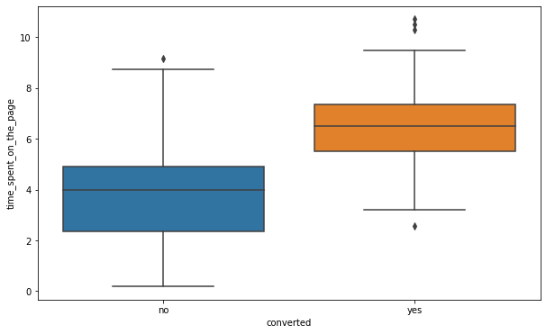
Bivariate - Conversion vs Time Spent on Page
It appears that the new page has converted more users than the older page.
Both pages have outliers beyond the max, but the new site has much more than the older site.
Average for new site: 6.30 Min Est.
Average for old site: 4 Mins Est.
Link to Appendix slide on data background check

Slide 18
Question 1: Do Users Spend More Time on New Landing
Page than on Existing Landing Page?
We will reference the following chart we used during our Bivariate analysis for landing page vs. Time Spent on The Page.
It appears that users spent more time indeed on the new landing page versus the older landing page.
We will walkthrough and explain our hypothesis testing to provide insight on how we arrived to our answer.

Slide 19
Hypothesis Testing/Conclusion (Question 1)
Null Hypothesis: People Spend an equal amount of time on the old site and new site.
Alternative Hypothesis: The New Site performs better than the old site with time spent.
We are testing to confirm if the current web landing page is functioning just as well as the new landing page or if the new landing page is performing better than the current page at a 5% Significance Level. This would be an independent T-Test with a 1 tailed Hypothesis. The Standard Deviation is unknown at this time as well.
Result: Since the P-Value is significantly less than the 5% level of Significance, we reject the null hypothesis. We have suffice evidence to prove that users spend more time on the newer landing page compared to the older landing page.
Link to Appendix slide on details of the test performed

Slide 20
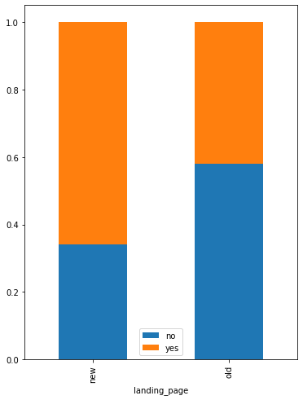
Question 2: Is the conversion rate for the new page greater than the conversion rate for the old page?
Referencing the data from our crosstab chart, we conclude that the newer landing page has a higher conversion rate than the older page.

Slide 21
Hypothesis Testing/Conclusion (Question 2)
Null Hypothesis: The Old Site is No Different In Conversions to the New Site
Alternate Hypothesis: The New Site Converts More than the Old Site
Based off the 2 independent control and treatment groups for the old and new website, this would be a 2 Sample independent T-Test with a 1 tailed hypothesis with a 5% Significance Level.
Result: Since the P-Value is significantly less than the level of significance, we reject the null hypothesis. We have suffice evidence to support that the conversion rate for the old site is less than the new site.
Link to Appendix slide on details of the test performed

Slide 22
Question 3: Is the conversion and preferred language are independent or related?
Referencing the data from our crosstab chart, we conclude that the newer landing page has a higher conversion rate than the older page.

Slide 23
Hypothesis Testing/Conclusion (Question 3)
Null Hypothesis: Conversion and Language are Related.
Alternate Hypothesis: Conversion and Language are Independent.
We are testing to see if these categories are independent or related.
We are testing if there is any correlation between the languages and site conversions. These are both categorical variables. Based off this finding, we compare using the Chi Squared Test of Independence.
Result: The P-value is significantly greater than the level of significance. Based of this finding, we fail to reject the null hypothesis. We possess enough information to determine if language is not related/independant to the conversions.
Link to Appendix slide on details of the test performed

Slide 24
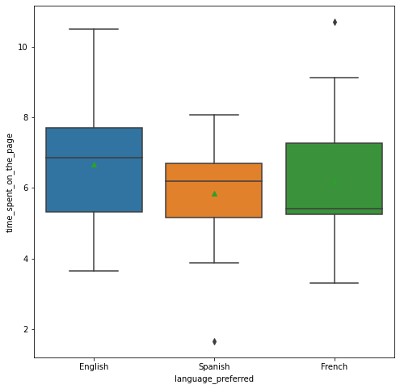
Question 4: Is the time spent on the new page same for the different language users?
Referencing the data from our boxplots, we discover that the languages preferred have different mean averages in time spent on the page.

Slide 25
Hypothesis Testing/Conclusion (Question 4)
Null Hypothesis: The Time Spent on the Website is equal for each users from language.
Alternate Hypothesis: The Time Spent on the website is different for users from language.
Based on comparing the means of English, Spanish and French languages, we would use the ANOVA Test to compare the independent populations.
Result: The P-Value is significantly greater than the level of significance. As a result, we fail to reject the null hypothesis. The means are fairly close and the distributions may overlap a bit.
Link to Appendix slide on details of the test performed

Slide 26
Final Conclusion
Question 1: Since the P-Value is significantly less than the 5% level of Significance, we reject the null hypothesis. We have suffice evidence to prove that users spend more time on the newer landing page compared to the older landing page.
Question 2: Since the P-Value is significantly less than the 5% level of significance, we reject the null hypothesis. We have suffice evidence to support that the conversion rate for the old site is less than the new site.
Question 3: The P-value is significantly greater than the 5% level of significance. Based of this finding, we fail to reject the null hypothesis. We possess enough information to determine if language is not related/independant to the conversions.
Question 4: The P-Value is significantly greater than the 5% level of significance. As a result, we fail to reject the null hypothesis. The means are fairly close and the distributions may overlap a bit.

Slide 27
APPENDIX

