Slide 1
Project ReCell
Julian Patton PGP-DSBA-UTA-APR22-A2
8/16/2022

Slide 2
Contents / Agenda
Executive Summary
Business Problem Overview and Solution Approach
EDA Results
Data Preprocessing
Model Performance Summary
Appendix

Slide 3
Executive Summary
Please mention actionable insights & recommendations
The Dataset contains 3454 Columns, 15 Rows

Slide 4
Business Problem Overview and Solution Approach
Buying and selling used phones and tablets used to be something that happened on a handful of online marketplace sites. But the used and refurbished device market has grown considerably over the past decade, and a new IDC (International Data Corporation) forecast predicts that the used phone market would be worth \$52.7bn by 2023 with a compound annual growth rate (CAGR) of 13.6% from 2018 to 2023. This growth can be attributed to an uptick in demand for used phones and tablets that offer considerable savings compared with new models.

Slide 5
Business Problem Overview and Solution Approach
Refurbished and used devices continue to provide cost-effective alternatives to both consumers and businesses that are looking to save money when purchasing one. There are plenty of other benefits associated with the used device market. Used and refurbished devices can be sold with warranties and can also be insured with proof of purchase. Third-party vendors/platforms, such as Verizon, Amazon, etc., provide attractive offers to customers for refurbished devices. Maximizing the longevity of devices through second-hand trade also reduces their environmental impact and helps in recycling and reducing waste. The impact of the COVID-19 outbreak may further boost this segment as consumers cut back on discretionary spending and buy phones and tablets only for immediate needs.

Slide 6
Business Problem Overview and Solution Approach
Objective: The rising potential of this comparatively under-the-radar market fuels the need for an ML-based solution to develop a dynamic pricing strategy for used and refurbished devices. ReCell, a startup aiming to tap the potential in this market, has hired you as a data scientist. They want you to analyze the data provided and build a linear regression model to predict the price of a used phone/tablet and identify factors that significantly influence it.

Slide 7
Data Description
brand_name: Name of manufacturing brand | os: OS on which the device runs | screen_size: Size of the screen in cm
4g: Whether 4G is available or not | 5g: Whether 5G is available or not | main_camera_mp: Resolution of the rear camera in megapixels
selfie_camera_mp: Resolution of the front camera in megapixels | int_memory: Amount of internal memory (ROM) in GB | ram: Amount of RAM in GB

Slide 8
Data Description (Con’t)
battery: Energy capacity of the device battery in mAh | weight: Weight of the device in grams | release_year: Year when the device model was released
days_used: Number of days the used/refurbished device has been used | normalized_new_price: Normalized price of a new device of the same model in euros | normalized_used_price: Normalized price of the used/refurbished device in euros

Slide 9
General Information Regarding Dataset
The Dataset contains 3454 Columns, 15 Rows
There are 202 duplicate entries within the dataset
4 Object Type Variables
9 Float Type Variables
2 Int Type Variables

Slide 10
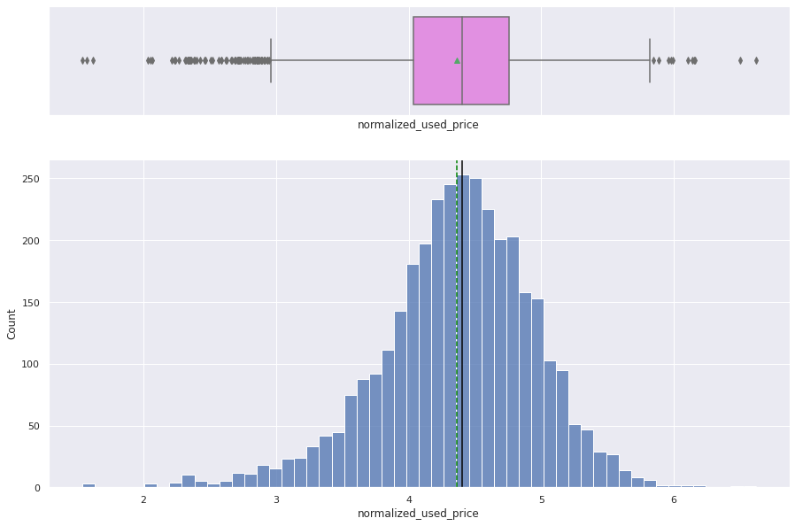
Univariate Analysis: Normalized Used Price
The normalized used price data appears to be left skewed.
The median normalized price: 4.40 Euros.
The average Normalized Used Price: 4.36 Euros.
There are several outliers for the normalized used price.
Link to Appendix slide on data background check

Slide 11
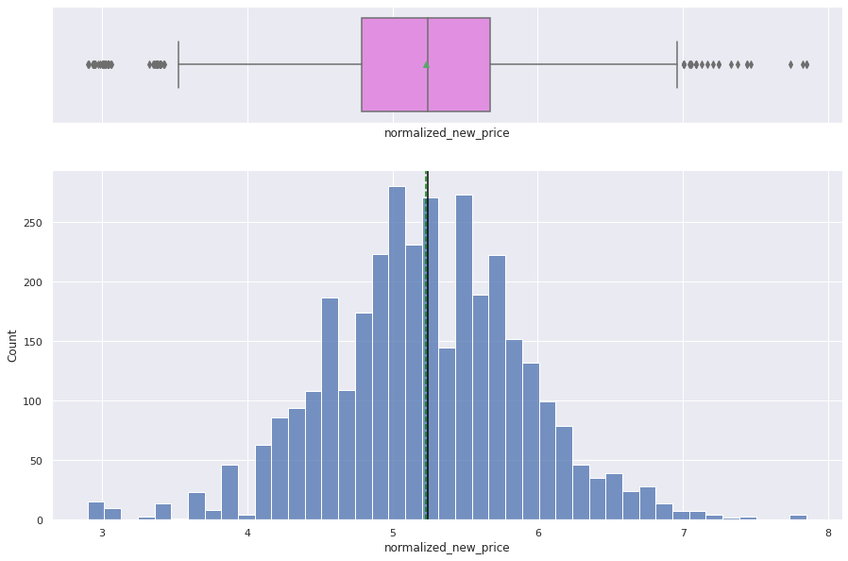
Univariate Analysis: Normalized New Price
The Normalized New Price data also appears to be slightly right skewed but evenly distributed for the most part.
The median normalized New price: 5.24 Euros.
The average Normalized New Price: 5.23 Euros.
There are several outliers for the normalized used price.
Link to Appendix slide on data background check

Slide 12
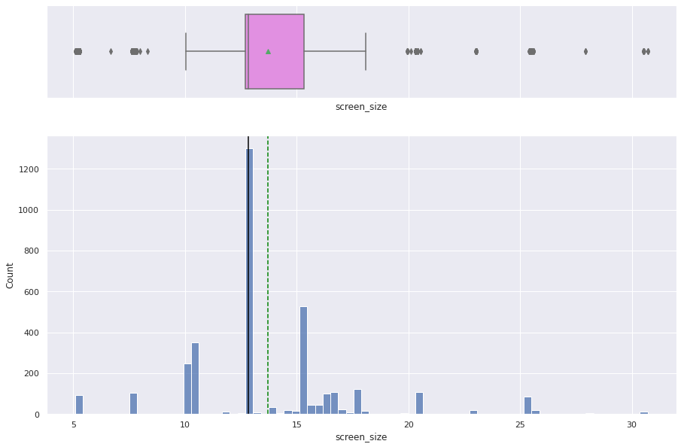
Univariate Analysis: Screen Size
The Screen Size Data is extremely right skewed.
Median screen size: 5.08 cm.
Average screen size: 13.71 cm.
The Screen Size data is vastly spread out with outliers.
Link to Appendix slide on data background check

Slide 13
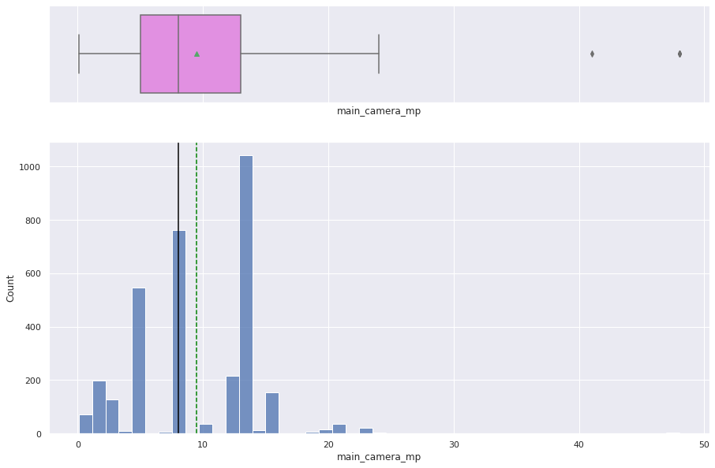
Univariate Analysis: Main Camera Mp (Mega Pixels)
The main camera mp data also appears to be right skewed.
The median megapixels for main camera: roughly 8 mp.
The average megapixels for the main camera: Roughly 9.46 mp.
There are not too many cameras with over 13 mp in this data set.
Link to Appendix slide on data background check

Slide 14
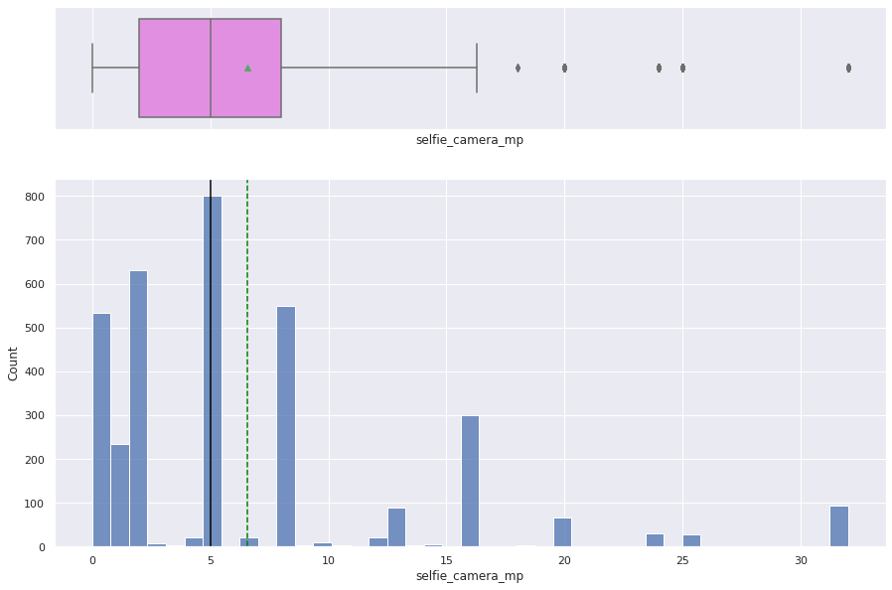
Univariate Analysis: Selfie Camera Mp (Megapixels)
The selfie camera mp data also appears to be right skewed.
Median megapixels selfie camera: 5 mp
Average megapixels selfie camera: 6.55 mp.
Max megapixels for selfie camera is 32 mp.
Link to Appendix slide on data background check

Slide 15
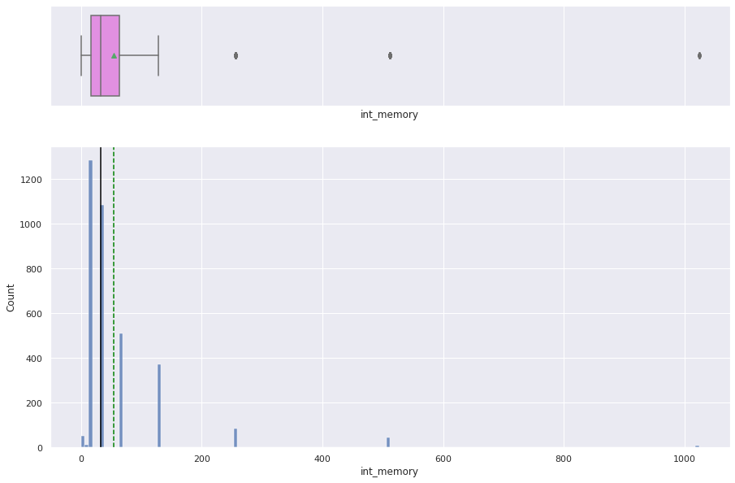
Univariate Analysis: Int Memory
The internal memory data also appears to be right skewed with very little outliers.
The median internal memory for most phones is 32 GB.
The average phone memory: roughly around 54.57 GB.
Some phones come with 64 GB and 1.24TB (1024GB) in storage.
Link to Appendix slide on data background check

Slide 16
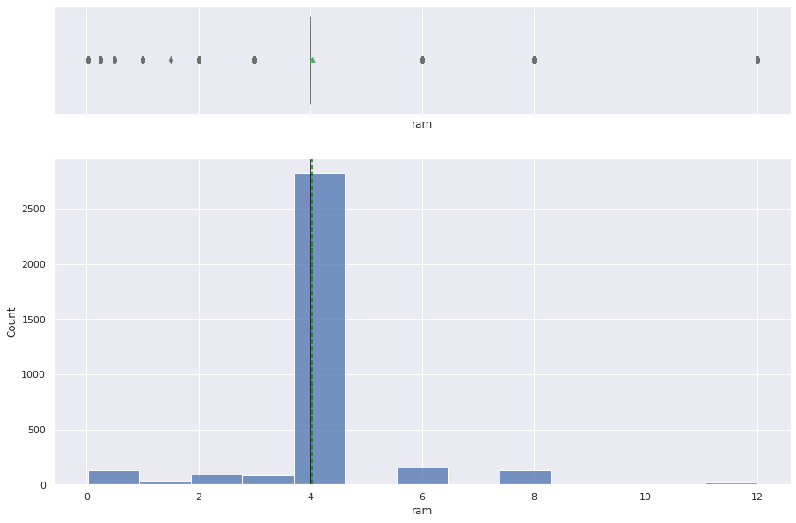
Univariate Analysis: Ram
The ram data also appears to be mainly around 4GB of RAM with a few outliers.
There are some devices that range as high as 12 GB of RAM.
Link to Appendix slide on data background check

Slide 17
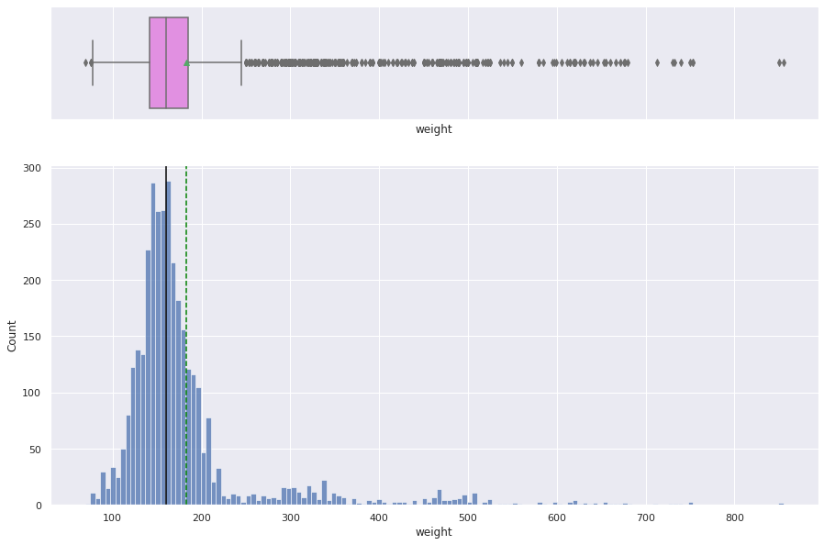
Univariate Analysis: Weight
There is a lot of variation in weight for the devices. The data is right skewed.
The median weight for the devices: 160 grams.
The average weight for devices: 182.75 grams.
Max weight for a phone is 855 grams.
Lightest phone weighs 69 grams.
Link to Appendix slide on data background check

Slide 18
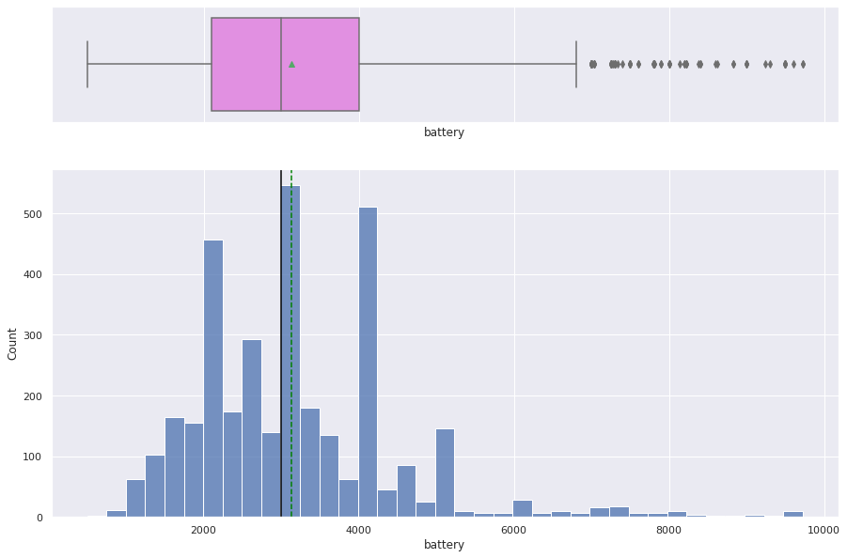
Univariate Analysis: Battery
The battery data also appears to be right skewed. Several Outliers outside 4000
Median battery weight: 3000 mAh
Average battery weight: 3133.40 mAH
Link to Appendix slide on data background check

Slide 19
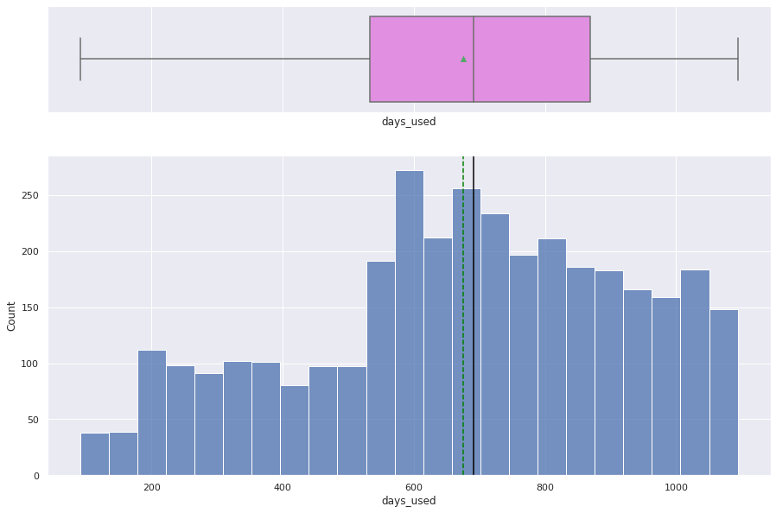
Univariate Analysis: Days Used
The days used data also appears to be left skewed.
Median days used: 690.50 days
Average days used: 674.86 days
There are no outliers for the days used on devices. This could be due to trade in contracts for carrier services.
Link to Appendix slide on data background check

Slide 20
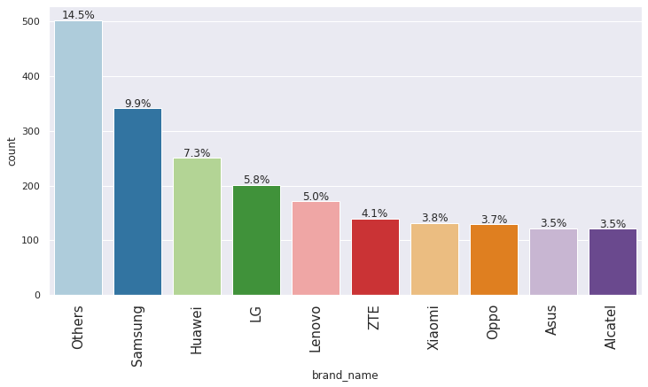
Univariate Analysis: Brand Name
14.5% of the Phones have a less commercial brand name in the data set.
9.9% of the phones in this data set are Samsung based. This is the 2nd largest amount of phones by brand name.
Alcatel and Asus have the least amount at 3.5%
Link to Appendix slide on data background check

Slide 21
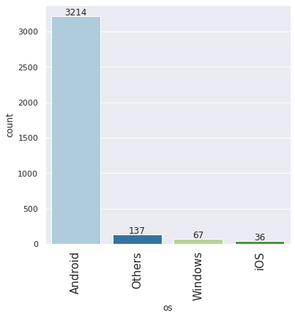
Univariate Analysis: OS (Operating System)
Contrary to popular belief, a majority of mobile devices are Android OS based.
Apple iOS has the least amount in this data set.
There are other OS that are used more than both Windows and iOS systems combined.
Link to Appendix slide on data background check

Slide 22
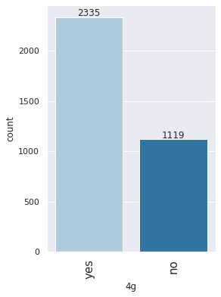
Univariate Analysis: 4G
Most of the devices are likely to carry 4G compatibility than none.
4G : 2335
No 4G: 1119
Link to Appendix slide on data background check

Slide 23
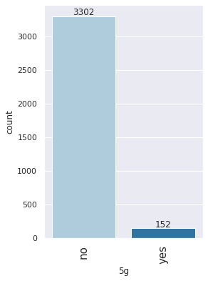
Univariate Analysis: 5G
Most devices appear not to be 5G Compatible yet. This could be due to 5G not being commercially rolled out and accessible to the masses yet.
Some devices do carry 5G compatibility.
5G: 152
No 5G: 3302
Link to Appendix slide on data background check

Slide 24
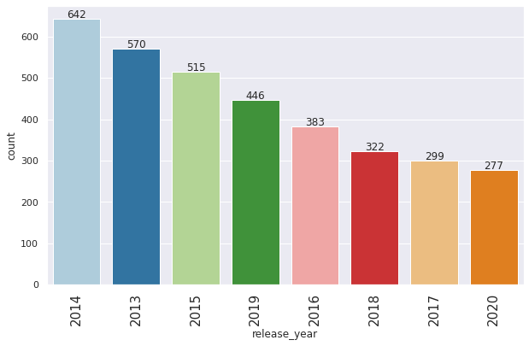
Univariate Analysis: Release Year
A majority of the phones were released around 2014.
There appears to be a trend as the years increased, less phones were being released.
Link to Appendix slide on data background check

Slide 25
Univariate Analysis Results
Average Normalized Used Price falls around 4.36 Euros.
Average Normalized New Price: 5.23 Euros.
Average screen size: 13.71 cm.
The Selfie (Front Camera) is less powerful than the main camera in Megapixels..
Safe to assume that most of the devices have roughly 4GB of RAM.
The average weight for devices: 182.75 grams. Lots of variation in weight between these devices.
There appears to be a trend as the years increased, less phones were being released.
Most phones are 4G Compatible, very few phones have 5G compatibility.
Contrary to popular belief, a majority of mobile devices are Android OS based.
Link to Appendix slide on data background check

Slide 26
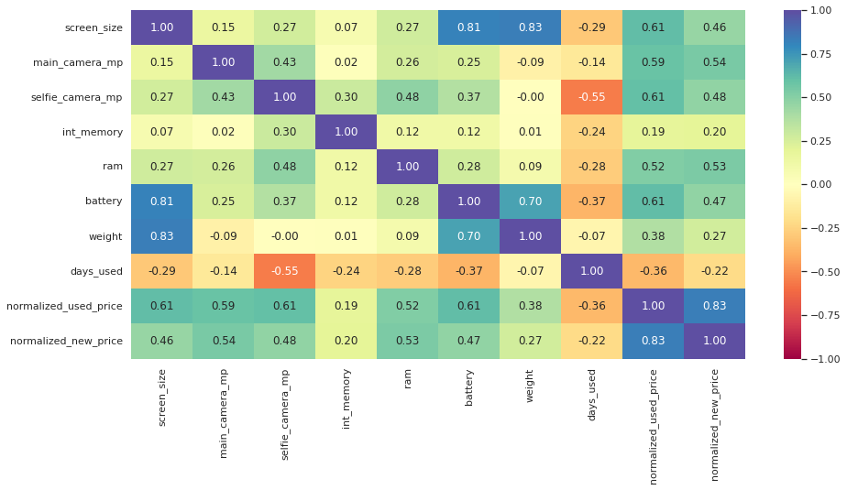
Bivariate Analysis: Correlation (HeatMap)
Link to Appendix slide on data background check

Slide 27
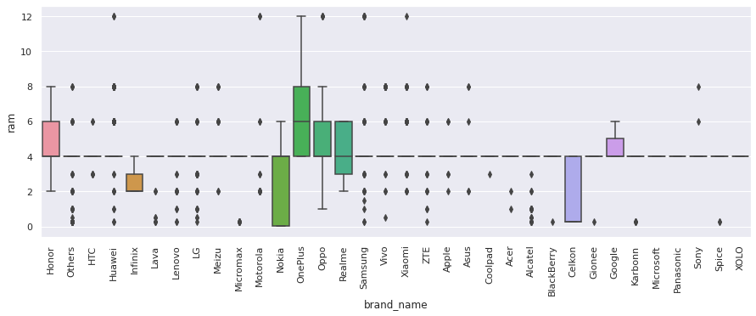
Bivariate Analysis: Ram across various Brands
Across the brands, most have outliers regarding the RAM except for a few brands.
Most of the brands range around 4-6 Gigs of RAM.
Link to Appendix slide on data background check

Slide 28
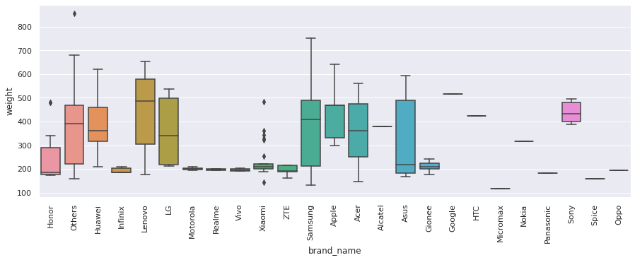
Bivariate Analysis: Battery across Several Brands
Most of the batteries for the brands are under 700 Grams.
There are some other brands that have outliers larger than 700 Grams.
Samsung and Lenovo brands provide a larger array of battery weight devices compared to other brands.
Link to Appendix slide on data background check

Slide 29
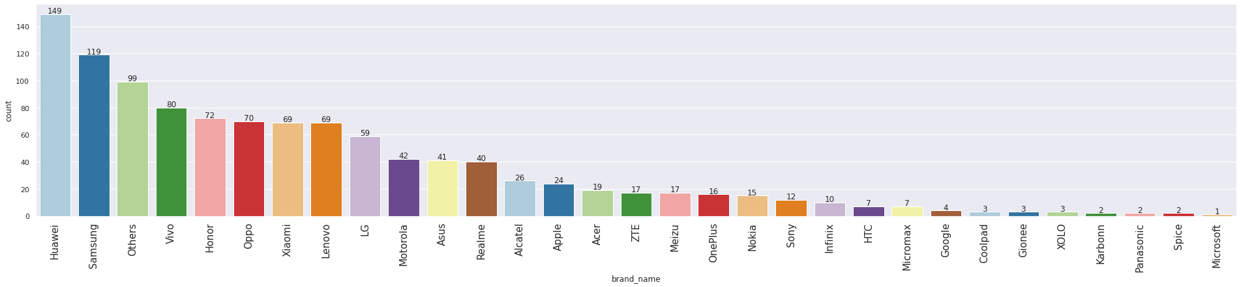
Bivariate Analysis: Large Screens Across Brands
Huawei & Samsung have the largest screens.
Microsoft Phones tend to have the smallest screens in the data set.
Link to Appendix slide on data background check

Slide 30
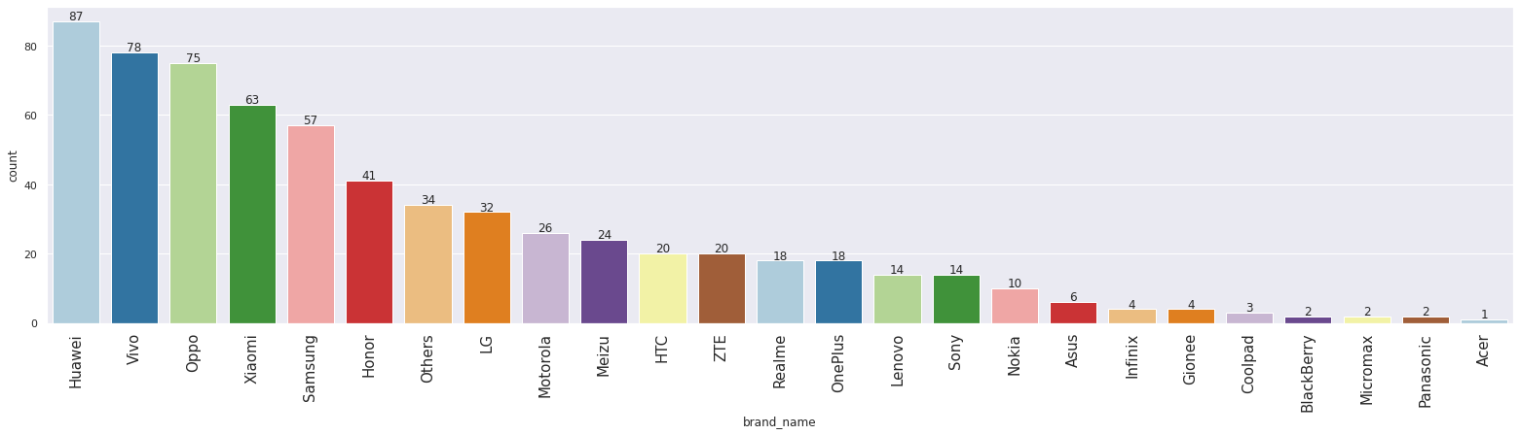
Bivariate Analysis: Selfie Cameras Across Brands
Huawei & Vivo have the largest amount of selfie cameras.
Acer Phones tend to have the least amount of selfie cameras in the data set.
Link to Appendix slide on data background check

Slide 31
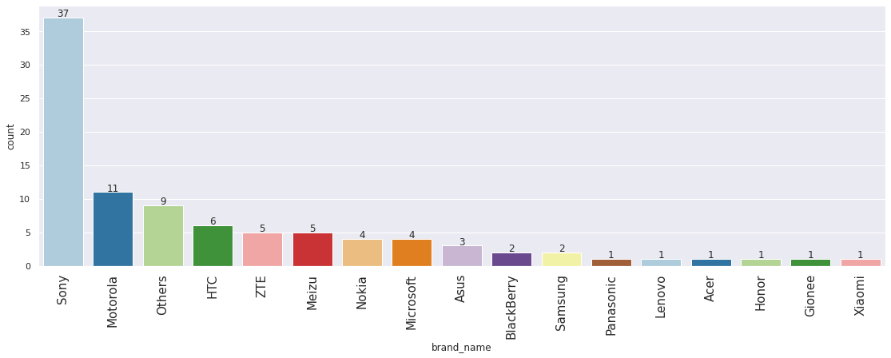
Bivariate Analysis: Main Cameras Across Brands
Sony has the highest quality main cameras in the data set.
Motorola has the 2nd largest quality main cameras in the data set
Link to Appendix slide on data background check

Slide 32
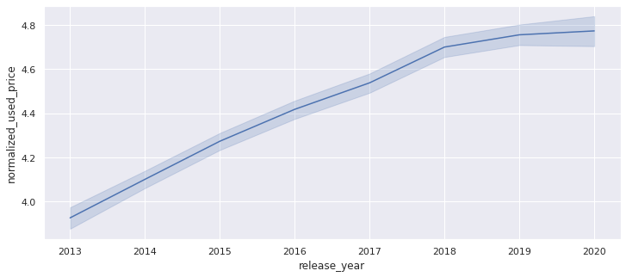
Bivariate Analysis: Release Yr. Vs Norm. Used Price
Noticeable trend that as the release years become more recent, the used price increases.
Recent used phones have a higher value than older outdated phones.
Link to Appendix slide on data background check

Slide 33
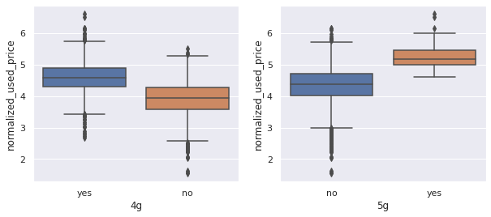
Bivariate Analysis: 4G/5G Vs Norm. Used Price
The normalized used price increased for phones that have 4G and 5G Compatibility.
Link to Appendix slide on data background check

Slide 34
Bivariate Analysis Results
Samsung and Lenovo brands provide a larger array of battery weight devices compared to other brands.
Most of the brands range around 4-6 Gigs of RAM.
Huawei & Samsung have the largest screens.
Huawei & Vivo have the largest amount of selfie cameras.
Sony has the highest quality main cameras in the data set.
The normalized used price increased for phones that have 4G and 5G Compatibility.
Noticeable trend that as the release years become more recent, the used price increases.
Recent used phones have a higher value than older outdated phones.
Link to Appendix slide on data background check

Slide 35
Data Preprocessing
There are 202 missing data points for the following variables:
Main_camera_mp - 179
Selfie_camera_mp - 2
Int_memory - 4
Ram - 4
Battery - 6
Weight - 7
To create a more accurate model, we created a copy of the dataset and imputed the missing values by the column medians grouped by the variables:
Release_Year
Brand_name

Slide 36
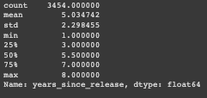
Feature Engineering
We created a new column called ‘years_since_release’ for our copied modified dataset (Based from the release_year column).
The baseline for year_since_release starts from the year 2021.
We eventually dropped the original release_year column.

Slide 37
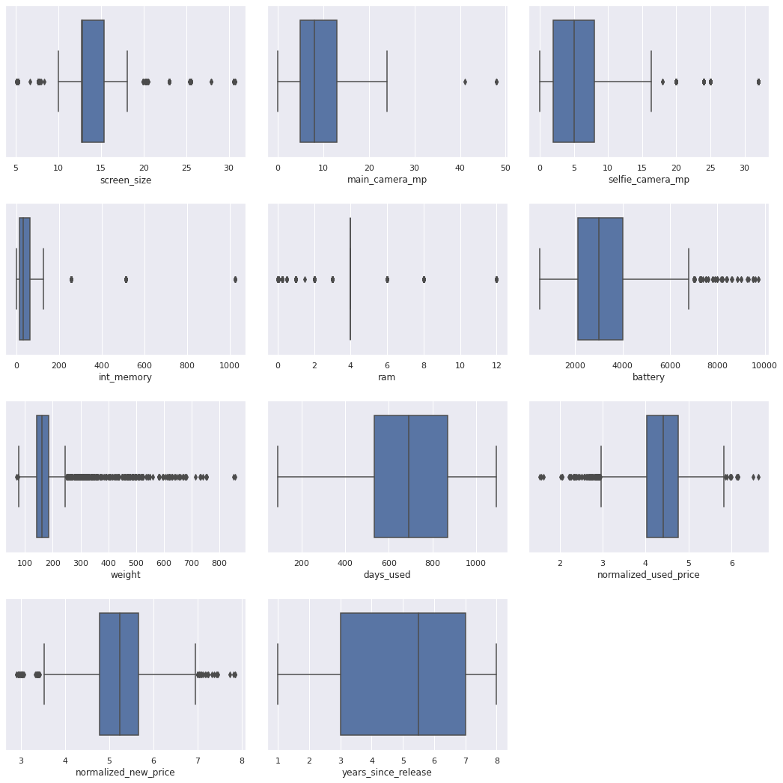
Outlier Check
Most of our variables listed have outliers except for the following:
Days_used
Years_since_released

Slide 38
Model Performance Summary
X (Independent Variables):
Brand Name
OS
Screen Size
4G
5G
Main_Camera_mp
Selfie_Camera_mp
Int_memory
Ram
Battery
Weight
Days_Used
Years Since Release
Y (Dependent Variable)
Normalized Used Price
We added an intercept and created Dummy Data for the independent variables.
70% for the Training Model
30% for the Testing Model
70:30 Ratio
Number of rows in train data = 2417
Number of rows in test data = 1037
Link to Appendix slide on model assumptions

Slide 39
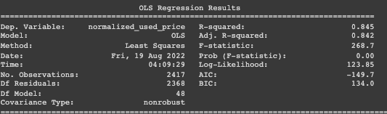
Model Performance Summary
Adj. R-Squared: Our fit for the model is currently at 0.842.
Const: Our Y-Intercept is currently at 1.3156
Link to Appendix slide on model assumptions

Slide 40
Model Performance Summary
Training Performance (70% Data)
RMSE | MAE | R-Squared | Adj R-Squared | MAPE
0.22984 | 0.180326 | 0.844886 | 0.841675 | 4.326841
Testing Performance (30% Data)
RMSE | MAE | R-Squared | Adj R-Squared | MAPE
0.23858 | 0.184749 | 0.842479 | 0.834659 | 4.501651
Link to Appendix slide on model assumptions

Slide 41
Conclusion
Based off the Training R2, our data is not underfitting.
The Training and Test RMSE and MAE are comparable, so the model is not overfitting.
We can predict data from the Test Model at 0.18 Mean Error on Test Data.
The MAPE of 4.50 shows that we can predict ideal phone prices within 4.50%.

Slide 42
APPENDIX

