Slide 1

Winning in the PLL: A Deep Dive into Team Performance & Strategy
Julian Quintero

Slide 2
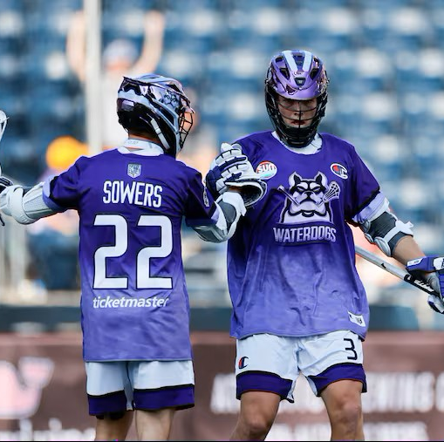
Problem Statement
Inconsistent Team Success in the PLL:
Why do some teams consistently have losing records?
Identifying Key Traits:
Focus on team stats, coaching strategies, and team dynamics.
Predicting Wins:
Using data-driven models to forecast team performance
Notes:
In the Premier Lacrosse League (PLL), certain teams consistently struggle with losing records, but the underlying causes of these struggles remain unclear. This project aims to analyze the traits and factors that differentiate winning teams from those with losing records. By examining team statistics, coaching strategies, and team dynamics, we seek to identify the key attributes necessary for a successful season. Using these insights, we will develop predictive models to forecast team performance, providing a data-driven approach to understanding and improving success in the PLL.

Slide 3
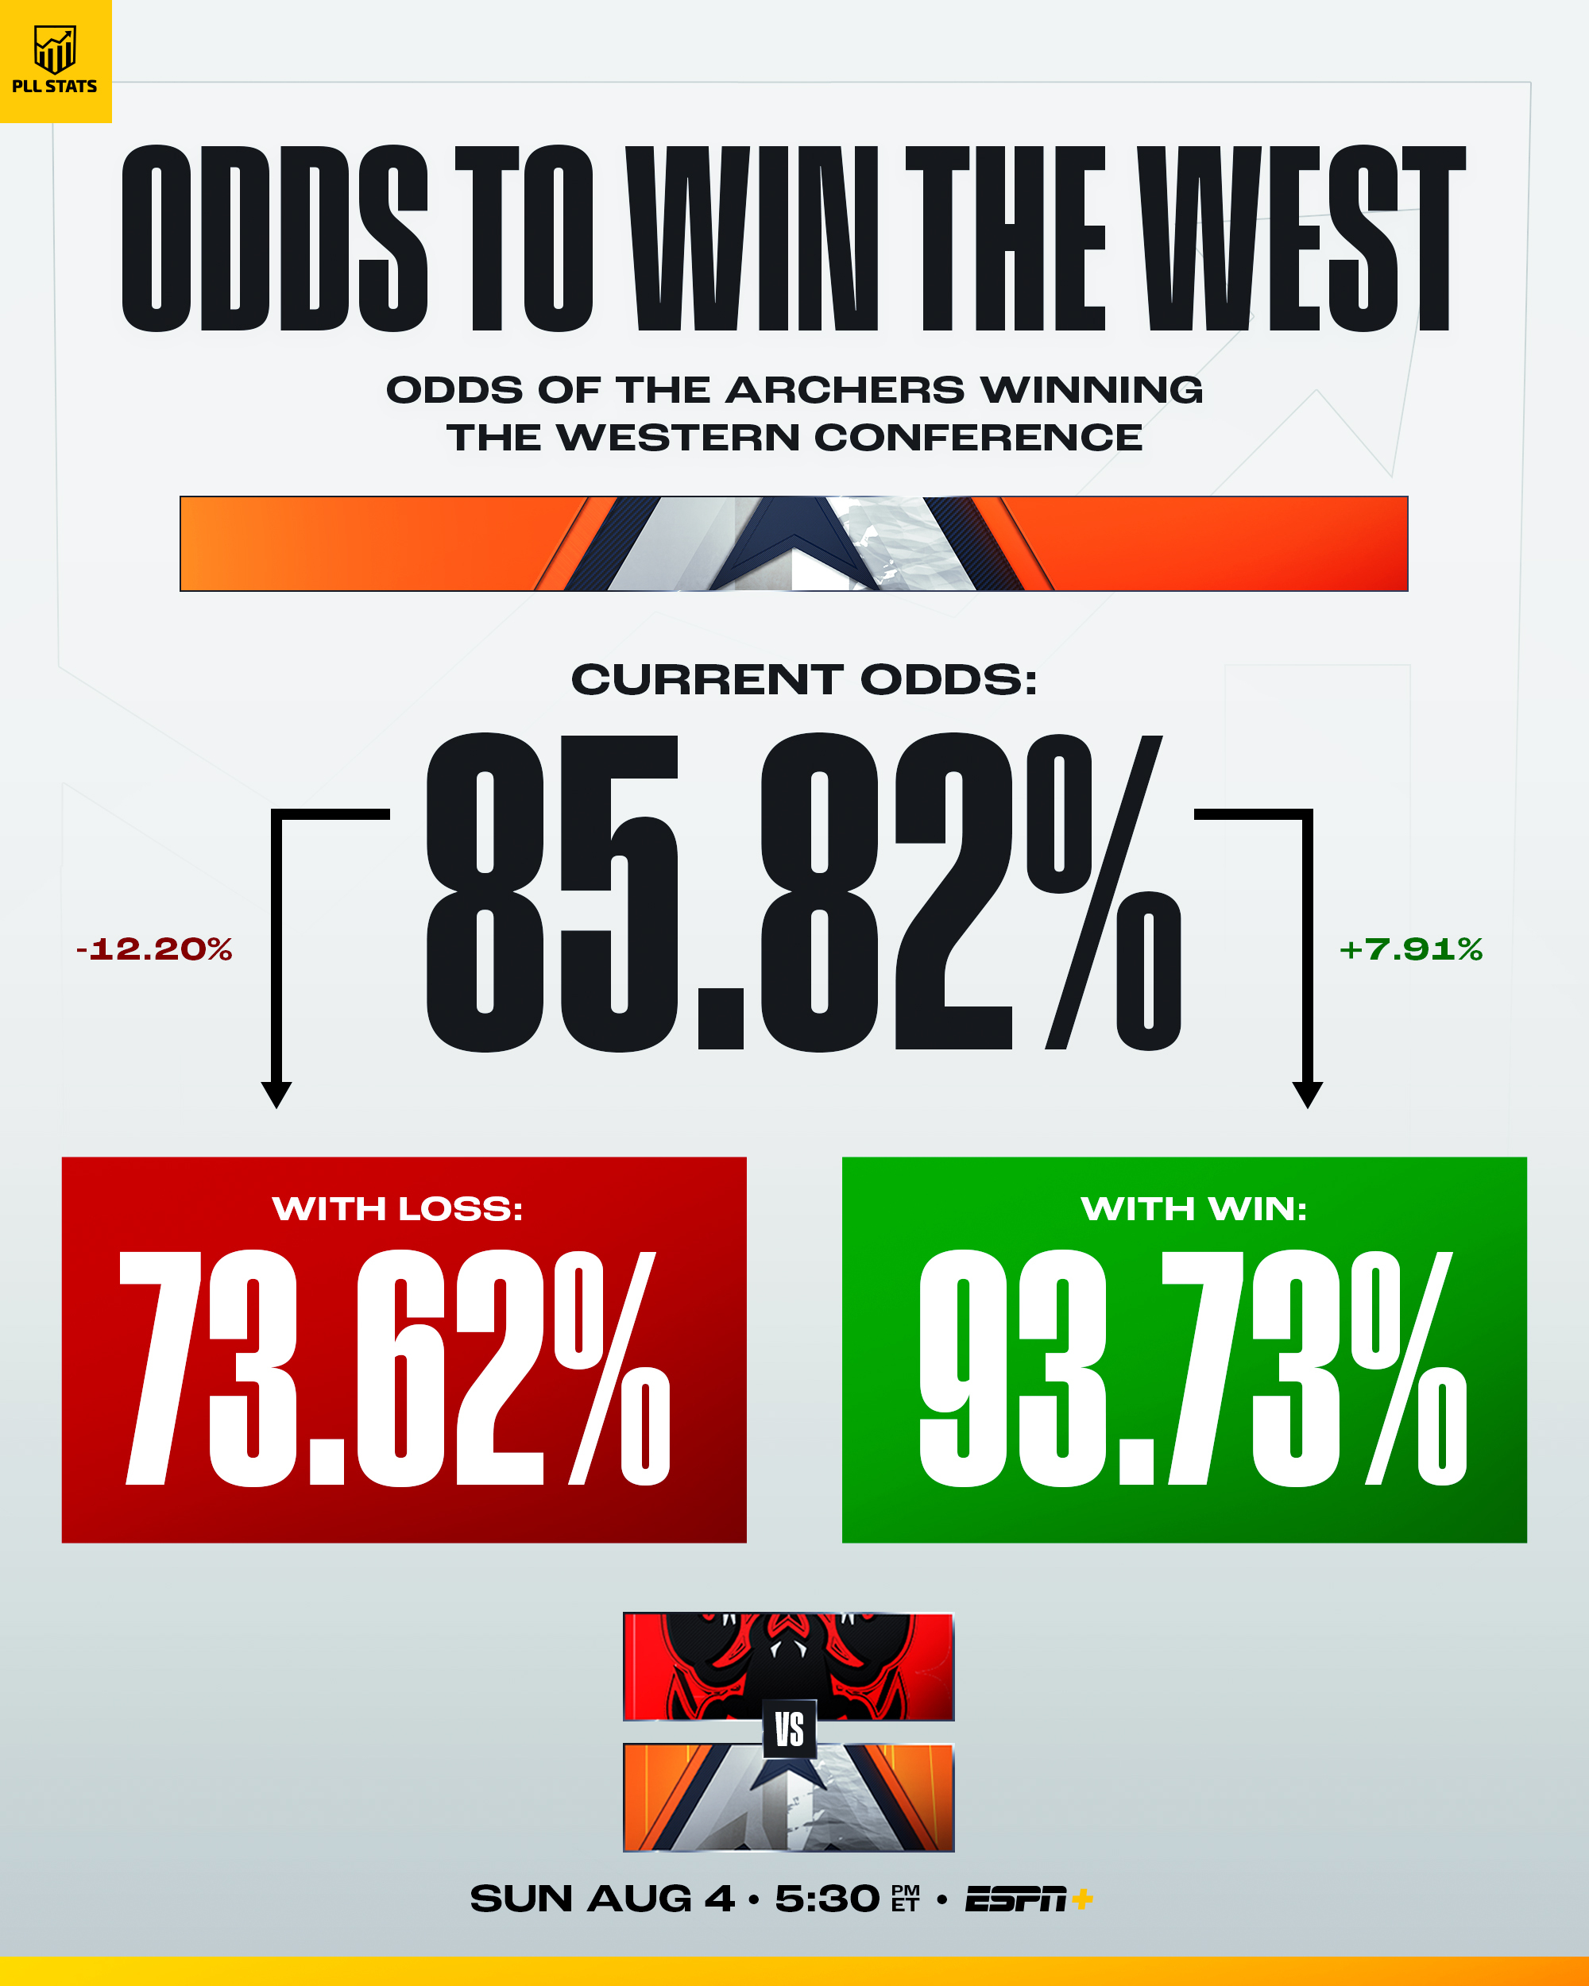
Hypothesis: Key Drivers of Team Success in the PLL
We hypothesize that team success is driven by key performance indicators, which include:
🥅 Goals
🥍 Groundballs
🔄 Turnovers
🧤 Saves
🔁 Faceoffs
Notes:
Through in-depth statistical analysis of historical game data from the Premier Lacrosse League (PLL), we hypothesize that identifying key performance indicators or (KPIs) at the team level will yield actionable insights for coaches and analysts. These insights can enhance overall team performance, inform strategic game planning, and improve season outcomes. Additionally, the analysis may reveal patterns linked to factors like injury risks or performance inconsistencies, enabling targeted interventions. Ultimately, this data-driven approach is expected to foster stronger team dynamics and contribute to a more competitive and engaging league for fans.

Slide 4
MECE Tree
Problem Statement: Why Do Teams Have Consistent Losing Records?
Player Retention
Key Players Boost Engagement.
Retaining Key Players Enhances Success
Player Acquisition
Filling Gaps with New Talent.
Notes:
This MECE tree helps us break down why certain PLL teams consistently struggle with losing records.
We’ve identified two main branches: Player Retention and Player Acquisition—both critical factors in building a successful team.
With this framework in mind, let’s dive deeper into the statistical insights behind team performance and how these factors translate into winning or losing seasons.

Slide 5
Data Dictionary
Variable | Type | Description
Teams | Char | Team Name
Game | Int | Identifier for the game within the season.
Season | Int | Season identifier as ordinal (year).
Win | Binary | Win outcome (0 for loss, 1 for win).
S | Int | Total points scored per game by Teams.
A | Int | Total amount of assisted goals per game by Teams.
TO | Int | Number of turnovers committed per game by the Teams.
2Pt_Sh | Int | 2-point shots per game by Teams.
SOG | Int | Number of shots on goal per game by Teams.
POSS | Int | Time of possession per game by Teams.
TCH | Int | Number of touches (times the Teams has controlled the ball) per game.
PAS | Int | Number of passes made per game by Teams.
CT | Int | Number of turnovers caused per game by Teams.
GB | Int | Number of ground balls recovered per game by Teams.
FO_% | Int | Faceoff Win percentage per game by Teams.
Sv | Int | Total saves per game by Teams.
Notes:
This table defines the key variables used in our analysis, providing a clear understanding of what each metric represents.
The dataset contains team performance metrics, game stats, and win/loss outcomes—all essential for identifying patterns that contribute to success in the PLL.
By analyzing these features, we can determine which factors most strongly correlate with winning records in the PLL.

Slide 6
Web Scraping
Dataset
Grabbing Overall Game Data from 2019-Current Season (Excluding 2020)
Scraping
Using website HTML to pull game stats

Slide 7

Analysis with Python
Transition to Python
Initially used R for early analysis, exploring multicollinearity and statistical relationships
Optimized for advanced predictive modeling and automation
Familiarity with coding principles
Strategic choice for future growth and development

Slide 8
Data Re-Pull
Change in Data from official PLL website
Data Changes allowed for better model accuracy
Excluded any games during Covid era (2020)
Included 2024 Season as it just ended
Notes:
Now that we understand the dataset, let’s explore how models handled the dataset.

Slide 9
Model Comparison
Model | Accuracy (Train) | Accuracy (Validation) | Mean Absolute Error (Train) | Mean Absolute Error (Validation) | F1-Score (Train) | F1-Score (Validation) | Total Misclassification % (Train) | Total Misclassification % (Validation)
Decision Tree (Depth 4, Leaf 3, Split 6) | 79% | 68% | 0.2935 | 0.3644 | 0.7978 | 0.6364 | 21.3 | 32
Random Forest (Tree 10, Leaf 30, Split 60) | 74% | 80% | 0.3582 | 0.3651 | 0.7405 | 0.7059 | 25.6 | 20
Logistic Regression | 69% | 52% | 0.4275 | 0.4628 | 0.7109 | 0.5714 | 31.4 | 48
Neural Network (6,6) | 49% | 44% | 0.4917 | 0.4835 | 0.6036 | 0.5 | 50.7 | 56
Notes:
We’re evaluating models based on accuracy, mean absolute error, F1-score (F1 score gives equal weight to precision and recall, which helps avoid overestimating a model's performance), and misclassification rates to determine the best fit.
DT:
The Decision Tree performed well, achieving 79% training accuracy and 68% validation accuracy.
Its low misclassification rate (21.3% train, 32% validation) suggests it generalizes reasonably well, though it may have some overfitting.
The F1-score of 0.6364 on validation shows it maintains a decent balance between precision and recall.
RFM: The Random Forest model outperformed others with an 80% validation accuracy, making it the most reliable model.
While its training accuracy (74%) is slightly lower than the Decision Tree, its higher validation accuracy (80%) and lower misclassification rate (20%) indicate better generalization.
It has the highest validation F1-score (0.7059), showing strong predictive power.
LR:
Logistic Regression had a 52% validation accuracy, meaning it struggled with this dataset.
Higher mean absolute error values indicate it had trouble making fine-grained predictions.
Misclassification rates were higher (48%), showing it's not the best fit for this problem."
Going forward, we can refine the Random Forest model further by tuning hyperparameters or experimenting with feature selection to improve performance.

Slide 10

Overall Stats
Notes:
Atlas, Archers, and Whipsnakes have the highest shots on goal and scores, meaning they are among the most offensively dominant teams.
Chaos and Cannons have moderate turnovers but still maintain strong win numbers, suggesting they compensate with efficient shooting or strong defense.
Teams with high assists (yellow bars) also tend to have more wins, reinforcing that team-oriented play leads to success.
Heatmap:
Teams like Cannons, Archers, and Atlas consistently record high passing numbers across multiple seasons, suggesting a structured, possession-based offense.
Teams like Chaos and Outlaws have lower passing stats, which could indicate a more direct, fast-paced style of play with fewer set plays.
Redwoods and Waterdogs have improved passing volume in recent seasons, which could explain any recent improvement in performance.
Bar Chart Right:
Archers, Redwoods, and Atlas lead in possession time, meaning they control the pace of the game and likely limit opponent opportunities.
Chrome and Outlaws rank the lowest in possession, indicating they either:
Struggle to maintain offensive possessions, leading to quick turnovers.
Play a high-tempo style focused on quick transitions rather than long possessions.

Slide 11
Logistic Regression Overview
Notes:
Scatterplot:
The trend line shows a positive correlation, suggesting that teams that take more 2-point shots tend to win more games.
Atlas, Archers, and Whipsnakes show strong performance in both wins and 2-point shot attempts. Chrome and Outlaws are outliers with low wins and fewer 2-point shots.
Heatmap:
Archers and Whipsnakes are dominant, maintaining steady win counts across seasons. Outlaws and Chrome have consistently struggled, showing a pattern of underperformance. Atlas and Chaos had fluctuations, meaning their success varies season to season.
Sankey: Each color represents a different team, showing their distribution of shots and corresponding wins.
The majority of winning performances occur when teams take between 12-16 shots. Archers, Atlas, and Whipsnakes have consistently high win counts when they fall within this range. Teams that take fewer than 10 or more than 18 shots per game see a sharp decline in win
Strategic Focus:
Shot selection & efficiency matter. Teams that attempt more 2-point shots and maintain an optimal shooting range tend to win more. Historical team performance shows that some teams are consistently dominant, while others fluctuate season-to-season. Future Analysis: We could expand this by evaluating defensive metrics to see how stopping opponents impacts winning.

Slide 12
Decision Tree Overview
Notes:
Violin plot:
Consistent vs. Variable Teams: Teams like Outlaws have a narrow range, indicating a steady playstyle, while Chaos & Whipsnakes have high variability, showing inconsistency in possession.
Outliers (dots) show extreme games where teams either dominated possession or struggled significantly.
Median Line indicates which teams generally maintain better possession control on average.
Radar: Atlas, Whipsnakes, and Archers dominate Groundballs → Winning more loose ball battles leads to extra possessions and scoring chances.
Possession (Yellow) is balanced across teams → No team has a major advantage in possession, suggesting fast-paced transitions over slower setups.
High Groundball Teams ≠ High Possession Teams → Some teams win groundballs but lose possession quickly, hinting at turnover issues or inefficient offensive play
Pie: Atlas & Whipsnakes have the largest slices, showing they consistently win groundballs, giving them more offensive chances.
Outlaws & Chrome have smaller slices, meaning they struggle to recover possession, limiting their scoring opportunities.
Groundball dominance correlates with higher scoring potential, reinforcing its importance in team success.
Strategic Focus:
Winning groundballs matters but must be paired with possession control to be effective. Teams with balanced metrics (GBs, Possession, and Shot Attempts) perform best. Future Exploration: Looking deeper into turnovers and transition play could reveal why some teams fail to convert groundball wins into success.

Slide 13
Random Forest Overview
Notes:
Face-offs are crucial for possession control, especially in a league where possession directly impacts scoring opportunities.
Low face-off ratings for certain teams may indicate weakness in securing possessions, forcing them to rely on defensive stops to regain control.
Teams with strong face-off performances likely dominate early offensive opportunities, dictating game pace
Donut Chart:
Possession & Saves remain stable across seasons, suggesting a consistent league-wide playstyle rather than drastic shifts in strategy.
If possession trends upwards, teams may be prioritizing controlled offensive setups over fast breaks.
Dips in possession in certain seasons could indicate rule changes or new tactical trends impacting gameplay.
Sankey: Higher assists correlate with more wins, reinforcing that team-oriented playstyles are more effective than individual efforts.
Teams with fewer assists but still winning likely rely on fast breaks or individual shot creation rather than structured offensive schemes.
Identifying team-specific patterns could reveal which teams emphasize playmaking vs. isolation scoring.
Bar chart:
Chaos & Redwoods lead in turnovers, showing ball security issues that likely cost them close games.
Outlaws have the lowest turnovers, indicating a more controlled offensive approach, though it may come at the cost of offensive aggression.
High-turnover but high-win teams (e.g., Atlas, Archers) likely compensate with high shot efficiency or strong defensive play.
Strategic focus:
Possession stability suggests a well-balanced league playstyle. High-assist teams tend to be more successful, emphasizing playmaking value. Turnovers significantly impact performance—teams must balance risk and control. Face-offs matter! Teams winning face-offs gain a major strategic advantage.

Slide 14
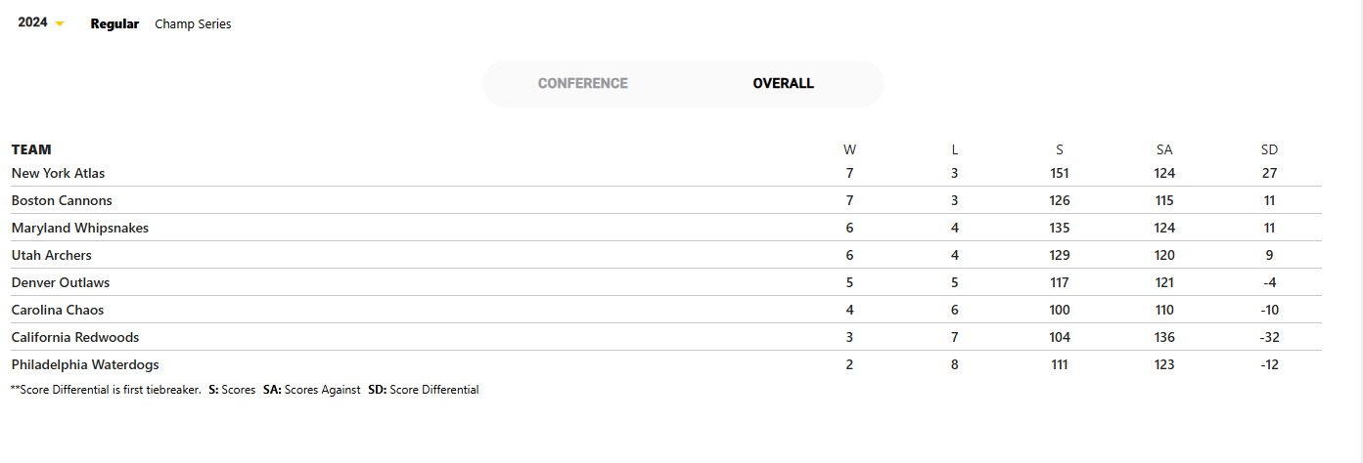
2024 Season Results

Slide 15
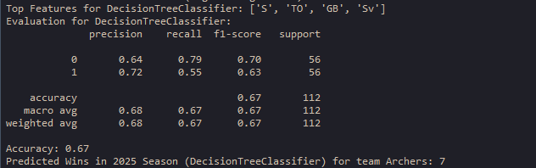
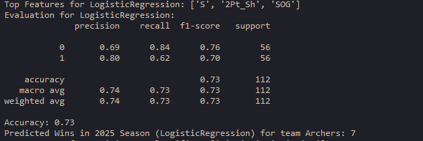
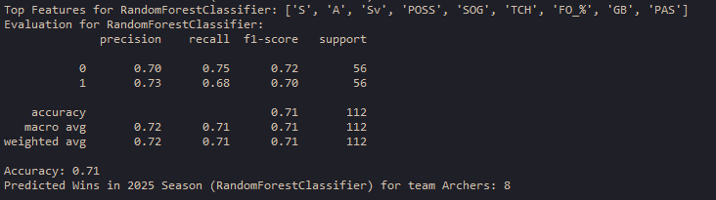
2025 Archers Win Prediction Results

Slide 16
Monetary Impact
NIL Data: $1M-$5M annually (if analytics drive better player branding & endorsements).
Higher Ticket Sales: A 5% increase in attendance (~2K more tickets per game at ~$50 each) could add $5M+ per season.
Increased Betting & Fantasy Sports Revenue: $2M-$10M in potential yearly revenue from betting & fantasy expansion.
More Competitive Media: $2.5M-$5M yearly in added media deal value.
Notes:
NIL:
If top-tier players negotiate better sponsorships based on data-driven performance metrics, this could increase PLL's overall sponsorship revenue.
NIL deals in major sports can range from $50K to $1M+ per player. Even a 5-10% boost in sponsorship efficiency could add millions in revenue over time.
Betting:
Lacrosse betting & fantasy leagues are growing. With your advanced analytics models, PLL could:Increase partnerships with sports betting companies.
Drive fantasy sports engagement, similar to how NFL/NBA use analytics to boost viewership.
Impact Example:The NBA earns ~$250M annually from sports betting partnerships. If PLL captures even 1% of that market, that's $2.5M+ in added revenue.
Streaming:
MLS signed a $2.5B streaming deal with Apple TV.
If PLL secures even a $50M long-term deal, analytics could boost its value by 5-10% ($2.5M+ per year).

Slide 17
Next Steps
Expand Project: Take a deeper approach to how these insights connect to player performance.
NIL Deals: How can these stats impact NIL deals for collegiate athletes?
Refining Models: Developing more accurate models with updated PLL data.
DSA Labs: Currently engaging with a Sports Analytics company.

Slide 18
Data Limitations
Potential Bias in Data: Team-specific trends or limited sample sizes may skew results.
Data Accuracy Concerns: Some inconsistencies, but ongoing refinements may address this.
Missing Key Metrics: Possession time and touches from the 2019 season are unavailable, limiting full-game analysis.
Expanding Dataset for Better Accuracy: More seasons or additional features could improve model predictions.

Slide 19


Personal Impact
Passion Project: Currently collaborating with a startup to apply sports data-driven solutions.
Expanded Skills: Gained advanced knowledge through coursework and hands-on experience.
Career Growth: Promoted to Data Analyst V at DFPS, demonstrating expertise and impact.

Slide 20
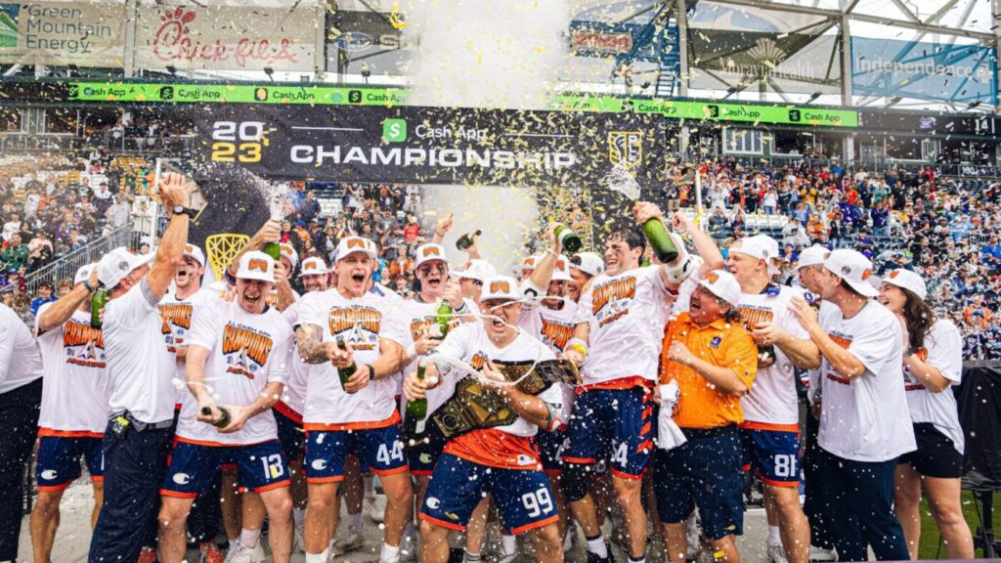
Questions?

