Slide 1
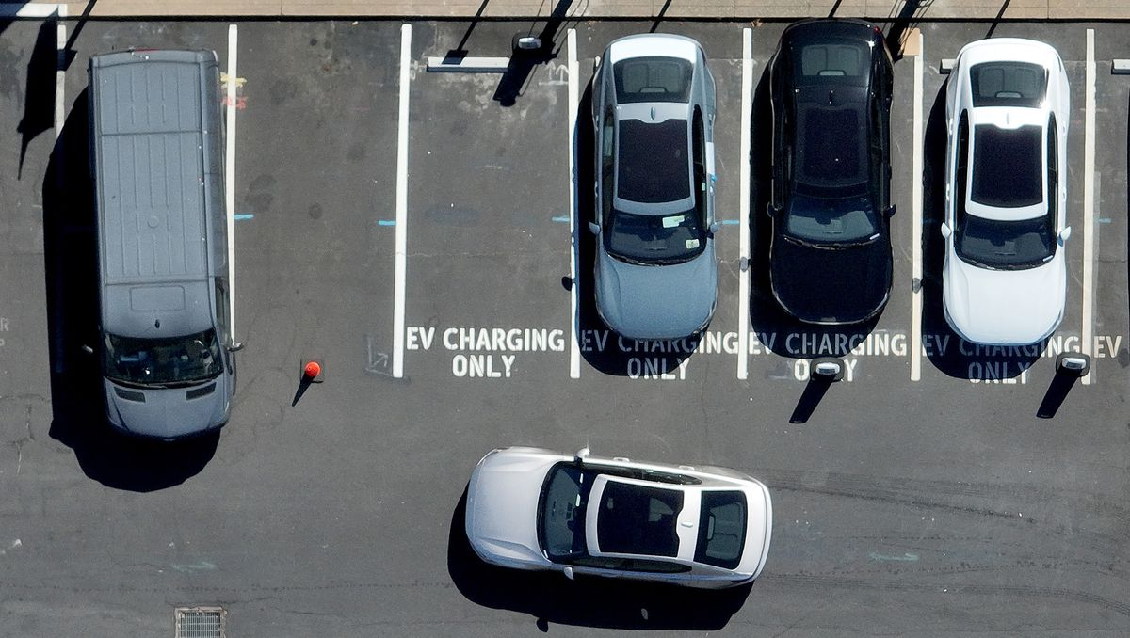
Electric Vehicle Use in New South Wales
Group 1
Cayley Morrow
Chang Yu
Damian Kifuso
Julian Ravelo

Slide 2
Project DESCRIBTION
Analyse the influence of electric vehicles (EVs) in NSW and whether the surge in EV adoption correlates with a change in primary fuel sources used within the state
Create a JavaScript dashboard that enables users to explore and interact with a collection of data through a combination of charts and map visualisations.
Provide insightful comparisons between NSW and other key Australian states, namely Queensland, Victoria, South Australia, and Tasmania.

Slide 3
sources
Electric Vehicle Council
https://electricvehiclecouncil.com.au/wp-content/uploads/2023/07/State-of-EVs_July-2023_.pdf
NSW Government (NSW Climate and Energy Action)
https://www.energy.nsw.gov.au/sites/default/files/2022-09/nsw-electric-vehicle-strategy-210225.pdf
Australian Government NationalMap
https://nationalmap.gov.au/
https://ev-infrastructure-mapping.s3-ap-southeast-2.amazonaws.com/ev_evc_prototype.csv
https://ev-infrastructure-mapping.s3-ap-southeast-2.amazonaws.com/chargers_by_postcode_prototype.csv
Australian Energy Market Operator
https://aemo.com.au/energy-systems/electricity/national-electricity-market-nem/data-nem/data-dashboard-nem
GeoJSON information
https://github.com/tonywr71/GeoJson-Data/blob/master/suburb-2-nsw.geojson
Websites used
https://stackoverflow.com/questions/22521982/check-if-point-is-inside-a-polygon

Slide 4
Data cleaning
chargers_by_postcode_prototype.csv
The dataset contains number of Electric Vehicle (EV) registrations by postcode for a specified year. The years documented in the dataset are between 2017 and 2021. There are 4,751 rows and 832 columns of data.
ev_evc_prototype.csv
The dataset contains the number and location of current Electric Vehicle (EV) charging stations.. There are 505 rows and 12 columns of data.
NEMFUELMIX_ALL_202311022059.csv
The dataset is a breakdown of energy sources in the Australian National Electricity Market (NEM), containing energy source distribution of all Australian States (not including WA, NT, and ACT) between 29th October 2022 to the 21st October 2023. There are 1,524 rows and 5 columns of data.

Slide 5
Data cleaning
Converts the data from csv files into Pandas DataFrames.
The data has been cleaned to display relevant columns (eg. Top 9 ev car brands)and Null values have been changed to zero values.
The data has then been converted to a SQL database and reflected in Data_Engineering.db file.

Slide 6
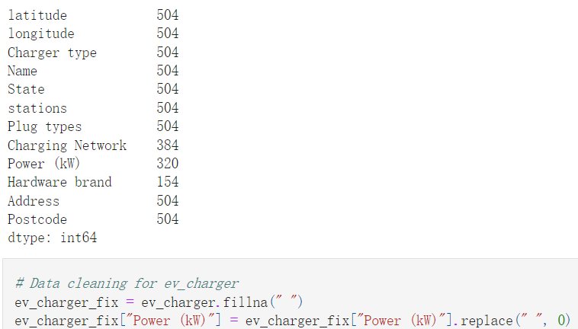

Slide 7
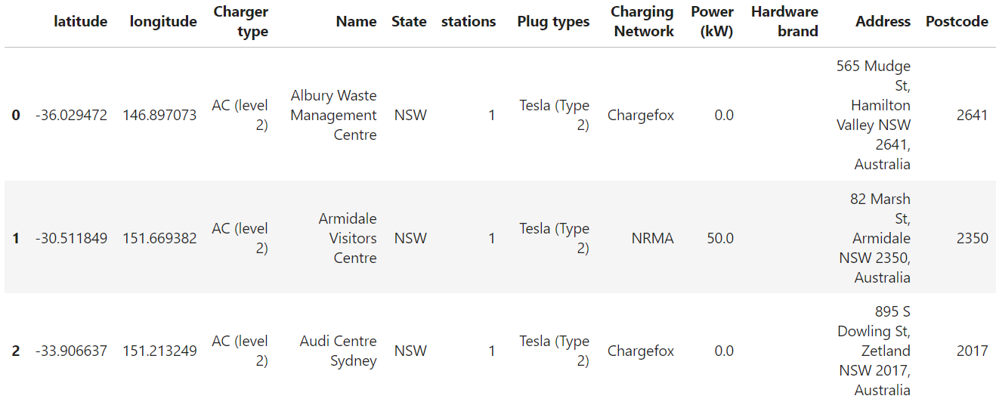
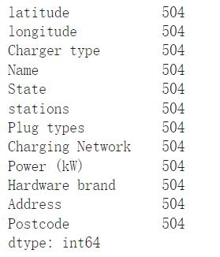

Slide 8
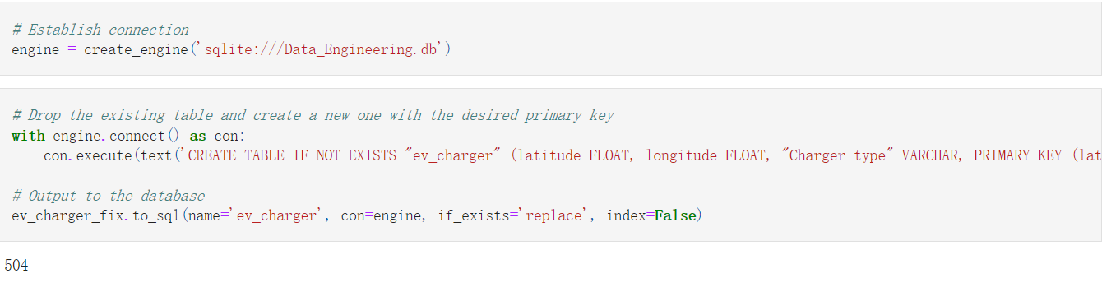
Save csv to sql

Slide 9
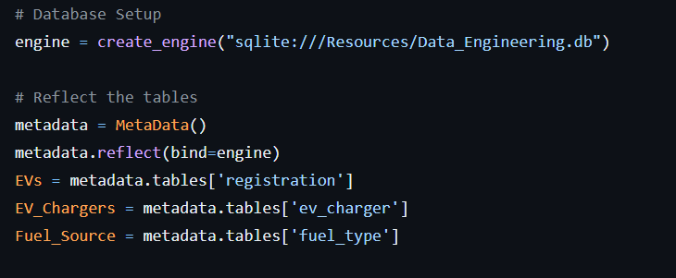
create an API using Flask
Create Python Flask-powered API for each of the csv files and geojson file.
Setup database and save reference to table

Slide 10
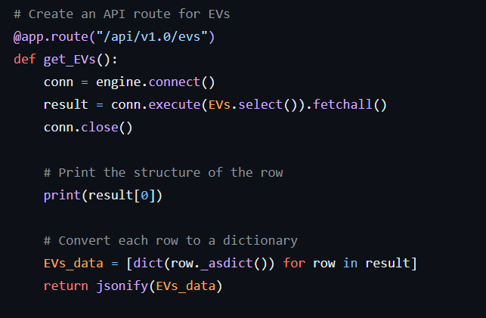
Define route for database and save result as a json file

Slide 11
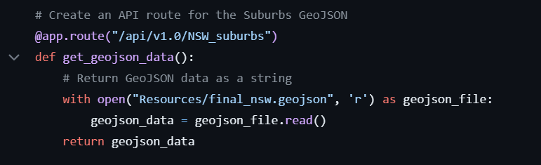
Define route for geojson

Slide 12
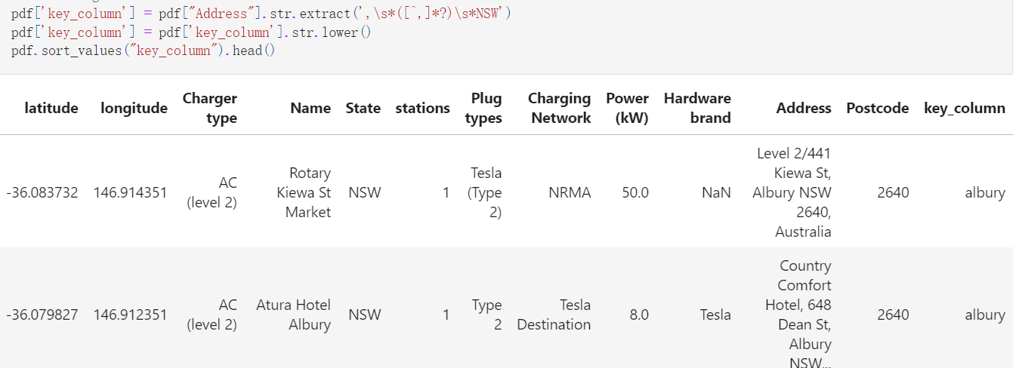
merge geojson file with information of the suburbs in NSW with the location of EV chargers
Extracting name of the suburb from address column

Slide 13
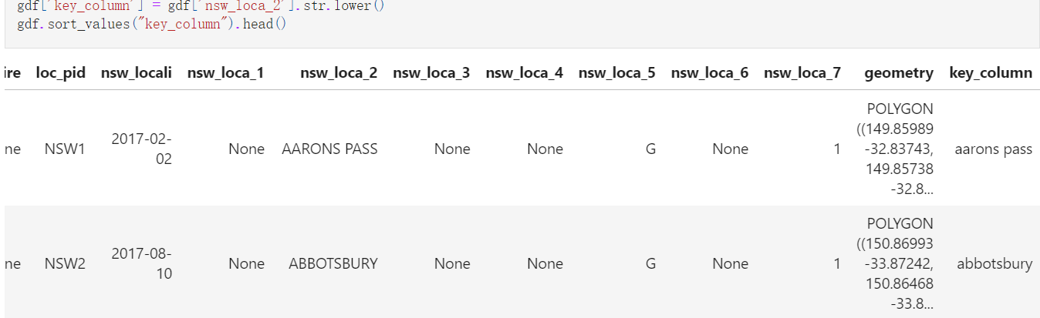
Lowercasing values before merging them

Slide 14
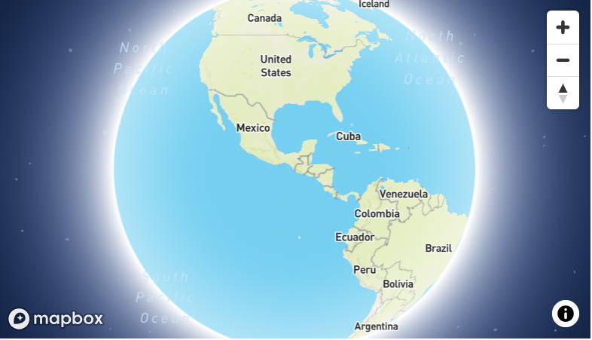
Mapbox api
“A client-side JavaScript library for building web maps and web applications with Mapbox's modern mapping technology”

Slide 15
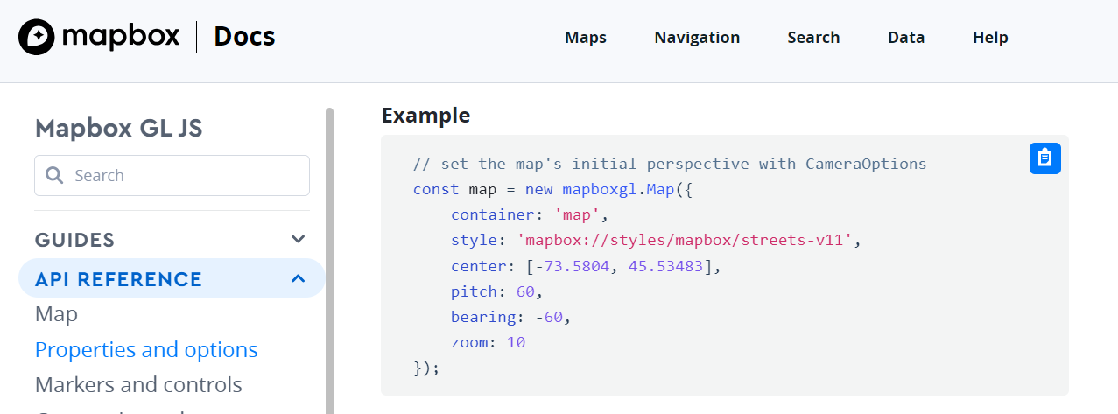

Slide 16
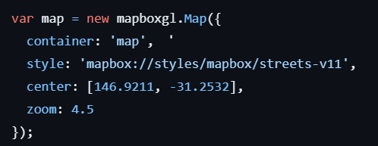
Set the token and variable

Slide 17
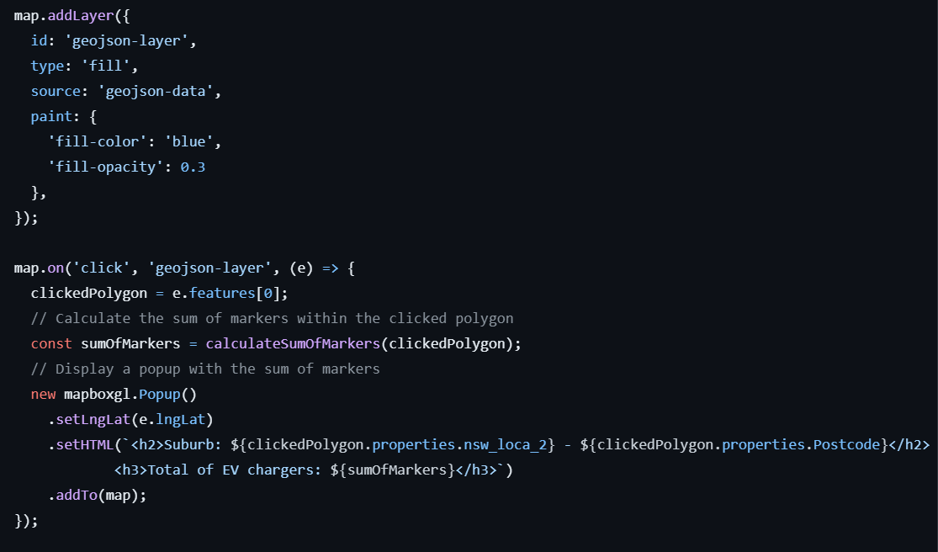
Add layer to map

Slide 18
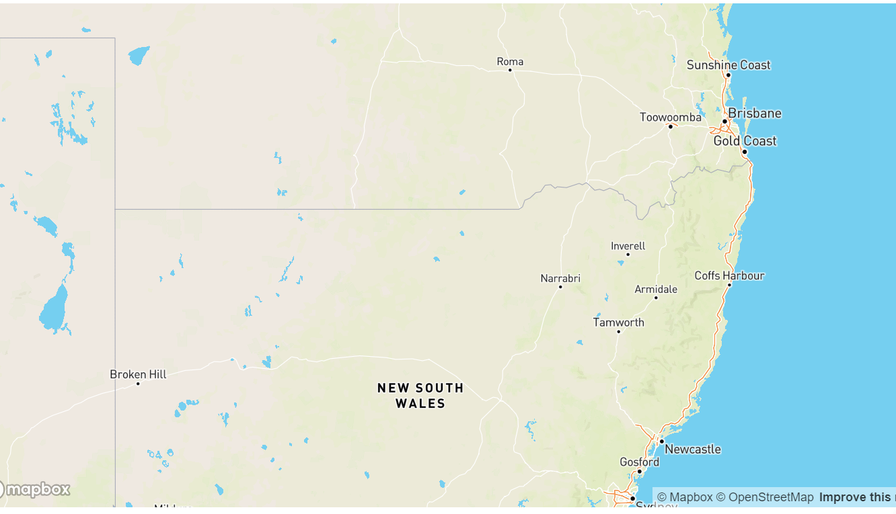

Slide 19
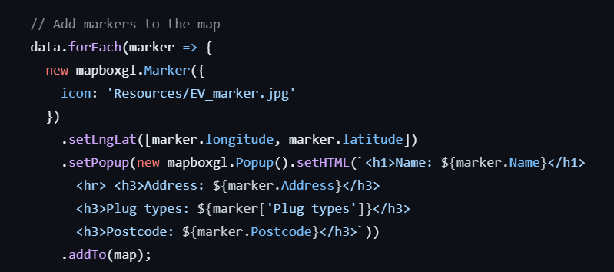

Slide 20
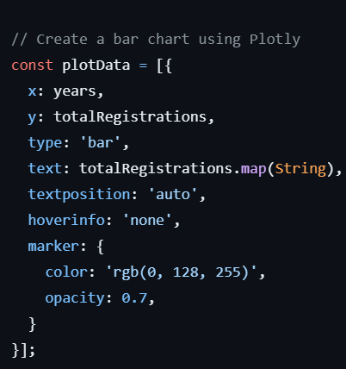
bar chart with the number of electric cars registered in NSW between 2017 and 2021

Slide 21

Calculate sum of

Slide 22
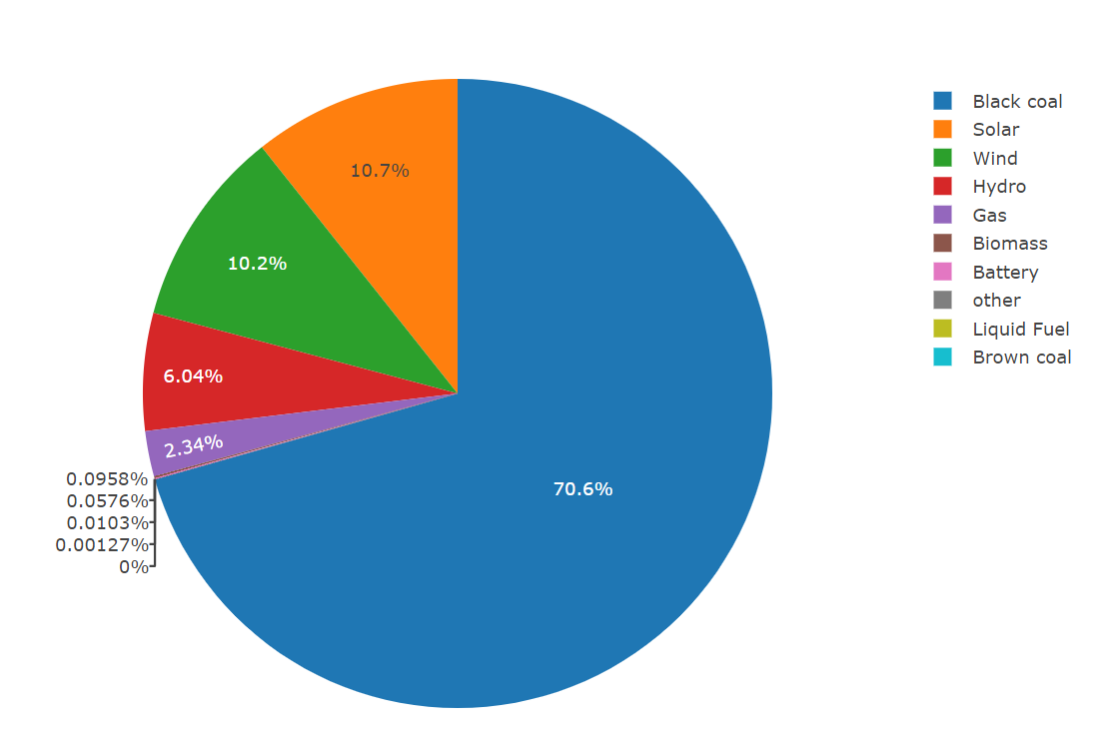
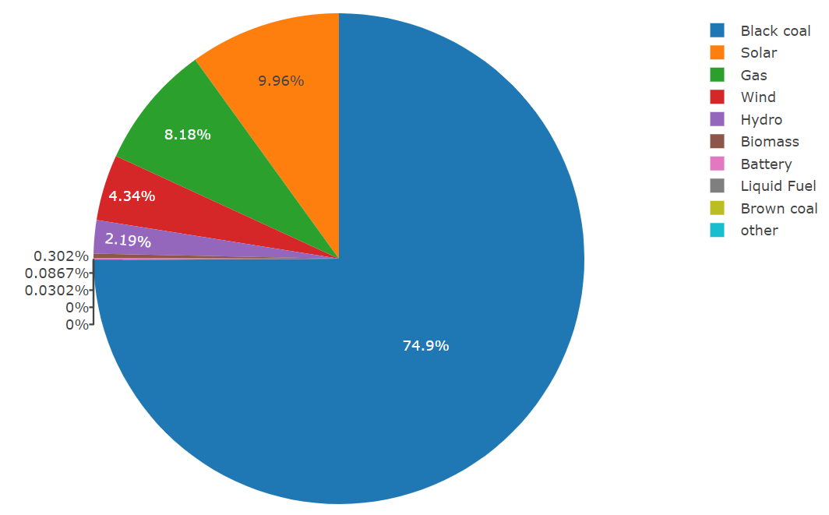
e.G primary fuel sources used within NSW and Queensland

Slide 23


