Slide 1
Intelligent Sports Analytics: A Progressive Web App for Extracting and Evaluating Team Results
By Julian Saria

Slide 2
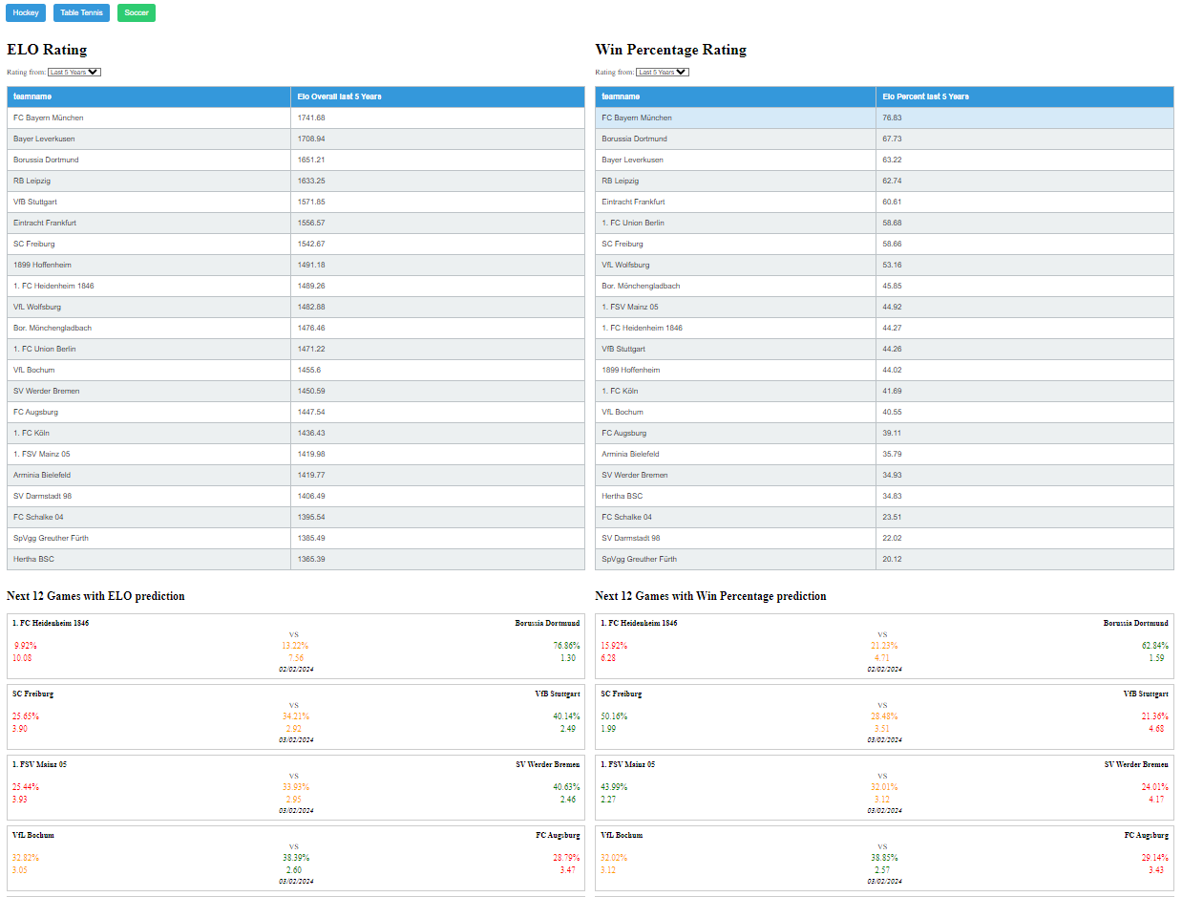
1. Project Definition 2. System Architecture 3. Rating Algorithms 4. Prediction Algorithms 5. Draw & Betting Quotes 6. Live Demo 7. Q & A
IMAGE OF APP

Slide 3
1. Project Definition
provide a Web-User Interface for hockey, table tennis and soccer
give an overview about three different ratings and predictions of the teams
option to evaluate past games on the past predicted ratings.
two main goals:
predict future games
evaluate past games

Slide 4
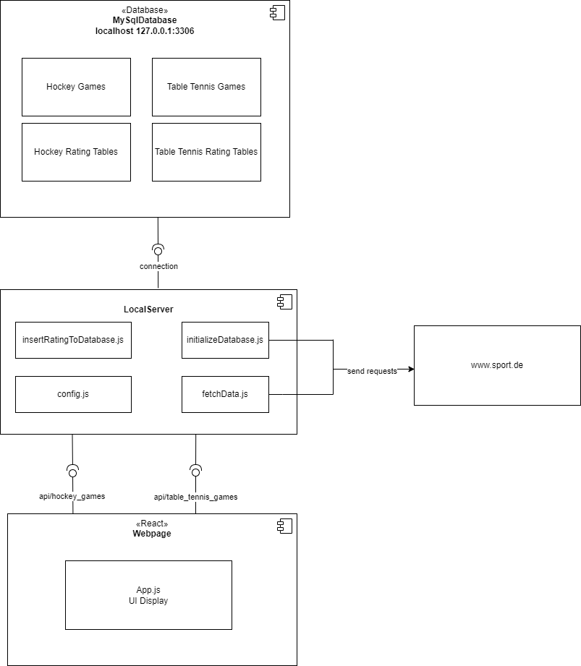
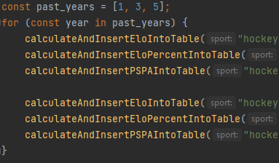
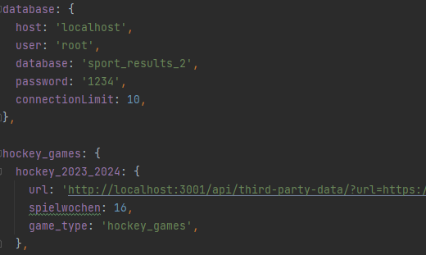
2. System Architechture
insertRatingToDatabase.js
config.js

Slide 5
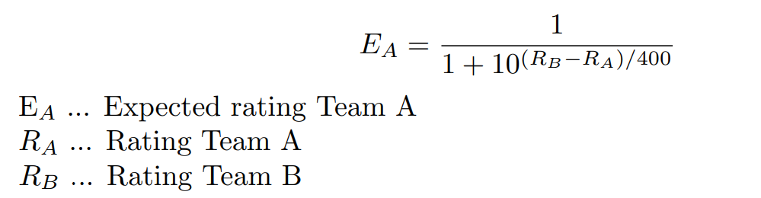

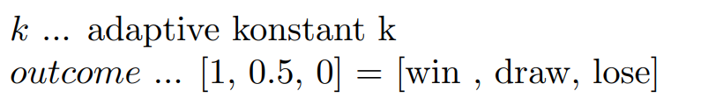
3.1. Elo Rating

Slide 6
3.2. Win Percentage Rating
take the win rate of a team over a specific time period
adjust it whether the team faced „good“ or „bad“ opponents.
Example for a Team A facing 2 different teams.
Team A 2 : 0 Team B
Team A 0 : 1 Team C
Team A = 50% League Average = 50% Team A faced
Team B = 40% Team B = -10% Teams -15% below
Team C = 30% Team C = -20% Team A new = 35%

Slide 7
3.3. Points Scored/Points Allowed Rating
Very useful measure since it can calculate win rates
total points scored / points allowed over a time period
devide through the number of games
adjust like in win percentage rating
Team A 3 : 0 Team B
Team A 0 : 1 Team C
Team A PS/G = 1.5
Team A PA/G = 0.5

Slide 8
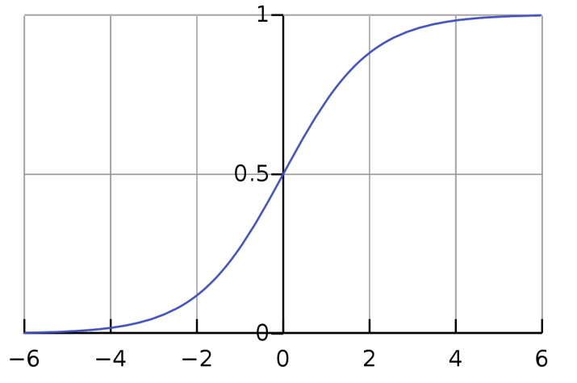
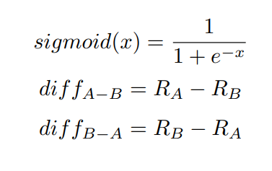
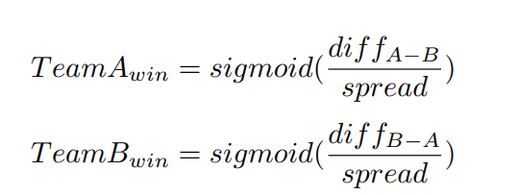
4.1 Elo Prediction
spread = 100

Slide 9
4.2 Win Percentage Prediction
difference between two teams win percentage rating
Evenly distrubute it around 50%
If difference >50 threshold it
Example:
Team A = 70%
Team B = 50%
Diff = 20%
Team A 70% : 30% Team B

Slide 10
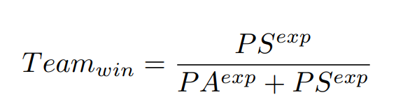
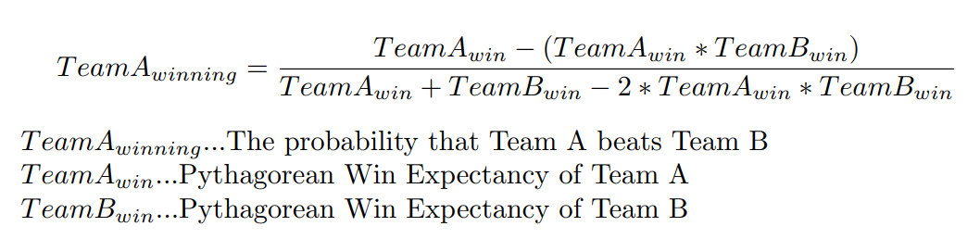
4.3. Points Scored/Points Allowed Prediction
Pythagorean Win Expectancy
Exponent depends on goals
Log5 Win Probability

Slide 11
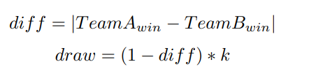
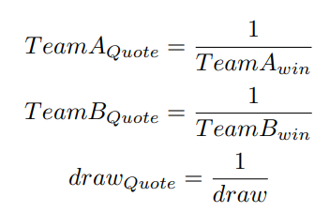

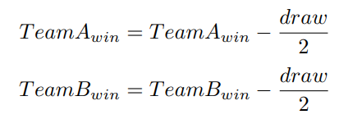

5. Draw & Betting Quotes
results are not binary
possibility of a draw
draw more likely the more evenly teams are matched

Slide 12

6. Live Demo

Slide 13

7. Q & A

