Slide 2
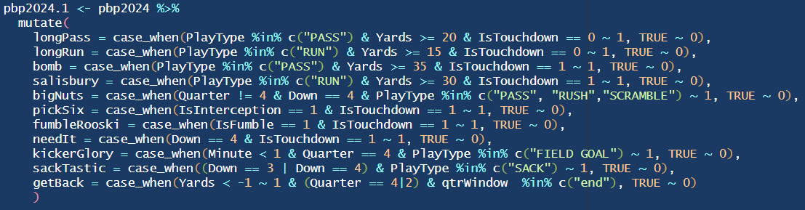
Cool plays

Slide 3
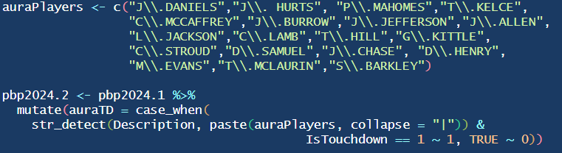
AURAAAA!

Slide 4
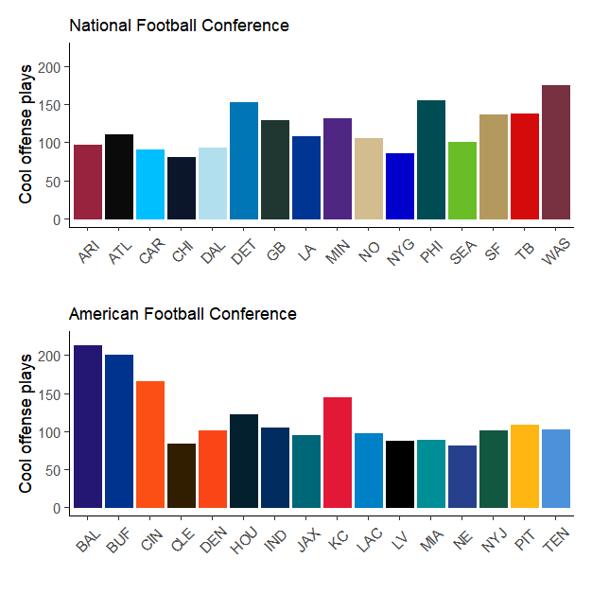

Slide 5
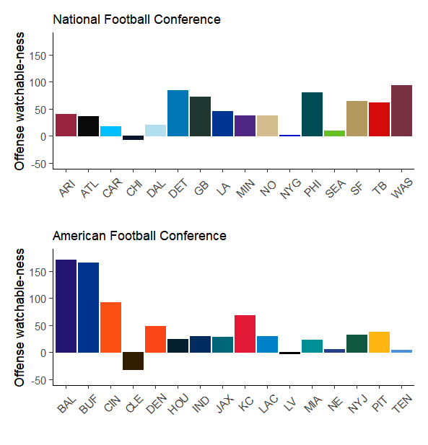
Defense clearly got the better of a few teams(Bears, Giants, Browns holy shit, Raiders

Slide 6
