Slide 1
Alpha-Zero
Julian Wandhoven
Notes:
We will do
- Reinforcement learning algorythem
- stated 2 player 0 sum games
- starting information
- self play

Slide 2
Overview
Traditional Approach
  MCTS
What Problems Exist
Solutions
Notes:
- Taraditional MCTS
- Analyse for problems
- Fix Problems

Slide 3
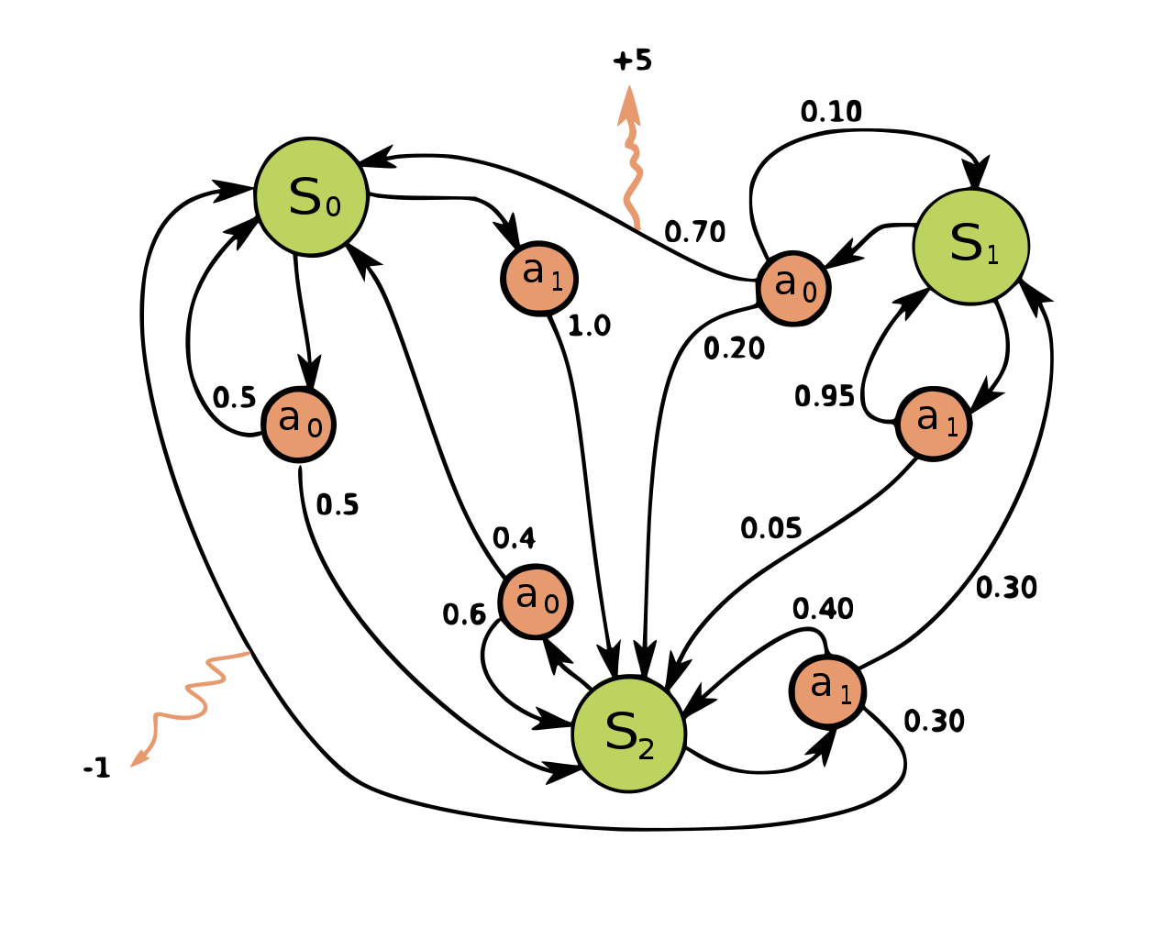
Markov Decision Process
State space
Action space
Reward
Transition-probability
[1]
Notes:
Example of a simple MDP with three states (green circles) and two actions (orange circles), with two rewards (orange arrows).
- board games are MDTs
- lemma?
Image caption:
Example of a simple MDP with three states (green circles) and two actions (orange circles), with two rewards (orange arrows).

Slide 4
MCTS [2]
Optimal Action selection in MDT
Converges to optimal Actions over time
Iterative 4 phase Optimization-loop
  Selection, Expansion, Evaluation, Backpropagation
Notes:
- Advantage, disadvantage over alpha-beta
- cancellable
- faster in large search spaces
- board games are Marcov descision process
States, actions, selection prob, reward
- 4 Phase sim process

Slide 5
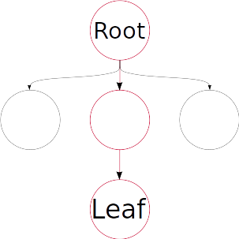
Selection
Select Leaf node
Next Action selection based on and
Notes:
- Iterative Selection
- Balance Exploration exploitation
- some function of Qn and N
- Find leaf
- Leaf?

Slide 6
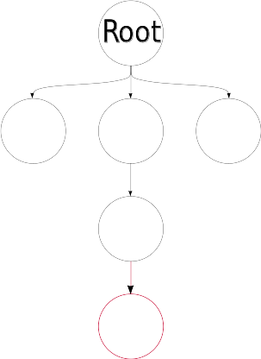
Expansion
Expand leaf Node with random new Node

Slide 7
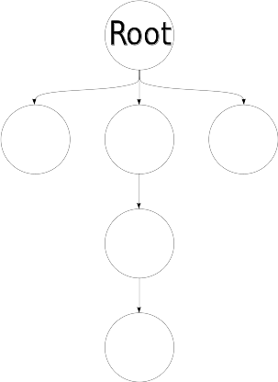
Evaluation
Play random Games
=> Determine Win Probability

Slide 8
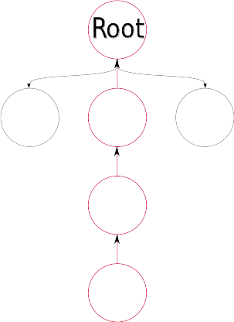
Backpropagation
Use to update
and

Slide 9
Problems
Prohibitively slow for large Search spaces
Determination is Slow

Slide 10
Solution- determination
Creates Problem
Neural Network Provider (val net)
Random Node expansion => More NN evaluation

Slide 11
Solution – Random Expansion
Expand all Leaf Nodes
Use Neural Network to prioritize Node selection on next simulation
Combine with val net to form a Bi-headed Neural Network

Slide 12
Training
Train Value to approximate game reward
=>
Train to for a given action and state

Slide 13
End Result
Good Agent within 8 h
Fast Ai evaluation time
Perpetually improving Agents the more time passes
No time loss for better agents

Slide 14
Human vs Ai
Ai Server providing game actions to Client

Slide 15
Sources
[1] Wikipedia contributors, "Markov decision process," Wikipedia, The Free Encyclopedia, https://en.wikipedia.org/w/index.php?title=Markov_decision_process&oldid=1127655849 (accessed December 19, 2022).
[2] Karl Kurzer, , Christoph Hörtnagl, and J. Marius Zollner. "Parallelization of Monte Carlo Tree Search in Continuous Domains".CoRR abs/2003.13741 (2020).

