Slide 1
Mastering the Game of Connect4 through self play
Julian Wandhoven

Slide 2


Thought Experiment 1
Red maximizes Value

Slide 3



Thought Experiment 2
Max, Min

Slide 4
Connect 4 Solver
Build the graph for connect 4
Unoptimized: 3.1197348e+35 Nodes
Optimized: 4531985219092 Nodes

Slide 5
MCTS
Best first
Self optimizing over time

Slide 6
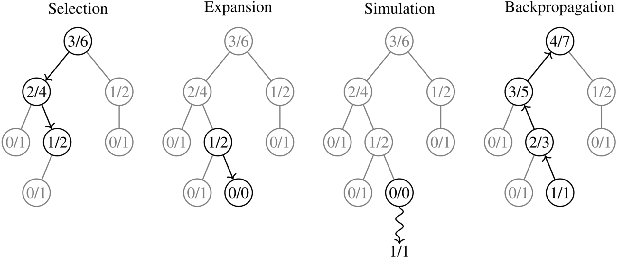
MCTS
https://en.wikipedia.org/wiki/Monte_Carlo_tree_search#/media/File:MCTS_steps.png

Slide 7
Estimation function
Estimate win rate for any node
=> Faster MCTS convergence
Neural network
=> MCTS provides data

