Slide 1
Mastering the game of Connect4 through self-play
Julian Wandhoven

Slide 2
Overview
Neural network introduction
AlphaZero (Time permitting)

Slide 3
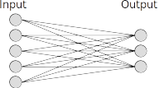
Dense Neural network

Slide 4
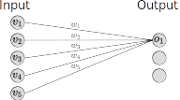

Dense Neural network

Slide 5





Slide 6





