Slide 1
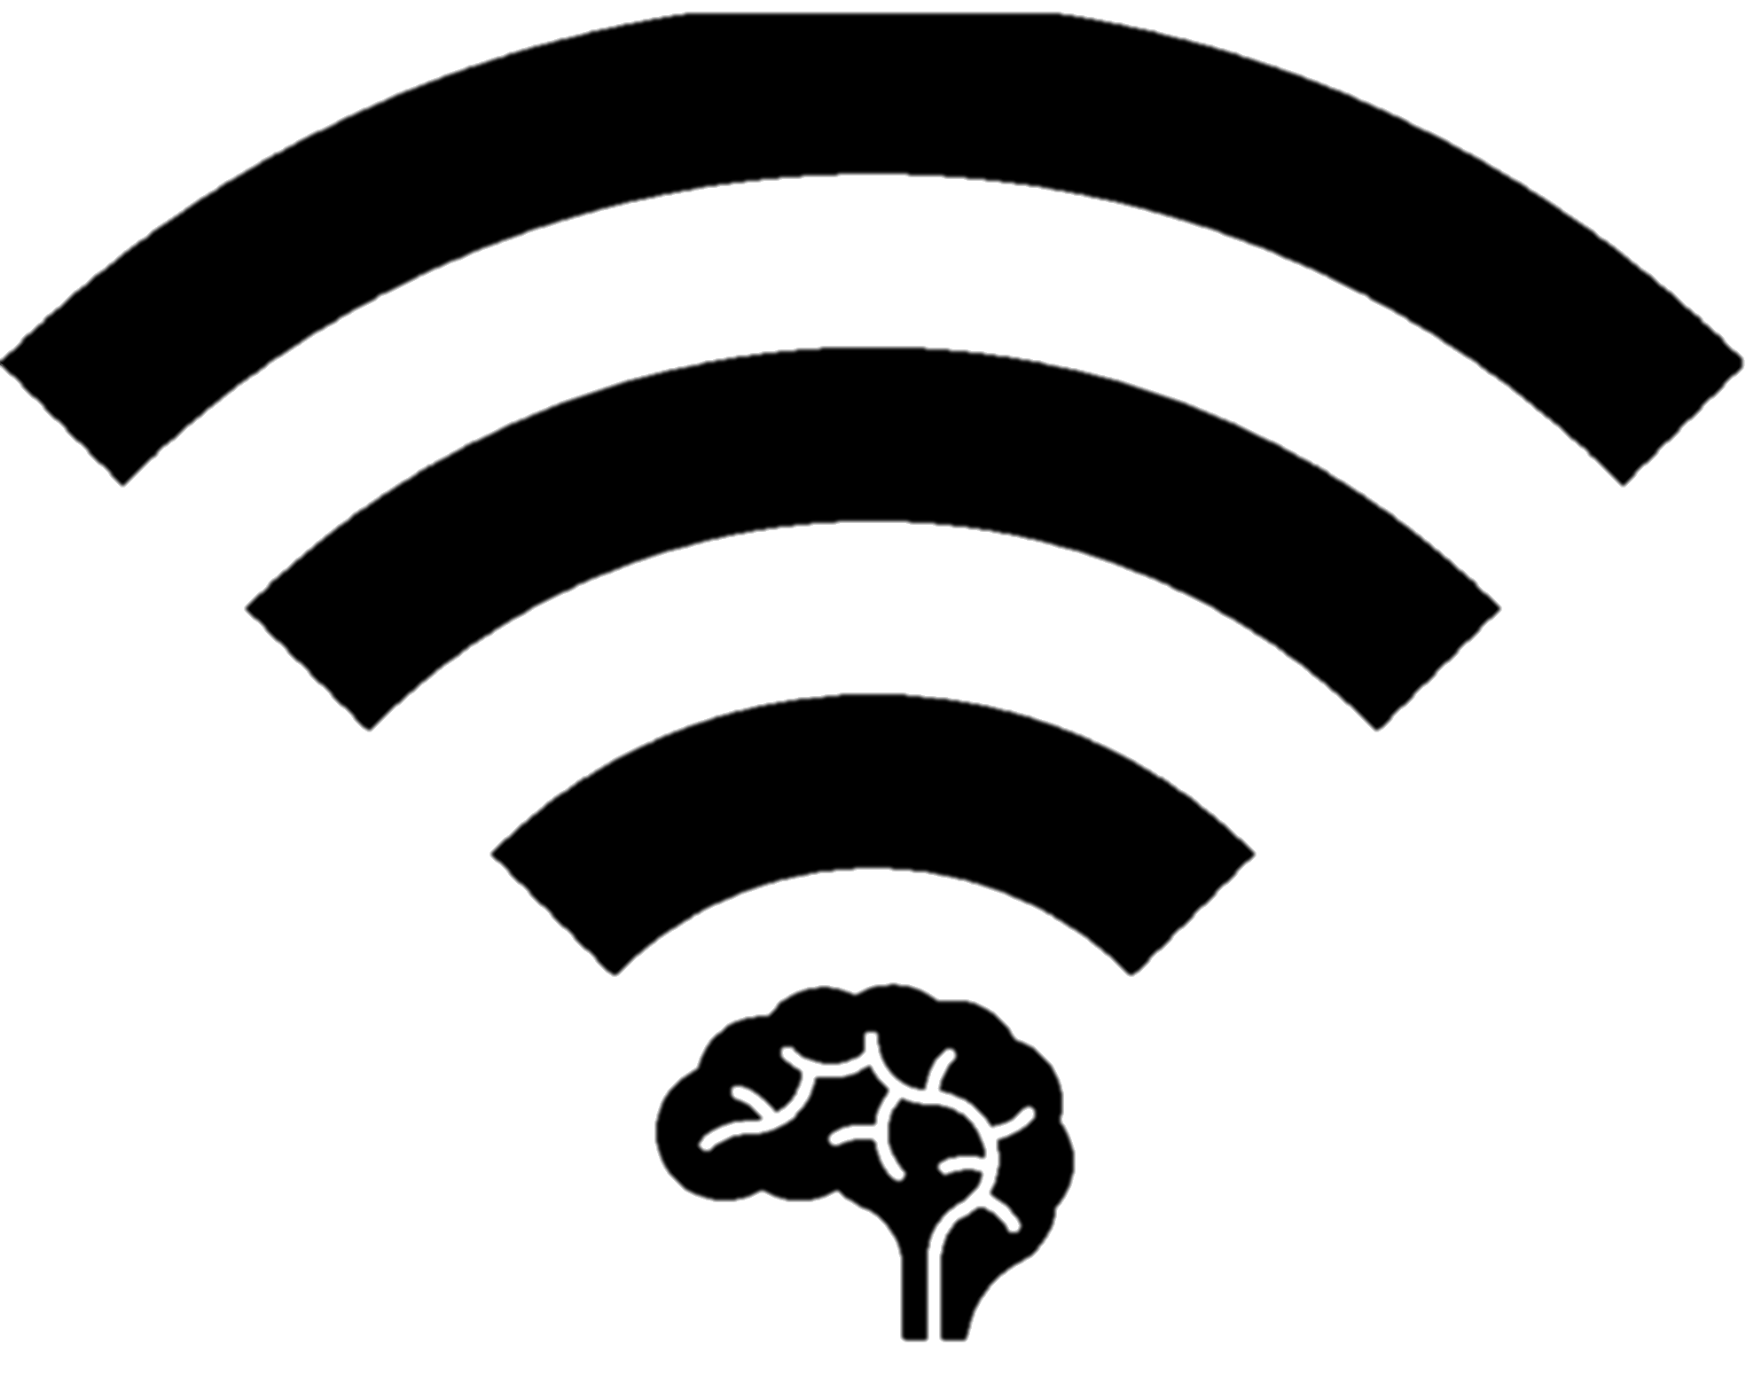

Wireless Neural Recorder
Stephen Xia
Tingkai Liu
Yuan Gao
Xin Huang

Slide 2
Motivation & Scope
Patients with severe epilepsy untreatable by medicine or therapy have to undergo invasive epilepsy surgery, to localize the source of the epileptic brain activity through intracranial EEG with a resolution greater than what is provided by scalp EEG.
Such data collecting procedures are invasive, expensive, and time-consuming. The current standard is to use a bedside rolling station with a monitor and computer racks that have wires connecting the electrocochleography system directly to the patient’s brain. This confines them to their hospital beds for days on end with barely any interaction or motion, severely limiting their quality of life.
WNR seeks to produce a new ECoG (a.k.a. Intracranial EEG) electrode that incorporates wireless connectivity between each individual intracranial electrode probe and a central terminal. Each electrode will be attached to a low-power wireless control unit that will read and transmit neural data in real-time to a receiver. An array of up to 16 wireless electrodes should be able to transmit simultaneously to a single receiver. From the receiver, medical professionals can access the data in real-time and analyze the captured data to best treat the patient. Our embedded system seeks to untether the patients and give them their mobility and their life back.

Slide 3
Affected Patients
1% of Population | 10 - 25 Million Operations/ Year
5 - 6 Days per Operation

Slide 4
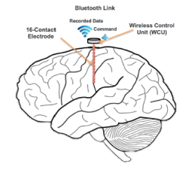
Wireless Neural Recorder Value
Improve Epilepsy patients’ quality of life
Untether them from the limitation of existing technology
Real world activity monitoring with more data for better procedural diagnosis
Wireless Probe Application not only limited to epilepsy
Sleep disorder diagnosis
Diagnose diseases of the brain
Brain stimulation

Slide 5
WNR Device Requirements
Safety & Regulation
Meets FDA Medical Device requirements & HIPPA Data Privacy Requirements
Do not heat up the surrounding skin by a change of more than 2℃/3.6℉
No leakage current from device into brain
Real-time, accurate, and comprehensive data collection
Wireless data link with adequate bandwidth and throughout sending to an external device
Sample and send data from at least 16 electrodes on 16 probes with sufficient bit resolution
Compress, encrypt, and decrypt data with no loss in resolution
Convenience, portability, and long-lasting
Independent usability of each probe without the need to physically network probes
Compact and lightweight form factor that does not interfere with each other
Battery lasts at least a working day and be easily user-replaceable

Slide 6
Final Design Specifications
16-channel amplifier chip A2D
Configurable to 32 or 64 channel A2D
1Mbps Bandwidth with BLE Radio
Configurable to 2.1Mbps Bandwidth with BT EDR Radio
Configurable to 54Mbps with Wifi Radio
310mAh @ 2.9V
High capacity achievable with custom solution
Packaged form factor of 8mm diameter by 12mm height

Slide 7
$300 Million Market Value
Hospitals | Clinics | Research Institutes
> 4500 | > 5500 | 150

Slide 8
