Slide 1
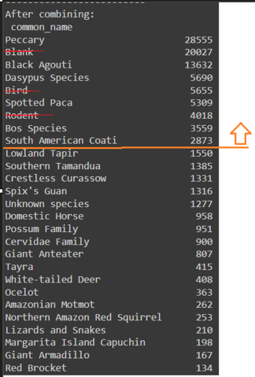
Our Species
species_list = ['Peccary', 'Black Agouti', 'Spotted Paca',
'Dasypus Species','South American Coati','Bos Species']

Slide 2
df_train, df_val, df_test
Columns Meaning
'timestamp'
'image_id'
'Sp_num'
'common_name'
'camera'
'image_number'
'filename_new'
'filename'
'seq_id'
'frame_num'
'seq_num_frames'
'seq_size'
'split'
Date and time the photo was taken in ISO8601 format
Unique id of each image
Number of species labelled for the image. Should be 1 as all multi-class images have been removed. Might have multiple animals of the same species in the same image.
Species label of the image
Camera at which the image was taken.
The six numerical digits before the .JPG extension. (e.g. 01080001.JPG)
File name in output folder format {camera}_{subfolder}_{image_number}
File name for locating raw image in GCP format {camera}/{subfolder}/{image_number}
Unique id of each image sequence
Image sequence within the seq_id
Number of images within the same seq_id
Number of images within the same seq_id and labelled as common_name
Which split this image belongs to. ‘train’,’ test’ or ‘validation’

Slide 3
/raw-data/orinoquia-camera-traps/public
All images with multiple classes
0_data/sample_images/dual_class_images_all.csv
Split images of each species by seq_size
Data_Splitting.ipynb
Single-class images with frame number, filename, filename_new etc.
0_data/sample_images/images_info_all.csv
70%
10%
20%
/raw-data/train_data
/raw-data/validation_data
/raw-data/test_data
Images information of train, validation and test set
Image Preprocessing_train_data.ipynb
Blacken bottom logo and information bar, extracted red channel.
/train_data_processed
0_data/train_downsampled.csv
0_data/val_downsampled.csv
0_data/test_downsampled.csv
Google Drive
GCP Storage
GCP Bucket name:
281-project-d5d834b8-2d7c-11ef-91d5-b89a2a9d8518/

Slide 4
/raw-data/orinoquia-camera-traps/public
w281_Project/0_data/dual_calss_images.csv
(Discarded from the preprocessed images)
Extract images from desired class and cameras.
Mounting data to GCS.ipynb
Dual-class (Bos Species + Domestic Horse) images
/raw-data/downsampled-data
OLD
Blacken bottom logo and information bar.
Preprocessing_black_pixels_at_bottom.ipynb
/raw-data/prepocessed_data
Extract red channel from images.
Preprocessing_red_channel.ipynb
/raw-data/prepocessed_data_red
Dual-class (Black Agouti + Crestless Curassow; Black Agouti + Spix’s Guan) images
GCP Bucket name:
281-project-d5d834b8-2d7c-11ef-91d5-b89a2a9d8518/

