Slide 1
APS1052 TEAM PROJECT
Option 3:
Explain and extend a case model in:
Machine Learning and Data Science Blueprints for finance by Tatsat
case study 1: Stock price prediction

Slide 2
List of Student in the team
Juliano Zhu - 1003976502
Zhichen Wang - 1003013393
Yinuo Wang - 1004325884

Slide 3
The Goal of this Project
Purpose
Independent Variables
Predicted Variables
In this project, we will explain and extend the case model of Apple stock return prediction where more machine learning model will be trained/enhanced and more features (indicators) will be included as well.
Stocks: Facebook(FB) and IBM(IBM)
Currency:
USD/JPY
Indices: S&P500, Dow Jones
The weekly return of Apple stock will be predicted based on historical data of Apple together with the assets are listed as our independent variables.

Slide 4
The list of Improvements applied to the seed program
apply the model (or models in one of Tatsat's cases) to new data
include new indicator inputs
include more model parameter grids during cross validation
if using scikit-learn and ta-lib (=parametrized features) move the feature parameter choice to a function inside the pipeline
use a model not discussed in class
program a new indicator
customize and use a customized Keras model by changing the loss or metric function from mean squared error or accuracy
replace a model with a more advanced version of the same model

Slide 5
Three key components
Pre-Proccessing
Selection/extraction
Model used
Differencing
Seasonal Decomposition
Deseasonalization
Use SelectKBest() feature selecter
k=24, score_func=f_regression
Reduce the total 32 features to 24 based on F score
Time-series regression model:
Seasonal Autoregressive Integrated Moving Average (SARIMA model)
Ensemble model:
Random Forest Regression
Regression model:
NuSVR Regression

Slide 6
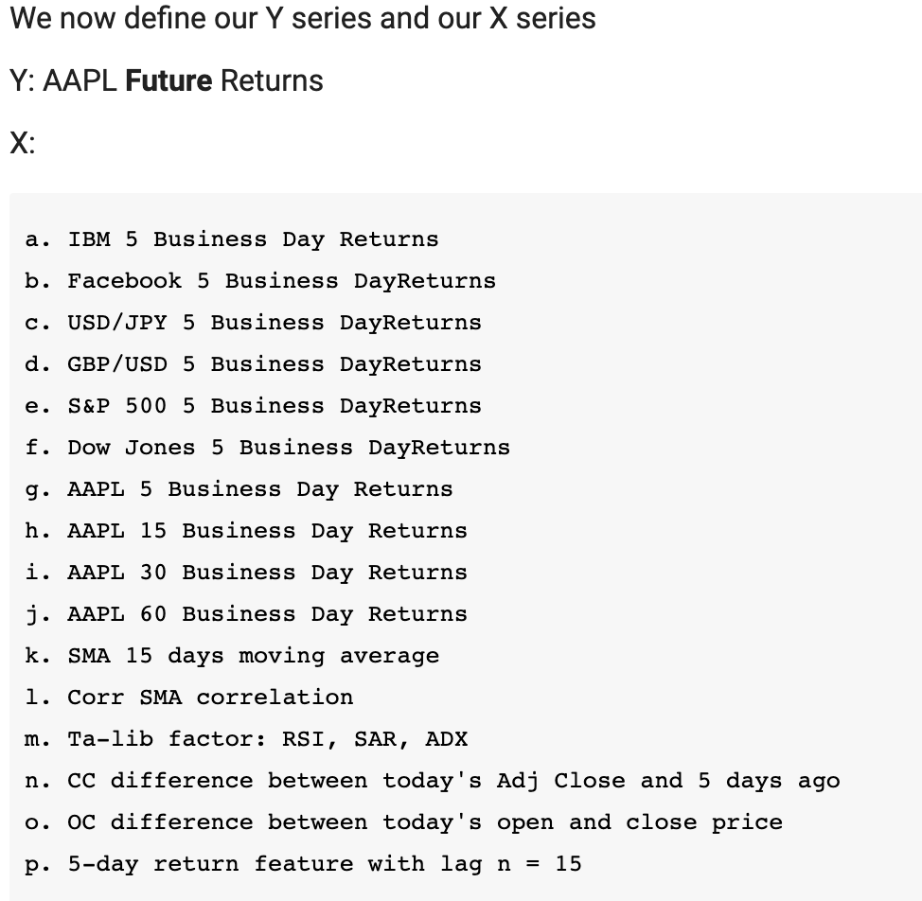
Data Processing
There are total 32 original features used as the input to predict 5-day Apple stock return.
Stock, exchange and index data are gathered from Yahoofinance (latetst update data).
The team choose to use Adj Close price to calculate the 5-day stock return and the team perform the log transformation on the return to make computation easier.
The team also add feature that observe the relationship between open, close, high and low to capture more information.
Finally, to capture time-series feature, the team add lag of the 5-day return with n from 1 to 15 into the input data.

Slide 7
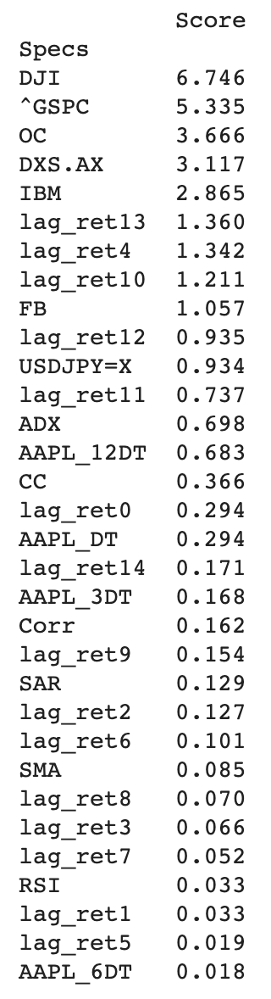
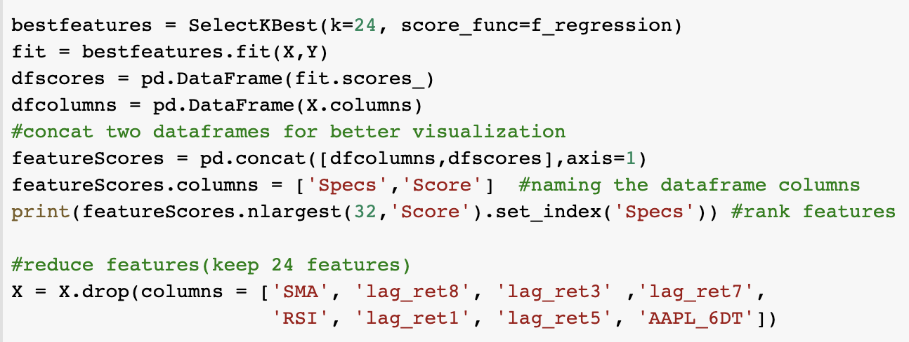
Feature Extraction
Use SelectKBest function to rank the feature importance and select 24 largest score features to be the input data.
The 8 lowest score features will be dropped.
The Feature Extraction/Reduction will helps to reduce the amount of redundant data from the data set. In the end, the reduction of the data helps to build the model with less machine's efforts and also increase the speed of learning and generalization steps in the machine learning process.

Slide 8
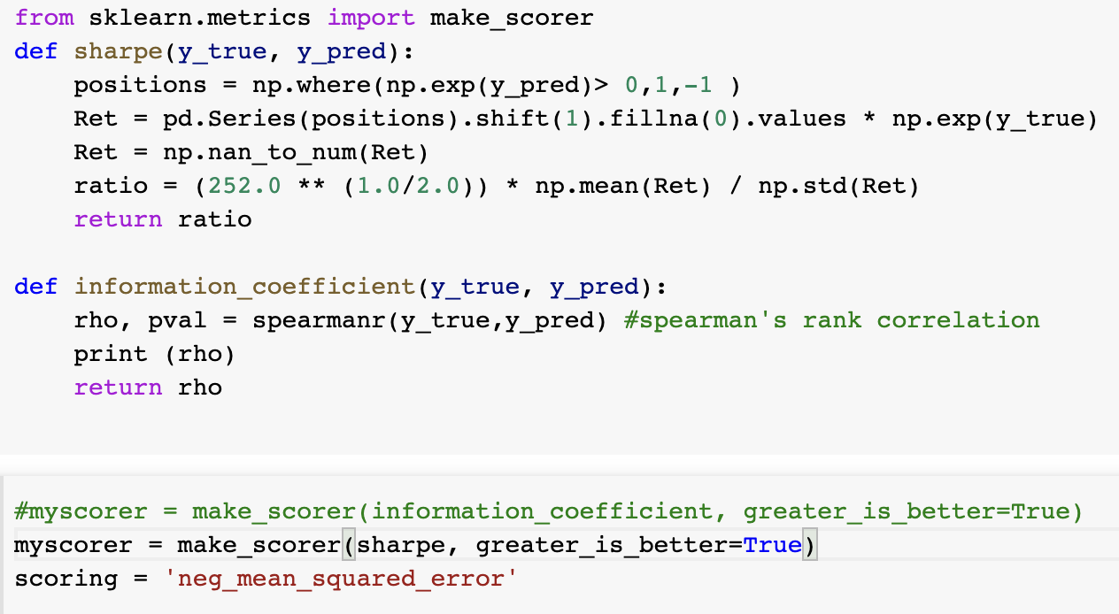
Scoring & Valuation Function
The team designed three scoring function used during the model training process:
Sharpe Ratio
Information coeff
NMSE
The team tried all three method on each model and found that NMSE has the best performance that minimize the error between real and prediction values.

Slide 9
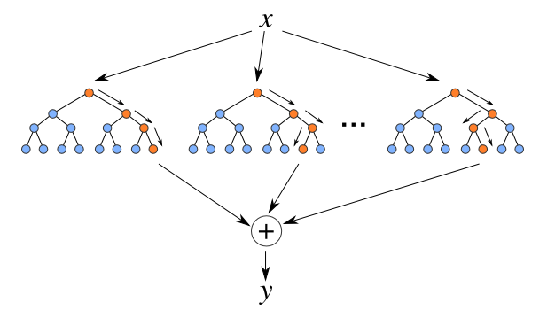
Introduction of Random Forest Regression
Random Forest Regression is a supervised learning algorithm that uses ensemble learning method for regression. To be more specific, Random Forest constructing several decision trees during training time and outputting the mean of the classes as the prediction of all the trees.
Notes:
Reference: https://levelup.gitconnected.com/random-forest-regression-209c0f354c84

Slide 10
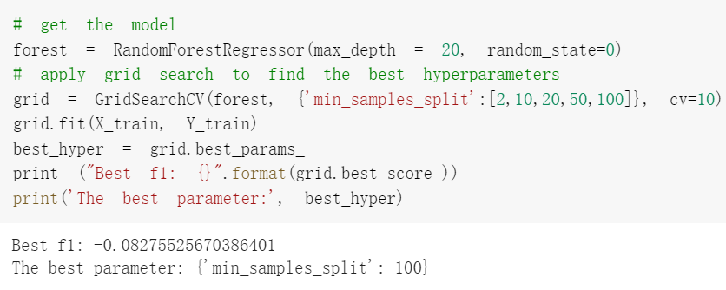
Random Forest Regression Cont.
1.Set model & fit
Firstly set the model and use gridsearch to find the best hyperparameters.
Here we use min_samples_split as tuned parameter since better min_samples_split will make the model capturing the noise in the training dataset easily.

Slide 11
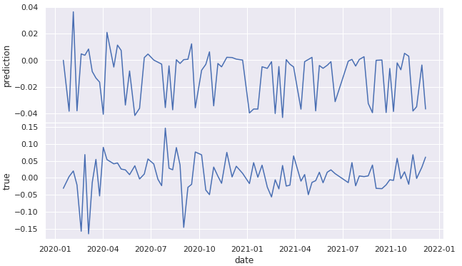
Random Forest Regression Cont.
Then we used the tuned model to fit the train sets and get predictions on the test set. After that, we compared the predicted result with the true data:
2. Comparison of True & Prediction

Slide 12
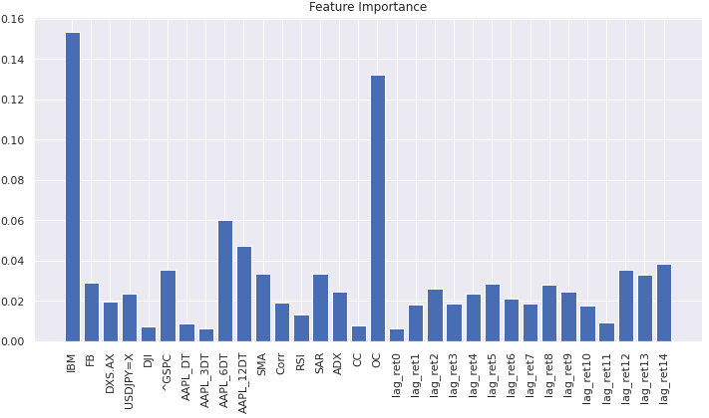
Random Forest Regression Cont.
3. Feature Importance Check of True & Prediction
Then we check the degree of influence of a feature on the prediction result. The greater the importance of a feature, the greater the impact of the feature on the prediction result, vice versa. The importance of a feature means the average value of the importance of all decision trees within the feature.

Slide 13
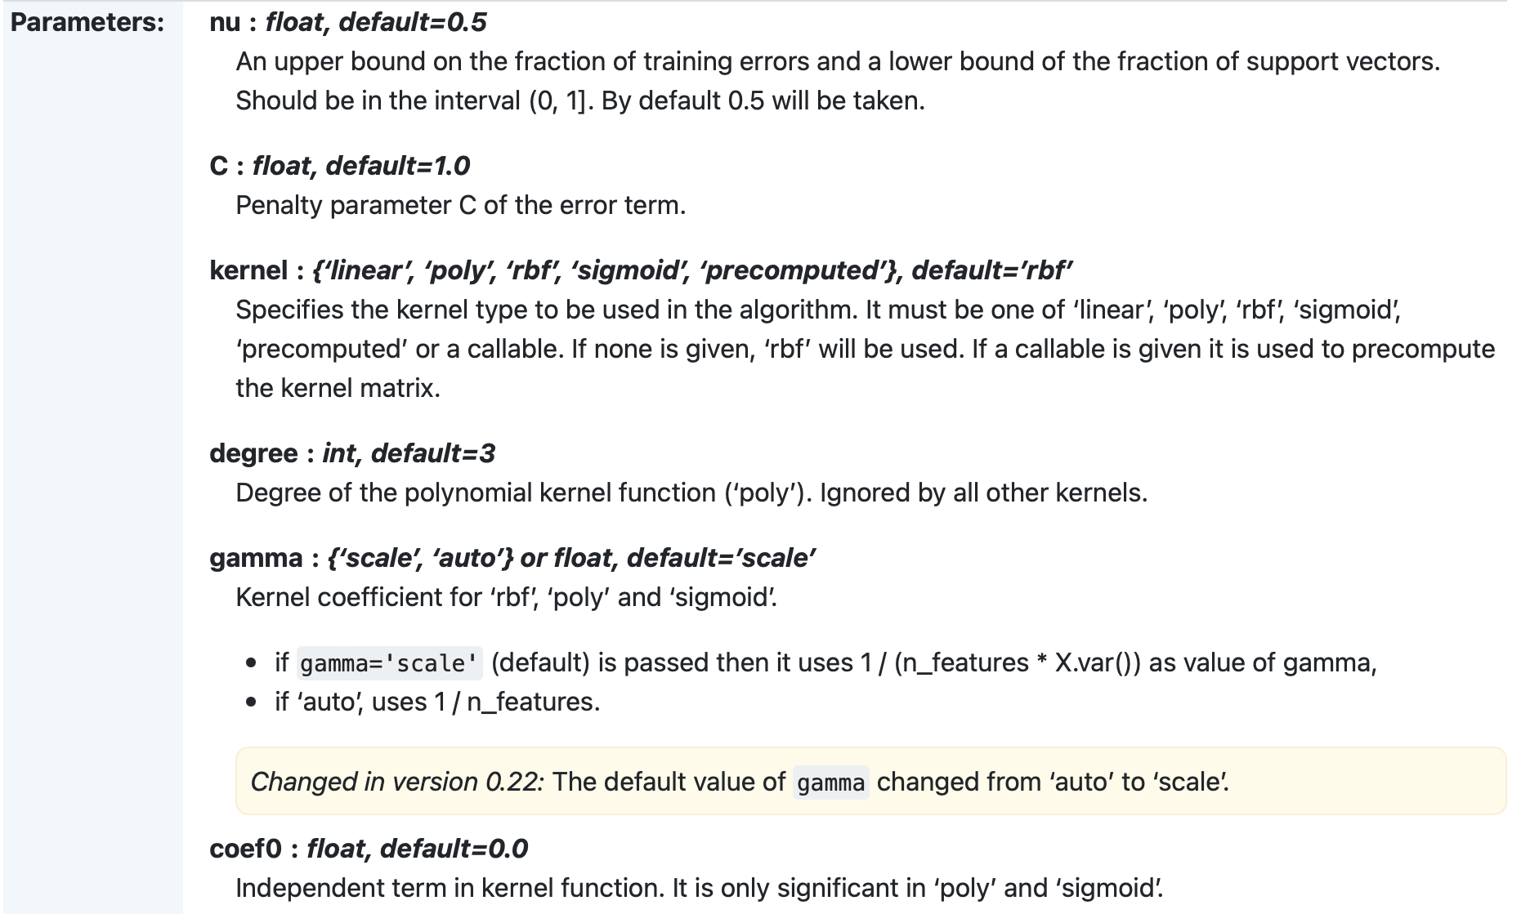
Introduction of NuSVR Regression
Nu Support Vector Regression.
Similar to NuSVC, for regression, uses a parameter nu to control the number of support vectors. However, unlike NuSVC, where nu replaces C, here nu replaces the parameter epsilon of epsilon-SVR.
The implementation is based on libsvm.
The basic hyperparameters are listed below
Notes:
Reference: https://levelup.gitconnected.com/random-forest-regression-209c0f354c84

Slide 14
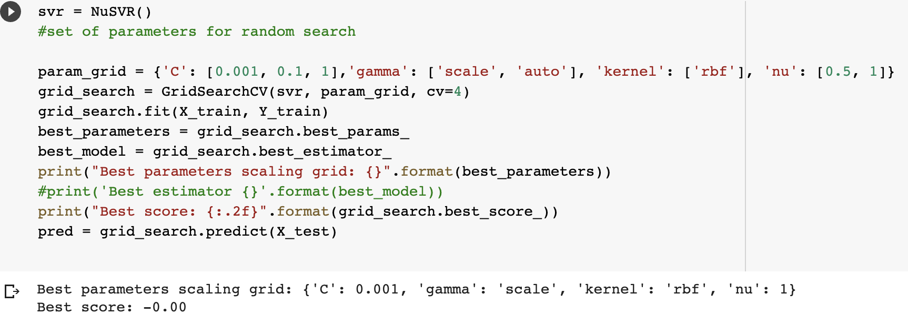
NuSVR Regression Cont.
1.Set model & fit
Firstly set the model and use gridsearch to find the best hyperparameters.
Here we choose nu, gamma, kernel and C as tuned parameter.
The best parameter combination is: C =
0.001, gamma = scale, kernel = rbf, nu =1.

Slide 15
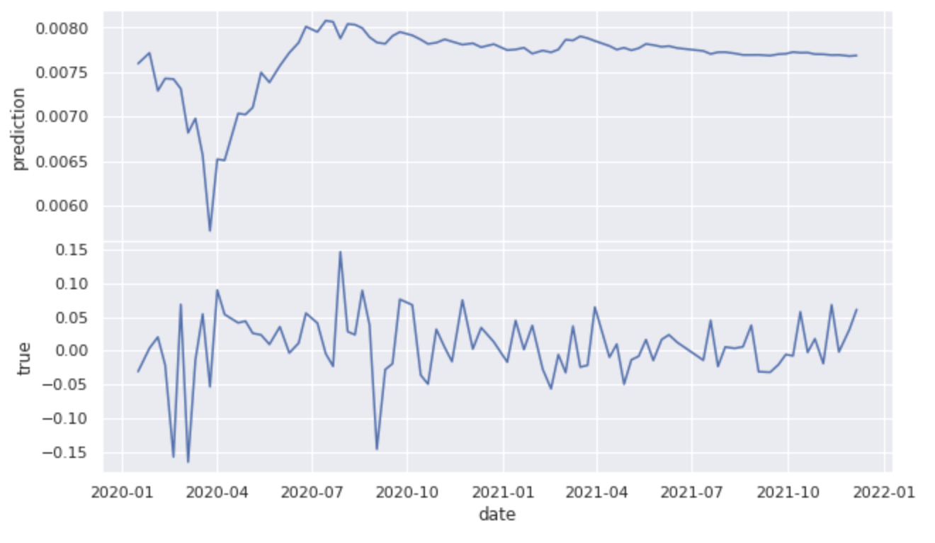
NuSVR Regression Cont.
Then we used the tuned model to fit the train sets and get predictions on the test set. After that, we compared the predicted result with the true data:
2. Comparison of True & Prediction
It seems the performance of the X test prediction is not desirable

Slide 16
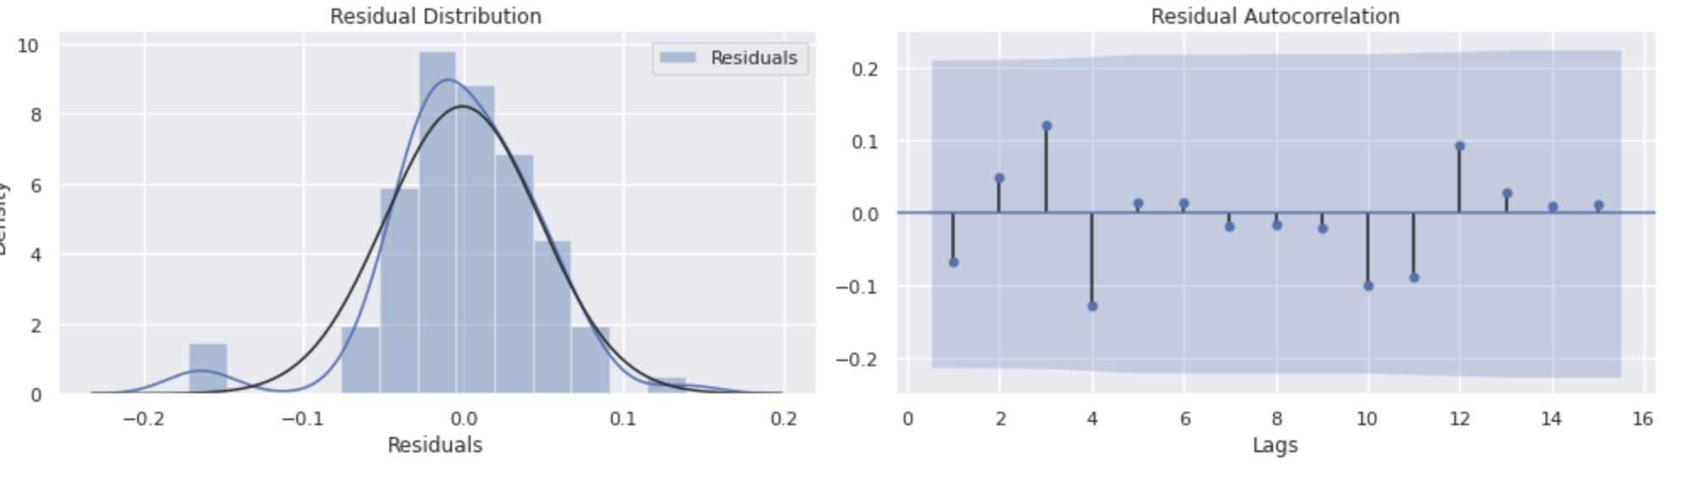
NuSVR Regression Cont.
3. Residuals Check of True & Prediction
To observe the model prediction performance, two residual plots are shown below.
It shows that the most of the error of prediction is between -0.05 and 0.05 which still is not a small range.

Slide 17
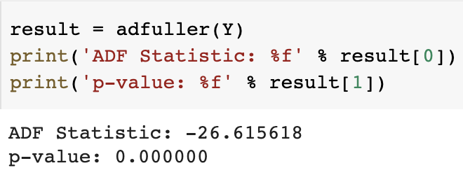
Enhance detail - Upgrade ARIMA to SARIMA
Before we do any futher process, firsly lets check if our time-series data is stationary or not by applying Dickey-Fuller test.
From the above result out of above Dickey-fuller test, where our orignal Null hypothesis(H0): The series behave like Random Walk(not stationary) vs Alternative hypothesis(Ha): The series is stationary. Although the p-value is almost zero and smaller than our significant level, we can reject the null hypothesis and conclude that our oringal series is stationary. There might still exits some seasonality that we need to take into consideration. Therefore, the pre-proccessing of time series analysis is still necessary before we actually fit the model.

Slide 18
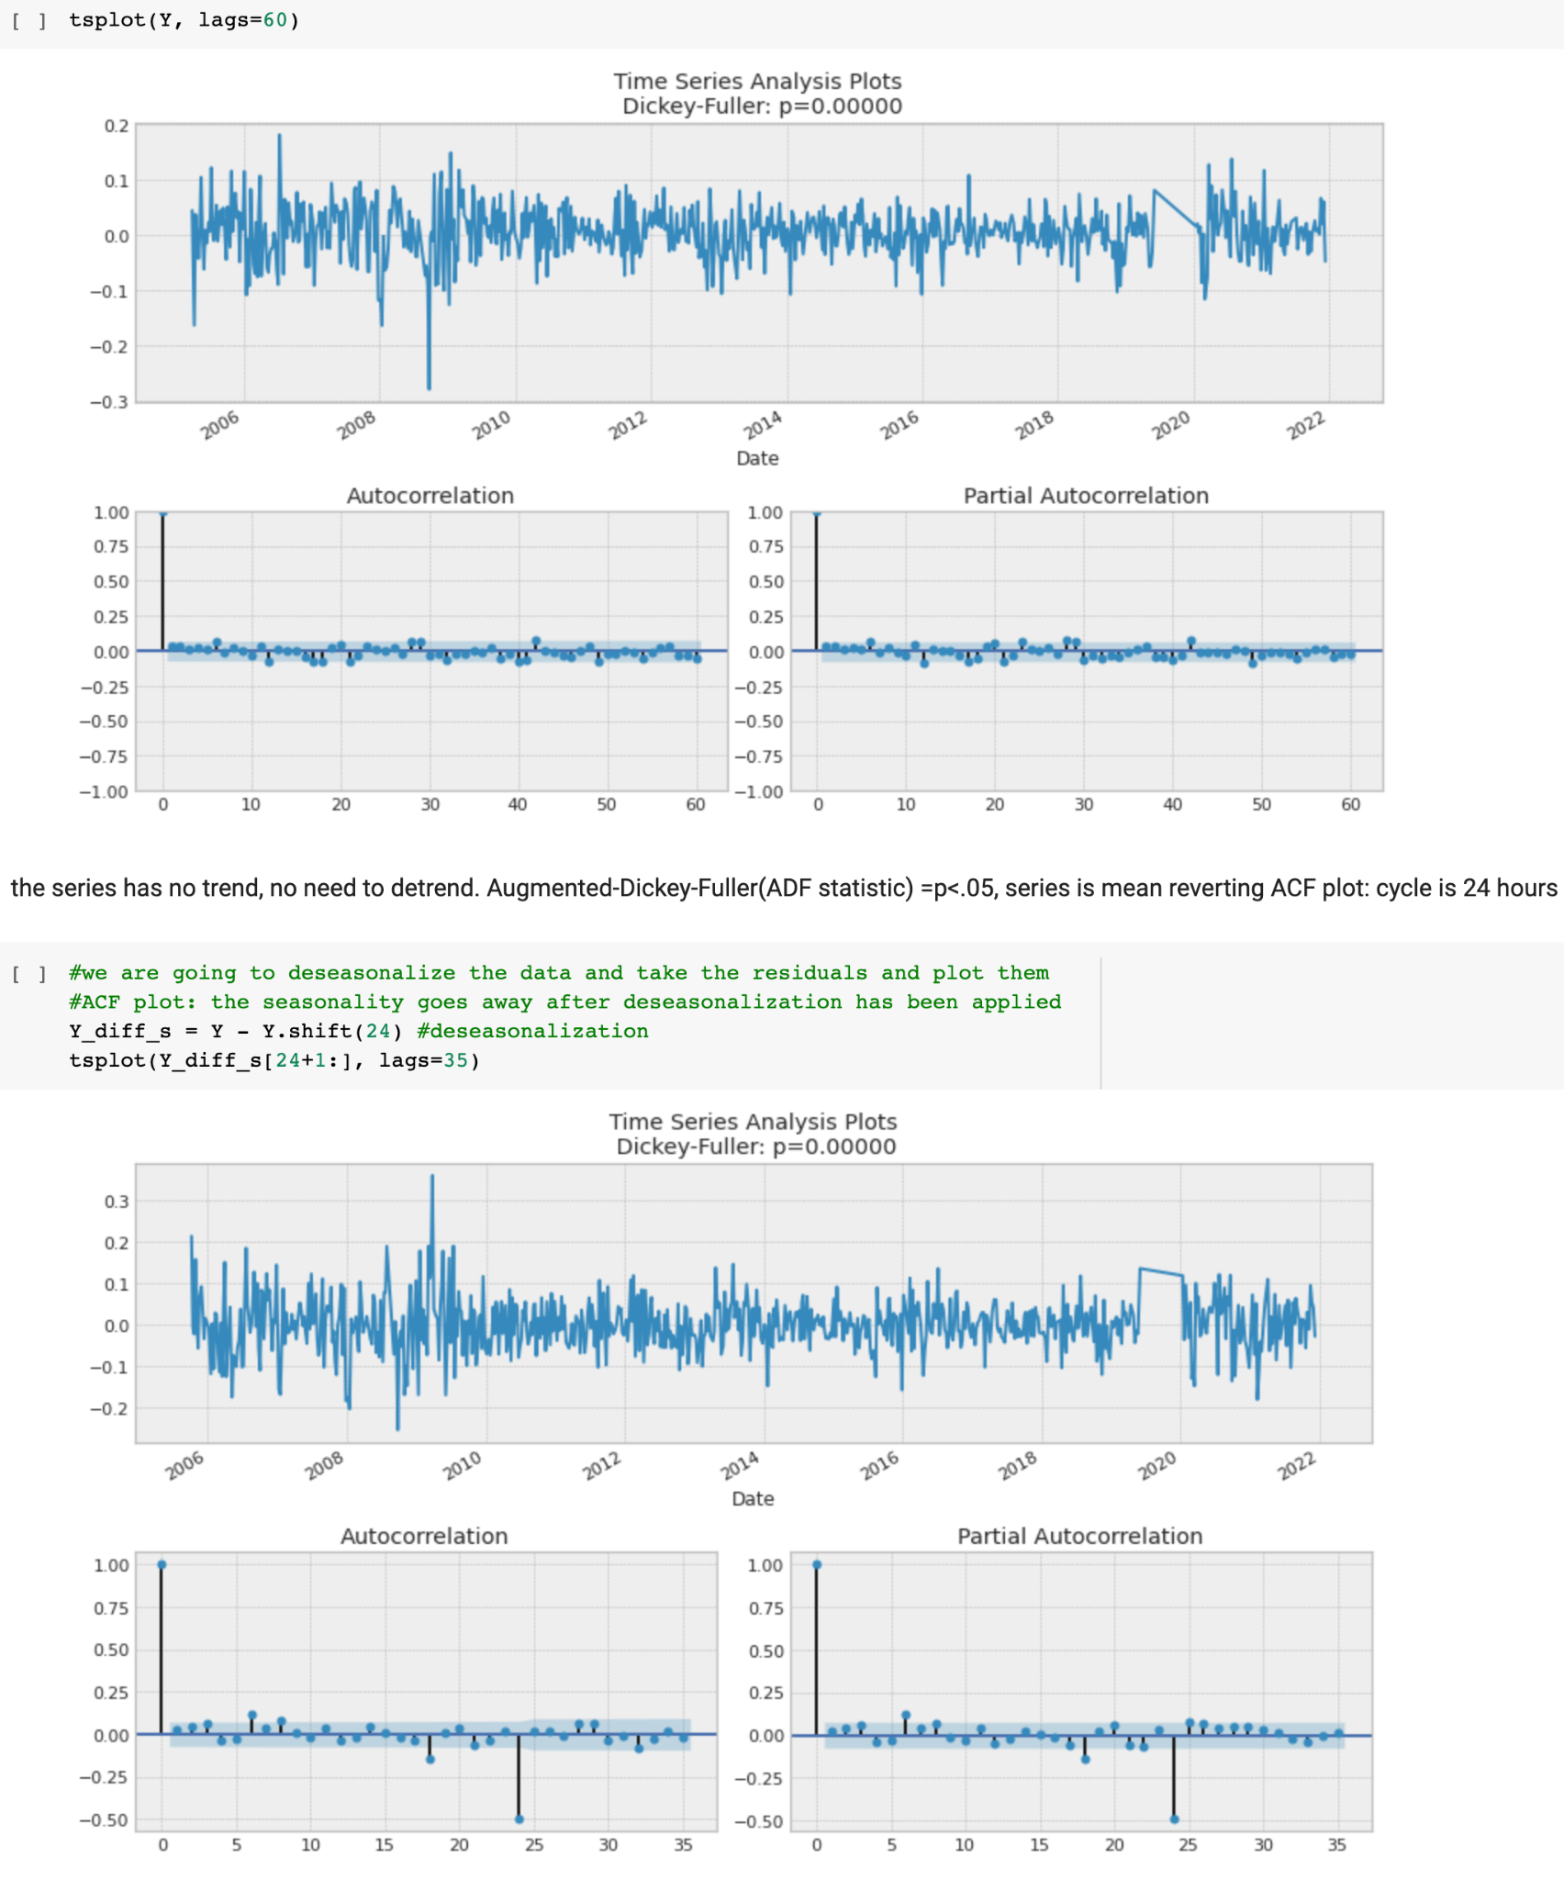
Enhanced Time series analysis
We can do some further time-series analysis here, since we have observe that there exist a clear seasonality, the deseasonalization maybe necessary to find the order for futher SARIMA model fitment.
After we remove the seasonality, the series seems much better, we are going to use pmdarima now, "guessing" that the seasonal parameter m=24 hours since we have daily data. Therefore, since difference is required and the seasonality is exist, the Seasonal Arima model shoul d be performed. We are going to find the order of SARIMA by using auto_arima function in order to minmize the AIC to find the best order.
Also, first order difference is not needed here.

Slide 19
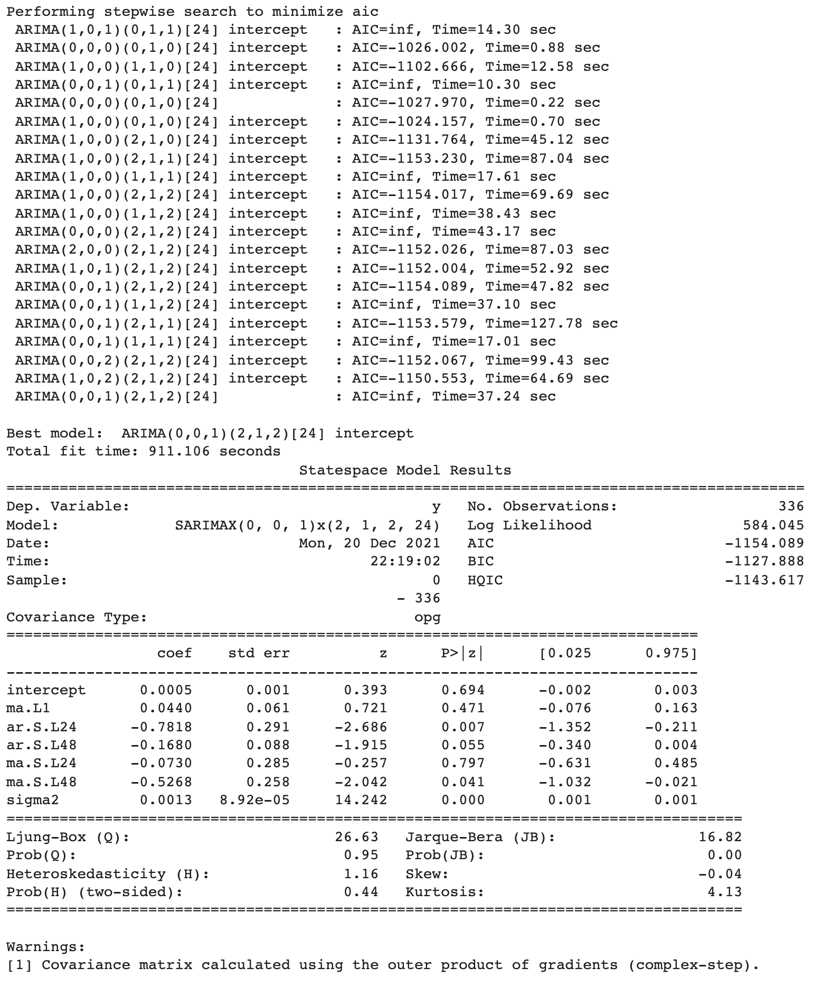
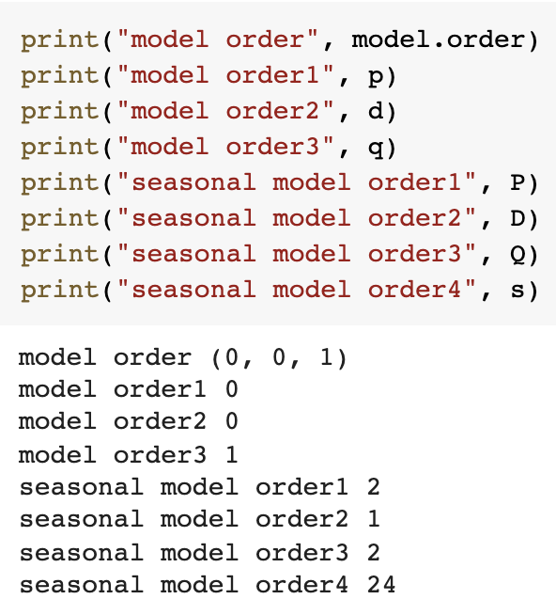
SARIMA Fitting (Method1: based on AIC)

Slide 20
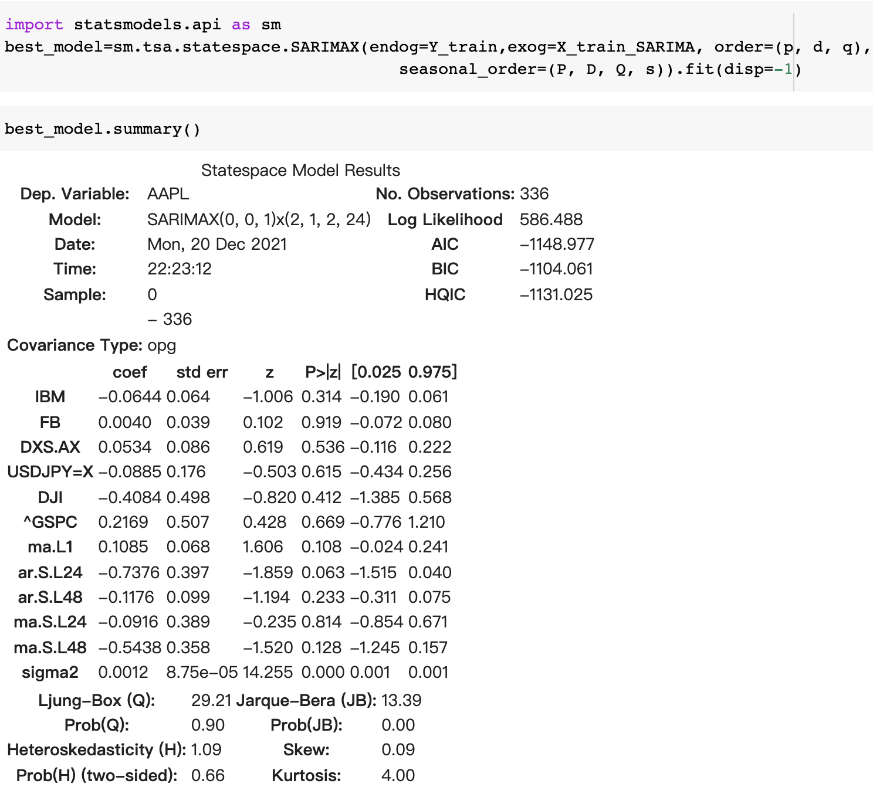
SARIMA Fitting (Method1: based on AIC)
Since we know that the smaller a AIC,the better a moedel. We can select our best model Parameter(p,d,q,P,D,Q,s) based on AIC by performaning “auto_arima” function.
Now we are going to take the parameters from pmdarima and instantiate a SARIMAX model (best_model), we firstly feeding it these parameters and take the residuals from running the model on the orginal trainning data and make sure the residuals behave like white noise: centered around zero(mean of zero), mean reverting and with little or no autocorrelation in between. We can do the diagnostic later.

Slide 21
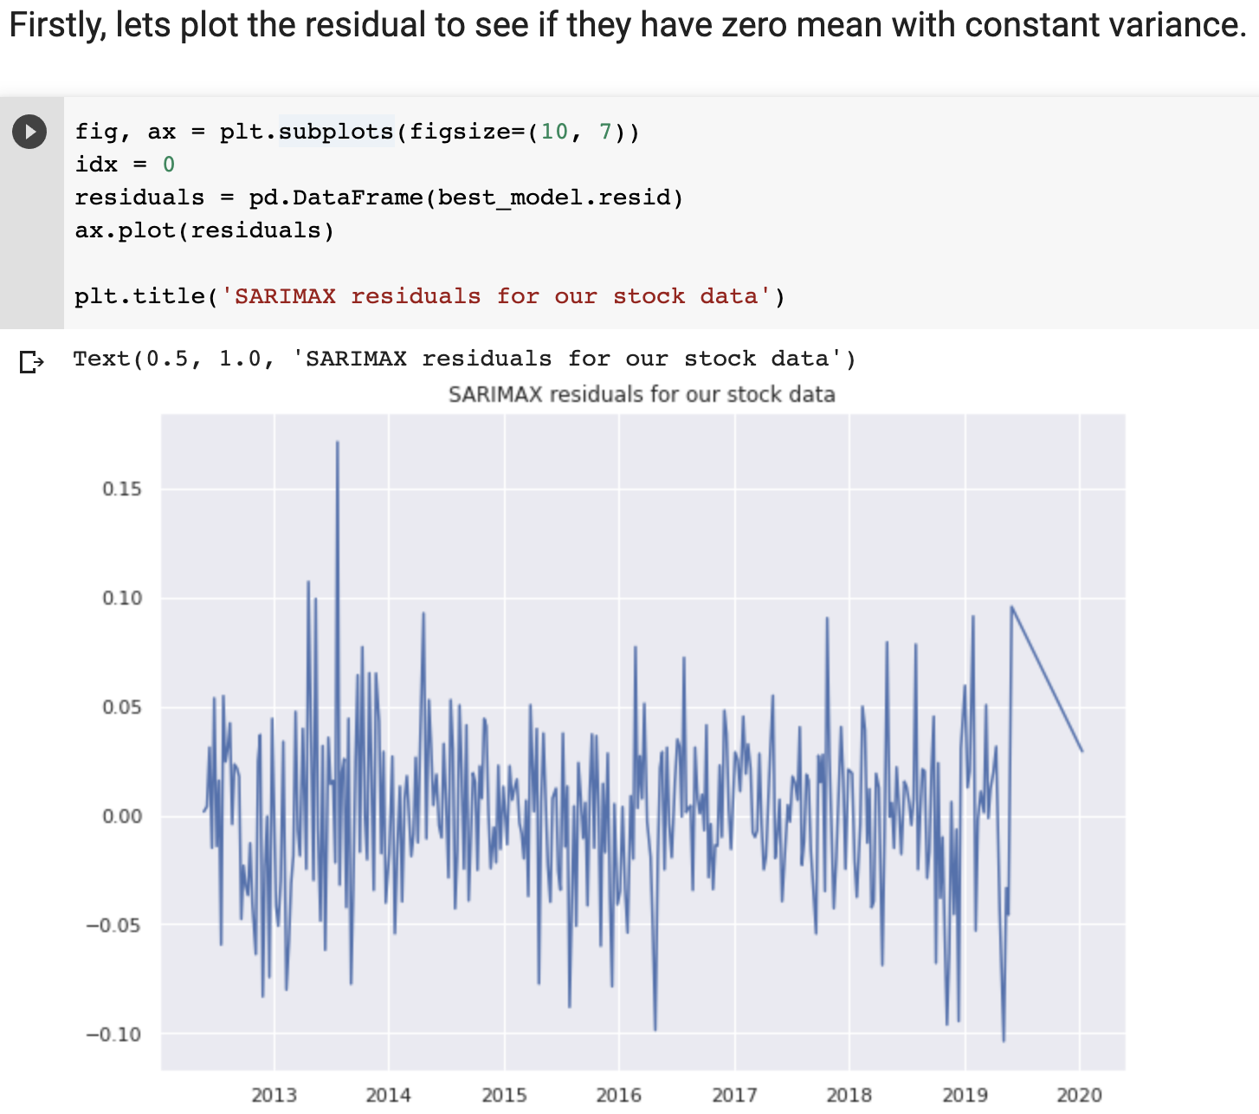
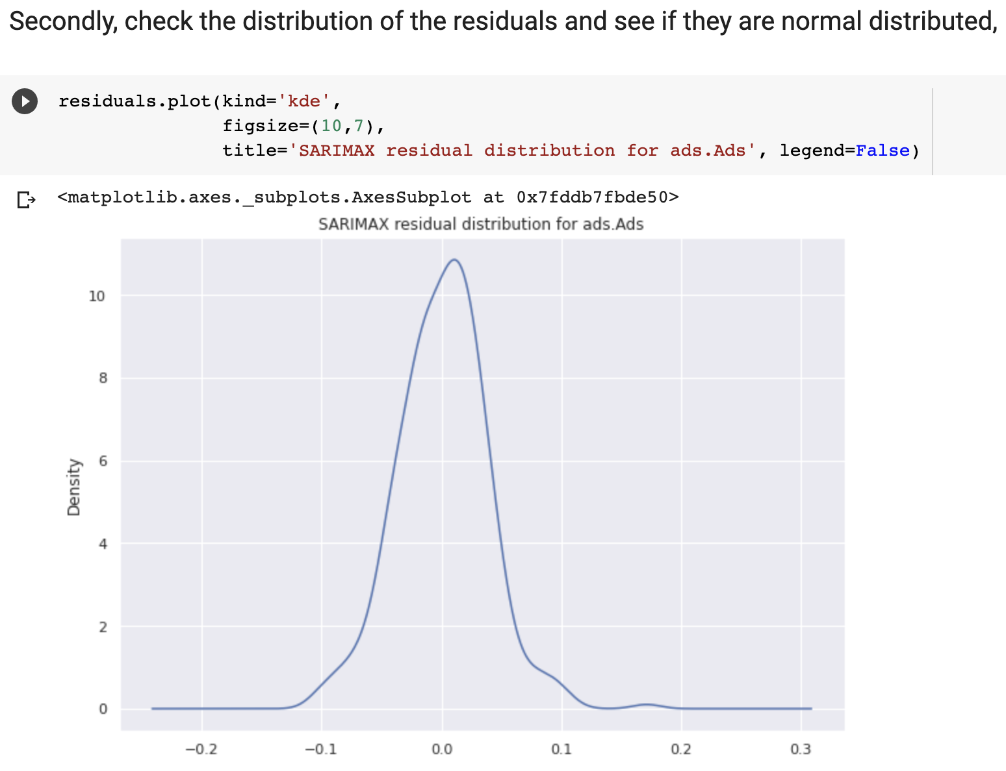
Model diagnostics
Before we are doing the forecasting, the fitment of the model needed to be determinated, we can check the model fit by applying the diagnostics on model's residuals. To be more specific, we want to make sure that the model's residual are zero mean, constant variance and their auto-covariance only depends on time. In other word, we want the residuals are behaving like white noise and this can be done by using the Lijun-box test.

Slide 22
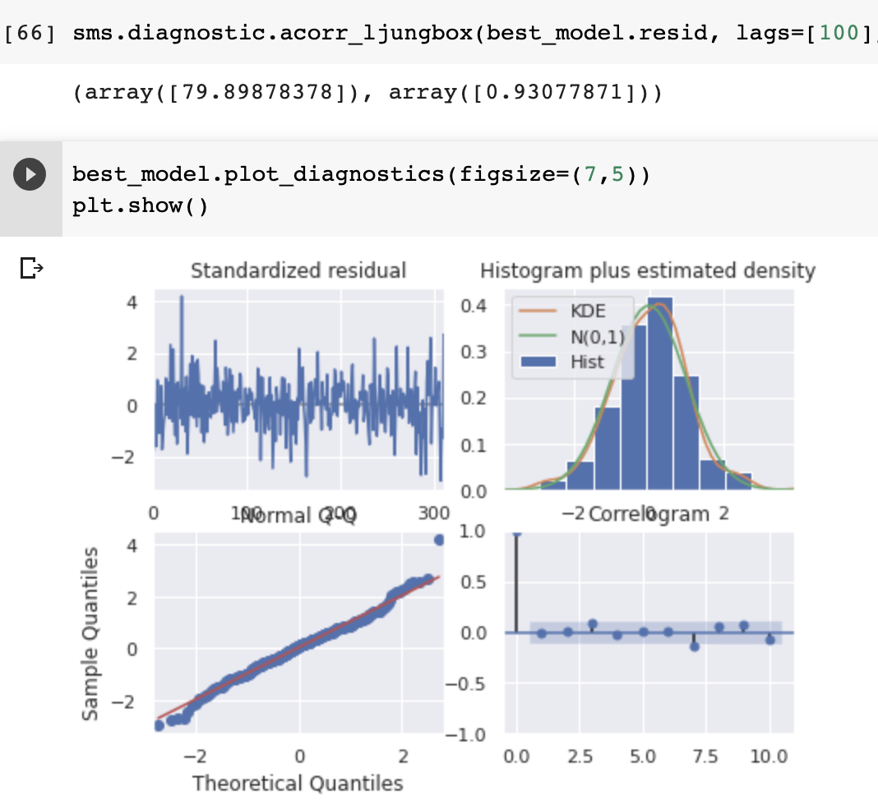
Ljung-box Test
As we mentioned before, the last but not the least thing is Ljung-box test, where the orignal Null hypothesis(H0): The residuals behave like white noise(strictly stationary) vs Alternative hypothesis(Ha): Otherwise(The residuals is not stationary). Since our p-value here is significantly larger than 0.05 so we are fail to reject the Null hypothesis and where we can say our residuals are behaving like white noise.
By the four tests, our model has a good fit according to the residuals.

Slide 23
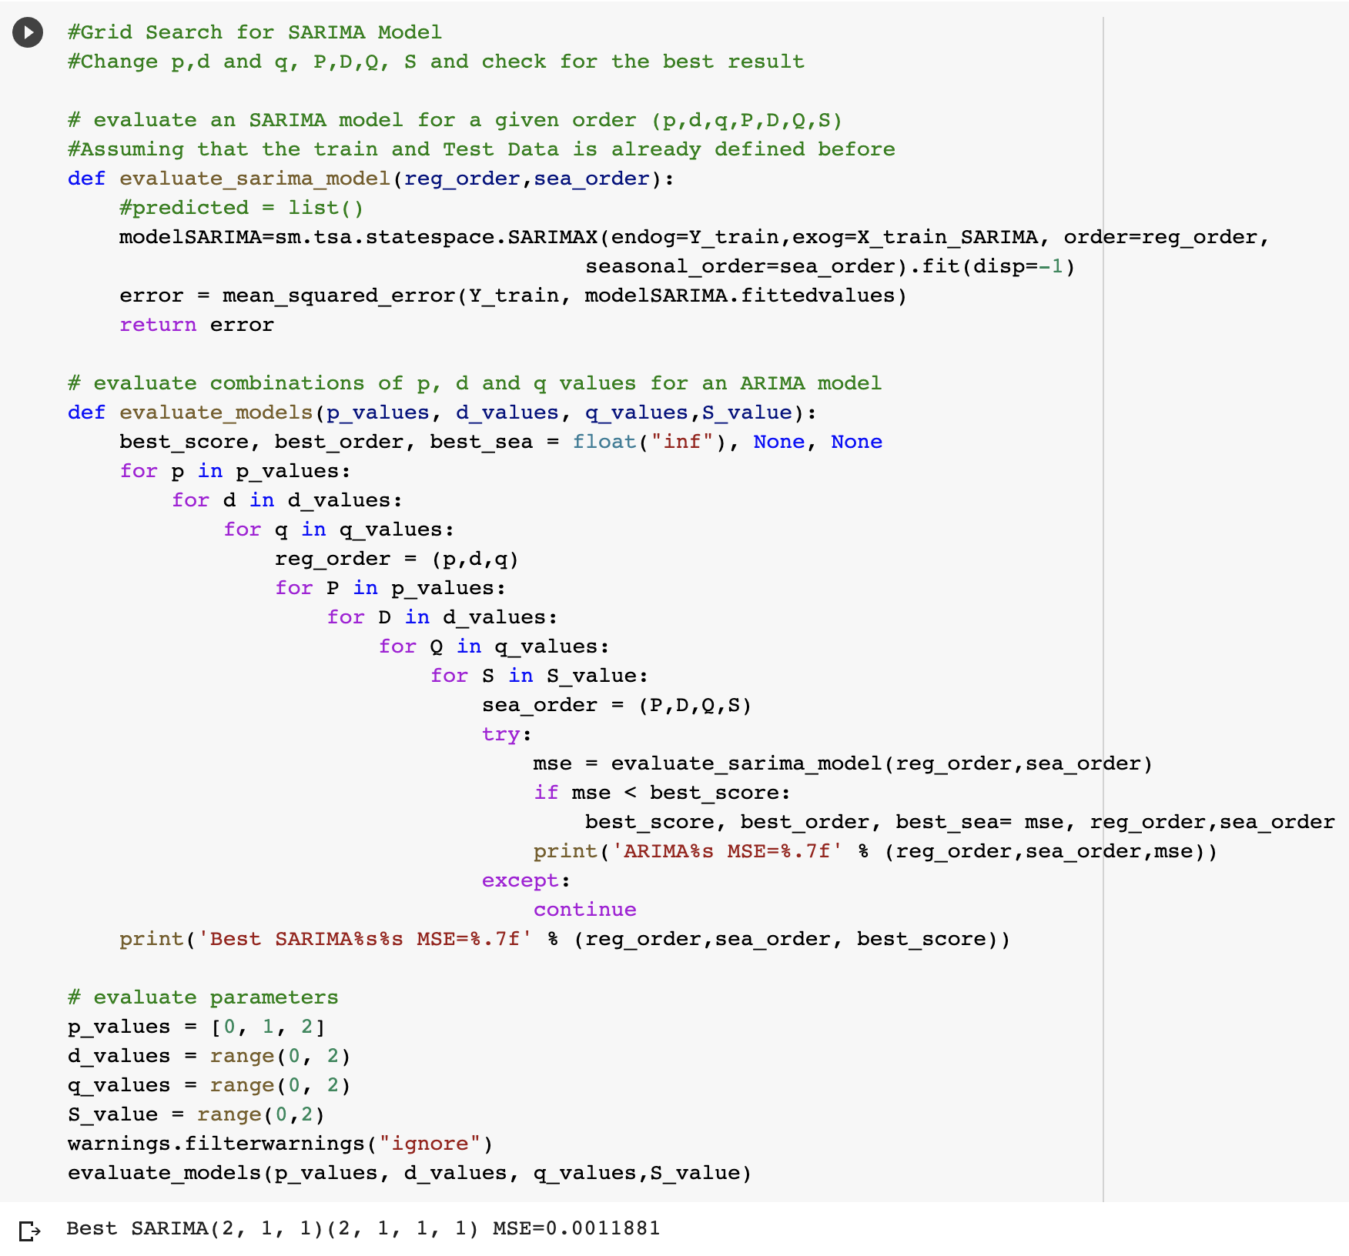
Enhanced Grid Search - SARIMA Fitting mthod 2
For the SARIMA model, we also simply enhance the grid search in order to find the best order of (p,d,q,P,D,Q,s).
These parameters will be optimaized by minimizing the Mean Square Error (MSE) on the training data and check for the best result.
We call this is the second method to tune the model parameter other than based on AIC only.

Slide 24
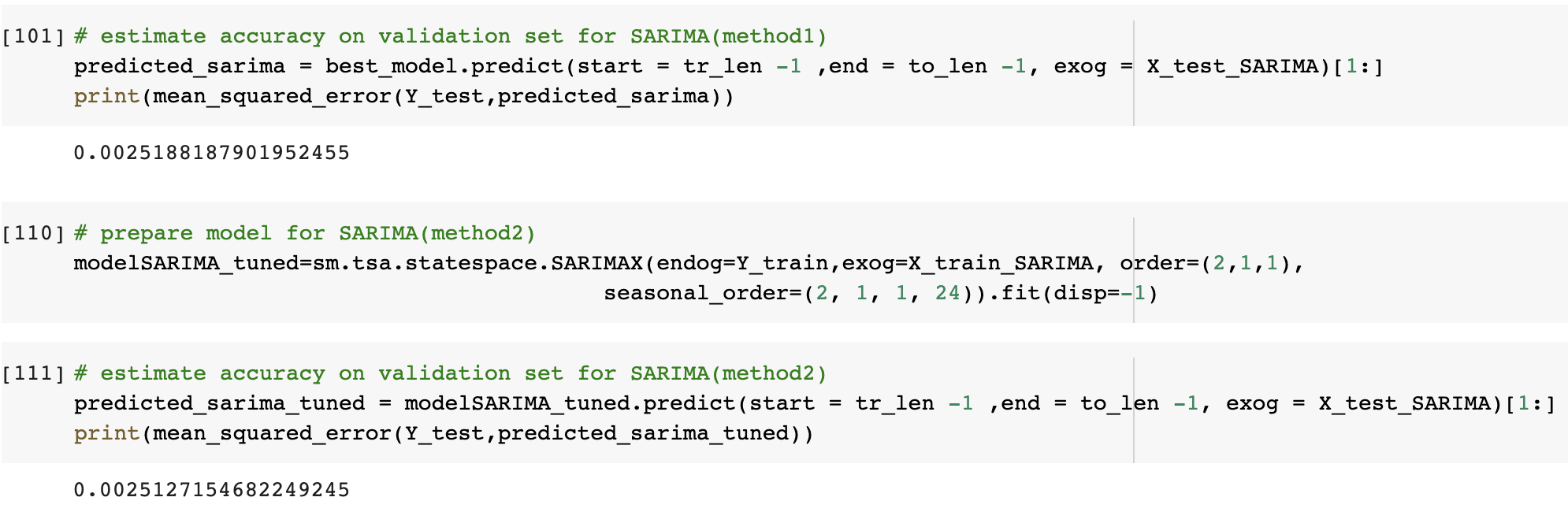
Comparsion on test error
After tuning the model and picking the best SARIMA model or the order 2,1,1,2,1,1,24 we select this model and can it can be used for the modeling/forcasting purpose since it has lower test error compared to ARIMA(2,0,1) and SARIMA order resulting from auto_arima(method 1).

Slide 25
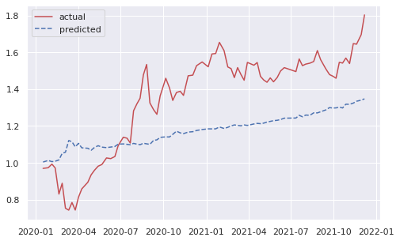

Final Forecasting comparsion
This is the orginal ARIMA model forecasting result and comparsion with actual test data.
This is the seasonal ARIMA model forecasting result where we also take other indicator/aeests price take into consideration. We can clearly see that more detailed has been successfully captured by the model’s prediction.

