Slide 1


K.RAMAKRISHNAN COLLEGE OF TECHNOLOGY
(AUTONOMOUS), TRICHY.
DAILY TASK SCHEDULER
PRESENTED
ESTHER JULIET S
2303811710422041
SUPERVISOR
Mr. M. Saravanan, M.E.,
AP/CSE.

Slide 2
PRESENTATION OVERVIEW
Objective
Project Introduction
Problem Statement
Methodologies (Programming concepts relevant to problem statement)
Architecture of the proposed system
List of Modules
Merits
Results and Discussion
Queries

Slide 3
OBJECTIVE
The Daily Task Scheduler is a console-based application that helps users manage tasks by adding, viewing, and deleting them. Each task includes a description and due time, and users can mark tasks as completed. It provides an easy way to stay organized and track daily activities.

Slide 4
PROJECT INTRODUCTION
Project Introduction: Daily Task Scheduler
The Daily Task Scheduler is a simple tool designed to help you plan your day effectively. It organizes your tasks, sets clear priorities, and ensures you make the best use of your time.
With this scheduler, you can:
Focus on important tasks.
Break your day into manageable steps.
Reduce stress by staying organized.
Achieve your goals more efficiently.
Whether you're a student, professional, or just looking to manage your day better, this scheduler keeps things easy and productive!

Slide 5
PROBLEM STATEMENT
Problem Statement: Daily Task Scheduler
Many people struggle to manage their time effectively, leading to:
Missed deadlines and incomplete tasks.
Stress from juggling multiple responsibilities.
Lack of focus on important goals.
Feeling overwhelmed or unproductive.
A Daily Task Scheduler addresses these challenges by providing a simple, structured way to organize tasks, prioritize goals, and maintain a healthy balance between work and rest. This tool helps people stay on track and make the most of their day!

Slide 6
METHODOLOGIES
A personal finance management project using Java focuses on helping users efficiently track and manage their income, expenses, savings, and budgets. By leveraging object-oriented programming principles, the projectcan include modules for transaction tracking, budget planning, and financial reporting. It employs Java libraries for file handling, GUI development (e.g., JavaFX), and data persistence to ensure a user-friendly and scalable solution.

Slide 7
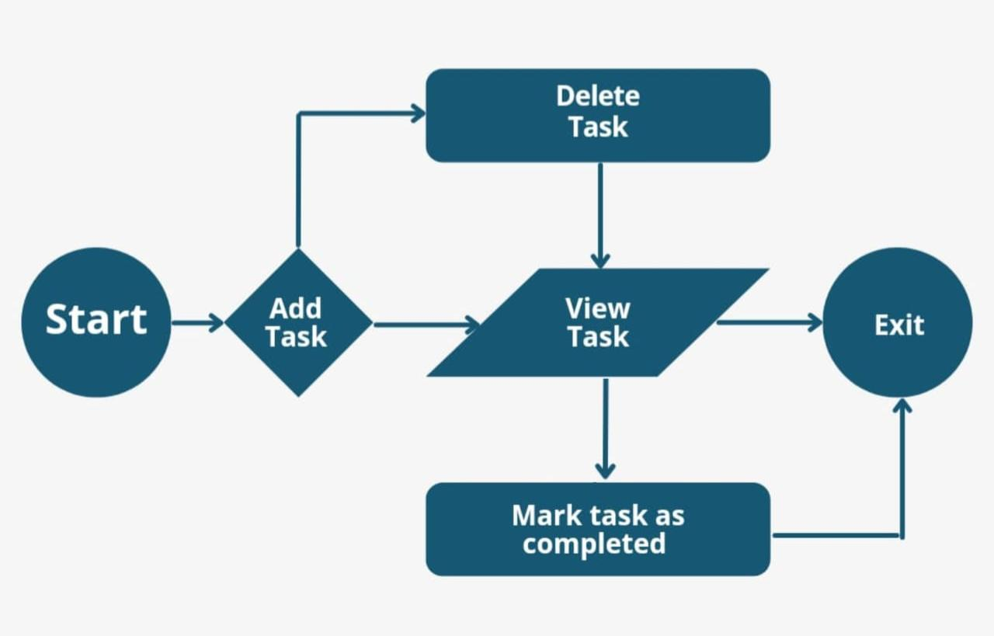
ARCHITECTURE OF THE PROPOSED SYSTEM

Slide 8
LIST OF MODULES
MODULE DESCRIPTION OF DAILY TASK SCHEDULER
MODULE DESCRIPTION OF DAILY TASK SCHEDULER
Task Creation Module
Allows users to easily add new tasks with details like title, description, priority, and deadline.
Scheduling and Time Management Module
Helps users allocate tasks to specific times or days, ensuring proper time distribution and deadlines.
Reminder and Notification Module
Sends timely alerts and reminders for upcoming or overdue tasks to keep users on track.
Task Tracking Module
Tracks the progress of tasks, marking them as completed and providing summaries of daily achievements.
Customization Module
Lets users personalize task categories, themes, and notification preferences to suit their needs.

Slide 9
MERITS
Merits of Daily Task Scheduler
Improves Time Management
Helps organize tasks efficiently, saving time and reducing stress.
Boosts Productivity
Encourages focus on important tasks, leading to better results.
Reduces Overwhelm
Breaks down big tasks into smaller, manageable steps.
Increases Accountability
Tracks progress and ensures tasks are completed on time.
Promotes Work-Life Balance
Ensures time is allocated for both work and personal activities.

Slide 10
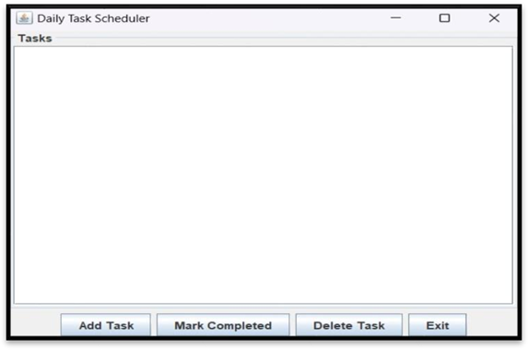
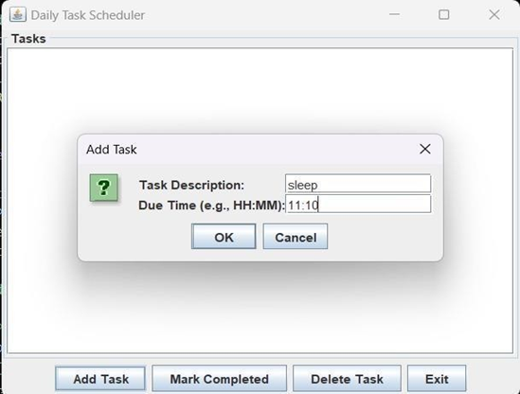
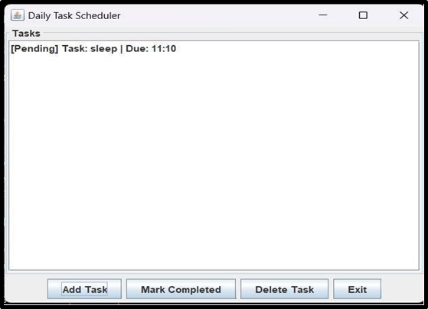
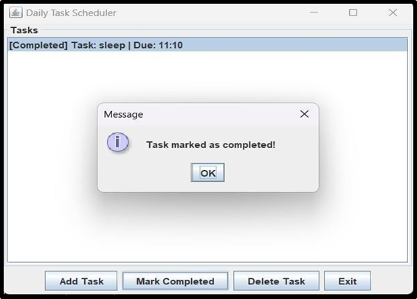
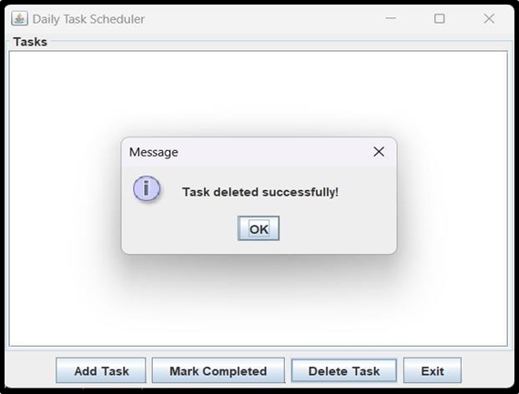
RESULTS AND DISCUSSION

Slide 11
QUERIES ?

