Slide 1
2013_imagen_anat_vgwas_spu

Slide 2
Data Preparation
Image Matrix
1292
Covariates (cov.npy)
SNP Matrix
10
466125
1292
336188
1292

Slide 3
Data Chunks
Image Matrix
1292
Covariates (cov.npy)
10
SNP Matrix
466125
336188
1292
1292
40 chunks
876 chunks
Roughly 11653
1292
1292
snp_chunk_i.npz
vox_chunk_i.npz
vox_chunk_875.npz
1292
384
188
i = {0,1,2,...,39}
i = {0,1,2,...,874}

Slide 4
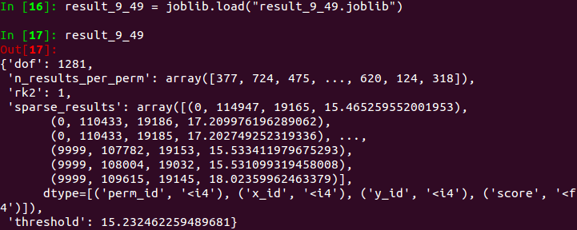
Result Matrix
876 vox chunks
40 snp chunks
result_9_49.joblib

Slide 5
Score Matrix (F score ?)
perm_id
snp_id
vox_id
score
perm_id=0 means no permutation.
Benoit Da Mota, etc. A fast computational framework for genome-wide association studies with neuroimaging data

Slide 6
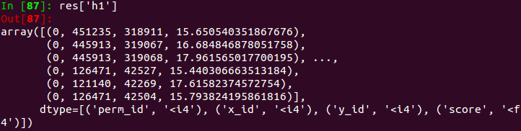
Reduce into h0 and h1
All the scores without permutation (perm_id=0)
the max score from perm_id=0
the max score from perm_id=1
the max score from perm_id=2
h0 =
h1 =
the max score from perm_id=9998
the max score from perm_id=9999

Slide 7
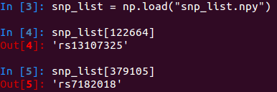
Significant SNP
snp id

Slide 8
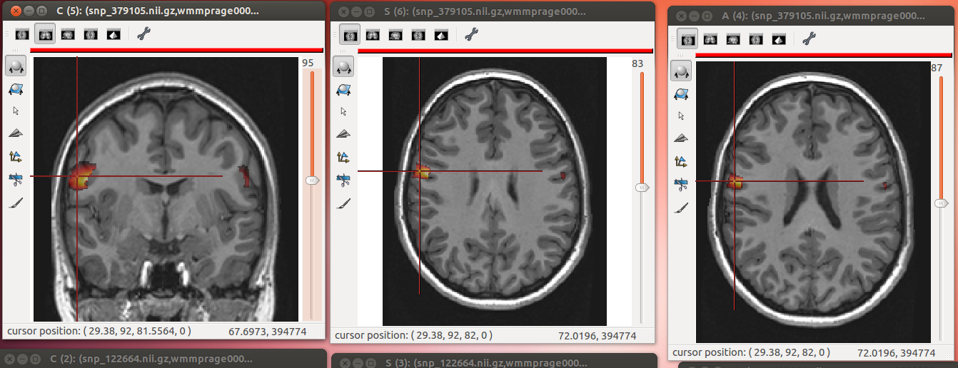
snp_379105
Created by https://github.com/neurospin/scripts/blob/master/2013_imagen_anat_vgwas_gpu/scripts/04_post_process_on_pc/create_brain.py

Slide 9
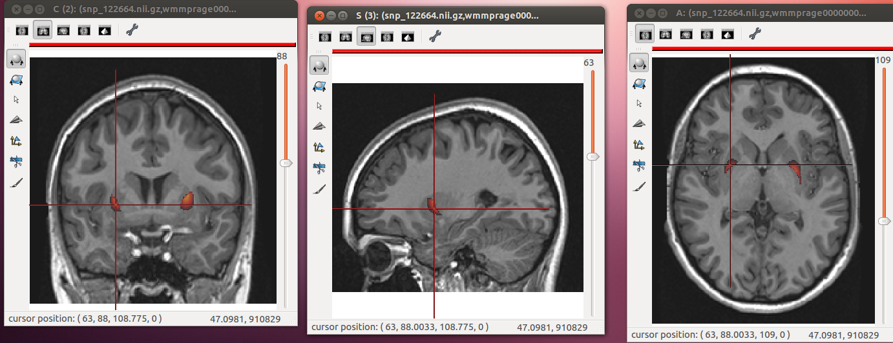
snp_12264
Created by https://github.com/neurospin/scripts/blob/master/2013_imagen_anat_vgwas_gpu/scripts/04_post_process_on_pc/create_brain.py

