Slide 1
Kiddo
A communication platform for parents and teachers of students in daycare and private school.

Slide 2
What is Kiddo?
An android app to facilitate easier communication between teachers and parents
Main user types are parent and teacher
Teachers use our app to post class and student-specific updates to approved parents
Parents view these updates in the app and follow-up with the teachers via a private chat
The administrator controls the creation and deletion of teacher accounts and classes to prevent phony teachers and classes from being created by anyone for their school

Slide 3
Why Kiddo?
Provides a centralized platform for school updates and notifications
Makes it easier for parents to view updates about their children and stay informed about what is happening at school
Makes it easier for teachers to share class updates, particularly photos and videos
It is secure since teachers must approve parents and the administrator controls the creation of teacher accounts and their classes

Slide 4

Who?
NOTE:
To change images on this slide, select a picture and delete it. Then click the Insert Picture icon
in the placeholder to insert your own image.
Worried Wanda
Parent of a young child in daycare
Works long hours at the office
Wants to stay informed about her child in daycare and know that her child is in good hands
Would love pictures and videos of precious moments of her child at the daycare

Slide 5

Who?
NOTE:
To change images on this slide, select a picture and delete it. Then click the Insert Picture icon
in the placeholder to insert your own image.
Teacher Ted
Teaches Junior Kindergarten at a private school
Wants to share class updates securely and easily
Would prefer a means of private and mass communication with parents that does not involve revealing personal contact info (ex. Phone number) that is less cumbersome than email

Slide 6
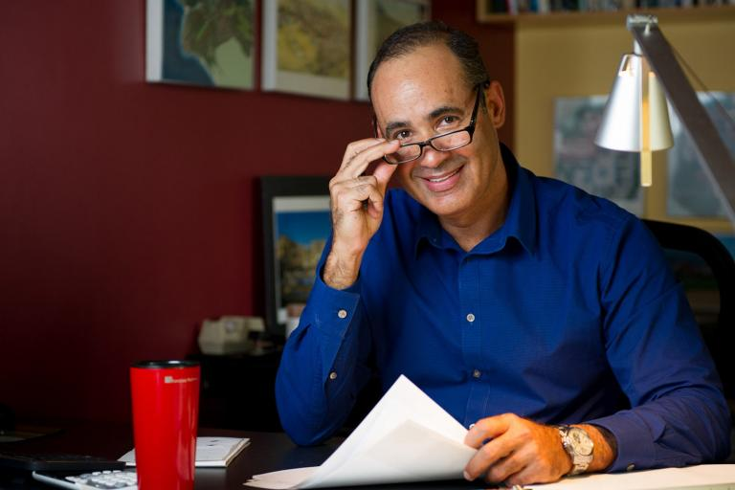
Who?
NOTE:
To change images on this slide, select a picture and delete it. Then click the Insert Picture icon
in the placeholder to insert your own image.
Principal Pat
Is the principal of an private elementary school
Wants to make his school more appealing to prospective parents looking to enroll their child in private school
Thinks working parents would be swayed by frequent class updates but needs a secure and easy system

Slide 7
What we have completed so far
Most of the front-end for the 3 user types
Linked database to the app
Started writing the required java classes to manipulate the database
Started building a web interface for the administrator because the administrator role may require lots of data entry will be difficult on a mobile device.

Slide 8
What we plan to do next
Finish writing the required java classes to manipulate the database
Finish front-end for the 3 user types
Finish the web interface for the administrator

