Slide 1

Lab 2 - Machine Learning

Slide 2
What is Machine Learning?
“The ability of a computer to learn without being explicitly programmed”
Arthur Samuel – IBM’er and Stanford Professor in 1959
“Systems that can learn from data”

Slide 3
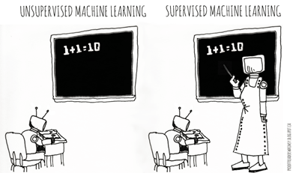
Categories of Machine Learning
Supervised learning
The program is “trained” on a pre-defined set of “training examples”, which then facilitate its ability to reach an accurate conclusion when given new data
The algorithm is presented with example inputs and their desired outputs (correct results)
The goal is to learn a general rule that maps inputs to outputs
Unsupervised learning
No labels are given to the learning algorithm, leaving it on its own to find structure (patterns and relationships) in its input
Unsupervised learning can be a goal in itself (discovering hidden patterns in data) or a means towards an end (feature learning)

Slide 4
Categories of Machine Learning
 | Discrete Output | Continuous Output
Supervised Learning (require Ground-Truth) | Classification Binary Classification Decision Trees Logistic Regression Naïve Bayes Multi class Classification Decision Trees Naïve Bayes K-NN | Regression Linear Ridge Lasso Decision Trees Random Forest Gradient Boosted Trees
Unsupervised Learning (no Ground-Truth data required) | Clustering K-means Associations FP-Growth | Clustering K-means Gaussian Mixture - Dimensionality Reduction PCA SVD

Slide 5
Preprocessing: Matrix for Machine Learning
Known as:
Attributes
Features
Predictor variables
Explanatory variables
a1 a2 a3 a4 a5 a6 a7 a8 a9 t
Scale variables:
Continuous variables, which can be measured on an interval scale or ratio scale
‘Weight’, ‘Temperature’, ‘Salary’, etc…
Categorical variables:
Data with a limited number of distinct values or categories (nominal or ordinal)
‘Hair color’, ‘Gender’, ‘Grape varieties’, etc…
Known as:
Label
Target variable
Dependent variable
Scale or Categorical
Notes:
Machine learning algorithms consume either numerical data (i.e., level of measurement is scale) or categorical (i.e., level of measurement is nominal or ordinal). This data needs to be in matrix form.
In the middle of the page here we have an image of a matrix – it has 9 attributes across the top (also commonly called “features”). And then on the far right it has the “target variable” – also known as the “label”, “dependent variable”, or “response variable”. This “t” attribute is what we are trying to predict.
The attributes themselves are either scale or categorical variables (nominal or ordinal). Scale variables are continuous, meaning that they can be measured on an interval scale or a ratio scale. Examples of scale variables are weights, temperature, salary, etc… Categorical variables are data that have a limited number of distinct values. Examples of this level of measurement could be hair color, gender, grape varieties, etc…
These attributes are known as the “attribute set” (also commonly referred to as the “features”). The dimensionality of the attribute set can have a large impact on the training time and performance of machine learning algorithms. Techniques such as feature selection are used to determine which attributes are useful, which need to be removed from the modelling process – and even if new attributes are need. For example, a common use case in deriving insight from data is to append new feature vectors to the matrix, such as sentiment, in an attempt to improve the machine learning algorithm’s ability to properly classify/predict the target variable.

Slide 6
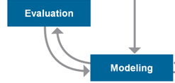
Training, testing, & validation sets
During the model development process, supervised learning techniques employ training and testing sets and sometimes a validation set.
Historical data with known outcome (target,label,dependent variable)
Source data randomly split into training, testing, and/or validation sets (mutually exclusive records)
Why?
Training set
Build the model
Tune the parameters
Testing set
Assess model quality during training/tuning process
Avoid overfitting the model to the training set
Validation set
Estimate accuracy or error rate of model after tuning
Used to compare multiple models
Notes:
When we are developing a model, we build it using a data set for which we know the outcome. That is, we need a set of historical data so that the machine learning algorithm can model the outcome based on the behavior of the explanatory variables (predictors). We call this the “training” set because we train the algorithm on that set to build a model.
Once we have a model, then we need to evaluate or “test” it using a set of mutually-exclusive data similar to the training set but not used in building the model, so that we do not overfit the model to the data and end up with a model that doesn’t perform well when applied to new data. We call this the “testing” set. We usually do the training-testing process multiple times, iterating on the model parameters to get the best model that we can with the training data that we have. Sometimes we may decide to go back to get additional data, depending on the insights that we gain (or the gaps that we identify) during training and testing.
Sometimes, a data scientist may apply the final model to a third (mutually exclusive) data set as a way to get final estimates of model accuracy and quality. But often only the training and testing sets are used, and model accuracy and quality measures are calculated using results from the testing set.
(Note: Just so that you’re aware, some people call the sets “training, validation, testing” instead of “training, testing, validation”. )

Slide 7
Spark ML
Spark ML is Spark’s machine learning (ML) library
Goal is to make practical machine learning scalable and easy
No need to understand the detailed math!
Divides into two packages:
spark.mllib contains the original API built on top of RDDs
spark.ml provides higher-level API built on top of DataFrames for constructing ML pipelines
A pipeline is a series of stages where each stage either transforms, or runs through a machine learning algorithm.
Using spark.ml is recommended because with DataFrames the API is more versatile and flexible
spark.mllib will continue to be supported

Slide 8
Spark ML Pipeline Terminology
Spark ML standardizes APIs for machine learning algorithms to make it easier to combine multiple algorithms into a single pipeline, or workflow
DataFrame: Spark ML uses DataFrame from Spark SQL as an ML dataset, which can hold a variety of data types
Transformer: A Transformer is an algorithm which can transform one DataFrame into another DataFrame
Estimator: An Estimator is an algorithm which can be fit on a DataFrame to produce a Transformer
Pipeline: A Pipeline chains multiple Transformers and Estimators together in a sequence to specify an ML workflow
Parameter: All Transformers and Estimators share a common API for specifying parameters

Slide 9
Lab 2 Exercise – Female Human Trafficking
Input
Generated fake travel records based on incoming custom forms.
Subset of records were vetted as “high”, “medium”, or “low” risk for Female Human Trafficking by an analyst.
Goal is to train a model on the vetted data to be able to score the unvetted travel records into high, medium, or low categories.

Slide 10
Demo Data
Field | Description
UUID | Hash-based unique identifier
VETTING_LEVEL | Analyst vetting status : 100- PENDING, 10 – HIGH, 20 – MED, 10 - LOW
NAME | Person name
GENDER | Person Gender
AGE | Person age at time of travel
BIRTH_DATE | Person birth date
BIRTH_COUNTRY | Person full birth country
BIRTH_COUNTRY_CODE | Person ISO 2 country
OCCUPATION | Person occupation as declared on form
ADDRESS | Person US address
SSN | Person Social Security Number
PASSPORT_NUMBER | Person Passport Number
PASSPORT_COUNTRY | Person Passport Issuing Country
PASSPORT_COUNTRY_CODE | Person Passport Issuing Country ISO 2 Code
COUNTRYIES_VISITED | The countries visited as declared on form
COUNTRIES_VISITED_COUNT | The number of countries visited as declared on form
ARRIVAL_AIRPORT_COUNTRY_CODE | ARRIVAL Airport country code ISO2
AIRPORT_ARRIVAL_IATA | ARRIVAL Airport 3 character code
AIRPORT_ARRIVAL_MUNICIPALITY | ARRIVAL Airport Municipality Derived from Code
ARRIVAL_AIRPORT_REGION | ARRIVAL Airport Region Derived from Code
DEPARTURE_AIRPORT_COUNTRY_CODE | DEPARTURE Airport Country code ISO2
DEPARTURE_AIRPORT_IATA | DEPARTURE Airport 3 character code
DEPARTURE_AIRPORT_MUNICIPALITY | DEPARTURE Airport Municipality Derived from Code.
Target
Features

Slide 11

Demo Flow
Read in dataset as a DataFrame from dashDB
Connect to dashDB
Read in the data
Identify Labels
Label the data (“VETTING_LEVEL”)
Select features
Feature Engineering (Transformation)
StringIndexer (occupation, country, gender, birth year variables)
VectorAssembler
Normalizer
Define Model and Setup Pipeline
Naïve Bayes
Train the Model
Split input data into Training (70%) and Test (30%) DataFrames
Cache the resulting DataFrames
Fit the Pipeline to the Training data set

Slide 12

Demo Flow (continued)
Evaluate the resulting predictions
Area under the ROC curve
Tune the model (hyperparamaters)
Build Parameter Grid
Cross-evaluate to find the best model
Score the unvetted records
Use Model to Score unvetted records (VETTING LEVEL == 100)
Write results into DashDB table

Slide 13
Classification - Naïve Bayes
Two or more outcomes.
Assumes independence among explanatory variables, which is rarely true (thus “naïve”).
Despite its simplicity, often performs very well… widely used.
Significant use cases:
Text categorization (spam vs. legitimate, sports or politics, etc.) using word frequencies as the features
Medical diagnosis (e.g., automatic screening)

Slide 14


Slide 15
Backup / Reference

Slide 16
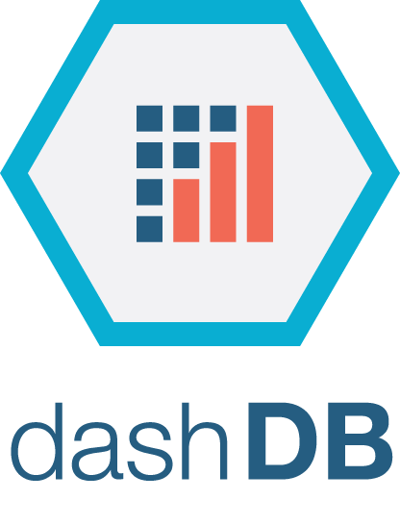
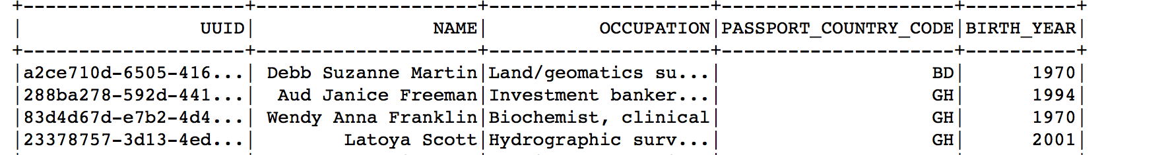
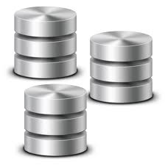

Lab Flow
Connect to the database and read in the data
Identify our labels and transform the data
Feature Engineering
Declare the model that we want to use
Setup the Pipeline
Train the data
Show and evaluate the results
Automatic Algorithm Tuning
Score the remaining records and load them into a new table in dashDB

Slide 17

Pipelines – How they work
A Pipeline is specified as a sequence of stages where each stage is either a Transformer or an Estimator
These stages are run in order and the input DataFrame is transformed as it passes through each stage
For Transformer stages, the transform() method is called on the DataFrame
For Estimator stages, the fit() method is called to produce a Transformer (which becomes part of the fitted Pipeline), and that Transformer’s transform() method is called on the DataFrame
For example, a simple text document processing workflow might include several stages:
Split each document’s text into words
Convert each document’s words into a numerical feature vector
Learn a prediction model using the feature vectors and labels

Slide 18
Spark Capabilities
Spark Core
Spark Streaming
Stream Processing
Micro-batch event processing for near real-time analytics
Process live streams of data (IoT, Twitter, Kafka)
No multi-threading or parallel processing required
Near real-time data processing & analytics
MLlib (machine learning)
Machine Learning
Predictive and prescriptive analytics, and smart application design, from statistical and algorithmic models
Algorithms are pre-built
Incredibly fast, easy to deploy algorithms
Spark SQL
Unified Data Access
Query your structured data sets with SQL or other dataframe APIs
Data mining, BI, and insight discovery
Get results faster due to performance
Fast, familiar query language for all data
Log processing
TBD
GraphX (graph)
Graph Analytics
Represent data in a graph
Represent/analyze systems represented by nodes and interconnections between them
Transportation, person to person relationships, etc.
Fast and integrated graph computation

Slide 19
Learning challenges
Diminishing returns:
People can:
Have more or less talent
get bored or enthusiastic
Machines will not, however:
Making progress initially is usually more easy, but improving gets harder as we move along. We may need to try different learning methods, styles to keep going:
Machine learning algorithms have hyper-parameters which need to be tuned properly (cross validation method in Spark).
It may be necessary to use more than just one single method / algorithm to reach the goal.

Slide 20
Training, testing, & validation sets
During the model development process, supervised learning techniques employ training and testing sets and sometimes a validation set.
Historical data with known outcome (target, class, response, or dependent variable)
Source data randomly split or sampled… mutually exclusive records
Why?
Training set ➔ build the model (iterative)
Testing set ➔ tune the parameters & variables during model building (iterative)
Assess model quality during training process
Avoid overfitting the model to the training set
Validation set ➔ estimate accuracy or error rate of model (once)
Assess model’s expected performance when applied to new data
Notes:
When we are developing a model, we build it using a data set for which we know the outcome. That is, we need a set of historical data so that the machine learning algorithm can model the outcome based on the behavior of the explanatory variables (predictors). We call this the “training” set because we train the algorithm on that set to build a model.
Once we have a model, then we need to evaluate or “test” it using a set of mutually-exclusive data similar to the training set but not used in building the model, so that we do not overfit the model to the data and end up with a model that doesn’t perform well when applied to new data. We call this the “testing” set. We usually do the training-testing process multiple times, iterating on the model parameters to get the best model that we can with the training data that we have. Sometimes we may decide to go back to get additional data, depending on the insights that we gain (or the gaps that we identify) during training and testing.
Sometimes, a data scientist may apply the final model to a third (mutually exclusive) data set as a way to get final estimates of model accuracy and quality. But often only the training and testing sets are used, and model accuracy and quality measures are calculated using results from the testing set.
(Note: Just so that you’re aware, some people call the sets “training, validation, testing” instead of “training, testing, validation”. )

Slide 21
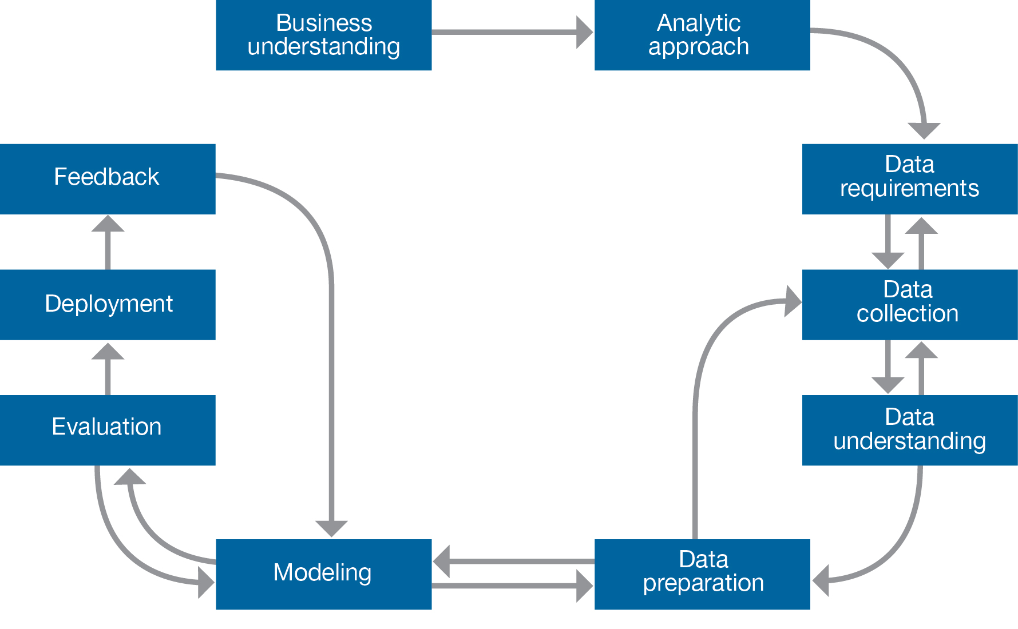
Data Science Methodology
Data Scientist /
Data Engineer
Statistician
Domain Expert
Notes:
If we look at the Data Science methodology discussed yesterday from the point of view of the people and roles involved, it is very rare to have one single person doing it all. It is typically a TEAM effort.
The data scientist can be in the role of the project manager with the “vision” in terms of the ultimate goal of the project.
However, there are typically several other players who have a role to play in the methodology:
Data Engineers
Statisticians
Business (domain) Experts: Epidemiologists, Bankers

Slide 22
Categories of Machine Learning
 | Discrete Output | Continuous Output
Supervised Learning (require Ground-Truth) | Classification (outcome is discrete) Binary Classification Detecting Fraud Predicting defaults on loans Discovering spam Predicting users who might churn Multi class Classification Classifying images, sounds Assigning categories to news articles, webpages, etc.… | Regression - Predicting the price of a house - Predicting loss amounts for loans
Unsupervised Learning (no Ground-Truth data required) | Clustering - Grouping discrete elements Frequent Patterns and associations - People who buy chips also buy beer | Clustering - Grouping continuous variables Dimensionality Reduction - PCA - SVD

Slide 23
Machine Learning vs Human Learning
In many aspects, ML not fundamentally different from HL:
Repeat the same task over and over again to gain experience.
Action of repeating the same task is referred to as “practice”
With practice and experience, we get better at learned tasks.
Examples:
Learning how to play a music instrument
Learning how to play a sport (golf, tennis, etc…)
Practicing for a math exams doing exercises
A teacher or coach will measure performance to evaluate progress
Practice makes perfect

Slide 24
Learning challenges
Under fitting:
Not knowing enough “basic” concepts, i.e. not being well-equipped enough to tackle learning at hand:
You can’t study calculus without knowing some algebra.
You can’t learn playing hockey without knowing how to skate.
You can’t learn polo without knowing how to ride.
This can lead to under fitting in Machine Learning: The chosen model is just not “sophisticated”, “rich”, enough to capture the concept.
aX + BY + C

Slide 25
Learning challenges
Over fitting:
Hyper-sensitivity to minor fluctuations, ending up in modeling a lot of the unwanted noise in the data:
This can lead to over fitting in Machine Learning.

Slide 26
Learning challenges
Compromise between bias and variance:
Prediction
Error
Variance (over fitting)
Bias (under fitting)
Overly
simple
model
Good
model
Over-
fitted
model
Complexity of the model

Slide 27
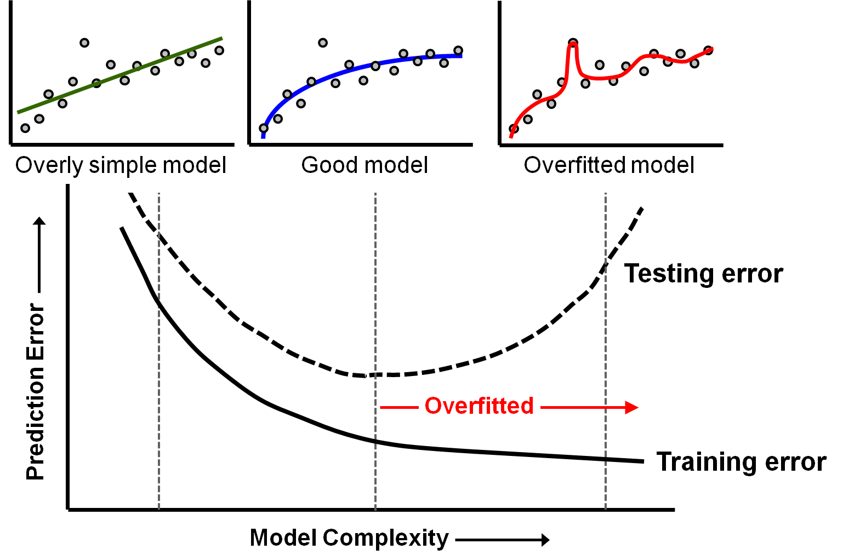
When to stop training a model
Notes:
So, how do we know when to stop the model building process?
We want to build the best model that will be useful when applied to new data.
This means that we want enough complexity to generate meaningful predictions but not so much complexity that the model will not perform well on new data.
As long as the prediction error on the testing data continues to decline with increasing model complexity, we are getting a better model.
But when the testing error begins to increase, we have begun to overfit the model to the training data. (Note that the training error will continue to decline as we fit the training data better and better with increasing model complexity.)
The optimal degree of training is where the testing error reaches its minimum point as shown in the graph.
Many model building algorithms have the ability to check for overfitting during the model building process, so that model refinement will automatically stop when it should.
Note: If this “best model” is inadequate for solving the problem, then we’ll need to go back to considering our analytic approach, data collection, and data preparation stages.
Note: Depending on how they are implemented, many machine learning algorithms have internal controls to control overfitting (such as an automatic “holdout sample” or ability to specify the testing set, for computing and comparing the testing error to the training error during model building).
Reference: Diagram is after Fig. 1 in http://scott.fortmann-roe.com/docs/MeasuringError.html

Slide 28
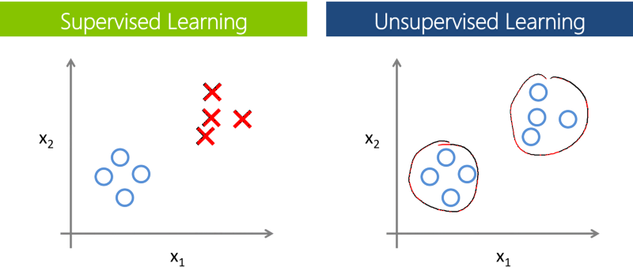
Supervised vs. Unsupervised Learning

Slide 29
Classification – Decision tree
Class variable (target) with two or more outcomes.
Splits records in a tree-like series of nodes along mutually-exclusive paths.
Algorithm decides which variable and threshold value to use at each split
New records are predicted (classified) based on the leaf assignment
Accurate
Explicit decision paths
Can also handle continuous target (“regression tree”).
Days Since Previous Visit <= 225
No
Yes
Readmit = No
Visits to Doctor in Past Year <= 3
No
Yes
10% of patients are readmitted.
Patient Age <= 61
Etc.
No
Yes
Etc.
Readmit = Yes
92% of patients are readmitted.
Notes:
Decision tree classifier (DTC) builds a tree-like or flowchart-like construction of nodes (final nodes are called “leaves”). The decision paths leading to the leaves are mutually exclusive. An algorithm called CART (classification and regression tree) splits the records into two groups at each node, as shown in the figure here. Another algorithm called CHAID (Chi-squared Automatic Interaction Detector <pronounced “chade”>) is able to split the records into more than two groups at a node.
DTC uses the explanatory variables (aka attributes or features) to split the records in such a way as to maximize the purity of the class variable at each leaf. At each node, the algorithm determines which variable, and which threshold value thereof, makes the purest split. Some algorithms allow variables to be reused at various nodes in the tree. A metric such as Gini or Entropy (measures of the impurity of a node, in terms of the values of the target variable, e.g., Yes and No) to evaluate the split at each node and determine the best variable and threshold to use there to make the split.
A decision tree model has the advantages of being accurate, easy to understand, and robust. It can handle both continuous and categorical variables, and it gives good performance with large data sets. An especially important advantage is that it gives explicit decision paths (in contrast to the “black box” approach of, say, neural networks), which is important in certain uses such as insurance underwriting (why a decision was made) and medical diagnosis (why a certain disease is likely to occur).
DTC can also handle a continuous class variable (e.g., monthly data usage), classifying records into bins instead of distinct values. This variation is called a regression tree.

Slide 30
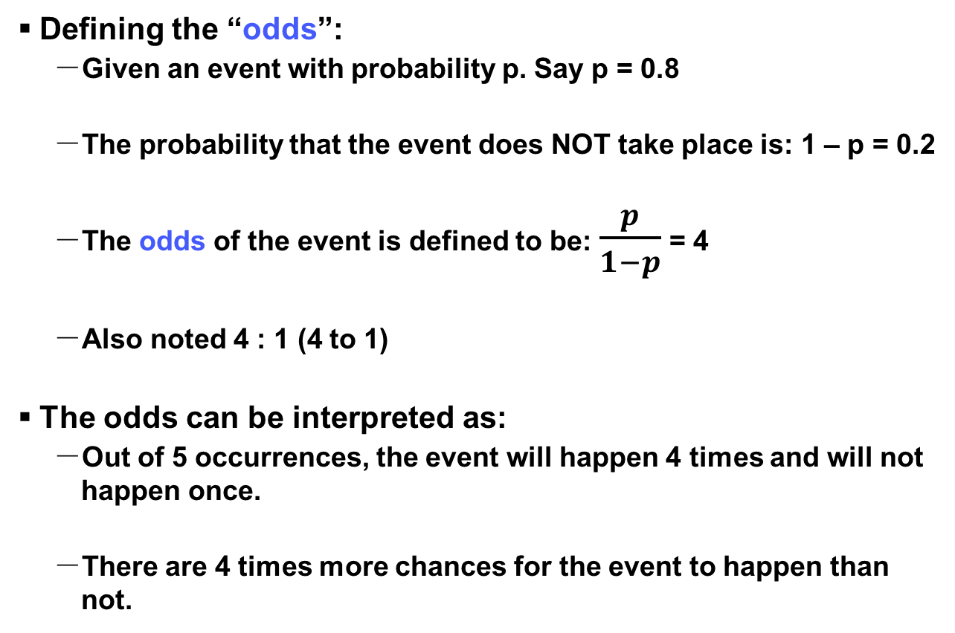
Logistic regression: Defining “odds”
Defining the “odds”:
Given an event with probability p. Say p = 0.8
The probability that the event does NOT take place is: 1 – p = 0.2
The odds of the event is defined to be: $\frac{p}{1−p}$ = 4
Also noted 4 : 1 (4 to 1)
The odds can be interpreted as:
Out of 5 occurrences, the event will happen 4 times and will not happen once.
There are 4 times more chances for the event to happen than not.

Slide 31
Logistic regression
Example:
Consider that you are a first time home buyer. Your credit score is 720 (values can range from 320 to 850). You know that credit scores are taken into account for mortgage approval and you would like to figure out the probability of being approved based on the credit score. (real scenario uses many more parameters).
You find online a list of credit scores and whether the applicant was approved or not. The list would look like this:
Credit Score | Approved
425 | 0
550 | 1
550 | 0
630 | 1
690 | 0
Etc… | Etc…

Slide 32
Logistic regression
For each credit score we can add up all the number of occurrences for approval and rejection and derive the probability of being approved.
Example: Suppose that in our data set, credit score 630 had 12 applications approved and 8 rejected.
We could then calculate for credit score 630:
Probability(approval) = 12 / (12 + 8) = 0.6
Probability(rejection) = 8 / (12 + 8) = 0.4
The same could be repeated for all credit scores and we could then plot a graph showing the credit scores, versus the probability of being approved. (see next slide).

Slide 33
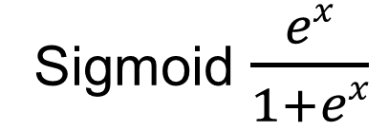
Logistic regression
Graph:
Probability
of approval
1.0
Sigmoid $\frac{ex}{1+ex}$
0.5
0.2
0.1
0.0
Credit Score

Slide 34
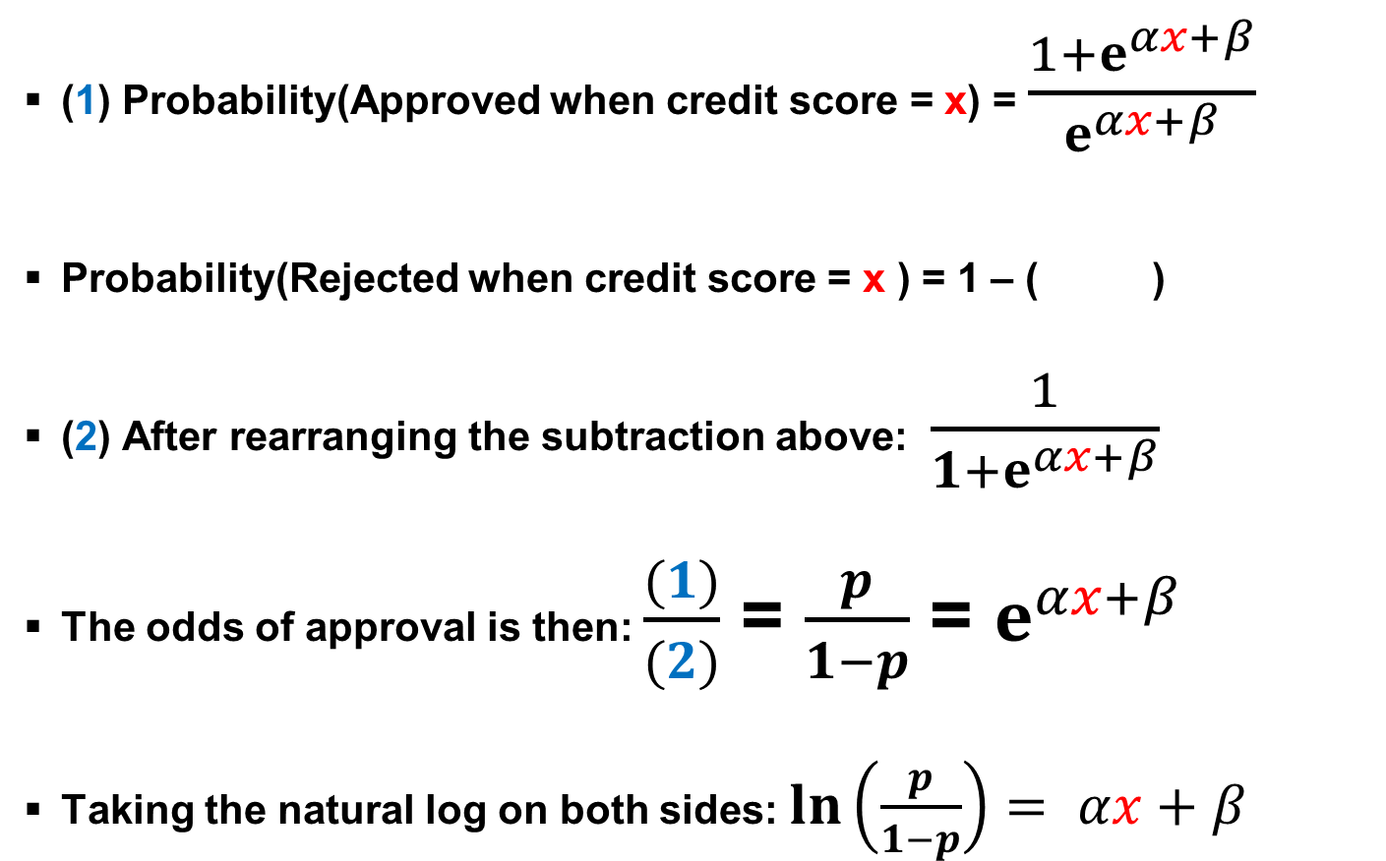
Logistic regression
(1) Probability(Approved when credit score = x) = $\frac{1+ⅇ^{αx+β}}{ⅇ^{αx+β}}$
Probability(Rejected when credit score = x ) = 1 – ( )
(2) After rearranging the subtraction above: $\frac{1}{1+ⅇ^{αx+β}}$
The odds of approval is then: $\frac{(1)}{(2)}$ = $\frac{p}{1−p}$ = $ⅇ^{αx+β}$
Taking the natural log on both sides: $ln\left(\frac{p}{1−p}\right)= αx+β$

Slide 35
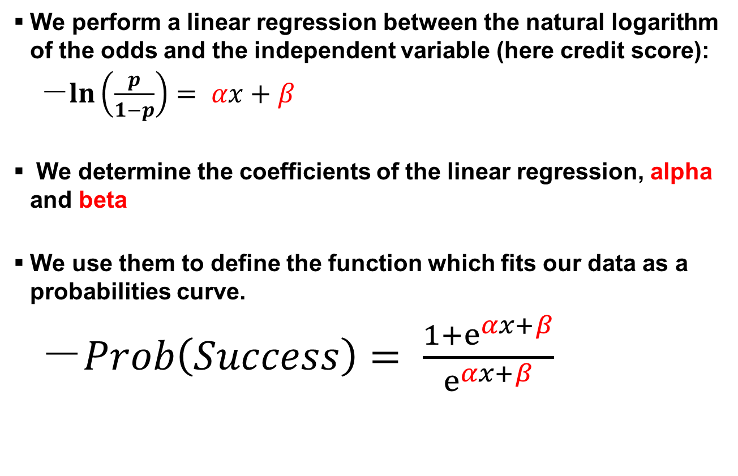
Logistic regression: Summary
We perform a linear regression between the natural logarithm of the odds and the independent variable (here credit score):
$ln\left(\frac{p}{1−p}\right)= αx+β$
We determine the coefficients of the linear regression, alpha and beta
We use them to define the function which fits our data as a probabilities curve.
$Prob\left(Success\right)= \frac{1+ⅇ^{αx+β}}{ⅇ^{αx+β}}$

Slide 36
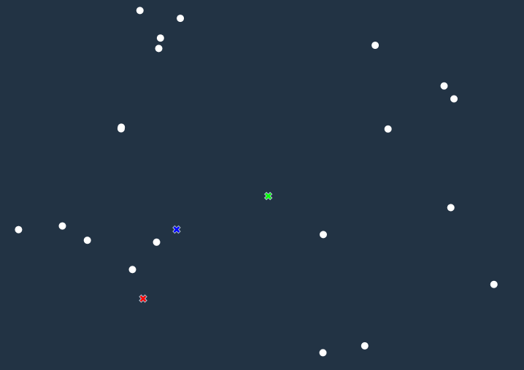
Clustering – K-means method
Start with 20 data points and 3 clusters
Notes:
K-means is a popular clustering algorithm that builds a user-specified k number of clusters. Each cluster center is represented by the mean values of the attributes (variables) for that cluster.
The algorithm computes cluster centers and compares each record to the centers to find the best fit (for that record) as it builds a model. Then it iterates, moving around the records to improve the fit until it converges (or hits the limit of a user-controllable parameter such as the max number of iterations).
Standardization is needed so that one or a few variables with relatively large values will not dominate the other variables in the distance measure and thereby disproportionately influence the formation of the clusters.
Categorical variables are converted to numeric (1,0 for each distinct value of a nominal variable such as eye color) since the algorithm requires numeric variables for computations.
Comparing the center of each cluster to the overall center enables us to interpret the cluster across the attributes. For example, we may see that customers in one cluster to spend much more than average, make more shopping trips, have above-average income, and have school-age children. These might be especially good customers to target for a back-to-school promotion.

Slide 37
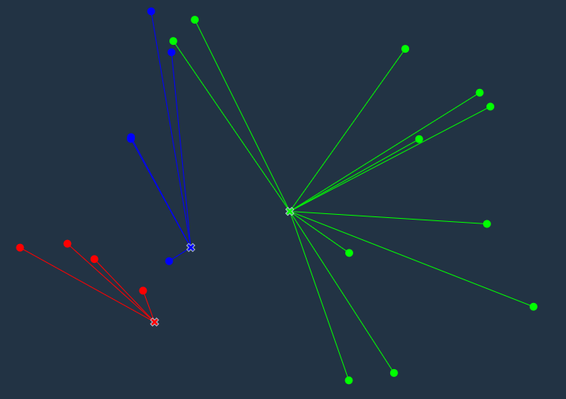
Clustering – K-means method
Assign each data point to the nearest cluster
Notes:
K-means is a popular clustering algorithm that builds a user-specified k number of clusters. Each cluster center is represented by the mean values of the attributes (variables) for that cluster.
The algorithm computes cluster centers and compares each record to the centers to find the best fit (for that record) as it builds a model. Then it iterates, moving around the records to improve the fit until it converges (or hits the limit of a user-controllable parameter such as the max number of iterations).
Standardization is needed so that one or a few variables with relatively large values will not dominate the other variables in the distance measure and thereby disproportionately influence the formation of the clusters.
Categorical variables are converted to numeric (1,0 for each distinct value of a nominal variable such as eye color) since the algorithm requires numeric variables for computations.
Comparing the center of each cluster to the overall center enables us to interpret the cluster across the attributes. For example, we may see that customers in one cluster to spend much more than average, make more shopping trips, have above-average income, and have school-age children. These might be especially good customers to target for a back-to-school promotion.

Slide 38
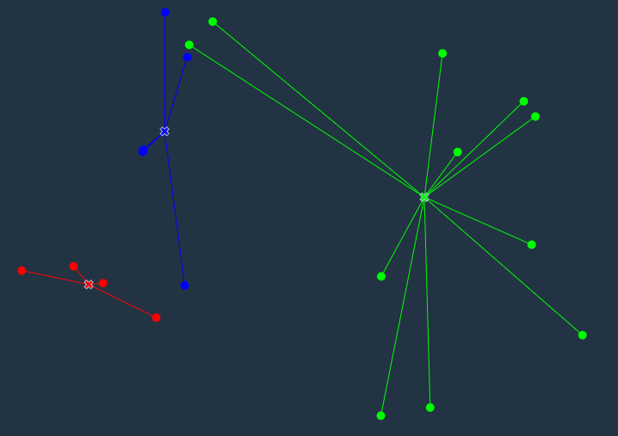
Clustering – K-means method
Calculate centroids of new clusters
Notes:
K-means is a popular clustering algorithm that builds a user-specified k number of clusters. Each cluster center is represented by the mean values of the attributes (variables) for that cluster.
The algorithm computes cluster centers and compares each record to the centers to find the best fit (for that record) as it builds a model. Then it iterates, moving around the records to improve the fit until it converges (or hits the limit of a user-controllable parameter such as the max number of iterations).
Standardization is needed so that one or a few variables with relatively large values will not dominate the other variables in the distance measure and thereby disproportionately influence the formation of the clusters.
Categorical variables are converted to numeric (1,0 for each distinct value of a nominal variable such as eye color) since the algorithm requires numeric variables for computations.
Comparing the center of each cluster to the overall center enables us to interpret the cluster across the attributes. For example, we may see that customers in one cluster to spend much more than average, make more shopping trips, have above-average income, and have school-age children. These might be especially good customers to target for a back-to-school promotion.

Slide 39
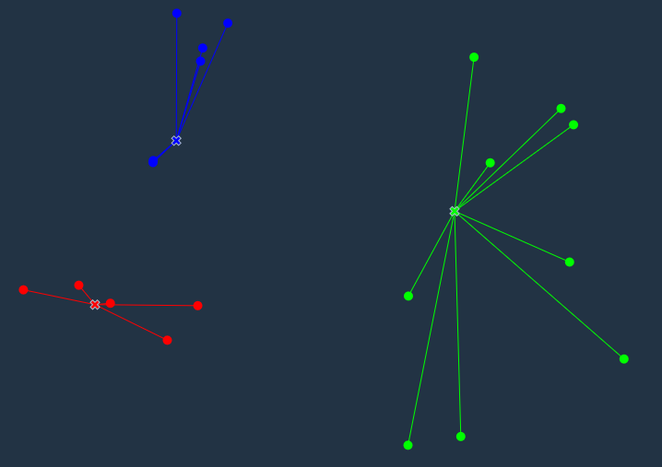
Clustering – K-means method
Assign each data point to the nearest cluster
Notes:
K-means is a popular clustering algorithm that builds a user-specified k number of clusters. Each cluster center is represented by the mean values of the attributes (variables) for that cluster.
The algorithm computes cluster centers and compares each record to the centers to find the best fit (for that record) as it builds a model. Then it iterates, moving around the records to improve the fit until it converges (or hits the limit of a user-controllable parameter such as the max number of iterations).
Standardization is needed so that one or a few variables with relatively large values will not dominate the other variables in the distance measure and thereby disproportionately influence the formation of the clusters.
Categorical variables are converted to numeric (1,0 for each distinct value of a nominal variable such as eye color) since the algorithm requires numeric variables for computations.
Comparing the center of each cluster to the overall center enables us to interpret the cluster across the attributes. For example, we may see that customers in one cluster to spend much more than average, make more shopping trips, have above-average income, and have school-age children. These might be especially good customers to target for a back-to-school promotion.

Slide 40
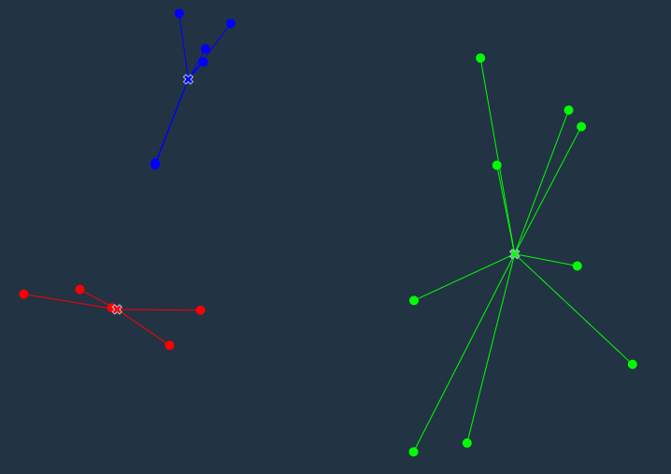
Clustering – K-means method
Calculate centroids of new clusters…until convergence
Notes:
K-means is a popular clustering algorithm that builds a user-specified k number of clusters. Each cluster center is represented by the mean values of the attributes (variables) for that cluster.
The algorithm computes cluster centers and compares each record to the centers to find the best fit (for that record) as it builds a model. Then it iterates, moving around the records to improve the fit until it converges (or hits the limit of a user-controllable parameter such as the max number of iterations).
Standardization is needed so that one or a few variables with relatively large values will not dominate the other variables in the distance measure and thereby disproportionately influence the formation of the clusters.
Categorical variables are converted to numeric (1,0 for each distinct value of a nominal variable such as eye color) since the algorithm requires numeric variables for computations.
Comparing the center of each cluster to the overall center enables us to interpret the cluster across the attributes. For example, we may see that customers in one cluster to spend much more than average, make more shopping trips, have above-average income, and have school-age children. These might be especially good customers to target for a back-to-school promotion.

