Slide 1
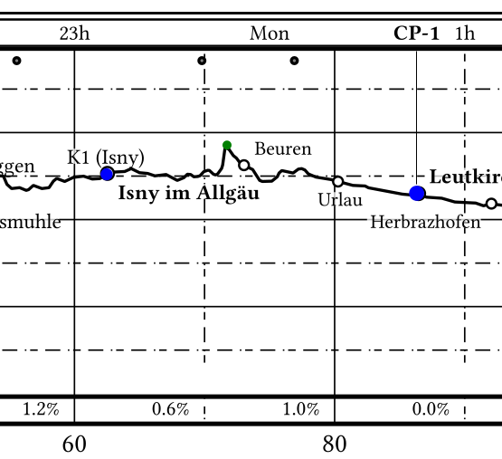
midnight
control point
cutoff time
cutoff points
average slope

