Slide 1
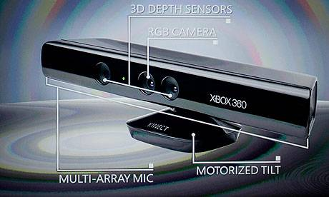
Virtual Reality with Kinect
Virtual Environment
Real User
Interaction
Kinect

Slide 2
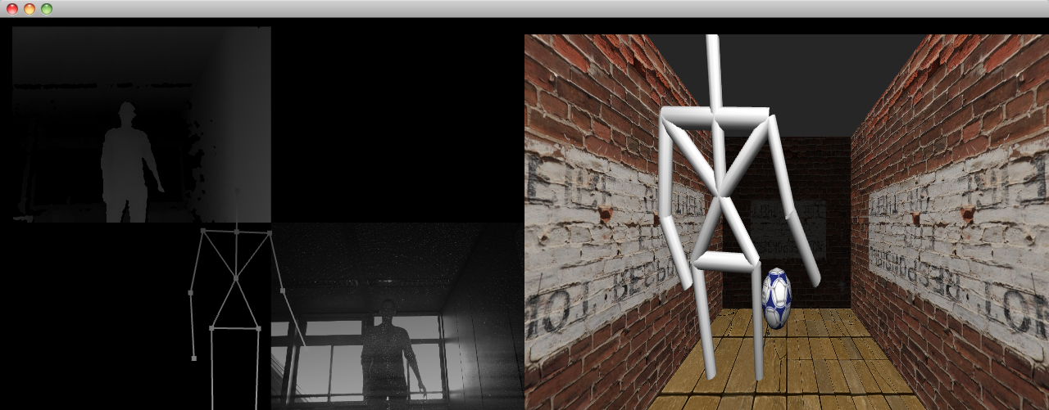
Details
OpenNI, Cinder libraries
Different viewpoints
''Physics''
Sound

