Slide 1
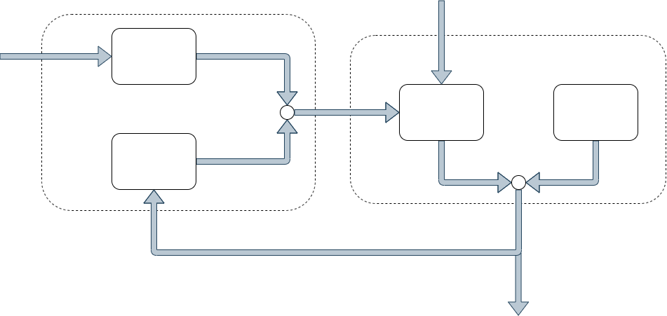
Prediction
Update

Slide 2
External Magnet
Magnetic
Sensor
BLDC-Motor
Reference
Sensor
Measurement
Magnetic Field Strength B
Position

Slide 3

Stator
N
Rotor
S
S
N
Coil

Slide 4
Ground Truth
Position
Speed
Offline
Measurement Equation
Magnetic Measurements
Regression
Online
Magnetic Measurements
Kalman
Filter
Position
and
Speed
Delay

Slide 5
Sensor
Motor Rückseite

Slide 6
Motor Backside
Sensor
Current Position
Sensor
Previous Position

Slide 7
Motor Backside
Sensor
Sensor
Sensor

Slide 8
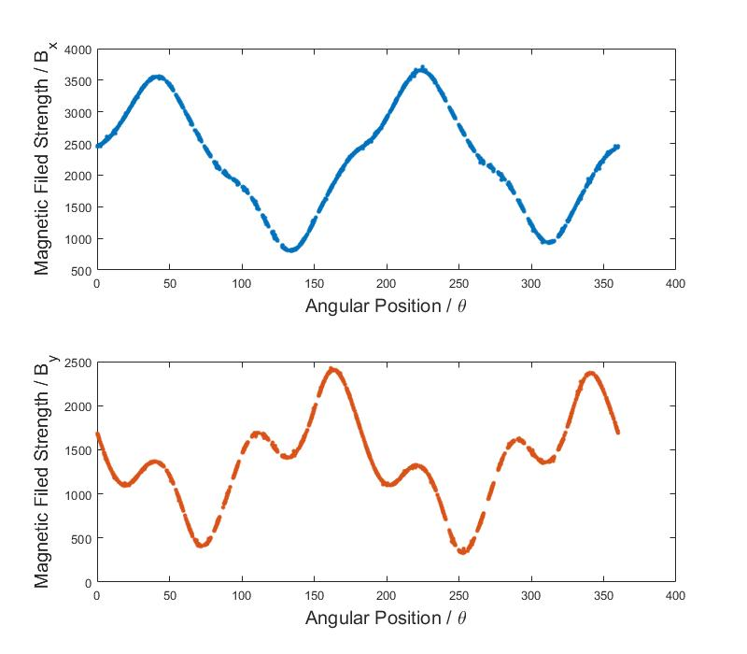
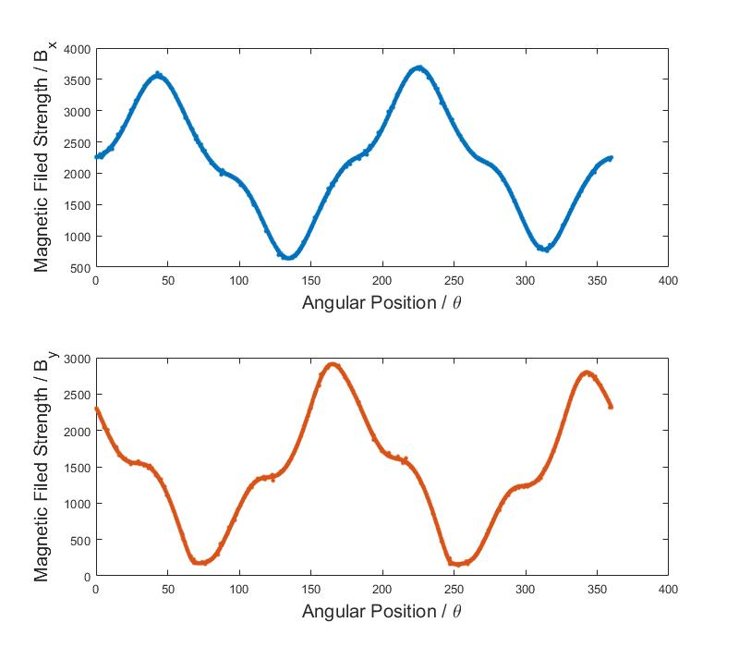
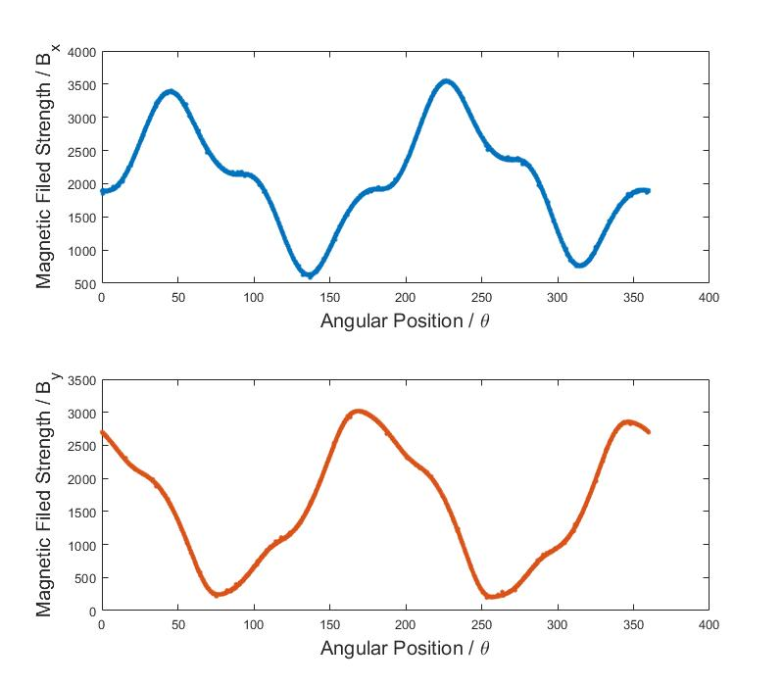
Original Position
!!
!!

Slide 9

(2)
Translationbereich
Alte Position
Sensor
Statorspule
(1)
Rotor

Slide 10
(2)
Sensor
(1)
Rotor

Slide 11
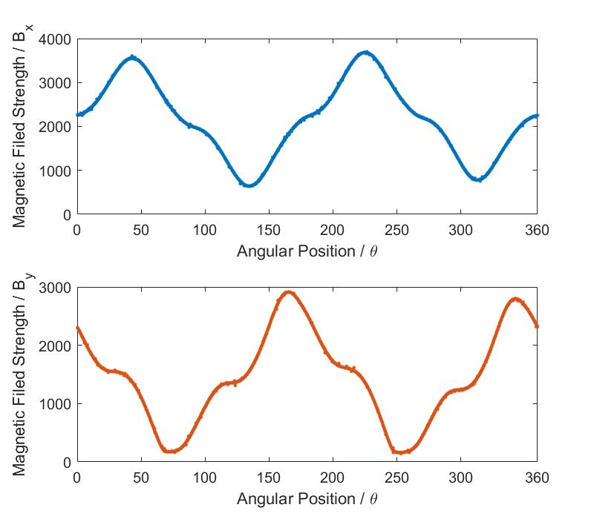
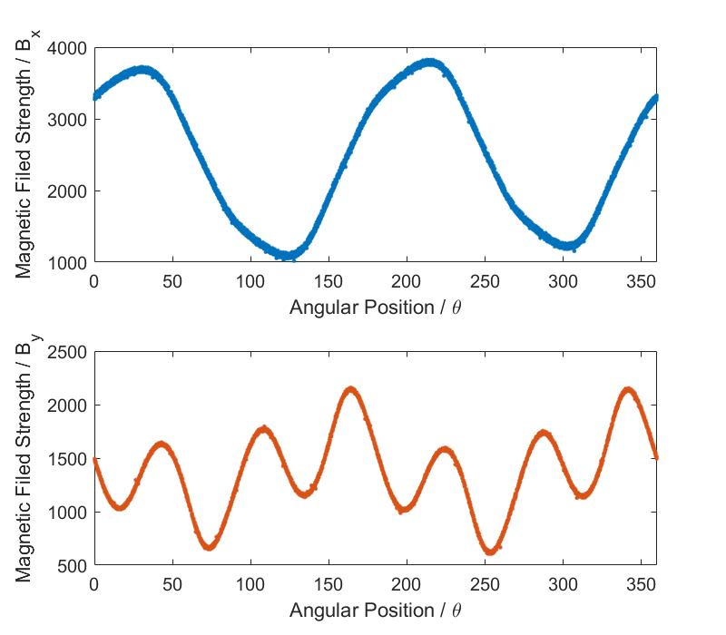
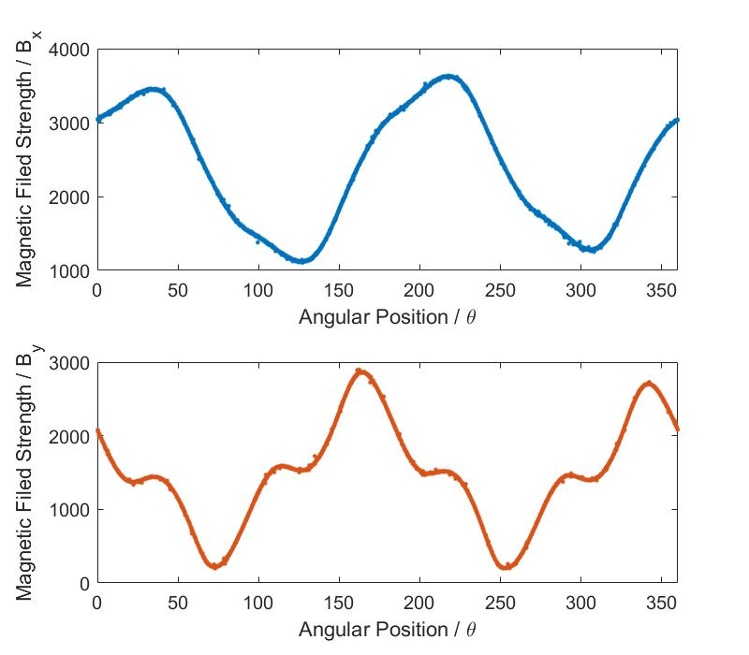
Original Position

Slide 12
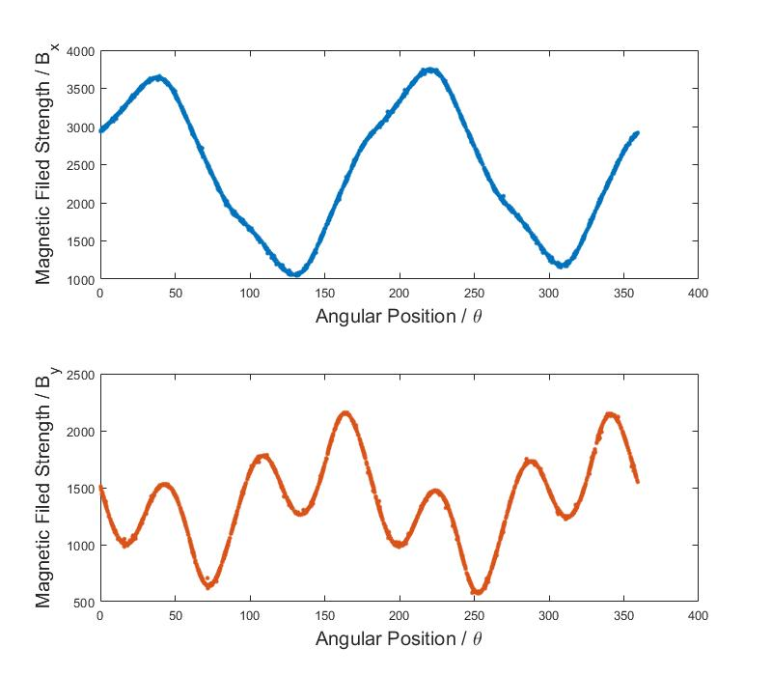
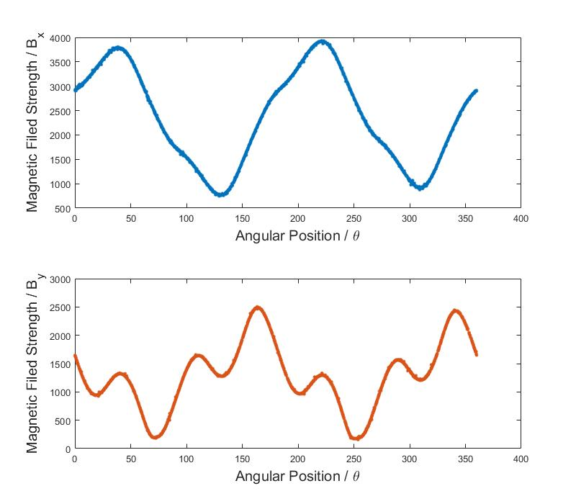
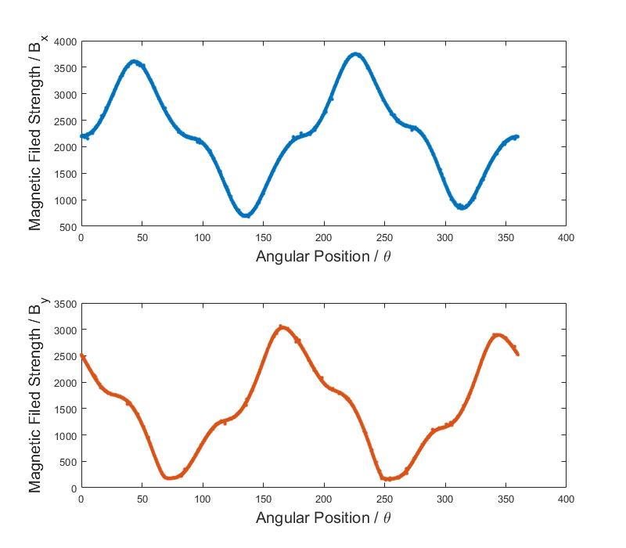
Original Position
-

Slide 13
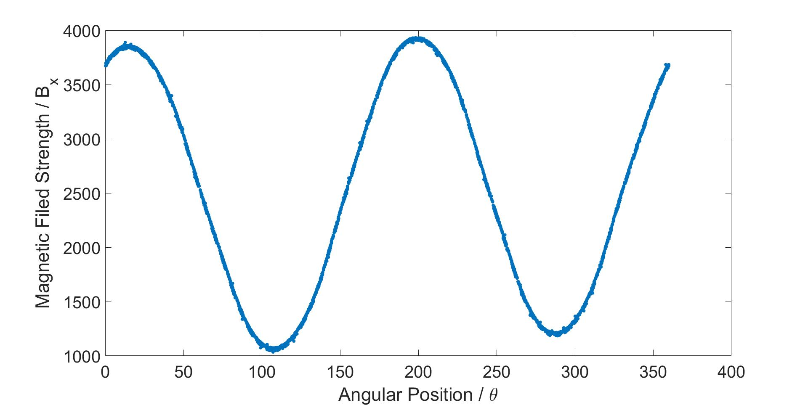
(2)
(1)
Sensor

Slide 14
Rotation
Simulation

Slide 15

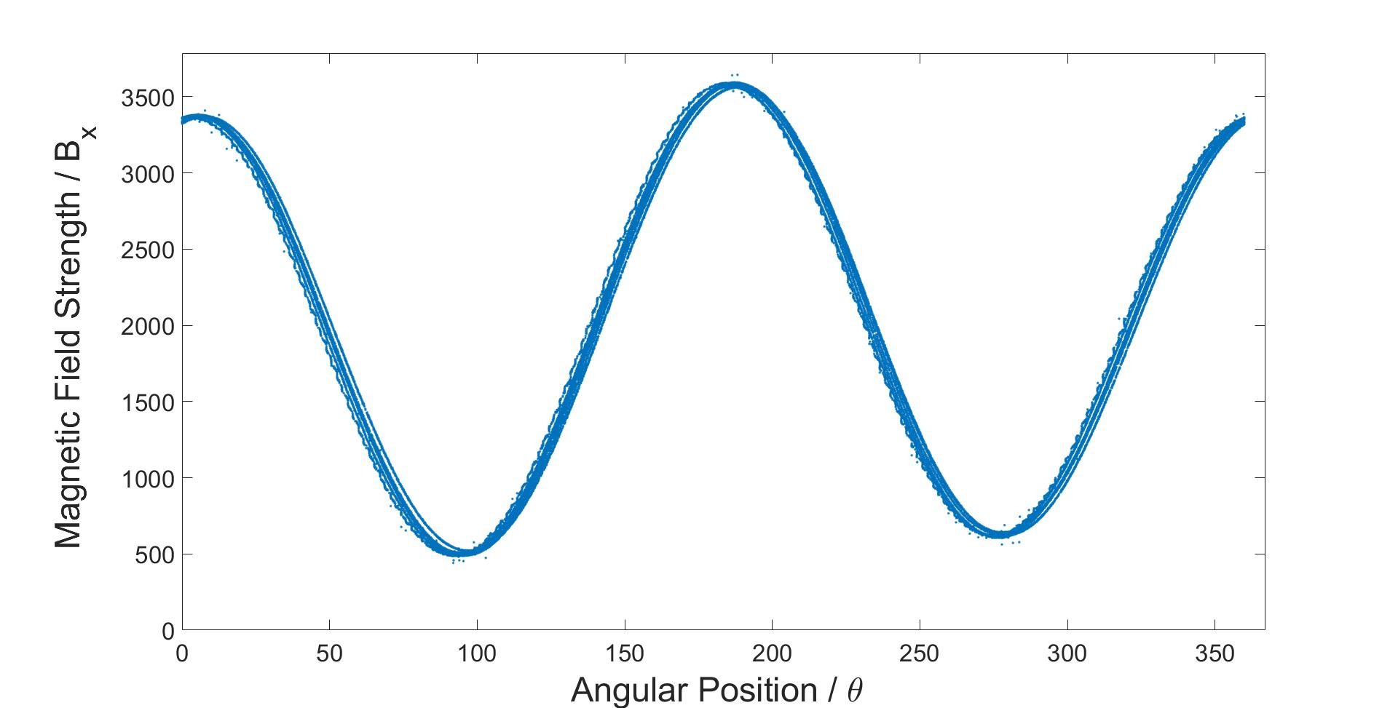

Slide 16
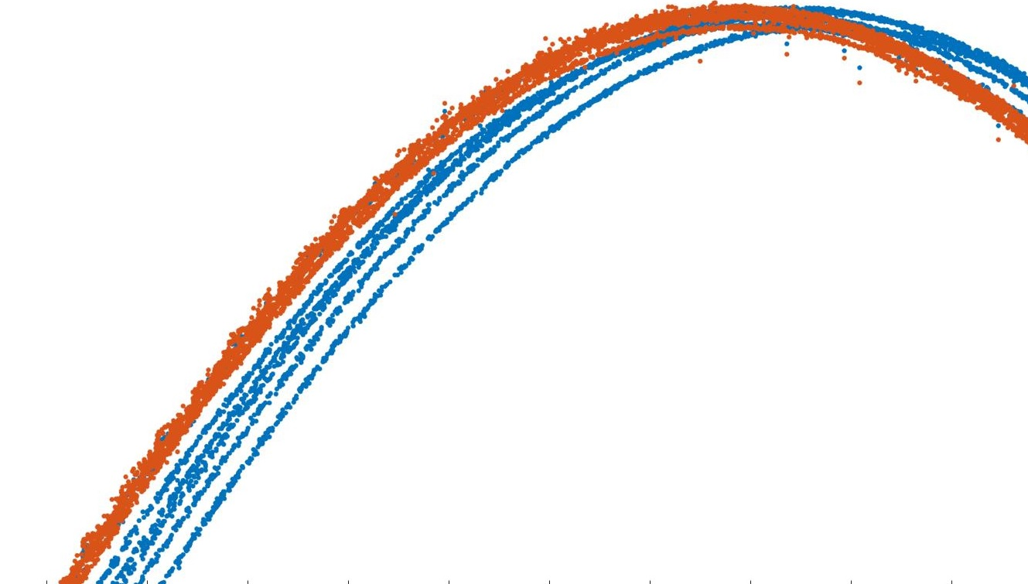
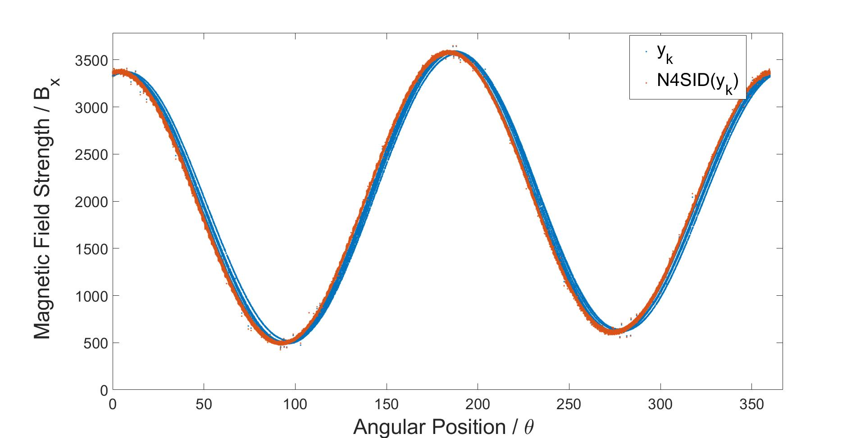

Slide 17
y

Slide 18
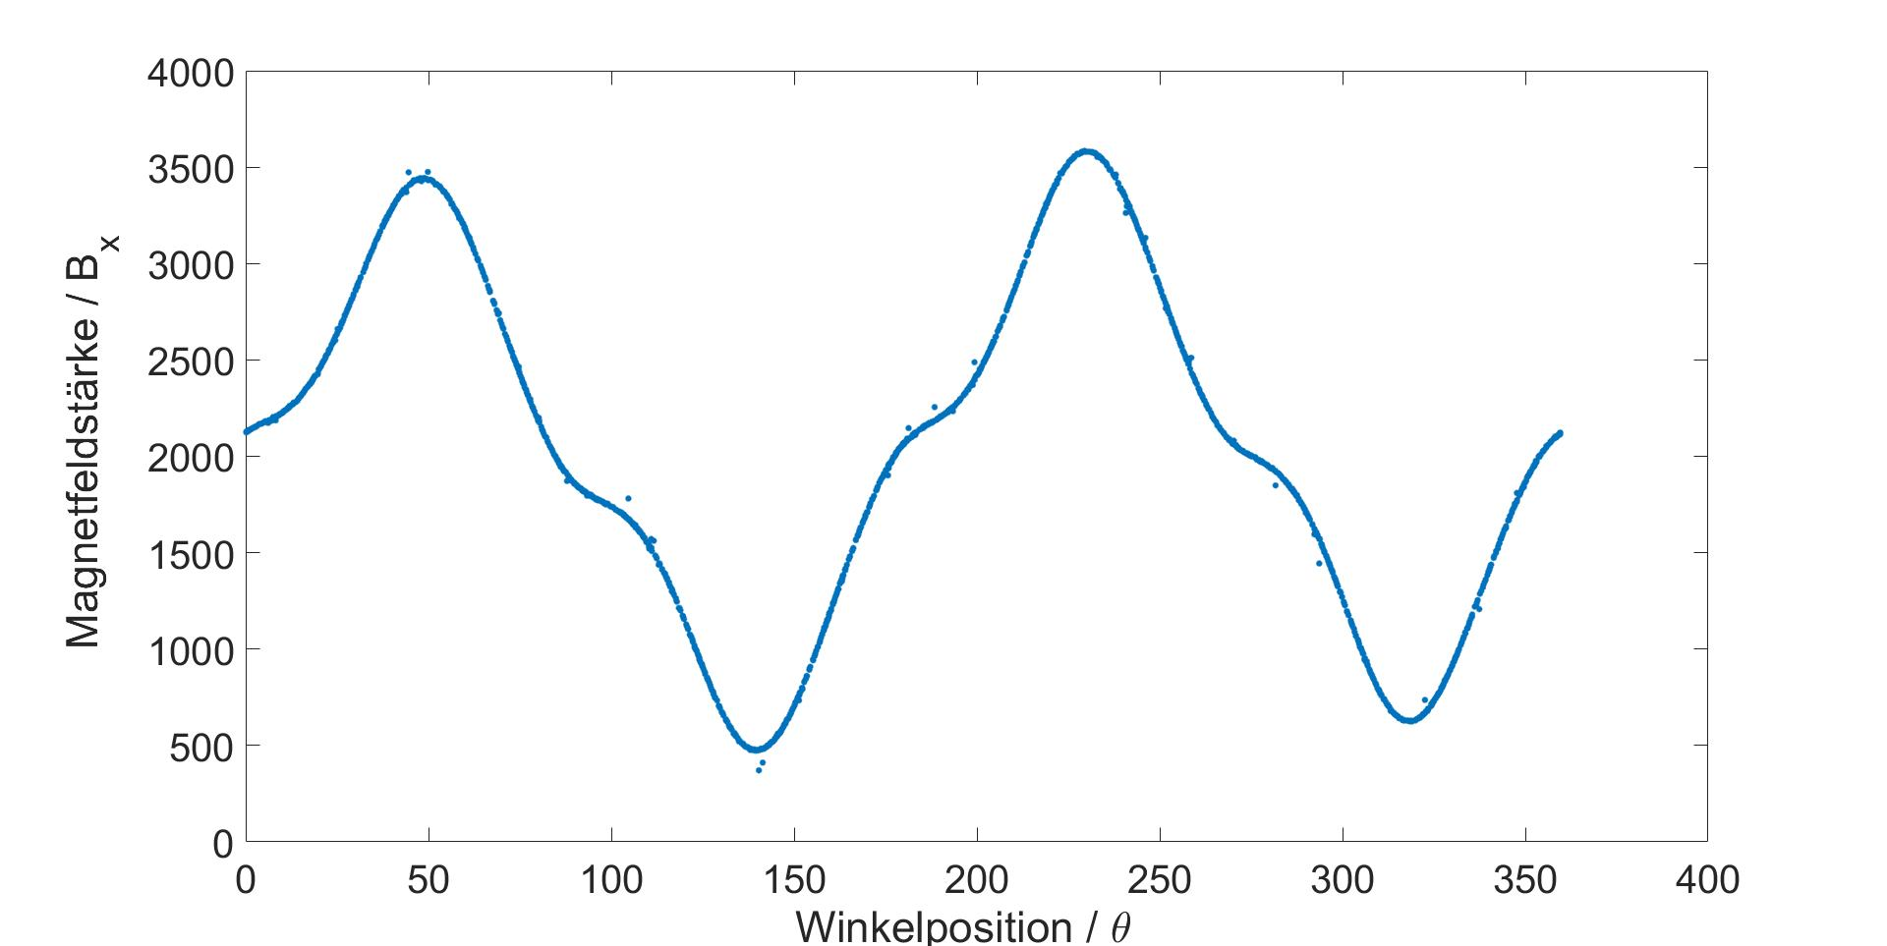

Slide 19
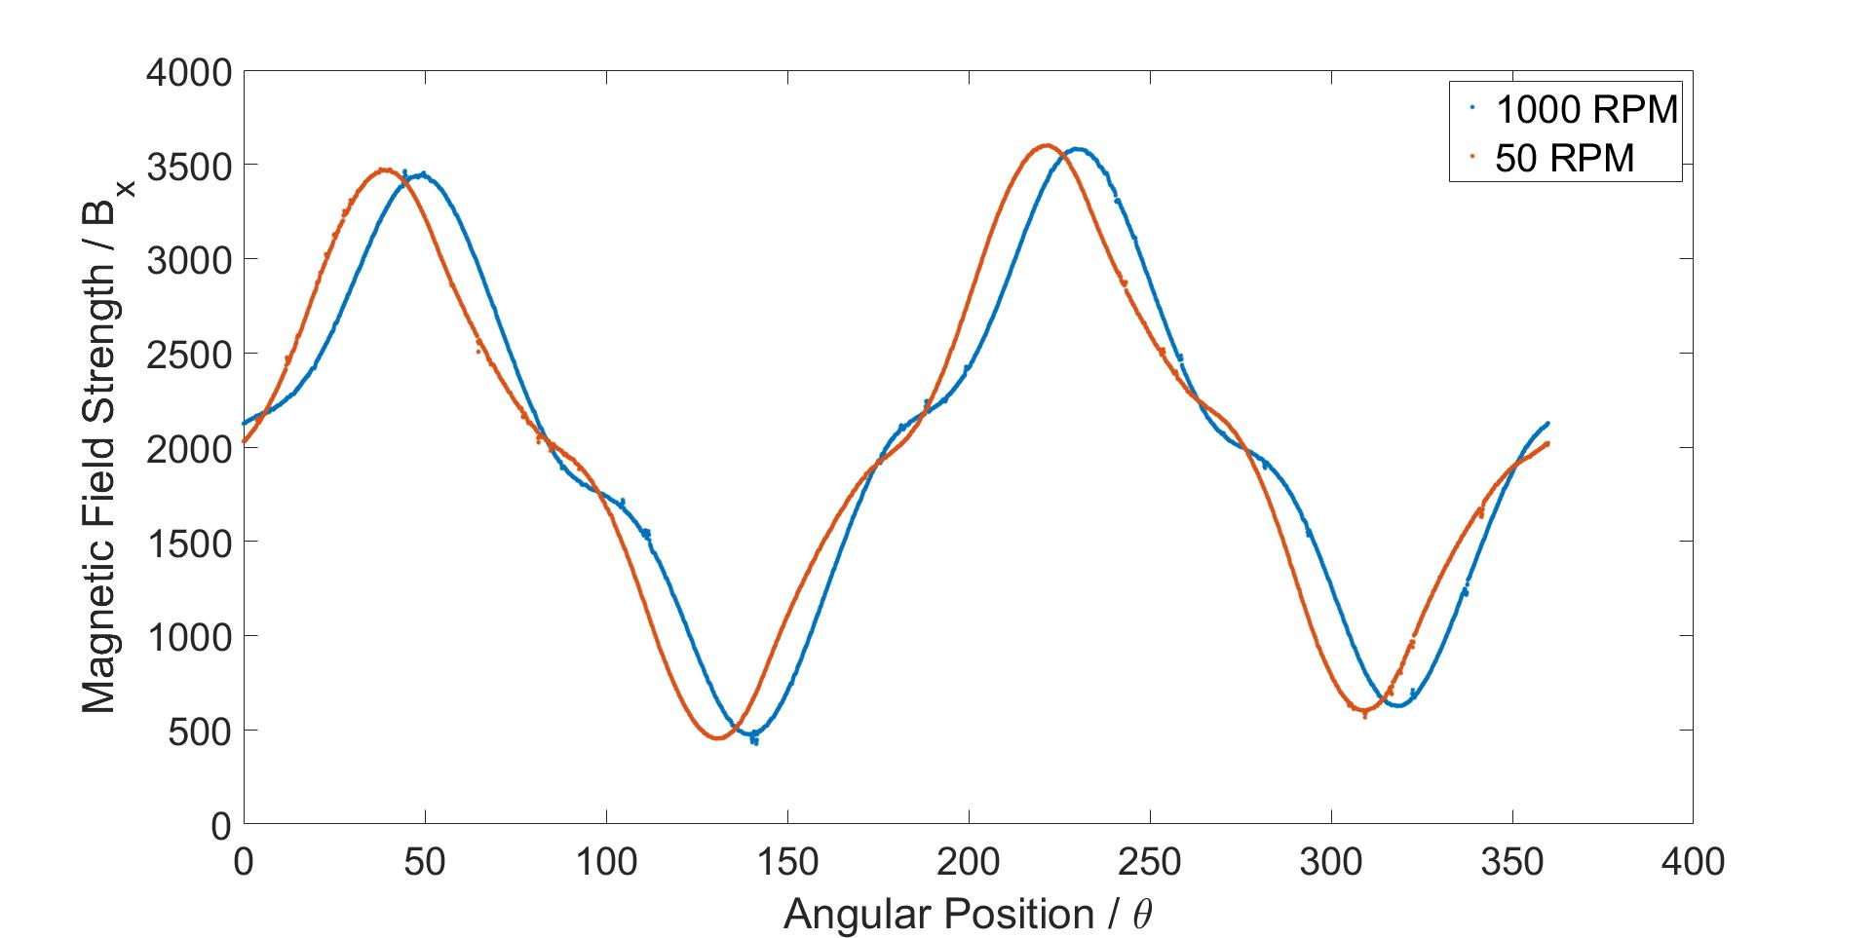

Slide 20
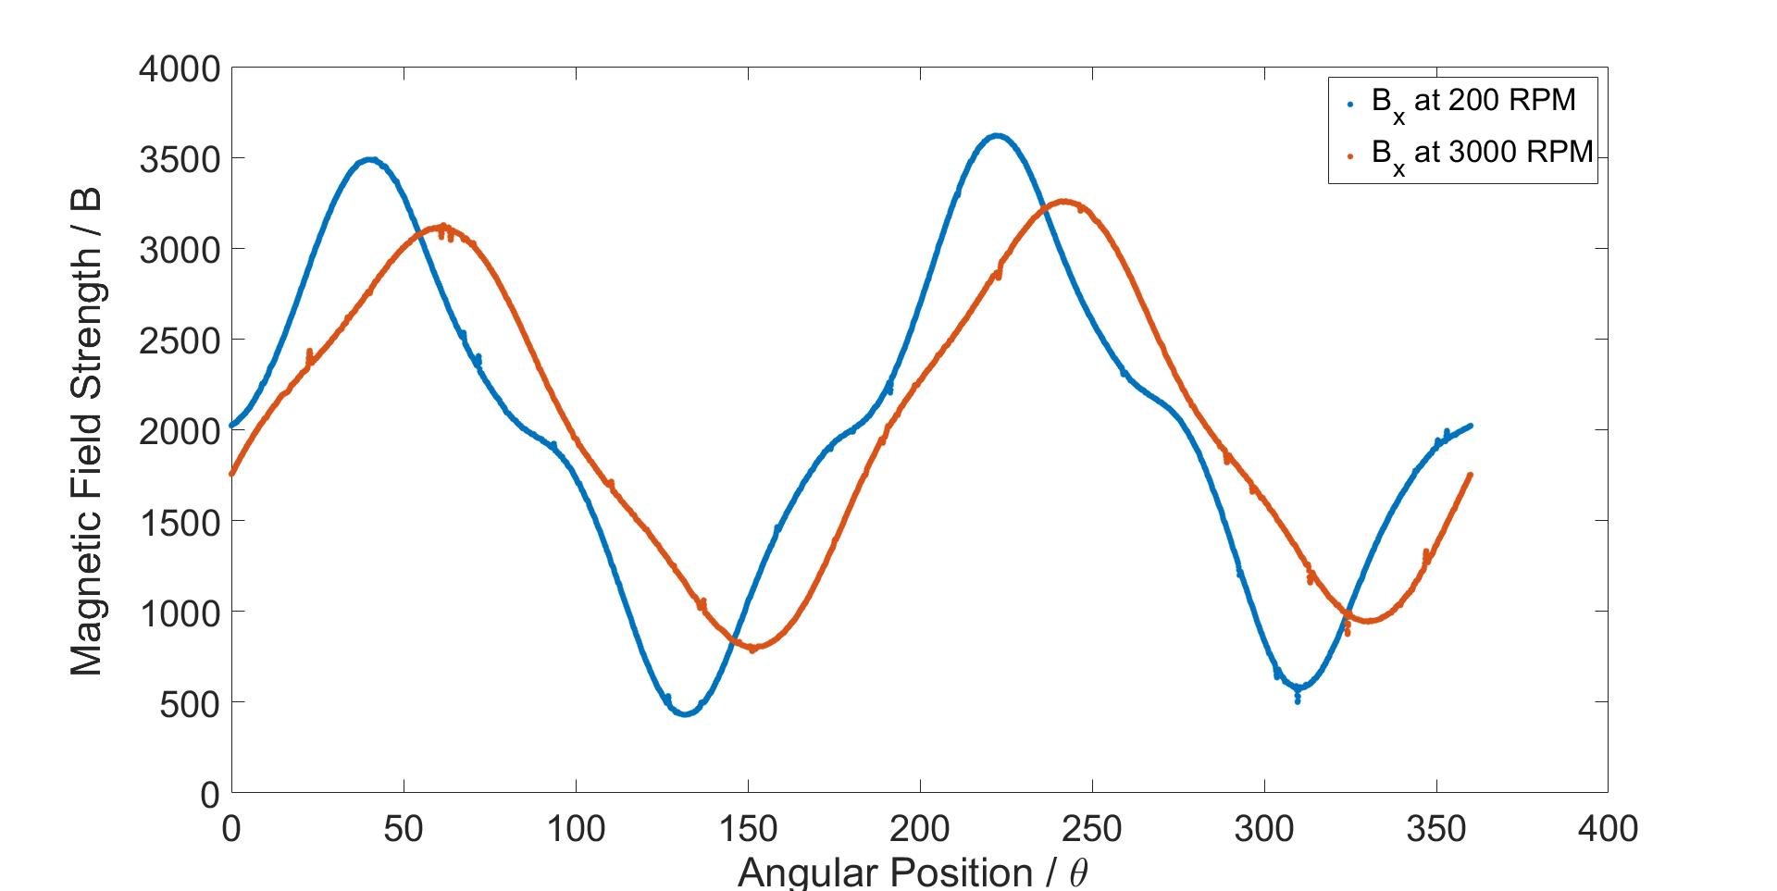

Slide 21
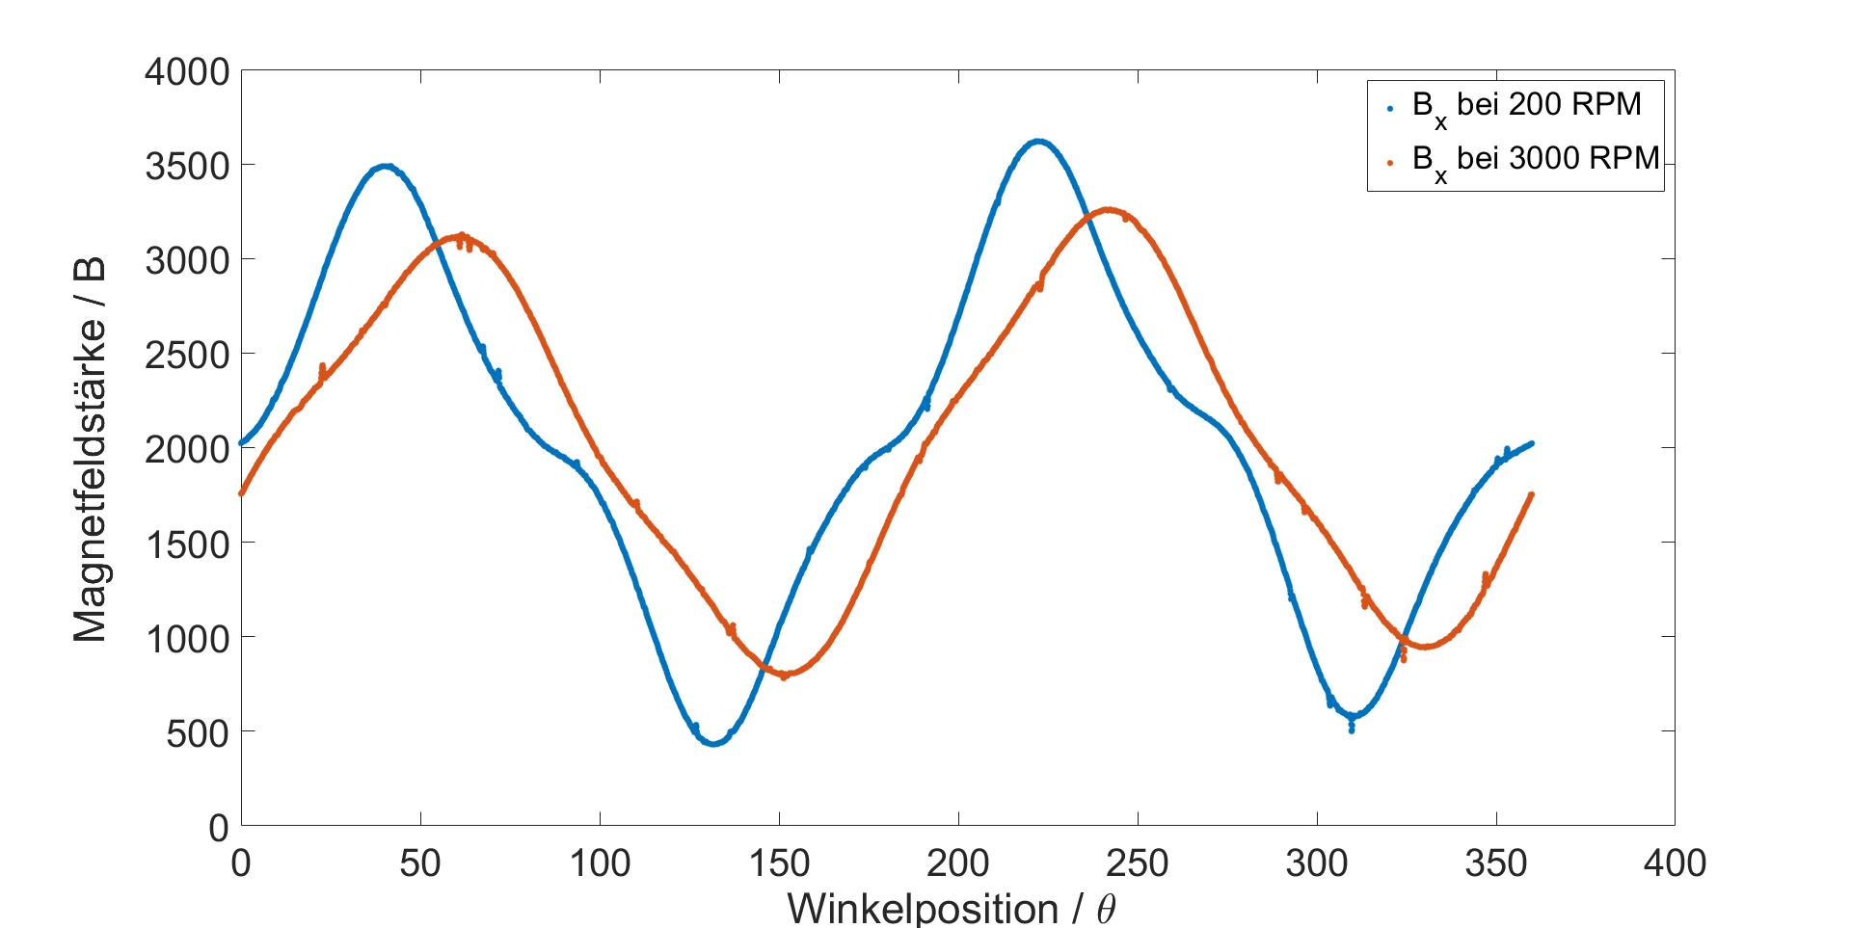

Slide 22
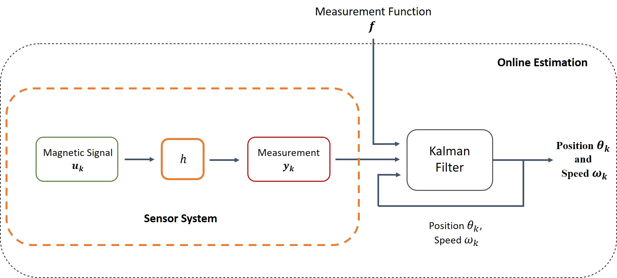
Delay

