Slide 1
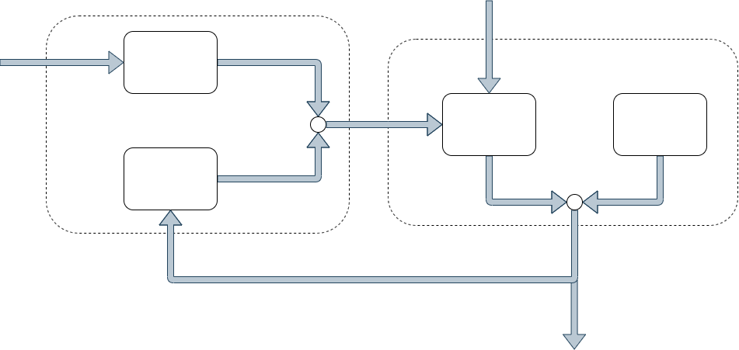
Prediction
Update

Slide 2
External Magnet
Magnetic
Sensor
BLDC-Motor
Reference
Sensor
Measurement
Magnetic Field Strength B
Position

Slide 3

Stator
N
Rotor
S
S
N
Coil

Slide 4
Ground Truth
Position
Speed
Offline
Measurement Equation
Magnetic Measurements
Regression
Online
Magnetic Measurements
Kalman
Filter
Position
and
Speed
Position , Speed

Slide 5
Sensor
Motor Backside

Slide 6
Motor Backside
Sensor
Current Position
Sensor
Previous Position

Slide 7
Motor Backside
Sensor
Sensor
Sensor

Slide 8
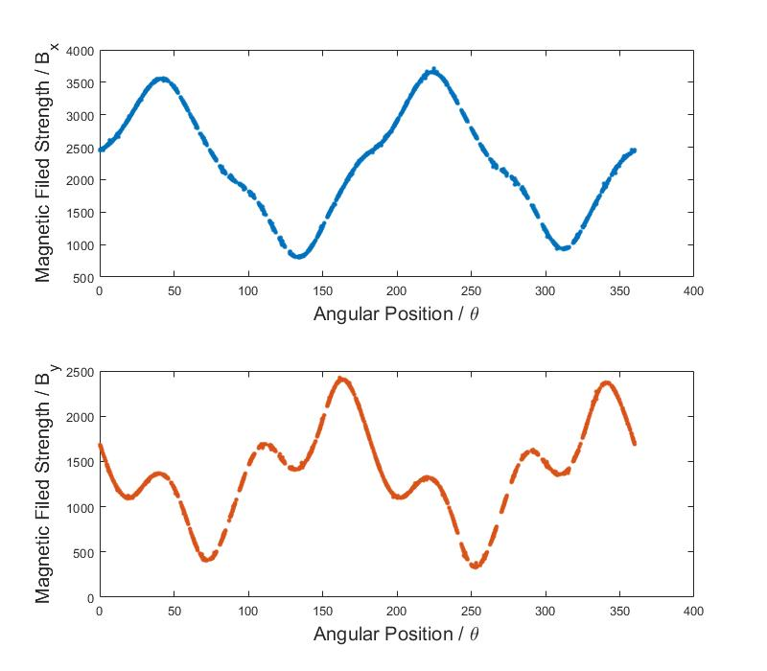
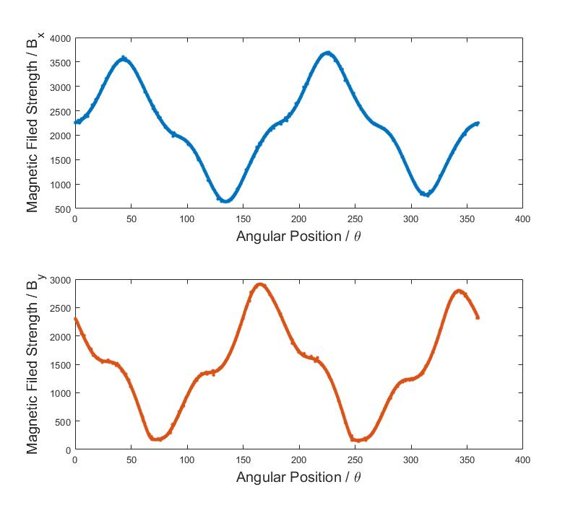
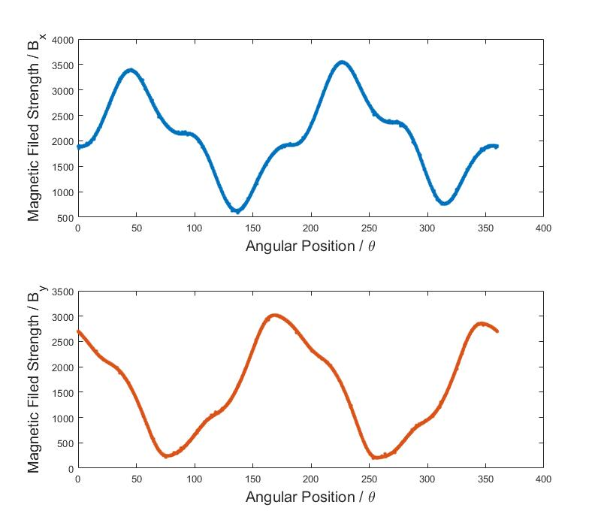
Original Position
!!
!!

Slide 9

(2)
Translation Area
Current Position
Sensor
Stator Coil
(1)
Rotor

Slide 10
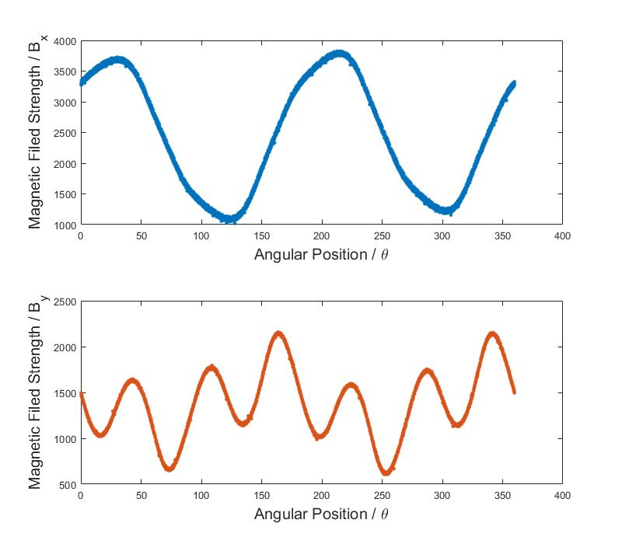
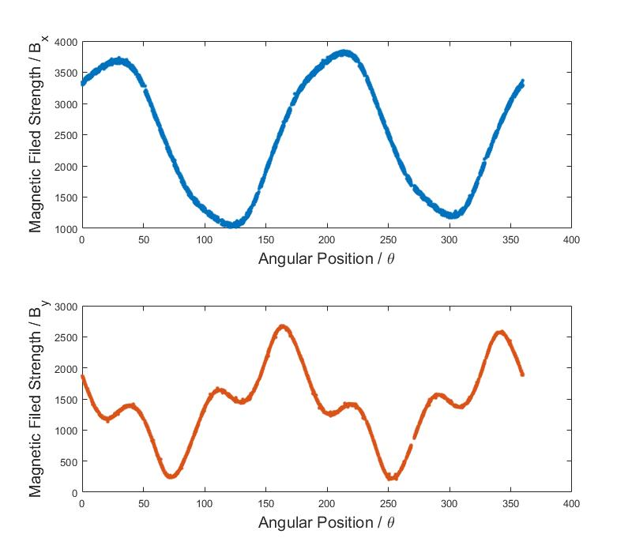
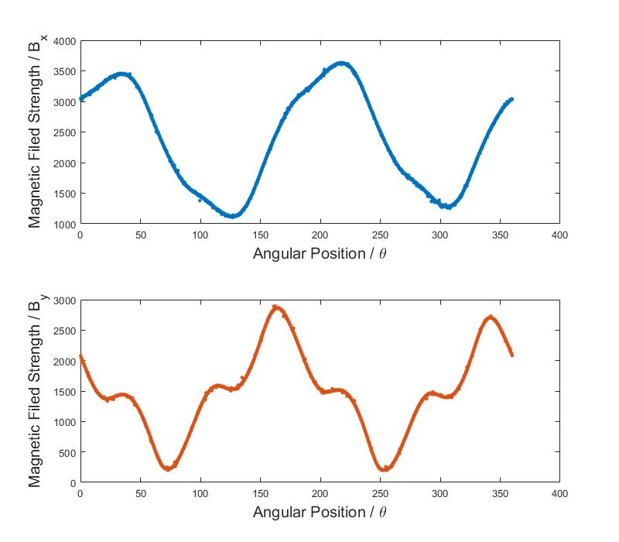
Original Position
!!
!!
!!

Slide 11
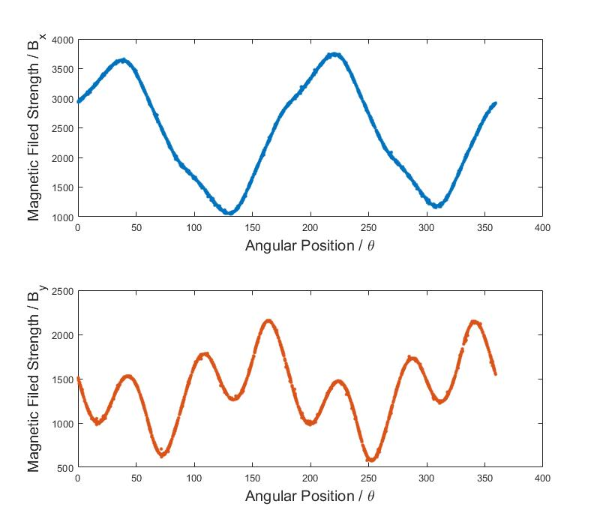
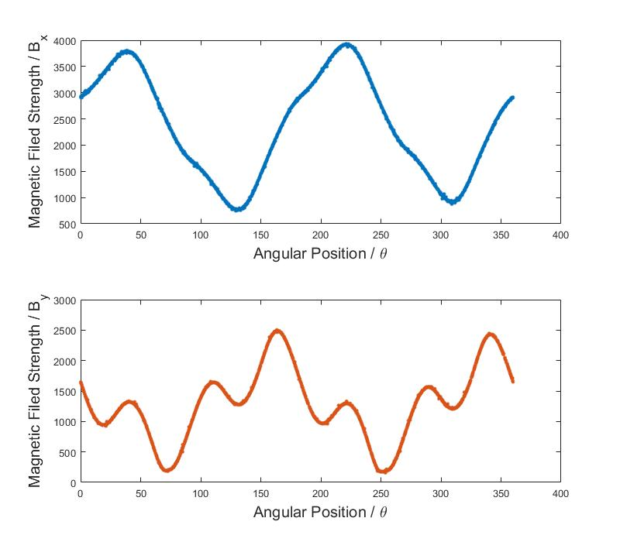
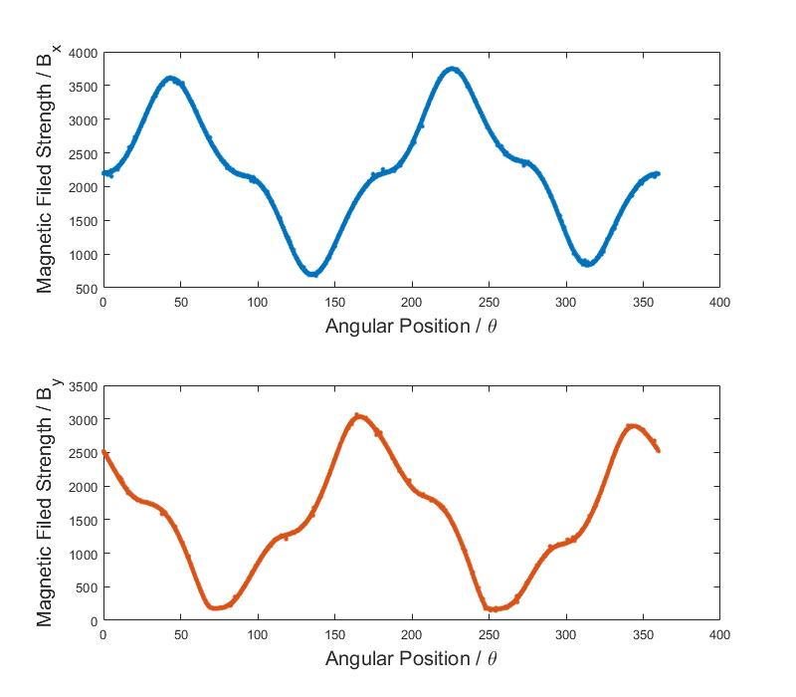
Original Position
!!
!!
!!

Slide 12
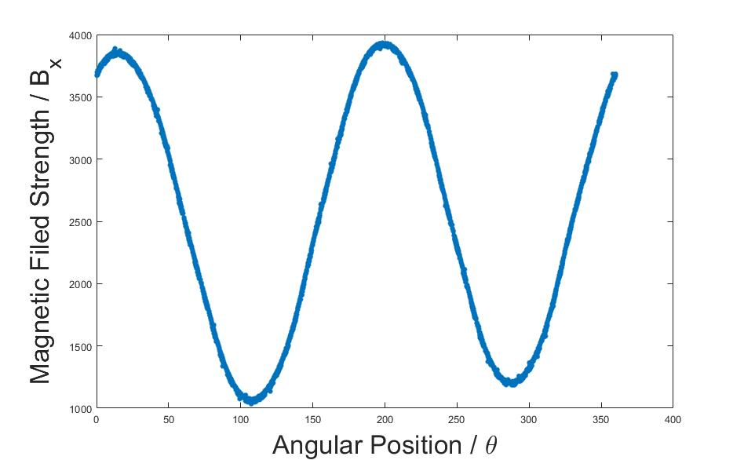
(2)
(1)
Sensor

Slide 13
Rotation
Simulation

Slide 14
