Slide 1

Optimizing Sports Betting Strategies in Football through Predictive Modeling and Utility-Based Optimization
Intern: Julien Delavande
Affiliation: ISAE-SUPAERO Toulouse
Tutor: Pierre Louis Perez
Tutor Supaero: Thomas Oberlin
Duration: April 2024 – September 2024
October 2024

Slide 2
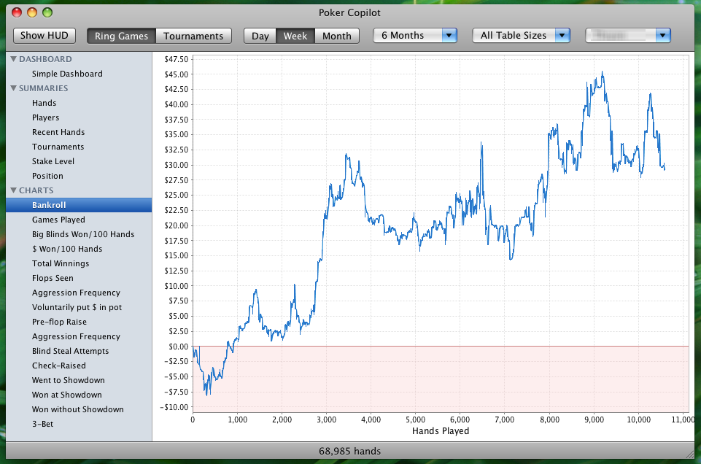
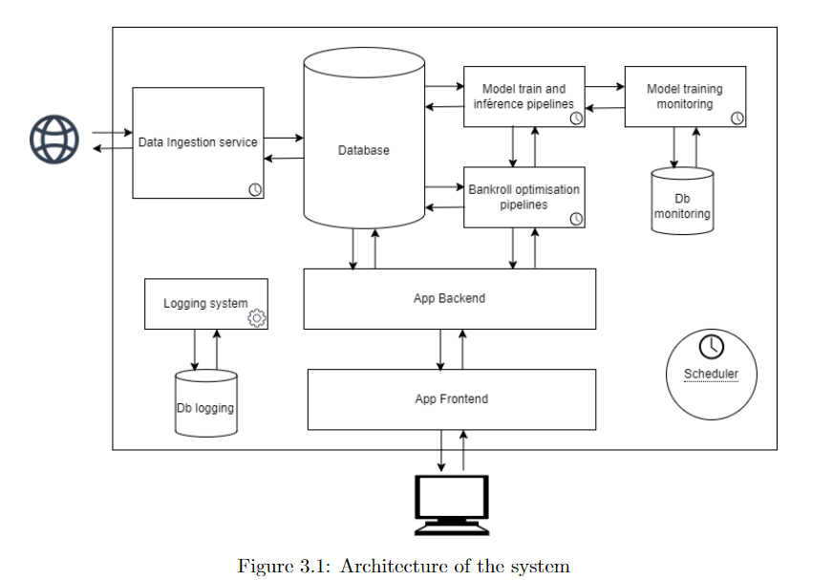

Main Objective
Develop a comprehensive system to optimize sports betting strategies in football.

Slide 3
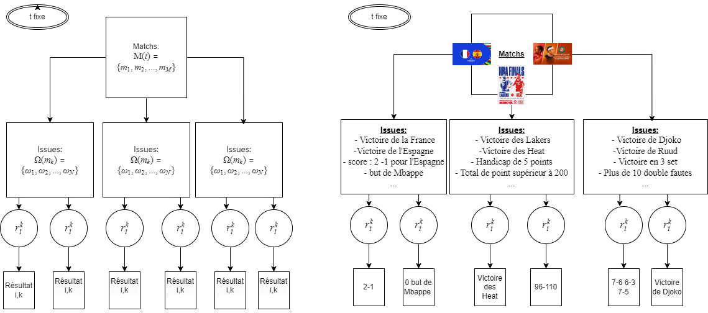
Concepts

Slide 4
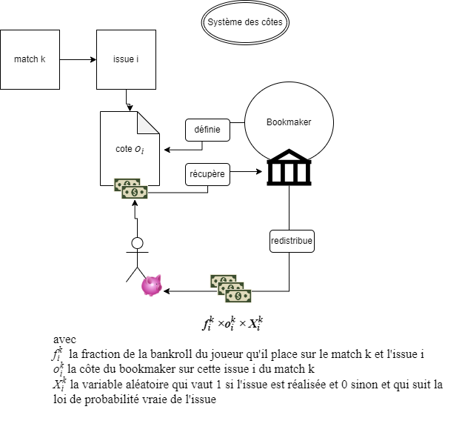
Concepts
B(t) the bankroll of the bettors or Player at t
BF, the bankroll factor, BF = B/B(0)
Trough the presentation B(0)=BF(0)=1

Slide 5
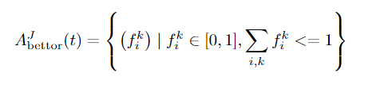

General Agent-Based Betting Framework
Agents: Bettors – Bookmakers
Actions:

Slide 6
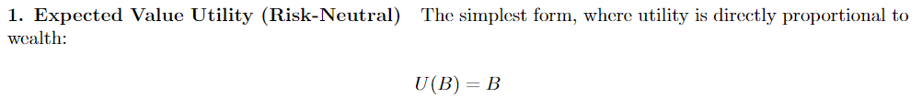
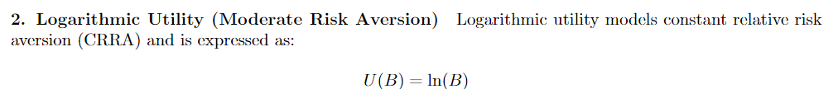
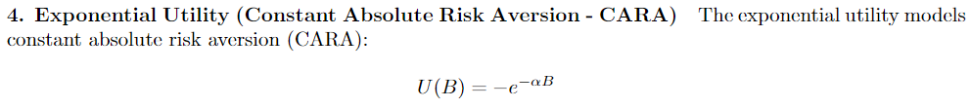

Utility Function as an objectif to incorporate risk

Slide 7
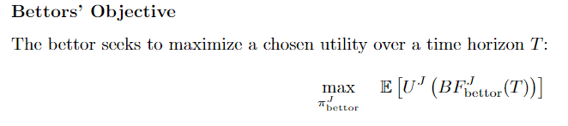
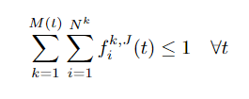


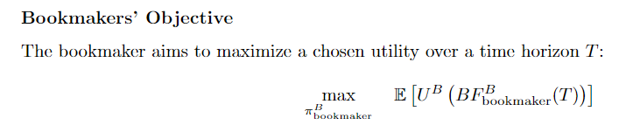



General Agent-Based Betting Framework - Objective

Slide 8
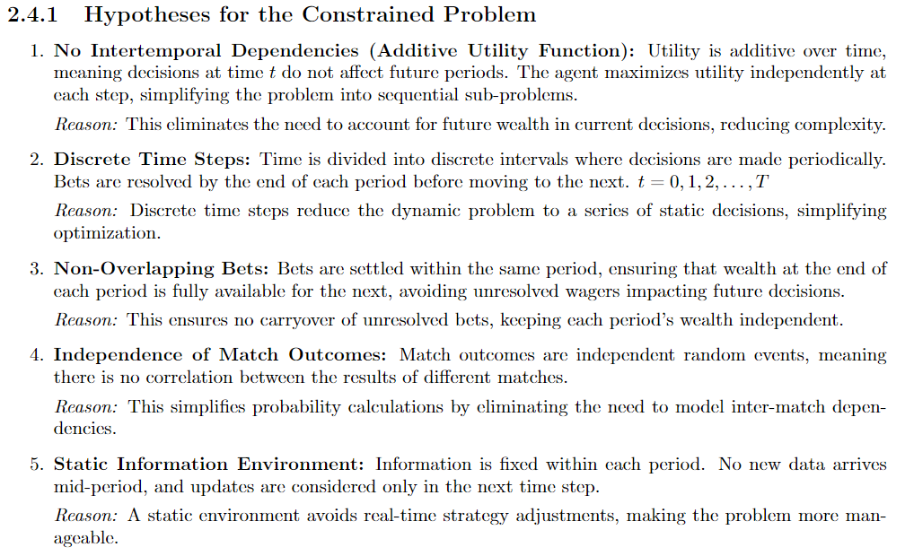
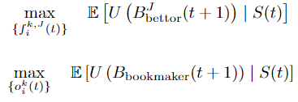
Reduction to the Studied Case – dynamic to static

Slide 9

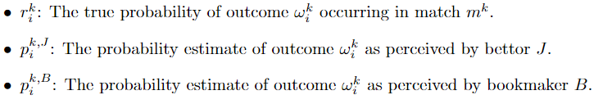

Reduction to the Studied Case – dynamic to static

Slide 10
Design and implementation of the solution

Slide 11


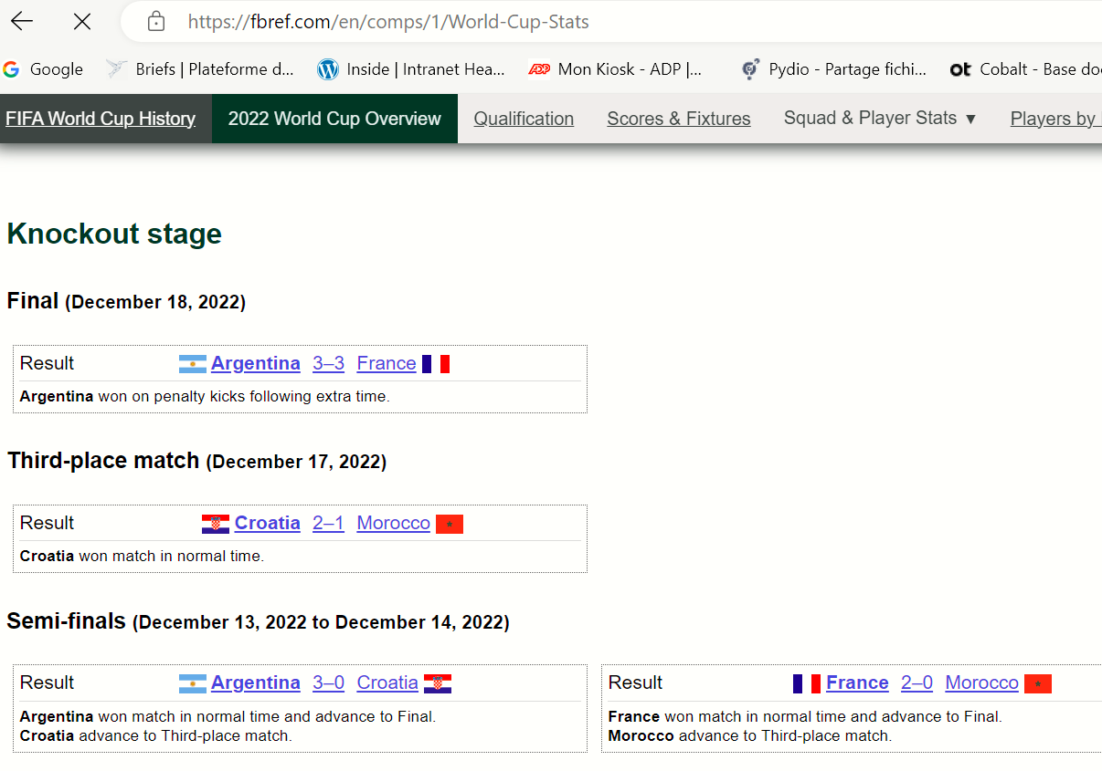
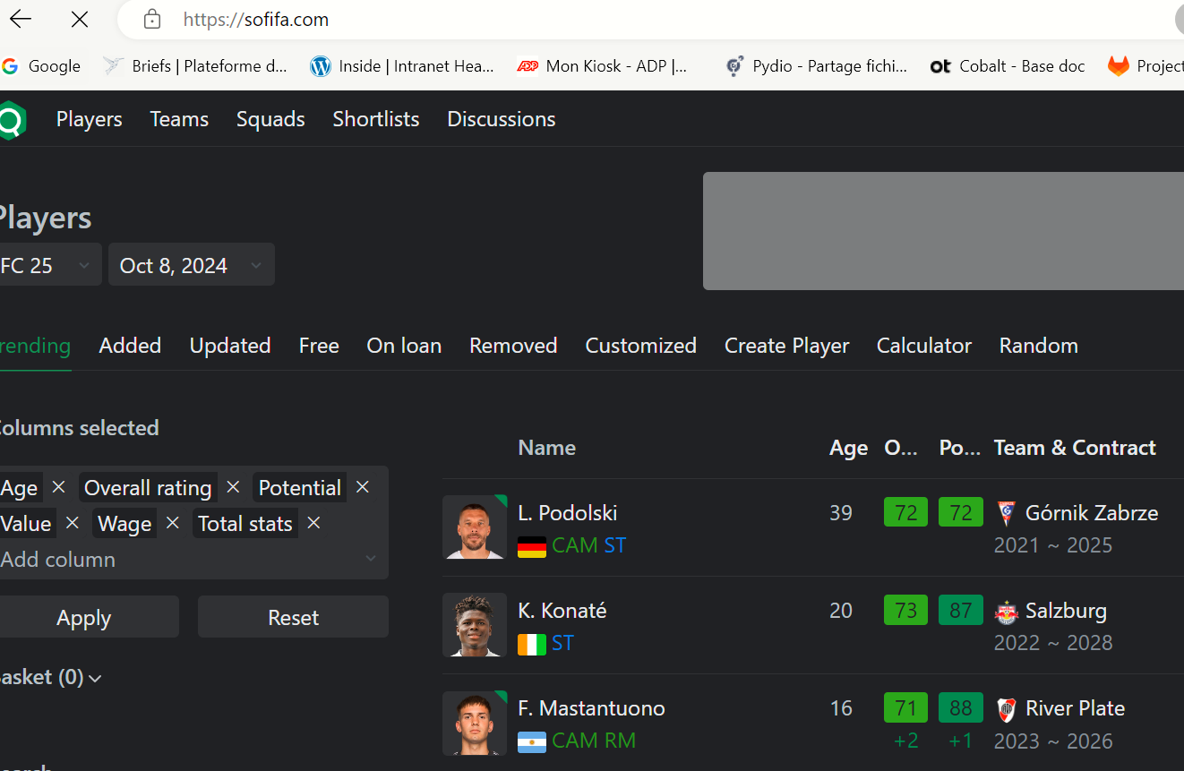
Data sources
SOFIFA

Slide 12
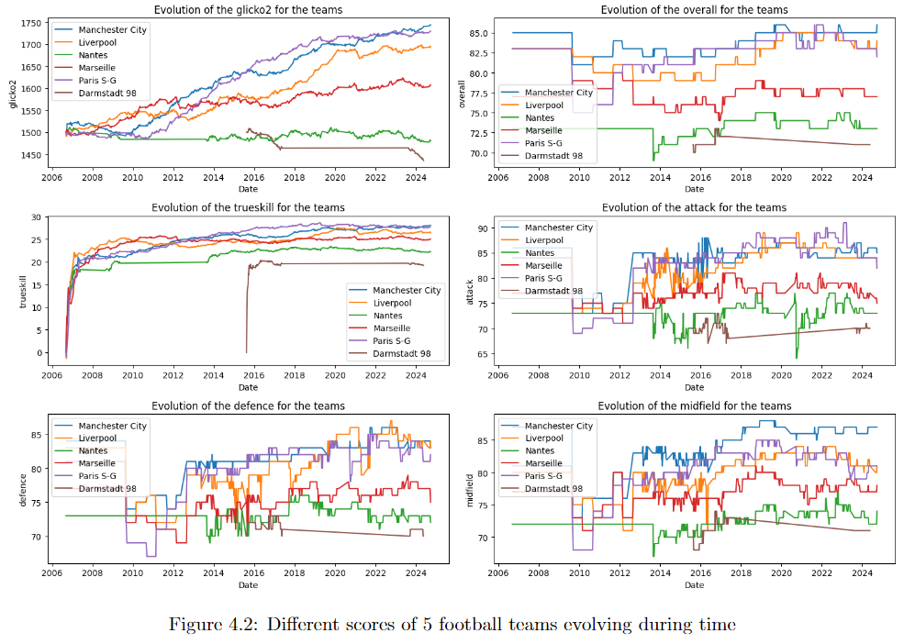
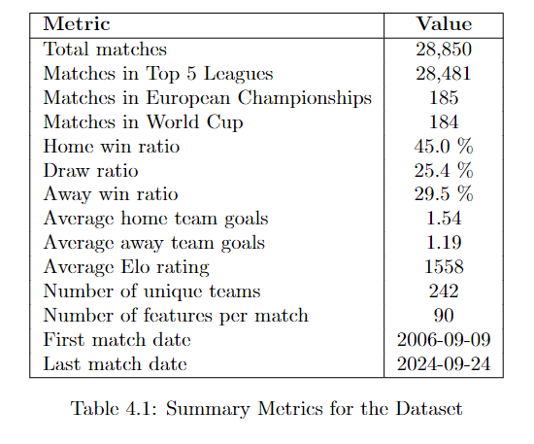
Features and data set
SoFifa features evolving during time for 5 football teams

Slide 13
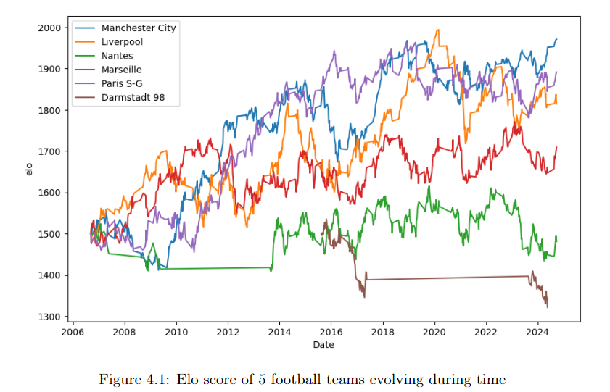
Features engineering

Slide 14
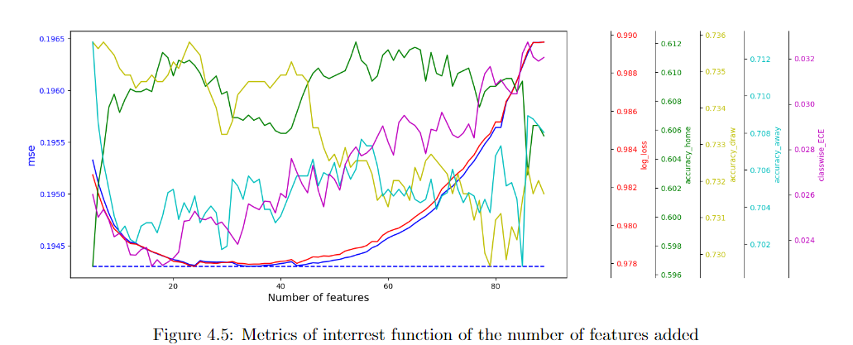
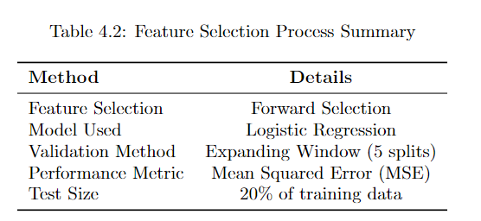
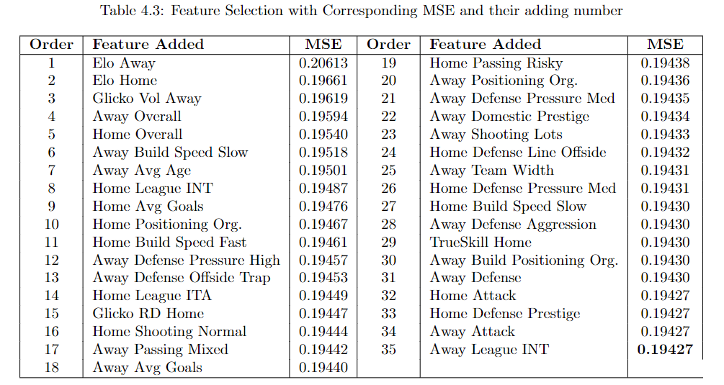
Features selection

Slide 15
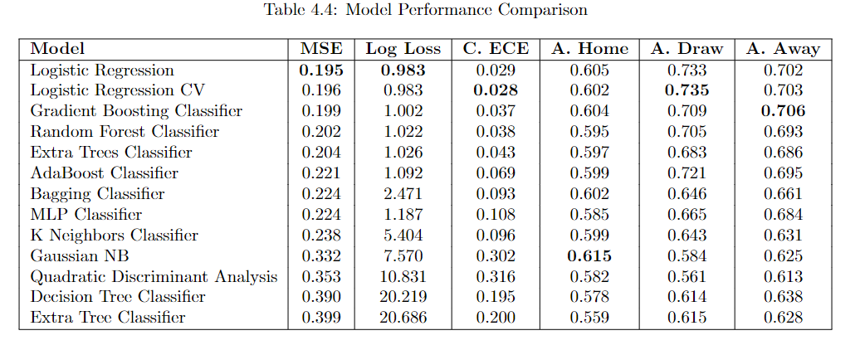
Model selection

Slide 16
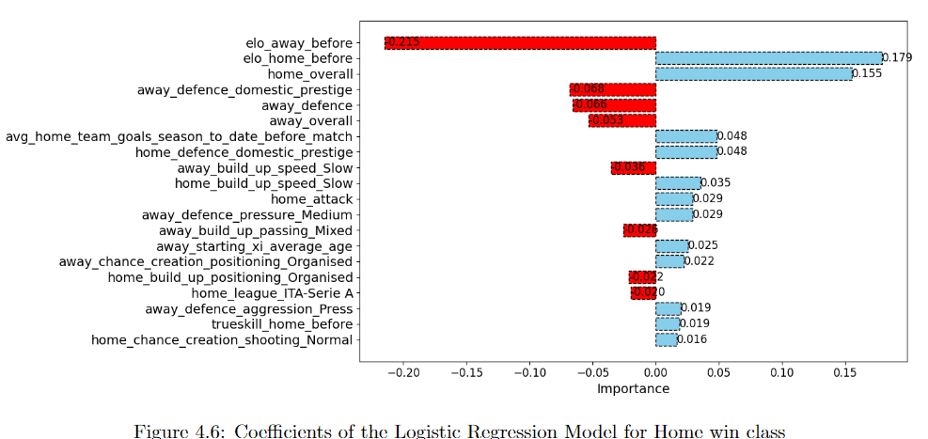
Interpretation

Slide 17
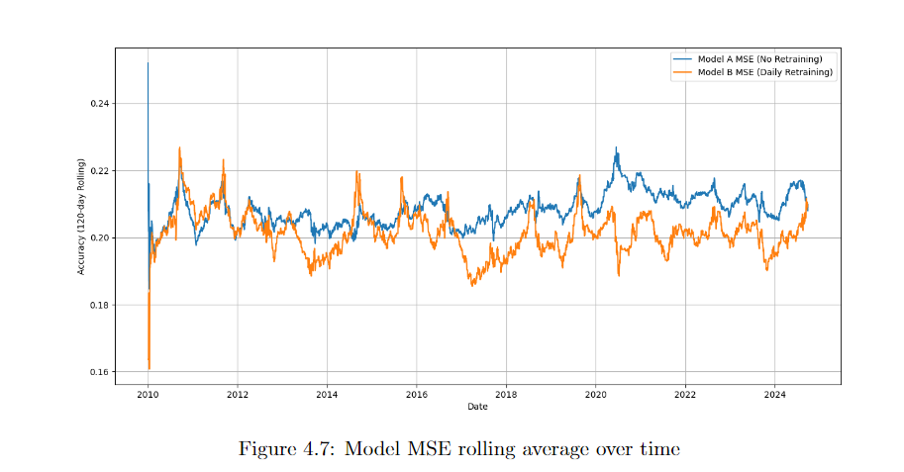
Retraining of the model
MSE

Slide 18
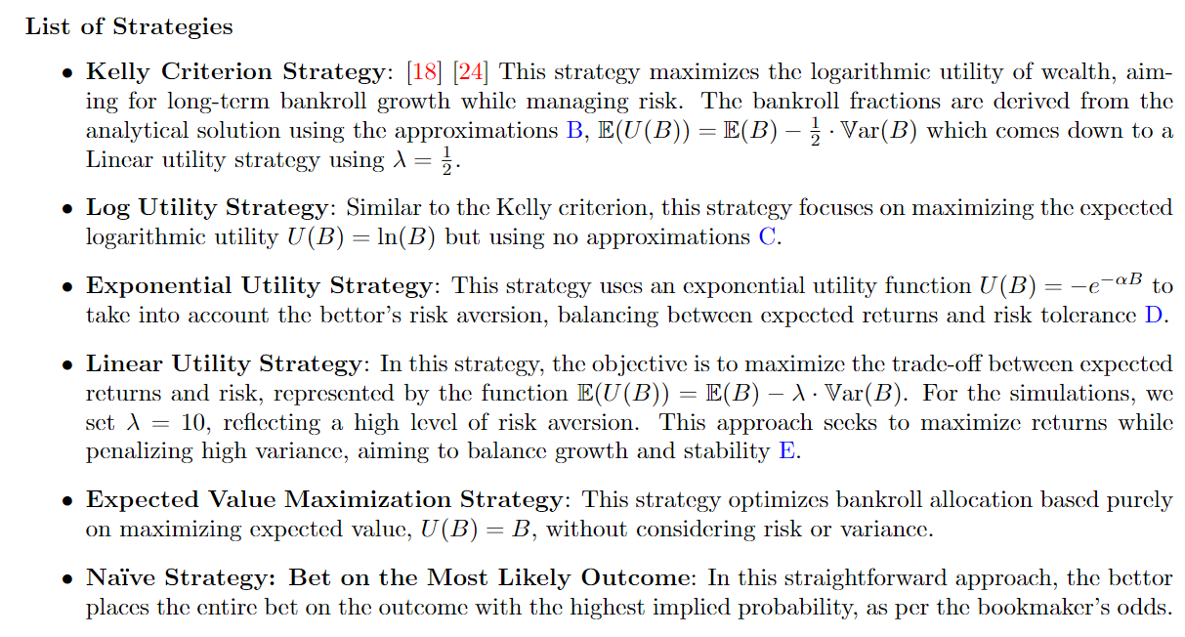
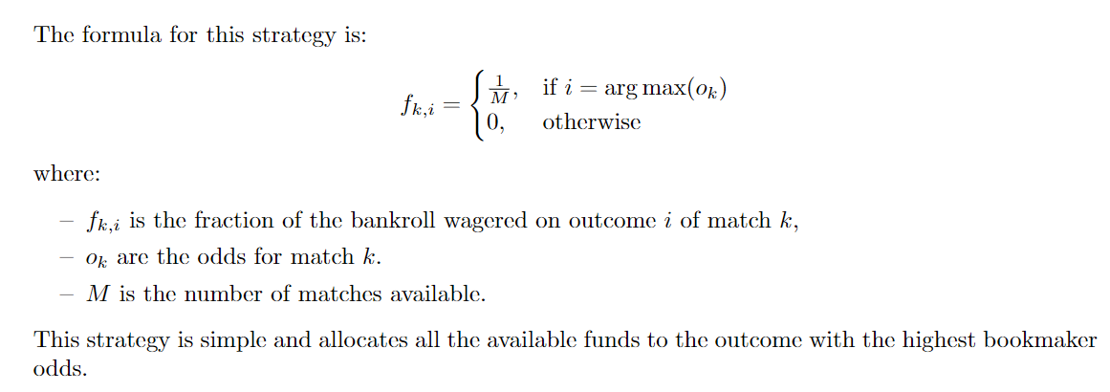
Investement strategies

Slide 19
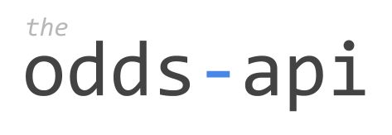
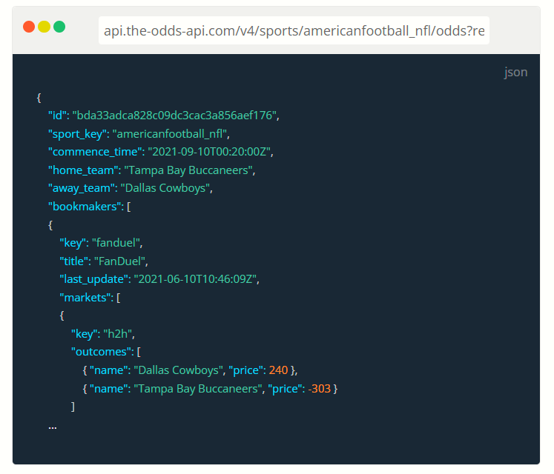
Data source

Slide 20

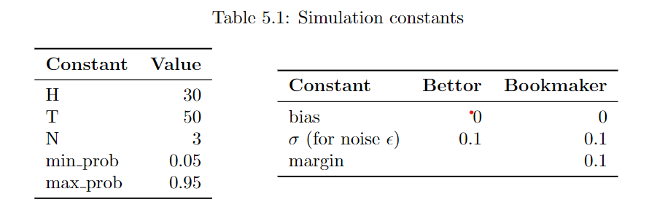

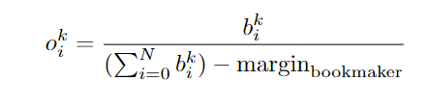
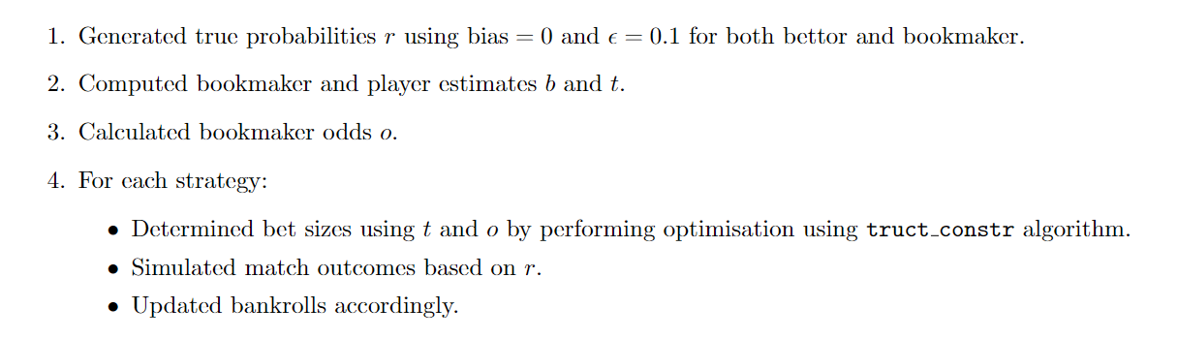
Monte carlo simulations – setup

Slide 21
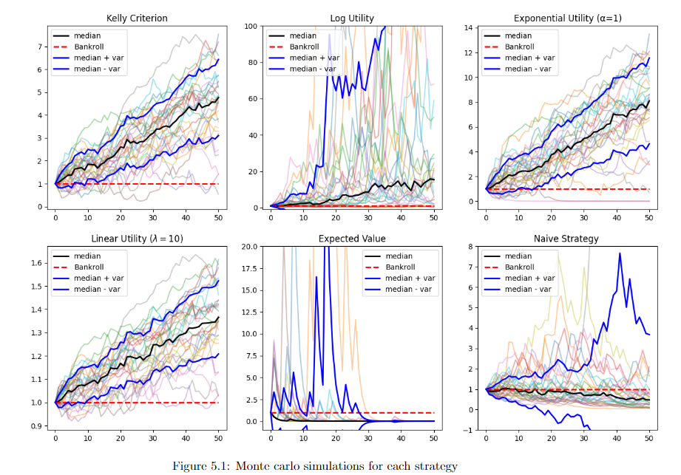
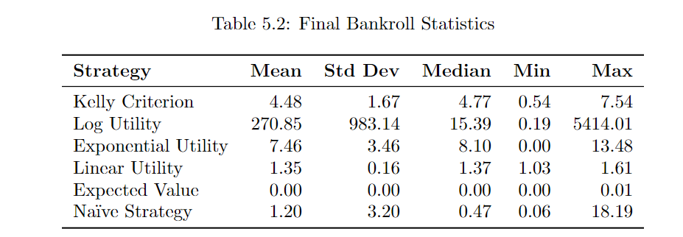
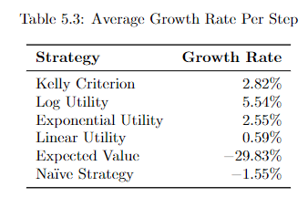
Monte carlo simulations

Slide 22
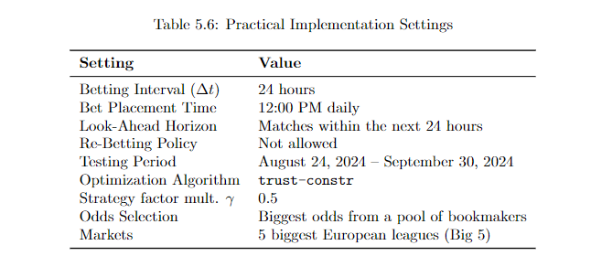
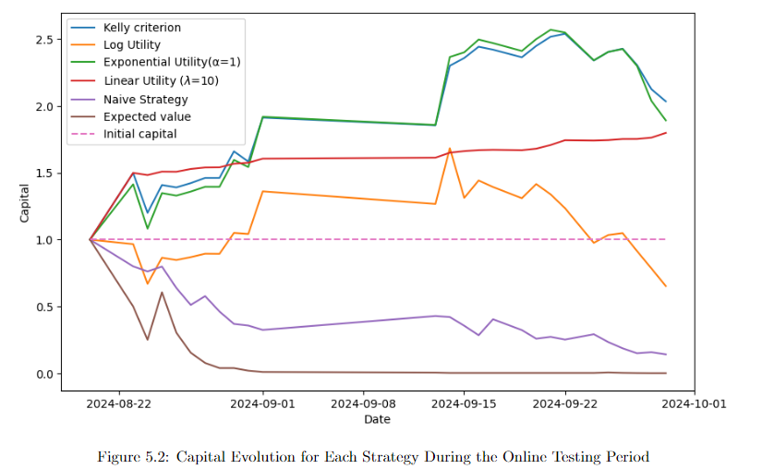
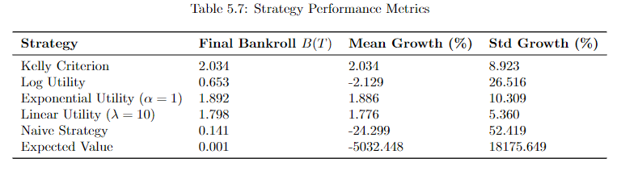
Online testing

Slide 23
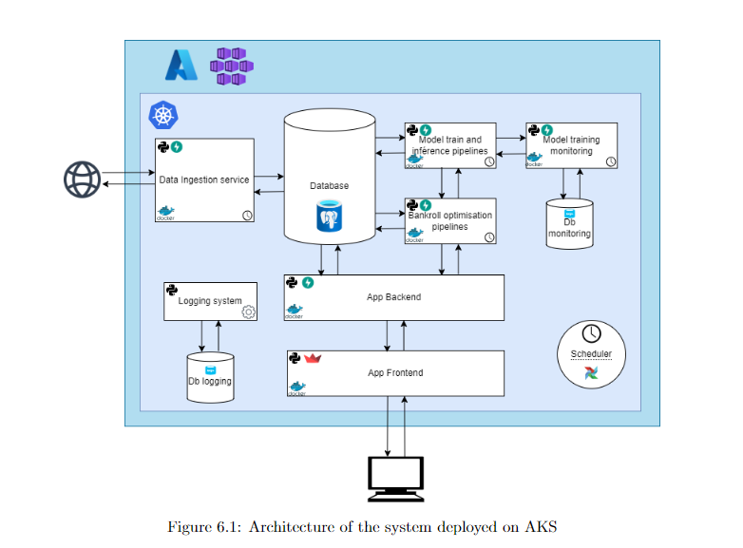
Deployment on AKS

Slide 24
Demo !

Slide 25
Thank you

