Slide 1

Betting on Data: How to Build a Winning Football Prediction Model

Slide 2



Context – End of study internship of ISAE-SUPAERO within Headmind AI Duration: 6 months – March – September 2024
Exploring MLOps practices and cloud deployment solutions to enable data science projects to be pushed to production, run continuously, monitored, and updated.
Major: Data Science and computer science
MLOps department
Working alone under the supervision of a Senior Data Scientist

Slide 3
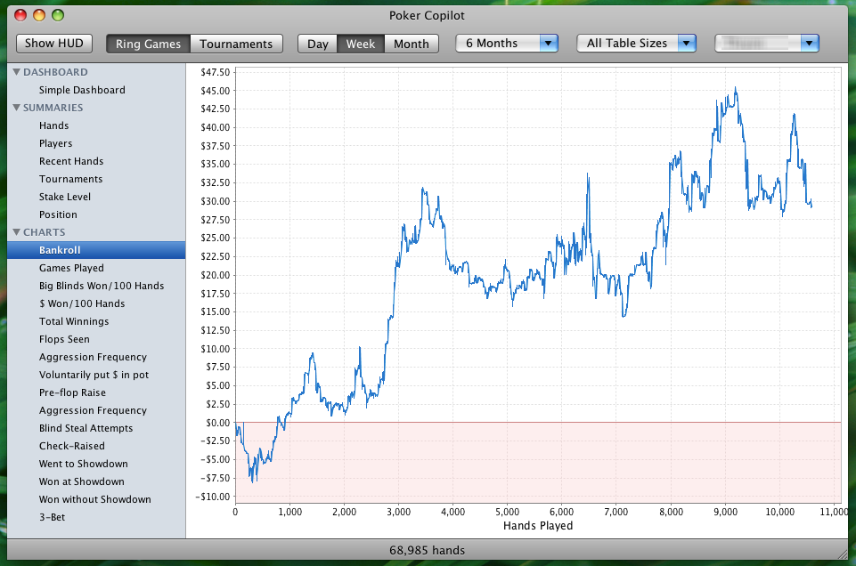
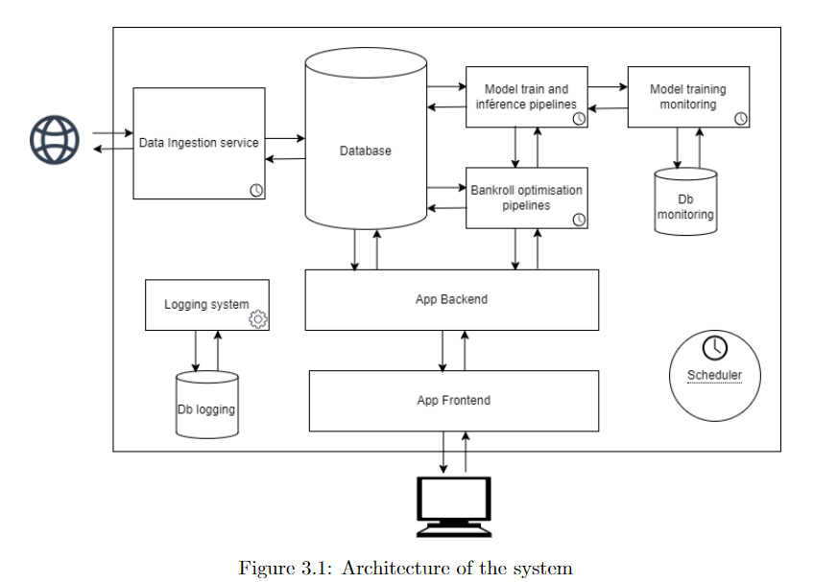
Main Objective
Develop a comprehensive system to optimize sports betting strategies in football.

Slide 4

I – Developping a theoritical framework

Slide 5
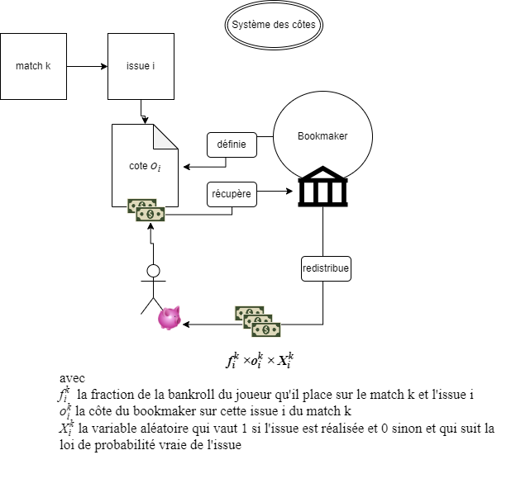
Framework

Slide 6
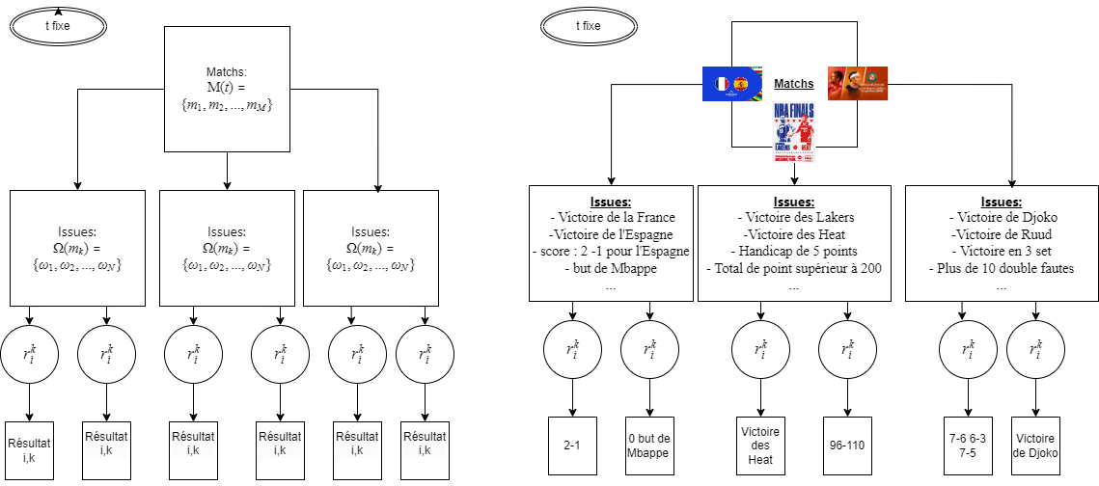
Framework

Slide 7
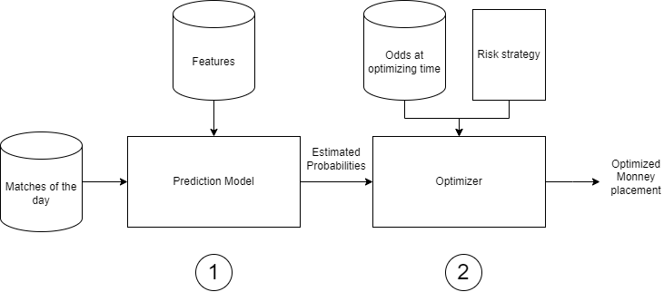
Framework

Slide 8
Design and implementation of the solution

Slide 9

II - Building the prediction model and maintaning it

Slide 10


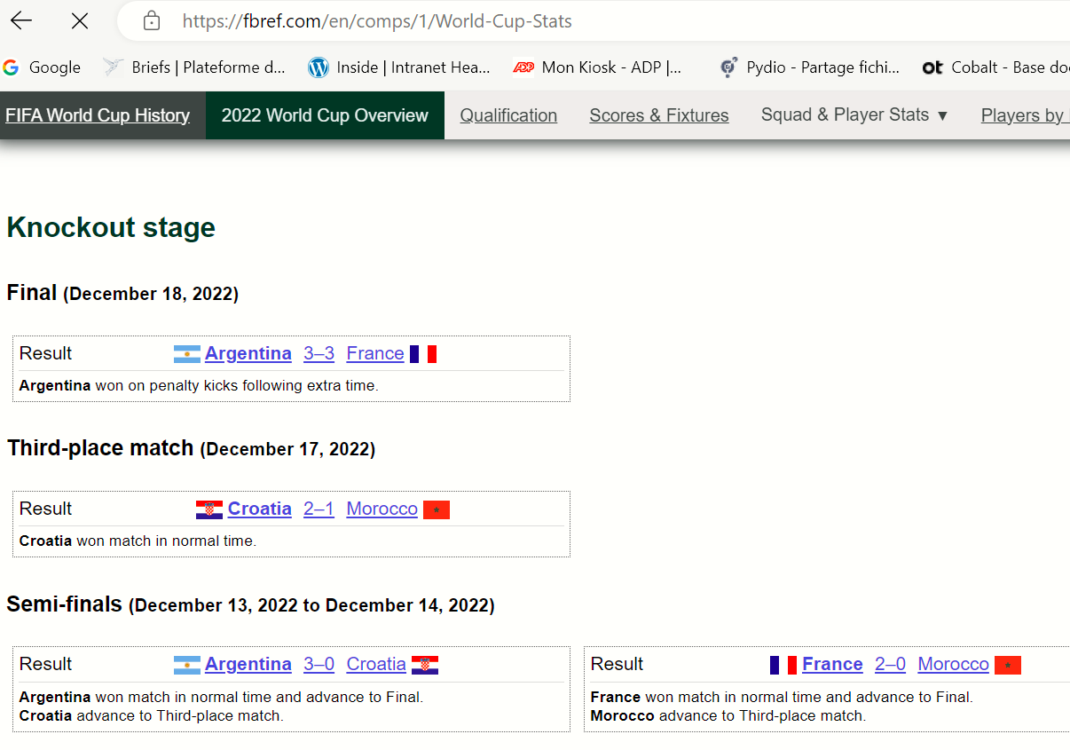
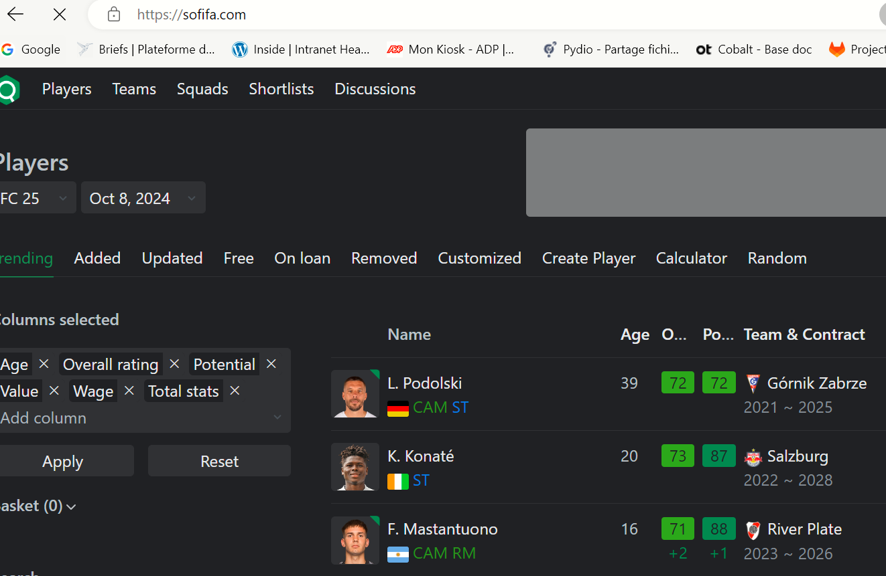
Data sources
SOFIFA

Slide 11
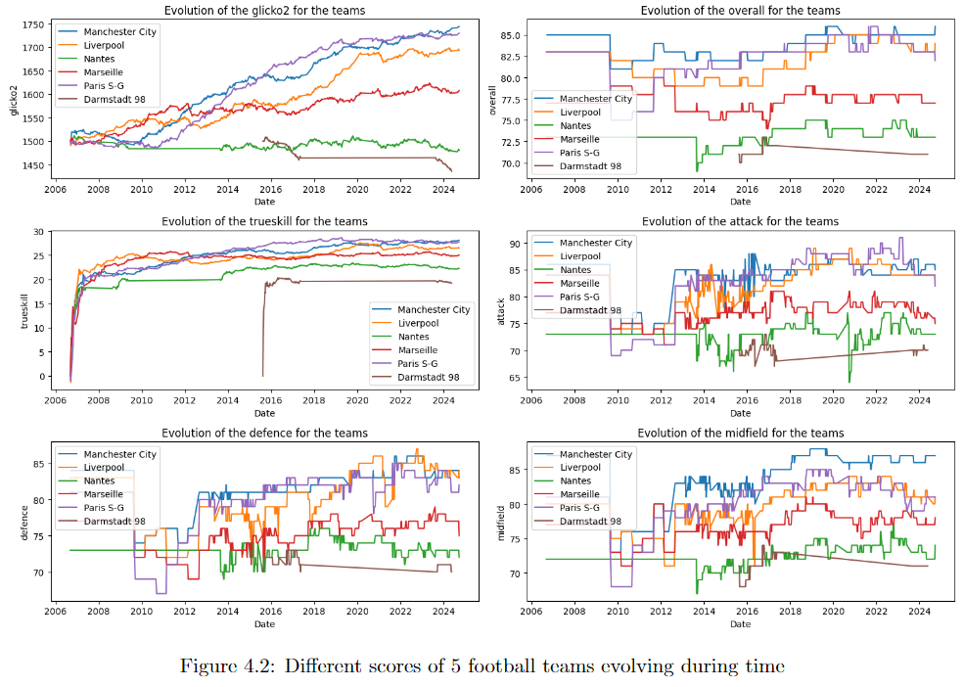
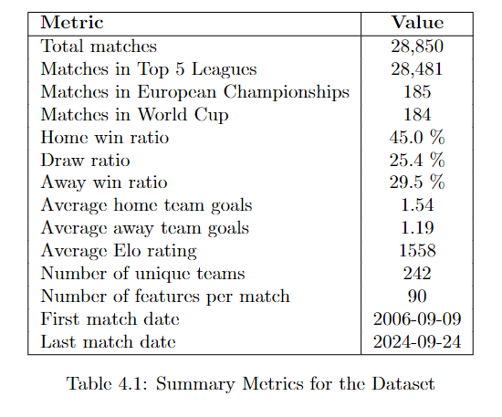
Features and data set
SoFifa features evolving during time for 5 football teams

Slide 12
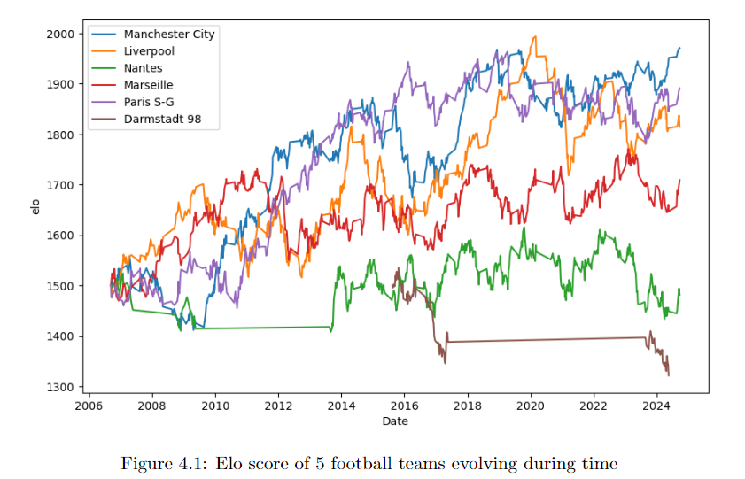
Features engineering

Slide 13
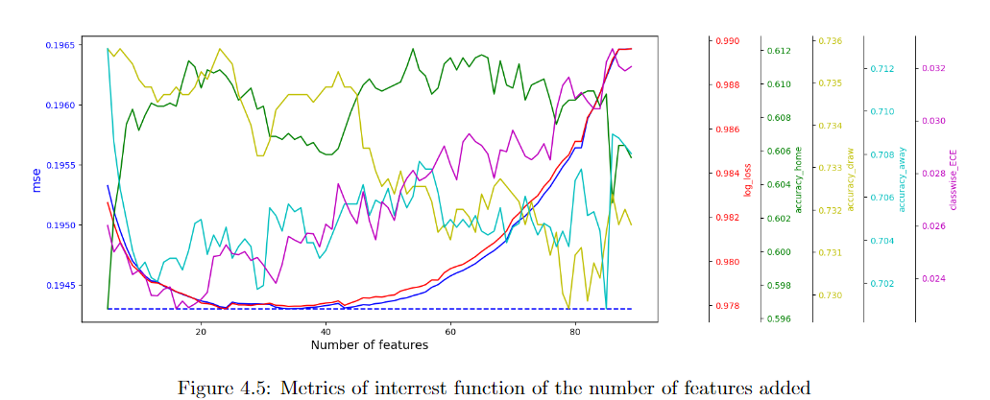
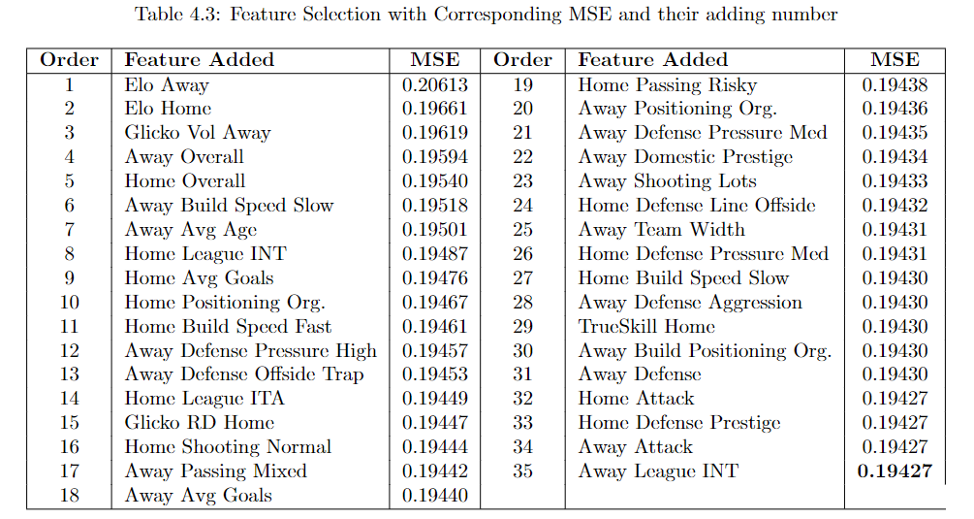
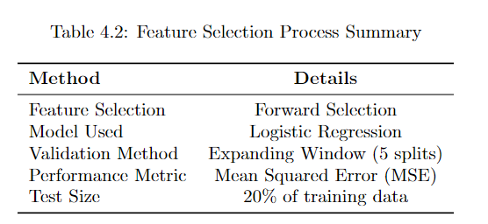
Features selection

Slide 14
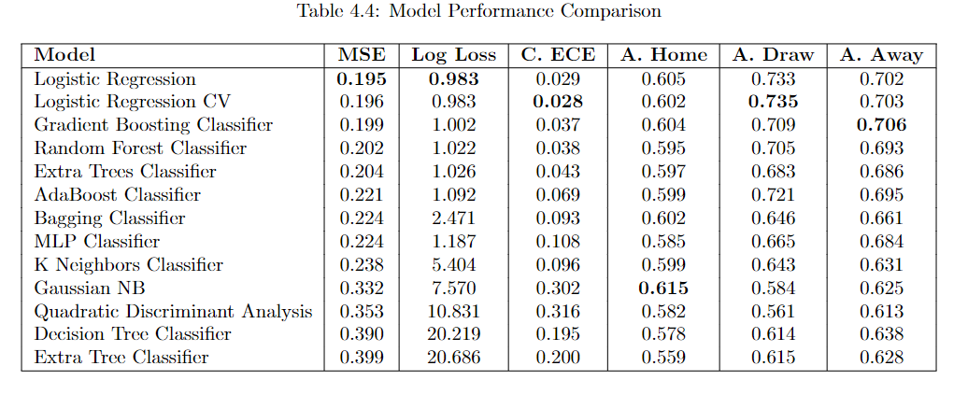
Model selection

Slide 15
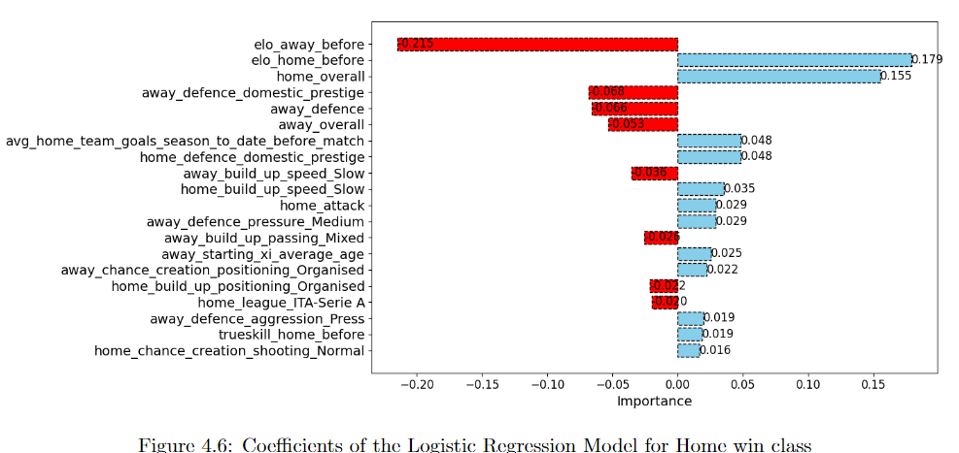
Interpretation

Slide 16
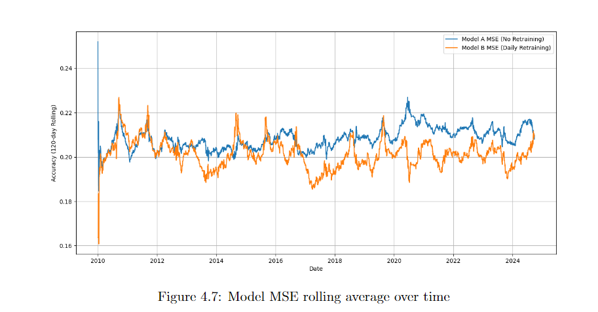
Retraining of the model
MSE

Slide 17

III – Investement strategy (optimizing) and testing

Slide 18
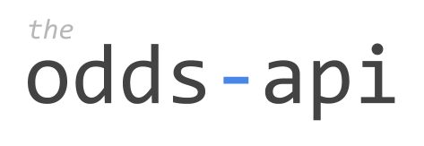
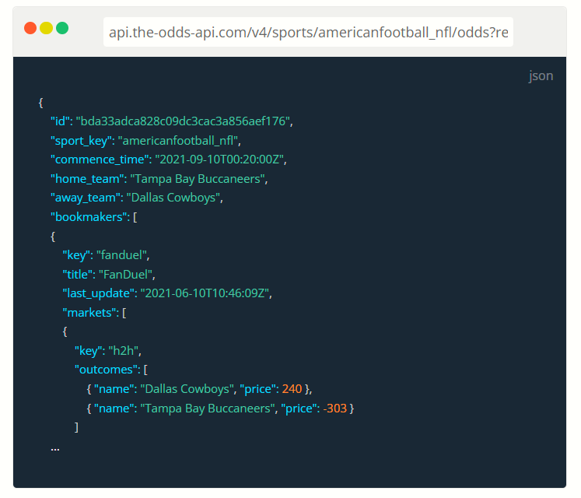
Data source

Slide 19
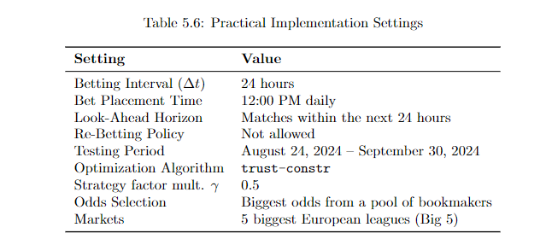
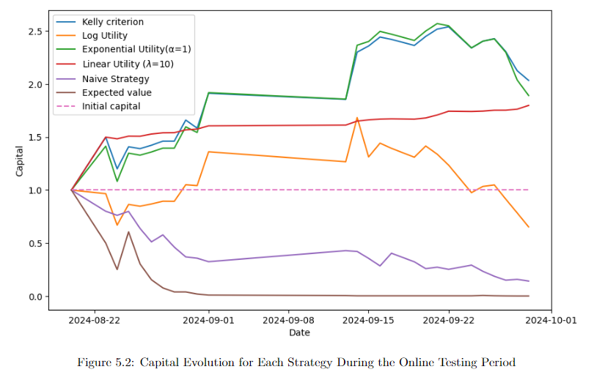
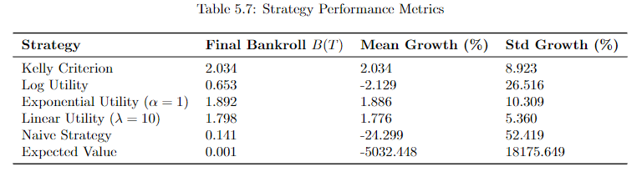
Online testing

Slide 20
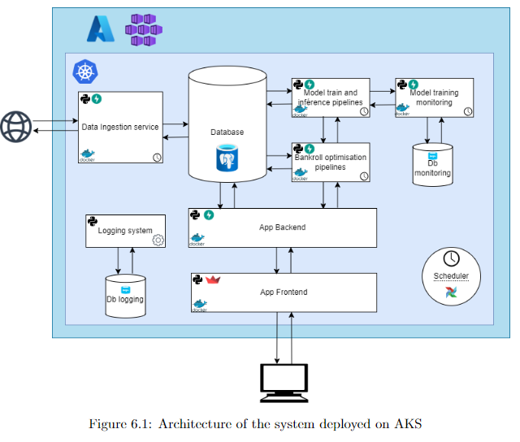
Deployment on AKS

Slide 21
Demo !
https://optibet.delavande.fr/

