Slide 1
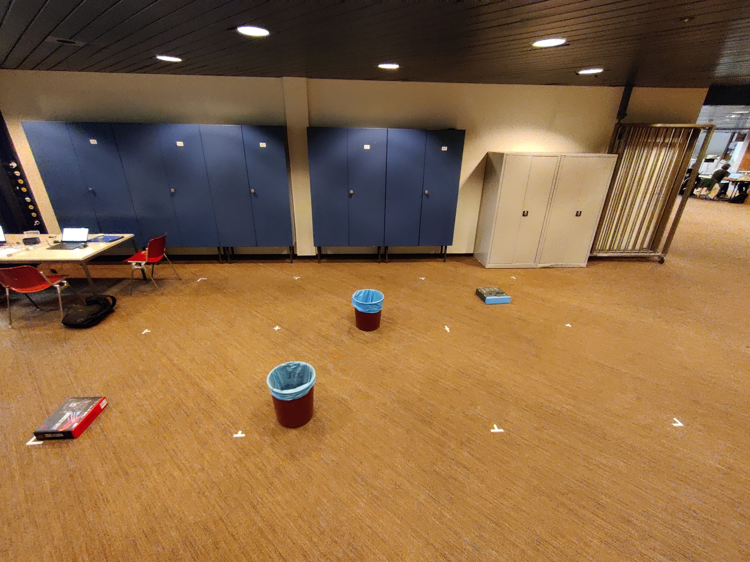
Experimental Setup
Landing Pad
Obstacle
Avoidance
Home Pad
Augustin Mohr
Nicolas Cavedon
Christopher Stocker

Slide 2


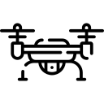

Strategy
Searching pattern
Generate hardcoded waypoints
Follow the waypoints
Avoid obstacles with repulsive force to avoid collisions, and inserting new waypoints to dodge the obstacle
Ends when a positive edge is detected
Landing Sequence
Center in x and y of the landing pad using negative edges
Land on the pad
Returning home
Take off from landing pad
Return to home waypoint
Concentric search of the home pad
Landing sequence
x
Augustin Mohr
Nicolas Cavedon
Christopher Stocker
y

