Slide 1
Jedi Tournament Manager
By Elian Cocchi, Paul Ferraron, Antoine Joulia, Victor Sallard & Julien Usson

Slide 2

Project Management

Slide 3
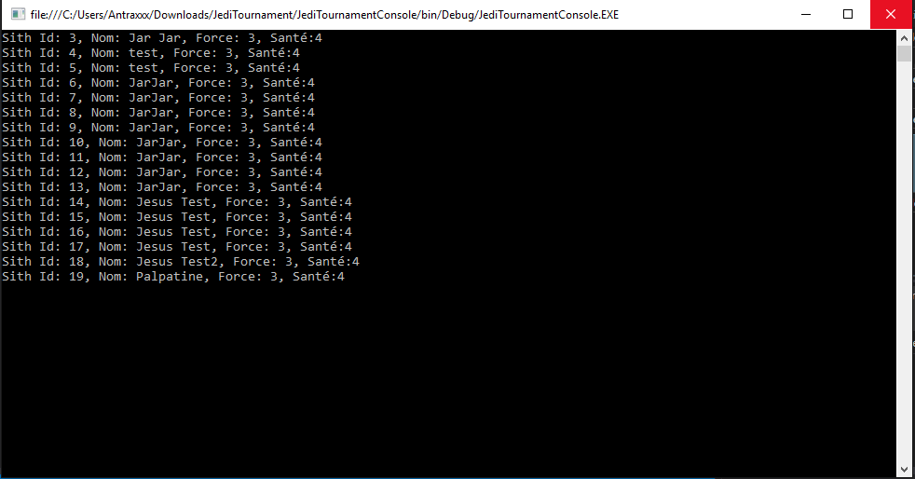
Console Application
Displays database information

Slide 4
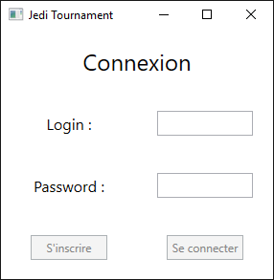
WPF Application
Login / Sign in

Slide 5
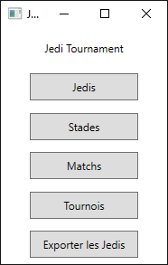
WPF Application
Menu

Slide 6
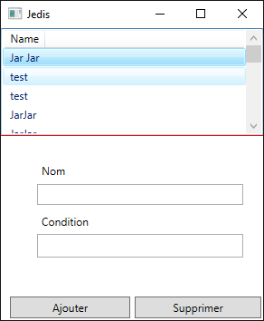
WPF Application
Jedi management

Slide 7
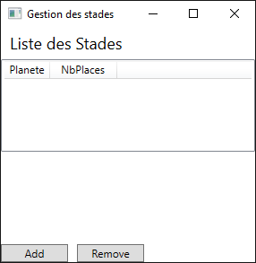
WPF Application
Stadium Management

Slide 8
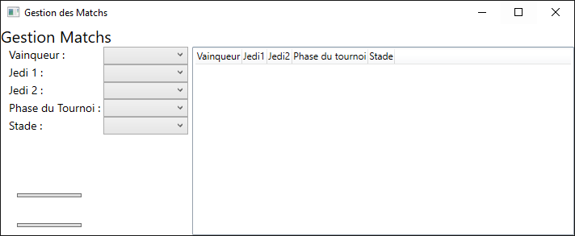
WPF Application
Match Management

Slide 9
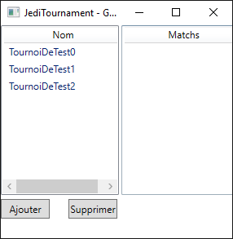
WPF Application
Tournament Management

Slide 10
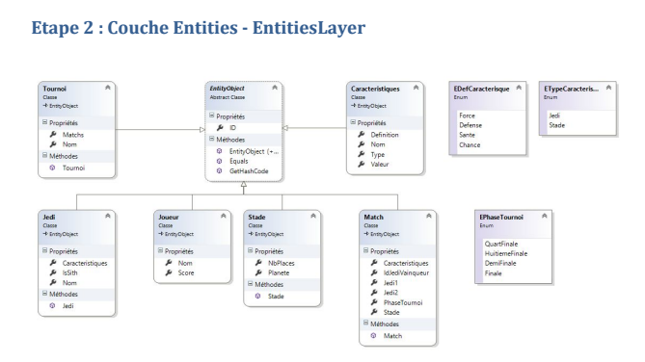
Database

Slide 11
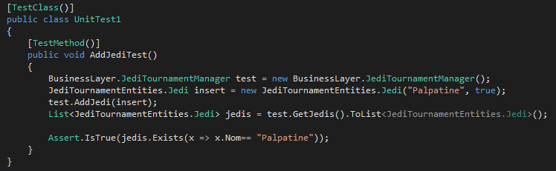

Unit Testing

Slide 12
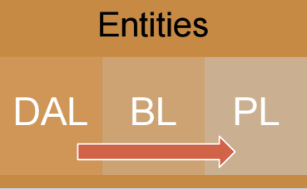
Architecture

