Slide 1
ACADEMY :
Education statistics exploration to determine markets abroad.
december 2022 – Julien Le Boucher

Slide 2


Goals
Determine a list of countries with a lot of potential clients for Academy.
Assess evolution in those countries.
Priority : where to operate first ?

Slide 3
Plan
Data contents and quality.
Data selection for score computing.
Markets ranking and comparisons.
Projections.
Conclusions.

Slide 4
The material
5 CSV files from the world bank open data.
    Global information about countries ;
    Information about observed indicators ;
    Description/source of series ;
    footnotes ;
    The main data.

Slide 5
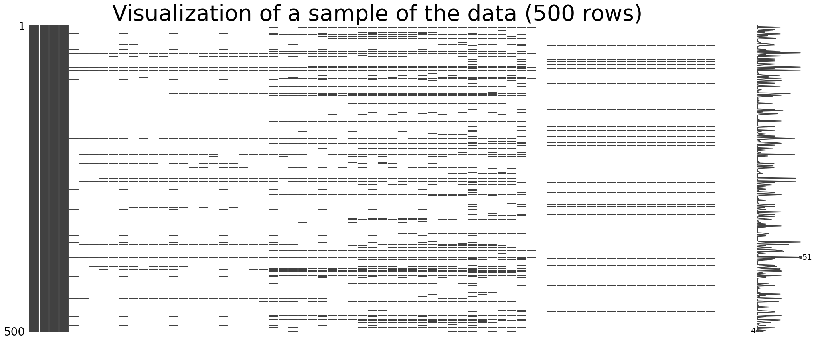
Data familiarization
- Data matrix shape : 886 930 rows x 70 columns.
- Percentage of missing data : 86 %.

Slide 6
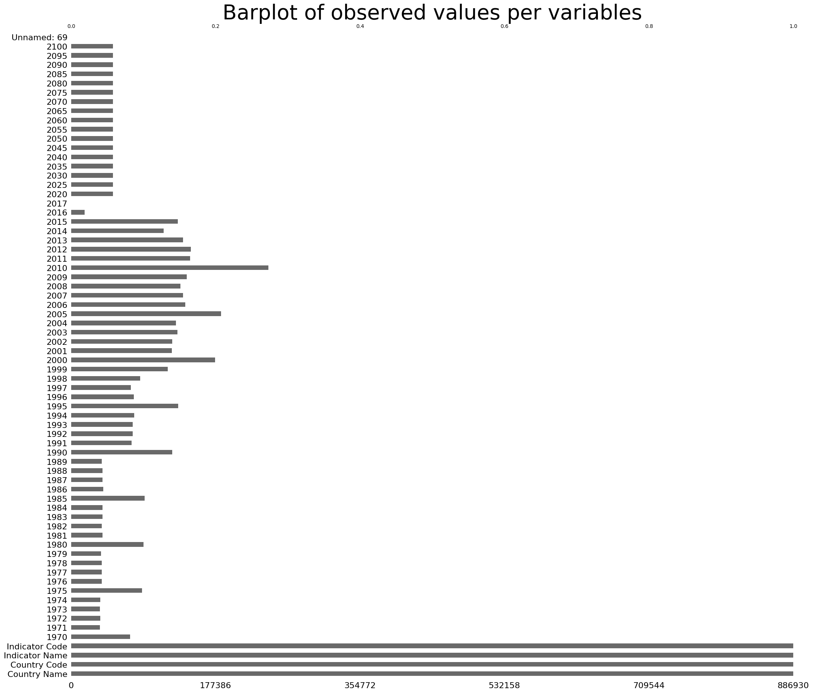
Observed values and columns meaning
  4 columns of text information about the country and the statistic observed.
  65 columns of years of observation :
    Historical data : 1970 -2016
    (each year).
    2017 (year of data gathering).
    Wittgenstein projections : 2020-2100
    (step = 5 years).
  1 unnamed column : to be discarded.

Slide 7
Data set quality
No duplicates found filtering on
(country / indicator name) in text columns.
Some duplicates where found in time-series
  → seemed reasonable.
  examples :
    « Theoretical duration of pre-primary education (years) » can be the same in many countries.
    An observation on the global population was also assigned to the female population.

Slide 8
Data set quality conclusion
Well-sourced data.
High percentage of emptiness.
No obvious duplicates.
Last historical data observed : 2016.
→ Select well-provided indicators (at least 5 values observed in the 2010-2016) and relevant to Academy’s business.

Slide 9
Relevant for Academy ?
3 indicators to build.
Potential clients number :
  People in secondary or tertiary education.
  Graduated people.
Access to technology :
  With a knowledge of computer use.
  With access to the internet.
Financial wealth :
  With a strong purchasing power.

Slide 10
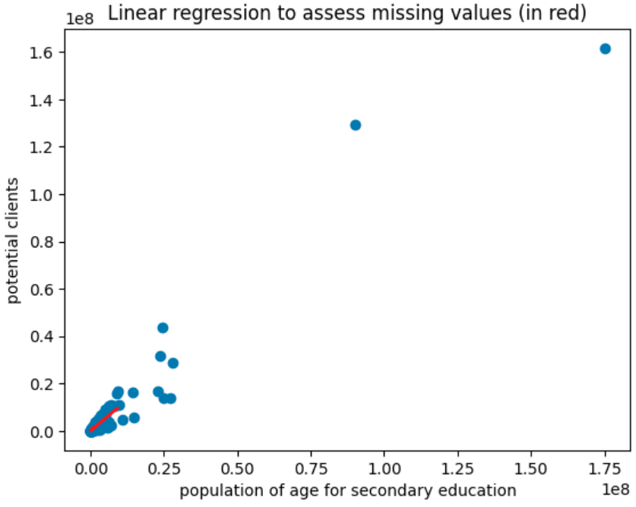
Assessment of the number of potential clients per country
When available for the country, Sum of two indicators :
“Enrolment in secondary education, both sexes (number)”
“Enrolment in tertiary education, all programmes, both sexes (number)”
(177 countries)
If not available, linear regression model :
between previous potential clients number and a highly correlated indicator : “Population of the official age for secondary education, both sexes (number)”
(+20 countries)

Slide 11
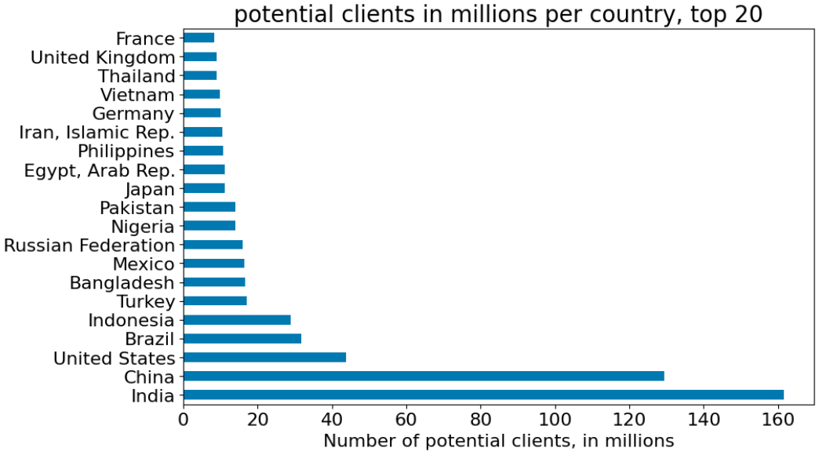
Potential clients : Top 20

Slide 12
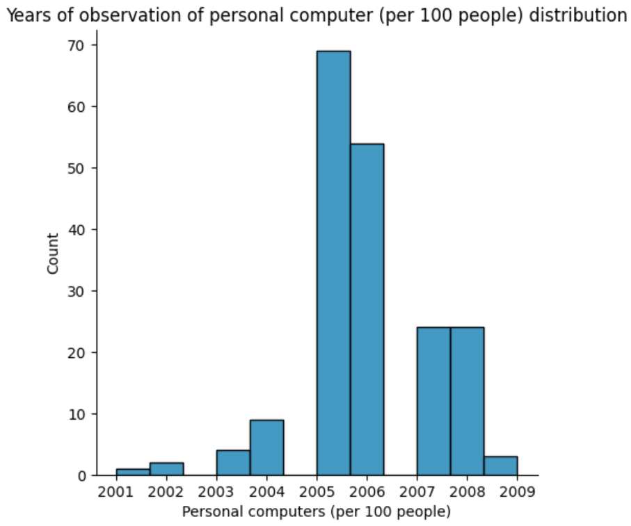
Technology skills per country
Unfortunately, the data set does not allow the assessment of technological skills in a country. Some indicators are available, but they were observed before 2010, or only on very few countries :
- “Personal computers (per 100 people)”
- “PIAAC: Adults by proficiency level in problem solving in technology-rich environments (%).”

Slide 13
Access to technology per country
Indicator used :
“Internet users (per 100 people)”
Definition :
individuals who have used the Internet (from any location) in the last 3 months. The Internet can be used via a computer, mobile phone, personal digital assistant, games machine, digital TV etc.

Slide 14
Financial Wealth per country
Indicator used :
“GDP per capita, PPP (current international $)”
Definition :
gross domestic product per capita, based on purchasing power parity.
It uses the prices of specific goods to compare the absolute purchasing power and readjust the standard GDP.
→ A Boost for emerging countries in the ranking.

Slide 15
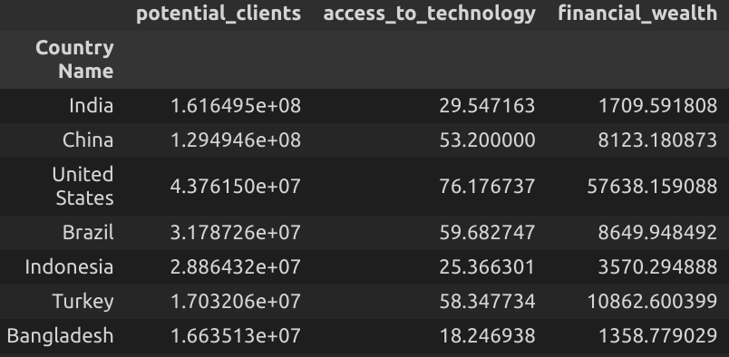
synthesis
Values provided for 194 countries.

Slide 16
Scoring function
Score = potential_clients * access_to_technology * financial_wealth
Score and $ are homogeneous.

Slide 17
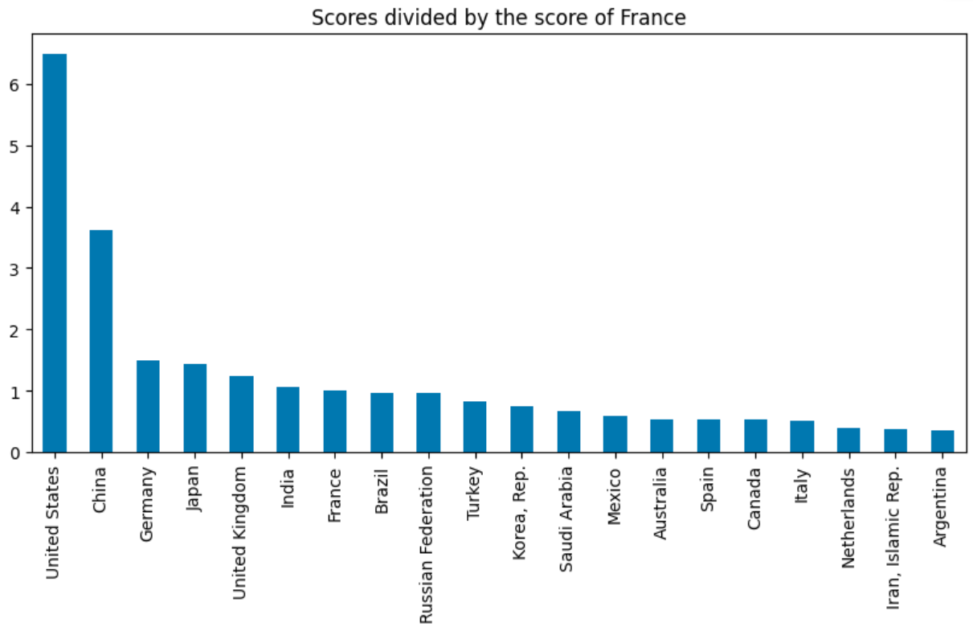
Results (2016)
The US and China seemed to be significantly the best countries to invest in, in 2016.

Slide 18
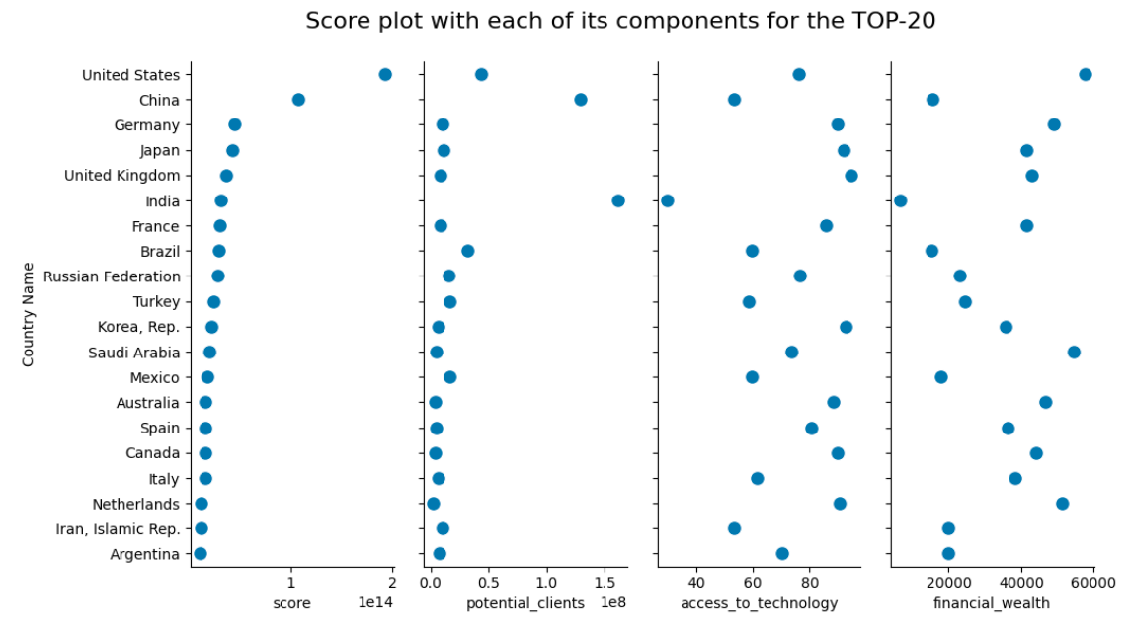
Results (2016)

Slide 19
Projections
Since 2016, evolutions might already have been huge for some countries regarding the access to technology.
It is probably going to converge toward 100 % for many countries quite fast. Having less impact on the ranking in the future.
Clients number and financial wealth must be looked at projection-wise.
The data only provide projections of clients number.

Slide 20
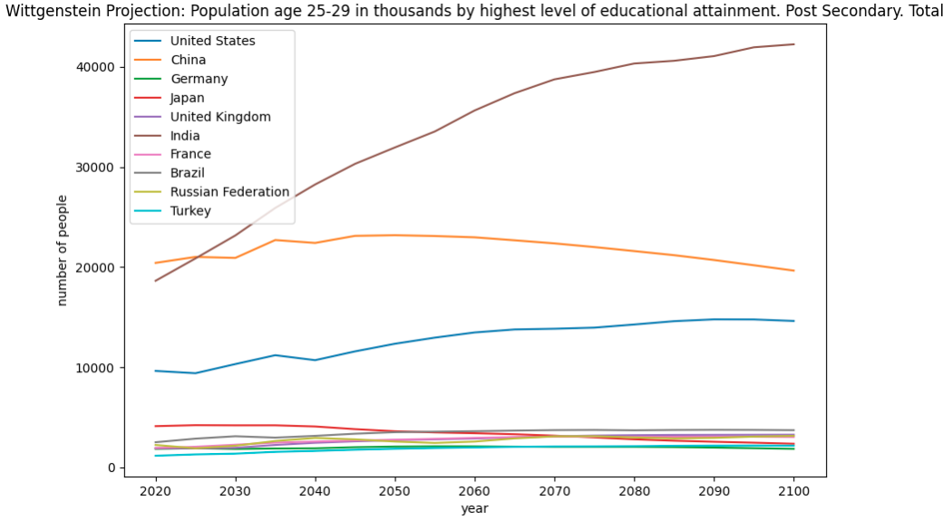
Number of well-educated people in the age range 25-29 per country

Slide 21
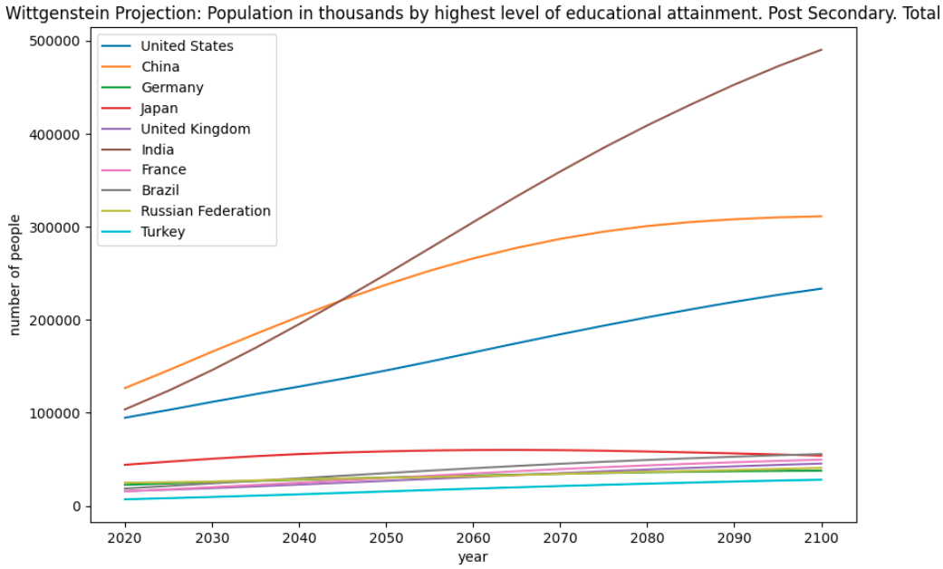
Number of well-educated people in the global population per country

Slide 22
Conclusion
No risk of decrease in the top 10 countries concerning high-graduated people number. The US (1) and China (2) are solid investments because the demographic projections confirm important growths and they already are ahead.
If India was 6th in the score ranking in 2016, It might become the first in 20 years or so. Indeed, the internet infrastructures are going to evolve, for example with the 5G, and the demographic gap will be an advantage.
Brazil could also become important at some point.

