Slide 1

Energy consumption
and
Greenhouse gases emission predictions
for the non-residential properties of Seattle.
Julien Le Boucher 03 - 31 - 2023

Slide 2
Plan
Context / motivation of this mission.
Work on the dataset and modelling approach
The best model and its performance.

Slide 3

Seattle's Climate plan Objectives
The city objectives :
zero net core greenhouse gas emission by 2050.
Sector-specific emissions reduction goals of 39% from building energy by 2030 comparing to 2008.
My missions :
Predict :
Energy Consumption
GHG emissions
of Non-residential Buildings from its structural attributes.
Evaluate the impact of the Energy Star Score when used as an input in the models.

Slide 4
Dataset Overview

Slide 5

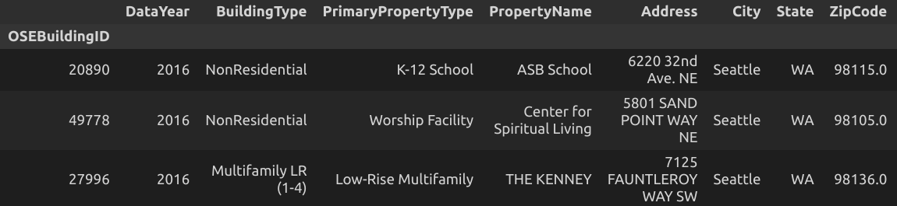
The dataset
information gathered in 2016. Mandatory for all Seattle's properties with a GFA > 20 000 feet square.
3376 properties of Seattle (rows).
45 features (columns).
A chunk of the dataset

Slide 6
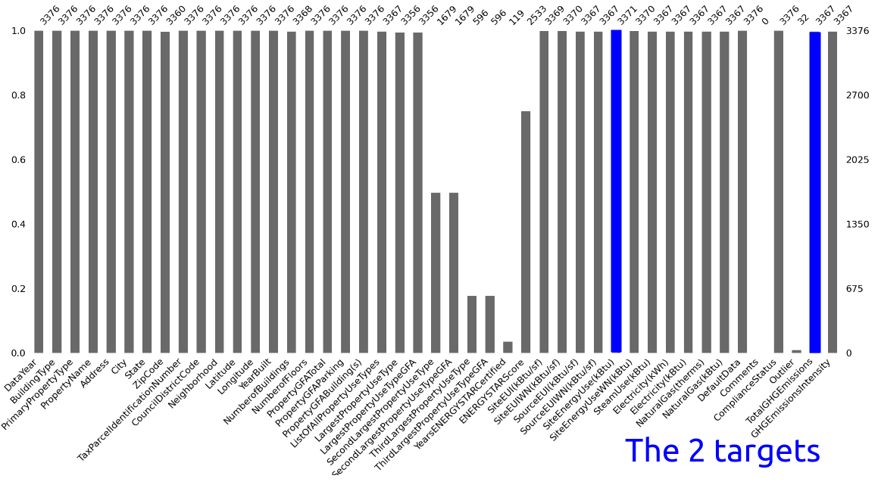
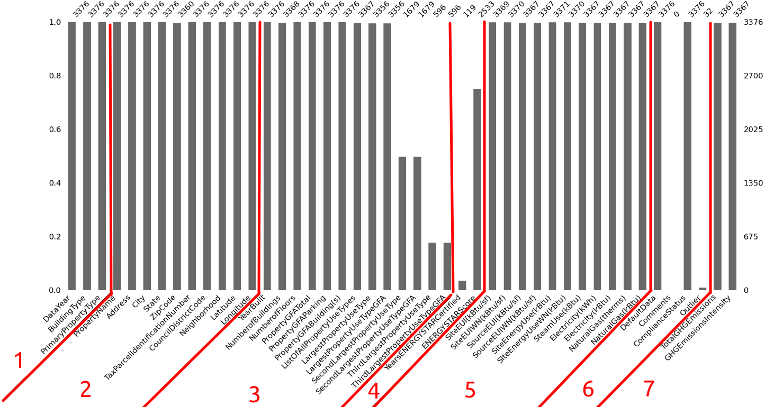
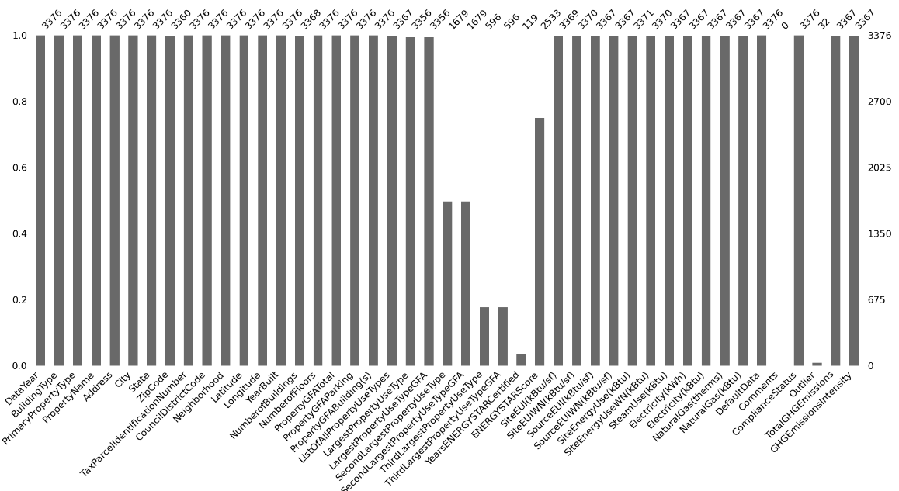
Missing values, Features groups and Targets.
1 - Type and primary use
2 - Name and localization.
3 - Buildings' attributes.
4 - ENERGY STAR Score.
5 - Energy Consumption.
6 - Data Status.
7 - GHG Emissions.

Slide 7
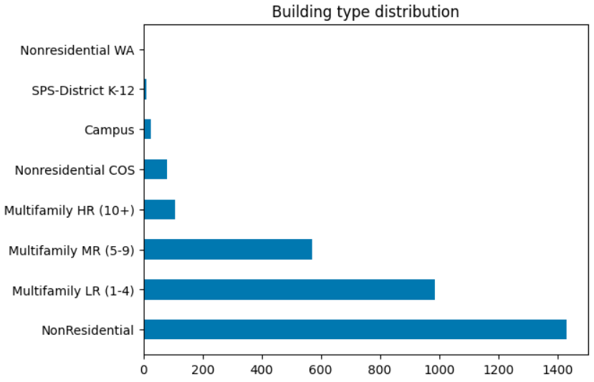
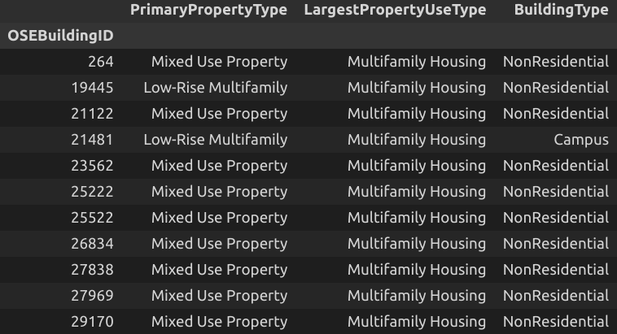
Filtering non-residential properties
Compliant Status → 165 properties discarded (missing or default data)
Filtered on a triplet of features to ensure only Non-Residential properties remained in the data.
3376 properties
1487
properties
Example of inconsistencies found.

Slide 8
EDA on non-residential properties
Features selection motives

Slide 9
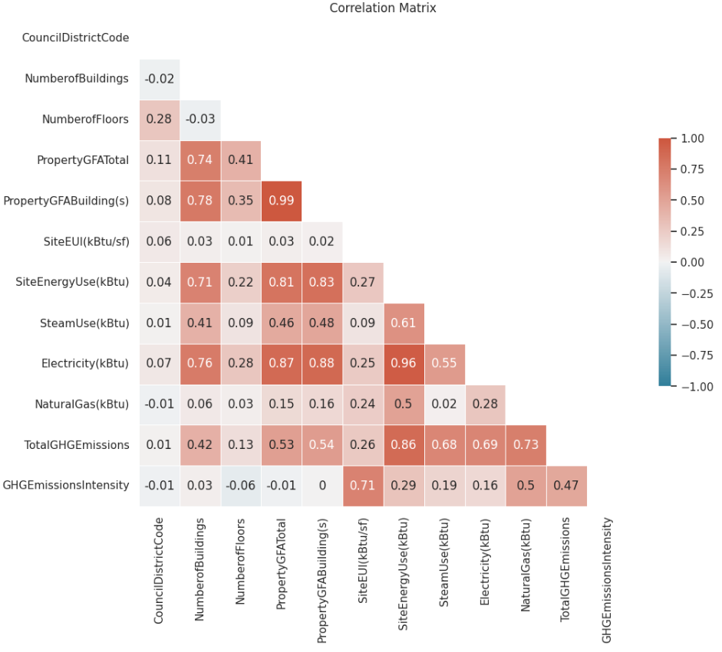
Structural attributes
TARGETS
4 structural attributes out of 5 are correlated with the targets. Thus, should go in the inputs.
Total GFA and buildings' GFA are highly correlated . → Choose only 1 as input to avoid multicollinearity.
Retained Structural Features as inputs :
'PropertyGFABuilding(s)'
'NumberofFloors
'NumberofBuildings

Slide 10
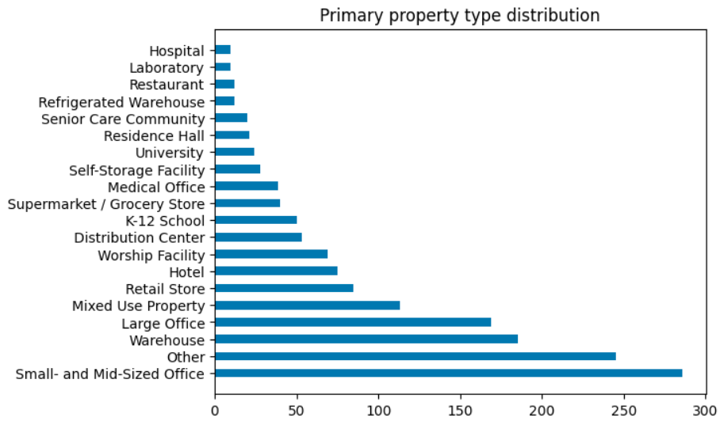
Grouping thanks to 'PrimaryPropertyType'
Enables to split properties in several groups without being too specific (unlike 'LargestPropertyUseType').
One-Hot Encoded dropping one column to avoid multicollinearity.
Correlated with the targets.

Slide 11
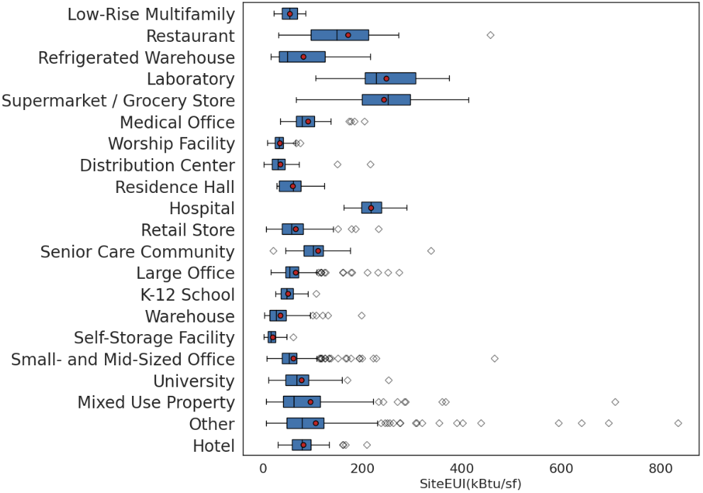
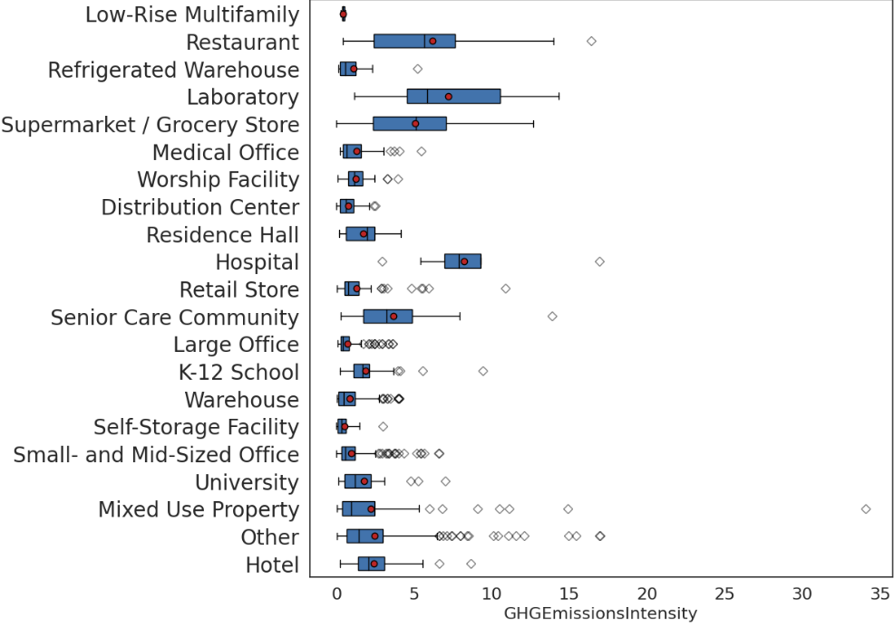


'PrimaryPropertyType' correlations with the targets' intensities
The category has an influence regardless of the surface of the property. Must be feed in the model

Slide 12
Features engineering

Slide 13
4 derived features.
From YearBuilt (date of construction or of a total renovation) → 2023 - YearBuilt = Age
From SiteEnergyUse and the 3 features (Electricity, NaturalGas, SteamUse). → Proportions of energy used per source type which can be seen as structural and should be assessable when building a new structure or renovating.
SteamUseProportion
ElectricityProportion
NaturalGasProportion. Currently not 100% reliable : Outliers problem ?

Slide 14
Models' inputs and targets

Slide 15
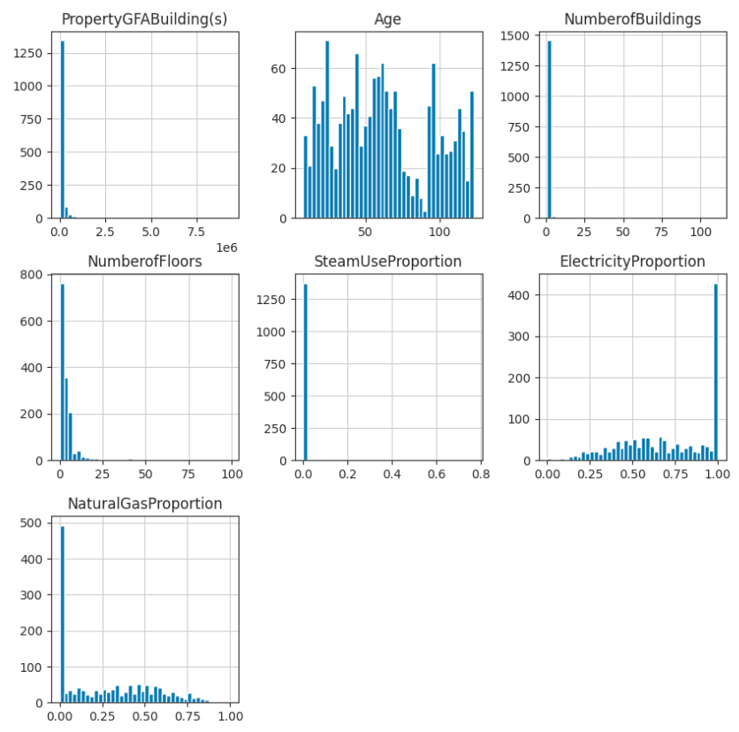
26 inputs
7 numericals inputs
Pre-processing possibilities
The proportions are already scaled between 0 and 1.
All the other features should be scaled? (MinMax, StandardScaler?)
3 skewed distributions. Transformation before going in the model? (log, quantile ?)
19 binary inputs
Primary property type One-Hot encoded feature.

Slide 16
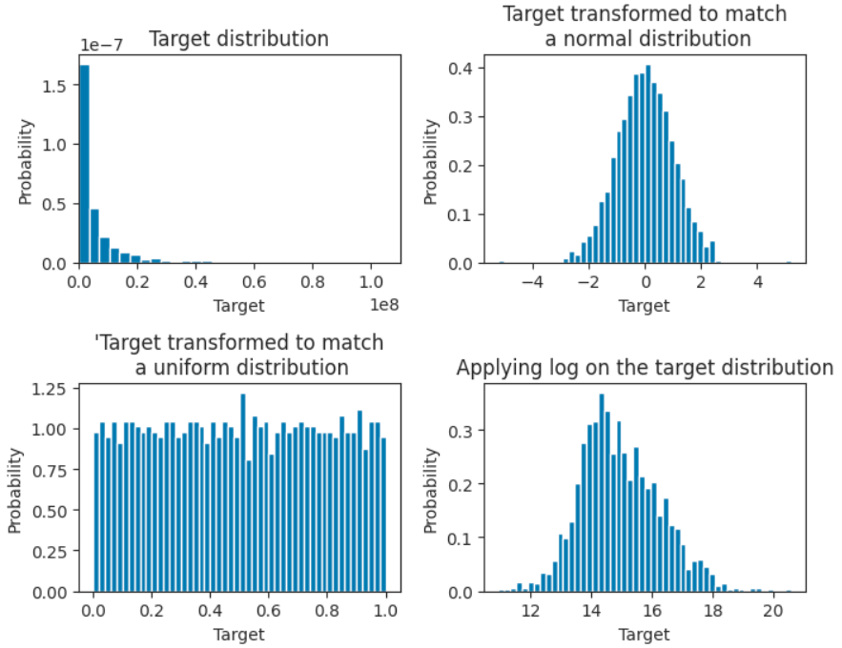
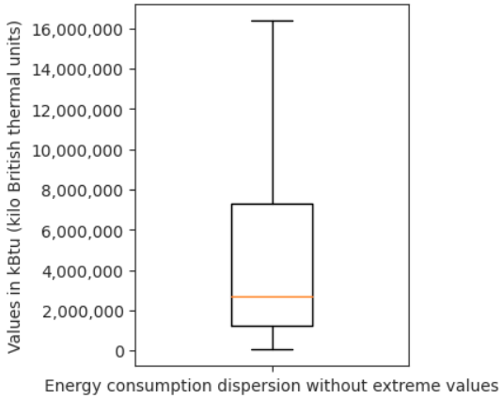
1st target : Total energy consumption (kBtu)
Min : 5 713 kBtu
Max : 874 000 000 kBtu

Slide 17
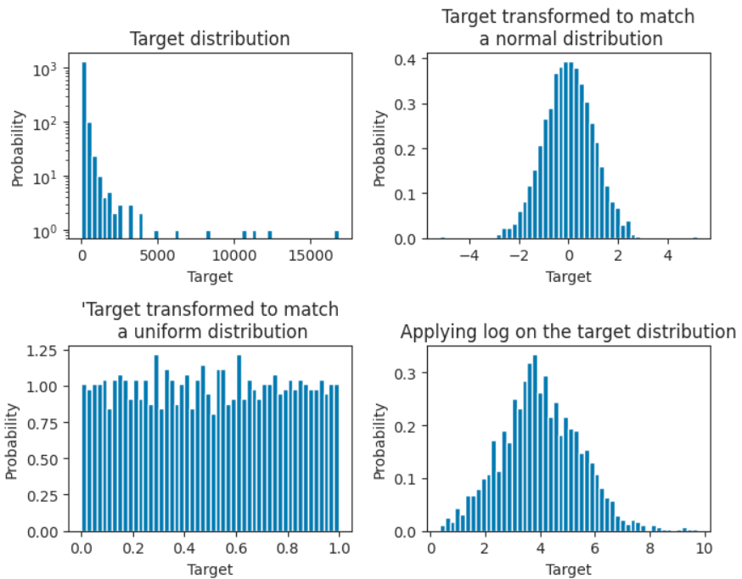
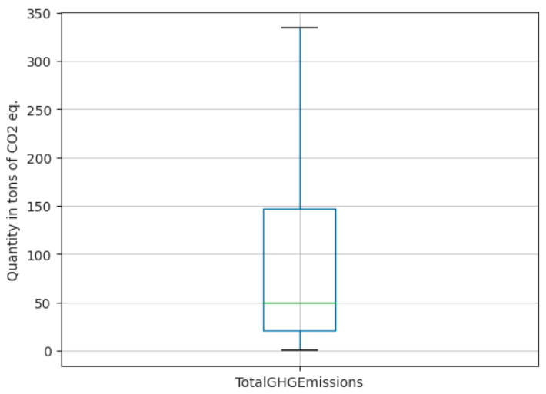
2nd target : Greenhouse gases emissions (in tons of CO2 eq)
Min : 0.4 tons CO2 eq.
Max : 16 870 tons CO2 eq.

Slide 18
Modelling approach
Searching the best model

Slide 19
1
Playing on the modelling steps complexity (1, 2, or 3) and permuting the following elements :
REGRESSOR :
OLS regressor
Lasso
Ridge
ElasticNet
Knn
Random Forest
XGBoost (gbtree)
PRE-PROCESSOR :
passthrough
MinMax
Standard
log transformer
log into the 2 firsts.
quantile transformer
TRANSFORMER :
log transformer
quantile transformer fit on the train set.
Regressor
raw inputs
raw target
2
Regressor
raw inputs
Pre-processor
raw target
raw target
3
transformer
Regressor
raw inputs
Pre-processor
transformed target

Slide 20
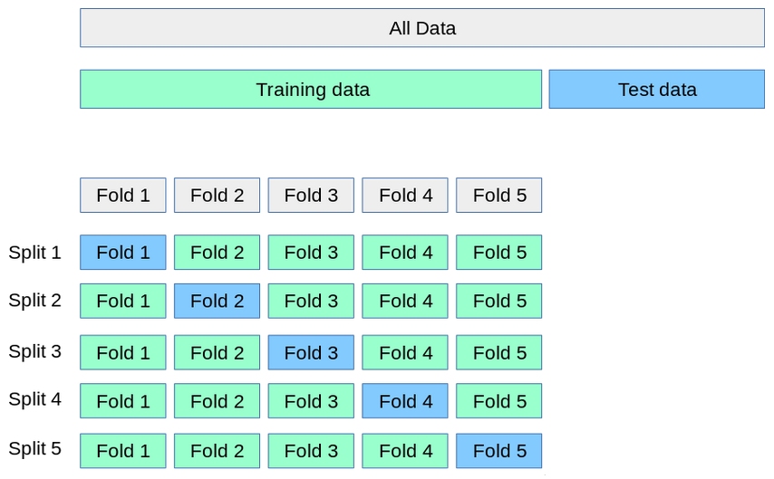
Hyperparameters tuning + evaluation of models' performances.
Test data : 25 % of the data.
Hyperparameters tuning :
Optimized sequentially thanks to grid searches.
Choices made with regard to 3 differents metrics : R2, MAE, RMSE. (can lead to model slightly different)
Optimized the mean score on 5 folds. Kept in mind that minimizing the variance was also important.
Evaluation of the model :
Saved the mean score on folds and the variance.
Compared fitting time on the train set.
Plotted predictions against the real values of the target on the test data.
sklearn's illustration of a 5-fold cross validation

Slide 21
Top scorers models

Slide 22
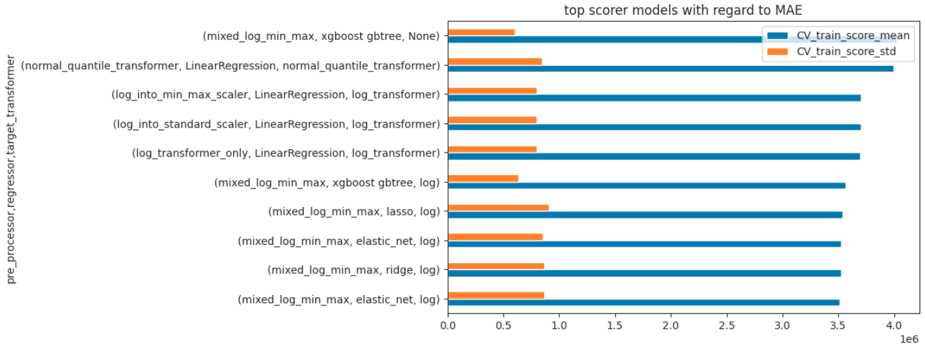
Energy prediction (MAE)
Dummy regressor : MAE ~ 8e6 kBtu
Regardless of the regressor, a log transformation on both skewed inputs and the target gave the best results.
Linear regression models gave the best results.
Interesting to note that the Xgboost model coming close after linear models has a lower variance

Slide 23
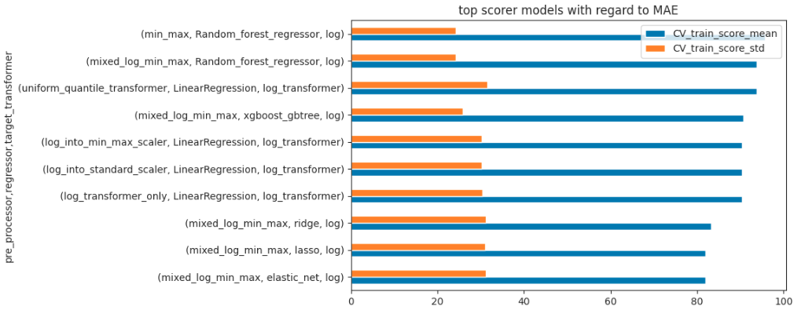
GHG emissions (MAE)
Dummy Regressor : MAE ~ 187 tons CO2 eq
log transformation also very important (inputs and target)
regularized version of linear models outperform the rest more significantly.

Slide 24
Best model for both predictions
raw target
log-transformer
ElasticNet
Log-transformer
and/or
MinMax scaler
raw inputs
transformed target
Note that results are fairly consistent when evaluating with the R2 , MAE and the RMSE metric.

Slide 25
Energy Star score

Slide 26
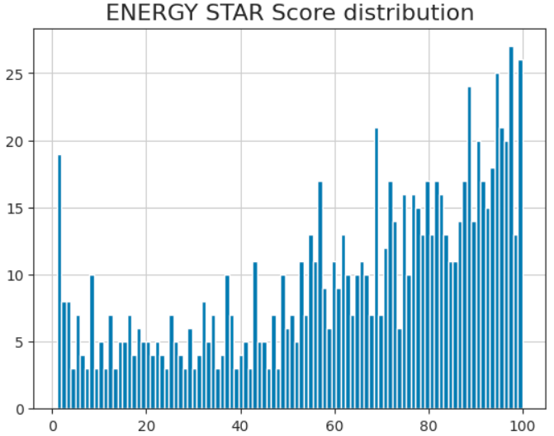
What is the Energy Star Score ?
available for 65 % of the selected properties.
currently being generated by colleagues (expensive/time consuming).
range between 0 and 100

Slide 27
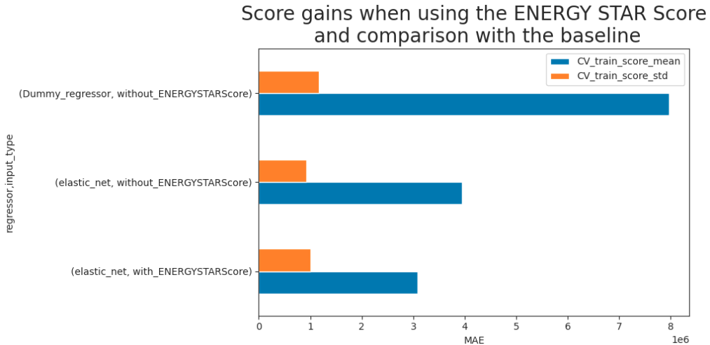
Impact on the best model : ElasticNet
(Energy consumptions)
Adding the Energy Star Score to the inputs of the model increases the performance (~21,9% gain)
Ultimately, the model has an MAE which is ~38,7% of the baseline's MAE.

Slide 28
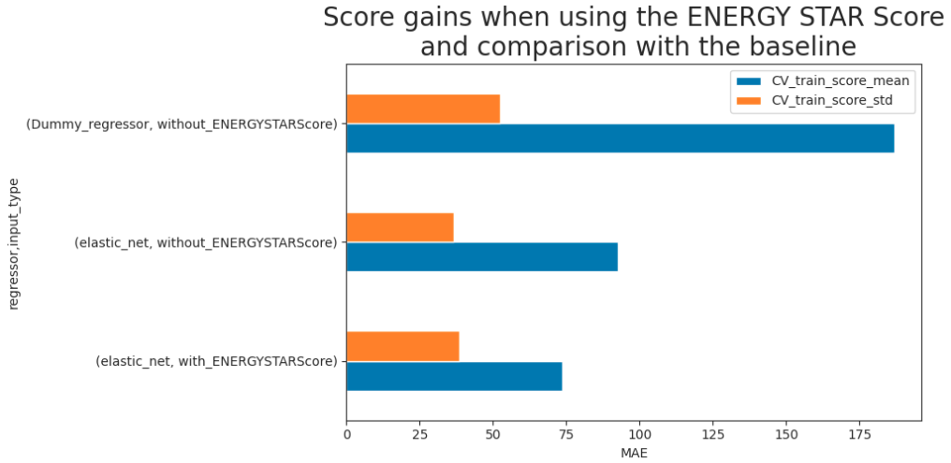
Impact on the best model : ElasticNet
(GHG emissions)
Adding the Energy Star Score to the inputs of the model increases the performance (~20,4% gain)
Ultimately, the model has an MAE which is ~39,4% of the baseline's MAE.

Slide 29
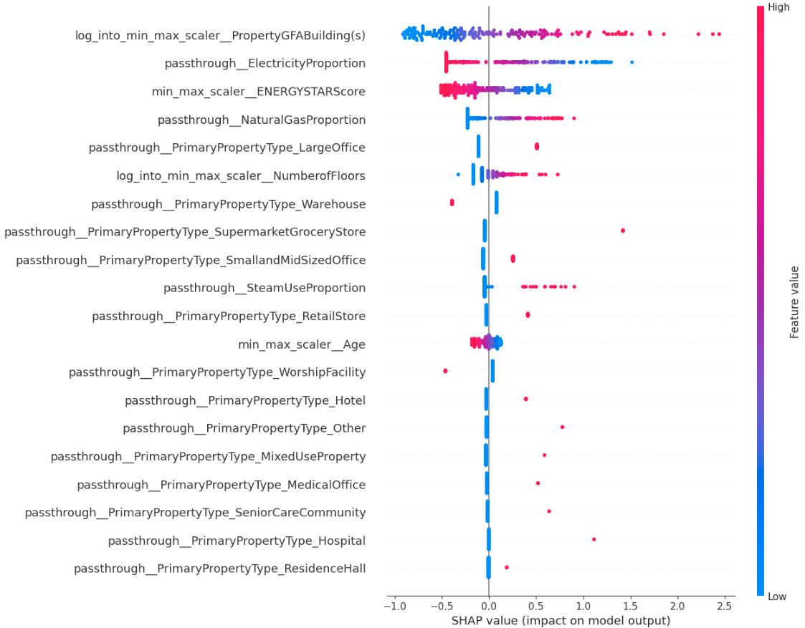
Features importance in the model :
(GHG emissions)
(Read the most important features from top to bottom.)
Energy Star Score ranked 3.
-> Not surprising considering the gains.
Energy sources proportions are important.

Slide 30
Conclusion
For both predictions, the ElasticNet gives the best performance.
In both cases, adding the Energy Star Score in the model's inputs improves the performance (~20% gain).

Slide 31
Going further ?
Some ideas to improve the performance ?
Address the energy sources proportions problem on some properties.
Introduce location information.
Retrieve number of buildings (very correlated with GFA).
Continue to build the Energy Star Score for the missing non-residential properties.
Feature engineering :
map each class of Primary, secondary and third type use (quite detailed) with the one-hot encoded variable classes AND weight the 1 with the respective GFA proportion.

Slide 32
Thank you for listening

Slide 33
Appendices

Slide 34
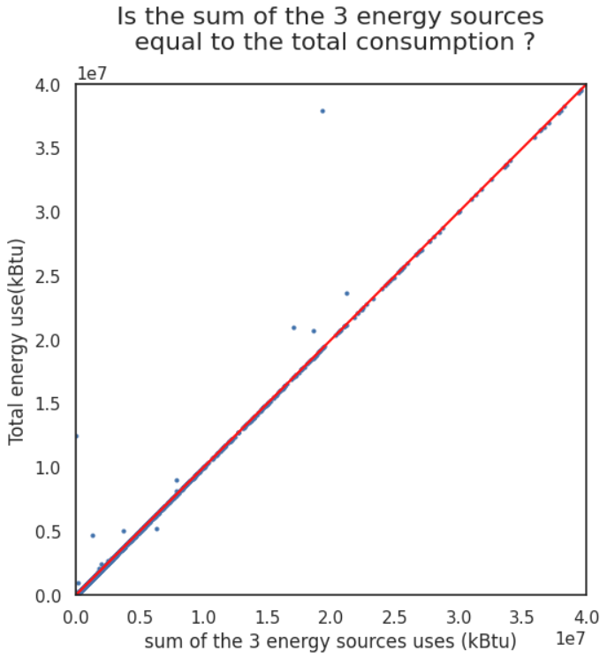
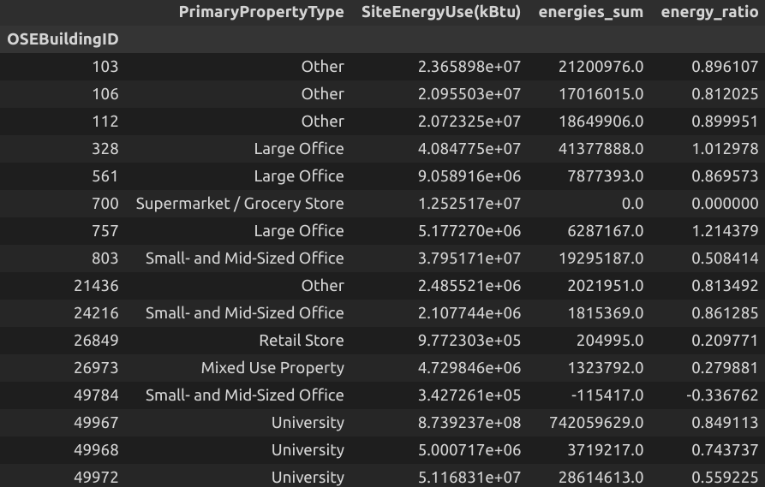
Energy source proportions outliers ?
I Discarded the 3 properties highlighted here. Not all, in order to keep some universities in the dataset. Explanations for the other ratios ?

Slide 35
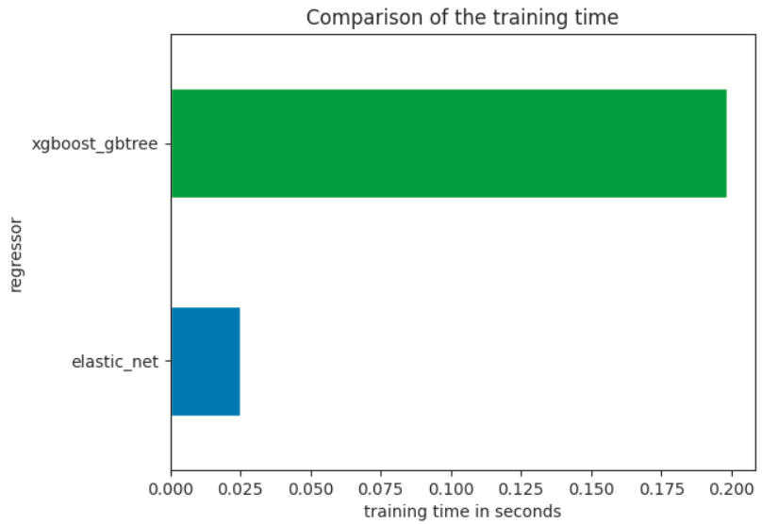
The Xgboost which could be a reasonable alternative to linear models is about 8 times longer to train on the training set.

Slide 36
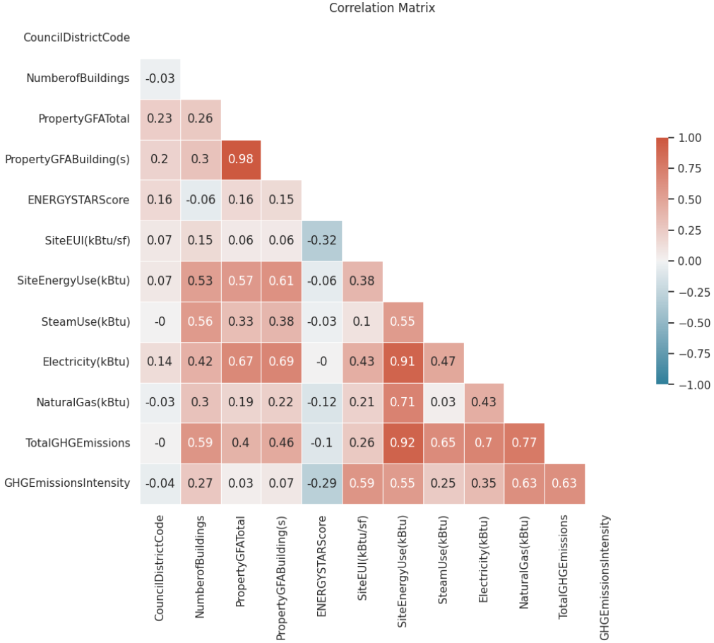
High Energy Star score could mean lower values for both predictions.

Slide 37
Features importance and
explainability with shap in the ElasticNet configured for GHG emission predictions
It confirms the assumption made with the correlation matrix about the Energy StarScore. The higher the Energy Star Score, the less polluter is the the property.

Slide 38
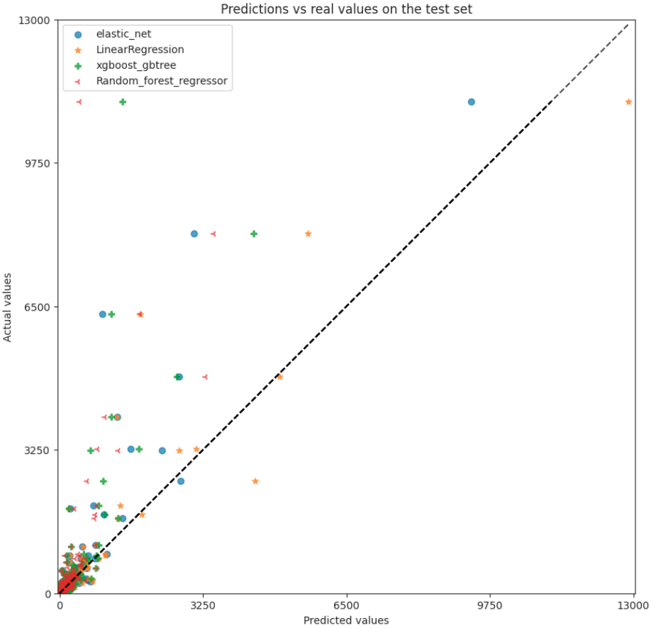
Linear models perform better for high values because they are not well represented in the dataset ?
Better capacity to extrapolate.
Would more data help tree-based to perform better?
-> We will not get more data, because such properties are not going to be built massively.

Slide 39
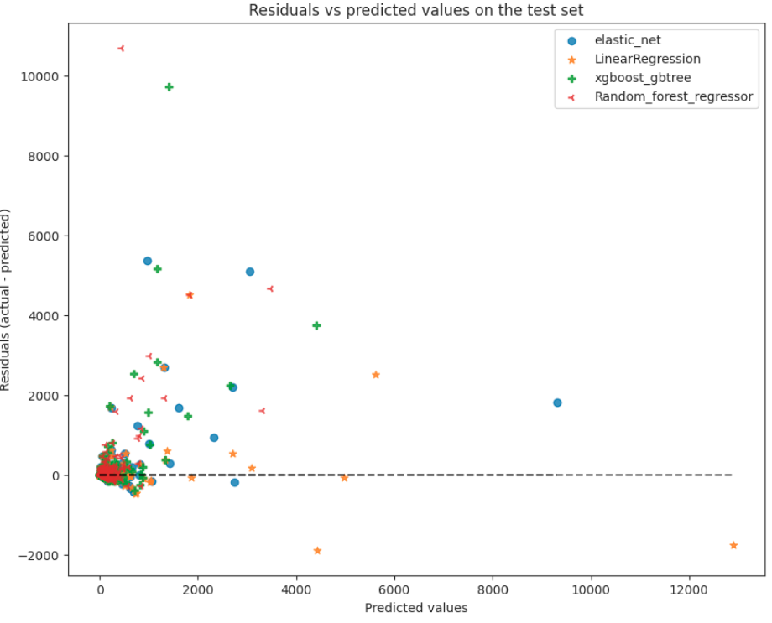

Slide 40
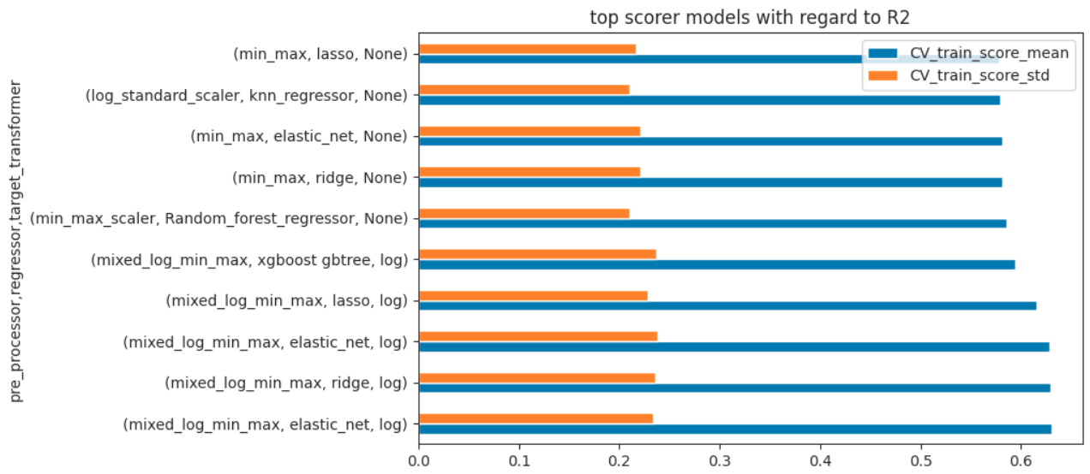
Energy prediction (R2)
Dummy regressor : R2 ~ 0
Regardless of the regressor, a log transformation on both skewed inputs and the target gave the best results.
Linear models give better results than tree-based models.

Slide 41
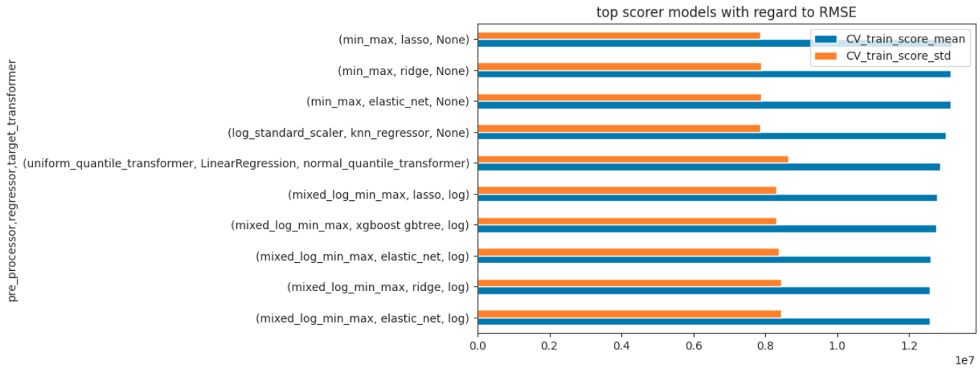
Energy prediction (RMSE)
Dummy regressor : RMSE ~ 3e7 kBtu
Idem

