Slide 1
Capstone Project 1 Summary
Julia Hu
July 2020

Slide 2
1. Introduction
Well logs are important for subsurface characterization
However it is difficult to obtain sonic logs directly
The goal of the “SPWLA’s 1st Petrophysical Data-Driven Analytics Contest” is to develop data-driven models to generate synthetic compressional and shear travel-time logs (DTC and DTS, respectively) in Well #2.

Slide 3
2. Training Dataset
All the values equals to -999 are marked as missing values.
- CAL - Caliper, unit in Inch,
- CNC - Neutron, unit in dec
- GR - Gamma Ray, unit in API
- HRD - Deep Resisitivity, unit in Ohm per meter,
- HRM - Medium Resistivity, unit in Ohm per meter,
- PE - Photo-electric Factor, unit in Barn,
- ZDEN - Density, unit in Gram per cubit meter,
- DTC - Compressional Travel-time, unit in nanosecond per foot,
- DTS - Shear Travel-time, unit in nanosecond per foot,
The test data has all features that you used in the train dataset, except the two sonic curves DTC and DTS.

Slide 4
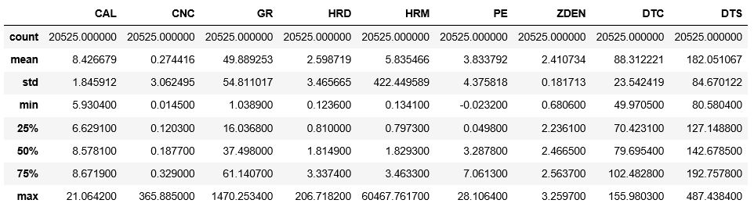
3. Data Exploration
Figure 1: Description of the dataset, about its statistic values.

Slide 5
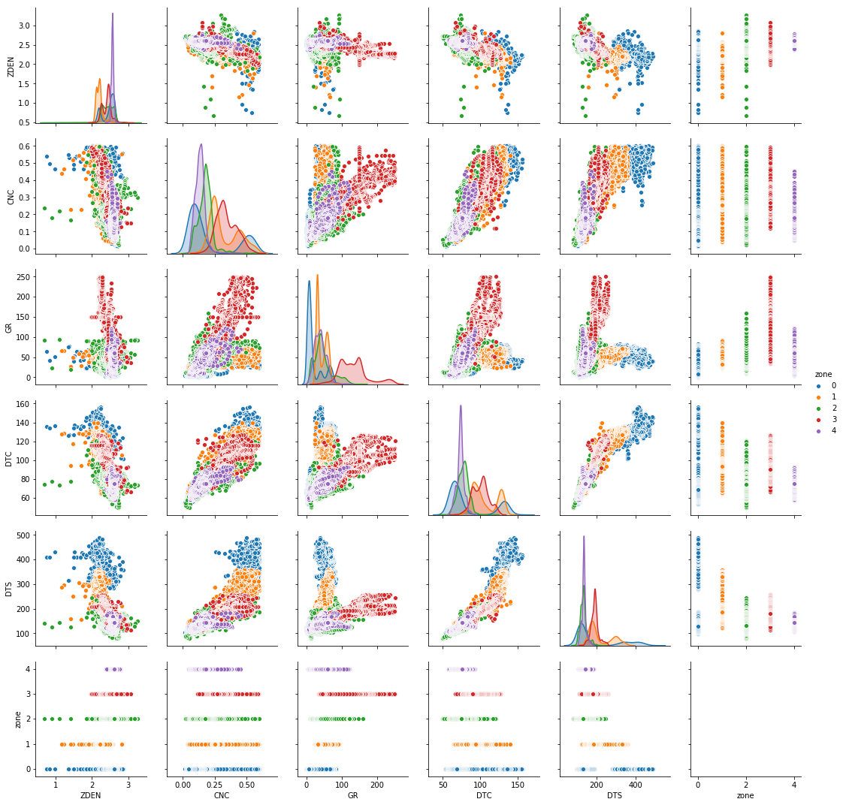
4. Pair Plot
Figure 2: Pair plot comparisons of the density log and DTC log.

Slide 6
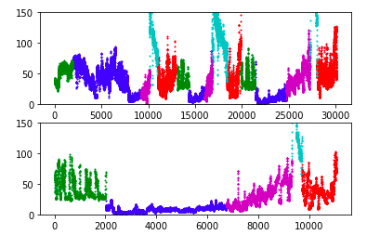
5. Sediment Based Zone Separation
Figure 3: Top figure shows training data rezoning. Bottom figure shows test data rezoning distribution.

Slide 7
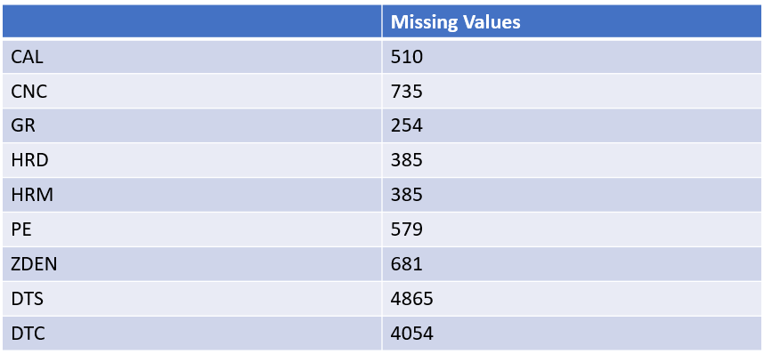
6. Fill in Missing Data
Figure 4: Value counts of missing values in logs.

Slide 8
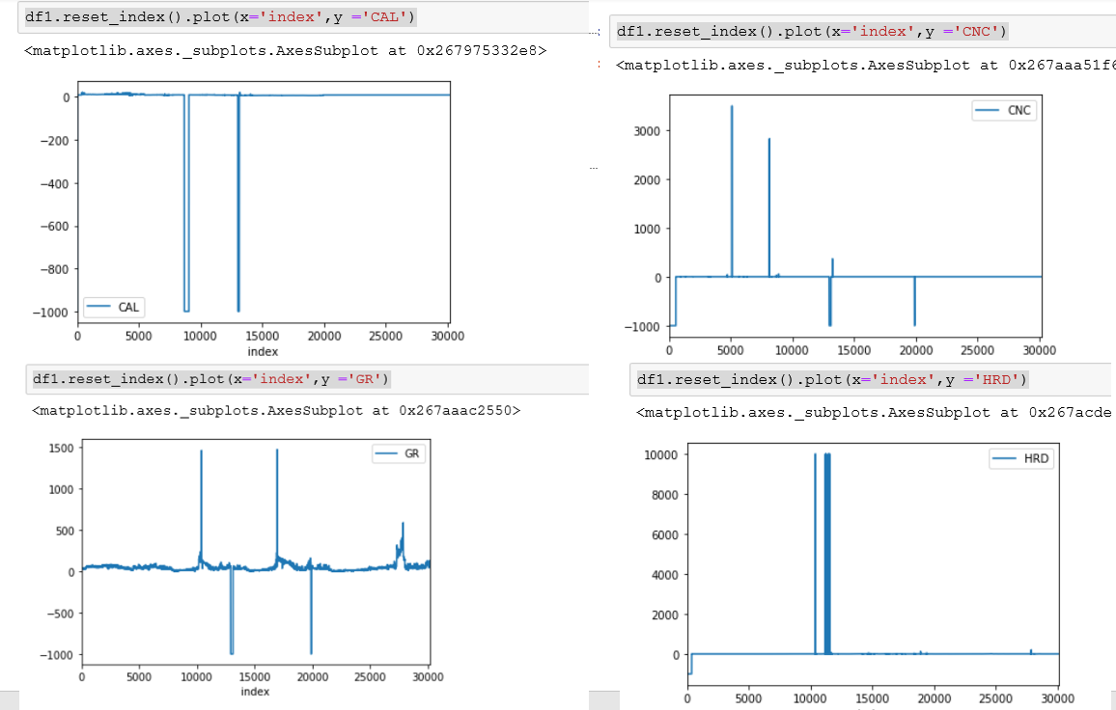
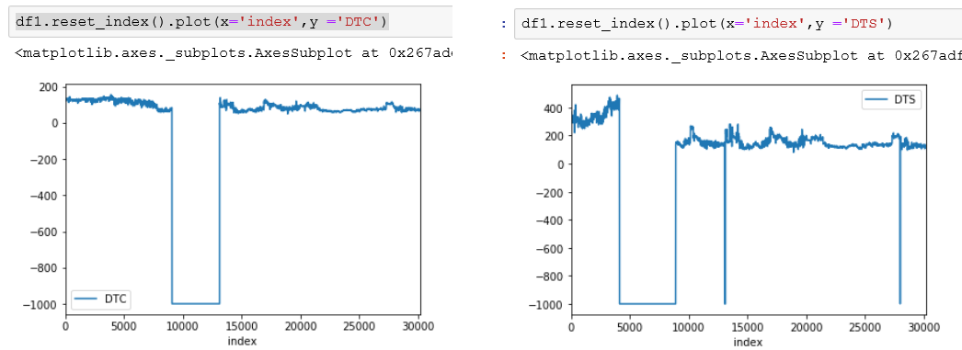
7. Plot of Missing Values in Well Logs
Figure 5: Visualization of missing values in logs.

Slide 9
8. First fill missing values by using Peudo-labeling method
First, ML modeling based approach is used to fill in missing values. This approach uses target without missing values to develop a ML model, such as XGBoost. Then this model is used to fill in missing values of the target.
However the filled in missing values do not improve the validation accuracy. There is no big difference after filled DTC missing values. From the RMSE values measured on validation data, the result is similar to that with missing values (2.8).

Slide 10
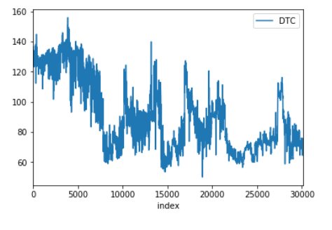
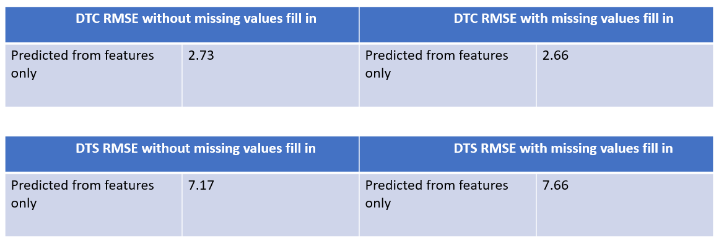
8. Visualization of Well Log after Filled Missing Values
Figure 5: Figure of DTC log with filled in missing values.
Figure 6: RMSE improvement for DTC and DTS.

Slide 11
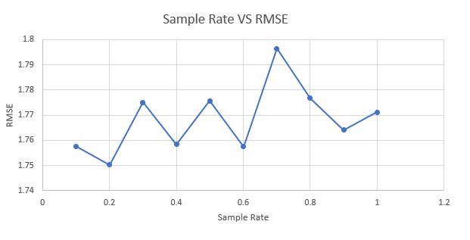
9. Accuracy of Pseudo-label method for filling missing units
Figure 7: The accuracy against varying percentage of psudolabeled data.

Slide 12
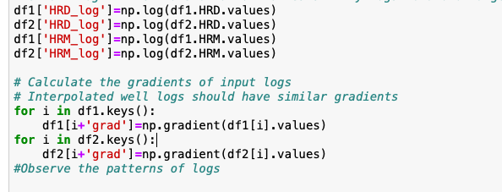
Feature Engineering Method
Two features were engineered to improve accuracy: (1) Apply logarithm. (2) Use Gradient method to accentuate difference.
Figure 8: Feature engineering to improve model.

Slide 13
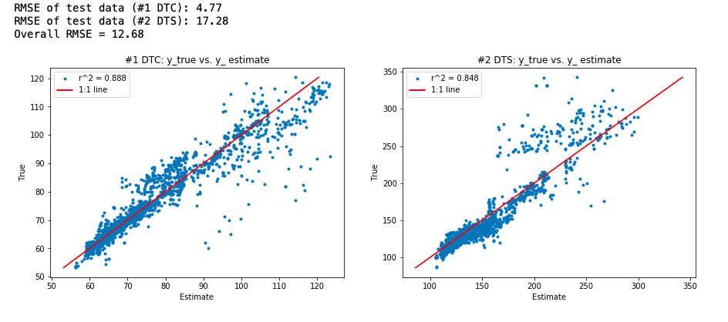
10. ML model Building
After preprocessing a simple fully connected ANN network, with very few nodes, was applied. The first layer has 24 nodes, second layer 8 nodes, and then connected to a dense layer before dropout.
Figure 9: Comparison of predicted data and test data shows good agreement.

Slide 14
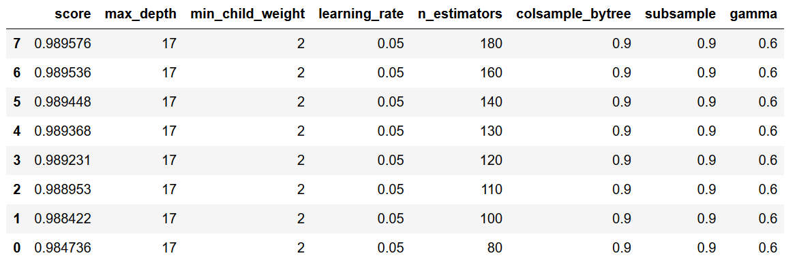
11. ML model comparison
XGBoost was also tested in this project, and the following table shows hyperparameter tuned with XGBoost for performance improvement.

Slide 15
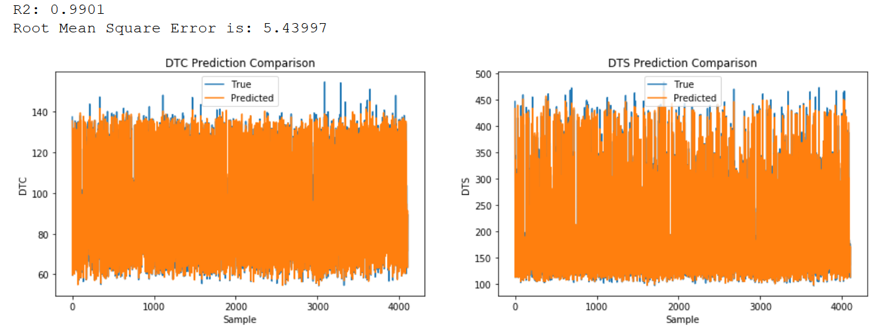
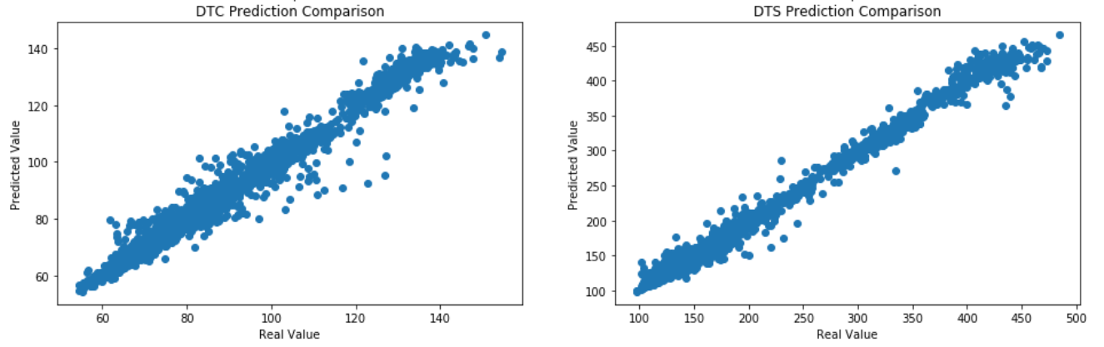
12. ML Best Algorithm R2 = 0.99

Slide 16
13. LSTM Alone
No change on Min-Max scaler
Used re-shape to prepare data for Multi-variate LSTM
Two layer LSTM, with each layer 256 neurons, history window size 40, epoch 100, Relu activation, MSE loss.
Initial result is promising, RMSE=2.84006, R2=0.9679.

Slide 17
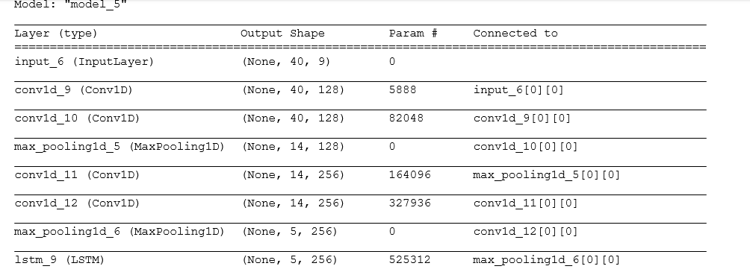
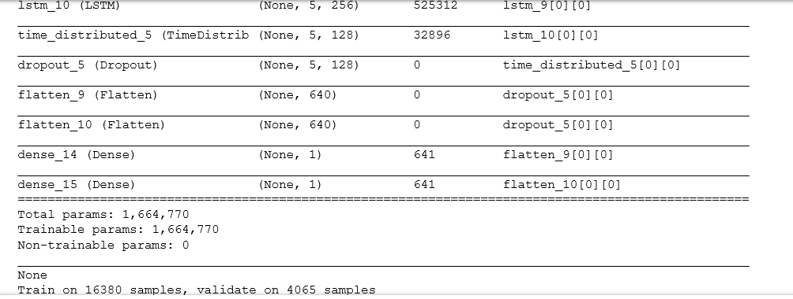
CNN + LSTM

Slide 18
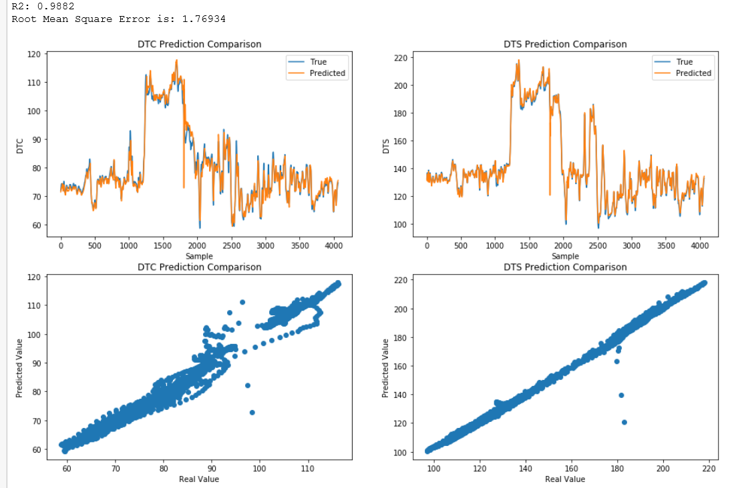
15. CNN+LSTM Result R2 = 0.988

Slide 19
16 Summary
Well log data science model is developed
Different algorithm, XGBoost, LSTM and CNN+LSTM are used for prediction.
XGBoost has the best accuracy with R2 = 0.99.
CNN +LSTM is already impressive, with R2= 0.98

Slide 20
Future Plan
In the future, more data from different wells will be tested. The developed will be tested for its accuracy against more data collected.

